Slide 1
Custom Hardware for Low-Power Processing
Carl Grace - LBNL
20200730

Slide 2
Introduction
Complex digital signal processing or data handling functions can be implemented using custom CMOS logic
However, such solutions can be error-prone, time consuming to design, expensive, and difficult to reuse
Leveraging open-source hardware with extensible instruction sets can provide excellent power efficiency, reduce cost and complexity, and simplify design reuse
This could also allow non-experts to take expanded role in implementing complex solutions (further lowering total system cost)

Slide 3
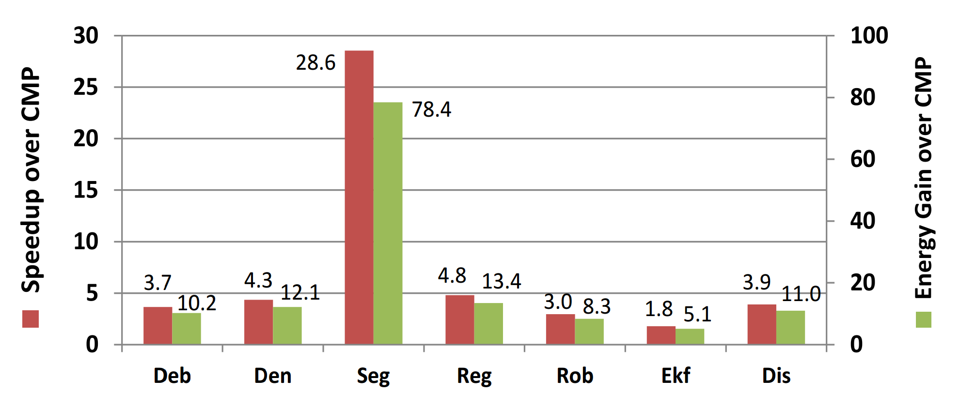
Benefits of custom instructions (FPGA or ASIC)
Significant improvement using custom instructions (accelerators) in FPGA compared to standard multi-threaded code on 12-core Intel Xeon for various image processing algorithms
Cong et al., DAC 2014

Slide 4
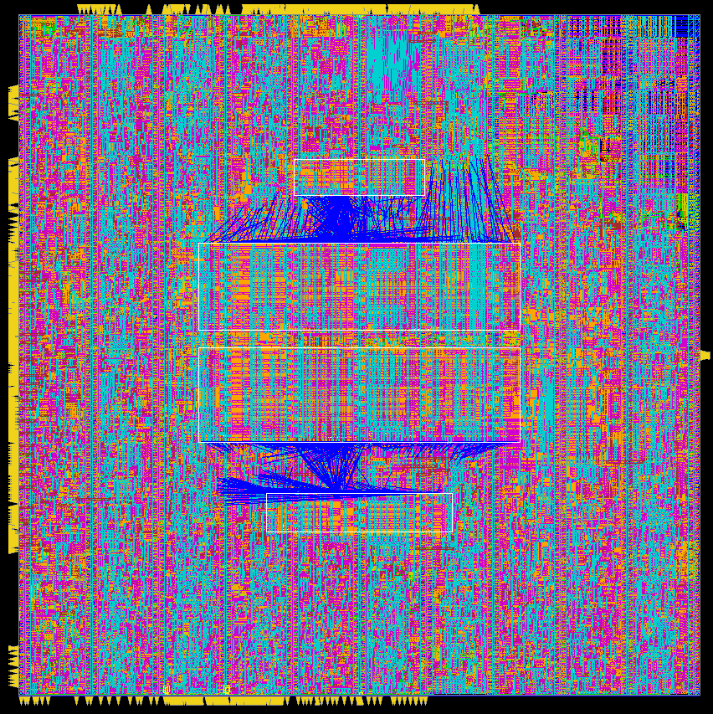
Leverage open-source IPs and tools to reduce costs
600µm
Open-source instruction set architecture
Royalty- and license-free and extensible
RISC-V and open-source design tools such as CHISEL make custom computing practical for small design teams such as in the HEP community
600µm
RISC-V core implemented in 65 nm CMOS

Slide 5
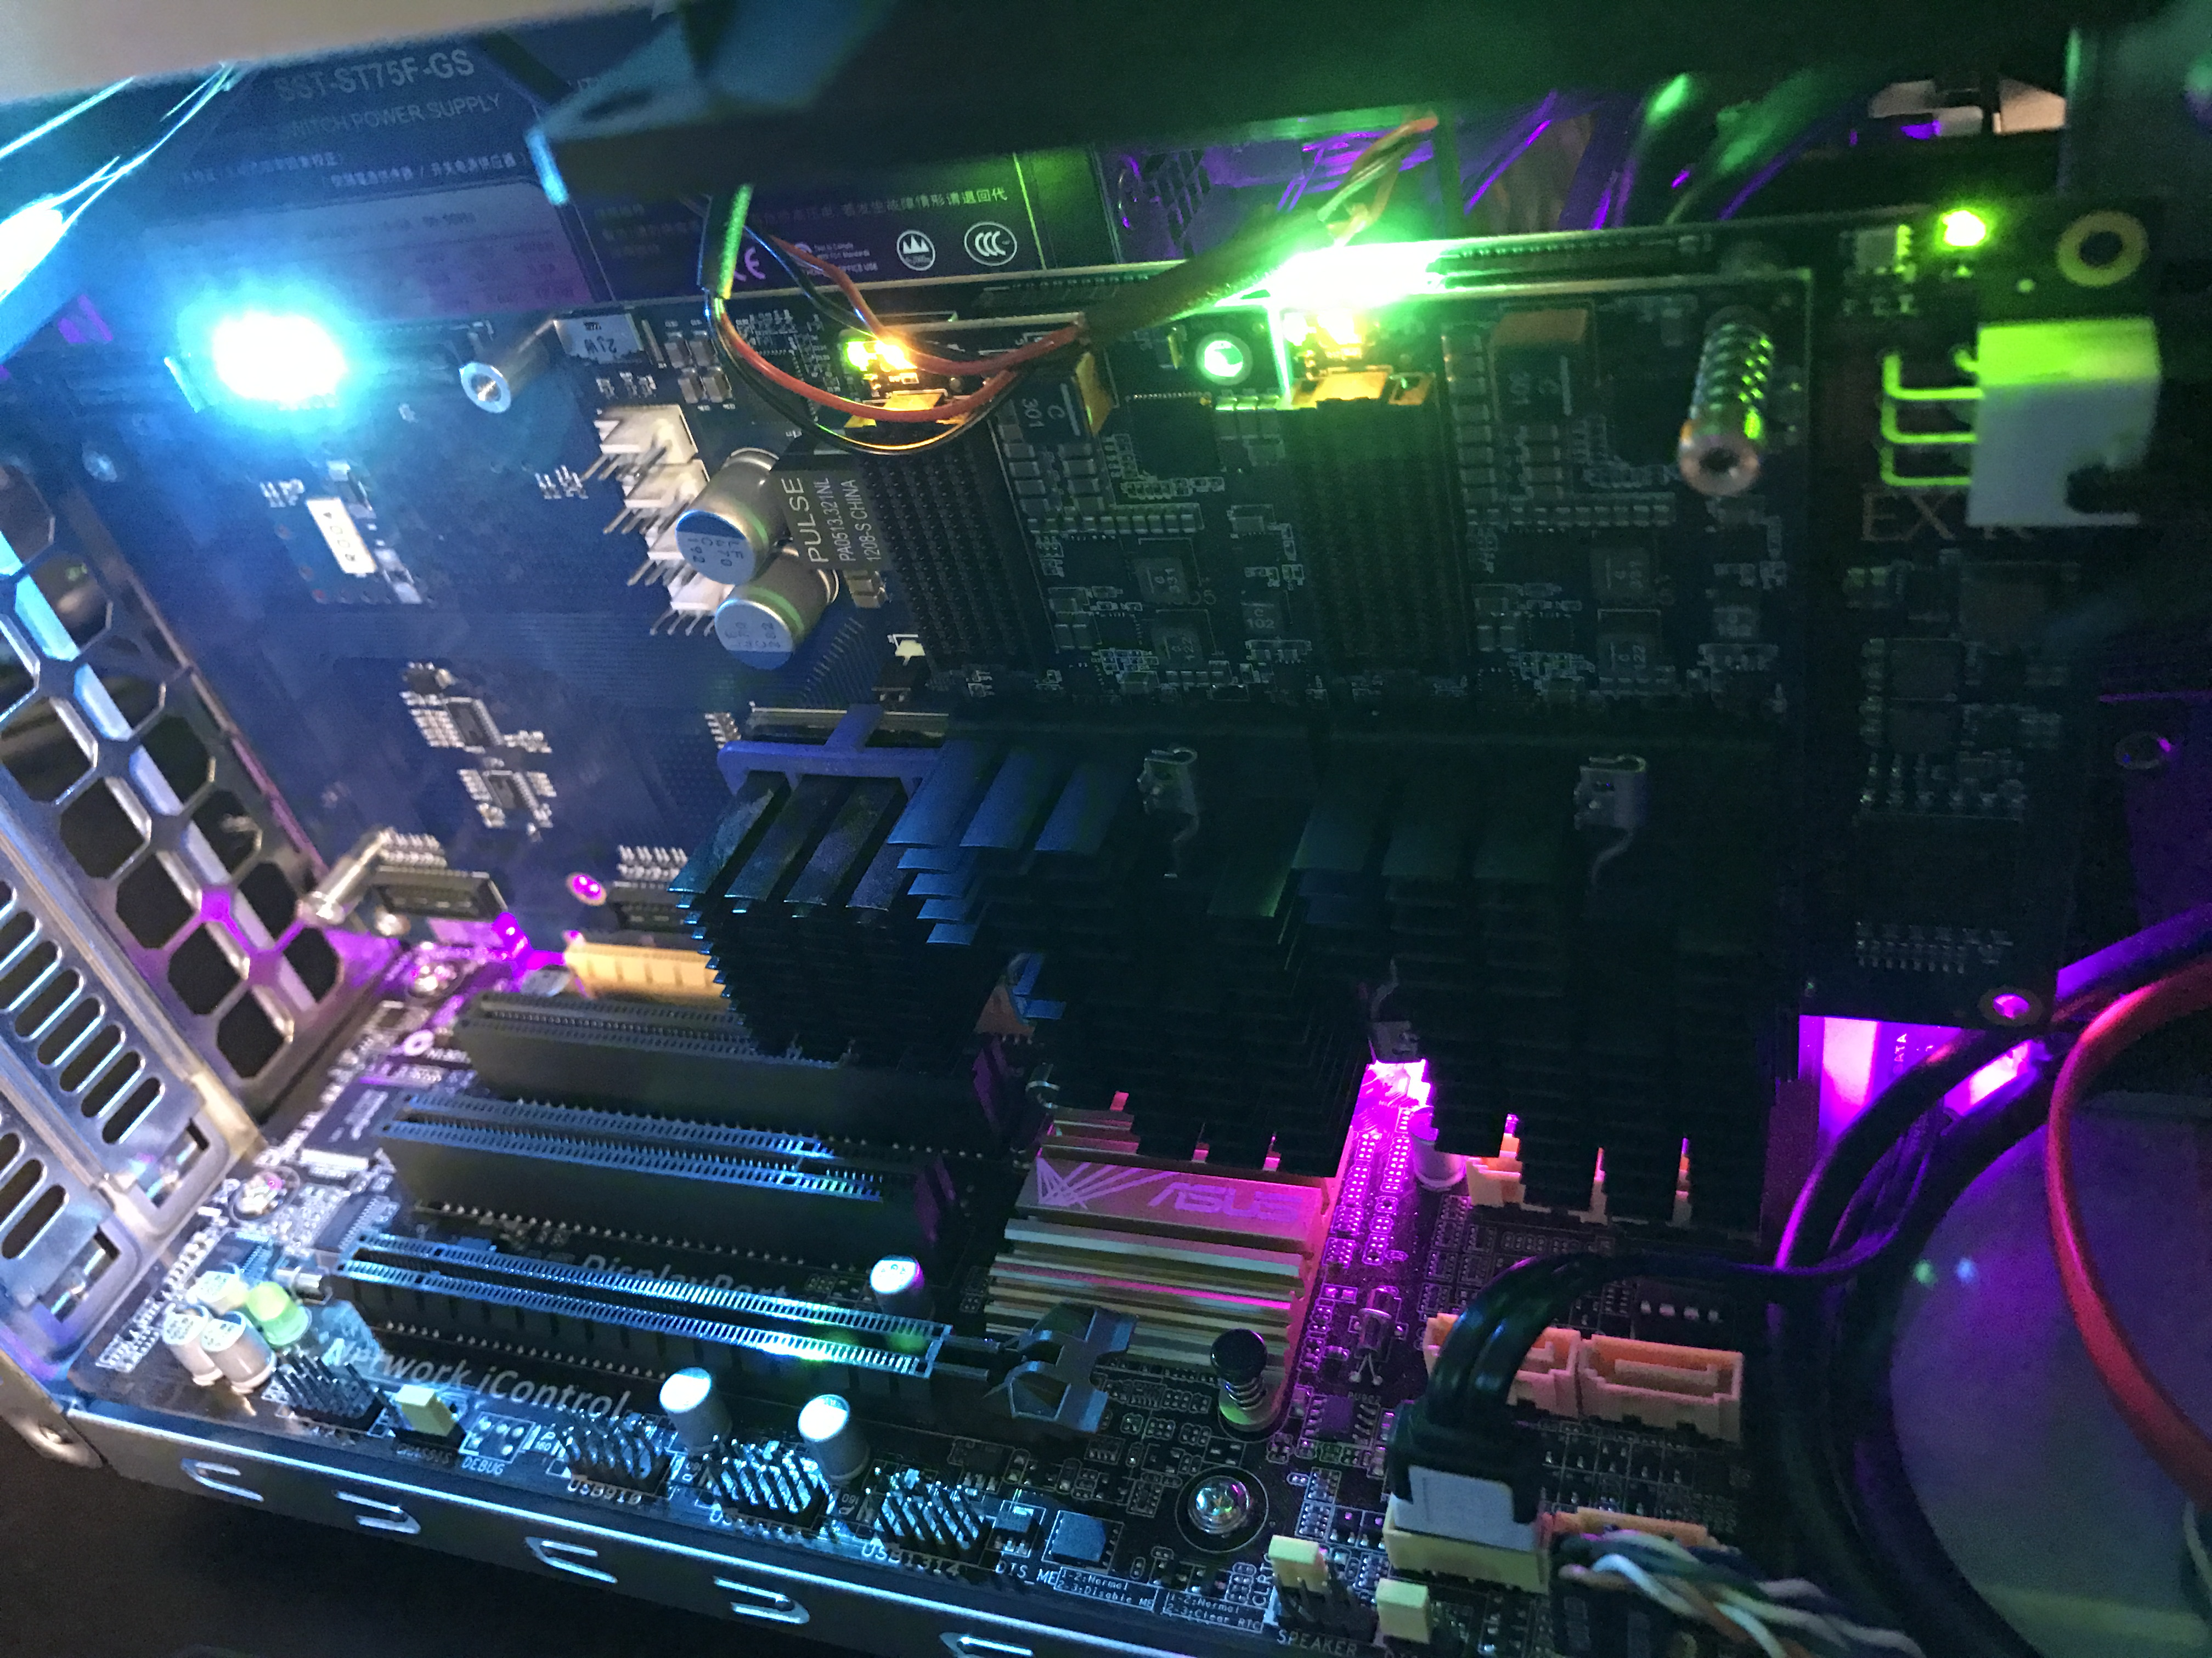
Example Benefits
FFT Accelerator runs about 100x faster than single-threaded CPU
SciPy FFT on Intel Core i7-5930K @ 3.50GHz: ~265ms
FFTAccel (Floating): ~2.10ms
Original Image
FFT
Open-Source RISC-V processor with custom FFT instruction
(implemented in FPGA)
D. Donofrio, LBNL
Powder Diffraction Experiment

Slide 6
Conclusion
Huge reductions in power consumption for data processing can be made by matching hardware to the algorithm used
This is practical for small design teams by leveraging open-source IPs and tools such as RISC-V.
Custom instructions can be implemented in FPGAs or ASICs (with different cost / power reduction trade offs)
HEP can take advantage of custom processing to reduce power consumption of large detector systems
Acknowledgement: David Donofrio, Farzad Fatollahi-Fard, Dario Gnani

