Slide 1
Smart Detector with on-chip Neuromorphic Computing Capabilities Sandeep Miryala, BNL
2020/07/30

Slide 2
What?
Data in Physics Experiment
Front-End Electronics senses, amplifies and conditions radiation induced signals forming intense streams of raw data to trigger farms, computers or just to data storage
Individual streams of data carry majorly ‘zeros’ and noise and the whole activity context is not known
The streams start reflecting zoned activities in the experiment when combined in data concentrators
Edge computing
Traditionally, data are minimally processed inside and processing needing context is outside real time or offline
Data processing outside is most efficiently done with commercial FPGA/GPU/DSP/Neural_Chips (>Bgates)
Introduce smartness by bringing processing inside with artificial neural networks is a future for ASICs
Immediate applications
Waveform: Denoising, digital interpolating filters for processing of sampled waveform, e.g. digital peak finding in readout circuits for liquid noble gas TPC or time of arrival measurement in 4D tracking,
Spatial Distribution: Enhancing of 2D or 3D spatial resolution and data reduction filtering, e.g. solving charge or light sharing problems in pixel detectors or extraction of depth of interaction in PET scanners,
Contextual Analyzes: Processing of multi-source waveforms in radiation detection system for on-the fly spatially-sensitive event reconstruction, e.g. processing of signals from arrays of detector electrodes or from detector subsystems

Slide 3
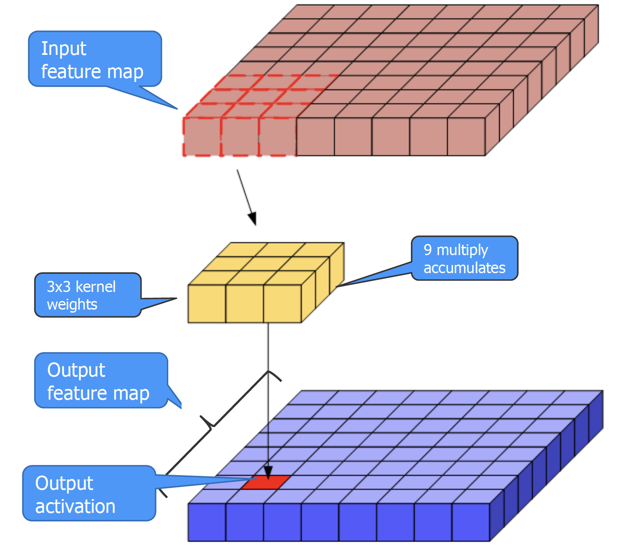
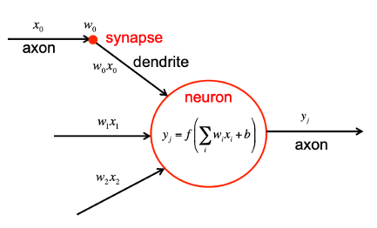
How?
Co-design Approach
Features of Neural Network Processor
Computational parallelism
Massive interconnections
Challenging matrix scalar algebra (dot-product)
Interfaces for data representation e.g. Spiking NN
Design of Neural Network
Architecture and size of Neural Processor fits only a class or problems
First, building and optimizing Neural Network model - tools available: Tensor Flow, PyTorch or Caffe2 frameworks
Second, training of NN model to estimate kernel weights,
Hardware Design
Implementation of worked out model in FPGA fabrics or synthesize and ASIC; preferred programmable architecture
Conventional semi-custom digital design flow:
area and power inefficient
quick realization
New methodologies to lower computation power of a scalar dot product
Non-volatile memories to reduce memory area footprint
CNN Overview
Initiative: S. Miryala, G. Deptuch, V. Manthena, G.Carini in collaboration with NSLS II, CSI division at BNL and with external research institutes
Florence - GEM student internship

Slide 4
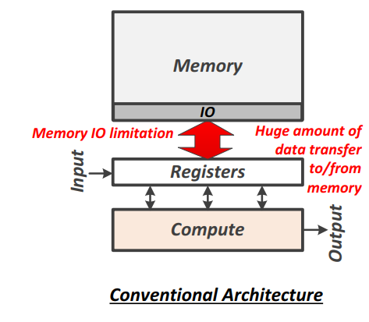
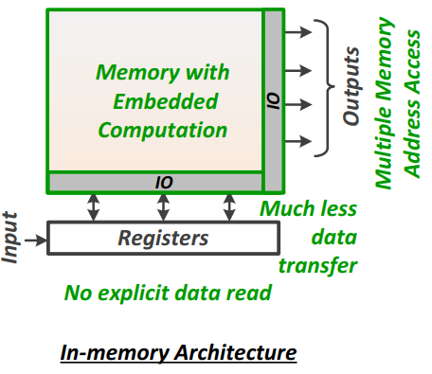
Why?
Process nodes going to single nanometers:
less precise analog vs. more poor-precision but parallel digital processing
classification and matching with patterns as a method of handling data processing without knowing analytical models
Overwhelming data quantities:
Smart detectors will reduce data throughput and number of data links
Aids in quick scientific findings
Power reduction:
Search for alternative methods for matrix algebra as multiply and accumulate computation and memory accesses are major sources of power dissipation
Investigate Non Von-Neumann architecture
Design architecture aware
Memristor functionality resembles a biological neuron
Less area and power dissipation than conventional memory
Ideally suited for Spiking Neural Network (SNN) model

Slide 5
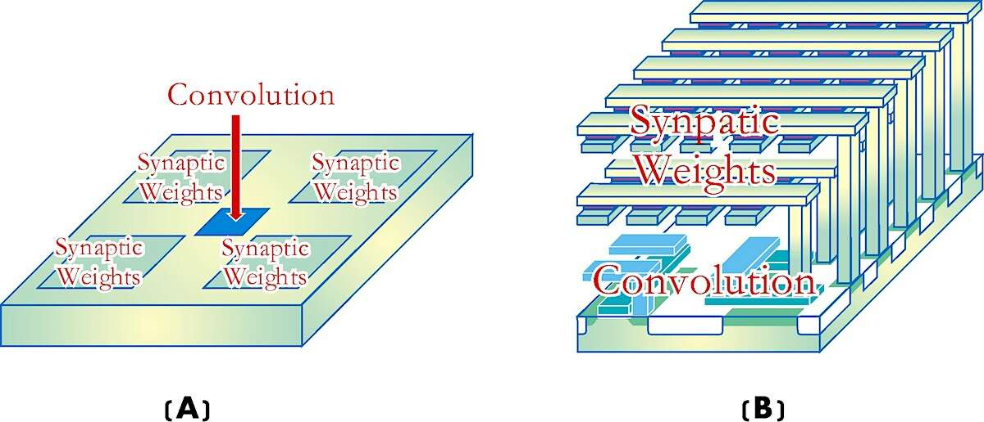
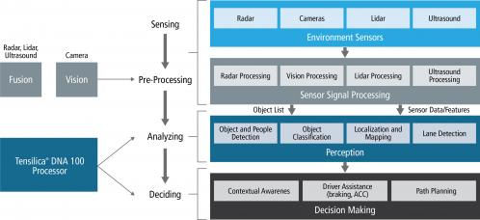
Synergies?
Commercial technologies supporting AI processing at the edge, available as IP for embedding AI in ASICs
Autonomous System (ADAS, AV), IoT,
Integration * Integration * Integration = 3D-IC
3D-IC – Industry: memory – HEP/BES: pixel detectors systems,
Comparison of 2D and 3D AI circuits: (A) on a 2D-AI die, computing (e.g. convolution circuit) only occupies ~10% of the die; (B) on a 3D-AI die, computing (e.g. convolution circuit) occupies ~90% of the die. The 3D-AI die increases the computational density nearly ten-fold. (EDN)
ADAS data processing example delivering 10-100 TMACs to support autonomous vehicles (Cadence).

Slide 6
Conclusion
Data and AI
Internet of Things to the Internet of Actions -> data not for storing + on-demand access, but to take action on
Success through analysis and interpretation of the data
Increase of data is rapid 50 Zettabyte’s in 2019 causes challenges on the cognitive edge,
Computational-based learning landscape includes: Bayesian machine learning, Deep neural networks Neuromorphic computing, High dimensional computing SDM holographic
AI implementations ASIC
Each AI method sets different IC and programming requirements, and each manages data differently,
Challenges in developing the different AI systems, and not an easy choice for AI ASICs for niche applications
Our focus is on smart techniques at front end electronics for scientific applications
Building big ICs represents similar problem to programming processors in Assembler: - Assembler yields compact and optimized code but unrealistic to build timely huge application - HLS is handy in translating algorithms to hardware but yields huge IC resources + no nonstandard circuits, ASIC needs to be Application-Specific, so need to be targeted and developed when no other solutions.
AI Major Strategy Points
Co-Design between neural network and hardware design -> AI it will not be one size fits all
Non Von-Neumann architectures -> computation in memory to reduce power and increase #MACs on the chip
Non-Volatile memories -> memristors as on-chip memory or a biological neuron in a spiking neural network
3D integration to meet the system learning challenges.

