Slide 1
1
1
Synchrotron Design and Methodical Cell Optics Study
Aaron Fawley, mentor: Carol Johnstone, co-mentor: Jeff Eldred
CCI Poster Presentation
08/05/2020
Notes:
1
1
1
1
1
1

Slide 2
Outline
Motivation for new Rapid Cycling Synchrotron (RCS) design
Accelerator terminology and optics background
Description of Particle Undulation Form Factor (PUFF) cell phase advance study
Description of transitionless RCS lattice.
Apply PUFF study to RCS design
Summary of project and main parameters of RCS design
2
Aaron Fawley | Synchrotron Design and Methodical Cell Optics Study
Notes:
2
2
2
2

Slide 3
Motivation
Future experiments requires greatly increased beam power.
  The Fermilab flagship neutrino experiment, DUNE, requires 2.4 MW of 120 GeV Main Injector (MI) protons on target delivered by the external beamline, LBNF.
A new, high-intensity, 800-MeV superconducting H- Linac (PIP II) is under construction to deliver increased beam power.
However, once PIP-II is commissioned, the now 0.8 – 8 GeV Fermilab Booster becomes the bottleneck for achieving the required beam intensity in the MI.
  At 20 Hz, the Booster is only capable of delivery ~20 x 10¹² p/sec.
To achieve the 2.4 MW of beam power will require a new transitionless Rapid Cycling Synchrotron (RCS) with the following specifications
  2 GeV injection energy to mitigate space charge effects (planned upgrade for PIP II Linac)
  Higher extraction energy: 16 GeV
  Between 480 and 620 m circumference (5-6 Booster batches in the Main Injector)
  Fermilab Booster multiturn injection will be upgraded from 400 MeV to accept 800 MeV H- beam from the PIP II Linac
3
Aaron Fawley | Synchrotron Design and Methodical Cell Optics Study
Notes:
3
3
3
3

Slide 4
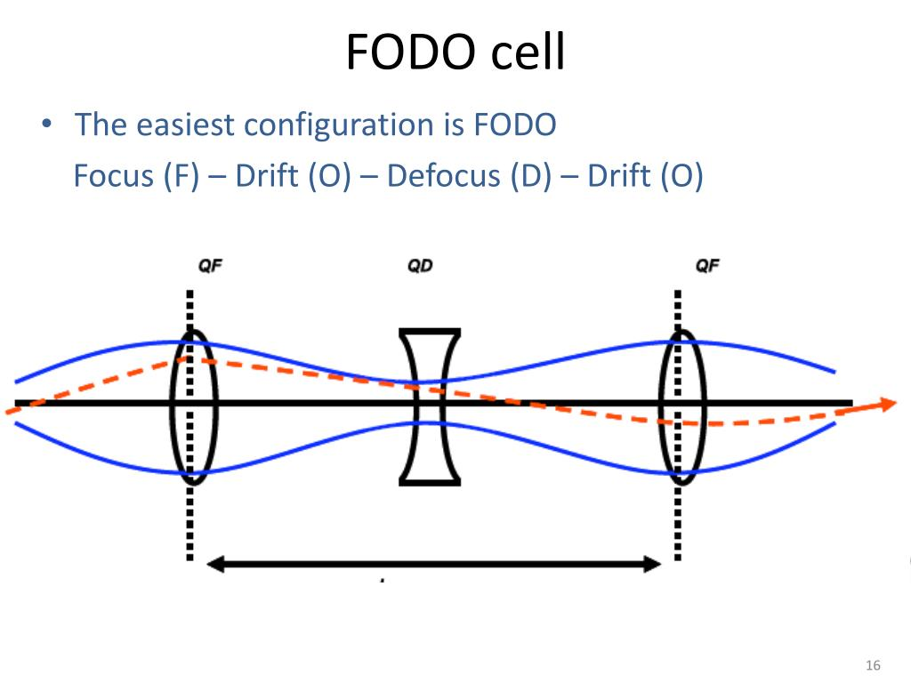
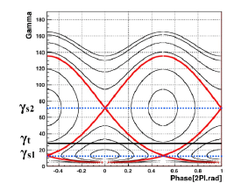
Background
FODO Cell – F Quad, Drift, D Quad, Drift, repeat for a periodic lattice.
  Dipoles which bend the beam in an arc are inserted in the drift section for a separated-function circular accelerator
Betatron Functions – “amplitude” or beam envelope in a transverse plane.
  Nominally vertical and horizontal with the dipoles or bending in the horizontal plane
Dispersion – offset of the reference trajectory for off-momentum particles.
Transition – the energy when revolution time does not depend on momentum, longitudinal focusing of off momentum particles is lost – in the current Booster it occurs at 4 GeV.
Phase Advance – Number of 2π oscillations a particle makes – per cell over a turn (machine tune) – always fractional # of oscillations to avoid resonances.
S(m)
Betatron Oscillation in Longitudinal Direction
in FODO cell.
Jeff Eldred
4
Aaron Fawley | Synchrotron Design and Methodical Cell Optics Study
Notes:
4
4
4
4

Slide 5
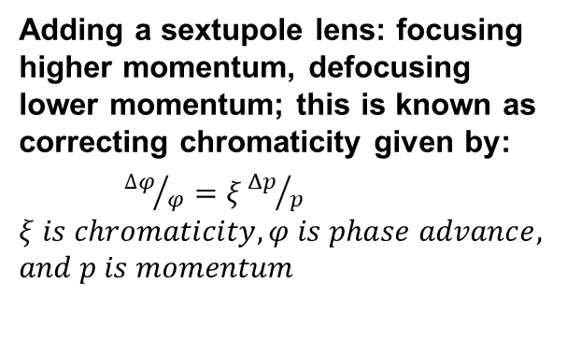
Off-momentum Chromatic Correction: Sextupoles
p > p₀
f
Blue: high momentum
Green: on momentum
Red: low momentum
p₀
p < p₀
high/low Momentum is on outside/inside of ring per dispersion: dispersion defines central trajectory for off-momentum particles.
Adding a sextupole lens: focusing higher momentum, defocusing lower momentum; this is known as correcting chromaticity given by:
${∆φ}/φ=ξ{Δp}/{p }$
$$ξ is chromaticity, φ is phase advance,$$
$$and p is momentum$$
Kick θ_{sext} ∝ x²
p > p₀
f
p₀
p < p₀
kick is in the same direction on either side of reference orbit.
Sextupole corrects the focal length of off momentum particles and phase advance.
Zero out chromaticity independently in each plane with 2 families of sextupoles.
  one at high βx and one at high βy
Carol Johnstone
5
Aaron Fawley | Synchrotron Design and Methodical Cell Optics Study
Notes:
5
5
5
5

Slide 6
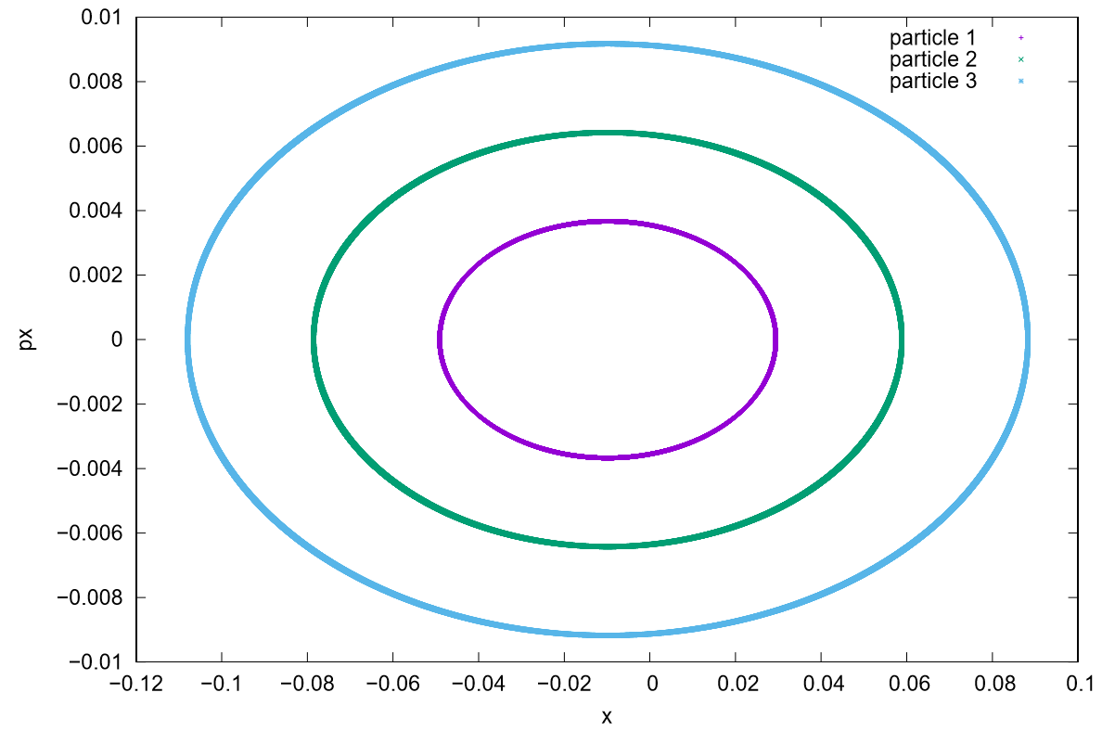
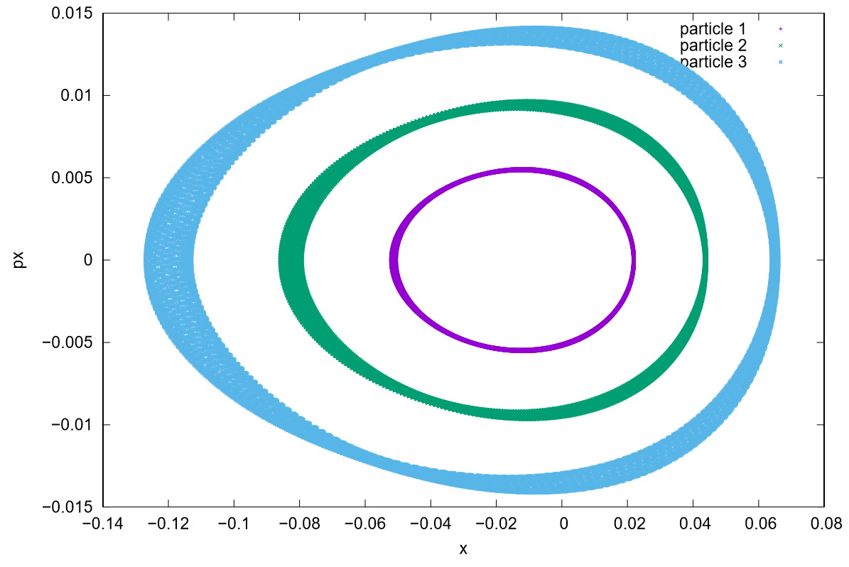
Linear vs. Higher Order Optics
Large particle oscillations outside a stable, phase space area develop halo and beam loss on vacuum pipe and components.
Linear optics do not develop halo particles. Sextupoles distort the phase space ellipse, leading to particle loss at high amplitudes – this is known as a tune-shift-with-amplitude.
Phase-space diagrams (prod. with MAD-X)
Linear optics (without sextupoles)
Higher Order Optics (with sextupoles)
6
Aaron Fawley | Synchrotron Design and Methodical Cell Optics Study
Notes:
6
6
6
6

Slide 7
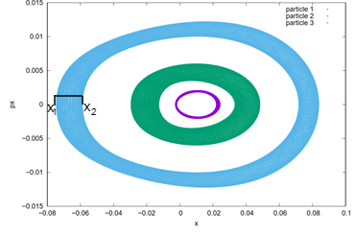

PUFF Cell Phase Advance Study
PUFF – Particle Undulation Form Factor
Method to study higher order effects on particle orbits.
Can be normalized to dispersion and beta function at sextupoles to account for varying sextupole strength.
7
Aaron Fawley | Synchrotron Design and Methodical Cell Optics Study
Notes:
7
7
7
7

Slide 8
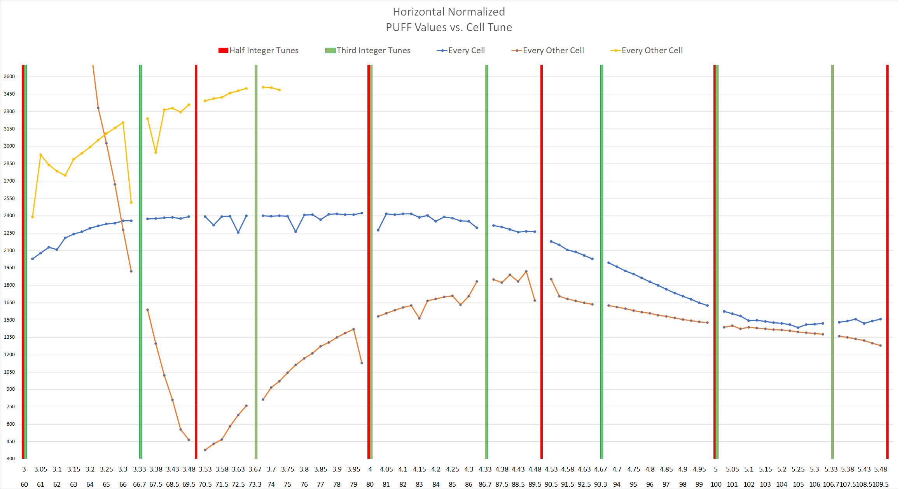
Dependence of Normalized PUFF on Cell Phase Advance and Sextupole Placement
| = Half integer resonance
| = Third integer Resonance
| = Sextupoles in every cell
| = Sextupoles in every other cell
| = Sextupoles in every third cell
8
Your Name | Title of your Presentation
Notes:
8
8
8
8

Slide 9

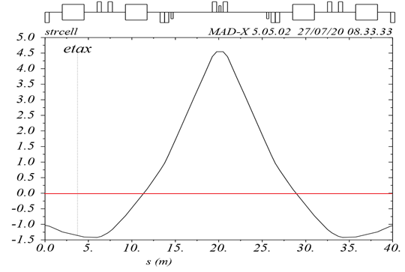
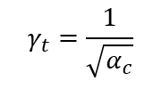
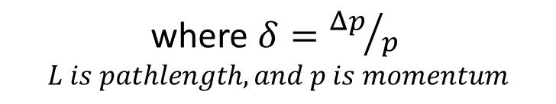
Imaginary Transition Lattice
Reference pathlength depends on the closed orbit trajectory determined by the dipoles.
Off-momentum depends on offset from the central trajectory as follows.
where $δ={Δp}/{p }$
$$L is pathlength, and p is momentum$$
Transition – is the energy, γ_{t}, all momenta have the same revolution time, and this represents a localized instability during the acceleration cycle.
9
Aaron Fawley | Synchrotron Design and Methodical Cell Optics Study
Notes:
9
9
9
9

Slide 10
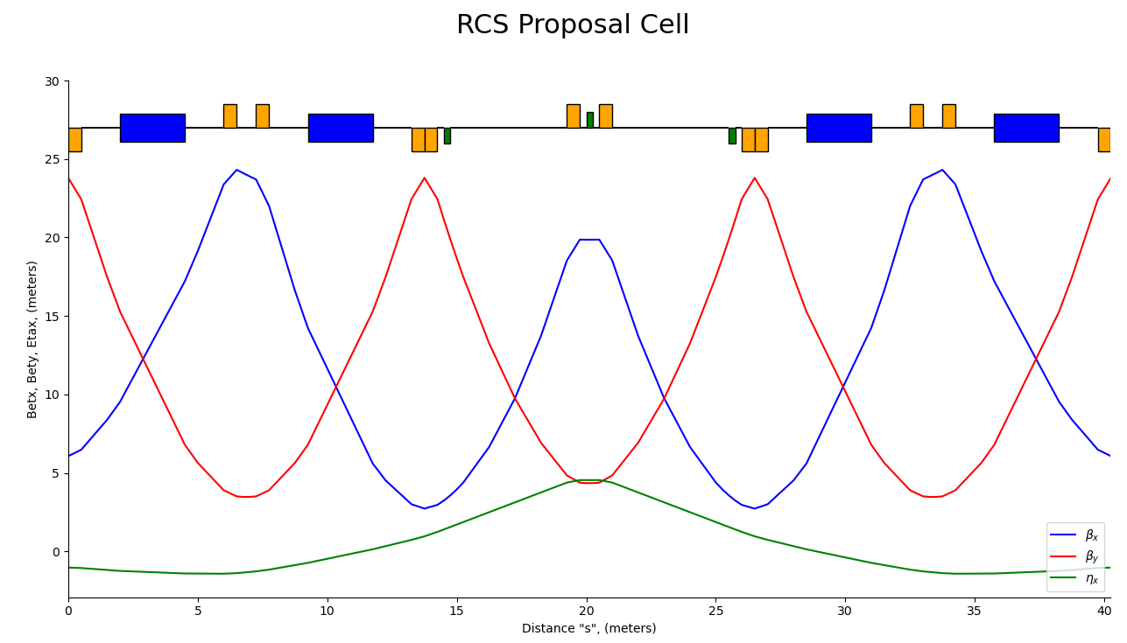
Imaginary Transition Lattice
Circumference = 563.57m
2 – 16 GeV protons
Power = (Intensity * Energy / Ramp Time) * Charge of Proton
Power = (5 (batches)*3.65E13 p/sec*120 GeV / 1.467s)*1.609E-19 C = 2.4 MW
Upgraded Linac will allow for even greater increases.
10
Aaron Fawley | Synchrotron Design and Methodical Cell Optics Study
Notes:
10
10
10
10

Slide 11
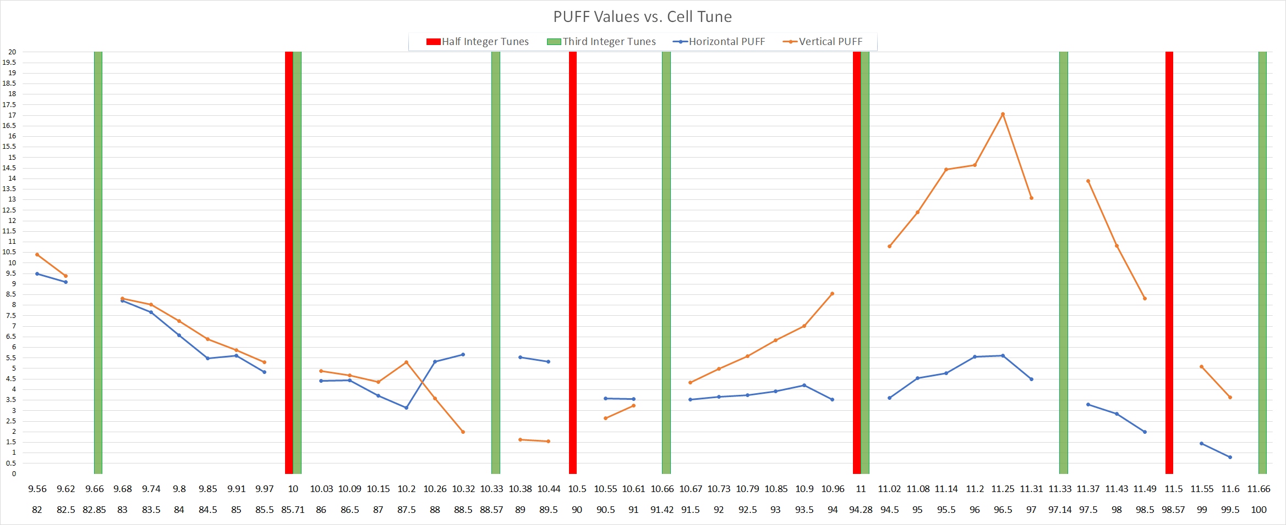
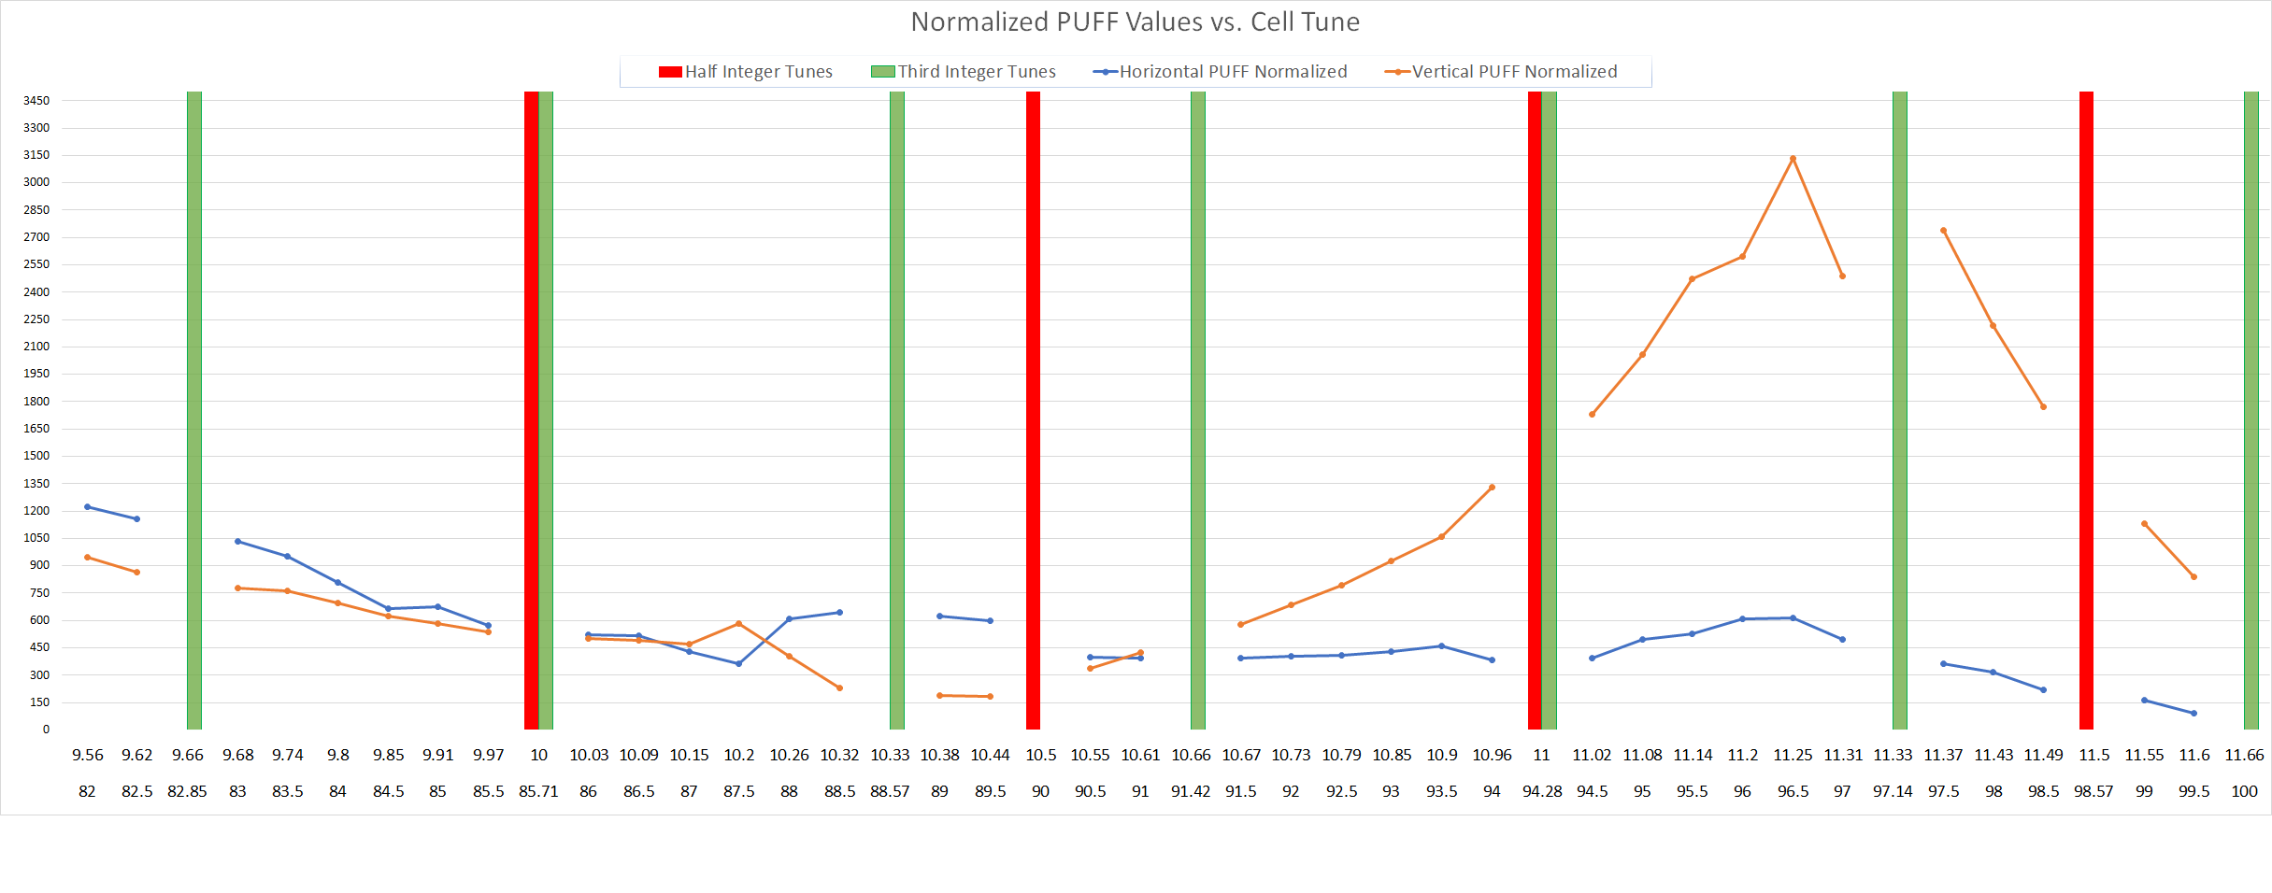
Imaginary Transition Lattice
PUFF plot for igtc lattice
*Normalized to beta function and dispersion at sextupole.
11
Your Name | Title of your Presentation
Notes:
11
11
11
11

Slide 12
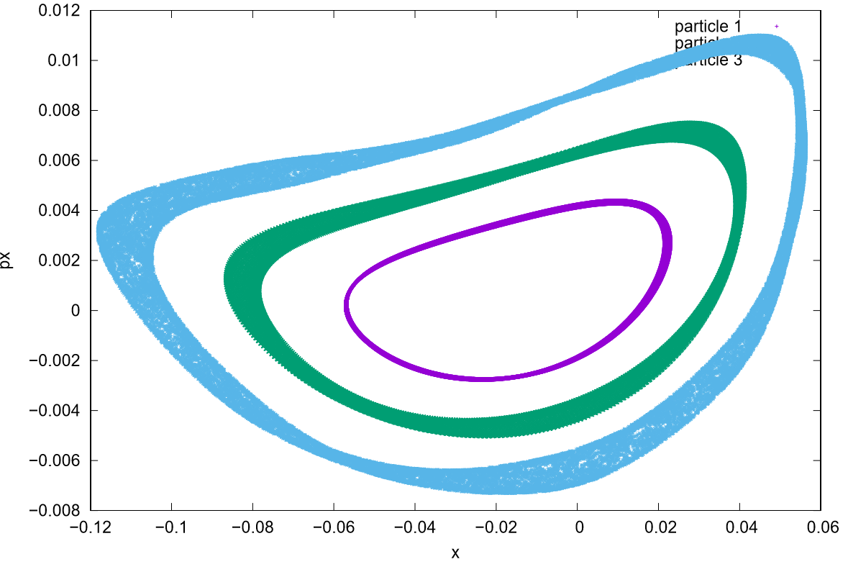
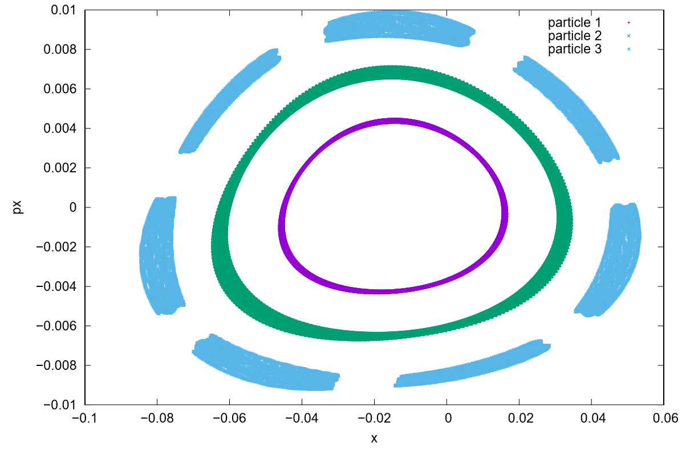
Sextupole Placement in RCS Lattice
Sextupoles in every 3rd cell Sextupoles in every center cell
6 with sextupole, 1 without
12
Aaron Fawley | Synchrotron Design and Methodical Cell Optics Study
Notes:
12
12
12
12

Slide 13
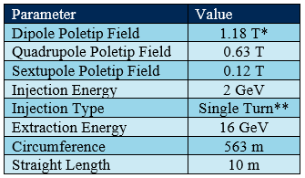
Summary of Project
Fermilab is in the planning stage for a new RCS for DUNE and other future experiments.
The PUFF metric developed in this study can be used to evaluate lattice optics in terms of machine performance which is particularly useful for next-generation transitionless lattices.
Applying PUFF to an RCS lattice design
guides choice of cell layout and properties
to optimize machine performance.
PUFF can be expanded to
develop a more rigorous estimate of
stable dynamic aperture and include a
metric for off-momenta performance.
*Poletip fields based on 3.25 in diameter beam pipe
**Injection based on multi-turn injection in previous ring
Email: afawley@services.fnal.gov
13
Aaron Fawley | Synchrotron Design and Methodical Cell Optics Study
Notes:
13
13
13
13

Slide 14
Backup Slides
BACKUP
14
Aaron Fawley | Synchrotron Design and Methodical Cell Optics Study
Notes:
14
14
14
14

Slide 15
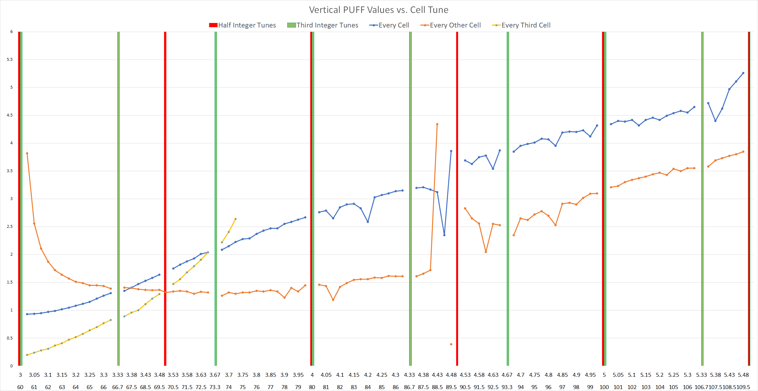
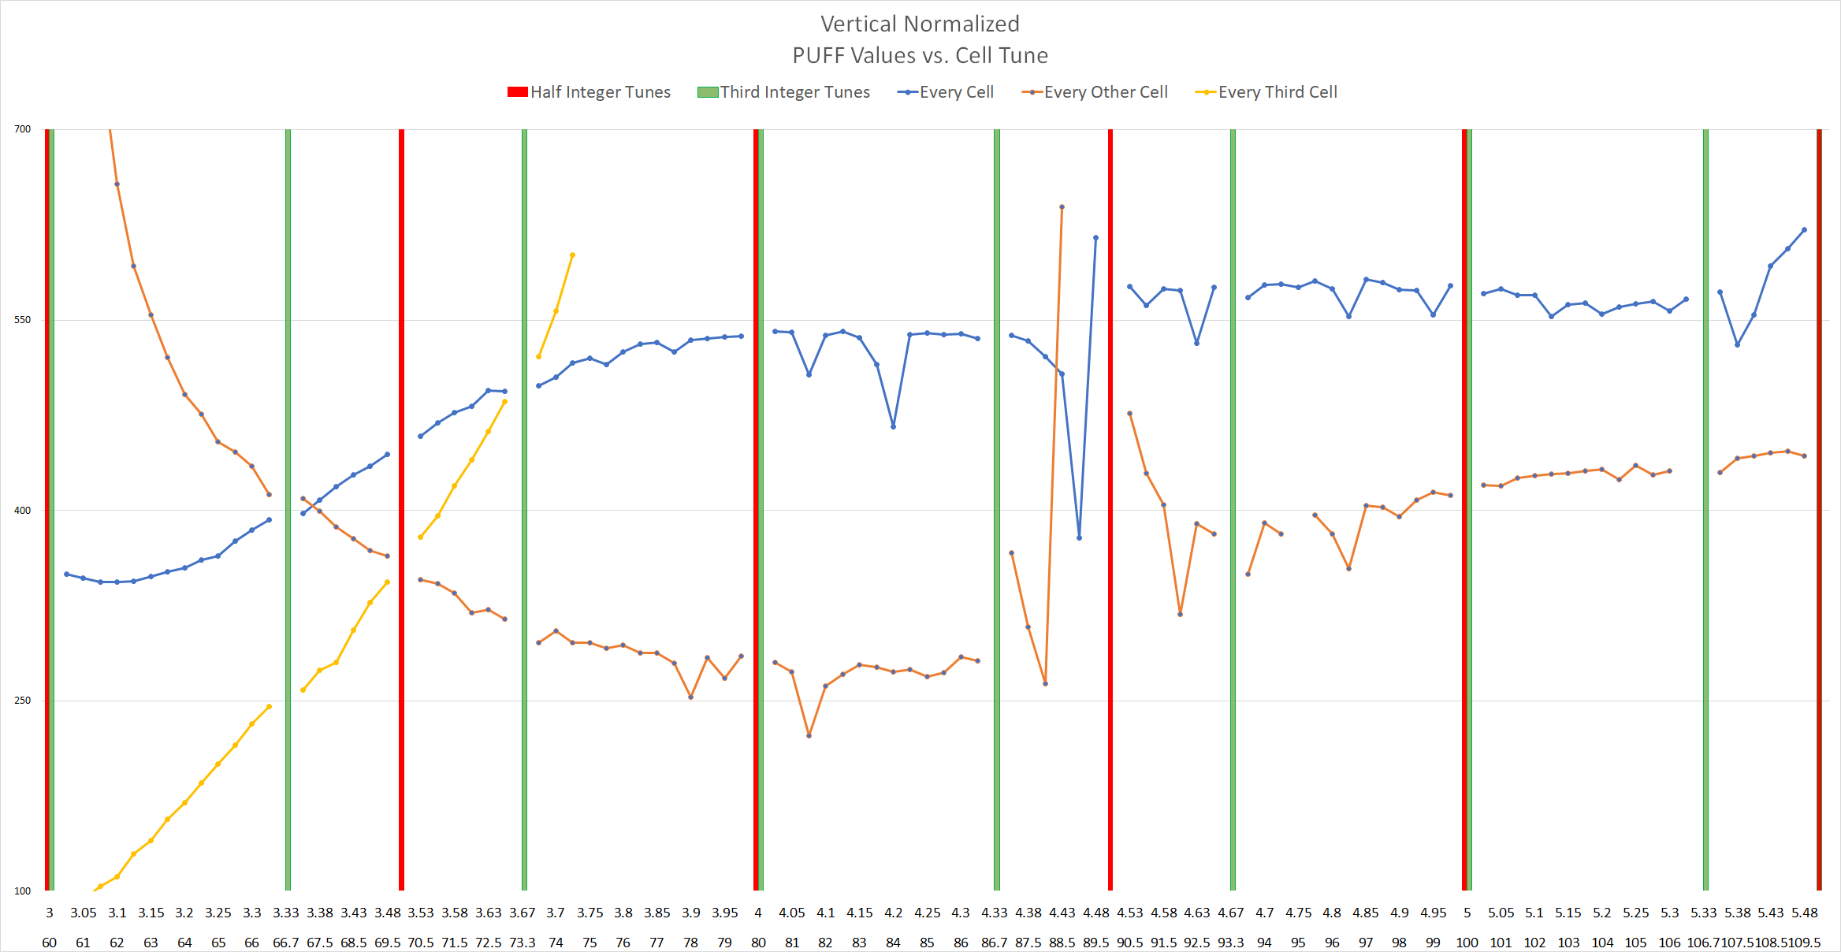
PUFF Cell Phase Advance Study
PUFF PLOTS of basic FODO lattice
15
Your Name | Title of your Presentation
Notes:
15
15
15
15

Slide 16
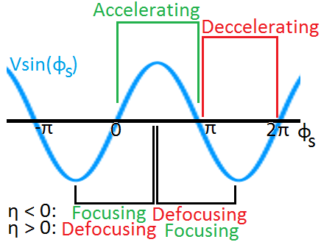
Phase-space at Transition
Jeff Eldred
Left side of peak pre-transition
Right side post-transition
Jeff Eldred
16
Aaron Fawley | Synchrotron Design and Methodical Cell Optics Study
Notes:
16
16
16
16

Slide 17
Single Turn Injection Diagram
Beam injects via a septum magnet
Travels off center through a focusing quad
An electrostatic kicker is pulsed and puts the injected beam on the closed orbit
Horz and Vert cell tunes ~0.75 (270°)
14 cells
For a 10m straight dispersion reached 10m
Sextupoles cannot be placed every cell considering injection/extraction
Sextupoles are 180° + integer apart every other cell
  Horz sextupoles every other cell
  Separate horz and vertical sextupoles
θ
Carol Johnstone
17
Aaron Fawley | Synchrotron Design and Methodical Cell Optics Study
Notes:
17
17
17
17

Slide 18
Single Turn Injection Diagram
Beam injects via a septum magnet
Septum magnet concept
Thin ferromagnetic steel plate separates injected beam trajectory from circulating beam trajectory
Single turn injection with kicker gap
  Can’t overlay identical beams
  This is the reason for H- stripping injection
Stray fields in the circulating region are common with a magnetic septum
  Electrostatic septa are weaker but no stray fields
X
X
Injected beam
Circulating beam trajectory
θ
Carol Johnstone
18
Aaron Fawley | Synchrotron Design and Methodical Cell Optics Study
Notes:
18
18
18
18

Slide 19
Single Turn Injection Diagram
3rd
Kicker
2nd
INJ
X
1st
~0.25 machine tune, injection turn #
Carol Johnstone
  PAINTING VS SINGLE TURN INJECTION
  Two types of injection that do not involve charge changing
    a) Injection painting which fills a larger ellipse off axis.
    b) Beam injected off axis and a high voltage kicker kicks (x’) the one-turn injected beam on the reference trajectory usually Nπ/2 in phase away from injection point.
19
Aaron Fawley | Synchrotron Design and Methodical Cell Optics Study
Notes:
19
19
19
19

Slide 20
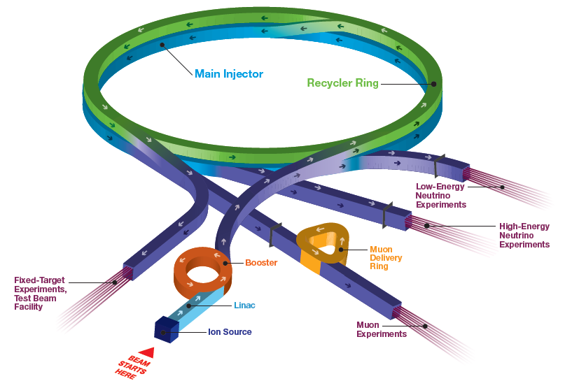
Fermilab Accelerator Complex
Short Baseline Neutrino:
MicroBooNE, ICARUS, SBND
SwitchYard 120:
SpinQuest, test beam (FTBF)
Long Baseline Neutrino:
NOvA, (LBNF/DUNE)
Muon Campus:
(g-2, Mu2e)
A.Valishev
20
Aaron Fawley | Synchrotron Design and Methodical Cell Optics Study
Notes:
20
20
20
20

Slide 21
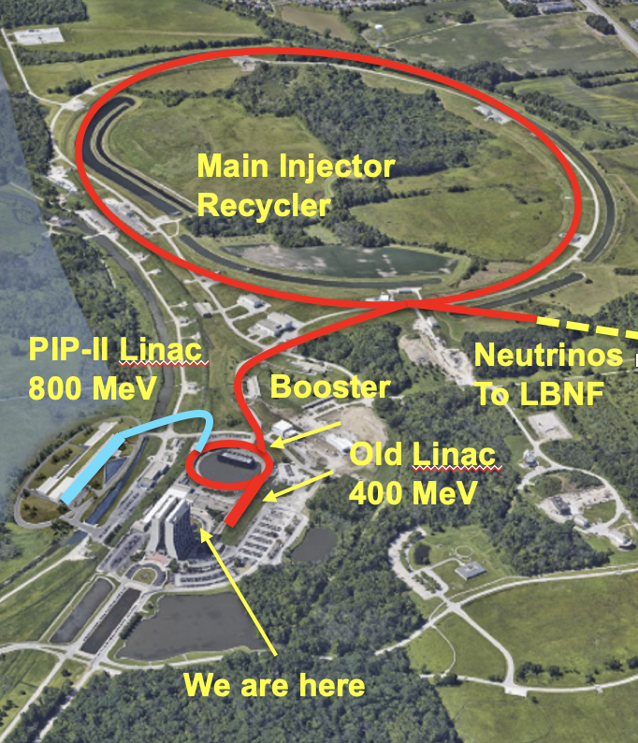
PIP-II
An 800-MeV superconducting H⁻, CW-compatible Linac
Beam transport of 800-MeV H⁻ from the SRF Linac to the Booster.
A new injection area in the Booster
Modifications to the Booster, Main Injector, and Recycler Ring to enable >1 MW power on LBNF target for 60-120 GeV.
Associated conventional facilities. The linac enclosure is compatible with upgrades.
A.Valishev
21
Aaron Fawley | Synchrotron Design and Methodical Cell Optics Study
Notes:
21
21
21
21

Slide 22
Lattice Specification and Considerations
Normal Conducting
  1.5T for ramping
Required straight Sections
  RF
    Currently 11 straight sections, or 66 m total
    Dispersion suppressed or periodic placement of RF cavities
  Injection and Extraction
    10m straight section
    Single turn injection
      Assumes a separate accumulator ring for H- to proton conversion
Periodic Lattice
  ≤ 24 cells, transition either < or > 2 GeV or transitionless
22
Aaron Fawley | Synchrotron Design and Methodical Cell Optics Study
Notes:
22
22
22
22

