Slide 1
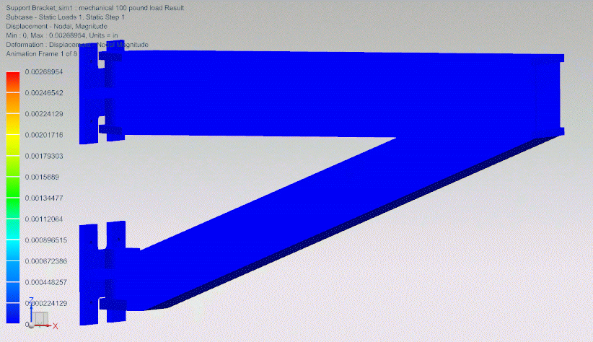
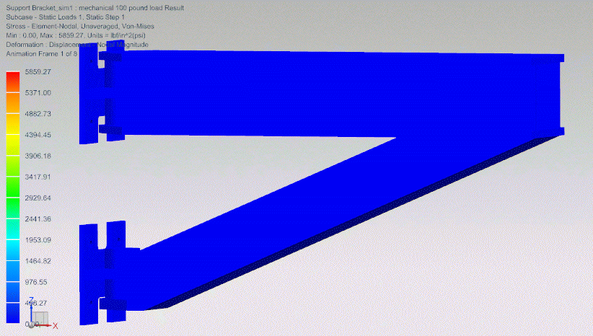
MAGIS-100 Atom Source Support Preliminary Design
Kelsey Scheidt, CCI Mentors: Linda Valerio, Jesse Batko, Beth Klein
Atom Source overview
Simulation Results
There are three Atom Sources within the MAGIS-100 experiment, located at the ends and midpoint of the shaft, adjacent to the vacuum tube.
Each Atom Source weighs approximately 700 pounds and contains the optical components for the atom interferometry and delivers the Strontium.
The stress and displacement of the structure were simulated with NASTRAN. All components were set to be made of 304 Stainless Steel (also known as 18/8), however 316 Stainless Steel would also be acceptable for this application for their shared corrosion resistance and non-magnetic properties.
A 1000-pound force was placed on the top plate of the Main Support Structure in the area which overlapped with the Adjuster Plate. Additionally, the back face of the Attachment Plates was secured to remain static as they would be when installed.
NX assembly model of the support. Adjustors mounted to the bottom of Atom Source frame.
The supports are made of three main components:
Main Support Structure: Made of two flat plates, 47 inches in length, ending in rounded triangles to allow for pivoting.
Wall Attachment Plate: 12x10 inch plate with triangular attachment points and space for the support to rotate through it. Specifics of securing the plate will be analyzed by FESS civil engineers.
Adjusters and Adjuster Plate: 3-point adjuster design based off existing Fermilab designs. Adjuster plate design is not final.
Additional designs for a pivoting system were made and accounted for, but the completion of which was outside the scope of this internship.
Atom Source in Shaft Assembly
Process
Displacement of the Main Support Structure and Attachment Plate. Maximum Displacement: 0.00268954 in,
My process for the design followed three main steps:
Initial hand sketches were completed to lay out the possible designs of each component, beginning with the main support structure.
NX models were then made to visualize the structure in three dimensions, allowing for easier redesigns.
Finally, NASTRAN simulations were done, and the model was adjusted from the data received.
Simulations were done with NASTRAN. A 1000 pound force placed on half of the top plate and the back of the attachment plates were restricted to static placement.
Stress placed on the Main Support Structure and Attachment Plate. Maximum Stress: 5859.27 psi (lbf/in^2). Ultimate Tensile Strength of 304: 73,200 psi

Slide 2
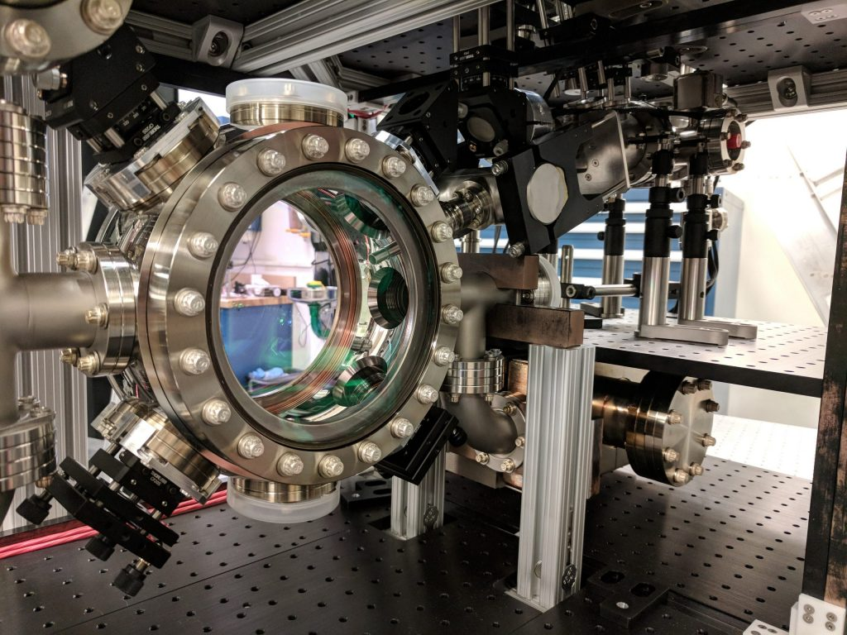
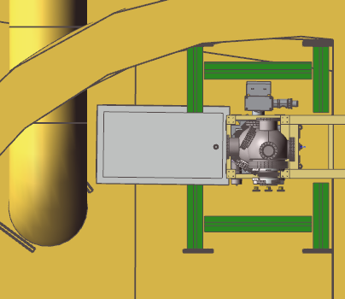
MAGIS-100 and the Atom Sources
MAGIS-100: Matter wave Atomic Gradiometer Interferometric Sensor
MAGIS-100 has three Atom Sources located at key locations within the shaft.
Each Atom Source weighs approximately 700 pounds and is located directly adjacent to the vacuum tube, around 22 inches from the back wall.
Each Atom Source contains the major optical components for the atom interferometry, the focus of this experiment.
Atom Source in the NX Top Assembly.
Atom Source optics; being assembled at Stanford.
Photo: Stanford University
Notes:
Atom Source picture: MOT- Magneto Optical Trap. Delivers Sr atoms to experiment

Slide 3
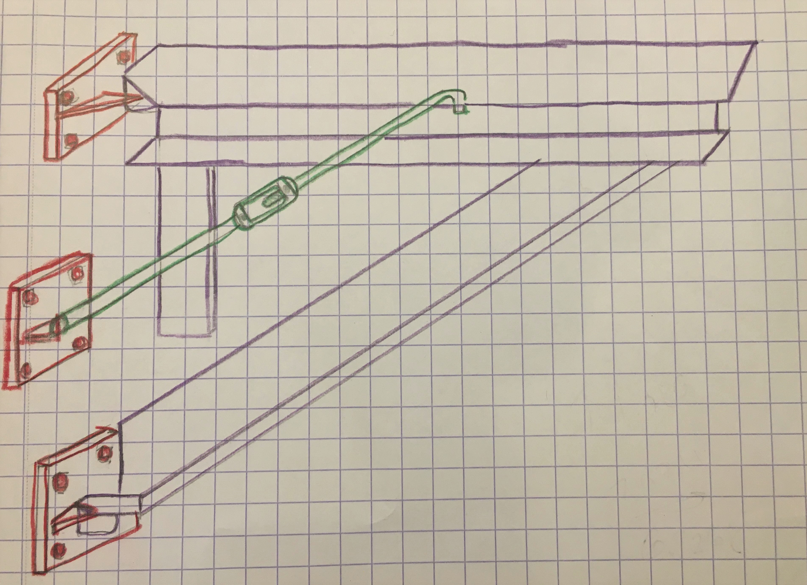
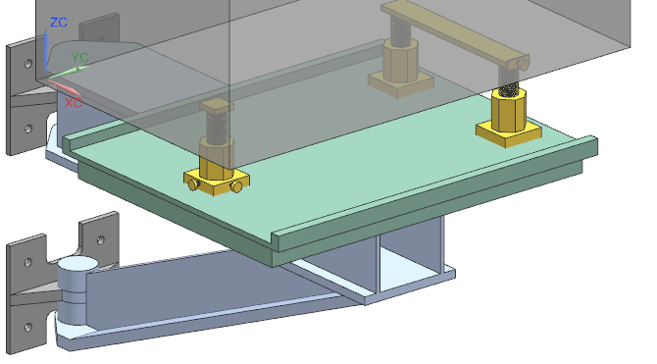
Requirements and Method
2
Non-Magnetic
Non-Corrosive
Non-Movement Impeding
Minutely Adjustable
Attach to curved wall
Initially beginning with hand sketches, multiple iterations for most components.
Modeling in NX, pivot system explored.
Final testing in NASTRAN
Initial hand sketches
Final NX Model
Notes:
Non-Magnetic: The experiment’s vacuum tube has magnetic shielding surrounding it, so the supports can't impede the precise fields.
Non-Corrosive: Because of the shaft’s location, it and the tunnels below it tend to flood. The support material has to be able to withstand large amounts of water coming down the shaft when rain comes.
Non Movement Impeding: Maintenance to the Atom Source cannot be impeded
Minutely Adjustable: Like accelerator magnets, the sources have to be able to be adjusted in small increments, so the design must contain adjusters.

Slide 4
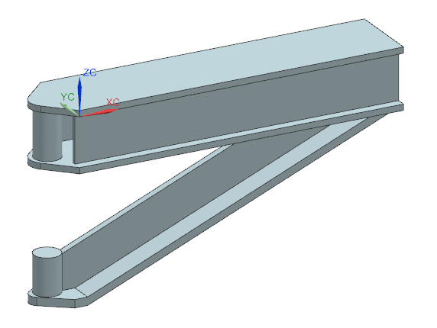
Structural Parts
3
All parts are made from 18/8 stainless steel, also known as 304
Non-Magnetic
Corrosion resistant
High Tensile Strength
Main Support Structure
Wall Attachment Plate
Notes:
Note that 316 also works, as it has similar properties.
Also note that the back of the Attachment Plate has been angled slightly to account for the wall’s curvature.

Slide 5
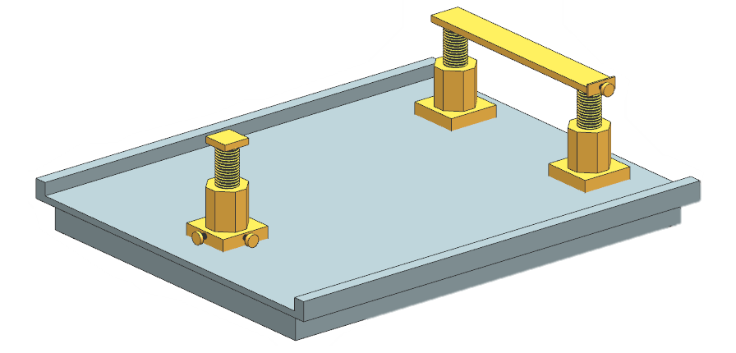
Adjustment System
4
Adjusters based off existing Fermilab design used for accelerator magnets.
3-point adjusters
Adjuster Plate bottom latticed for additional support
Adjusters attach precisely to bottom of Atom Source
Plate design not final
Picture of Adjusters and Adjuster Plate
Notes:
The Adjusters are attached to the frame of the Atom Source.

Slide 6
Pivoting System
5
Space has been left for a pivoting system.
Necessary because all Sources are aligned vertically.
Allows for the removal of lower Atom Sources
“Slice” of attachment plate goes into cylindrical connection. Either bearings or glacier plates allow for movement.
A locking mechanism is needed to prevent supports from moving when not required.
Wall Plate with “Slice”
Close view of pivoting section
Notes:
Talk about overhead crane being used to take sources out for mantience

Slide 7
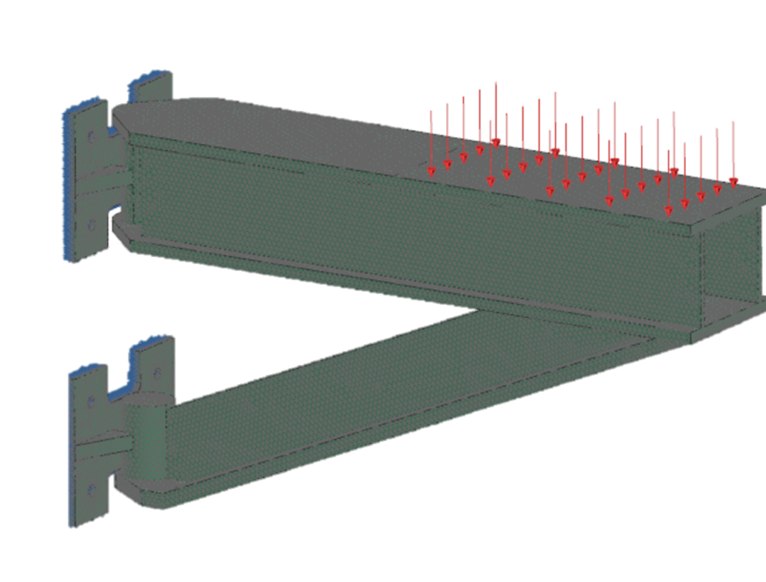
Simulations/Results
6
Simulations done in NASTRAN
1000-pound force on top plate of support
Static mounting plate to simulate connection to wall
Ultimate Tensile strength of 304: 73,200 psi
Stress simulation max:
5859.27 psi (lbf/in^2)
NASTRAN mesh prior to simulation. Element Size: .4 inches
Deformation simulation max: 0.00268954 in
Notes:
Yield Strength- 31,200 psi

Slide 8
7
Final NX model

