Slide 1
Radioactive Cleaning Robot
Emily Stachowicz
AD Robotics Initiative - CCI
5 August 2020

Slide 2
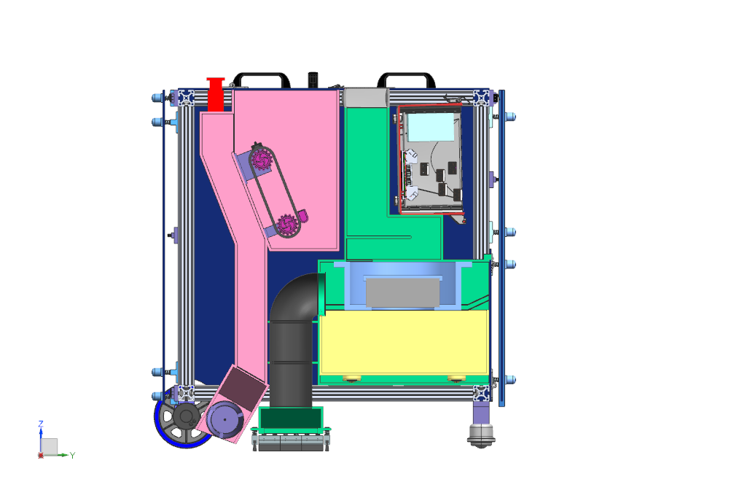
Radioactive Cleaning Robot
Problem
Particle Accelerator Gives off Radioactive Dust
Dust build up can be harmful
Dust requires yearly, expensive cleaning
Area must be shut down during this
Solution
Radioactive Cleaning Robot can be used attract and contain the harmful dust
Can be ran year round to ensure constant cleaning

Slide 3
Radioactive Cleaning Robot
Functionality
Distributes “Tough Guy” powder
Special powder attracts radioactive dust
Sucks up powder and dust combination
Air flows through the vacuum into the reservoir
Dust falls downward while air passes through the vacuum fan and filter
Remaining dust settles in the baffle system
Dust reservoir is removed and emptied via hatch/ramp combination
Powder is refilled through top hatch

Slide 4
Concept Sketches

Slide 5
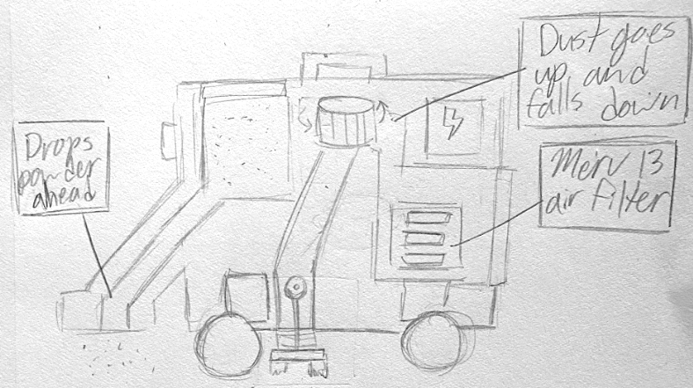
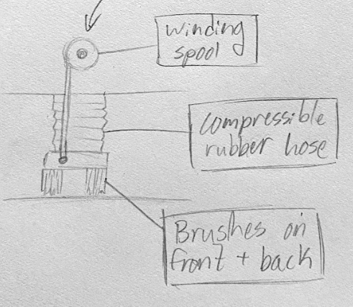

Slide 6
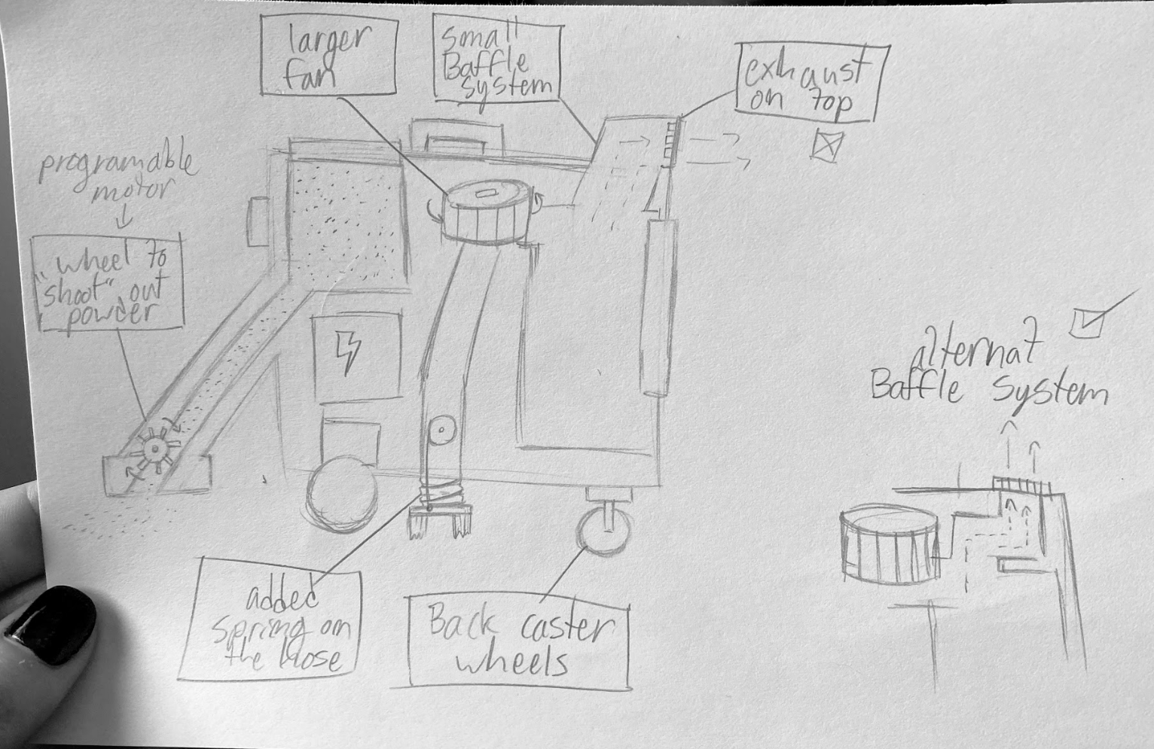
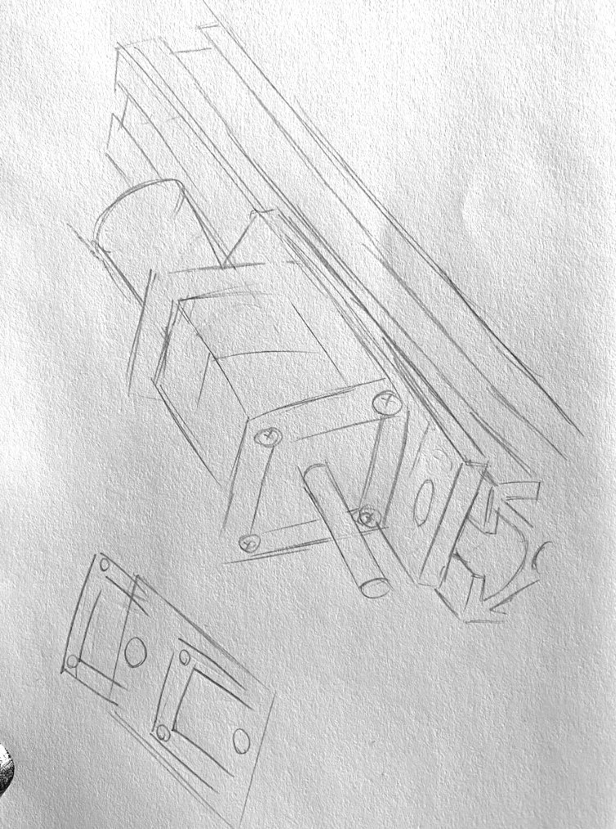

Slide 7
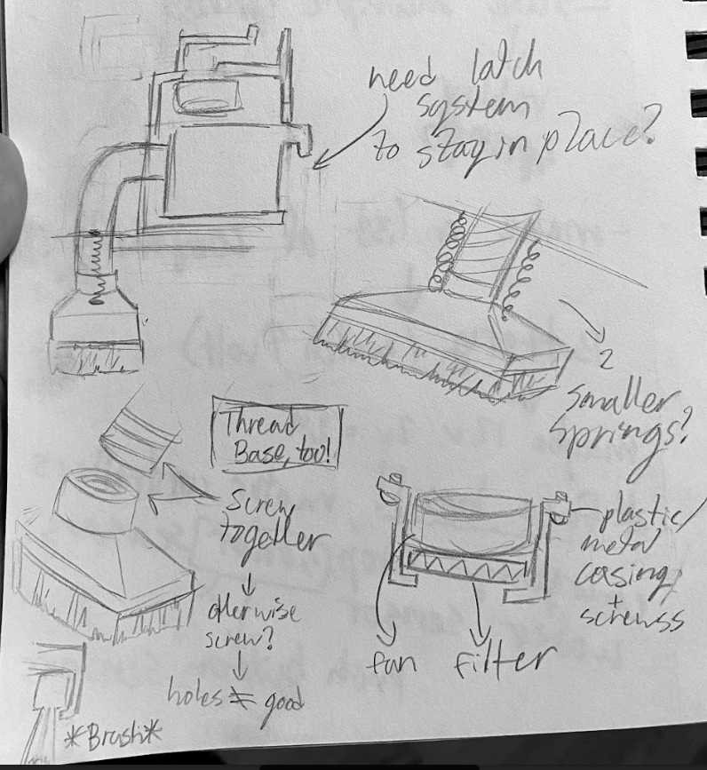

Slide 8
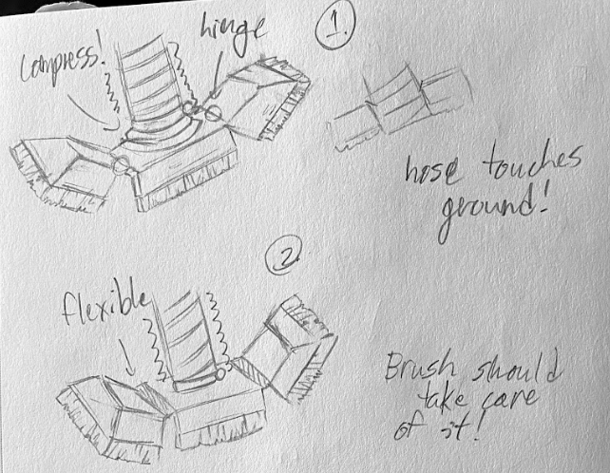
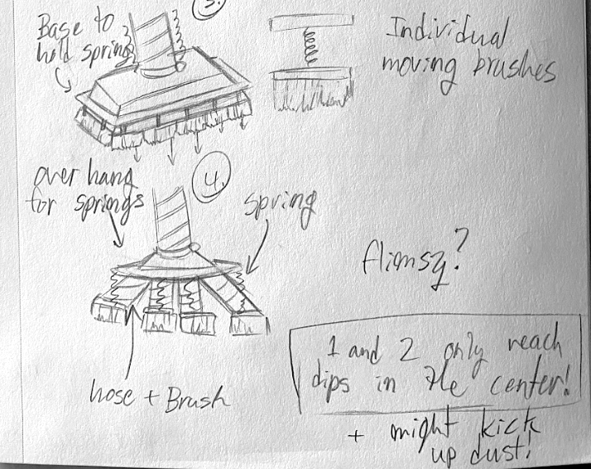

Slide 9
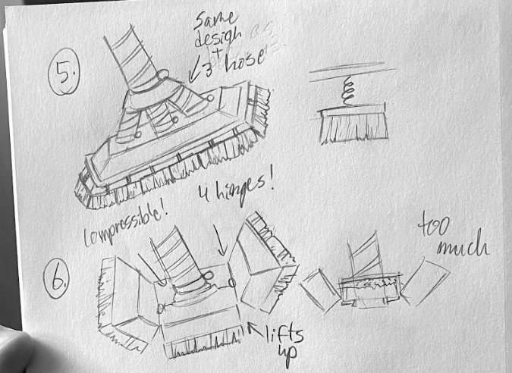
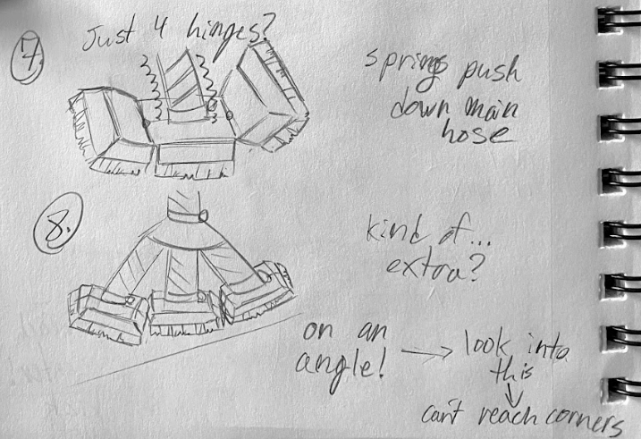

Slide 10
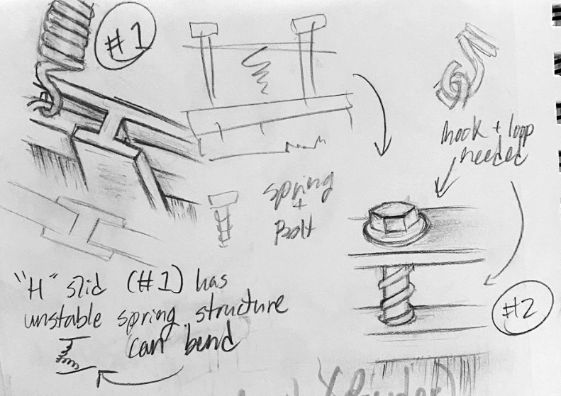

Slide 11
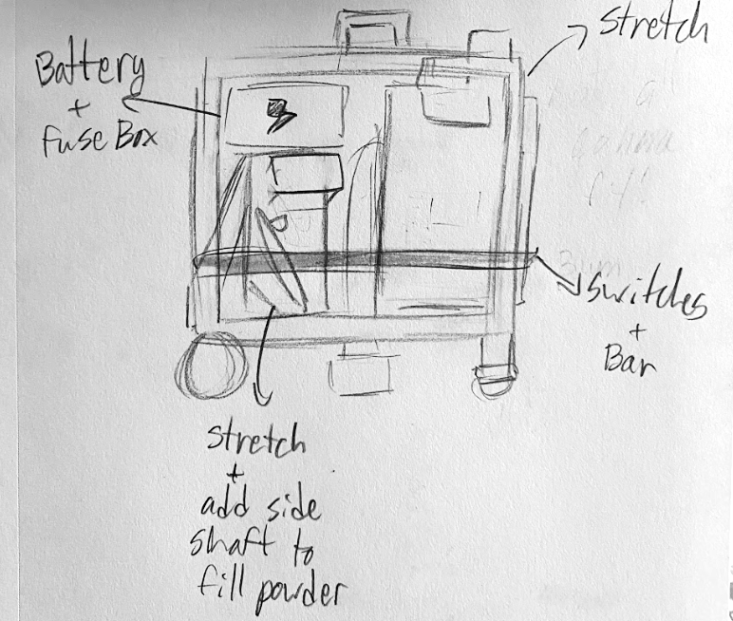

Slide 13
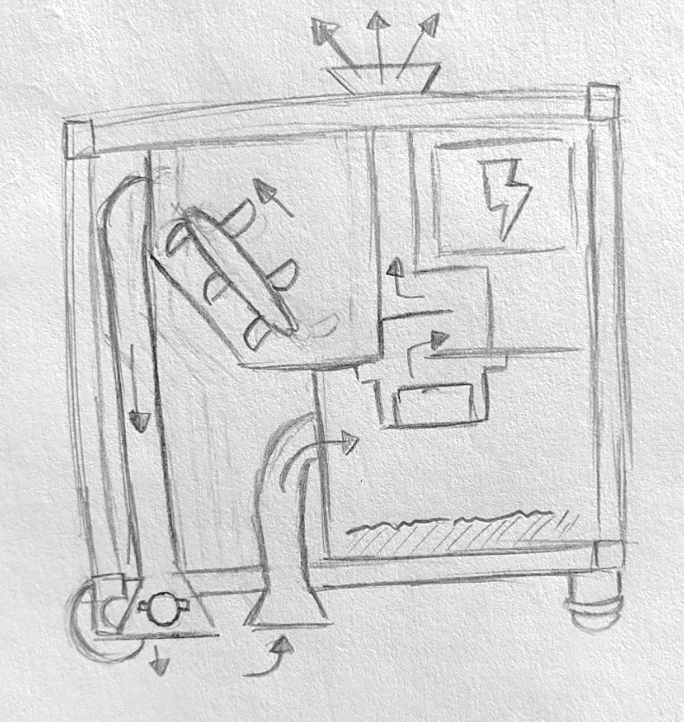

Slide 14
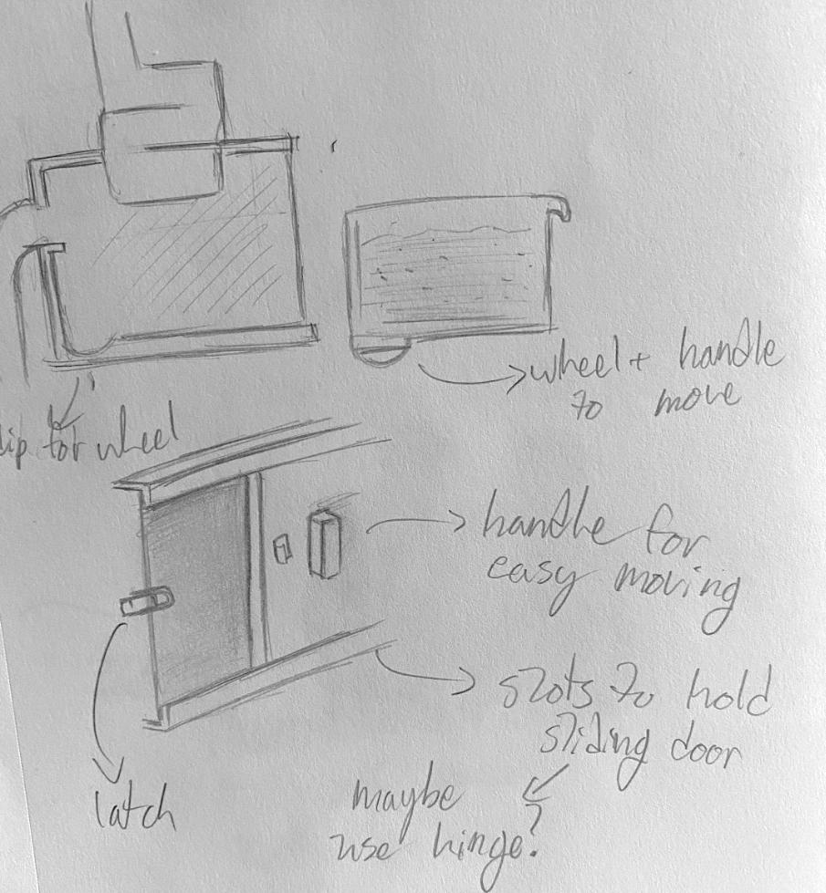
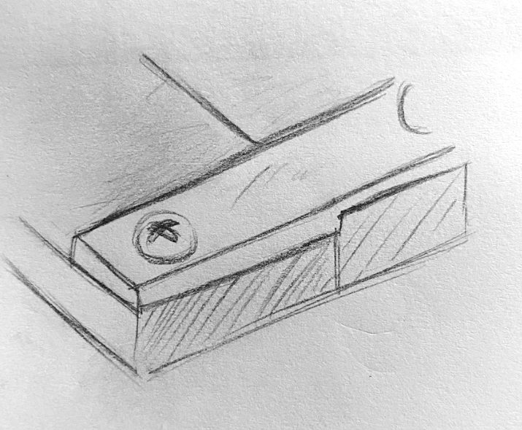

Slide 15
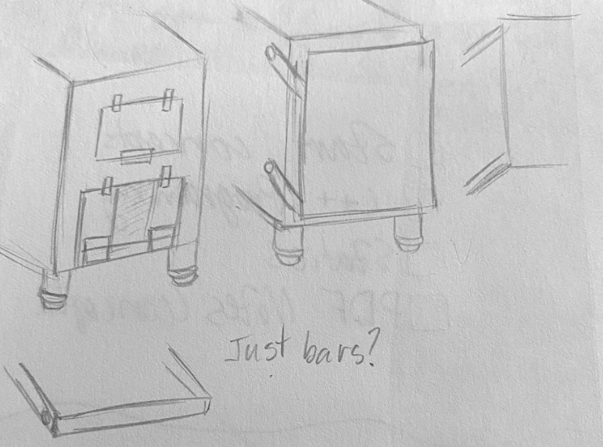
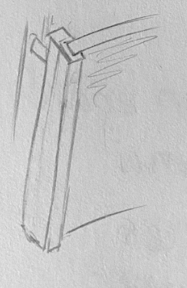

Slide 16
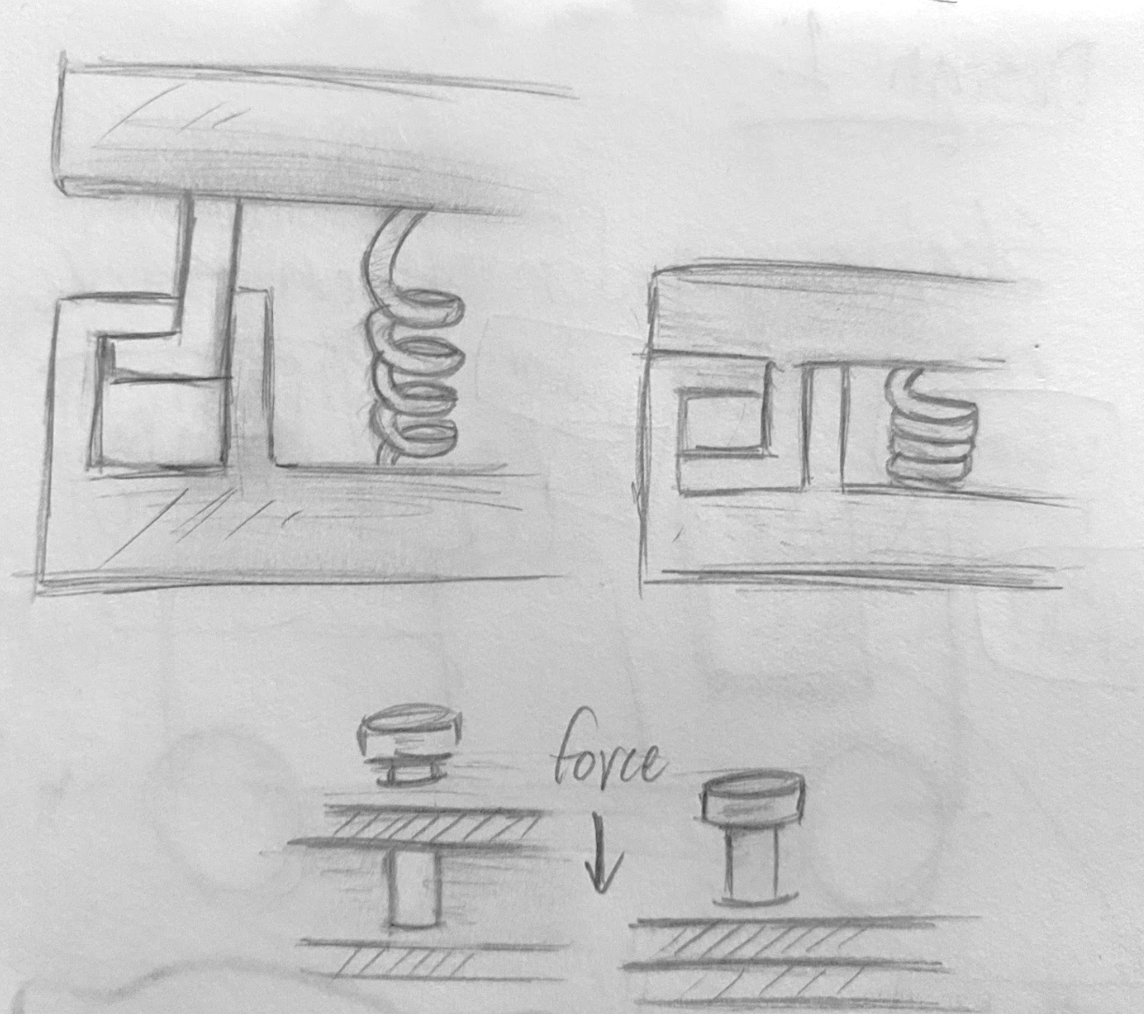

Slide 17
CAD Models

Slide 18
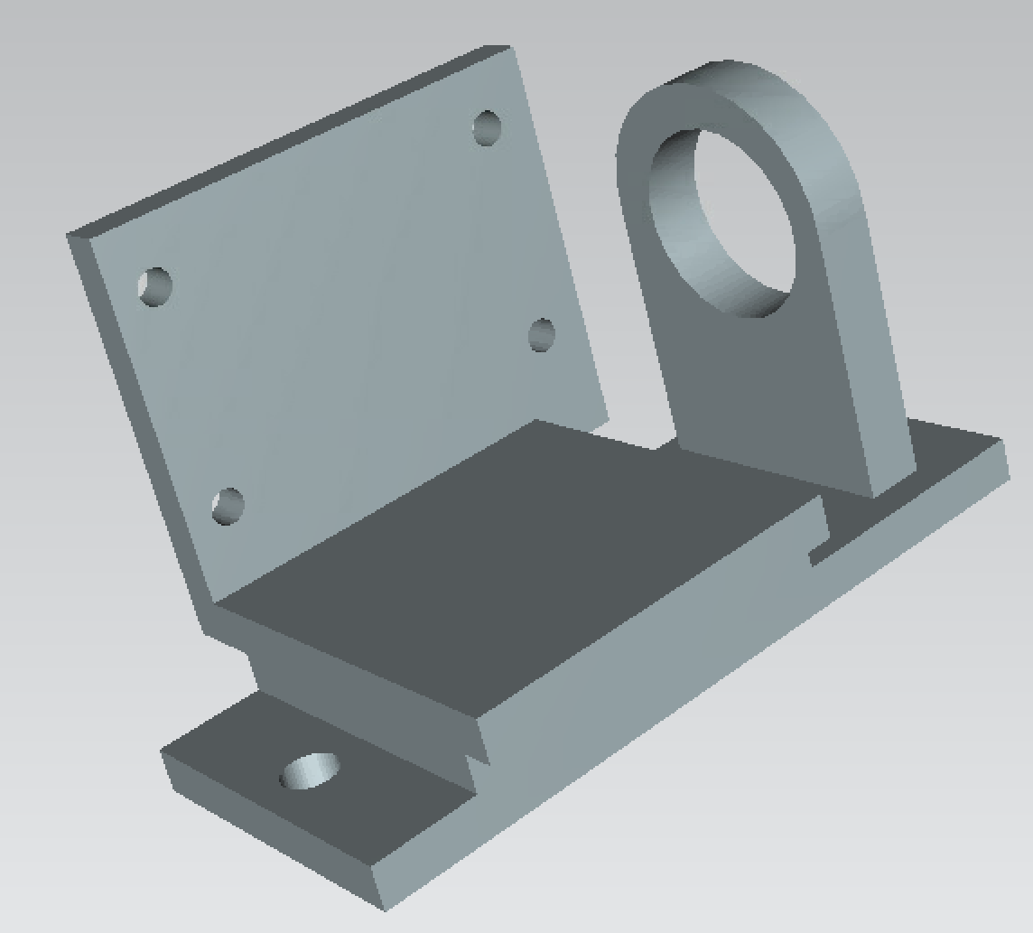

Slide 19
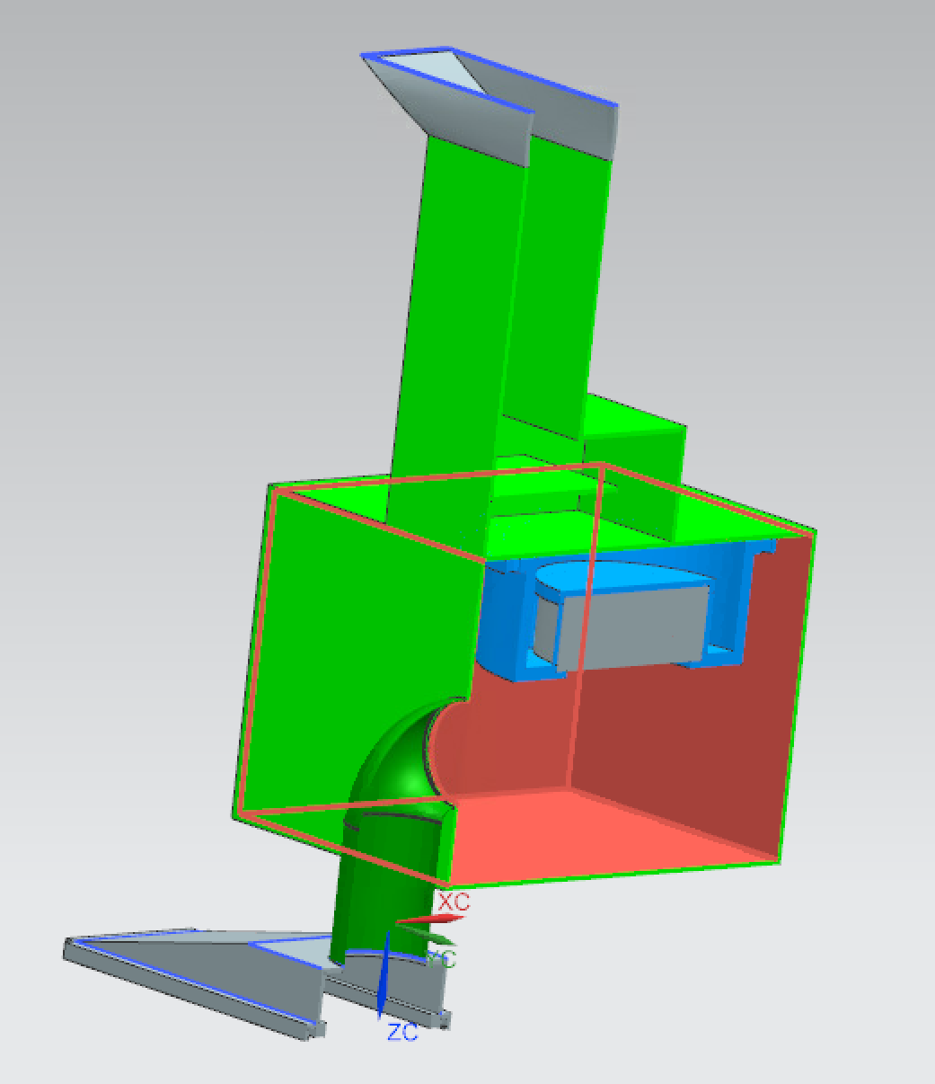
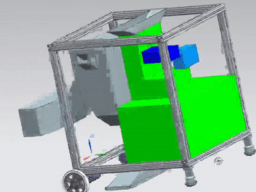

Slide 20
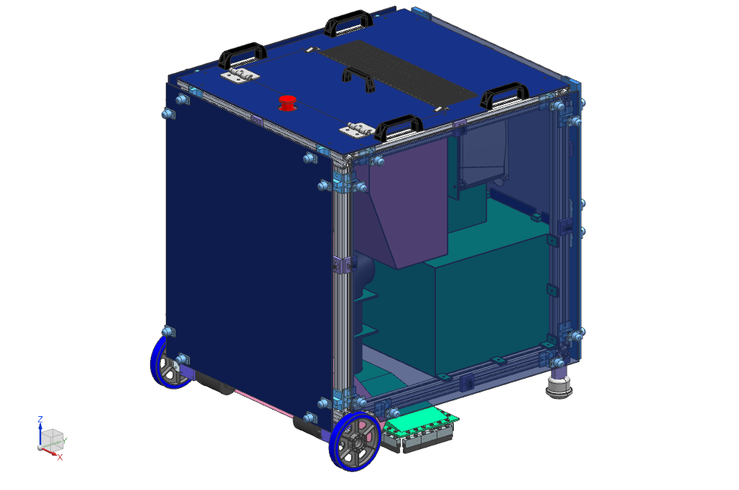
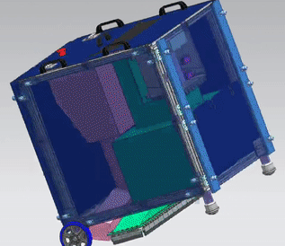

Slide 22
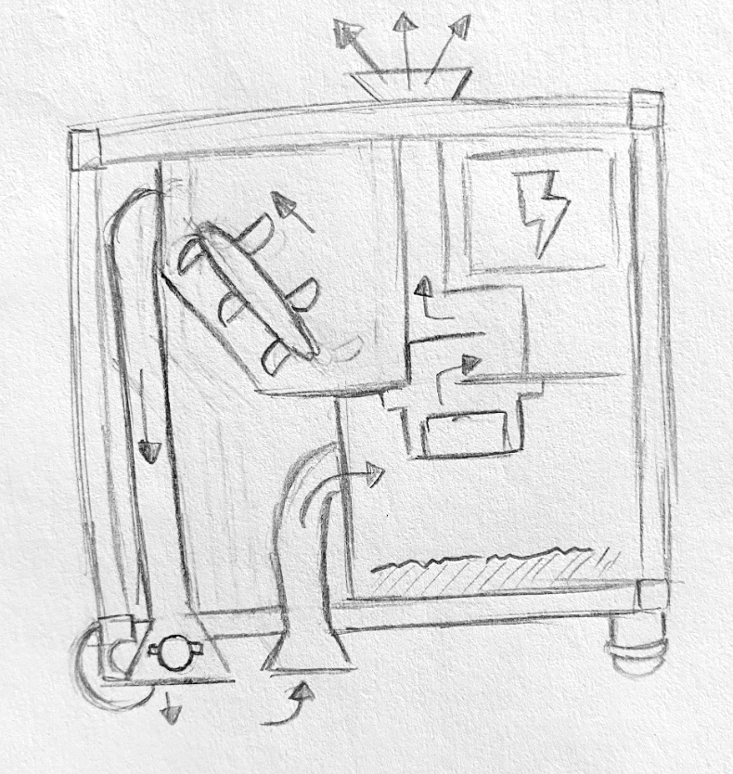

Slide 24
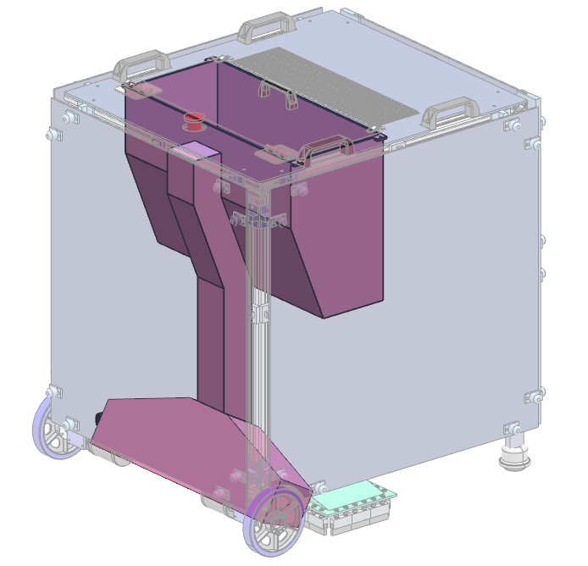

Slide 25
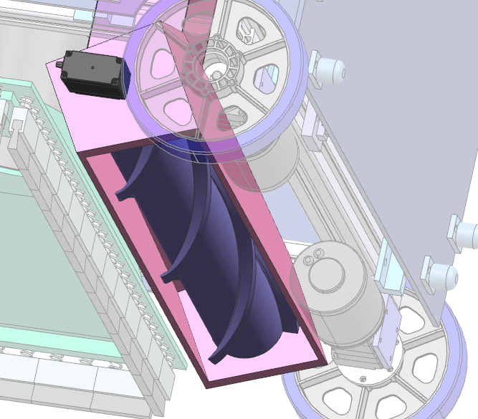

Slide 27
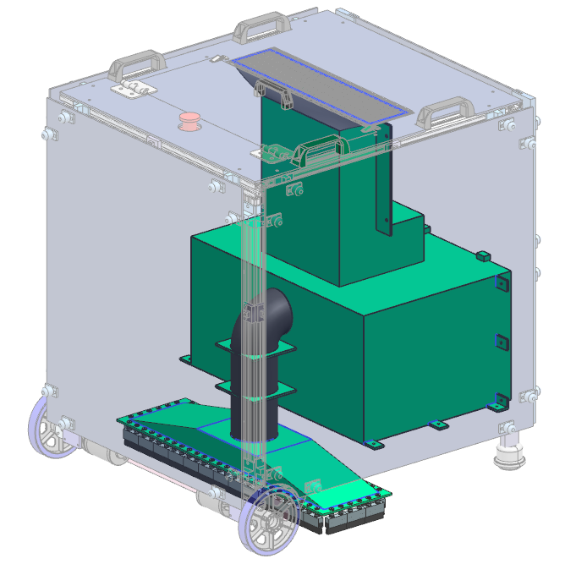

Slide 28
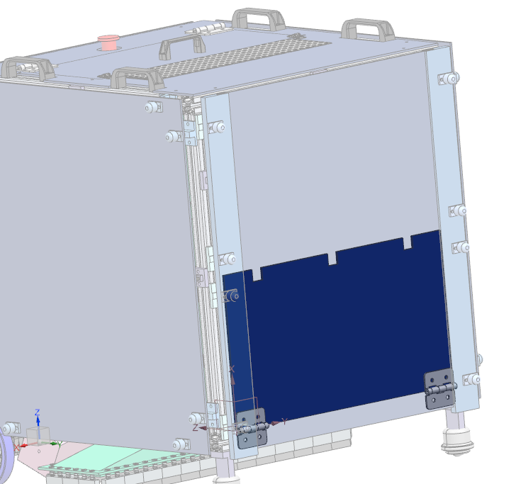
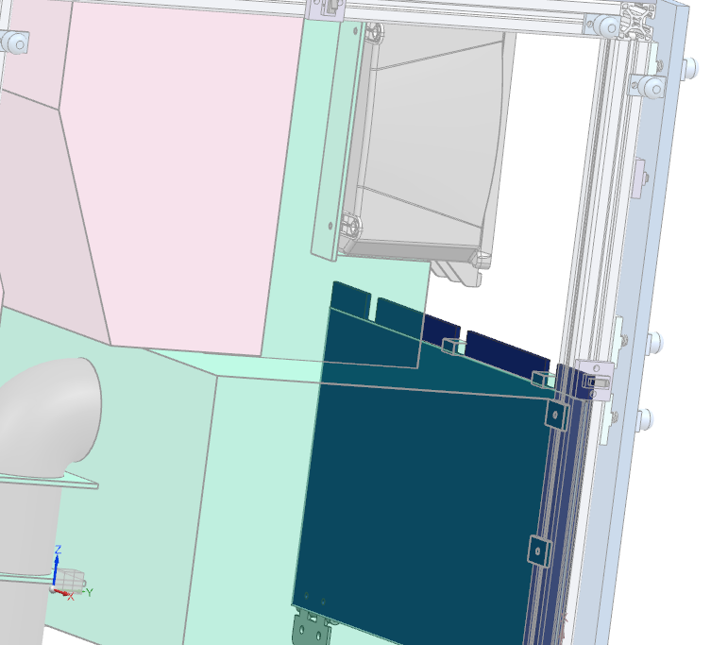

Slide 29
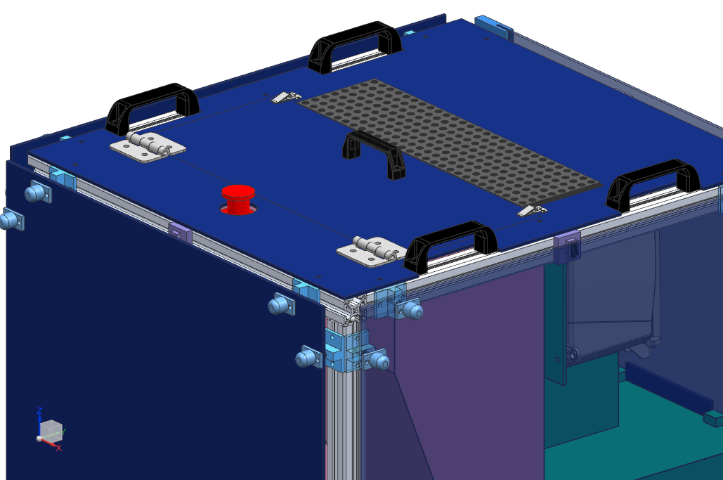

Slide 30
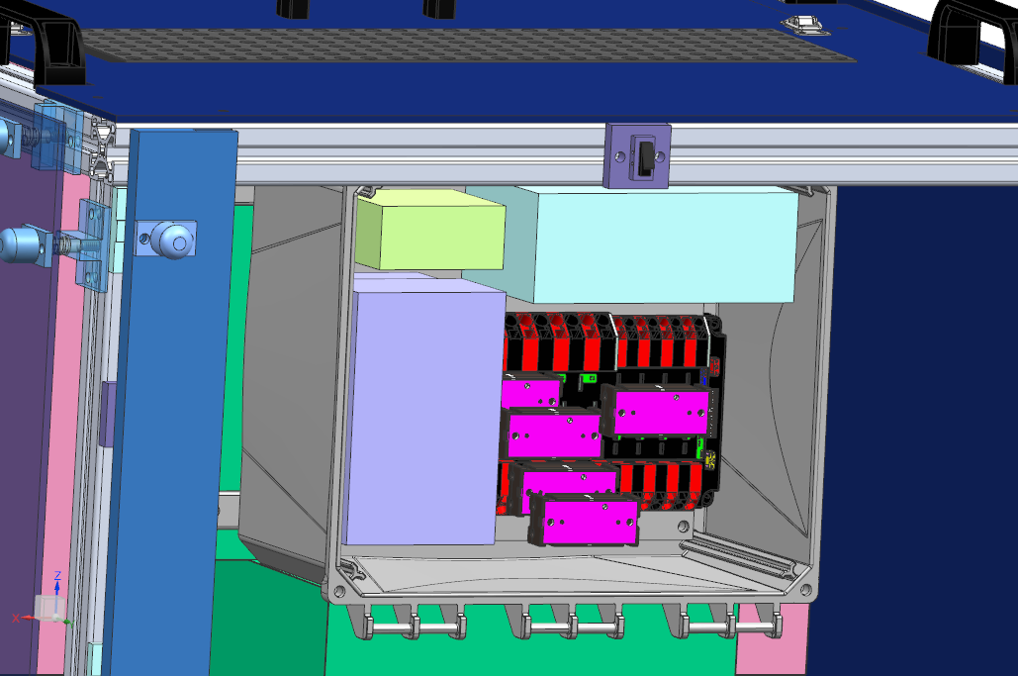

Slide 33
Thank you for attending!
Any questions?

