Slide 1
MTA Beam Line Commissioning
05/23/2011 Update

Slide 2
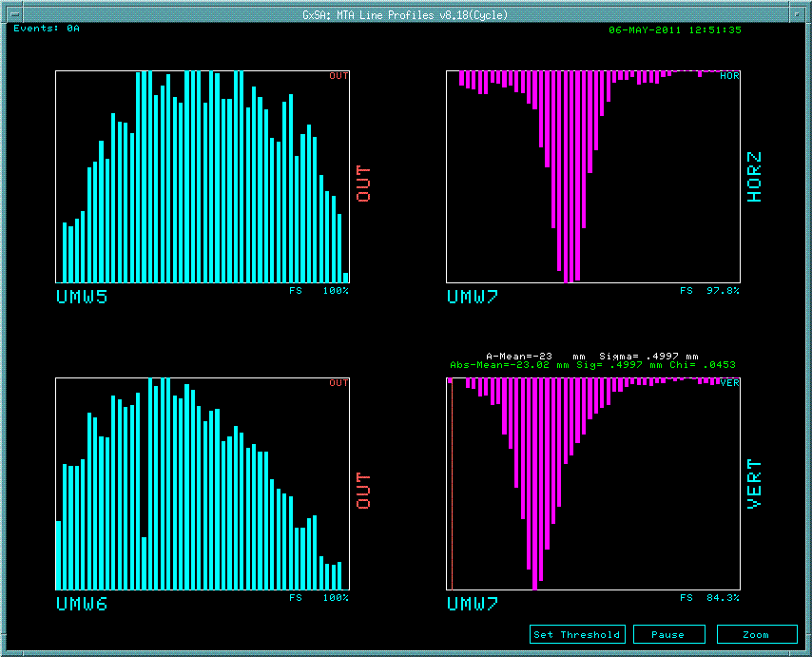
Added Temporary SWIC Immediately Upstream of Experiment’s Collimator
New SWIC (S8) is read out using cables from MW5 and MW6 – chose to do this instead of pulling new cables.
Horizontal plane is read out through MW5; vertical plane is read out through MW6.
MW7 is approximately 20 feet upstream of S8.
H- beam is stripped as it passes through vacuum window, leaving a positive beam.
Able to steer beam using final bend.

Slide 3
Added Two Correctors to Aid Steering
Added second Booster corrector
to form dog-leg. This allows one
to set position and angle on final
focusing triplet.
MW7
S8
Added additional dipole. Initial
single dipole was inadequate to
achieve 1.6 deg bend.

