Slide 1
HVS Camera Plan
July 31, 2020

Slide 2
HVS Camera System Scope
Cold cameras for HV system monitoring purpose were transferred from the CALCI consortium to the JT-HVS consortium.
We are currently planning to install 12 cold cameras as the baseline (same scope as when these cameras were in CALCI’s scope) in the liquid argon.
These cameras can be divided into 3 groups of 4 based on their locations and targets.
Group 1: targeting the HV cups/feedthroughs
Group 2: top corners of the TPC
Group 3: bottom corners of the TPC

Slide 3
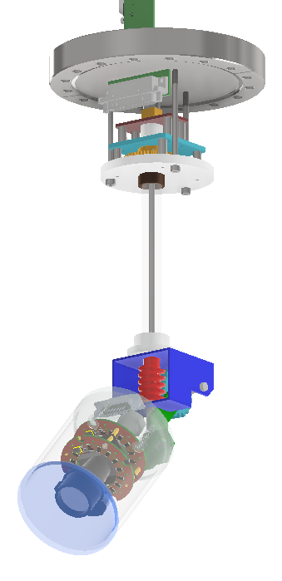
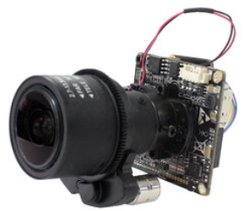
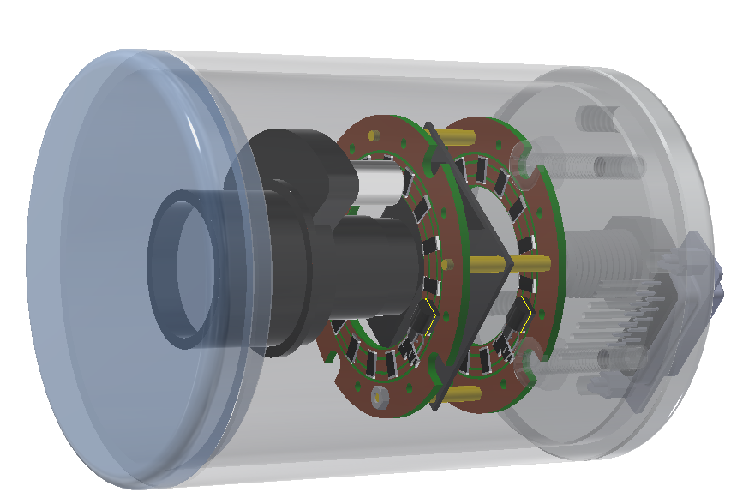
Cold Camera Design
Several cold cameras in acrylic housing have been used in both NP04 and NP02 with reasonably good results. The construction and installation in NP04 is described in this document in EDMS.
The default camera design for DUNE is the same as those used in NP04 and NP02.
LED lights will be mounted on the camera housing so we don’t need separate light sources in the cryostat. We’ll reach an agreement with PDS on the type of light , and any interlock with PDS operation.
We are testing cameras with better sensors (Sony Starlight) with improved light sensitivity, and remote zooming and focusing capabilities.
We are also designing a port mounted camera that can be steered remotely as a special inspection tool.

Slide 4
Cold Camera Installation
Each of these cameras requires a 8 wire connection to the outside of the cryostat. We choose to use the same cable used in NP04 (Superior Essex CAT6A-UFTP-STP-FEP).
3 cameras can share a DB25 feedthrough mounted on a flange. With 12 cameras, a total of 4 such signal feedthrough flanges are needed, one on each corner of the cryostat top.
However, at this moment, we have not secured any port that can provide us with these signal feedthroughs. It is our intention to work with the DSS team to develop parasitic ports on 4 DSS penetrations.
Once an agreement is reached with DSS, we’ll document it in the interface document with DSS.

Slide 5
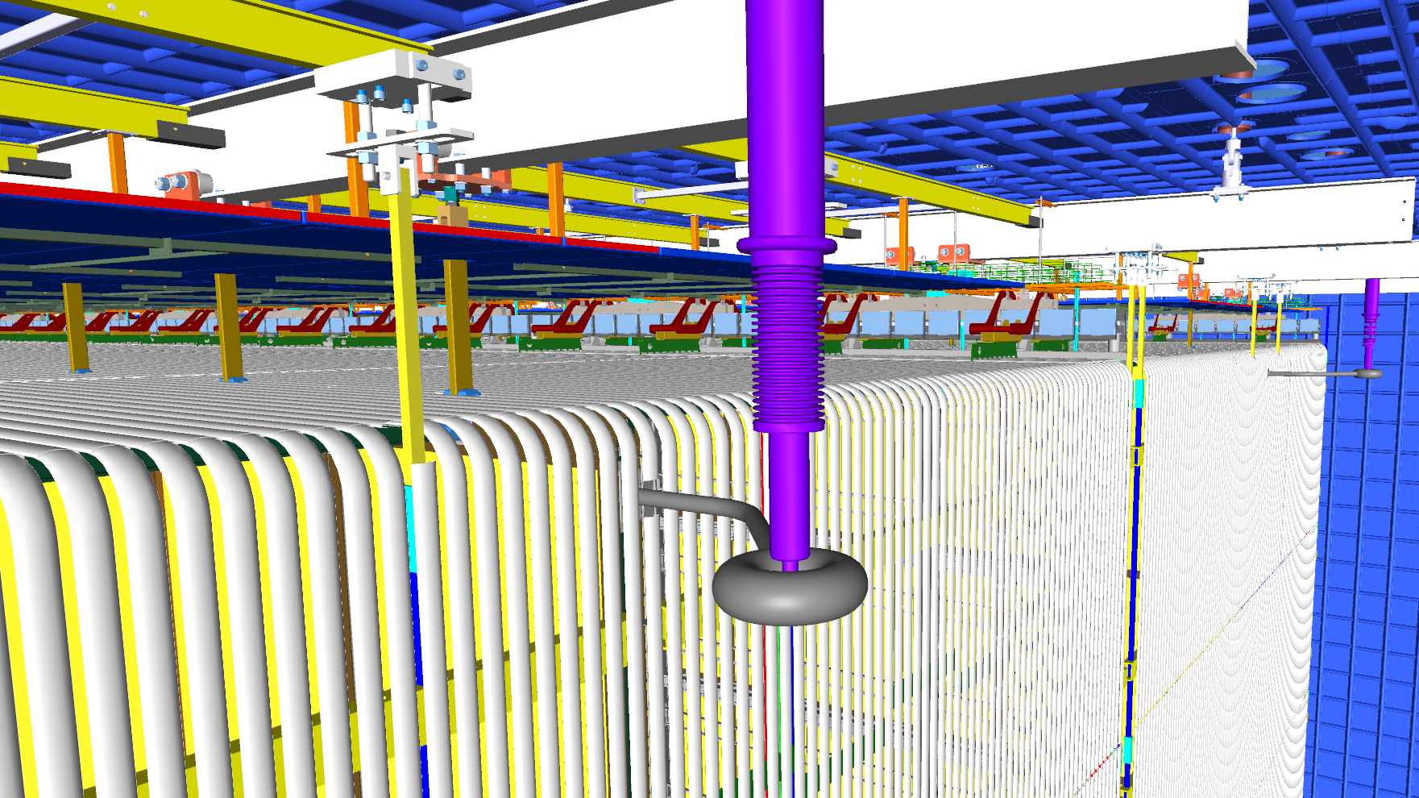
Group 1 Cameras
The target of group 1 cameras are the 4 HV feedthrough cup on the end of the TPC. Two of the cups on the east end will have the HV feedthroughs connected, as shown in this picture.
A total of 4 such cameras will be installed using mounting brackets extended from the upper edge studs on the cryostat.
These cameras will be used to observe feedthrough position, boiling on the feedthrough, and any visible light emanating from the HVFT. They will also have a good view of the edges of the CPA and nearby field cage surfaces.
Run cables to the nearest ports along the roof-endwall edge.

Slide 6
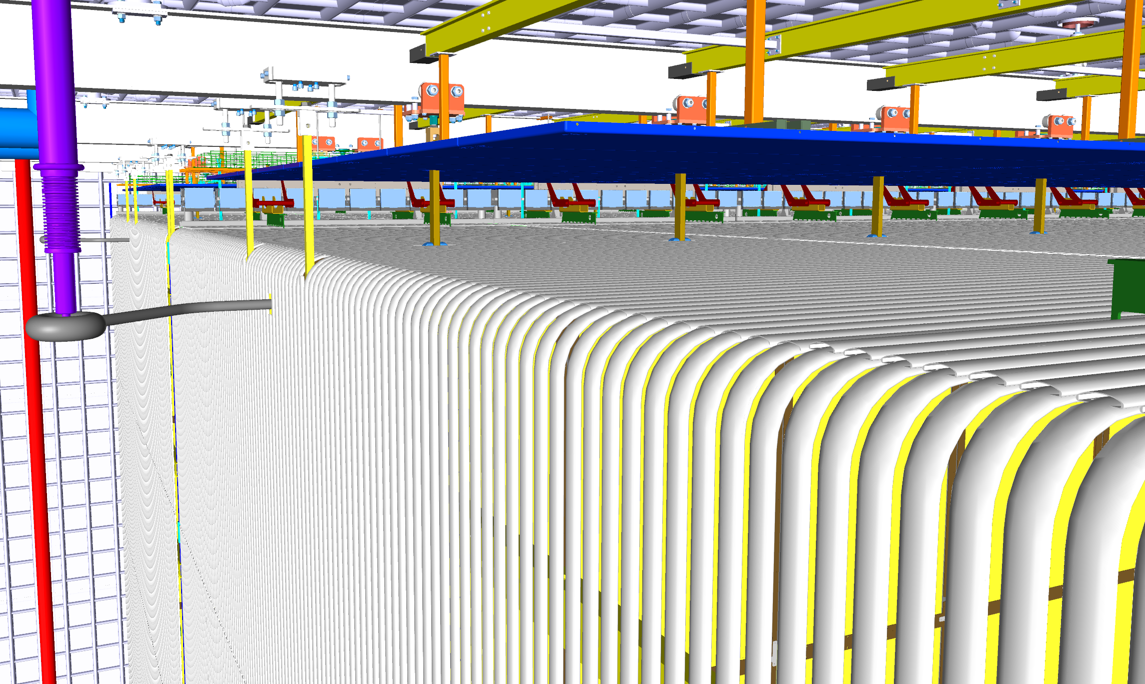
Group 2 Cameras
Four group 2 cameras are mounted near the top 4 corners of the TPC, and aimed at the top edges of the end wall FC modules.
The purpose of these cameras is to observe the position of the endwall FC, the ground planes, and the top FC near the endwall.
They also have a peripheral view of the HVFT, and also the objects inserted through the multi- purpose ports from CALCI.
They could also be used to see the cool down sprayers near the endwall.
Run cables to the nearest ports.

Slide 7
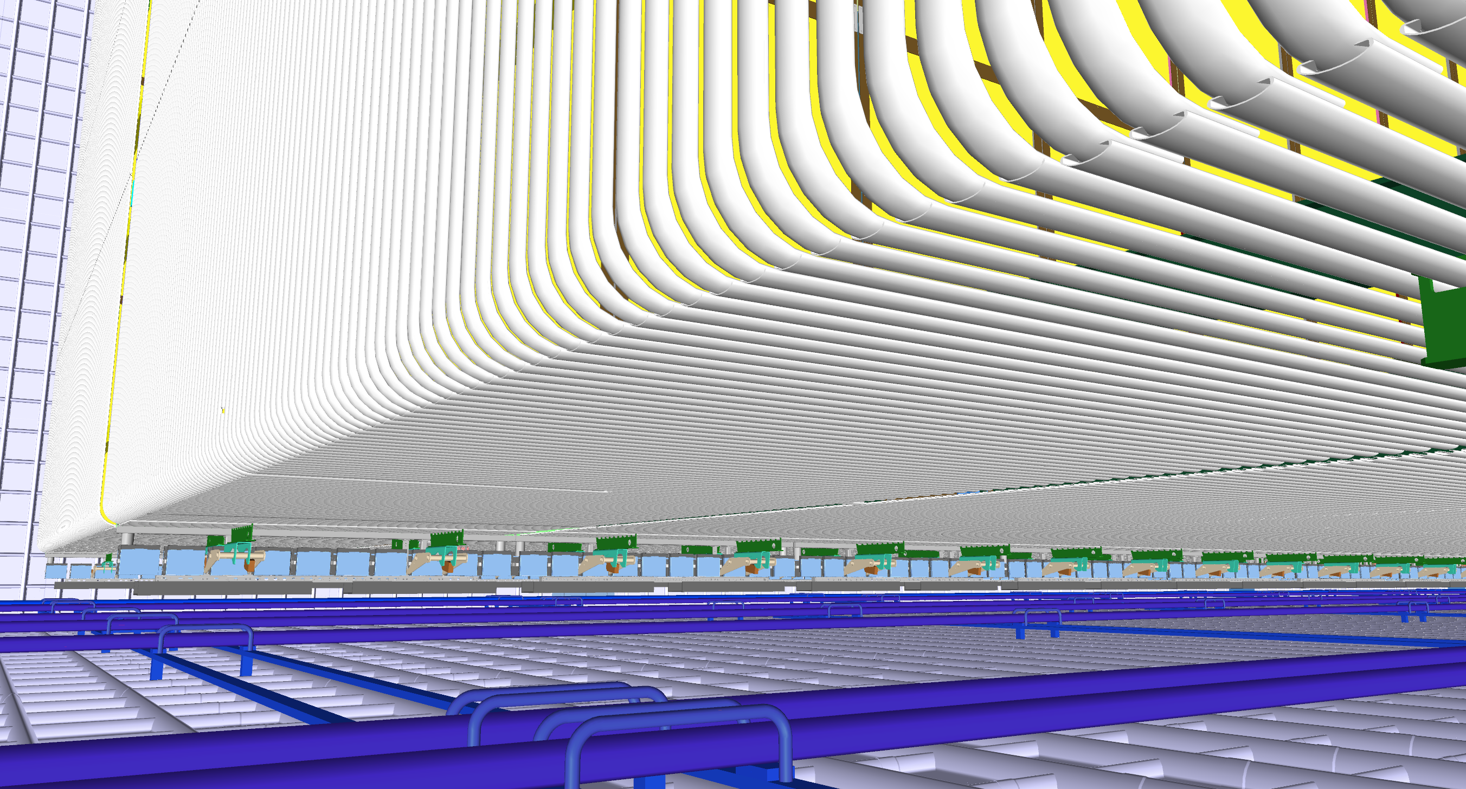
Group 3 Cameras
Four group 3 cameras are mounted on the bottom the cryostat at the 4 corners. They observe the position of the bottom of the endwall FC modules, and the bottom FC modules near the endwalls.
They also see some of the purging pipes on the floor.
We can observe the initial LAr filling process through these cameras.
The pressure at this depth is about 30 psig. One of the NP04 style cameras has been used in a LAr filled pressure vessel at 35psig.
Run cables up along the edges of the cryostat walls to the nearest ports.

Slide 8
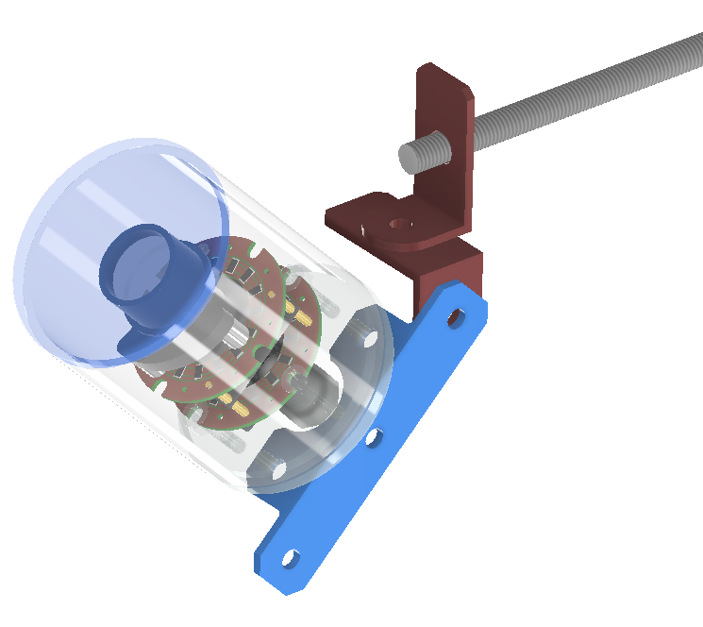
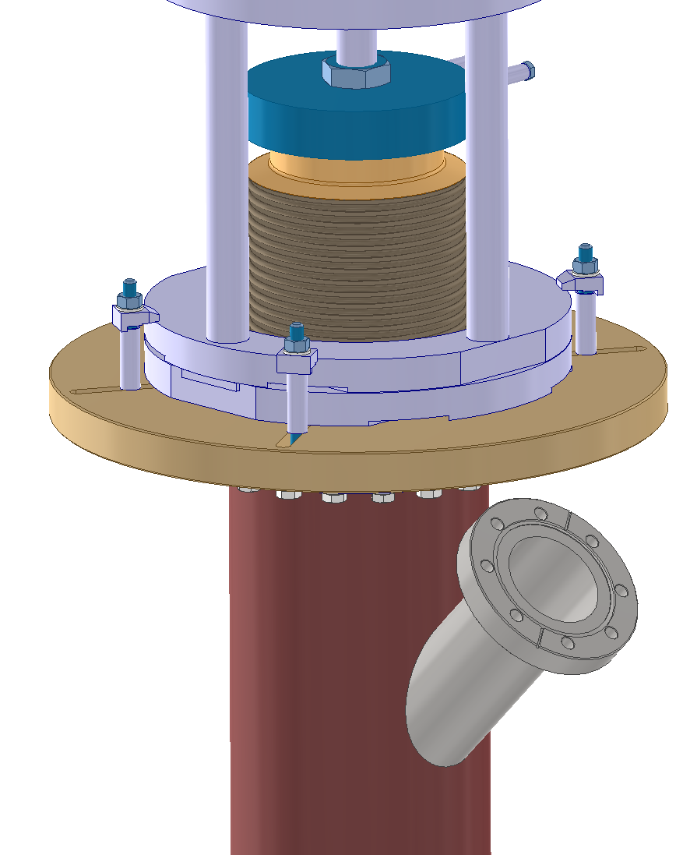
Interfaces
Mechanical: a couple of brackets on the back of the camera enable adjustment of the camera orientations. The camera assemblies can be easily mounted on the threaded rods along the edges of the cryostat, or extensions from them.
Electrical:
Total of 8 wires connecting to the camera assembly using a cat-6 cable.
2 pair of wires for 100BASE-T data transmission
1 pair for camera power + internal heater:
Heater voltage >13V, use a 12V regulator for camera function.
More flexible heating power control
1 pair for LED lights
Required cryostat ports
4-1/2” CF flange with two DB25 connectors. Provide up to 6 cameras per port
For 12 cameras total, need 2 such ports (one on each end of the cryostat).
Prefer to have 4 such ports (one on each corner of the cryostat) to reduce cable length.
Best option is to have the ports parasitic to the 4 outer most DSS APA penetrations.

Slide 9
Major Issues
Cryostat ports
At this moment, there are no roof penetrations allocated for the HVS cameras.
Assuming using DSS ports is the only option, need to secure their agreement.
Illumination
With integrated LED lights, it is probably ok for the short range cameras (aimed at the HV feedthroughs/cups) to have reasonably good images.
Wide view cameras at the corner of the cryostat will have good illumination of nearby objects and quickly fade into darkness for far away objects.
Additional lighting is needed if one want to see everything in the views of the cameras.
Coverage
The positions of the EWFC relative to the CPA/APA have attracted our attention due to the expected roof deformation, and the Ash River finding of very stiff EWFC structure. It would be really beneficial to be able to see with good details the gaps between EWFC and CPA/APA at the bottom of the TPC, and observe the movement if additional height adjustment of the DSS SRA is required.
The current camera positions only allow us to see the two outer corners of each EW, not the CPA gaps.
Likely need 4 more cameras at the bottom of the cryostat looking at the CPA-EWFC gaps.

