Slide 1
Storage Ring Proton
EDM Experiment
William Morse – BNL
Snowmass EDM-MDM Workshop - September 16, 2020

Slide 2
Storage Ring Proton EDM
History of Storage Ring EDM
Studies with Polarized Beams
PEDM Ring Design
Systematics
Statistics
Dark Matter/Dark Energy

Slide 3
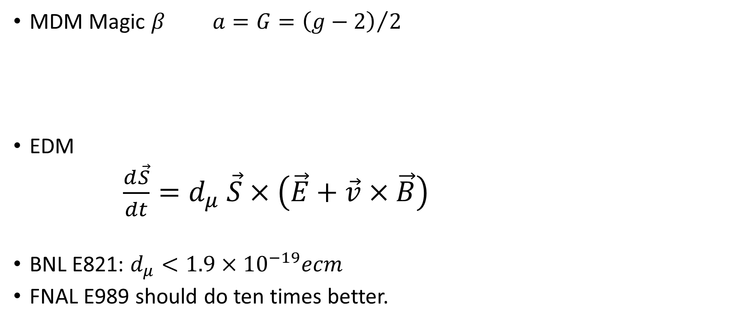

Idea came from BNL E821 muon $g−2$ experiment
MDM Magic $β a=G={\left(g−2\right)}/2$
EDM
$\frac{d\vec{S}}{dt}=d_{μ} \vec{S}×\left(\vec{E}+\vec{v}×\vec{B}\right)$
BNL E821: $d_{μ}<1.9×10^{−19}ecm$
FNAL E989 should do ten times better.

Slide 4
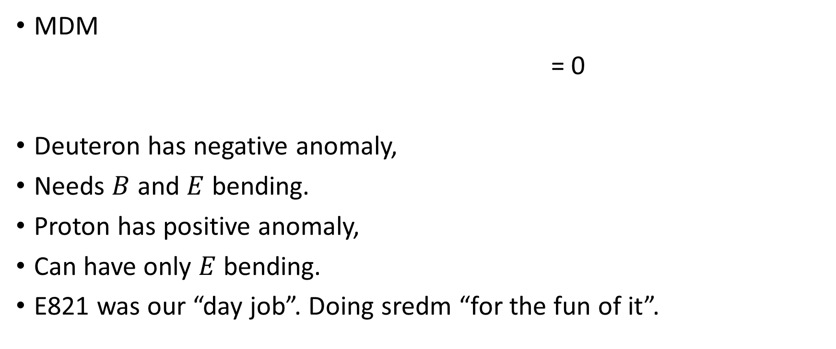
Yannis Semertzidis Idea 24 years ago
MDM
= 0
Deuteron has negative anomaly,
Needs $B$ and $E$ bending.
Proton has positive anomaly,
Can have only $E$ bending.
E821 was our “day job”. Doing sredm “for the fun of it”.

Slide 5
BNL Director’s
Review 2009

Slide 6
Experiments with Polarized Beams
We have done polarized beam experiments at:
KVI, Groningen, Netherlands,
COSY, Julich, Germany,
AGS, BNL, USA.

Slide 7
Polarized Beam Experiments Publications
G. Guidoboni, E. Stephenson, A. Wronska et al., | Connection between zero chromaticity and long in-plane polarization lifetime in a magnetic storage ring | Phys. Rev. ST Accel Beams 22, 024201 (2018)
A. Saleev, N. Nikolaev, F. Rathmann et al., | Spin tune mapping as a novel tool to probe the spin dynamics in storage rings | Phys. Rev. ST Accel. Beams 20, 072801 (2017)
Nils Hempelmann | Phase Locking the Spin Precession in a Storage Ring | Phys. Rev. Lett, 119, 014801 (2017)
G. Guidoboni, E.J. Stephenson, et al. | How to reach a thousand-second in-plane polarization lifetime with 0.97-GeV/c deuterons in a storage ring | Phys. Rev. Lett. 117, 054801 (2016)
D. Eversmann et al. | New method for a continuous determination of the spin tune in storage rings and implications for precision experiments | Phys. Rev. Lett. 115, 094801 (2015)
Z. Bagdasarian et al. | Measuring the polarization of a rapidly precessing deuteron beam | Phys. Rev. ST Accel. Beams 17, 052803 (2014)
N. Brantjes et al. | Correcting Systematic Errors in High Sensitivity Deuteron Polariztion Measurements | Nucl. Inst. Meth. A664, 49 (2012)
P. Benati et al. | Synchrotron oscillation effects on an rf-solenoid spin resonance | Phys. Rev. ST Accel. Beams 15, 124202 (2012)
FNALE989
Y. Orlov
Edm Note
1 - 3

Slide 8
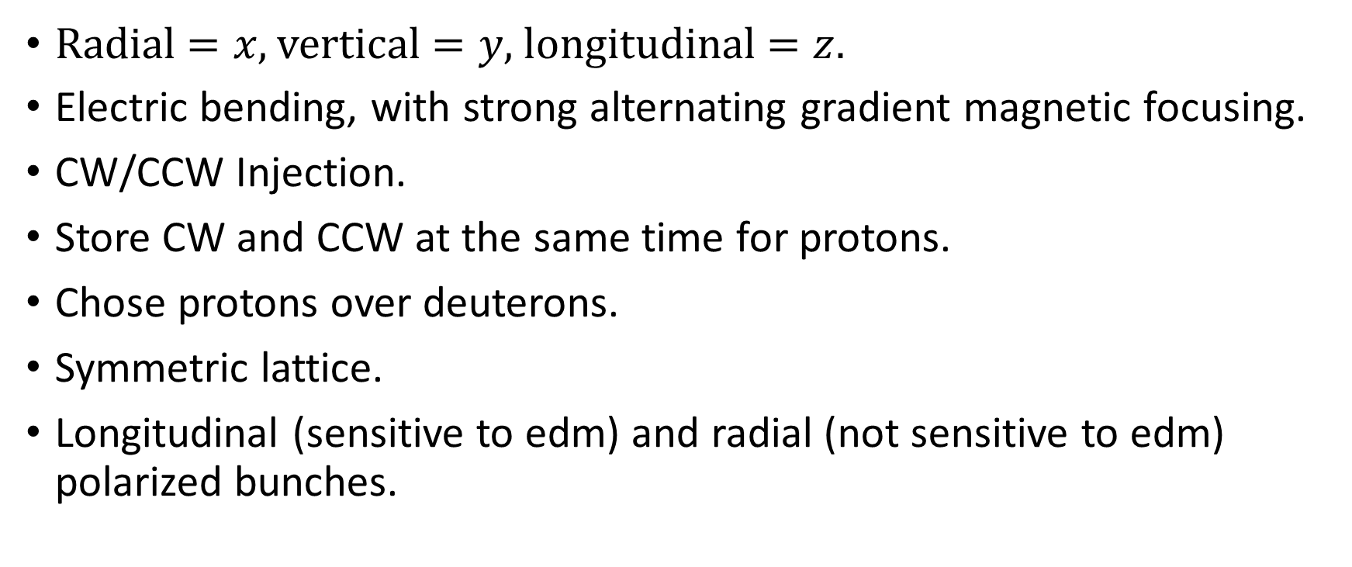

Symmetries $\frac{d{\vec{S}}_{y}}{dt}=d_{p} {\vec{S}}_{z}×\left({\vec{E}}_{x}+\vec{v}×\vec{B}\right)$
Radial $=x$, vertical $=y$, longitudinal $=z$.
Electric bending, with strong alternating gradient magnetic focusing.
CW/CCW Injection.
Store CW and CCW at the same time for protons.
Chose protons over deuterons.
Symmetric lattice.
Longitudinal (sensitive to edm) and radial (not sensitive to edm) polarized bunches.

Slide 9

P. Graham et al. Dark matter, dark energy
$$β=0.6$$

Slide 10
P. Graham et al. Dark matter, dark energy

Slide 11
Longitudinal (edm) and radial (DM/DE) polarized bunches.
flat
Longitudinal spin:
edm and edm-like
background is max.
Radial spin:
DM and DM-like
background is max.
DM-like background
can not imitate edm –
wrong symmetry.

Slide 12
CW,CCW,
Long, Radial
Stray Magnetic Field < 0.1mG
Flux gates and trim coils

Slide 13
Discuss the two most difficult systematic effects:
EDM-like systematic effect.
Electric quadrupole multipole effect.
DM-like effect.
Vertical velocity effect.

Slide 14
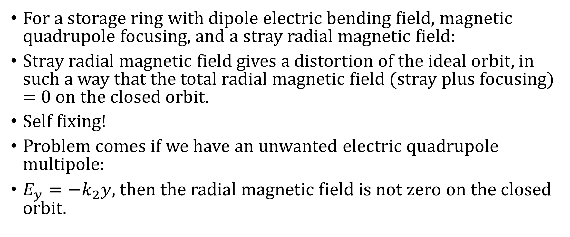
EDM like systematic
For a storage ring with dipole electric bending field, magnetic quadrupole focusing, and a stray radial magnetic field:
Stray radial magnetic field gives a distortion of the ideal orbit, in such a way that the total radial magnetic field (stray plus focusing) = 0 on the closed orbit.
Self fixing!
Problem comes if we have an unwanted electric quadrupole multipole:
$E_{y}=−k_{2}y$, then the radial magnetic field is not zero on the closed orbit.

Slide 15

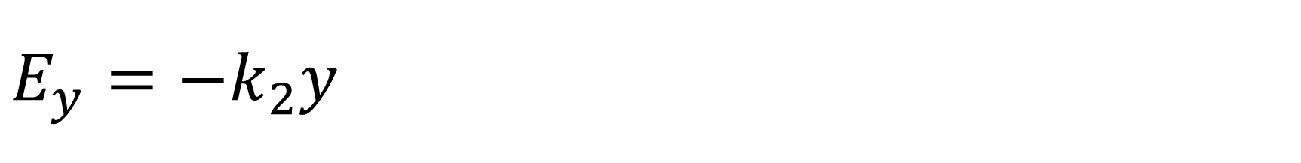
$$E_{y}=−k_{2}y$$
Normal dipole.
What we want for bending.
Skew dipole.
Plates are rotated by $θ$.
Spin effect canceled by
CW/CCW symmetry.
Skew quadrupole.
Skew dipole plus misaligned
by angle $α$. $∝θα$.
Ronald Reagan: Trust but verify.

Slide 16
Closed Orbit

Slide 17

Electric quadrupole multipole
Create a large radial magnetic field with trim coils.
${≈10}^{2} ×$ larger than stray radial magnetic fields.
See how much ${{dS}_{y}}/{dt}$changes.
Adjust trim electric quads to get acceptable ${{dS}_{y}}/{dt}.$

Slide 18
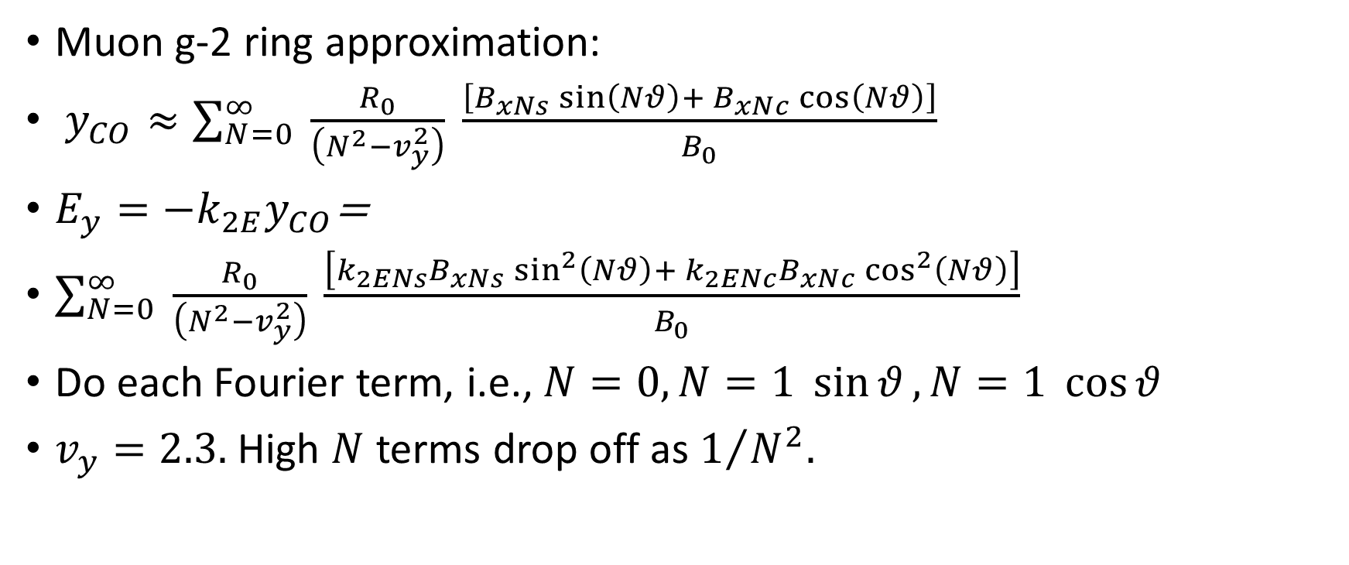
Electric Quadrupole
Muon g-2 ring approximation:
$y_{CO}≈\sum_{N=0}^{∞}{ \frac{R_{0}}{\left(N^{2}−v_{y}^{2}\right)} \frac{\left[B_{xNs}\sin\left(Nθ\right)+ B_{xNc}\cos\left(Nθ\right)\right]}{B_{0}}}$
$E_{y}=−k_{2E}y_{CO}$=
$\sum_{N=0}^{∞}{ \frac{R_{0}}{\left(N^{2}−v_{y}^{2}\right)} \frac{\left[k_{2ENs}B_{xNs}\sin^{2}\left(Nθ\right)+ {k_{2ENc}B}_{xNc}\cos^{2}\left(Nθ\right)\right]}{B_{0}}}$
Do each Fourier term, i.e., $N=0, N=1 \sin{θ}, N=1 \cos{θ}$
$v_{y}=2.3.$ High $N$ terms drop off as $1/{N^{2}.}$

Slide 19
DM-like background

Slide 20
Four Straight Sections – Minimum Number

Slide 21
SPEC

Slide 22
48 cells – more symmetry

Slide 23
SPEC
Radial Polarization

Slide 24
Zanibek Omarov
Symmetry

Slide 25
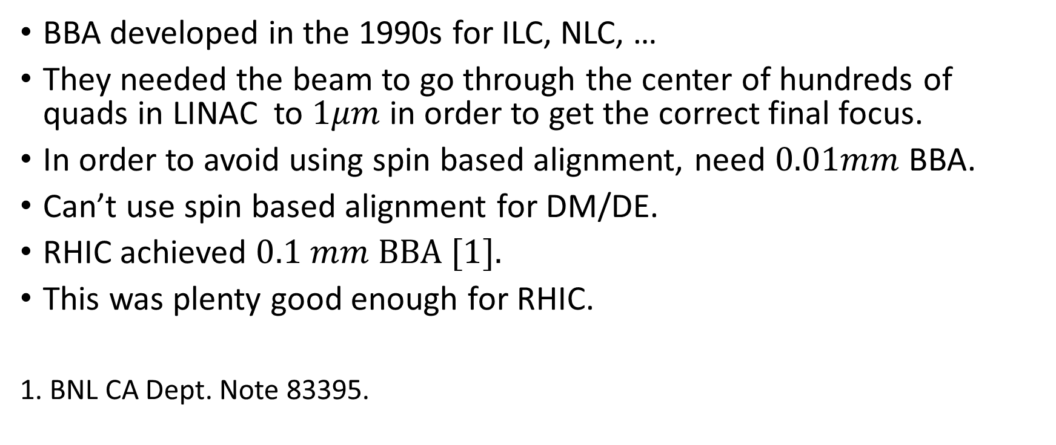
Beam Based Alignment/Spin Based Alignment
BBA developed in the 1990s for ILC, NLC, …
They needed the beam to go through the center of hundreds of quads in LINAC to $1μm$ in order to get the correct final focus.
In order to avoid using spin based alignment, need $0.01mm$ BBA.
Can’t use spin based alignment for DM/DE.
RHIC achieved $0.1 mm BBA [1].$
This was plenty good enough for RHIC.
1. BNL CA Dept. Note 83395.

Slide 26
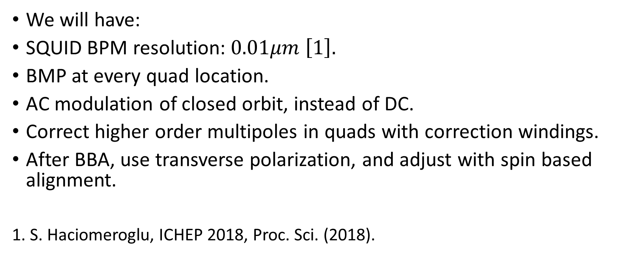
Beam Based Alignment/Spin Based Alignment
We will have:
SQUID BPM resolution:$0.01μm \left[1\right].$
BMP at every quad location.
AC modulation of closed orbit, instead of DC.
Correct higher order multipoles in quads with correction windings.
After BBA, use transverse polarization, and adjust with spin based alignment.
1. S. Haciomeroglu, ICHEP 2018, Proc. Sci. (2018).

Slide 27

Statistics
${10}^{11}$polarized protons
per fill from AGS.
Storing protons in a ring
is easy.
Excellent polarimeter
analyzing power.
$10^{−29}ecm/{10}^{7}s$

Slide 28

PEDM limited by statistics at $10^{−29}ecm.$
Limited by statistics.

Slide 29
LOI

Slide 30
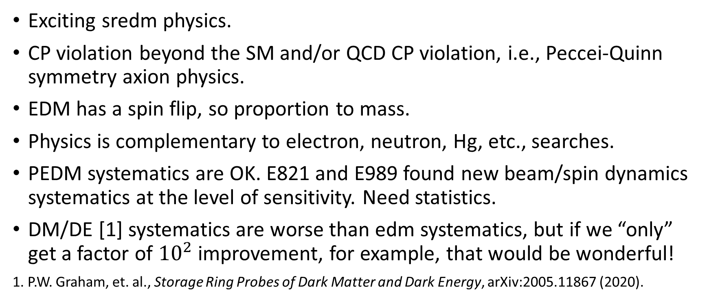
Summary
Exciting sredm physics.
CP violation beyond the SM and/or QCD CP violation, i.e., Peccei-Quinn symmetry axion physics.
EDM has a spin flip, so proportion to mass.
Physics is complementary to electron, neutron, Hg, etc., searches.
PEDM systematics are OK. E821 and E989 found new beam/spin dynamics systematics at the level of sensitivity. Need statistics.
DM/DE [1] systematics are worse than edm systematics, but if we “only” get a factor of ${10}^{2}$ improvement, for example, that would be wonderful!
1. P.W. Graham, et. al., Storage Ring Probes of Dark Matter and Dark Energy, arXiv:2005.11867 (2020).

Slide 31
Extra

Slide 33
Extras

Slide 38
CW/CCW
The major conceptual and technological strengths of the srEDM method render it ready for technical evaluation. Its critical conceptual strength is the realization that a ring with purely electric bending sections and alternate magnetic focusing (a hybrid-ring lattice) permits simultaneous clock-wise (CW) and counter-clock-wise (CCW) storage, thus eliminating firstorder systematic error sources, i.e., out-of-plane electric fields, as well as the need to significantly shield the ring from external magnetic fields.

