Slide 1
Cryostat Assembly Status Update
R. Rabehl
August 3, 2020

Slide 2
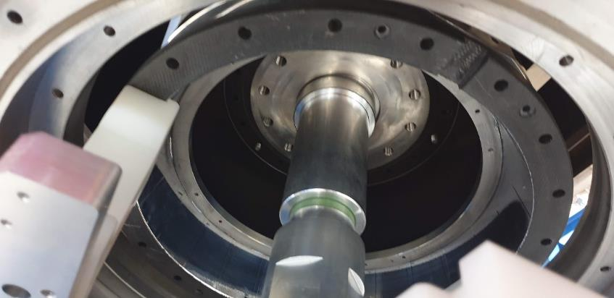
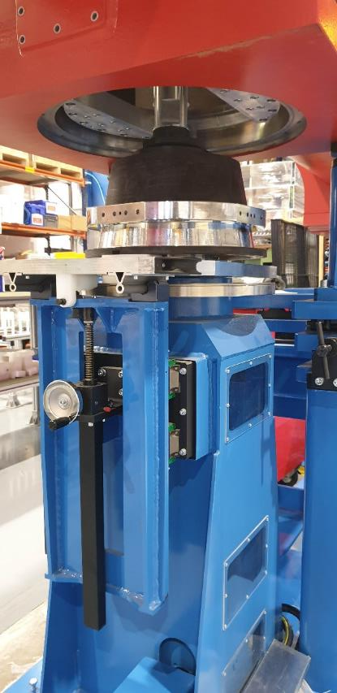
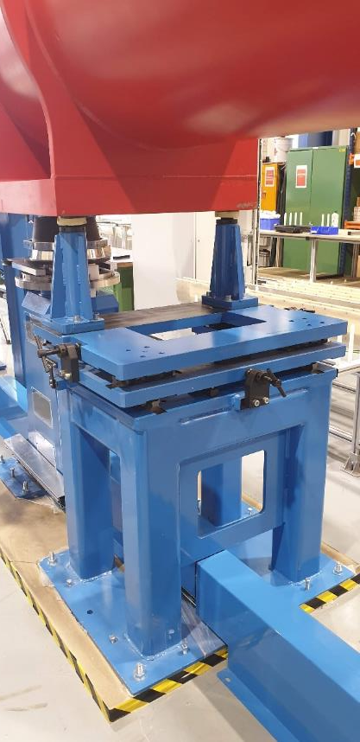
Tooling
Validation tests 7/16-7/17
Received draft report from CERN (docdb 3653):
A full de-cryostating of a cold mass dummy from a pre-assembled Q1 vessel was performed with the Fermilab tooling.
Only minor issues to be resolved.
Tooling is packed, will ship in September
We have requested shipment ASAP.

Slide 3
Shipping post
Drawings
Final details of drawings for shipping post and associated post are nearing completion, after which they will be formally reviewed and approved.

Slide 4
Tooling Installation at Fermilab
Installation requirements:
We have a draft tooling installation procedure (aka, Integration Plan).
Will follow requirements (e.g., subcontractor training) of 013100 ES&H Requirements for Subcontractors.
Installation activities will adhere to FESHM 2060 “Work Planning and Hazard Analysis,” which was rewritten in the last few months and is defined by SHAPE.
Scope – define the scope of the work
Hazard – identify hazards and controls
Authorize – authorize the work to begin
Perform – perform the work
Evaluate – post-work evaluation

