Slide 1
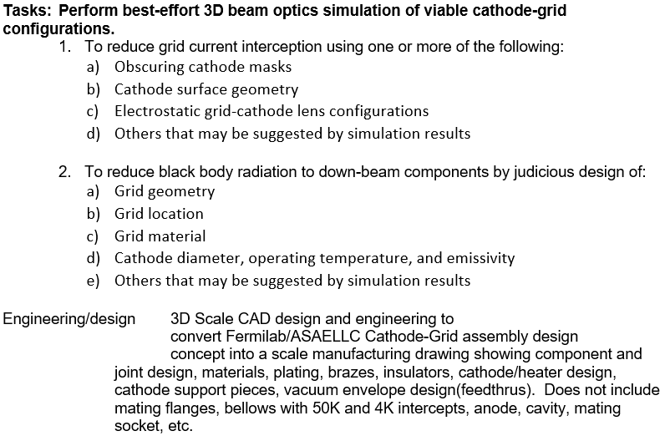

Slide 2
+1.32
+1.39
+1.38
+1.36
+1.42
7.5 MeV
+0.63
Frequency | 650 | MHz
Energy | 7.5 | MeV
Current | 28 | mA
phase shift | 90 | ⁰
σ Energy | 2.3 | %
Beam phase rms | 9.0 | ⁰
Losses on the cavity walls | 0 | W
Losses on the grid | 1.1 | W
Back bombardment | 0.4 | W
$$I_{max}= 0.253 A$$
$$I_{aver}= 0.044 A$$
$J_{peak}$=14.1 A/${cm}^{2}$

Slide 3
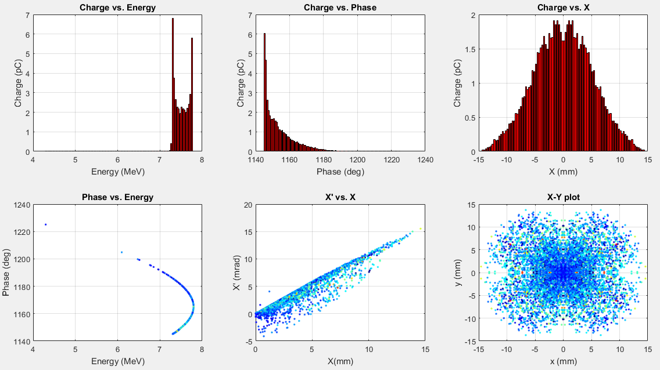

Slide 6
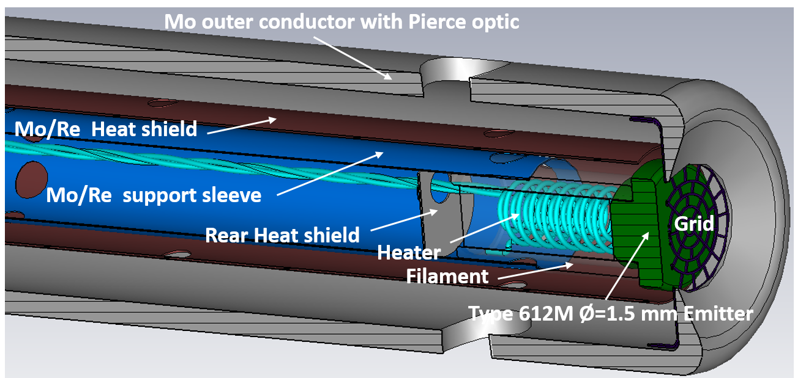
HeatVawe Labs. website
#111821

Slide 7
