Slide 1
LBNF Neutrino Beamline Horn and Baffle Modules Preliminary Design Review
Module Mainframe Design
Mike Campbell
August 13, 2020

Slide 2
Outline
Horn-A Module
Overview
Vert and Horiz Positioning
Water Cooling Panels
Horn-B and C Modules
Baffle Module
Target Hall Integration
Work in Progress
Lifting Fixture
Drawings
Summary

Slide 3
Outline
Horn-A Module
Overview
Vert and Horiz Positioning
Water Cooling Panels
Horn-B and C Modules
Baffle Module
Target Hall Integration
Work in Progress
Lifting Fixture
Drawings
Summary
The Team:
Keith Gollwitzer
Mike Campbell
Cory Crowley
Nnamdi Agbo
Matt Sawtell
Joe Angelo
Kris Anderson
Vladimir Sidorov
Meredith Lee

Slide 4
Horn-A Module Overview

Slide 5
Horn-A Module Overview

Slide 6
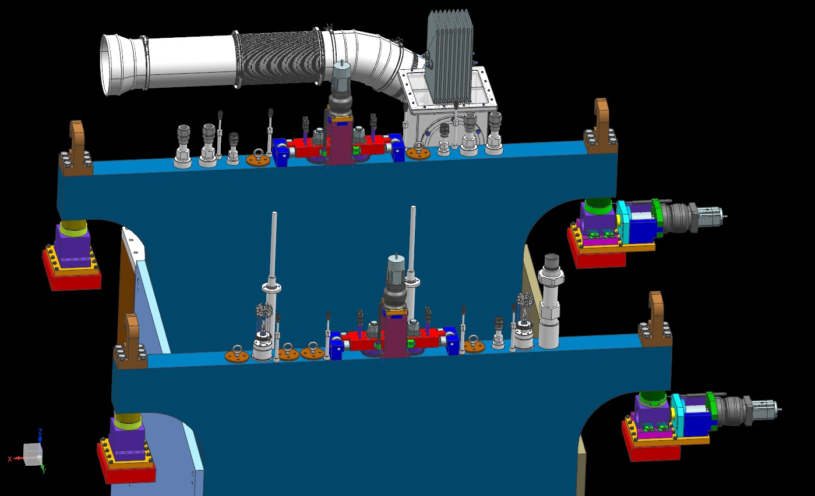
Vertical and Horizontal Positioning Axes

Slide 7
Vertical and Horizontal Positioning Axes
Separate
Presentation

Slide 8
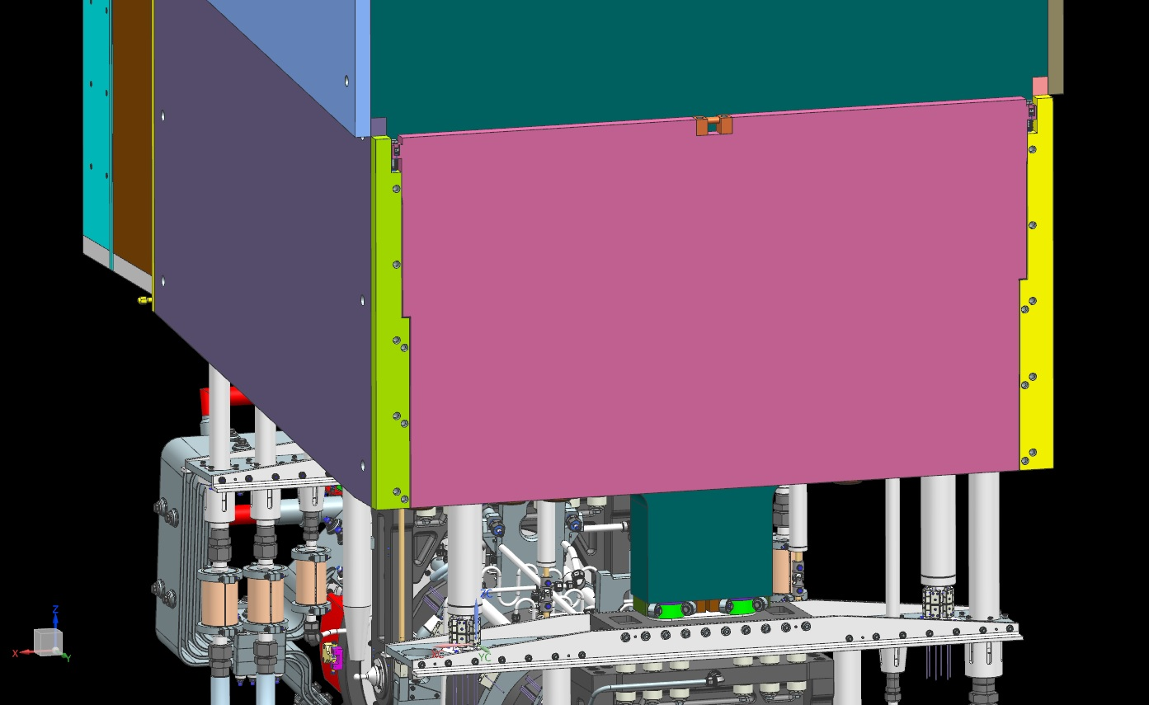
Water Cooling Panels

Slide 9
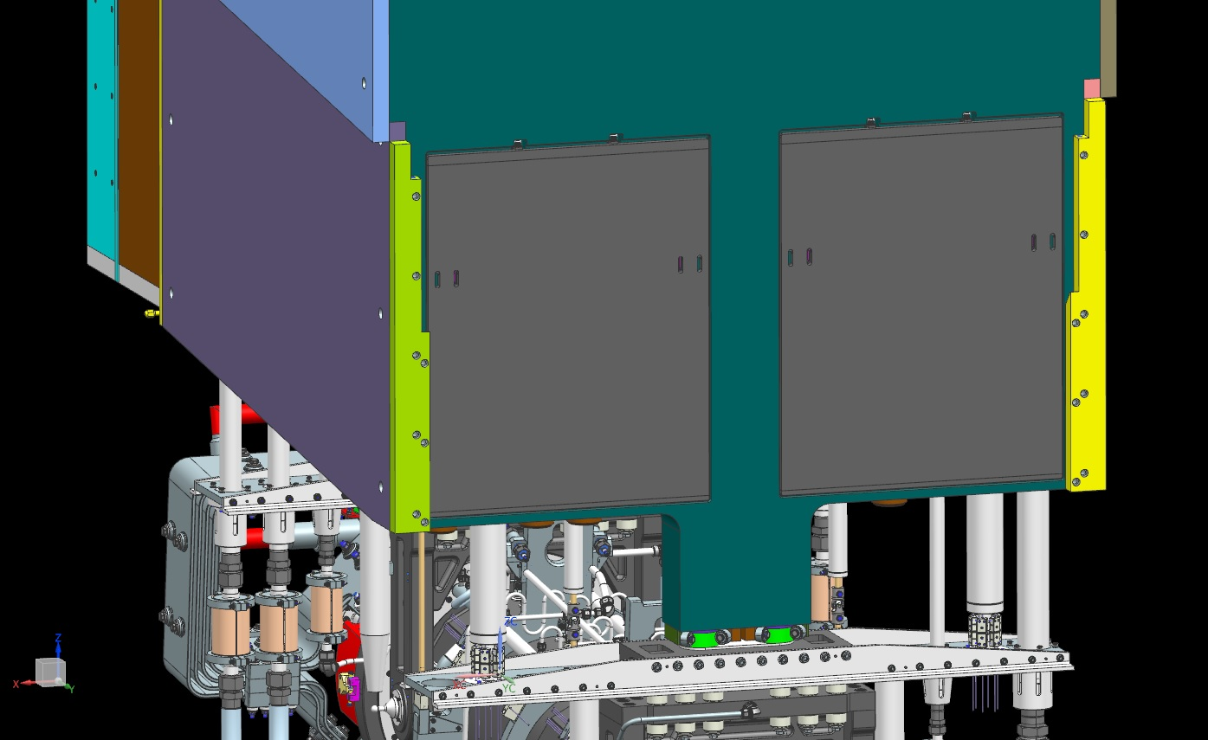
Water Cooling Panels

Slide 10
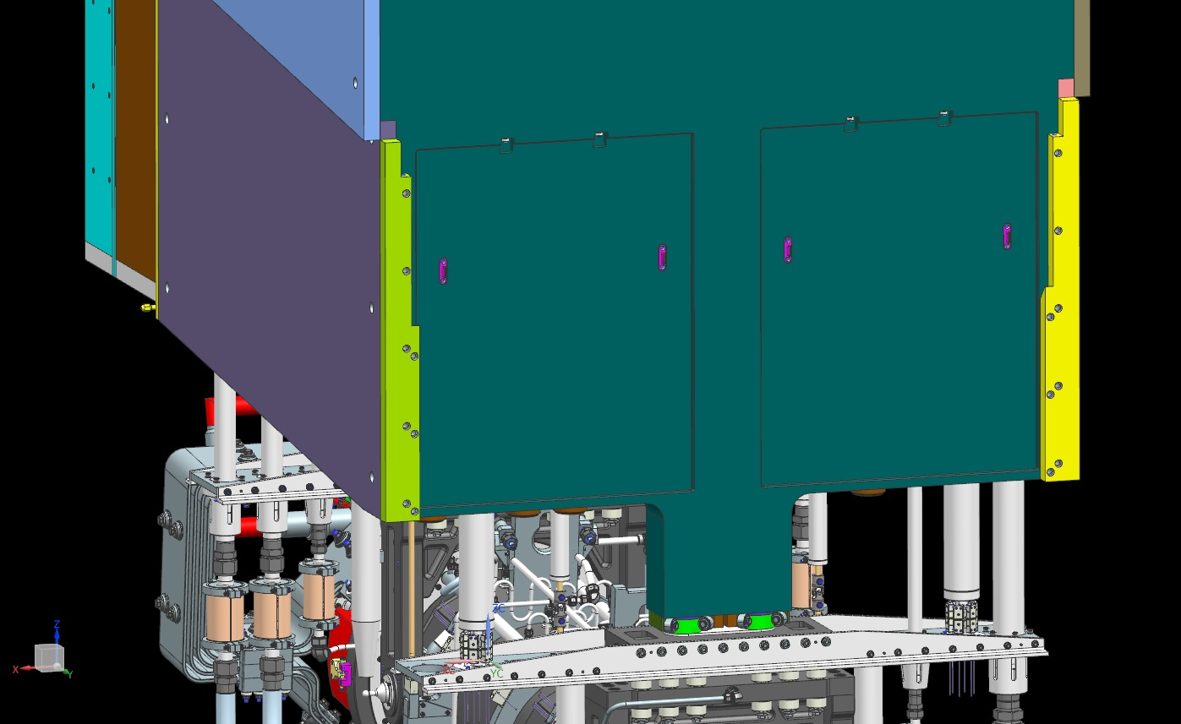
Water Cooling Panels

Slide 11
Water Cooling Panels

Slide 12
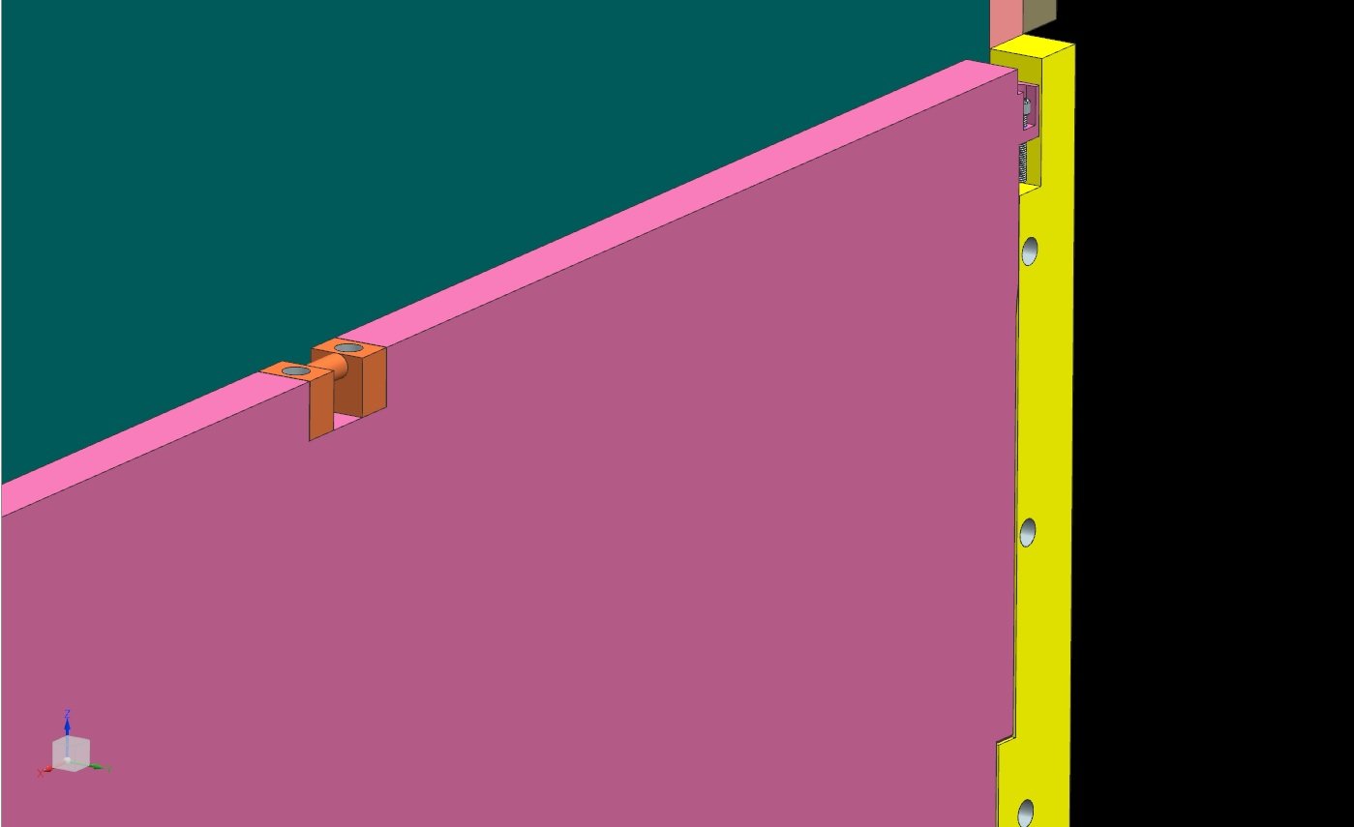
Water Cooling Panels

Slide 13
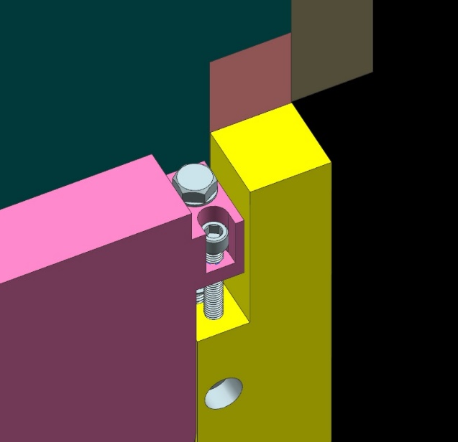
Water Cooling Panels

Slide 14
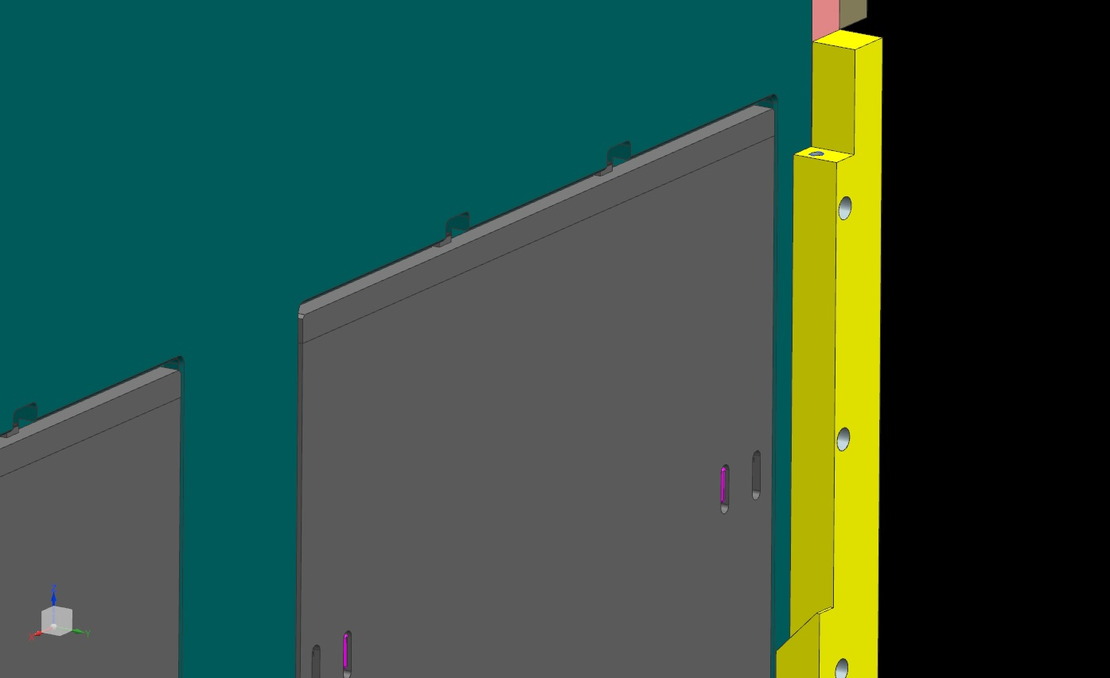
Water Cooling Panels

Slide 15
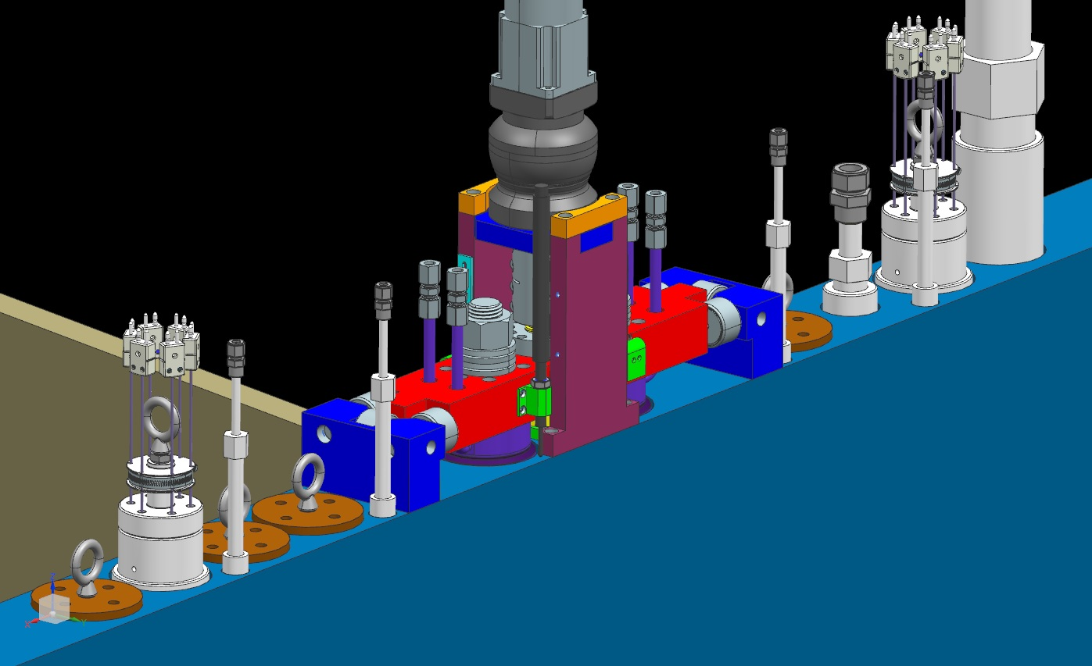
Water Cooling Panels

Slide 16
Water Cooling Panels

Slide 17
Water Cooling Panels - Analysis
Current assumption: no cooling panels required for 1.2 MW
For 2.4 MW operation, 2 cases were considered:
4 cooling panels per endwall (2 inner + 2 outer), calculations:
RAW water: 70psi supply, 20psi return, 1.3 gpm / panel
Q = 5kW / endwall
RAW water: T_{in} = 70 ⁰F = 21.1 ⁰C, ∆T = 3.6 ⁰C, T_{out} = 24.7 ⁰C
Max Temp in Steel = 25.6 ⁰C = 78 ⁰F
2 cooling panels per endwall (2 outer only), calculations:
RAW water specs and Q = same as above
RAW water: T_{in} = 70 ⁰F = 21.1 ⁰C, ∆T = 7.2 ⁰C, T_{out} = 28.3 ⁰C
Max Temp in Steel = 37.2 ⁰C = 99 ⁰F
FEA separate presentation

Slide 18
Horn-B Module

Slide 19
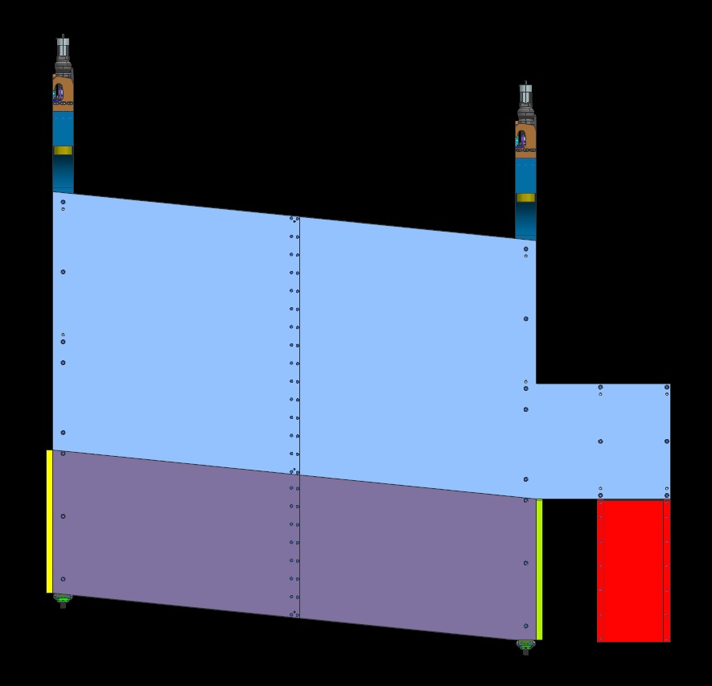
Horn-B Module

Slide 20
Horn-C Module

Slide 21
Horn-C Module

Slide 22
Baffle Module

Slide 23
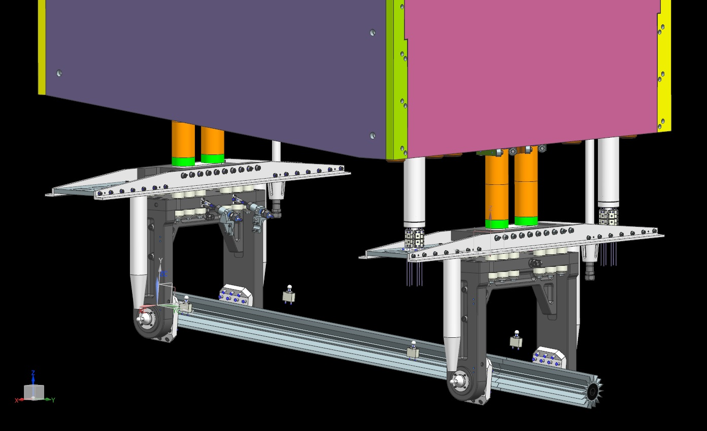
Baffle Module

Slide 24
Baffle Module

Slide 25
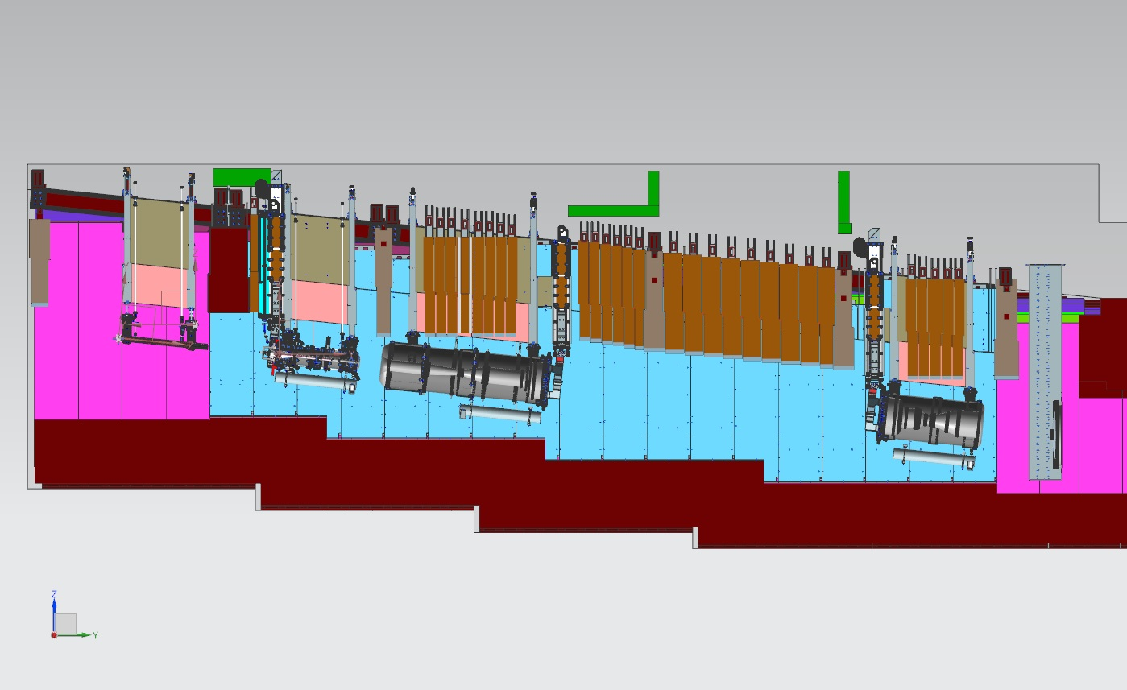
Target Hall Integration

Slide 26
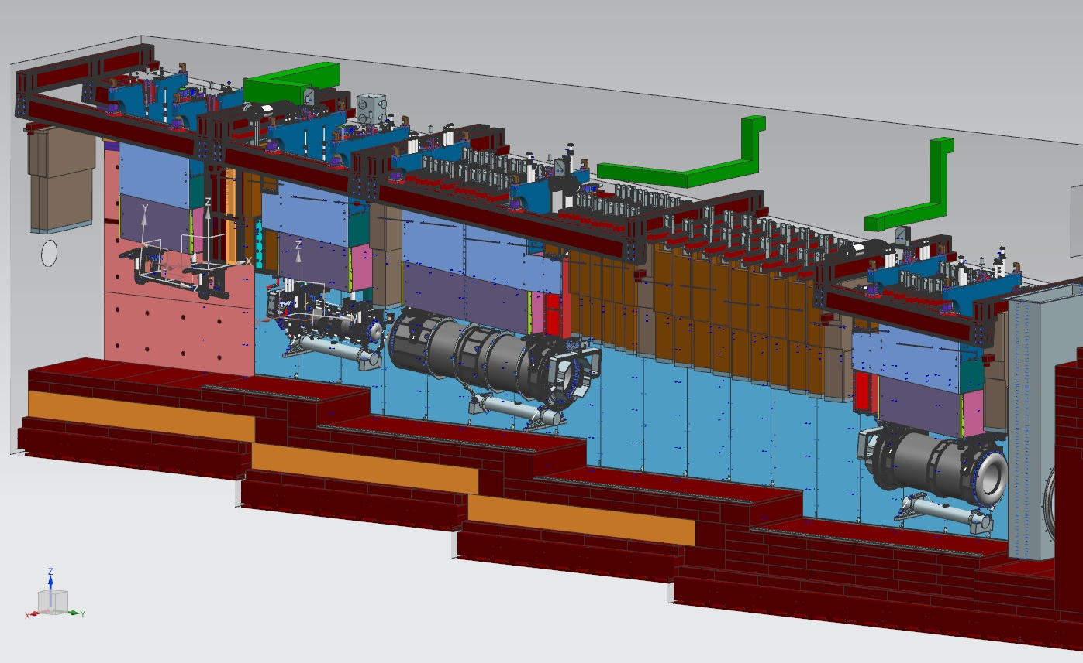
Target Hall Integration

Slide 27
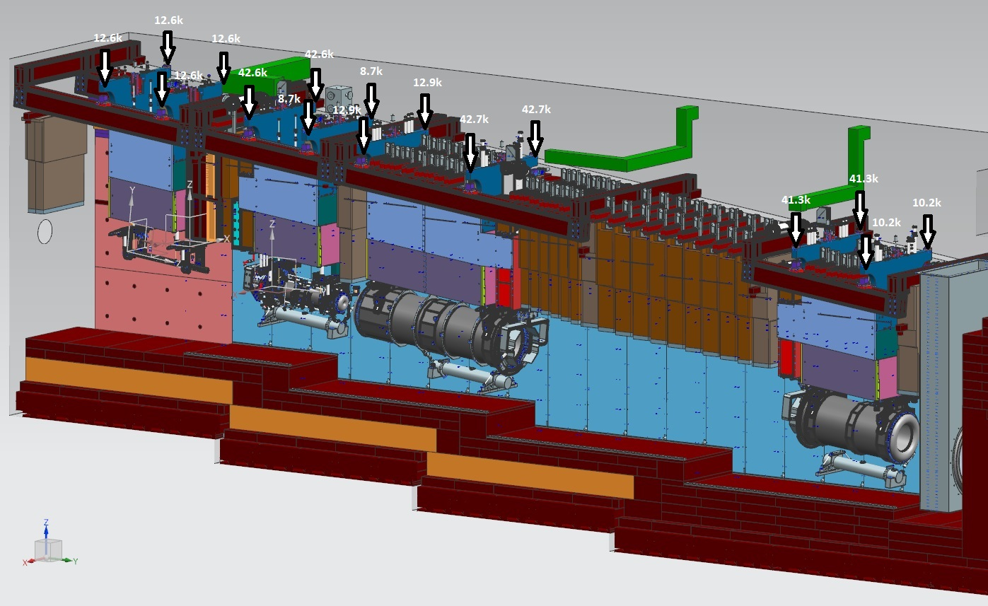
Target Hall Integration – Load Calculations

Slide 28
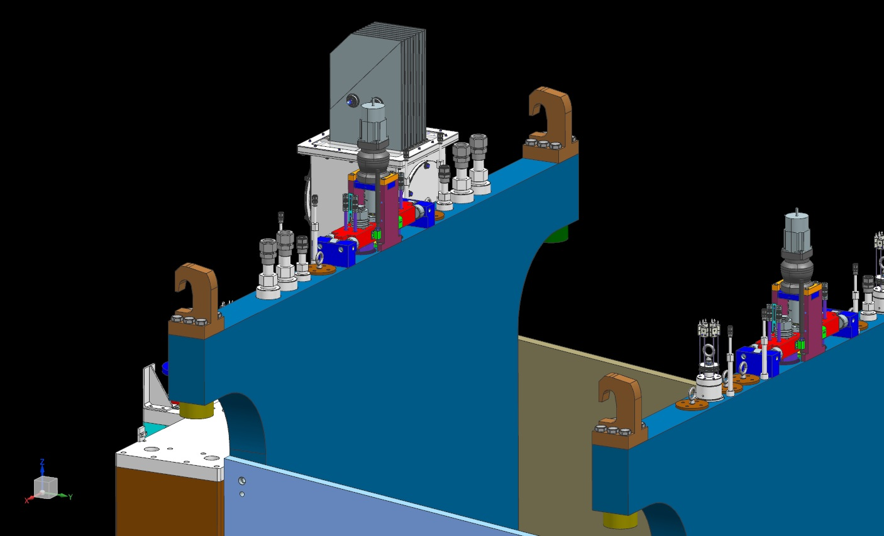
Work in Progress – Lifting Fixture

Slide 29
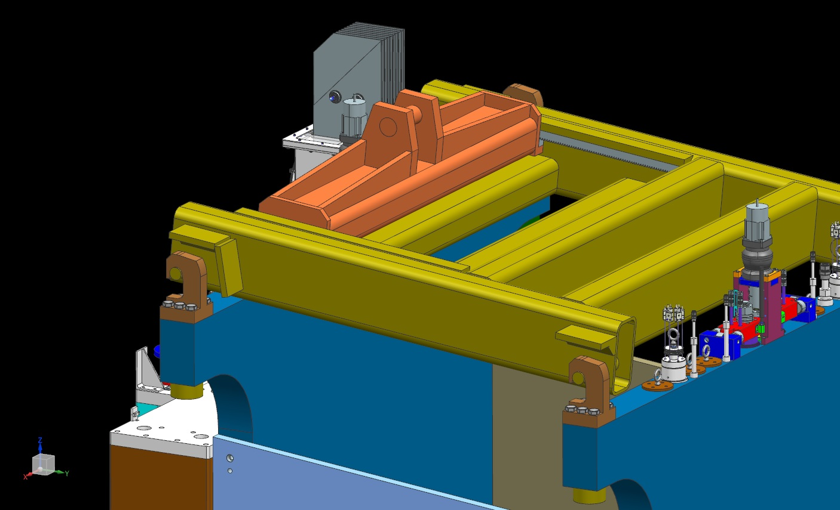
Work in Progress – Lifting Fixture

Slide 30
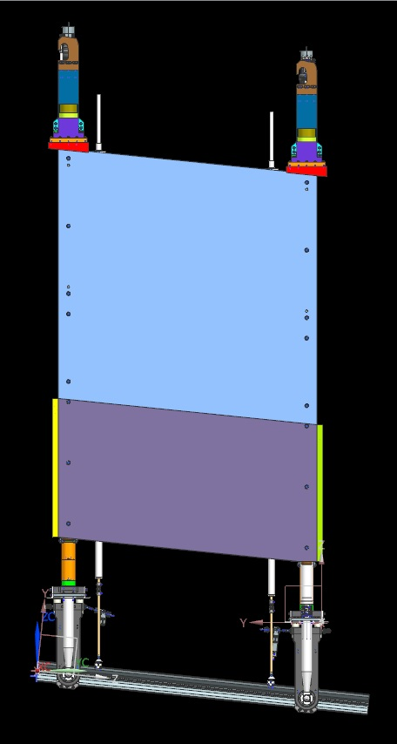
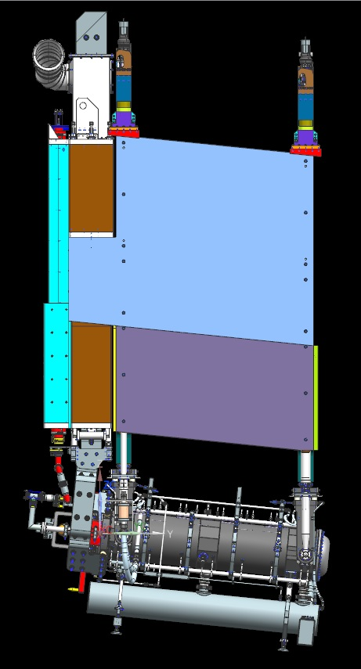
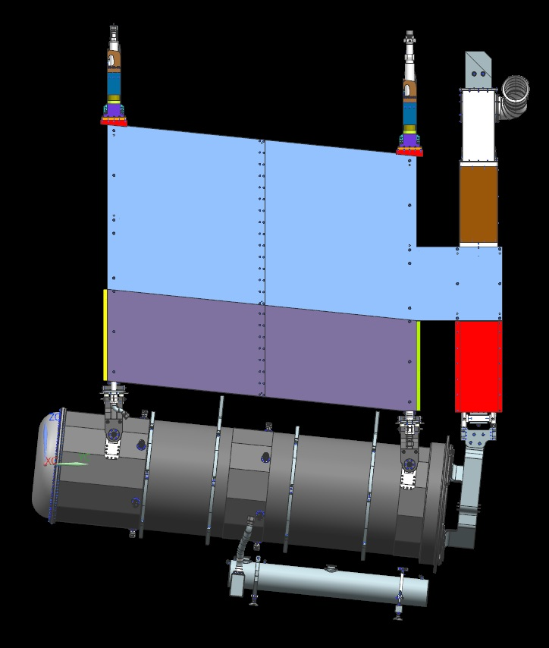
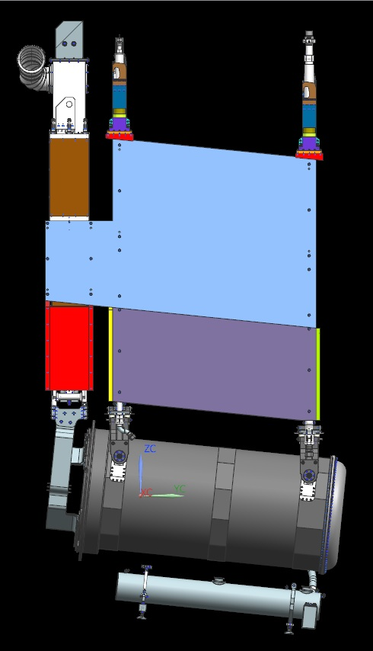
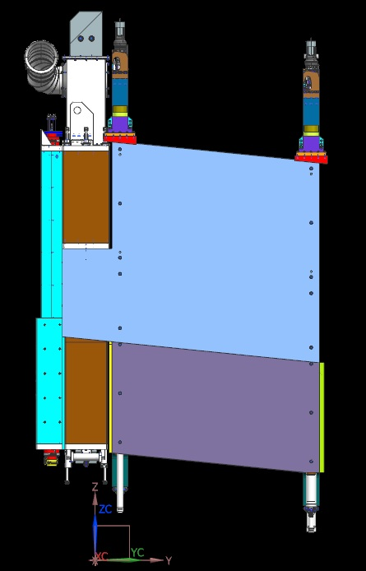
Work in Progress – Lifting Fixture – Load Calculations
70.5”
70.5”
132.5”
83.0”
11.75”
30.5”
16.25”
49.3 klbs
101.6 klbs
110.3 klbs
102.0 klbs
Baffle
Horn-A
Horn-B
Horn-C
70.5”
11.0”
98.1 klbs
Horn-A

Slide 31
Work in Progress – Drawings

Slide 32
Summary
Reviewed module designs for Horns A, B, C, and Baffle
Modules include horiz & vert positioning (separate presentation)
Analysis complete (FEA separate presentation)
No cooling panels for 1.2 MW operation
Two cooling panels per endwall for 2.4 MW operation
Cooling panels can be installed/removed via remote handling
All modules correctly located in target hall integration model
Lifting fixture started, design in progress
Drawings started, also in progress

