Slide 1
Neutrino Beamline Modules Preliminary Design Review
Answers to Day 1 Questions
Cory Crowley
14 August 2020

Slide 2
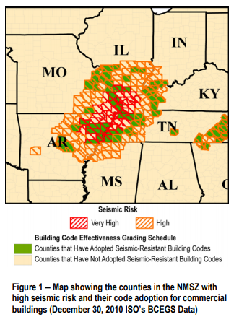
Question 1 – Seismic Activity Assessment
No seismic activity assessment has been performed on modules.
State of Illinois has no statewide mandatory building codes; state defers to localities.
FNAL Defers to Uniform Building Code.
Working draft from CF engineering on what seismic threshold structures should be designed for.
Working draft from MSD Engineering (Structural Support Design Guide, ED0011268), suggests 0.1g triaxial loading.
These documents are not approved for distribution; working state only.
We are working with CF & Project Engineering to determine if an applicable code exists.
Module mainframes are inherently overbuilt. If 0.1g triaxial loading becomes the standard, we will meet it.

Slide 3
Question 2 – Deliverables List (Origin: ProtoDUNE)
Preliminary Design Review Deliverables:
Design choice identified (See C. Crowley / M. Campbell Talks)
Design in accordance with detector requirements
Detailed engineering drawings, schematics, models, interface drawings and
preliminary parts list. (See Dune-doc-20093, Other Files & Related Documents)
Interface documentation (See 20093 Related Documents)
Engineering safety analysis plan and initial engineering analysis (20093 Other Files)
Preliminary installation and testing plans (See Schedule, Signed PPD, TSIB Layout)
Incorporation of ProtoDUNE & other prototyping lessons learned
Manufacturing methods and acquisition strategy
Plans for production and evaluation of prototypes (See C. Crowley Talk)
Draft manufacturing, quality assurance, testing and procurement plans (See M. Lee Talk)
Preliminary installation plans including special tools and fixtures
Preliminary cost and schedule estimate (See Dune-docs 8816,8825,8831)
Results of value engineering exercise
Resolution of previous or relevant ProtoDUNE review recommendations

Slide 4
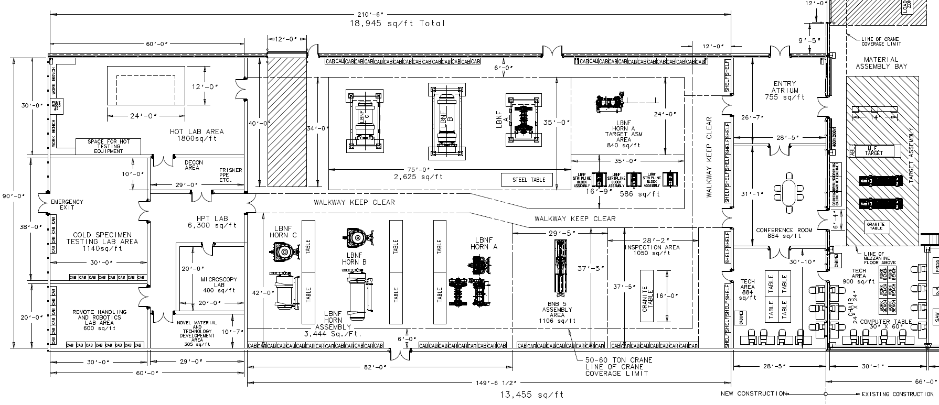
TSIB Layout

Slide 5
Manufacturing Methods & Acquisition Strategy
Engineering Document ED0012516
Embedded in BOE Supporting Documents
ITEM | REVISION | DESCRIPTION | QTY, EACH | COST, EACH | COST, TOTAL
F10128180 | NONE | LBNF INSTRUMENTATION LINE CONNECTOR BODY, MODULE PENETRATION SIDE | 1 | 400 | 400
F10132365 | NONE | TUBE, LBNF MODULE - INSTRUMENTATION LINE FEEDTHROUGH | 6 | 19.5 | 117
F10132361 | NONE | TUBE, LBNF MODULE - LINE CONNECTOR MAIN | 1 | 1510 | 1510
F10132364 | NONE | LBNF MODULE, INSTRUMENTATION LINE CAP CONNECTOR BODY | 1 | 400 | 400
F10132362 | NONE | TUBE, LBNF MODULE - LINE CONNECTOR LABYRINTH | 1 | 414 | 414
F10135204 | NONE | FILL, LBNF MODULE A TUB - INSTRUMENTATION LINE GROUT | 1 | 50 | 50
F10132379 | NONE | LBNF MODULE, INSTRUMENTATION LINE TOP PLUG | 1 | 5 | 5
FC0071115 | NONE | SERRATED BELLEVILLE, 0.539 ID, 0.748 OD, 0.042 THK, 0.071 HT SS304 | 1 | 1 | 1
FC0074842 | NONE | MCMASTER-CARR P/N # 8891T790_316 STAINLESS STEEL EYEBOLT | 1 | 27 | 27
F10135239 | NONE | ASSEMBLY, OMEGA NHX CERAMIC ULTRA HIGH TEMPERATURE TYPE K MALE THERMOCOUPLE | 6 | 10 | 60
FC0019827 | NONE | DOWEL PIN, 0.25OD X 1.75LG, SS416 | 1 | 1 | 1
FC0051843 | NONE | BHMS-PH,4-40X.75LG,SS416 | 6 | 1 | 6
FC0073578 | NONE | MCMASTER-CARR P/N # 91007A614, 18-8 SS OVERSIZED SPLIT LOCK WASHER, #4, 0.12" ID, 0.223" OD | 6 | 1 | 6
F10135240 | NONE | ASSEMBLY, OMEGA NHX CERAMIC ULTRA HIGH TEMPERATURE TYPE K FEMALE THERMOCOUPLE | 6 | 10 | 60
FC0074843 | NONE | MCMASTER-CARR P/N # 5416K210_WORM-DRIVE CLAMPS FOR FIRM HOSE AND TUBE | 1 | 5 | 5
 |  | CUT LENGTH & MACHINING ALLOWANCE | 1 | 2500 | 2500
 |  |  |  | TOTAL | 5562

Slide 6
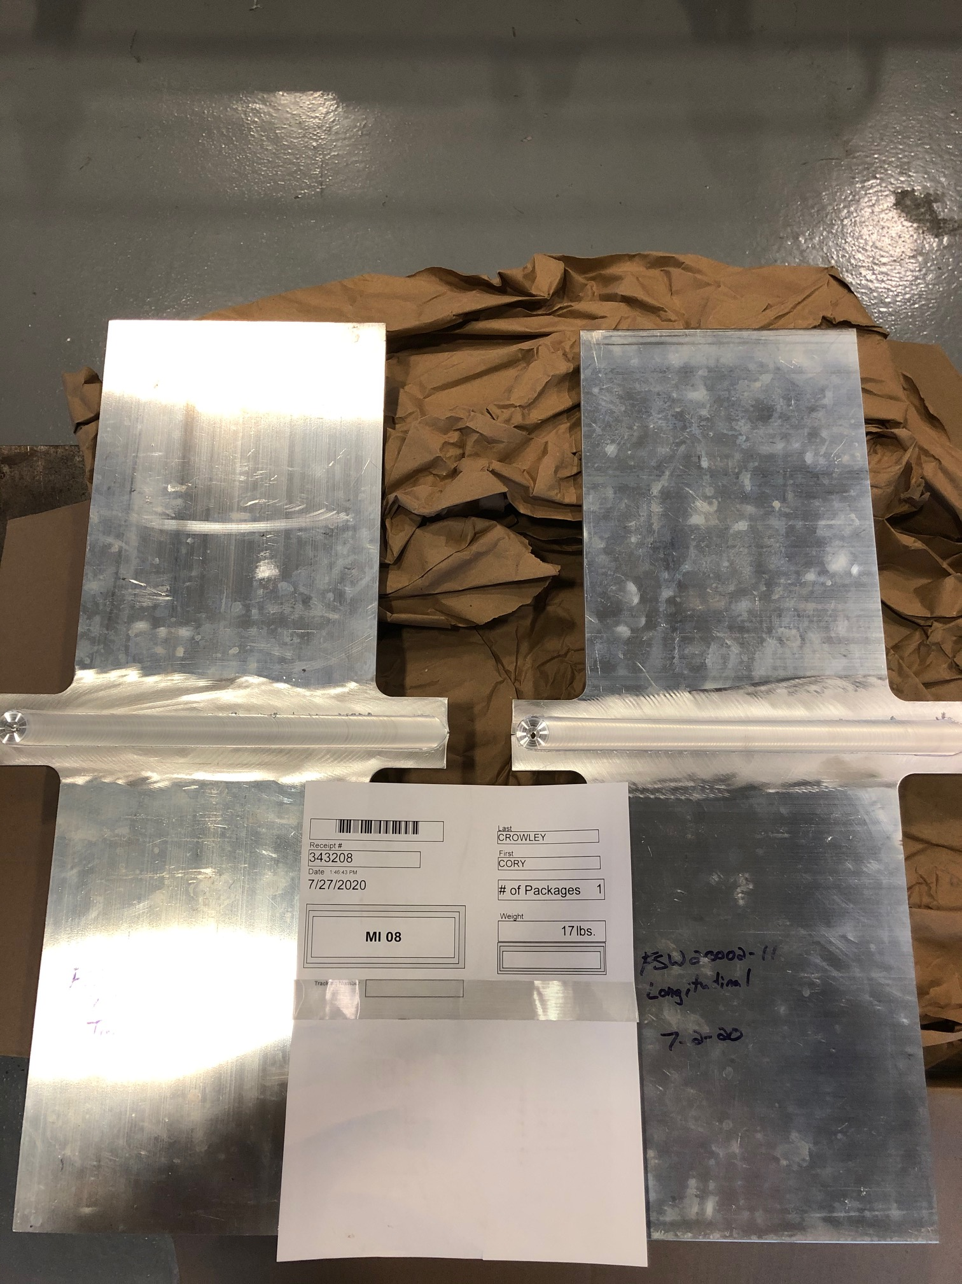
Additional Prototype / Vendor Qualification Parts

Slide 7
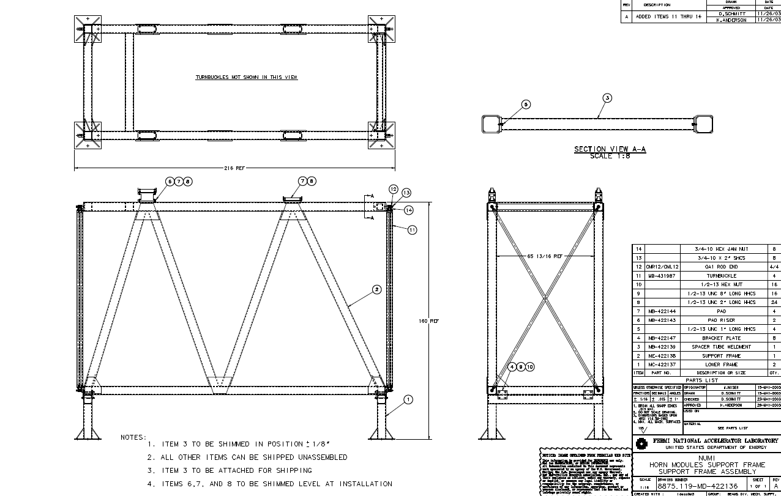
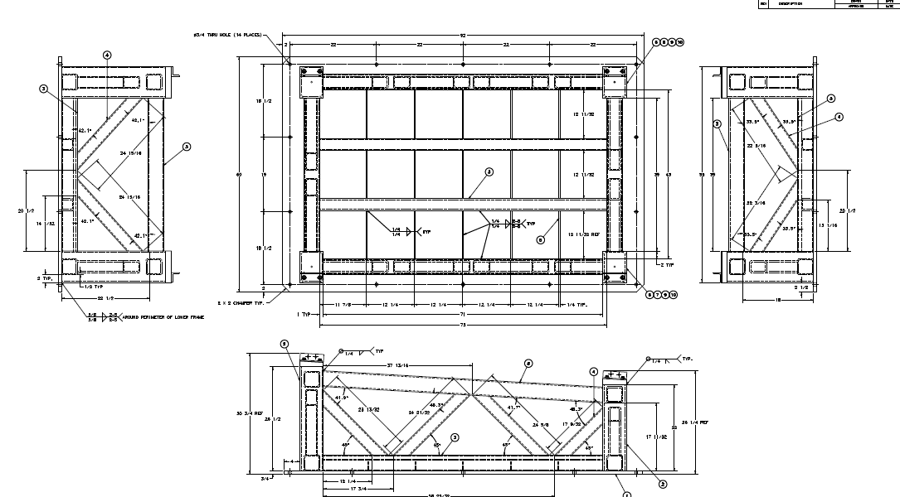
Preliminary Installation Plans: Special Tools & Fixtures
Horns - Module Assembly & Support Stands
Scope Item | Chicago Metal Fabricators | Milan's Machining | Comet Fabricating | Robinson Fab & Machine | Burns Machine | Dial Machine | Precision Boring
Module Assembly & Test Stands | 31,992 | 38,075 | 44,525 | 53,119 | 58,070 | 74,000 | 92,000
Total | 31,992 | 38,075 | 44,525 | 53,119 | 58,070 | 74,000 | 92,000
 | Total Average | 38197.33333
1.75 X cost for 3 test stands and 2 assembly tables | Total with Increase | 66845

Slide 8
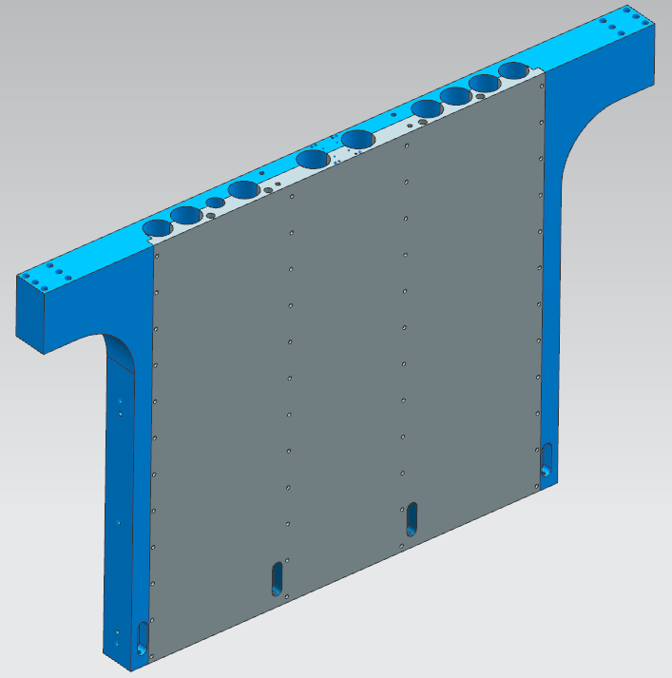
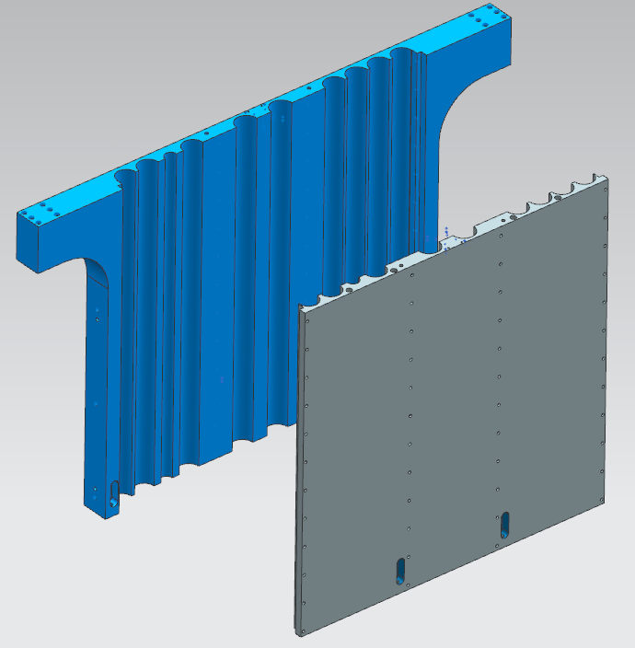
Results of Value Engineering Exercise
Three Major Efforts:
End-wall alternative machining
Cooling panel optimization.
SLB, Utility / Insturmentation, & drive system standardization.
Results:
Stick with gun drilled holes, otherwise adds another ~100K+
No 1.2MW panels needed. 2.4MW drops from 4 to 2.
Significant engineering & drafting package design savings / schedule advancement.

