Slide 1
Neutrino Beamline Modules Preliminary Design Review
Instrumentation & Utility Line Design
Cory Crowley
14 August 2020

Slide 2
Outline
Design Approach
Line Placement / Positioning
System Interfaces
Line Specifications
Water / gas
Instrumentation
Testing & Quality Assurance Plans
Summary

Slide 3
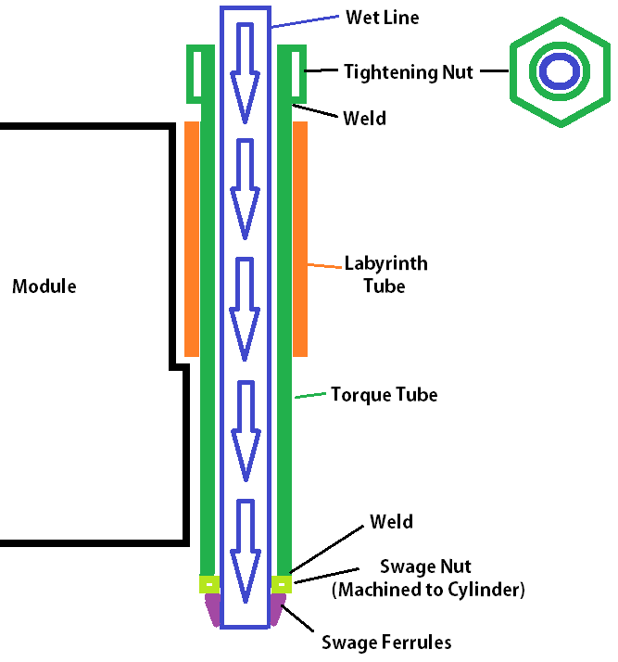
Design Approach - Utility Line Concept
Utilizes modified COTS swage fittings.
Allows for 100% remote connection to water, gas, or vacuum connections.
Swage nut is machined to ring and welded to tube/pipe.
Tube/pipe has hex nut welded on top to act as a long socket.
Concept Credit: PPD Engineering

Slide 4
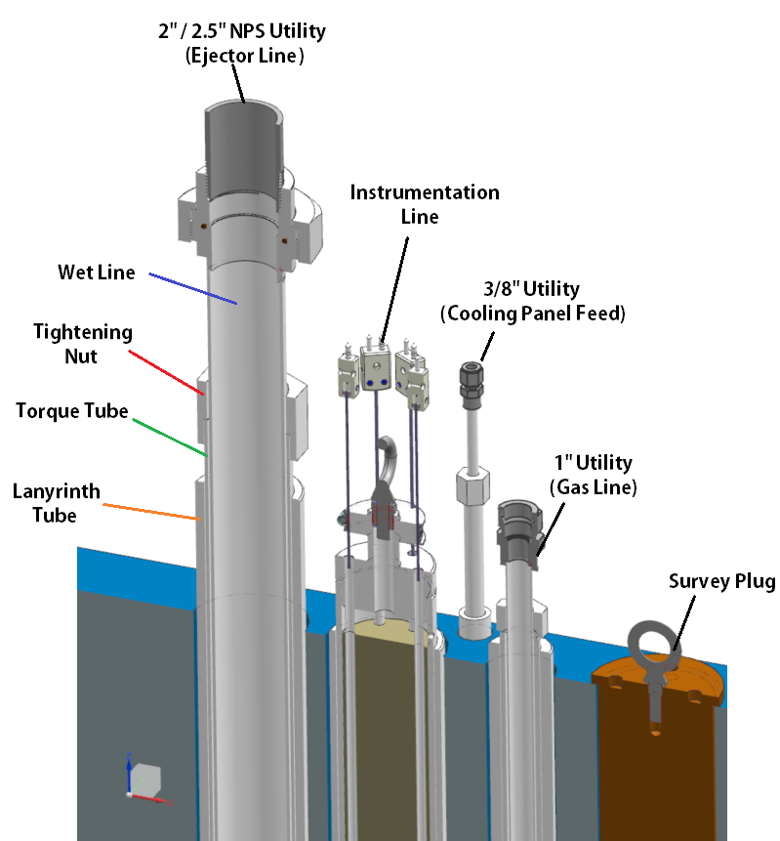
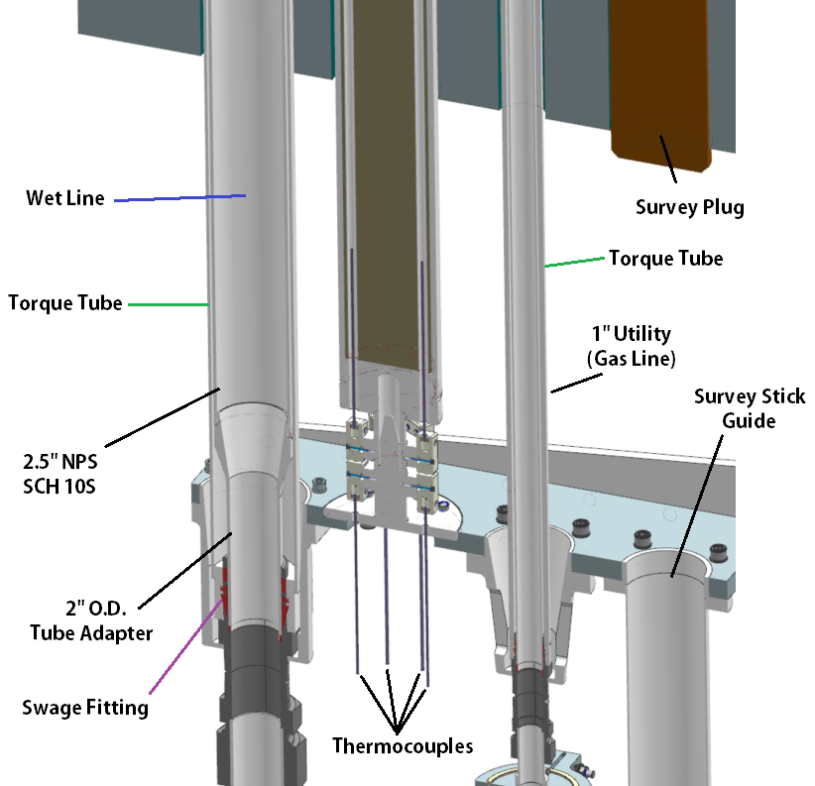
Utility Line Layout

Slide 5
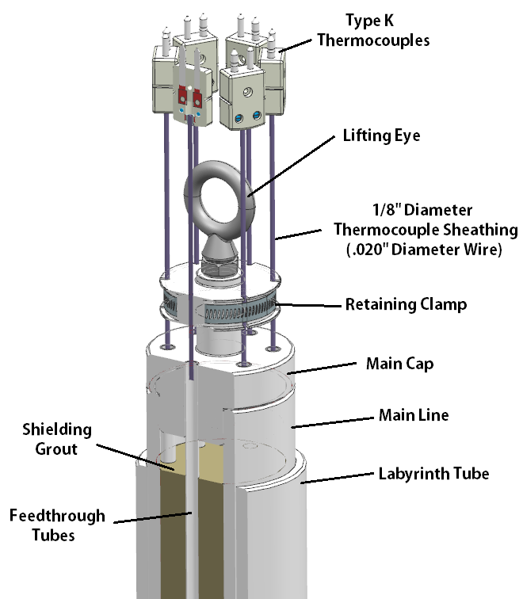
Instrumentation Line Layout
Type K thermocouples.
Alumel/Chromel.
Reduced corrosion potential.
Lifting Eye.
No more choker sling lifts.
Retaining clamp for stress relief.
No more tack welds / RTV.
Dedicated feedthrough tubes.
Allows for thermocouple replacement
Ease of identification / clocking.

Slide 6
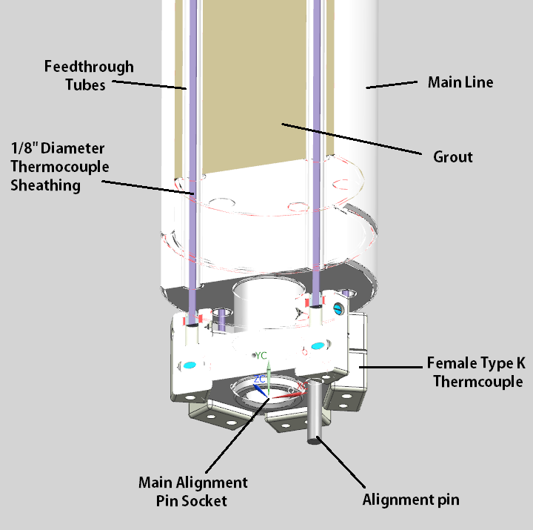
Instrumentation Line Layout
Main alignment socket guides line to connection pins.
Alignment pin serves two purposes:
Holds line up on connection register so pins don’t crash.
Clocks line to pins for readout traceability.
Concept Credit: PPD Engineering

Slide 7
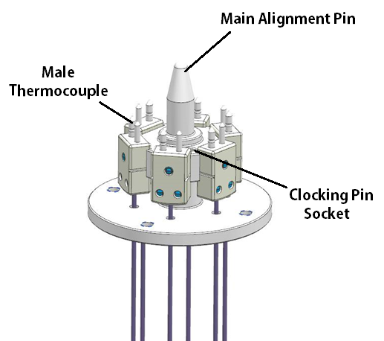
Instrumentation Line Connection – Component Side
Male Thermocouples go on bottom end.
Prevents falling debris entrapment.
Mockup shown here used to verify final instrumentation line build and test thermocouple readouts.

Slide 8
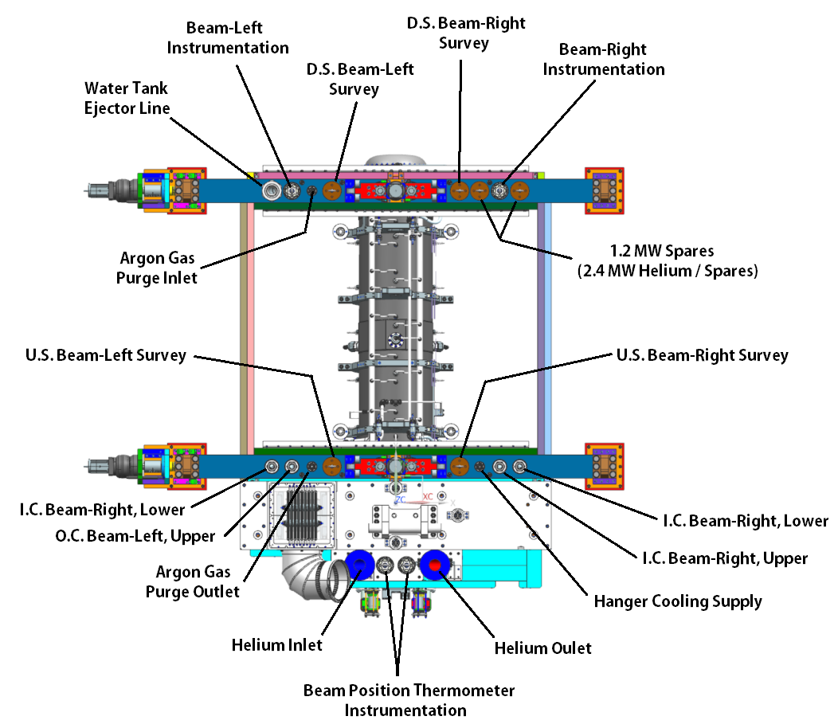
Horn A + TUB Utility / Instrumentation Line Placement

Slide 9
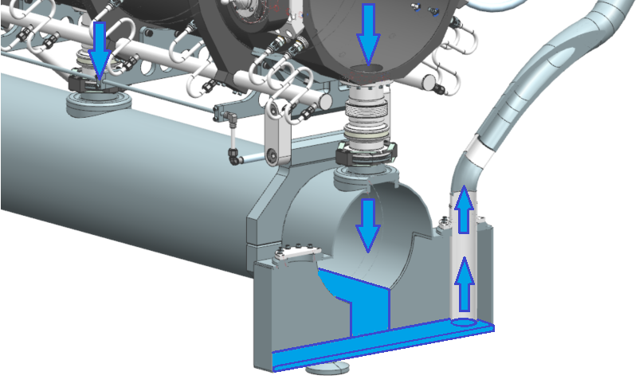
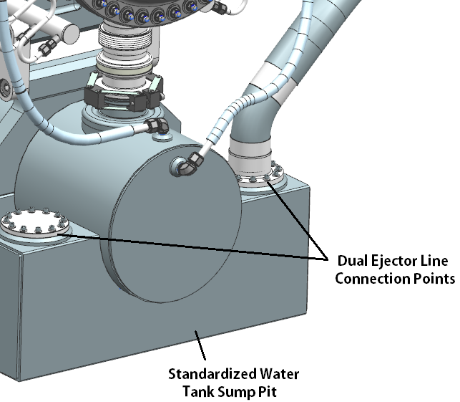
Ejector Lines
Horn A cooling flow can be supported through a single ejector line.
Horns B & C cooling flow requires dual ejector lines.
Spare location @ Horn A module becomes permanent ejector route for Module B & C.
Baffle module is pressurized circuit, so no ejector lines needed.

Slide 10
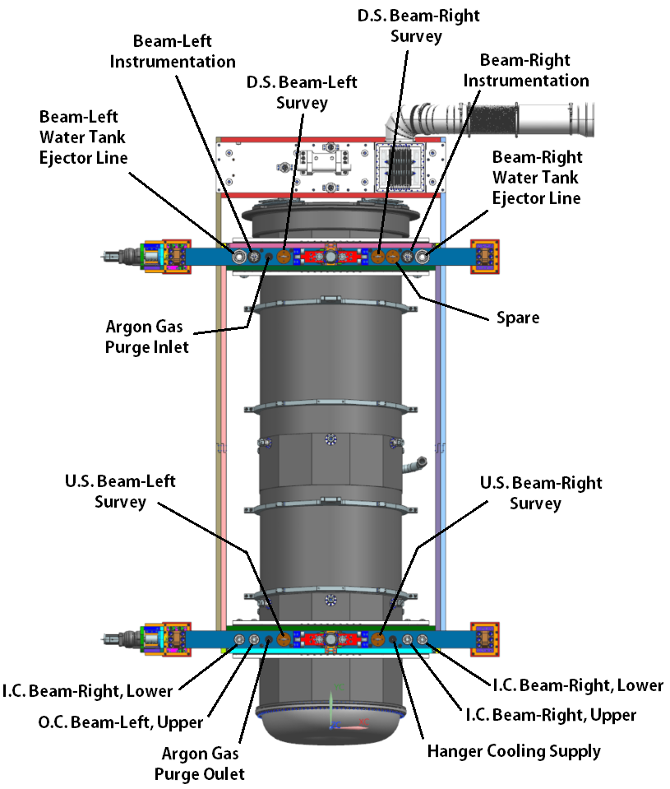
Horn B Utility / Instrumentation Line Placement

Slide 11
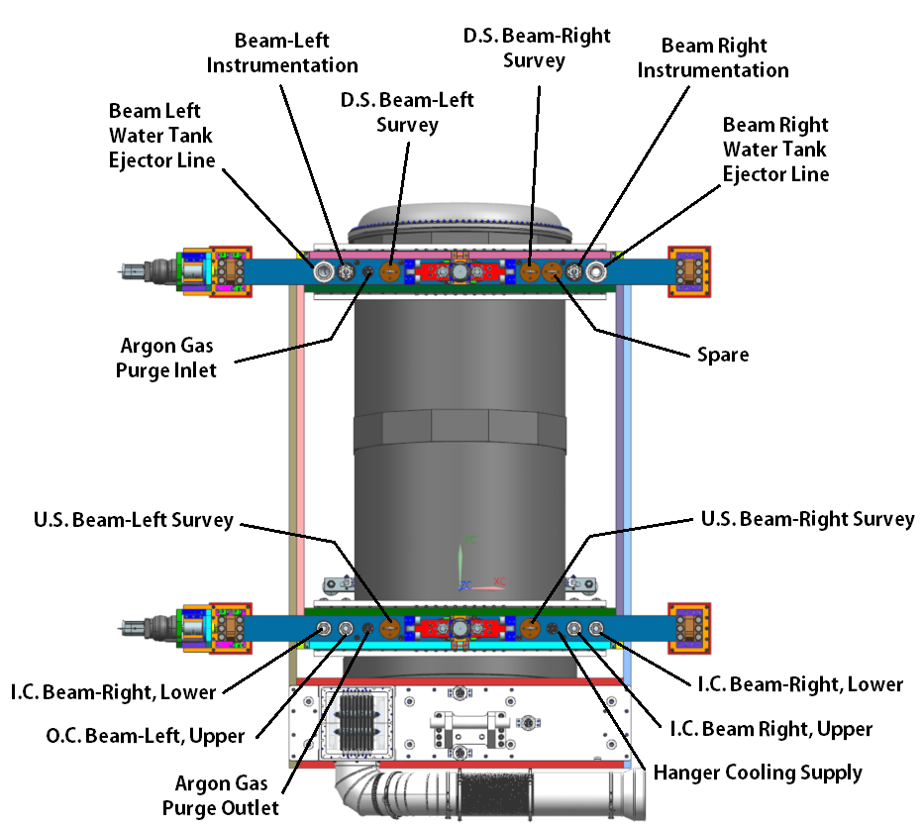
Horn C Utility / Instrumentation Line Placement

Slide 12
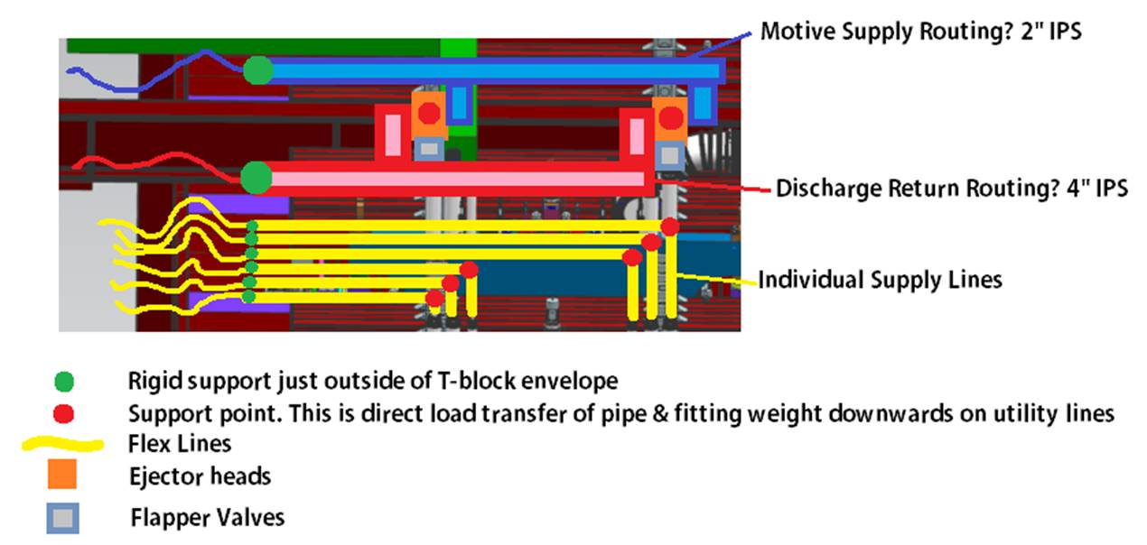
Upper Interfaces
All lines have independent connections to battlement feed-through.
Solid lines put weight on vertical penetrations until support on beam-left can accommodate a flex line.
Ejector motive flow and return flow likely split large feed pipes.

Slide 13
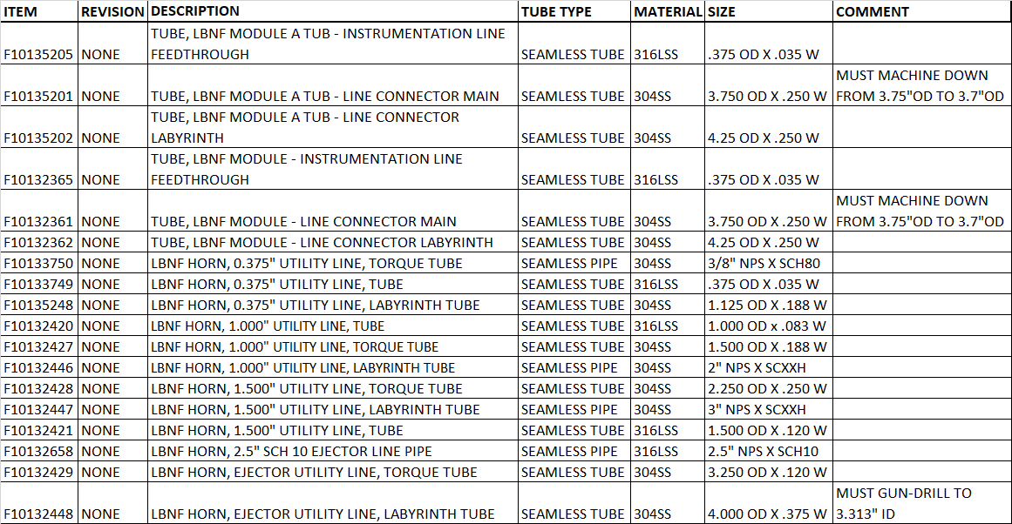
Utility / Instrumentation Line Specifications: Material
Utilizes COTS tube/pipe sizes. Three have minor machine work.

Slide 14
Utility / Instrumentation Line Specifications
All line specifications meet or exceed NuMI specs.
Weight increase must be handled by specialized lifting fixture for careful thread engagement.
Bare lines, even without shielding, surpass 50-100lbs due to shielding thickness and should not be engaged without a fixture.
Line Type / Feature | Specification
Type K Thermocouple Range | -35C to 1260C
Nominal Utility Operating Pressure (Argon) | 1PSIG
Nominal Utility Operating Pressure (RAW) | 40PSIG
Maximum Utility Test Pressure | 150PSIG
0.375” Utility Weight | 20lbs
1.0” Utility Weight | 100lbs
1.5” Utility Weight | 210lbs
2.0” Utility Weight | 200lbs
Instrumentation Line Weight | 285lbs
Instrumentation Line Grout | Masterflow 885 (Metal Aggregate)

Slide 15
Testing & Q/A Plans
All utility & Instrumentation lines must be tested for pressure or continuity / correct readout.
Multiple lessons learned from NuMI experience.
Need readout maps for what thermocouples go where.
Bagged & tagged utility lines with test date & witness.
Cap utility lines.
Protect ceramic ends of instrumentation lines.
See detailed assembly & testing procedure by Meredith Lee.

Slide 16
Summary
The utility and instrumentation lines are derived from NuMI / NoVA Module design.
Utility line sizes range from 3/8” to 2”.
2” size utilizes adapter to 2.5” NPS SCH 10.
3/8” size is likely not installed until 2.4MW operation, and rarely changed.
Penetration line-sets are identical across all modules.
Exception are the twin instrumentation lines routed through the TUB.
Instrumentation line expanded from 5 to 6 thermocouple connections.
Improvements made for rigging concerns, connection Q/A, & repairability.
Questions?

