Slide 1
Neutrino Beamline Modules Preliminary Design Review
Instrumentation Line Assembly Procedure
Meredith Lee
14 August 2020

Slide 2
Outline
Background
Assembly procedure
Summary

Slide 3
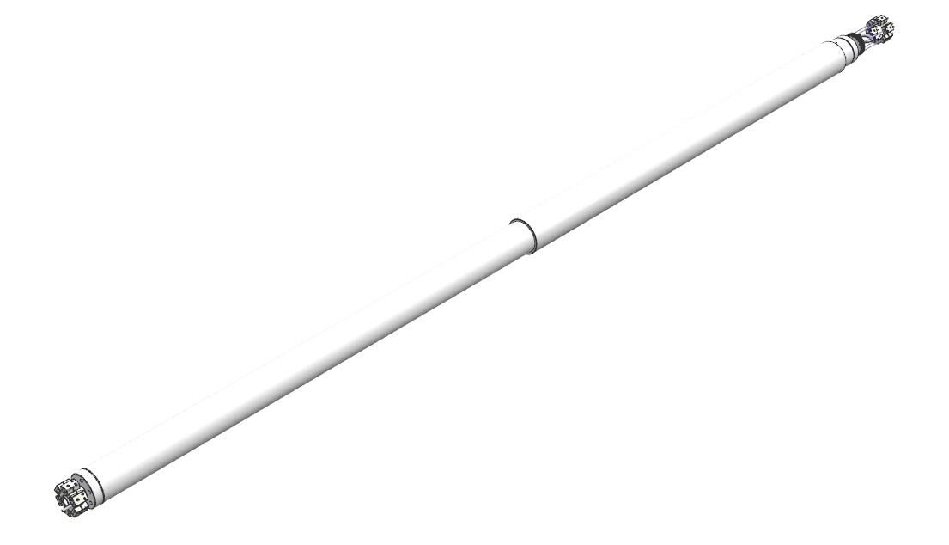
Background
Instrumentation lines contain thermocouples feeding from horn to module
Provide radiation shielding
Assembly procedure necessary for consistent installation and traceable documentation for quality assurance
LBNF procedure is revision of NuMI procedure with lessons learned

Slide 4
Assembly

Slide 5
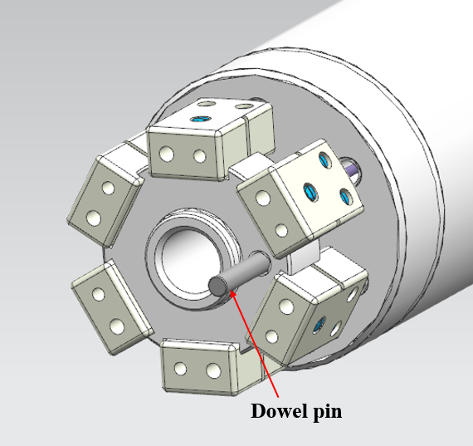
Inspection and Initial Assembly
Inspect all components in the assembly for any visible defects and to ensure drawing specifications are met
Use liquid nitrogen to shrink fit the dowel pin to the phase 1 piece of the weldment for alignment

Slide 6
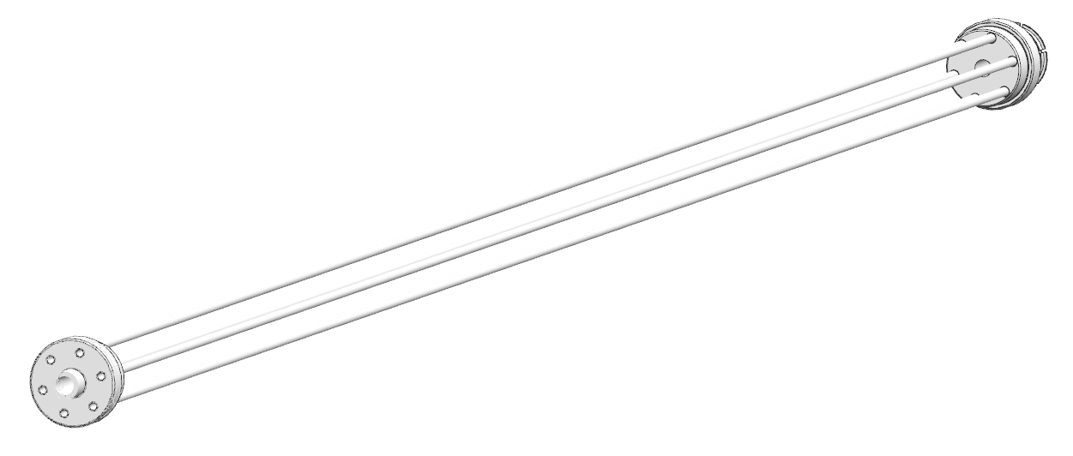
Welding
Lay out the individual parts of the weldment
Check top and bottom clocking on feedthrough pipes to ensure no twisting
Double-check using feedthrough clocking on top of module
Certified Fermilab welder will weld parts to form the weldment
AWS B2.1-8-212

Slide 7
Eyebolt Side Assembly
Insert a funnel into the cap and fill the interior with MasterFlow 885 grout
Use the weep hole on the outer tube to observe when the grout has reached the top
Inspect the pipe threads at the top of the weldment to ensure they are clean
Apply a thin layer of Loctite 569 to threads and twist on the plug
Place serrated Belleville washer on top of the plug
Screw in eyebolt until the Belleville washer is sufficiently compressed

Slide 8
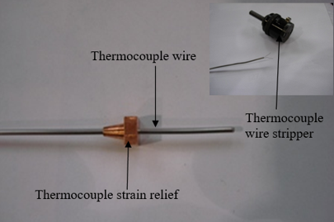
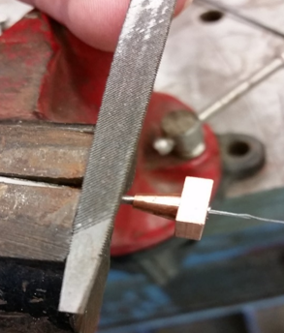
Thermocouple Assembly
Use a thermocouple wire stripper to expose 1” of the internal wire on each thermocouple wire
File the area of the thermocouple wire that the strain relief will be soldered to remove oxidation
Omitting filing this area will prevent the solder from properly adhering to the wire
Solder the strain relief onto the thermocouple wire

Slide 9
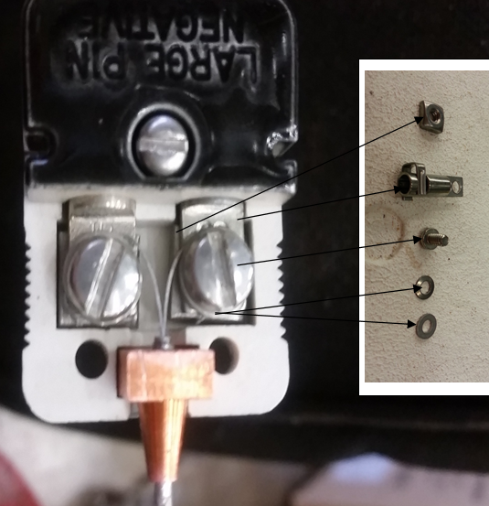
Thermocouple Assembly
Position the wires and strain relief in the male thermocouple connector
For Type K, yellow wire is positive and non-magnetic, and the red wire is negative and magnetic
Cross check by using a magnet on both wires
Install the washers on the flathead screw
Wrap the stripped thermocouple wire around the screw under the washers to relieve all strain on the wires and carefully tighten the screw
Use of Glyptal is undesired
Repeat slides 8-9 for the female thermocouples

Slide 10
Thermocouple Assembly
Slide the female thermocouples into the grooves in the module-side weldment section
Tighten each female thermocouple into place in the weldment with the center screw and serrated Belleville washer

Slide 11
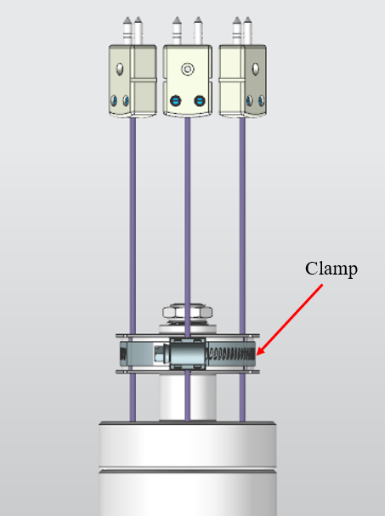
Final Assembly
Fasten the clamp at the top of the weldment to secure the thermocouple wires

Slide 12
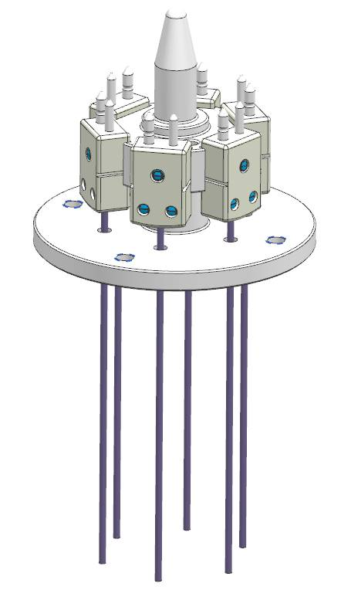
Testing
Use a multimeter to test:
Individual thermocouple resistance
Continuity in each wire and pin
To verify readout, use a heat gun to heat the pigtail on the horn side of the instrumentation line
Confirm the readout displays increasing temperatures
Mate male instrumentation spike with terminated thermocouples to verify tolerances and pin fitment

Slide 13
Summary
Welding will be completed by certified Fermilab welder
Modified version of NuMI assembly procedure
No Glyptal desired
Eyebolt install
Written procedure available for quality assurance
Formal Teamcenter procedure ED0012202

