Slide 1
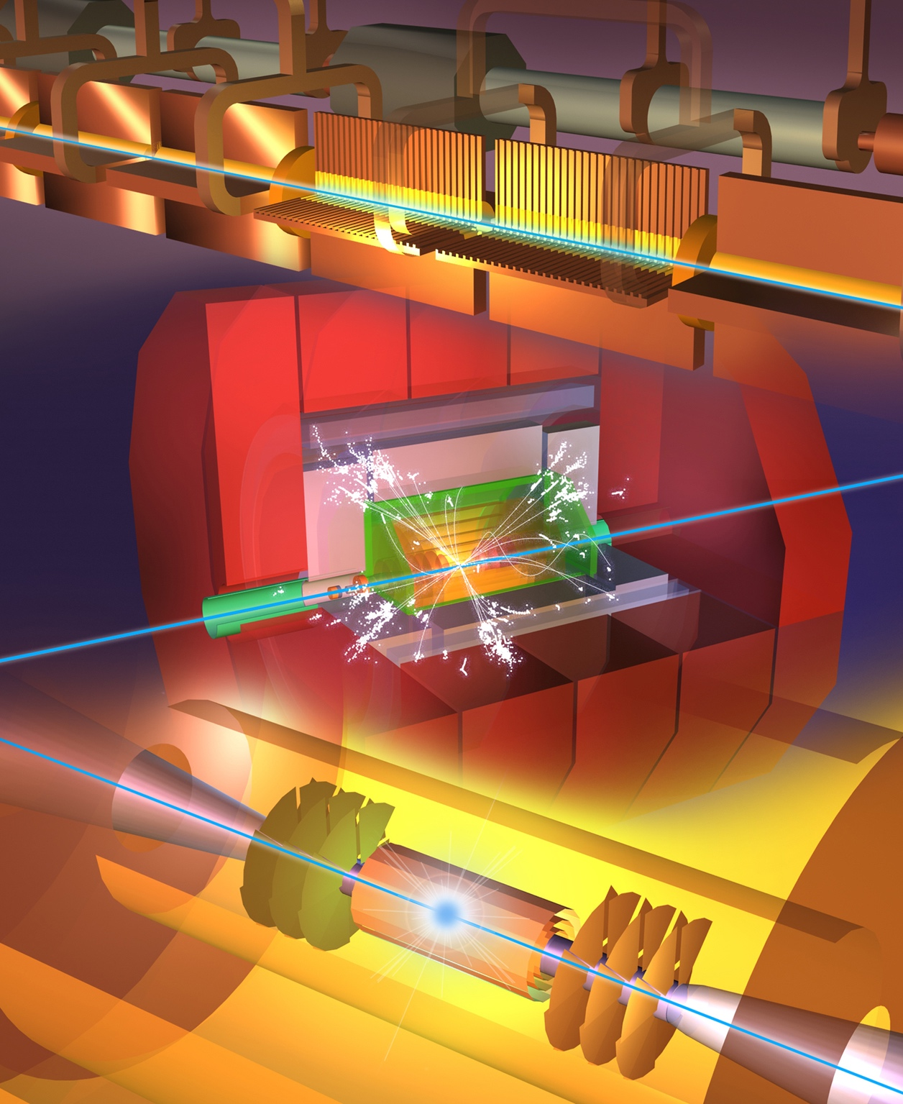
Steinar Stapnes
on behalf of CLIC
The Compact Linear Collider (CLIC)
Outline
Project overview
Plans 2021-25
Resources and more information
Snowmass CPM
October 6th, 2020

Slide 2
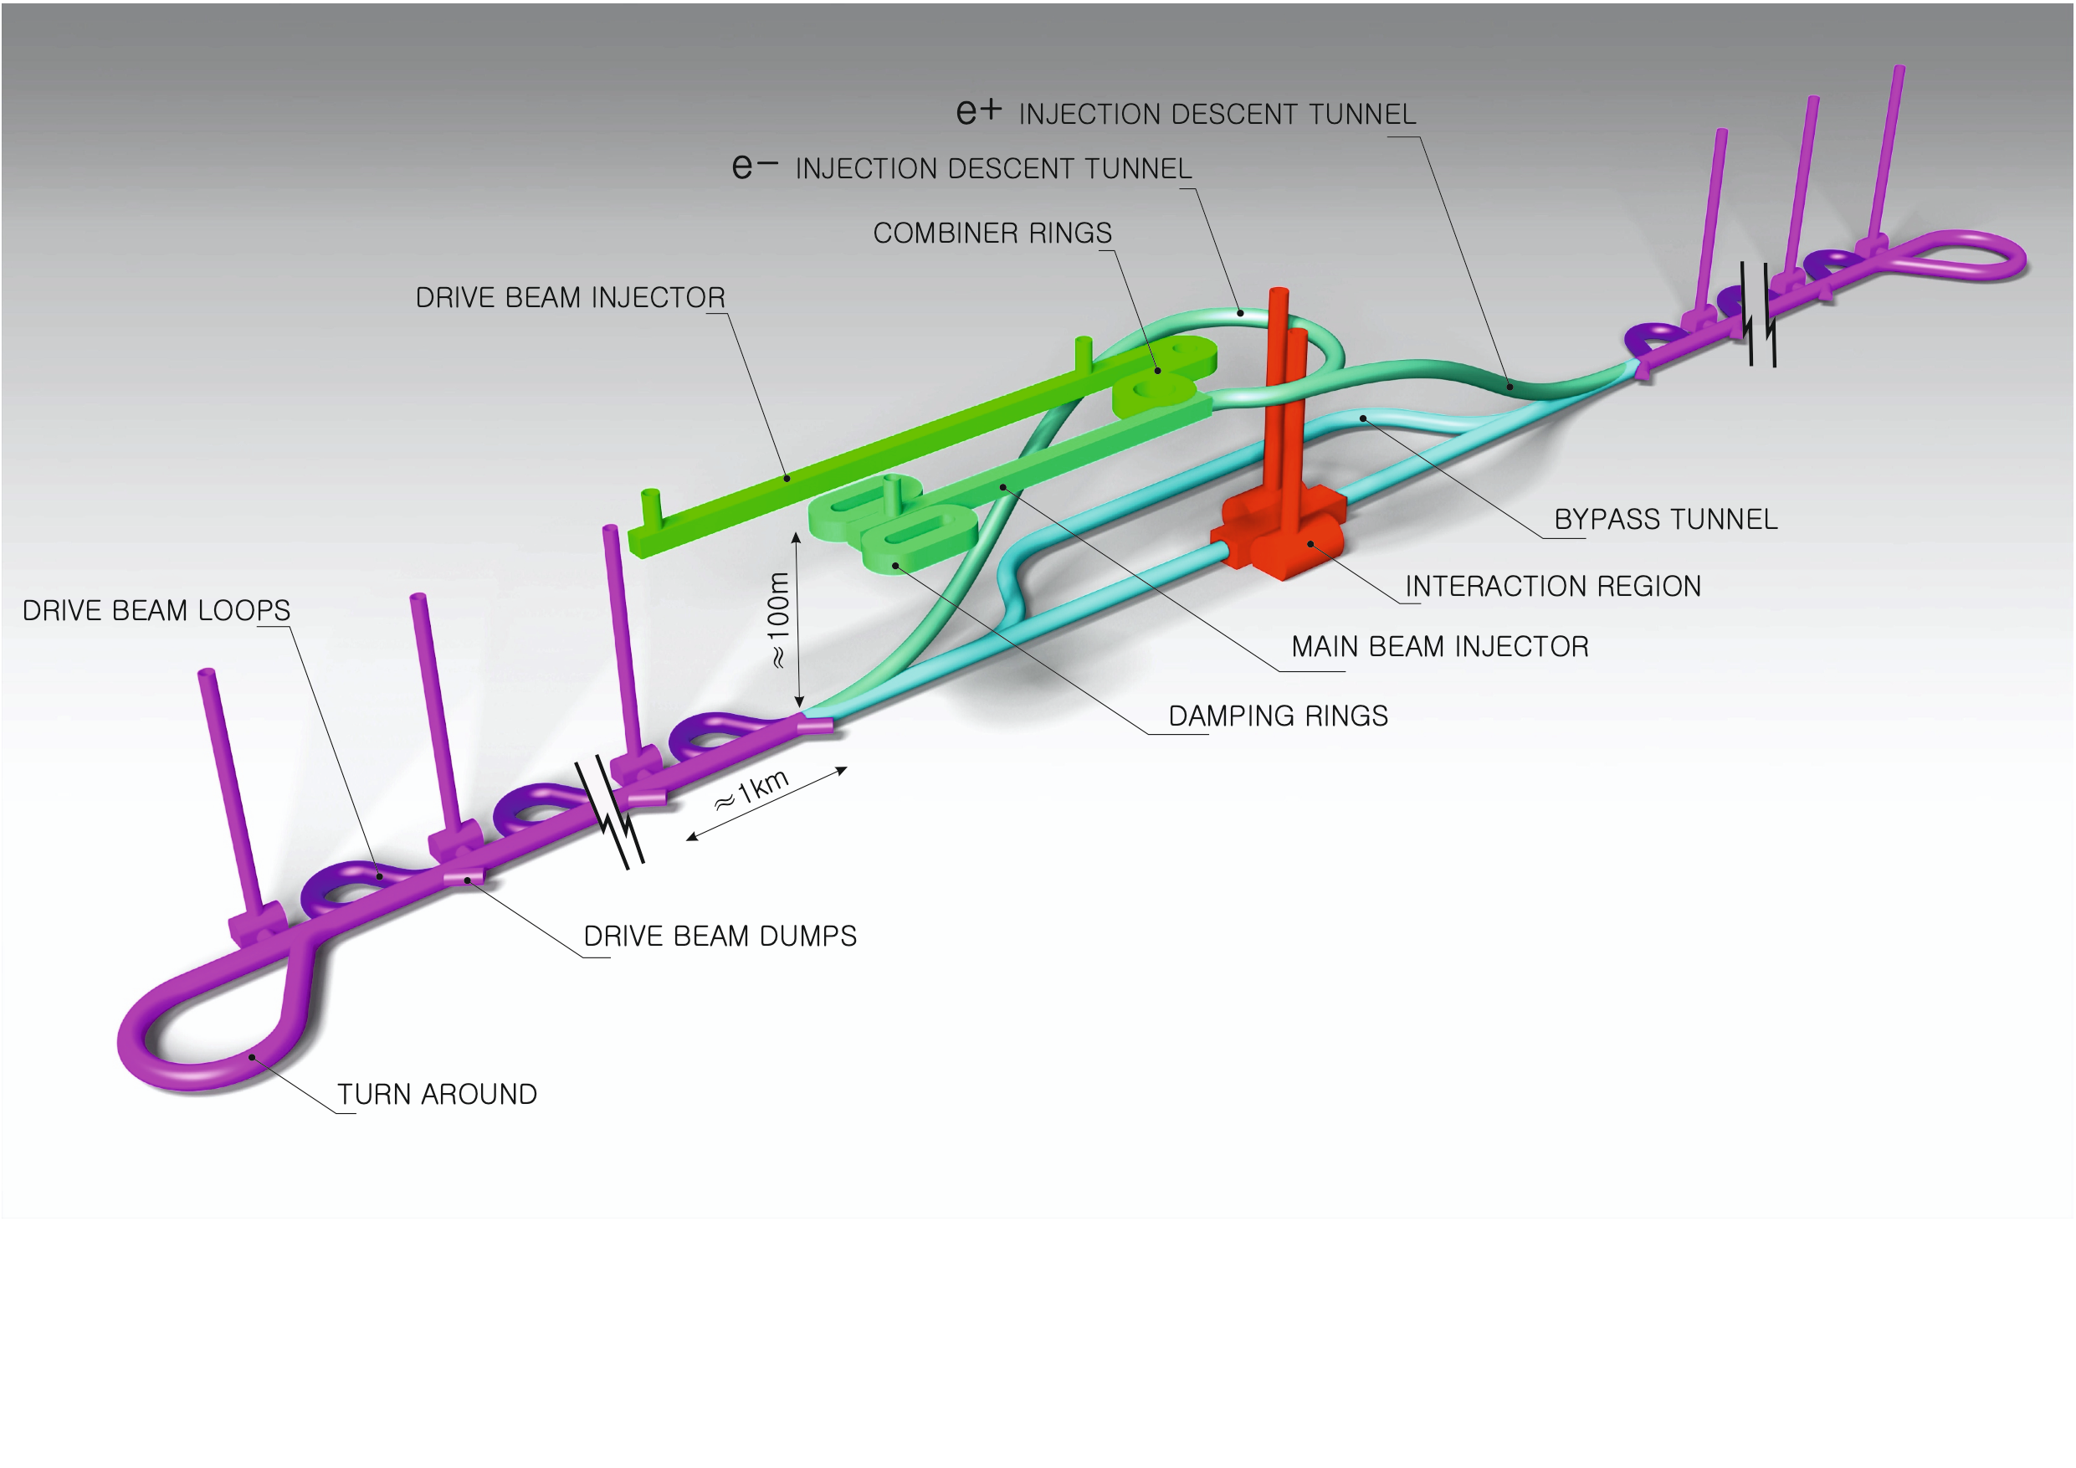
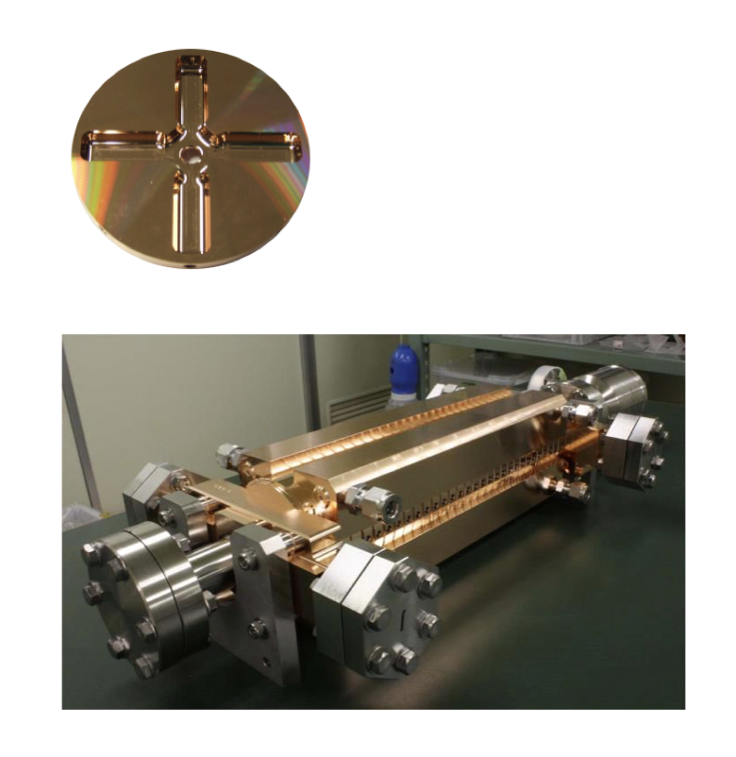
Proposed e⁺e– linear colliders – CLIC
The Compact Linear Collider (CLIC)
  Timeline: Electron-positron linear collider at CERN for the era beyond HL-LHC (~2035 Technical Schedule)
  Compact: Novel and unique two-beam accelerating technique with high-gradient room temperature RF cavities (~20’500 cavities at 380 GeV), ~11km in its initial phase
  Expandable: Staged programme with collision energies from 380 GeV (Higgs/top) up to 3 TeV (Energy Frontier)
  CDR in 2012. Updated project overview documents in 2018 (Project Implementation Plan). See resource slide.
  Cost: 5.9 BCHF for 380 GeV (stable wrt 2012)
  Power: 168 MW at 380 GeV (reduced wrt 2012),
  some further reductions possible
  Comprehensive Detector and Physics studies
Accelerating structure prototype for CLIC:
12 GHz (L~25 cm)

Slide 3
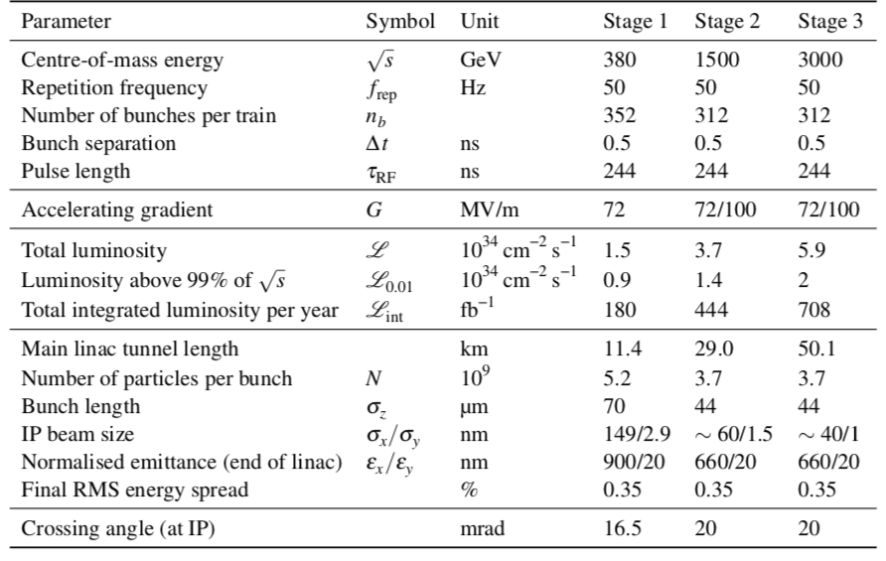
CLIC parameters

Slide 4
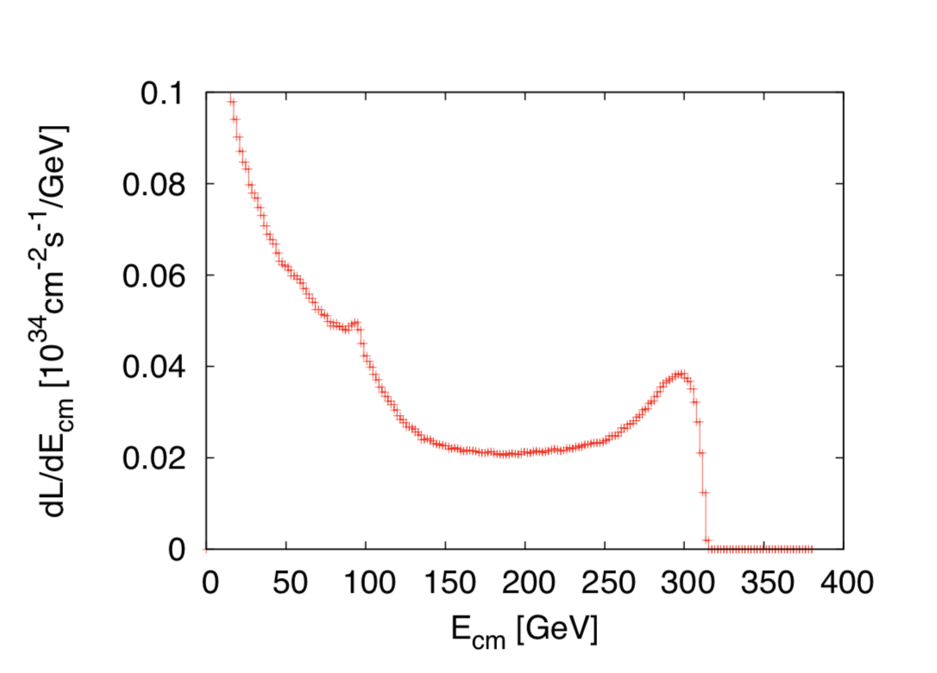
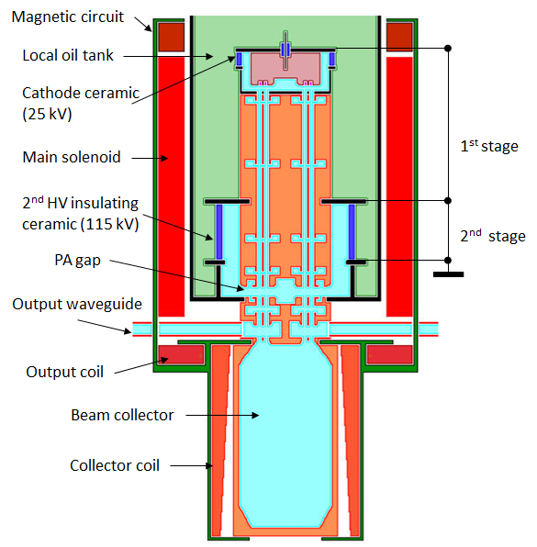
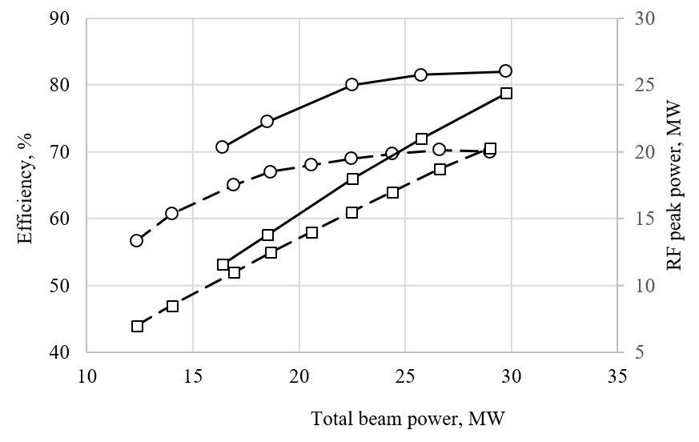
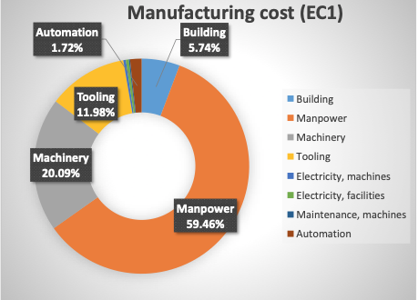
CLIC acc. studies 2019/20 – some examples
Further work on luminosity performance, possible improvements and margins, operation at the Z-pole and gamma-gamma
    Z pole performance, 2.3x10³² – 0.4x10³⁴ cm⁻² s⁻¹
      The latter number when accelerator configured for Z running (e.g. early or end of first stage)
      Gamma – Gamma spectrum (example)
      Luminosity margins and increases
      Baseline includes estimates static and dynamic degradations from damping ring to IP: 1.5 x 10³⁴ cm⁻² s⁻¹, a “perfect” machine will give : 4.3 x 10³⁴ cm⁻² s⁻¹, so significant upside
      In addition: doubling the frequency (50 Hz to 100 Hz) would double the luminosity, at a cost of +50 MW and ~5% cost increase
    CLIC note about these studies
Industrial questionnaire:
Based on the companies feedback, the preparation phase to the mass production could take about five years. Capacity clearly available. Talk of of Anastasiya
Drivebeam klystron: The klystron efficiency (circles) and the peak RF power (squares) simulated for the CLIC TS MBK (solid lines) and measured for the Canon MBK E37503 (dashed lines) vs total beam power. See more later.
Publication: https://ieeexplore.ieee.org/document/9115885

Slide 5
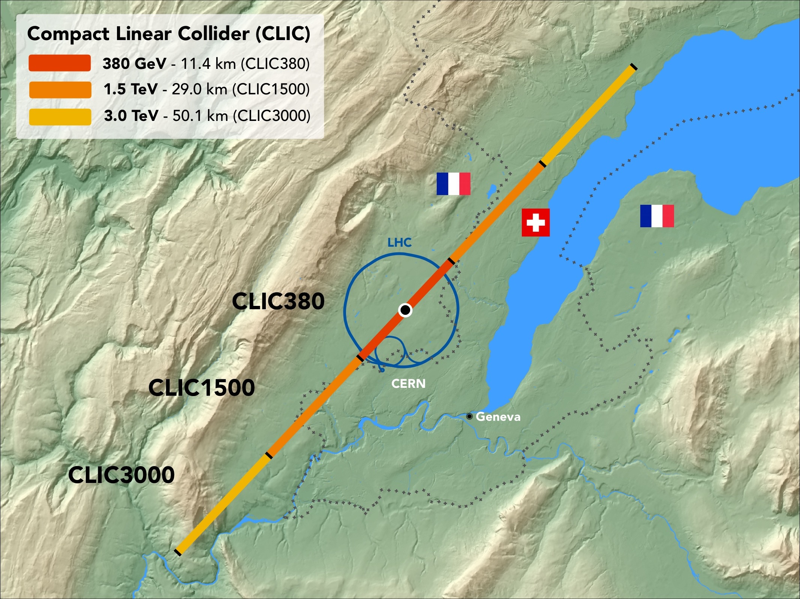
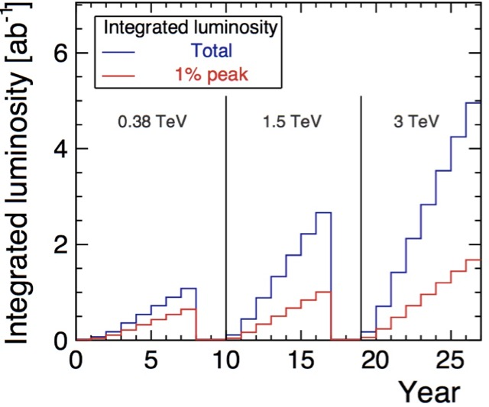
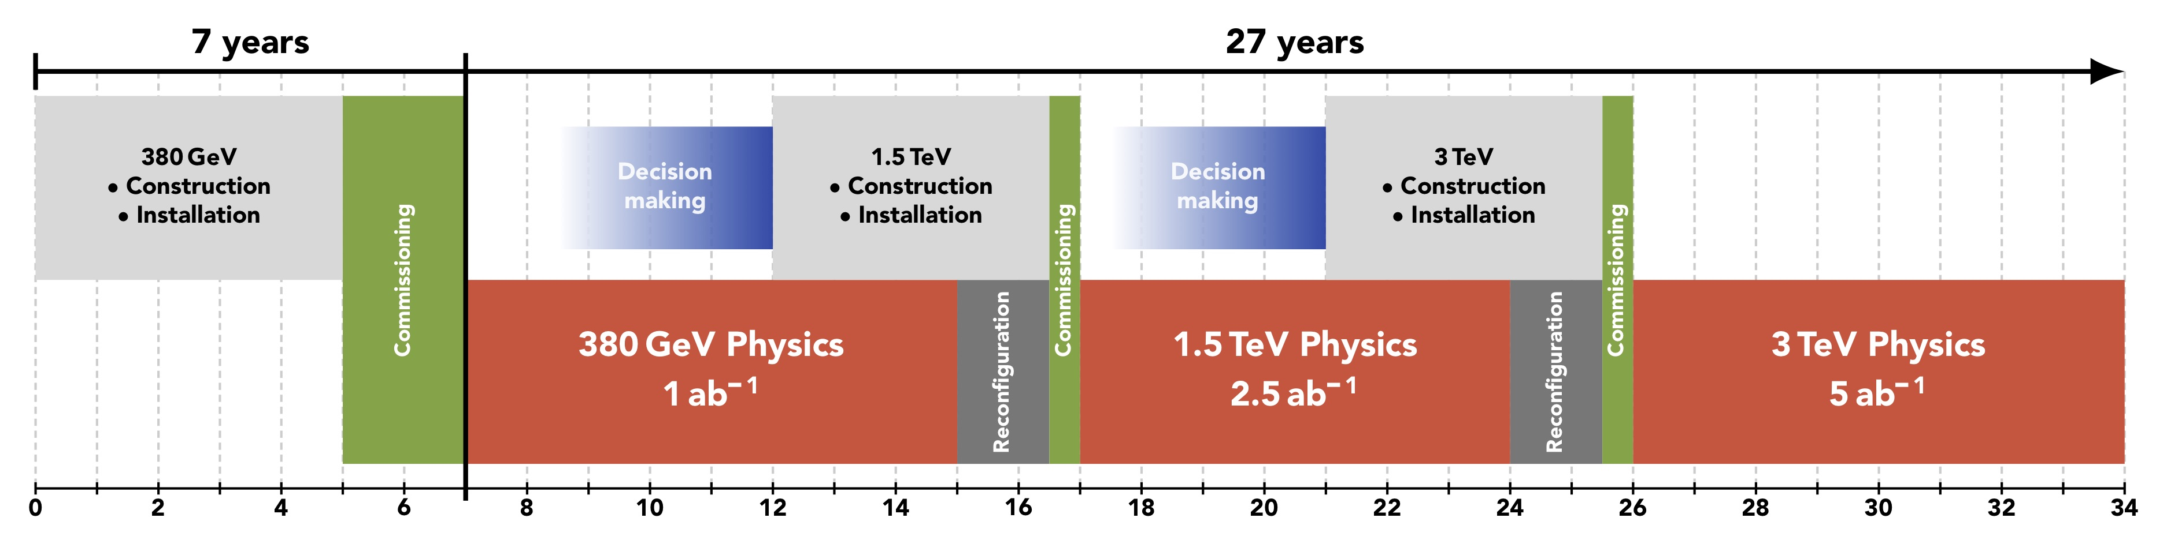
CLIC timeline
Ramp-up and up-time assumptions: arXiv:1810.13022, Bordry et al.
Technology Driven Schedule from start of construction shown above.
A preparation phase of ~5 years is needed before (estimated resource need for this phase is ~4% of overall project costs)

Slide 6
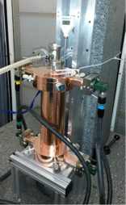
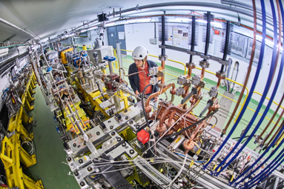
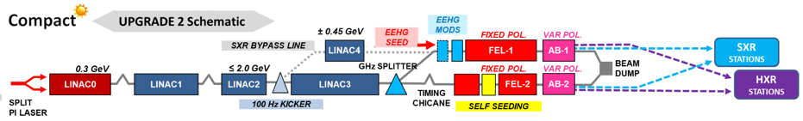
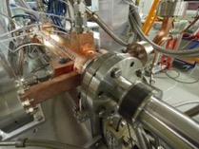
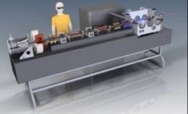
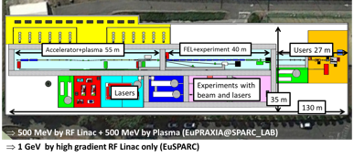
CLIC studies 2021-25 (Snow-mass slide)
X-band technology:
Design and manufacturing of X-band structures and components
Study structures breakdown limits and optimization, operation and conditioning
Baseline verification and explore new ideas
Assembly and industry qualification
Structures for applications, FELs, medical, etc
Technical and experimental studies, design and parameters:
Module studies (see some targets for development below)
Beamdynamics and parameters: Nanobeams (focus on beam-delivery), pushing multi TeV region (parameters and beam structure vs energy efficiency)
Tests in CLEAR (wakefields, instrumentation) and other facilities (e.g. ATF2)
High efficiency klystrons
Injector studies suitable for X-band linacs (coll. with Frascati)
Application of X-band technology (examples):
A compact FEL (CompactLight: EU Design Study 2018-21)
Compact Medical linacs (proton and electrons)
Inverse Compton Scattering Source (SmartLight)
Linearizers and deflectors in FELs (PSI, DESY, more)
1 GeV X-band linac at LNF
eSPS for light dark matter searches (within the PBC-project)
More information: CLIC mini week (1.10.2020)

Slide 7
Some recent overview talks and papers
A slightly more substantial talk in June: https://indico.fnal.gov/event/43871/contributions/188884/attachments/130314/158693/clic_stapnes_short.pptx
(more about technology, cost/energy, power)
Several LoIs have been submitted on behalf of CLIC and CLICdp to the Snowmass process:
The CLIC accelerator study: Link
Beam-dynamics focused on very high energies: Link
The physics potential: Link
The detector: Link

Slide 8
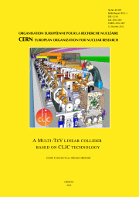
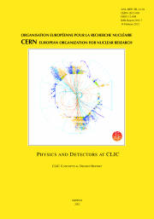
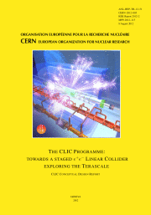
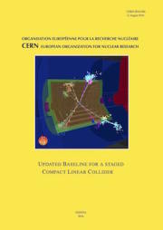
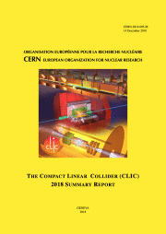
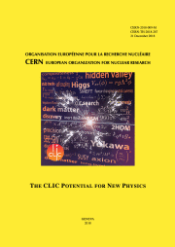
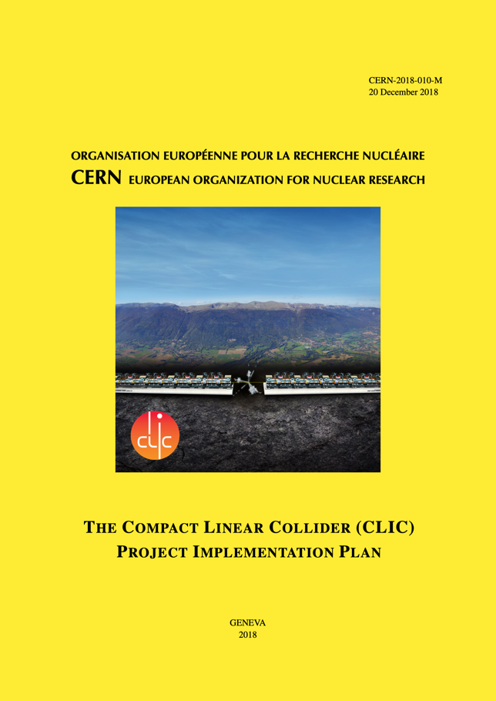
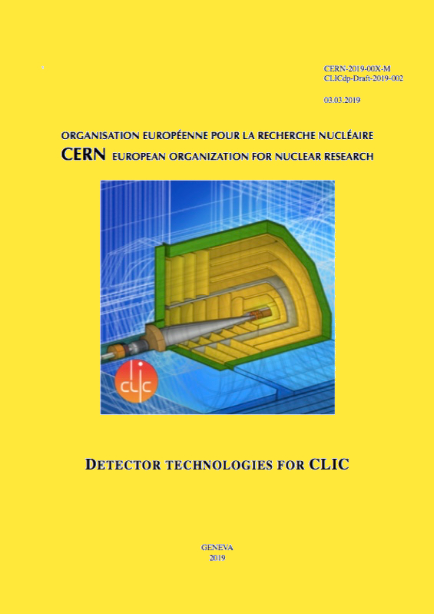
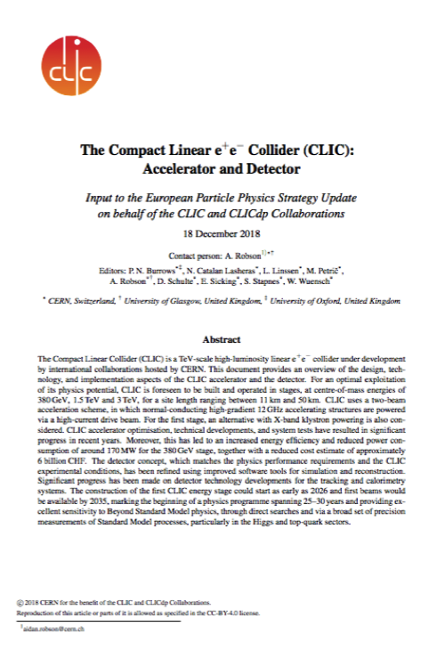
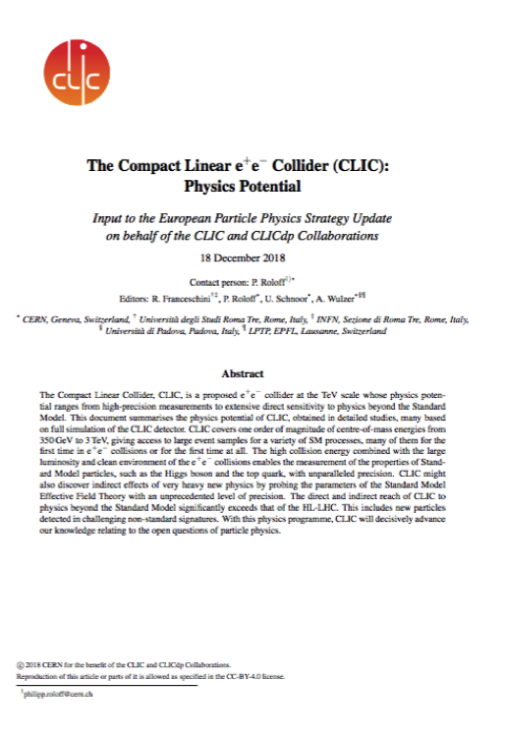
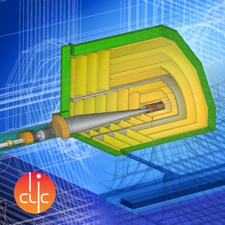
Resources
3-volume CDR 2012
Updated Staging Baseline 2016
Available at:
clic.cern/european-strategy
4 CERN Yellow Reports 2018
Two formal submissions to the ESPPU 2018
Details about the accelerator, detector R&D, physics studies for Higgs/top and BSM

Slide 9
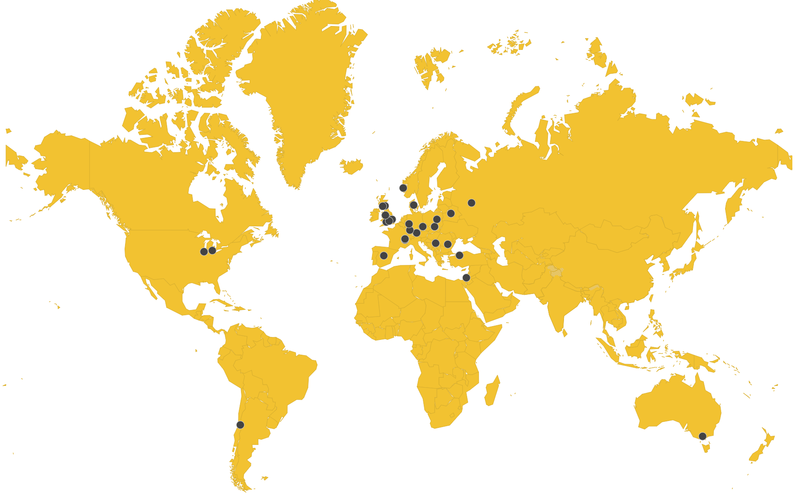
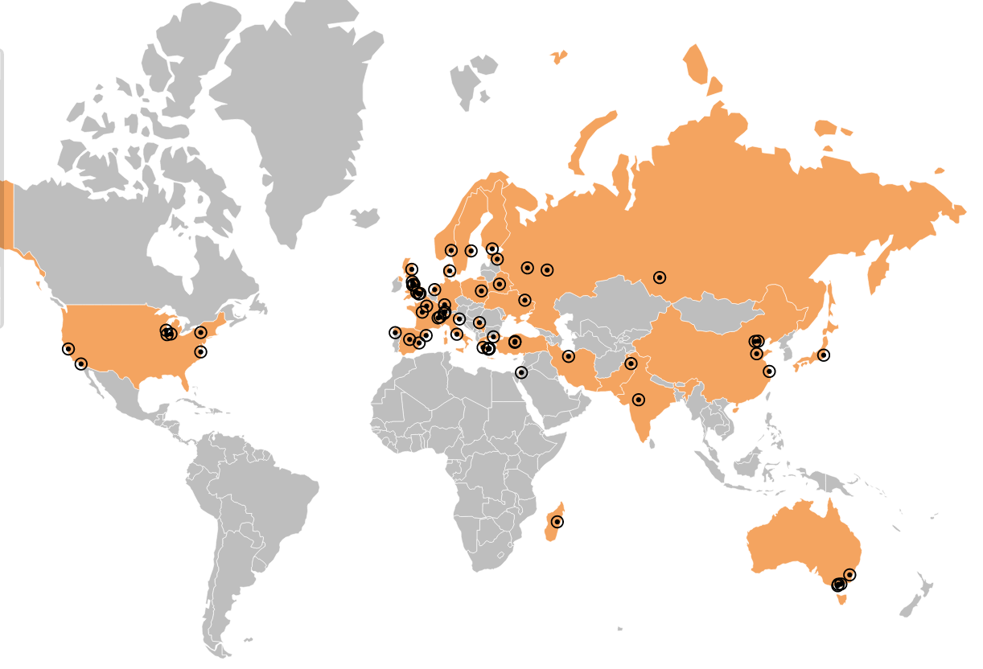
Collaborations
CLIC accelerator
  ~50 institutes from 28 countries
  CLIC accelerator studies
  CLIC accelerator design and development
  Construction and operation of CLIC Test Facility, CTF3
CLIC detector and physics (CLICdp)
  30 institutes from 18 countries
  Physics prospects & simulations studies
  Detector optimisation + R&D for CLIC
+ strong participation in the CALICE and FCAL Collaborations and in AIDA-2020

