Slide 1
Transduction for New Regimes in Quantum Sensing
Snowmass CPM - AF5 organization with contributors
Oct. 5, 2020
Emilio Nanni – nanni@slac.stanford.edu
LOI:
SNOWMASS21-IF1_IF2-AF5_AF7_Nanni-162
Heinz, Nanni, Safavi-Naeini, Schleier-Smith, Welander

Slide 2
Efficient Quantum Transduction Needed to Link Quantum Systems
Quantum computing at 10² qubit scale; needs 10⁶ qubits for applications
Efficient optical quantum memory systems; leading QC candidates are superconducting microwave qubits
Quantum advantage (ADMX, DM Radio, CASPER) of dark matter detectors up to 10s µeV scale $→$ Dark Matter BRN goes to meV
A scalable solution: utilize nonlinear high-kinetic inductance materials
Two pump photons, ω_{p} = (ω_{mm} − ω_{µwave})/2 , combine with microwave photon to produce a mm-wave output
Google
Four-Wave Mixing Transduction
10⁶-10⁹ Increase in Conversion Efficiency
M. Pechal, et al. Phys. Rev. A 96, 042305 (2017).

Slide 3
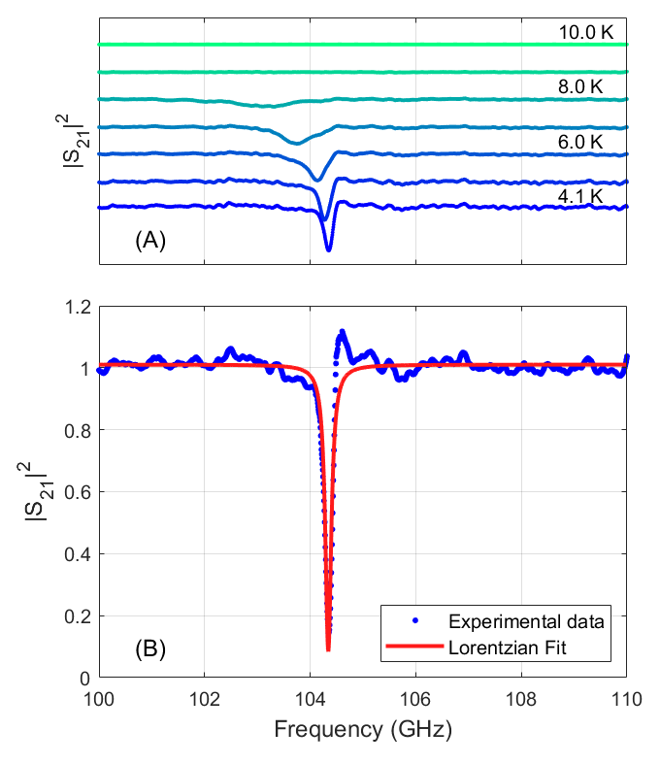
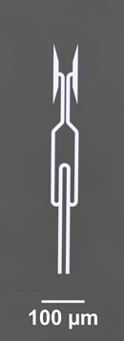
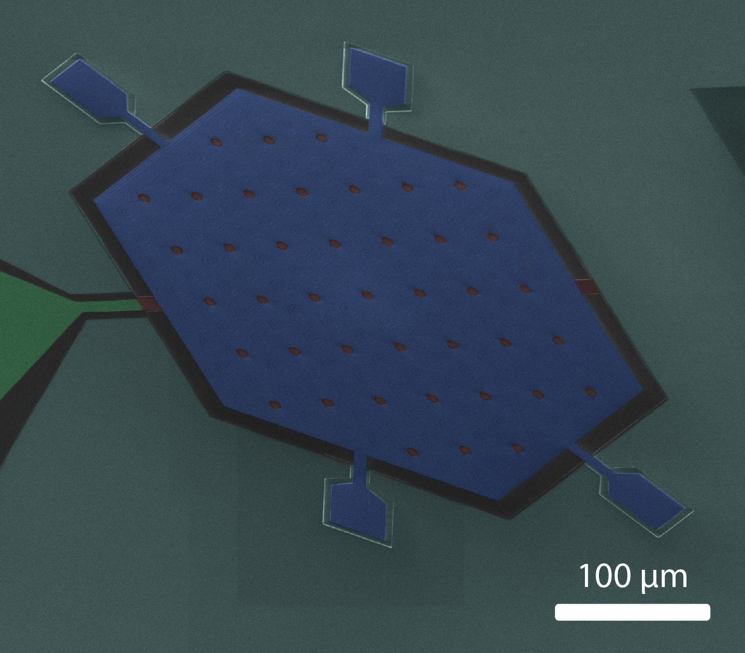
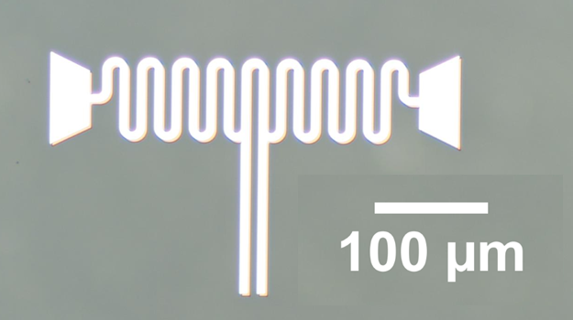
Transduction for New Regimes in Quantum Sensing
Exploring mm-wave regime as an intermediate quantum transduction channel between microwave/optical devices and quantum sensors
Transduction allows for sensing at higher frequencies, higher operation temperature, very high quantum efficiency, fast measurement, large bandwidth
Microwave photon in
mm-Wave photon out
Theory of Quantum State Transduction: Three coupled nonlinear resonators
Pechal and Safavi-Naeini, Phys. Rev. A 96, 042305 (2017)
mm-Wave pump
First mm-wave superconducting resonators
Preparing to test multi-frequency resonators
Developing microwave input air-gap capacitor
Y-Wing
~50/100 GHz
X-Wing
Multani, Stokowski, Das
Notes:
Bottom Right: False color SEM of air-gap capacitor in development
blue = Nb top plate,
Red = silicon dioxide (capacitor dielectric/sacrificial layer for releasing)
cyan = Niobium GND plane
green = contact pad
Funds Received $490k covers full period of award FY20/FY21
No deviation from expected budgetary expenditures or from proposed scope

Slide 4
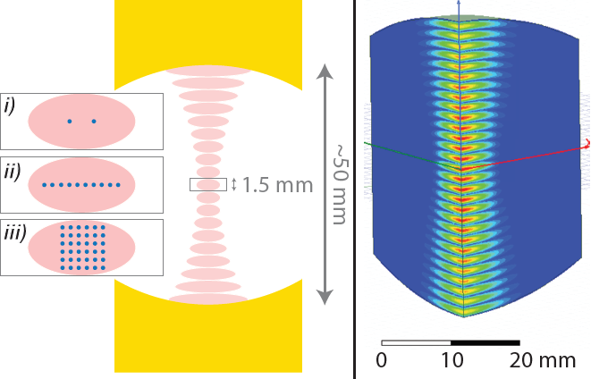
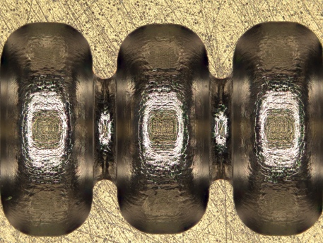
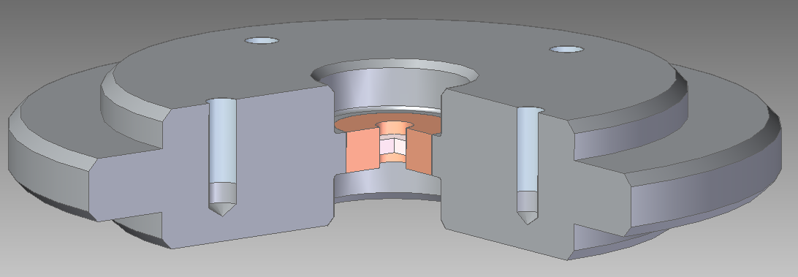
Opportunities in the Emerging QIS Landscape (1/3) RF and Cryogenic Instrumentation
Strong connections between QIS and accelerator technology
Leveraging accel. fabrication capabilities for vacuum/cryo windows, waveguide, cavities, coatings
Partnering w/ QIS leaders to pursue new opportunities:
Research Technology for QIST
QIS-based Quantum Devices
Vacuum/cryo windows from mm-wave accel. R&D
mm-Wave Mediated Atomic Transitions
Zhang, Schleier-Smith
3D SRF Cavities
w/ Thin Films
van Bibber
Feedback to Accelerator R&D: Improved SC films and cavity coatings; low-loss mm-wave/THz waveguides and mode convertors
Notes:
trap cold atoms in high-Q superconducting mm-wave Fabry-Perot
induce strong coupling between cavity mode and resonant atomic transition
cavity mode mediates effectively nonlocal atom-atom interactions
applications to quantum computation and simulation

Slide 5
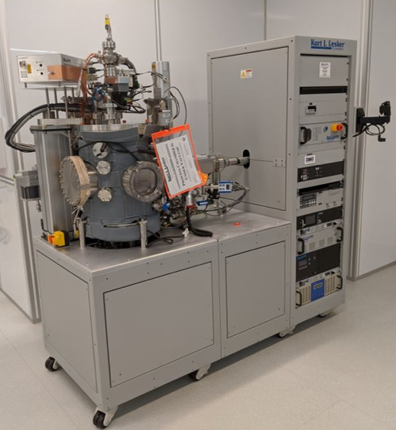
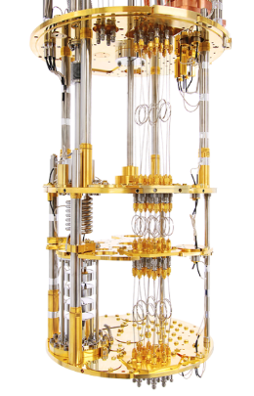
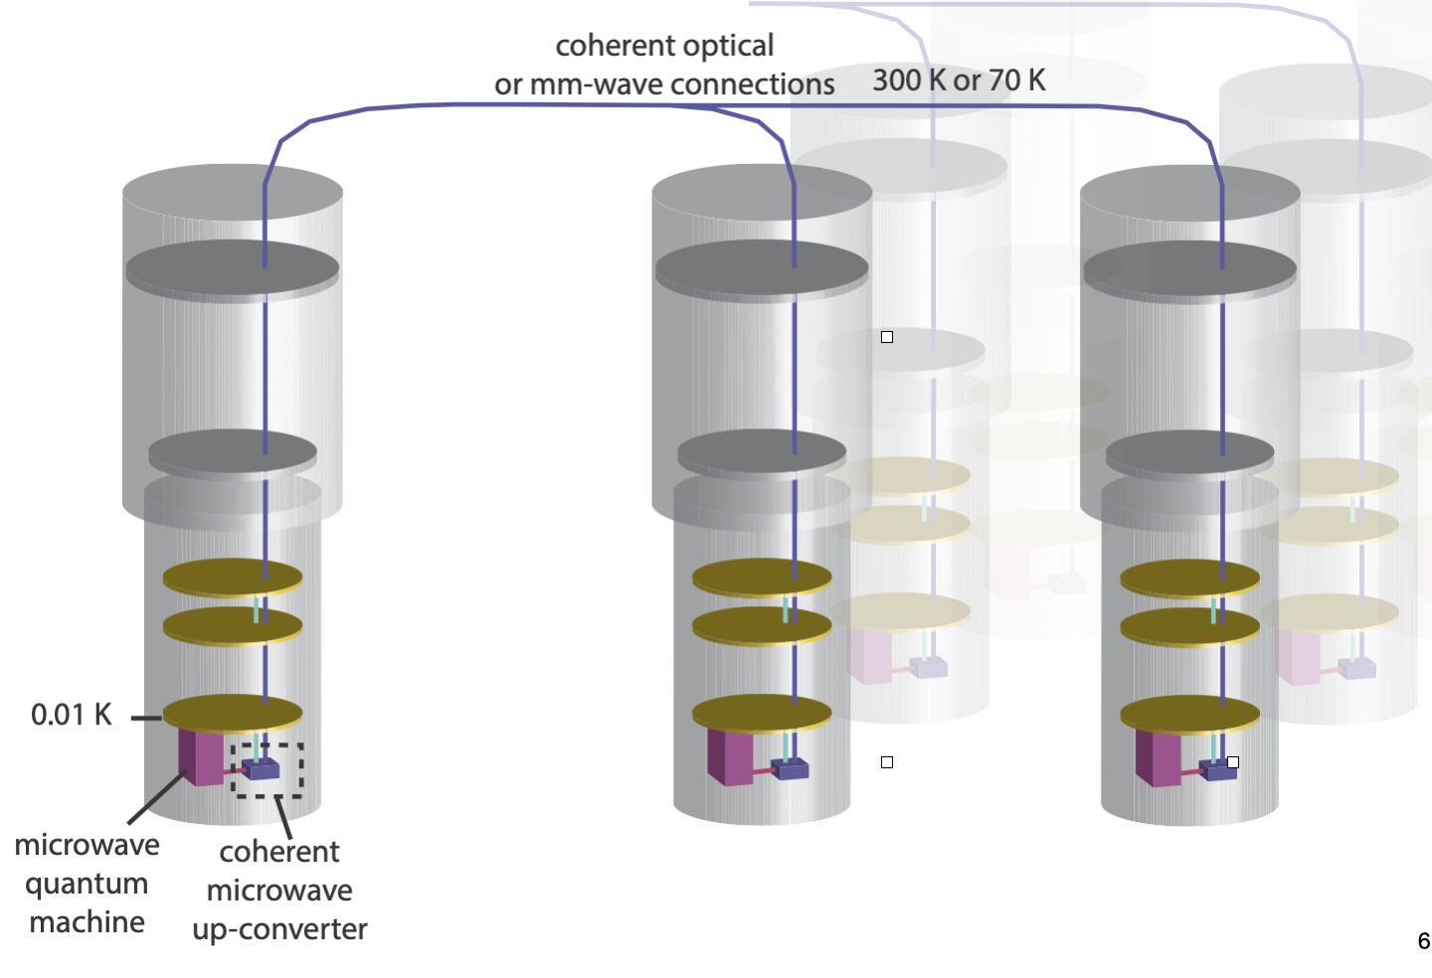
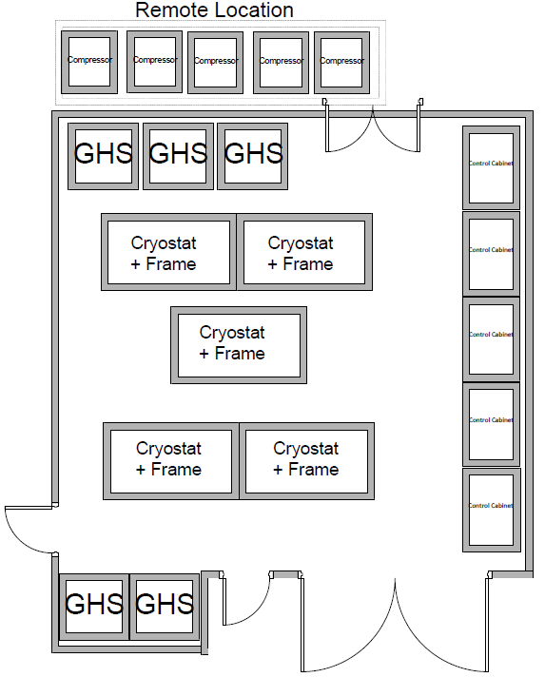
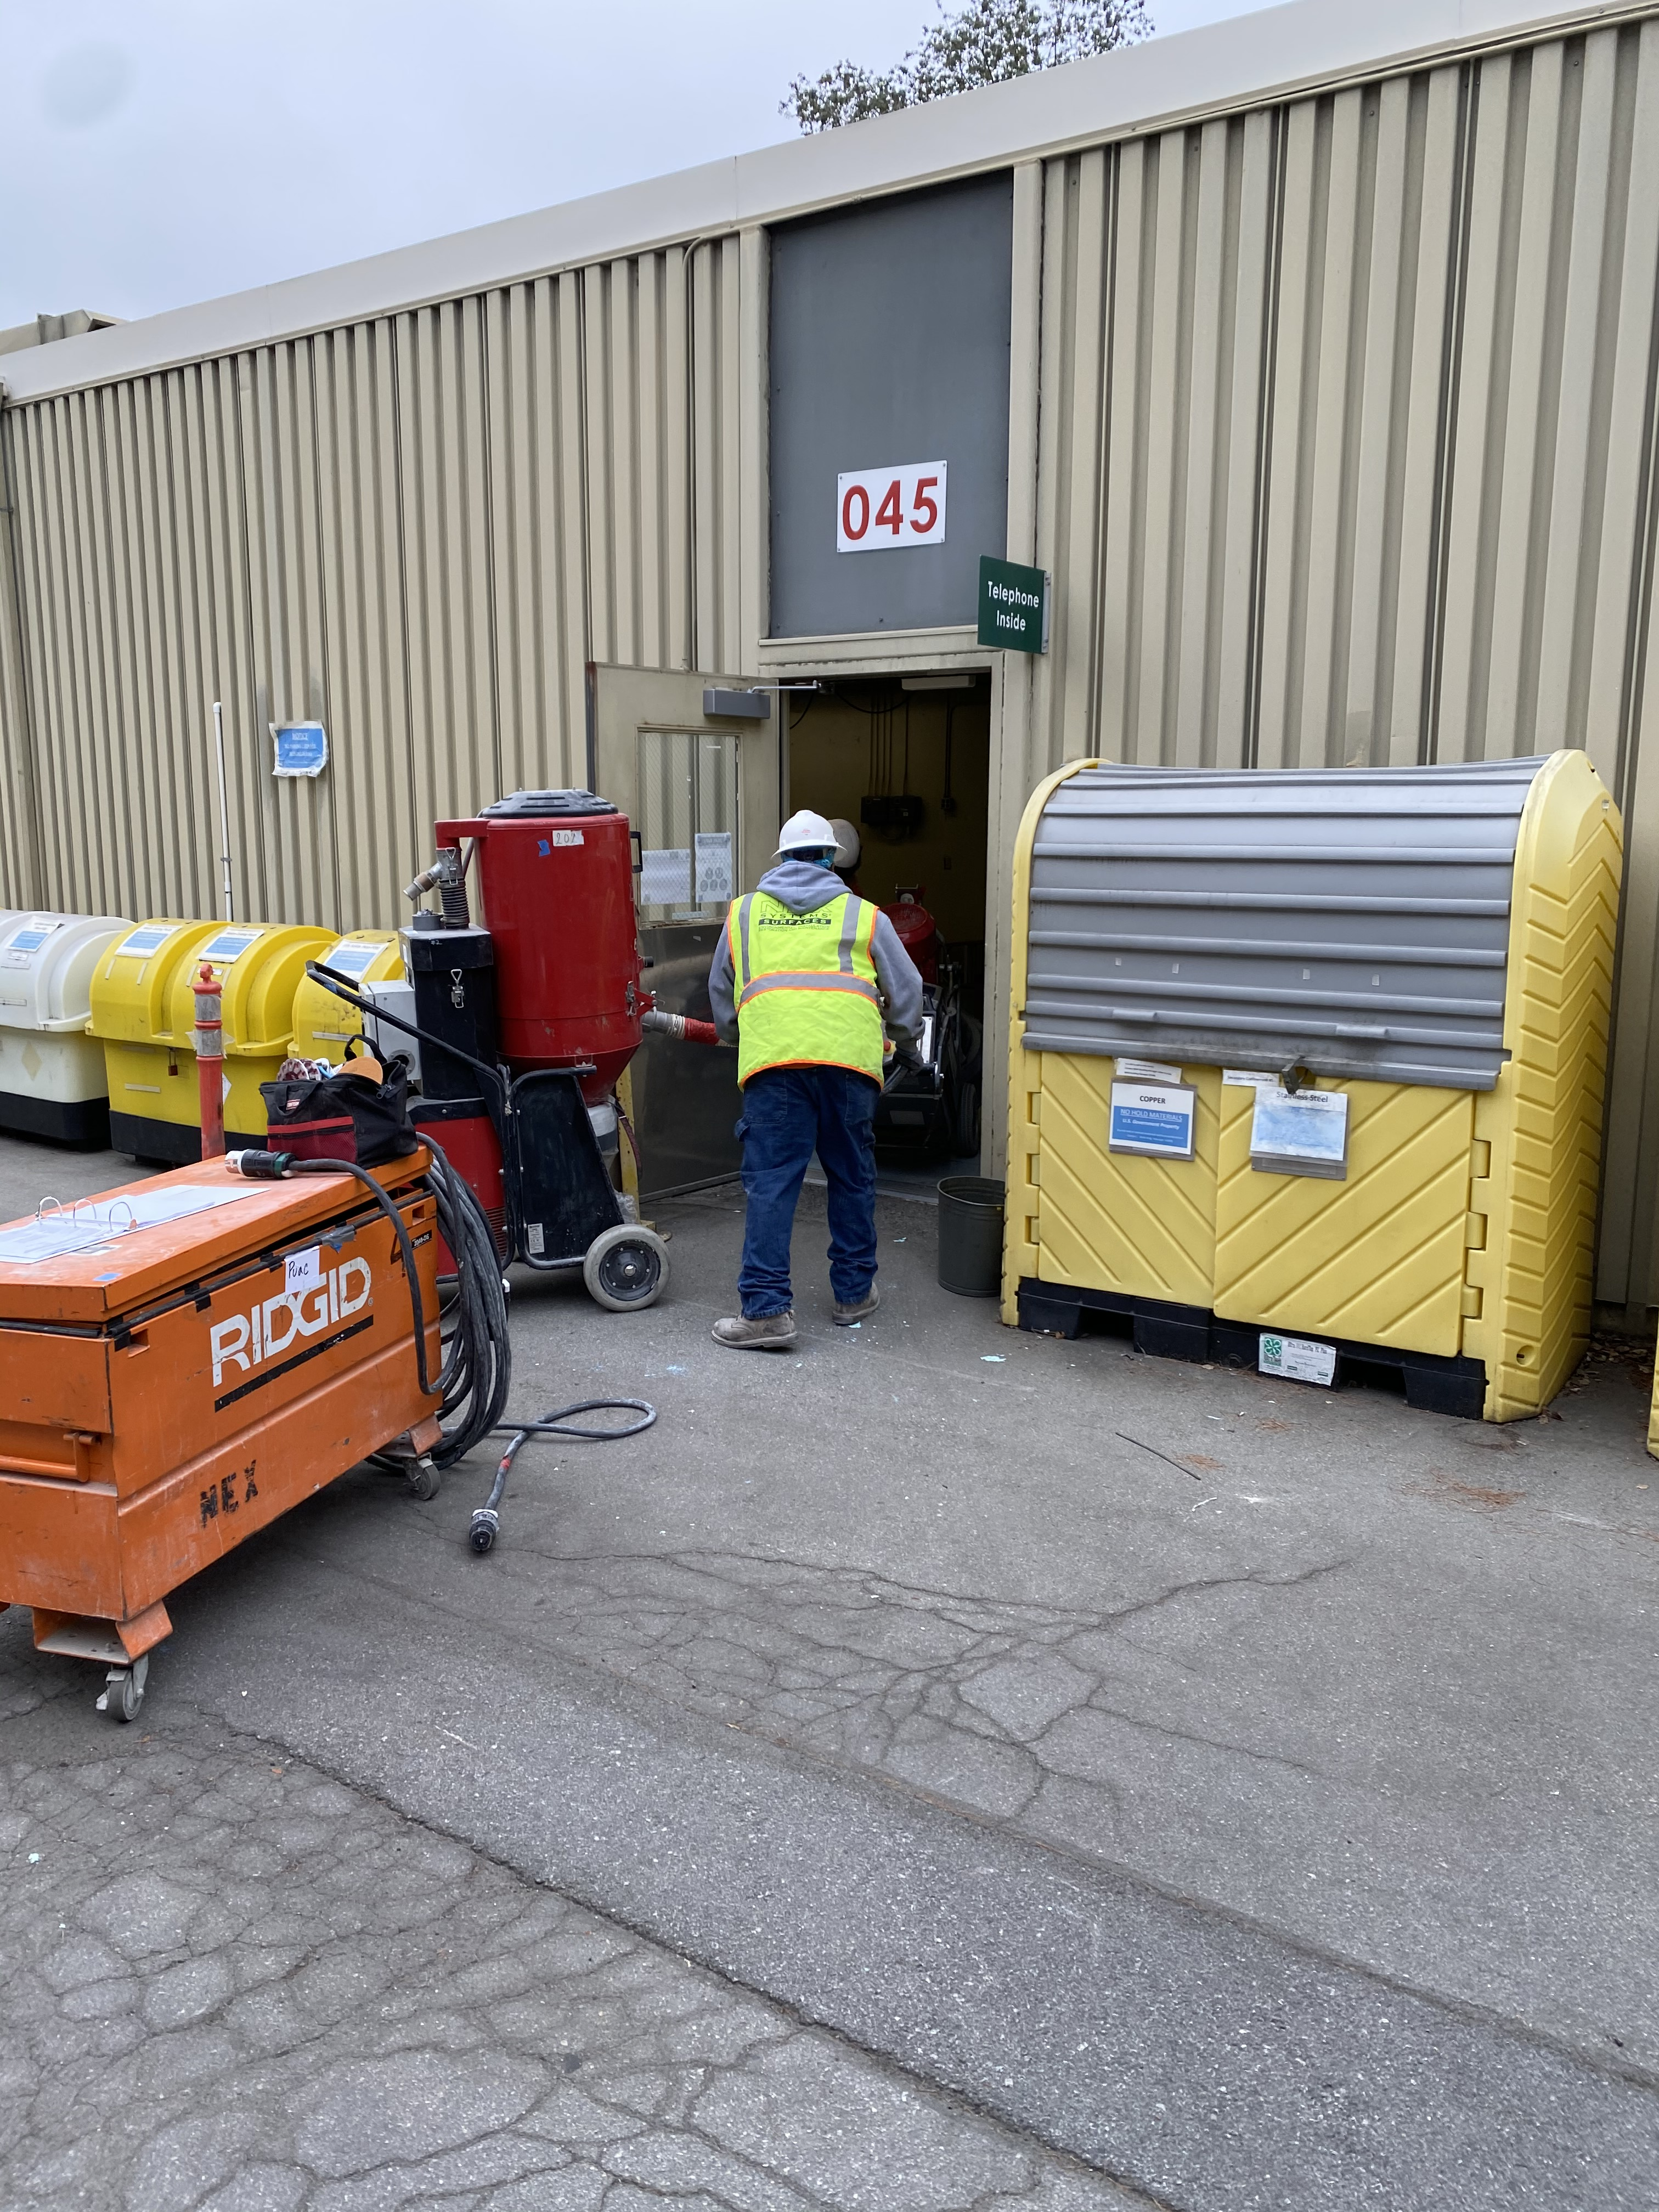
Opportunities in the Emerging QIS Landscape (2/3) System Architecture and Test
As technology develops we should be the first to utilize it
Sources of high quality devices coming online (SLAC = DMF/Nano-X)
Infrastructure for multiple cryogenic systems
Investigate Q-LAN for experiments in distributed computing, communication and sensing
Integrate Process Development for Tools in Nano-X and DMF
High Capacity Dilution Refrigerator (Support single cell L-band Cavity)
Bluefors LD400
Cryogenics Lab Layout at SLAC:
Fiber-linked and networked quantum data center
Occupancy w/ 5 Large Volume Dilution Units
One unit on site; Q-NEXT has funding for additional two

Slide 6
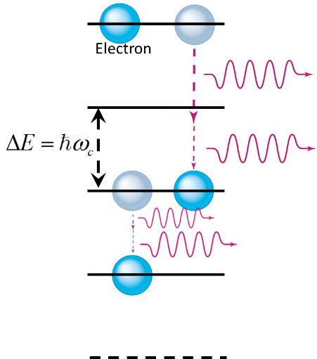
Opportunities in the Emerging QIS Landscape (3/3) Sources of Entanglement & Precision Beams
Source of Entanglement:
Entanglement of photonic sources can provide dramatic enhancement in sensitivity (quantum illumination$+$)
Explore implementing w/ e⁻ beams
$+$arXiv:1910.12277
Defect Creation:
SiV-SiC defects created by MeV e- beams as a qubit platform
Challenge – precision placement (<100 nm) and coherence
Demo e⁻ beam generation of Color-Centers
Vuckovic
Purcell-like enhancement of multi-photon transitions between Landau levels

