Slide 1
SRF for
Linear Collider Higgs Factories
Snowmass Community Planning Meeting
2020/Oct/6
KEK CASA Kensei Umemori, Shin Michizono

Slide 2
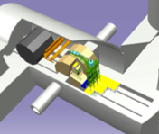
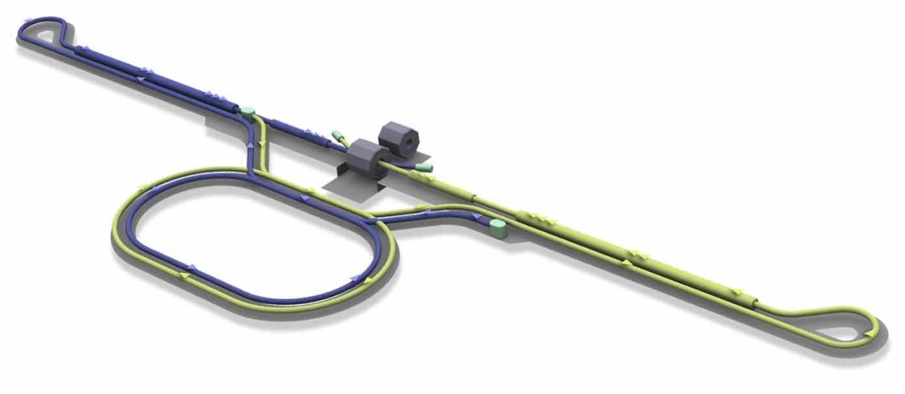
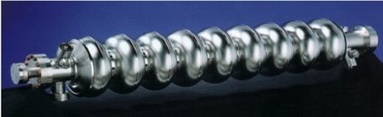
ILC250 accelerator facility
Item | Parameters
C.M. Energy | 250 GeV
Length | 20km
Luminosity | 1.35 x10³⁴ cm⁻²s⁻¹
Repetition | 5 Hz
Beam Pulse Period | 0.73 ms
Beam Current | 5.8 mA (in pulse)
Beam size (y) at FF | 7.7 nm＠250GeV
SRF Cavity G. Q₀ | 31.5 MV/m (35 MV/m) Q₀ = 1x10 ¹⁰
e- Main Linac
e+ Source
Beam delivery system (BDS)
Physics Detectors
e- Source
Damping Ring
e+ Main Liinac
Total 20.5 km
Key Technologies
Nano-beam Technology
SRF Accelerating Technology
8,000 SRF cavities will be used.

Slide 3
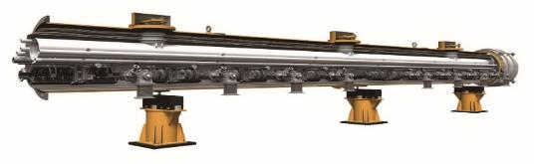
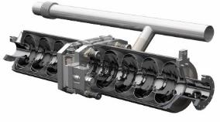
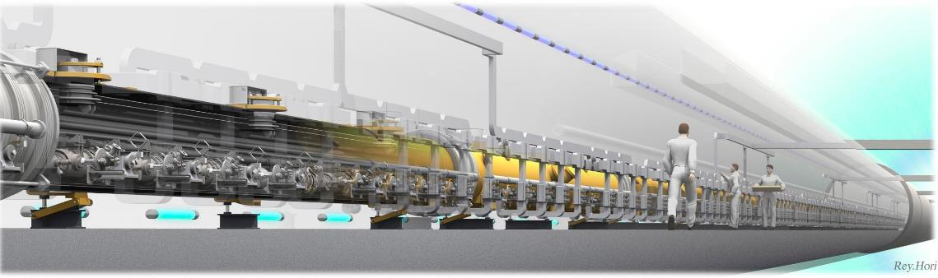
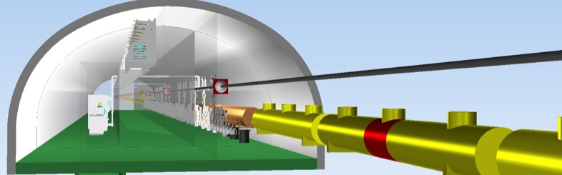
Main Linac at the ILC
# of SRF cavities ~8,000
~900 cyomodules
12 m
1 m
Tunnel
RF Distribution
RTML
Cryomodules
RF Power Source

Slide 4
Technical Maturity
ILC based on superconducting radiofrequency (SRF) technology started its R&D from 2005 (GDE). Reference Design Report (RDR) was published in 2007 and TDR was published in 2013.
More than 2,400 researchers contributed to the TDR.
The SRF technology’s maturity was proven by the operation of the European X-ray Free Electron Laser (X-FEL) in Hamburg, where 800 superconducting cavities (1/10 of ILC SRF cavities) were installed.
In addition to European XFEL, LCLS-II at SLAC, SHINE in Shanghai are under construction.
Nano-beam technology has been demonstrated at ATF hosted in KEK under international collaboration and almost satisfied the requirements of the ILC.
Remaining technical preparation (such as mass-production of SRF cavities, positron source, beam dump) can be carried out during the preparation phase at Pre-lab before ILC construction. These are listed in “Recommendations on ILC Project Implementation” [3].

Slide 5
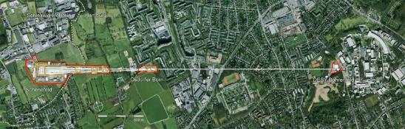


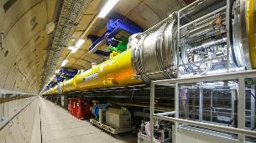
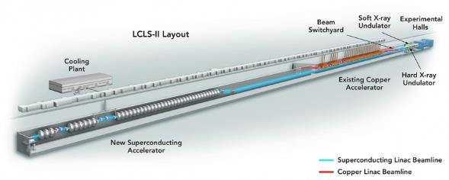
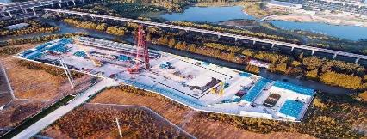
Worldwide large scale SRF accelerators
International Linear Collider (ILC) (Plan)
Euro-XFEL
Operation started from 2017
LCLS-II + HE (under construction)
-100 cyromodules
-800 cavities
-17.5 GeV (Pulsed)
© Rey.Hori/KEK
ILC
-35 + 20 cyromodules
-280 + 160 cavities
- 4 + 4 GeV (CW)
DESY
-900 cyromodules
-8,000 cavities
-250 GeV (Pulsed)
LAL/Sacray
SLAC
Cornell
INFN
LCLS-II
FNAL
KEK
JLab
SINAP
SHINE (under construction)
-75 cyromodules
-~600 cavities
- 8 GeV (CW)
1.3GHz 9 cell cavity

Slide 6
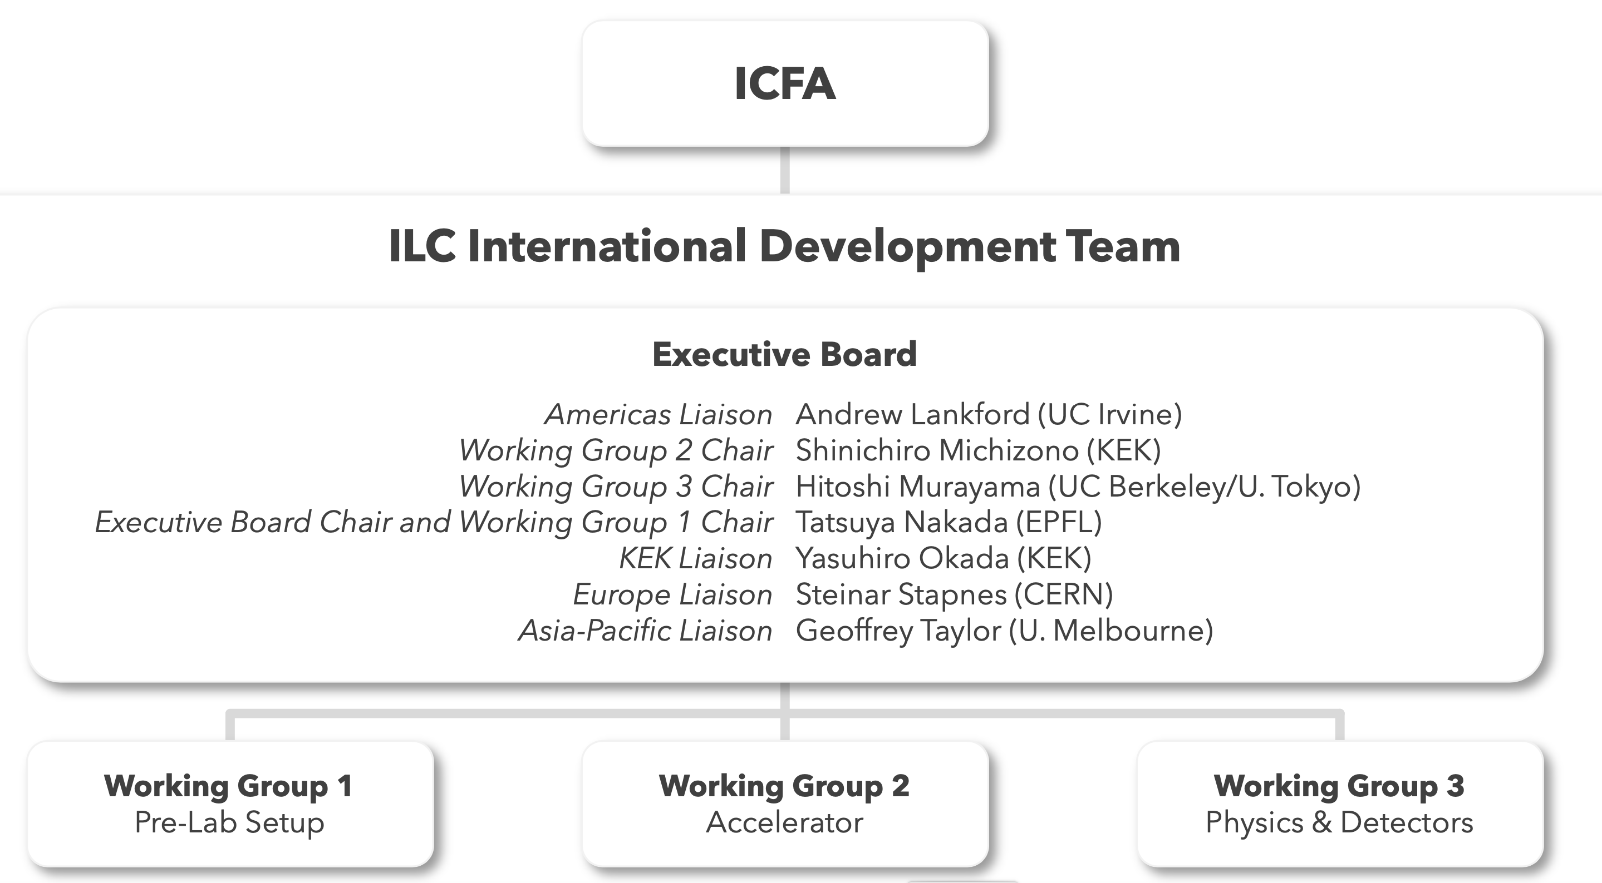
International Development Team (IDT)
IDT: Smooth transition to the ILC Pre-lab
Prepare a proposal for the organization and governance of the ILC Pre-Lab
Prepare the work and deliverables of the ILC Pre-laboratory and workout a scenario for contributions with national and regional partners
Accelerator activities at ILC Pre-lab phase
Technical preparations /performance & cost R&D [shared across regions]
Final technical design and documentation [central project office in Japan with the help of regional project offices (satellites) ]
Preparation and planning of deliverables [distributed across regions, liaising with the central project office and/or its satellites]
CE, local infrastructure and site [host country assisted by selected partners]

Slide 7
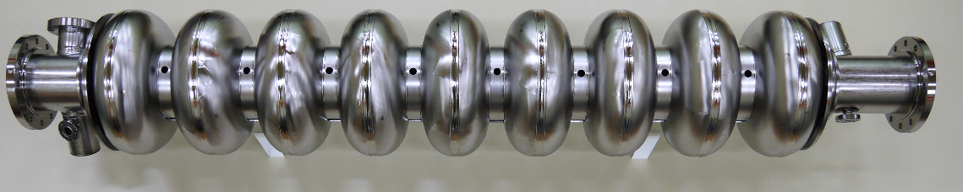
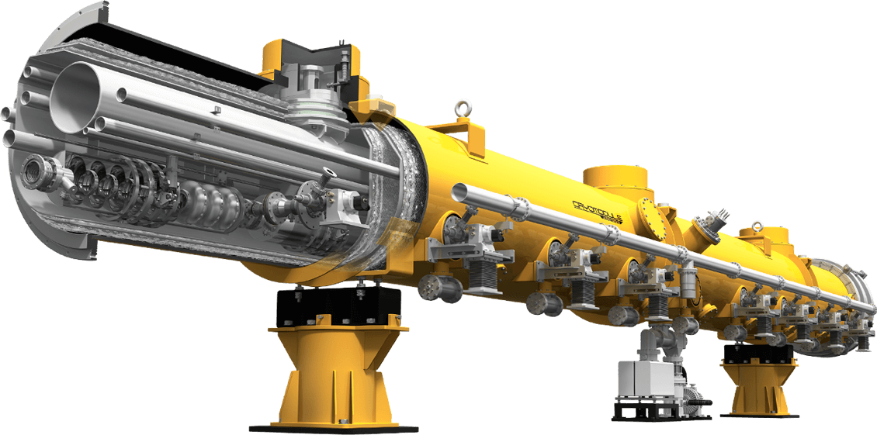
Technical preparation of SRF
ILC spec. should be satisfied!
Mass production
  Cavity production by cost effective method
    Japan: 50 cavities, Others: 50 cavities
  Ancillaries production (power coupler, tuner, HOM antenna, etc.)
  Cryomodule production (Prototype, Type A, Type B)
CM transportation
  After marine transportation, CM test is done in Japan (maybe in others)
  After CM test, CM may return to home country
Remarks:
Necessary cost should be considered based on TDR.
Another important point is whether new technology can be (or prospectively) reliable.
In case of Japan;
Construction of hub-laboratory for mass production
Demonstration of beam acceleration satisfied with ILC spec.

Slide 8
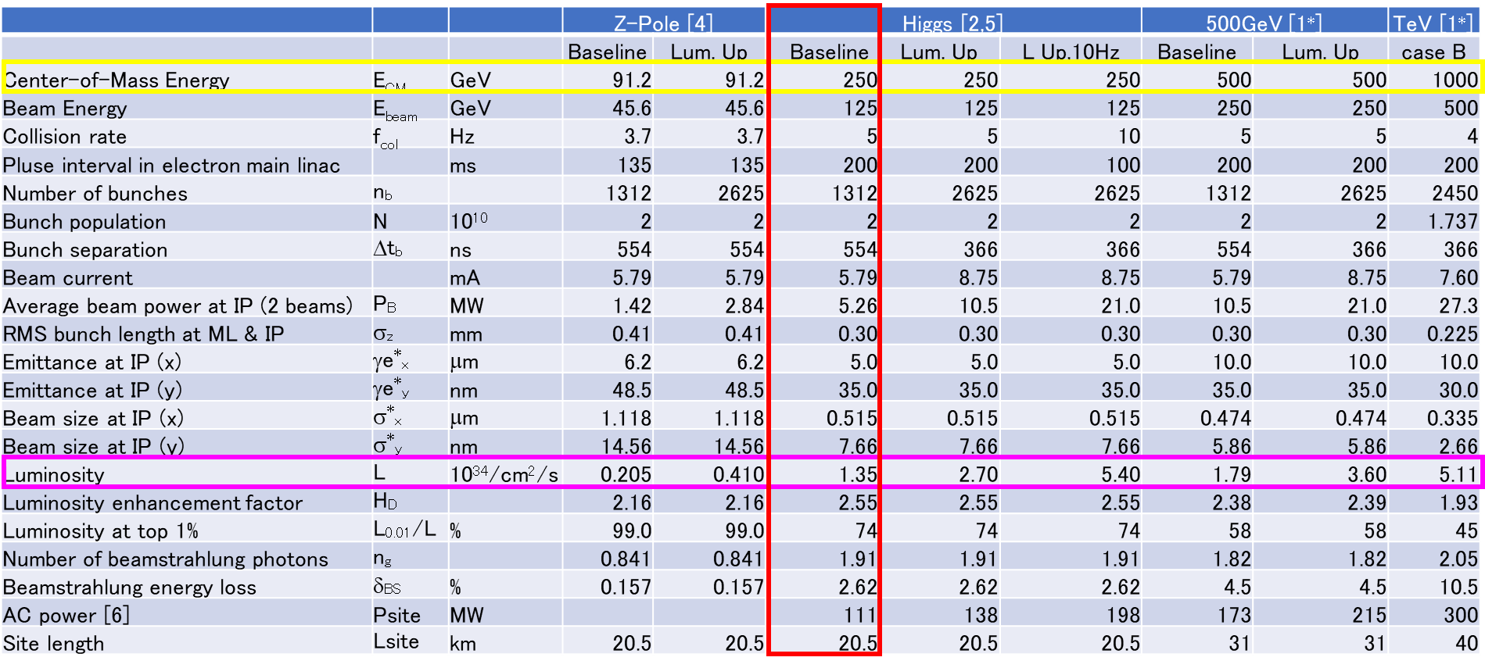
Potential for upgrades
The ILC can be upgraded to higher energy and luminosity.
Energy
Lumi.

Slide 9
Summary
ILC250 accelerator is 20 km long e-/e+ collider for the Higgs factory.
The ILC is upgradable in energy and luminosity.
International collaborations (GDE, LCC and IDT(International Development Team from summer 2020)) have been leading the R&Ds of the ILC since 2005.
TDR was published in 2013 and these technologies are matured.
Key technologies at the ILC are superconducting rf (SRF) and nano-beam.
  SRF technology has been widely adopted at XFELs such as European XFEL.
  Nano-beam technology has been demonstrated at ATF hosted by KEK
Construction cost (value) is ~5 B$ and we assume 4-year preparation and 9-year construction.
Preparation phase activities are
  Technical preparation
  Final engineering design
  Preparation for mass production, …

Slide 10
Backup slide

Slide 11
Superconducting RF ( SCRF )
Technical Preparation of SCRF
Technical concern pointed out by SCJ and MEXT’s advisory panel
Mass production : New production method (cost reduction) and the yields
Cryomodule transport.
Technical preparation at preparation phase
International collaboration
- Performance test of cost reduction and mass production preparation
- Transport of the cryomodules produced by the different regions
Issue | Tasks | Cooperation candidates
Mass production | Performance / mass production technology | France, Germany, USA
Cryomodule transport | Performance assurance after transport | France, Germany, USA

Slide 12
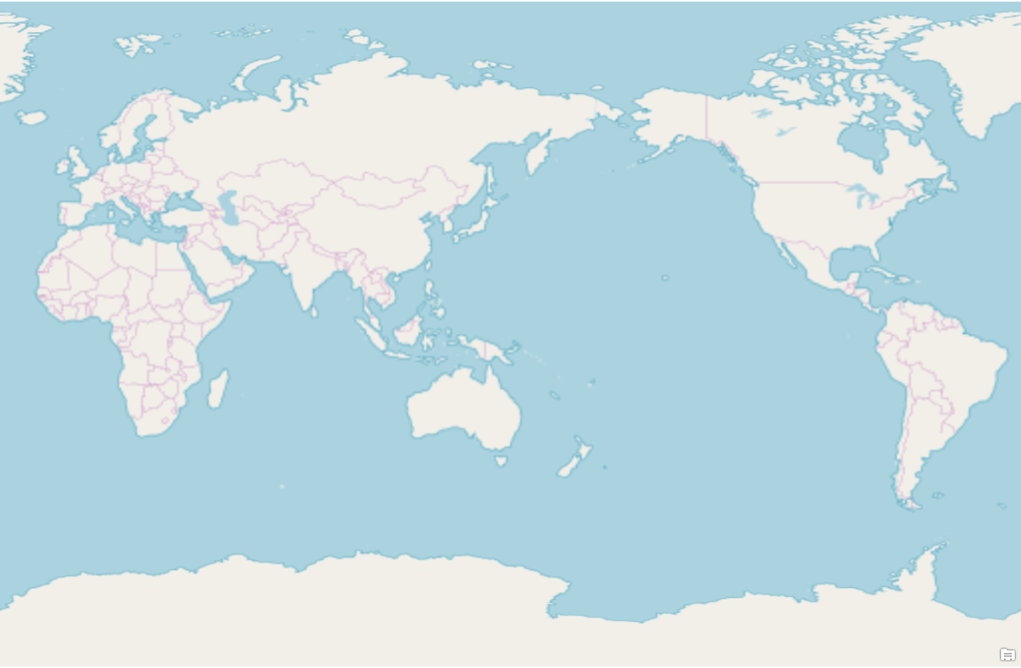
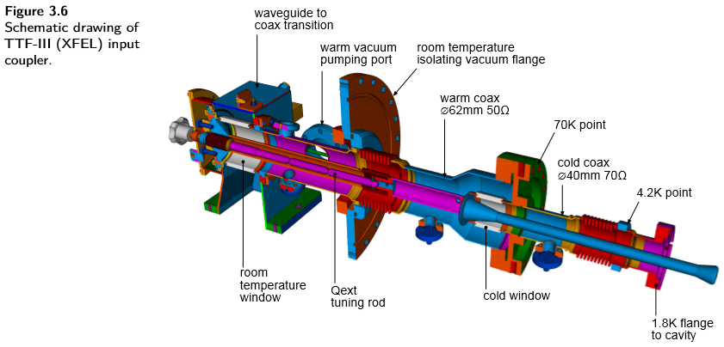
Mass production
Before mass production starts, tuner design should be fixed!!
Done by Japan-U.S. collaboration
EU
Japan
America
x ?
x ?
x 50
x ?
x ?
x >16+8
x ?
x ?
x >2+1
Which lab. is responsible for cavity, power coupler, tuner, CM, etc.?
How many cavities, couplers, CMs are produced?

Slide 13
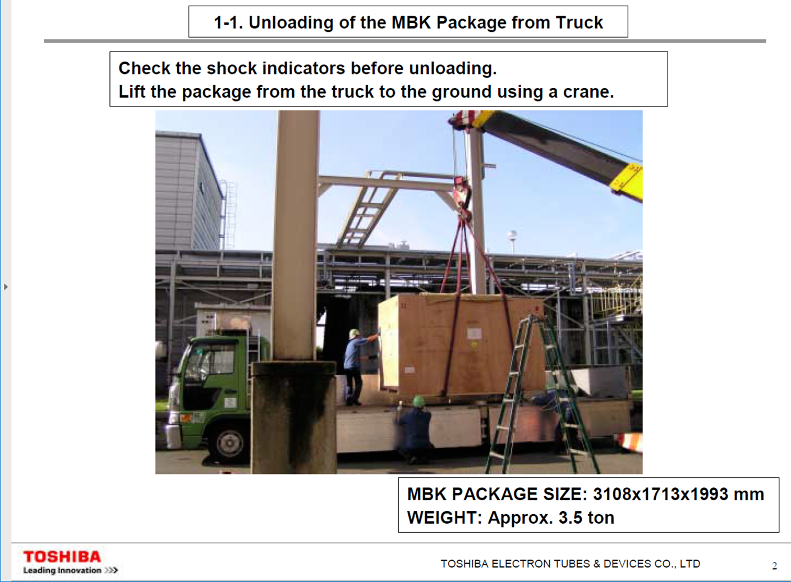
Cryomodule transportation from overseas
?
EU
Japan
America
conforming to high-pressure gas regulation
Multi-beam klystron transportation from Japan to EU
New CM production/test
@America/EU
Transportation
(Surface shipment)
CM inspection/test @Japan
Note: Returning the CMs to Europe/Americas for redundant confirmations, to be discussed.

Slide 14
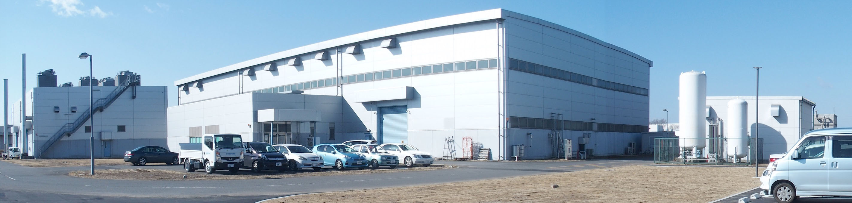
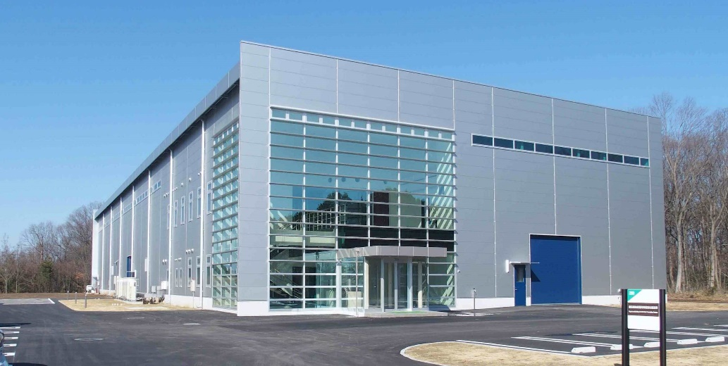
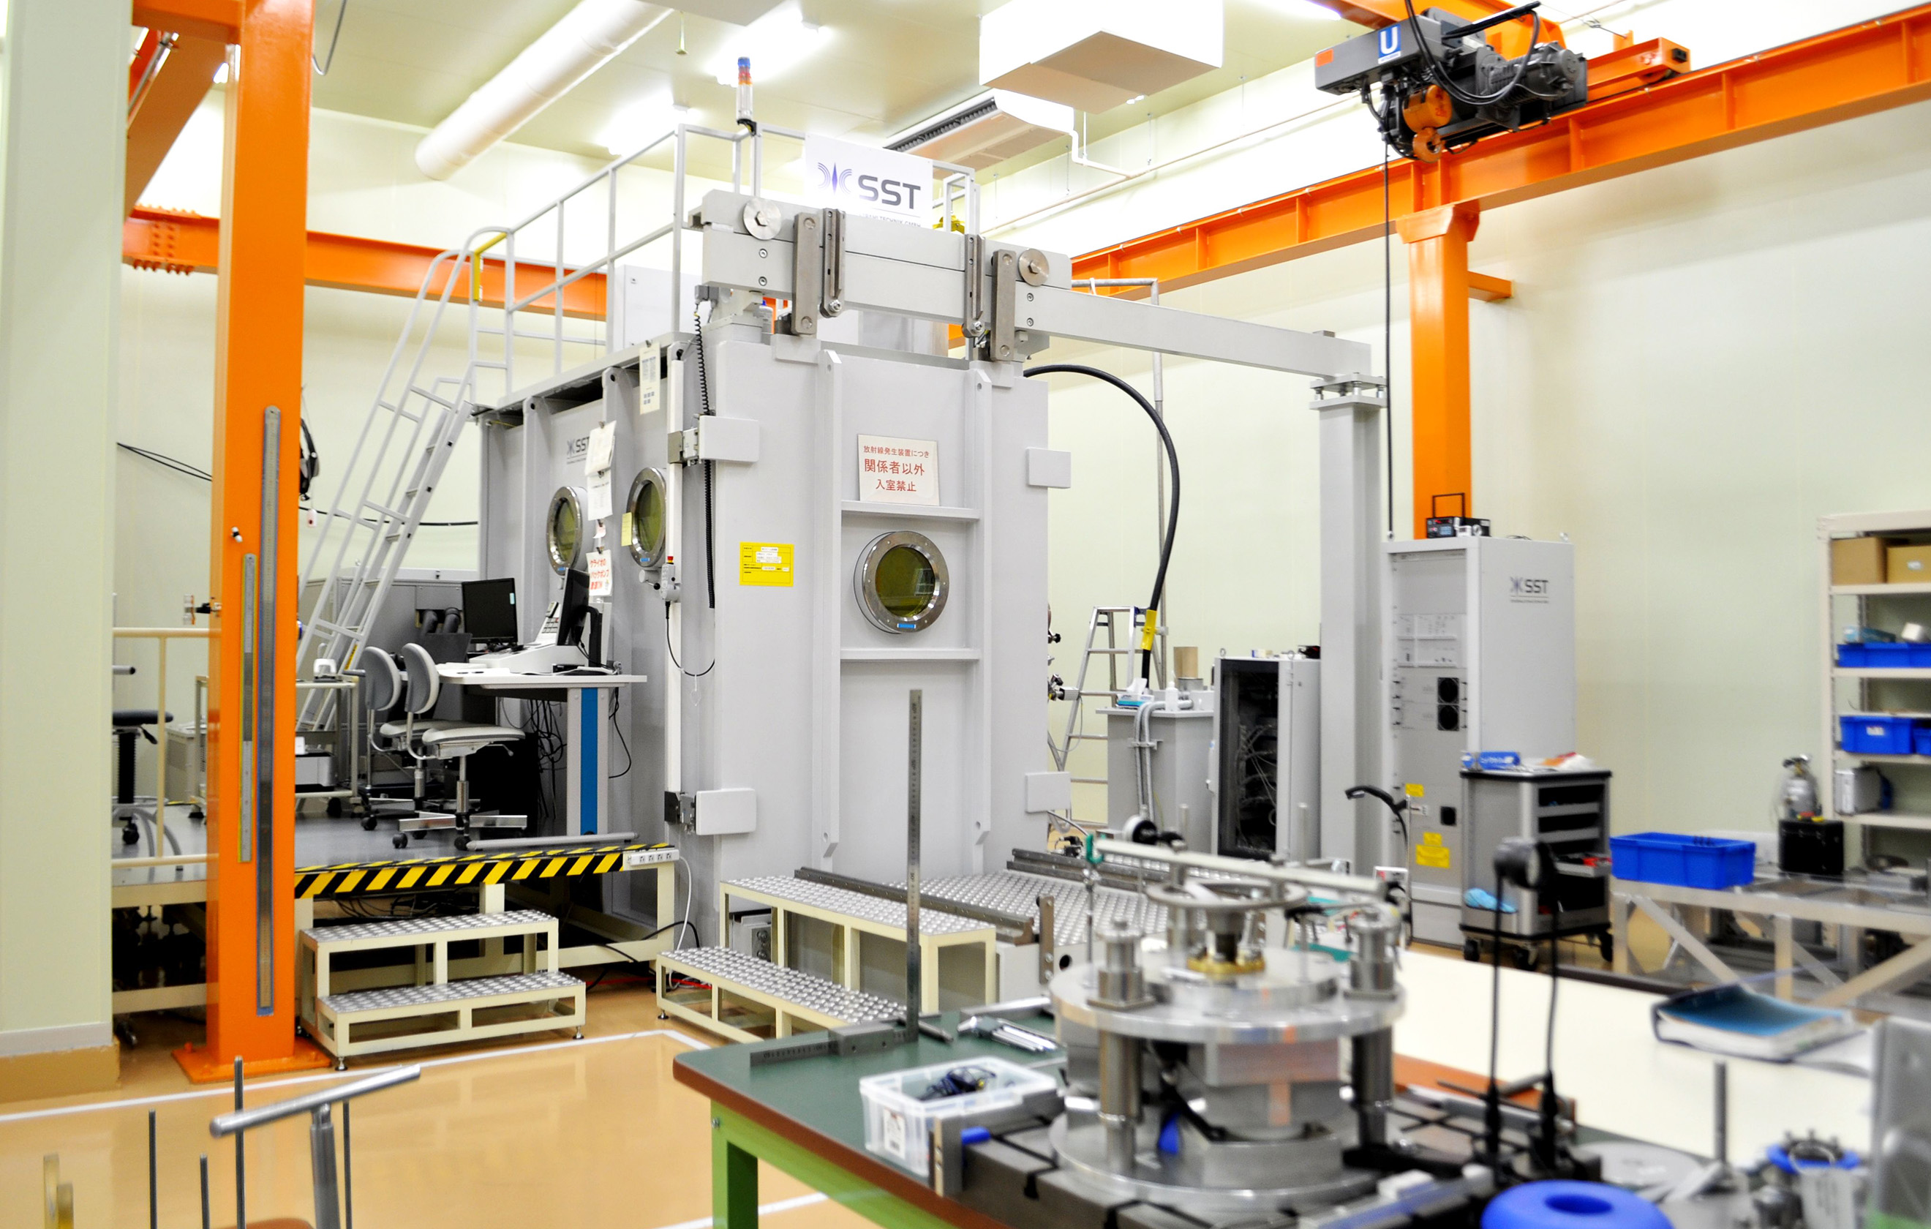
In case of Japan (KEK)…
Demonstration of beam acceleration satisfied with ILC spec.
STF
Infrastructure upgrade for hub-lab. is mandatory!
COI
CFF
Mass production of CM
Mass production of cavity

Slide 15
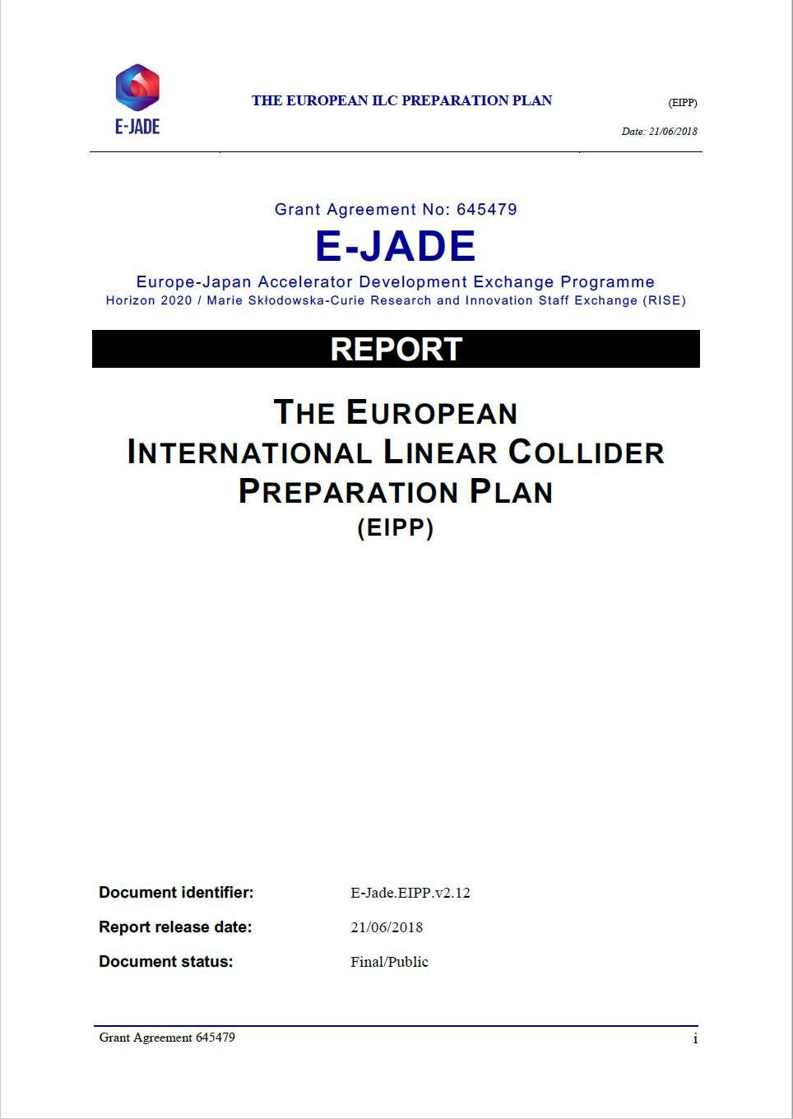
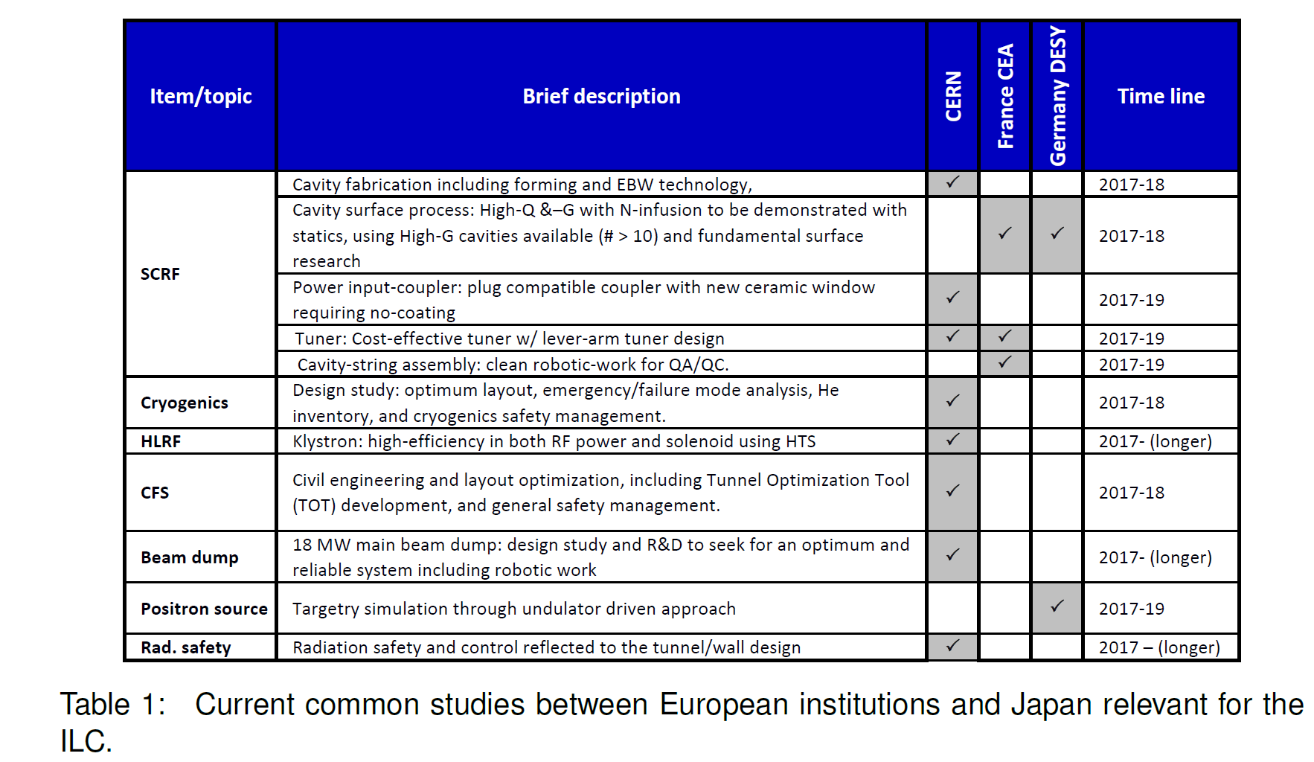
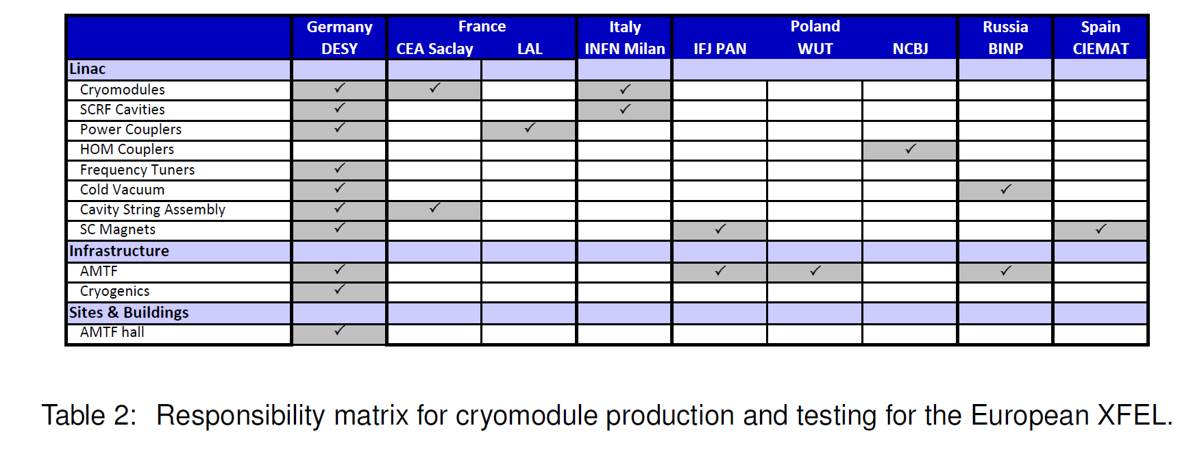
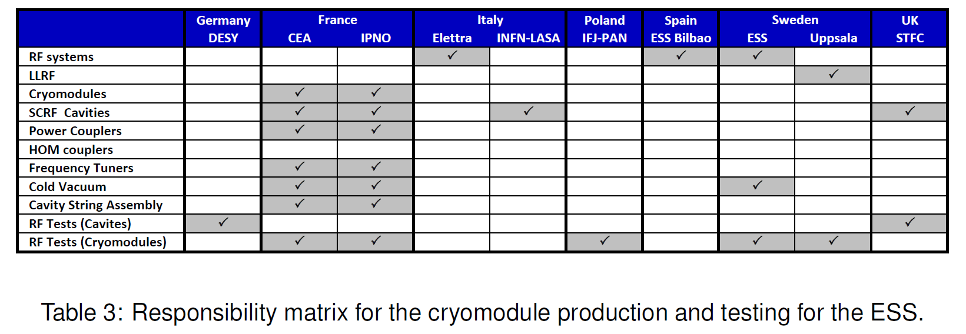
Contribution from each lab. (case of E-JADE)
SRF sub-groups need to make similar table for each region (Asia, America).
Addition to these items, some new contents need to be added to the table.
  CM transportation, automation, etc.
And, budget, human resources…
KEK starts development of automation technique

Slide 16
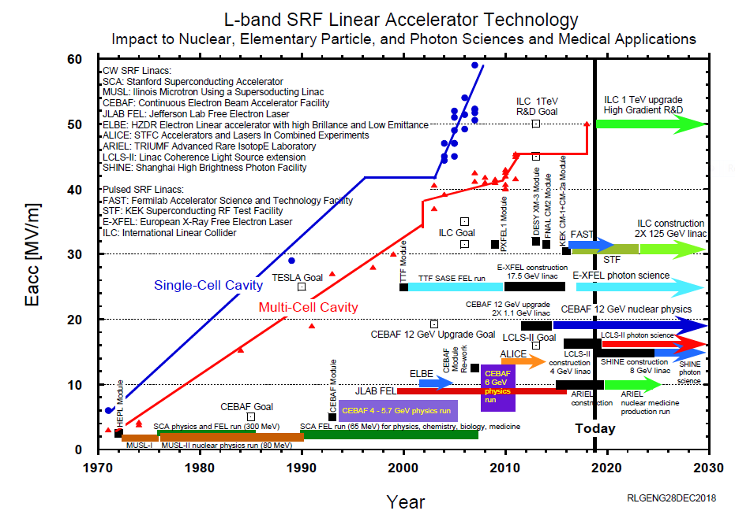


Matured SRF technologies
R. Geng (JLAB)
ILC:
Accept:35 MV/m +/-20%
Operate: 31.5MV/m +/-20%
European XFEL
800 cavities
(10% of ILC ML)

Slide 17





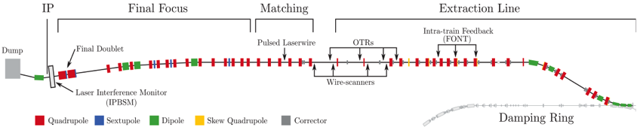
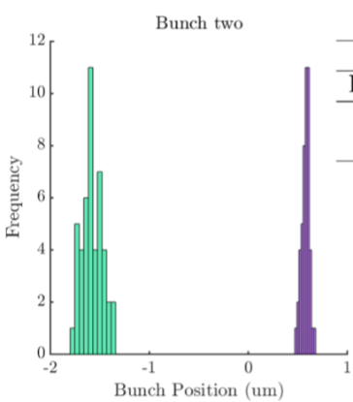
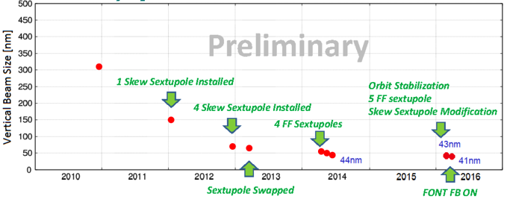
Nano-beam R&D at ATF2
Goal 1: Establish the ILC final focus method with same optics and comparable beamline tolerances
ATF2 Goal : 37 nm → ILC 7.7 nm (ILC250); achieved 41 nm (2016)
Goal 2: Develop the position stabilization for the ILC collision
FB latency 133 nsec achieved (target: < 366 nsec)
positon jitter at IP: 106 → 41 nm (2018) (limited by the BPM resolution)
Nano-meter stabilization at IP
(2018)
FB off
FB on
History of ATF2 small beam

Slide 18
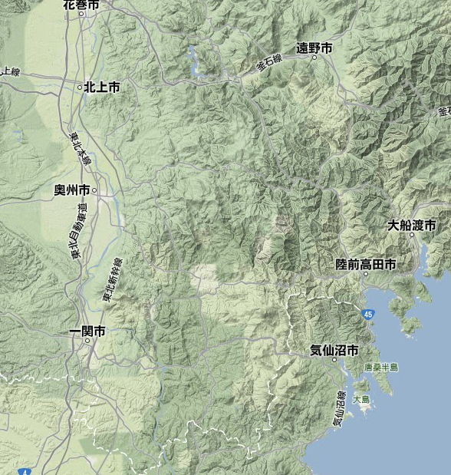
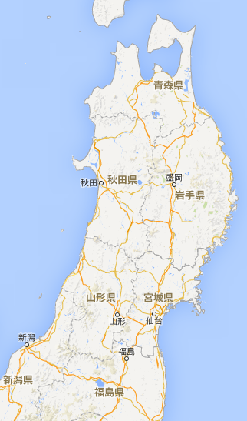
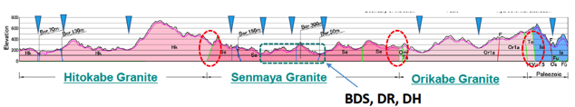
ILC Site Candidate Location in Japan: Kitakami
Preferred site selected by JHEP community,
Endorsed by LCC, in 2013
High-way
Oshu
Express-
Rail
Ofunato
Kesen-numa
Sendai
Ichinoseki
IP Region

Slide 19
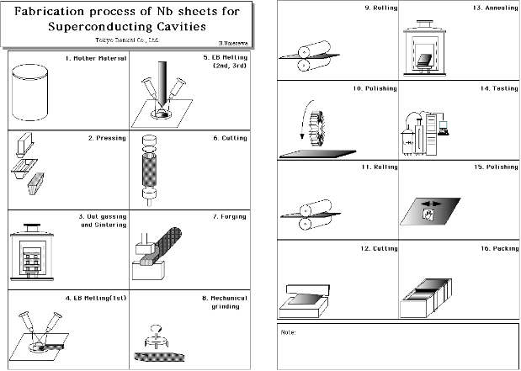

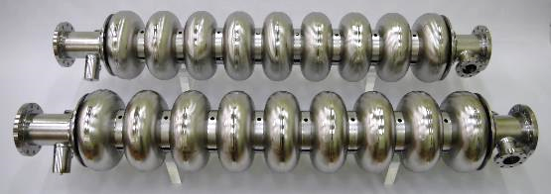

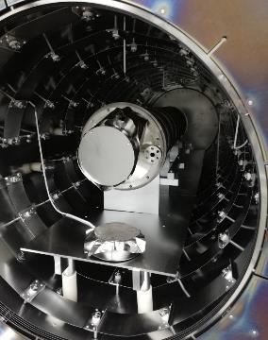
ILC Cost-Reduction R&D in US-Japan Cooperation
Based on recent advances in technologies;
  Nb material/sheet preparation
  - w/ optimum Nb purity and clean surface
  Surface treatments for high-Q and high-G
Anna Grassellino
TTC2019 Vancouver

Slide 20
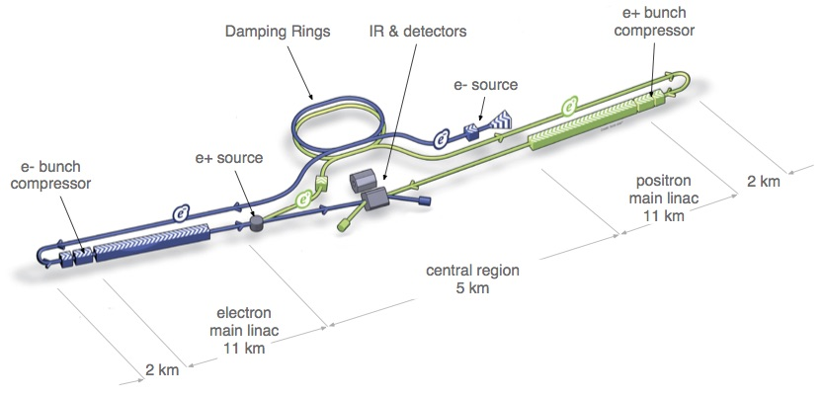
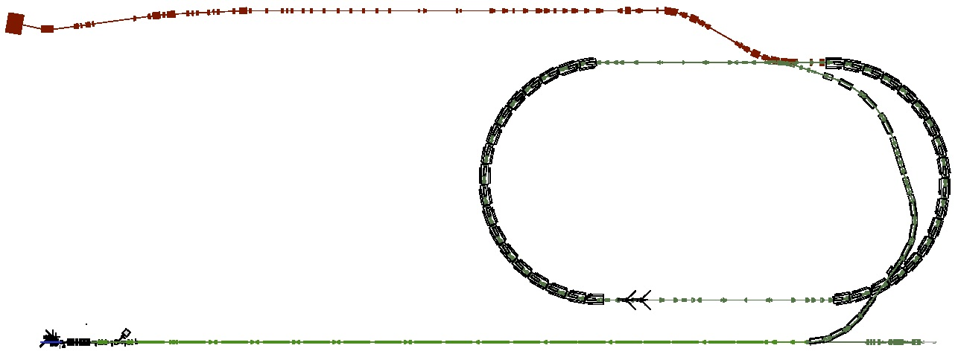
ATF/ATF2: Accelerator Test Facility
Develop the nanometer beam technologies for ILC
Key of the luminosity maintenance
7.7 nm beam at IP (ILC250)
Layout of ILC
ATF2: Final Focus Test Beamline
  Goal 1:Establish the technique for
  small beam
  Goal 2: Stabilize beam position
Damping Ring (~140m)
Low emittance electron beam
1.3 GeV S-band Electron LINAC (~70m)

