Slide 1
Advanced SRF R&D for
Higgs Factory
Luminosity (and Energy) Upgrades to 380 GeV Top Factory
Hasan Padamsee
Cornell University
Discussed in Snowmass LOI and accompanying paper:
Perspectives on International Superconducting Linear Colliers (ILC) to the Next Century Part A: High Luminosity Higgs Factory and Top Factory

Slide 2
General Remarks
Best gradient for ILC start at 250 GeV is 31.5 MV/m for Cryomodule gradients
Demonstration of CM gradients > 32 MV/m has been achieved at Fermilab with beam.
> 30.5 MV/m in full scale cryomodule at KEK
Many Cryomodules at EXFEL showed average gradient near the administrative limit of 30.5 MV/m

Slide 3
Paths for Luminosity Upgrades for ILC- Higgs
A key area of further SRF development is higher Q values with the invention of new techniques of Nitrogen Doping
Higher gradient at higher Q, with Nitrogen infusion
Higher gradient at higher Q with Cold Electropolishing /Two-Step baking
LCLS-II and LCLS-II_HE are benefitting from high Q cavities.
A new and exciting development (harder to implement, but revealing potential)
  Q = 5x10¹⁰ at 32 MV/m by baking at 300 C to dissolve the natural oxide (and other surface layer) into the bulk, but not exposing the cavity to air or water before RF measurements.

Slide 4
Luminosity Benefits from Higher Q
Q values (2x10¹⁰ at 31.5 MV/m) can lead to higher Luminosity Upgrades for ILC via higher beam power (no change in bunch charge or final spot size)
Higher Q opens the option of increasing the RF pulse length (and so the beam-on duty cycle)
Allowing the population of the RF pulse with more bunches (e.g. 2,624 instead of 1312) at the same bunch spacing in the linac as for the 250 GeV baseline
which helps to preserve emittance in the linac.
Higher Q allows increase of the repetition rate of the pulses from 5 Hz to give corresponding luminosity increase of a factor of 4 - 6.
The paper discusses the corresponding challenges for RF power, cryopower, damping rings, damping time reduction, positron source, and beam dumps for higher beam power (skip here)

Slide 5
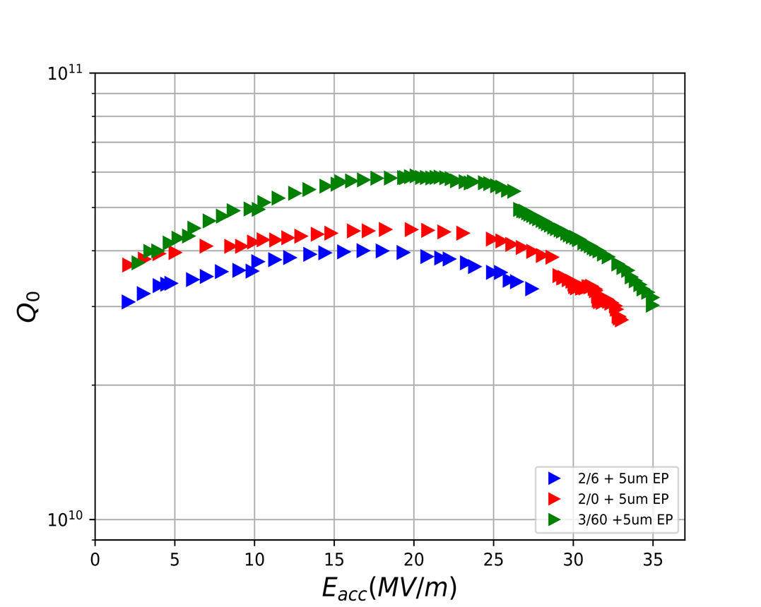
Path 1: N-Doping Recipes for LCLS-II-HE
2/0 and 3/60 Doping
1-cell Results: G near 35 MV/m, Q > 2x10¹⁰

Slide 6
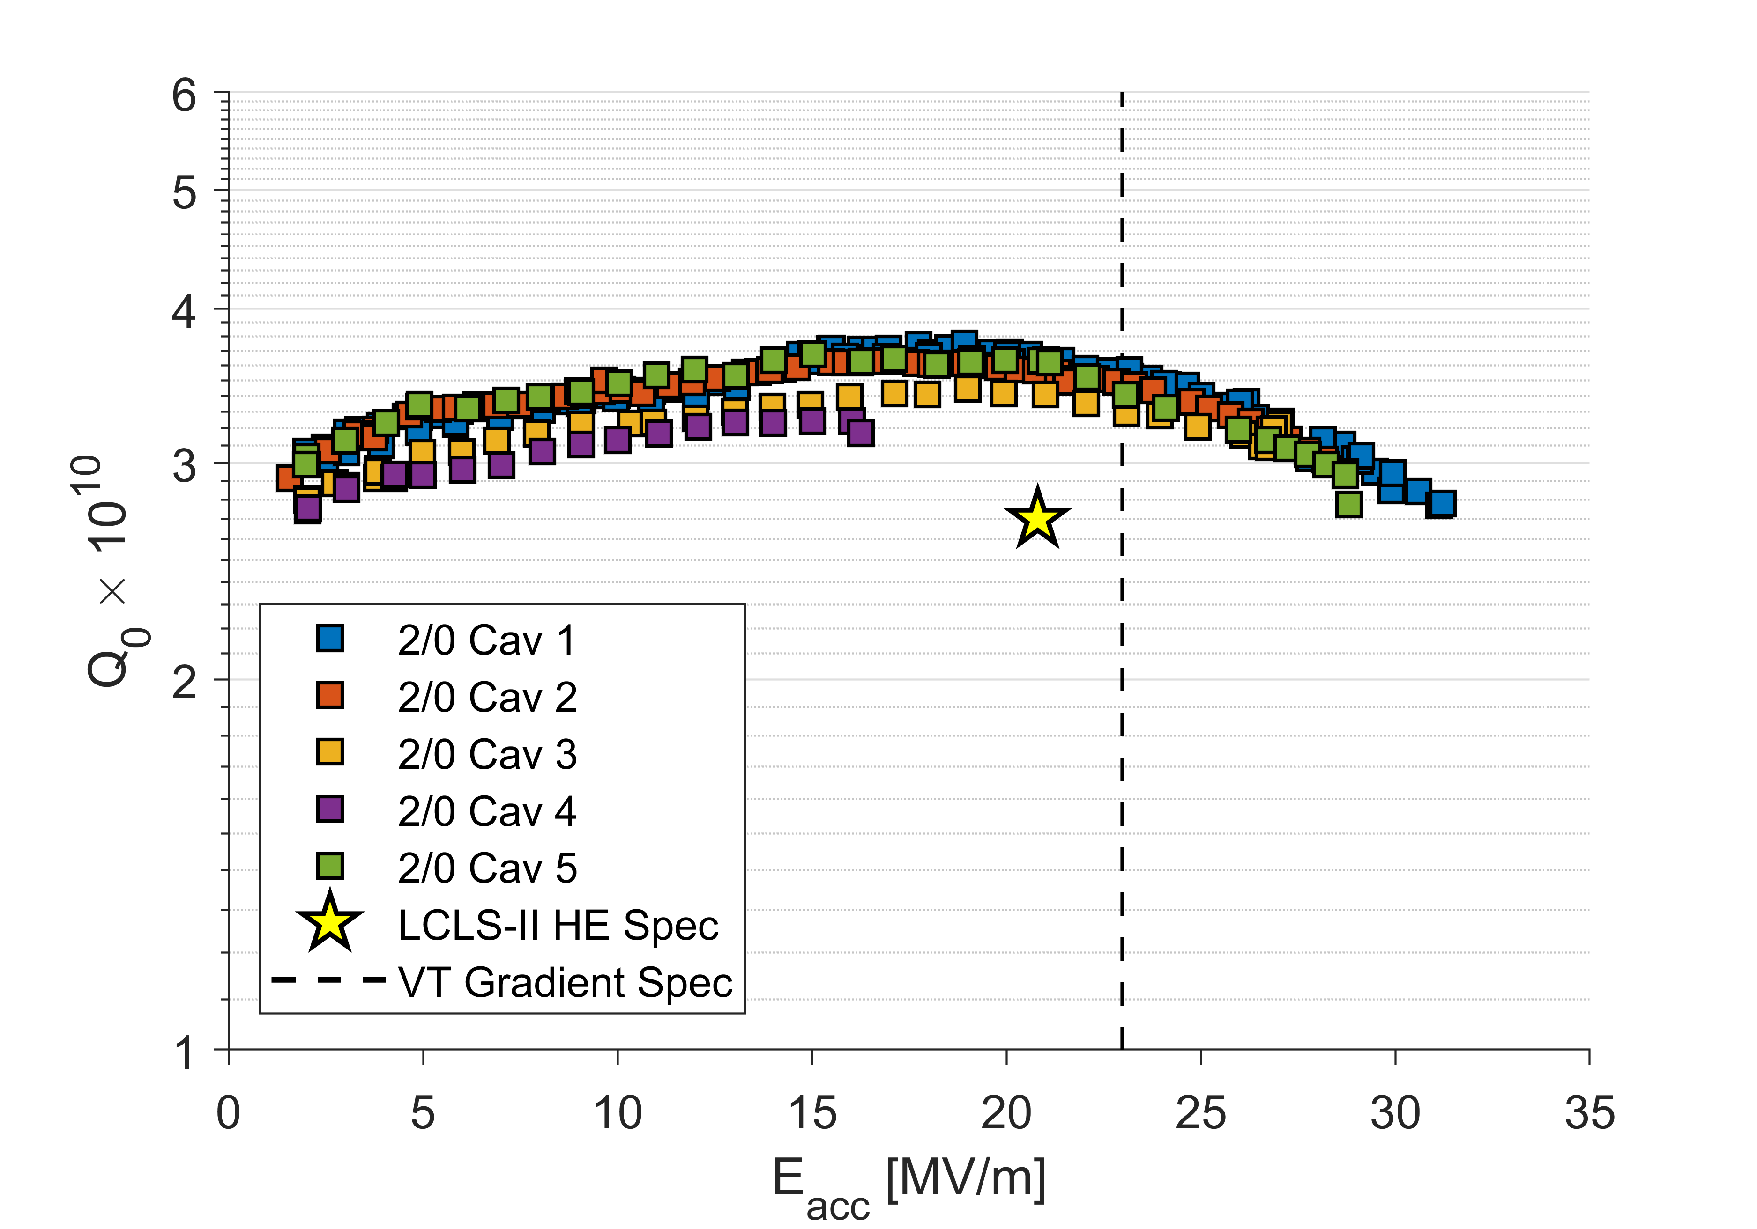
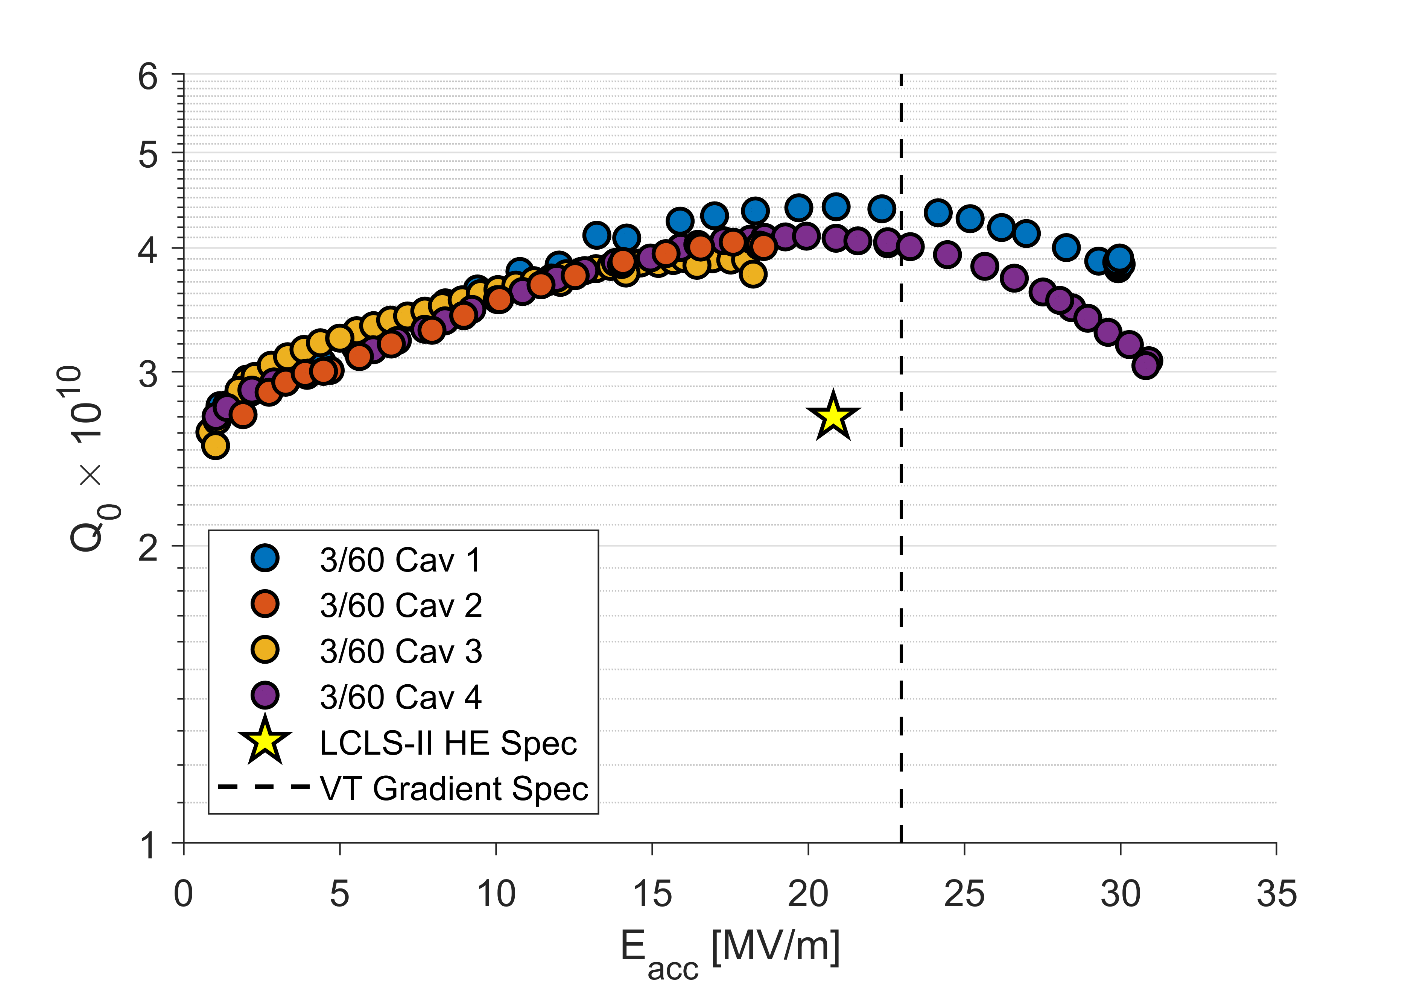
9-Cells N-Doping for LCLS-II - HE
2N0
3N60
Q₀ > 4x10¹⁰

Slide 8
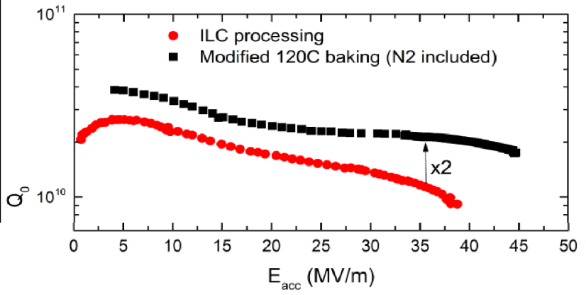
Path 2: Nitrogen Infusion (Derived from N-doping)
Q above 2×10¹⁰ is reached at 31.5 MV/m.
Challenge is that the infusion method is sensitive to furnace cleanliness - and may be difficult to implement on a wide scale.

Slide 9
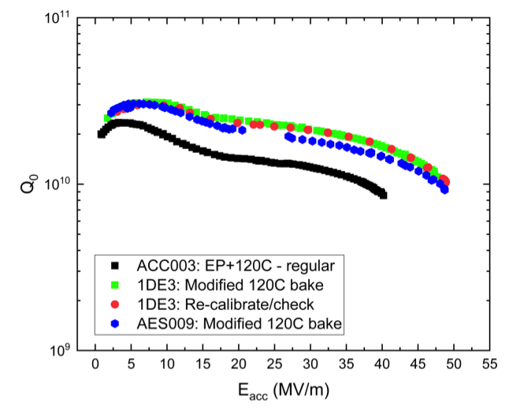
For the Top Factory energy upgrade
Additional linac to raise the energy is based on a gradient of 40 MV/m at Q = 2x10¹⁰
Path 1: Cold EP/Two-step Baking of 1-cell Cavities=> Near 50 MV/m
Cold EP/Two-step baking
Standard ILC recipe

Slide 10
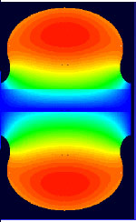
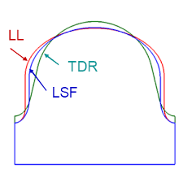
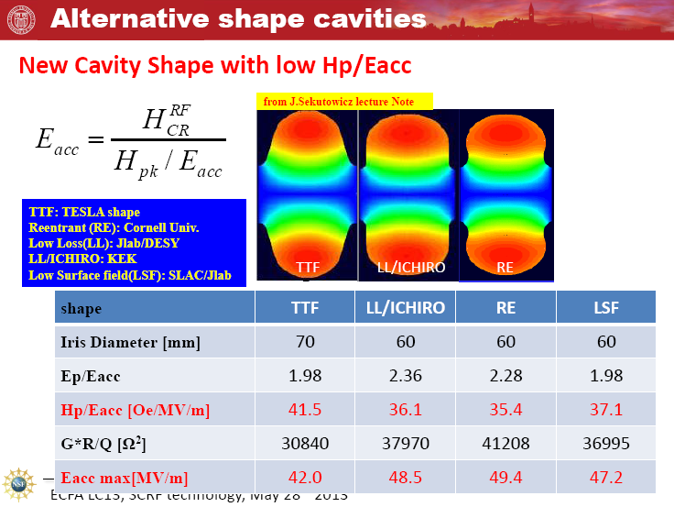
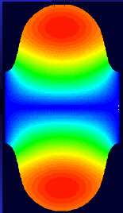
Path 2: Advanced Cavity Shapes (50 – 60 MV/m)
Re-entrant shape
60 mm aperture
H_{pk}/E_{acc} 35.4 Oe/(MV/m) and E_{pk}/E_{acc} = 2.28
Newer:
LSF Shape
SLAC/Jlab/KEK
Low-Loss/Ichiro Shape
60 mm aperture
H_{pk}/E_{acc} to 36.1 Oe/(MV/m), Epk/Eacc = 2.36
H_{pk}/E_{acc} = 37.1 Oe/(MV/m)
E_{pk}/E_{acc} = 1.98
Standard TESLA shape
60 mm aperture
H_{pk}/E_{acc} to 42 Oe/(MV/m), Epk/Eacc = 2.0

Slide 11
KEK Results
Low Loss
Ichiro
Re-entrant – 70 mm
52 MV/m
Cornell Results
Re-entrant 60 mm
59 MV/m

Slide 12
LSF Shape
50 MV/m in 3 mid-cells in the 5-cell cavity LSF5 _ JLAB/KEK
Need to improve welds

Slide 13
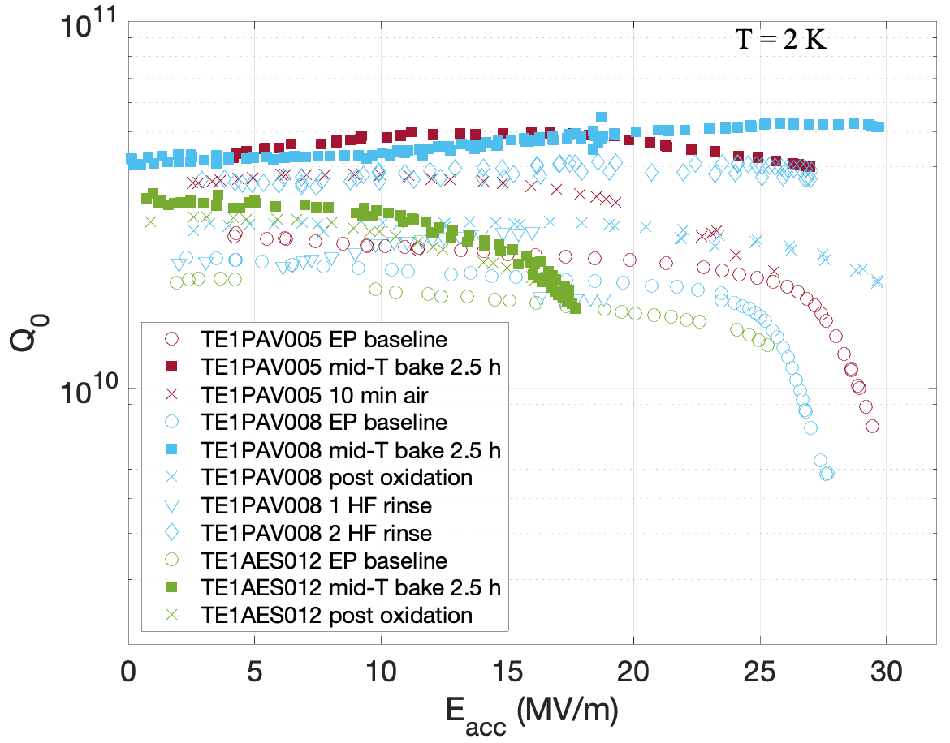
Teaser: Mid-T (300 C) Baking
=> Oxide Free Cavity
Q = 5x10¹⁰ at 30 MV/m

Slide 14
Final Remarks
R&D on high Q can lead to higher luminosities
R&D on high Gradients will lower cost of Top Factory, and subsequent energy upgrades
In later talk, I will present other paths to higher gradients for ILC energy upgrades.

