Slide 1
Accelerator and Beam Physics Grand Challenges
S. Nagaitsev (Fermilab/UChicago)
GARD ABP roadmap task force:
Z. Huang (SLAC/Stanford), J. Power (ANL), J.-L. Vay (LBNL), L. Spentzouris (IIT), J. Rosenzweig (UCLA), P. Piot (NIU)
October 6, 2020

Slide 2
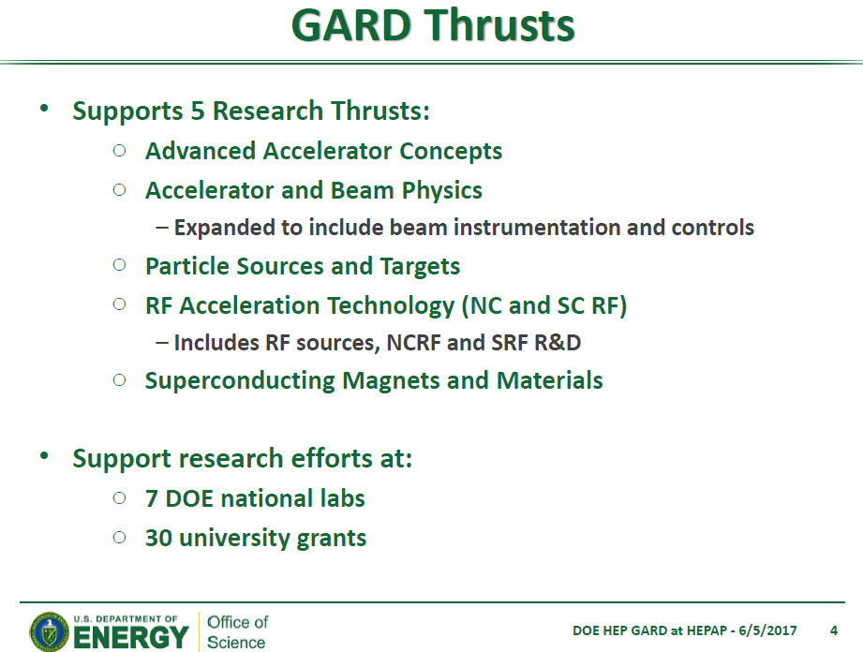
The ABP thrust supports research efforts at DOE national labs and university grants

Slide 3
Introduction
The most recent HEPAP presentation by J. Rosenzweig about GARD execution of the 2014 P5 plan:
https://science.osti.gov/hep/hepap/Meetings/201911

Slide 4
Science is a proposal-driven enterprise
We are to bring to DOE/NSF proposals for research and they respond (with guidance, requirements, and/or funding)
  Accelerator scientists (like all scientists) should be continuously proposing new ideas and experiments
  DOE GARD as a whole is to address “Technology Gaps” for HEP; ABP is supported as a small fraction of GARD.
Our research proposals should address both “Knowledge gaps” and “Technology gaps” in Accelerator and Beam Physics.

Slide 5
2014 P5 report, 2015 GARD report, other GARD road maps
https://www.usparticlephysics.org/ -- the 2014 P5 report
https://science.osti.gov/~/media/hep/hepap/pdf/Reports/Accelerator_RD_Subpanel_Report.pdf -- 2015 GARD report
https://science.osti.gov/~/media/hep/pdf/accelerator-rd-stewardship/Advanced_Accelerator_Development_Strategy_Report.pdf -- the AAC roadmap
https://science.osti.gov/~/media/hep/pdf/Reports/DOE_HEP_GARD_RF_Research_Roadmap_Report.pdf -- the RF roadmap
https://science.osti.gov/~/media/hep/pdf/Reports/MagnetDevelopmentProgramPlan.pdf -- the HF magnet roadmap
High-power targets and ABP are coming soon

Slide 6

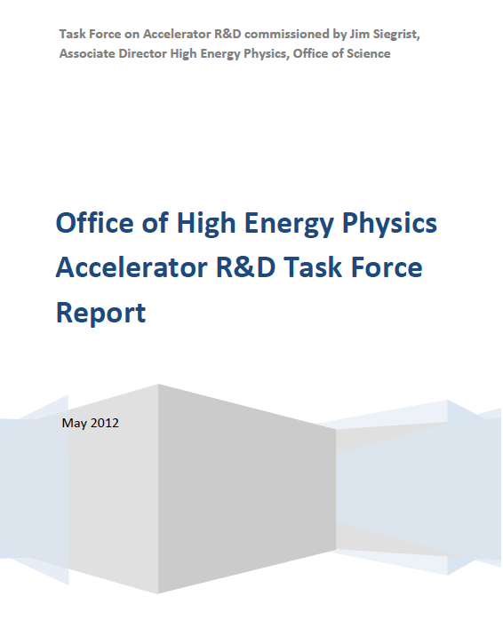
Prior to 2014
2012
~2009

Slide 7
From the 2012 report

Slide 8
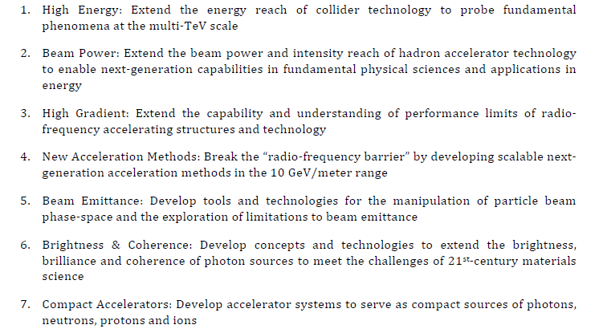
From 2012 report: the seven grand challenges

Slide 9
ABP community-driven roadmap
Working group meetings since ~Sep 2018
Two community information-gathering workshops:
  Dec 2019 at LBNL: https://conferences.lbl.gov/event/279/
  Apr – June 2020 (Zoom): https://indico.fnal.gov/event/22709/
Workshops considered:
  Single-particle dynamics, including nonlinearities, and spin dynamics.
  High-brightness beam generation, transport, manipulation and cooling.
  Mitigation and control of collective phenomena: instabilities, space charge, beam-beam, etc
  Advanced accelerator instrumentation and controls.
  Modeling and simulation tools; fundamental theory and applied math.
  Early conceptual integration and optimization, maturity evaluation
  Connections to other GARD roadmaps; synergies with non-HEP programs

Slide 10
Definitions and vision statement
Accelerator and beam physics is the science of the motion, generation, acceleration, manipulation, prediction, observation and use of charged particle beams.
The Accelerator and Beam Physics (ABP) thrust focuses on fundamental long-term accelerator and beam physics research and development.
The ABP thrust explores and develops the science of accelerators and beams to make future accelerators better, cheaper, safer, and more reliable. Particle accelerators can be used to better understand our universe and to aid in solving societal challenges.

Slide 11
GARD ABP mission statement
The primary scientific mission of the ABP thrust is to address and resolve the Accelerator and Beam Physics Grand Challenges. Other equally important ABP missions are associated with the overall DOE HEP missions:
  Advance physics of accelerators and beams to enable future accelerators.
  Develop conventional and advanced accelerator concepts and tools to disrupt existing costly technology paradigms in coordination with other GARD thrusts.
  Guide and help to fully exploit science at the GARD beam facilities and operational accelerators.
  Educate and train future accelerator physicists.

Slide 12
ABP Grand challenges
Grand challenge #1 (beam intensity): How do we increase beam intensities by orders of magnitude?
Grand challenge #2 (beam quality): How do we increase beam phase-space density by orders of magnitude, towards quantum degeneracy limit?
Grand challenge #3 (beam control): How do we control the beam distribution down to the level of individual particles?
Grand Challenge #4 (beam prediction): How do we develop predictive “virtual particle accelerators”?
Link to Grand Challenges (a more detailed description):
https://docs.google.com/document/d/11XhutaKropA9kToZhrYmCsoDf6oBunhuQ8mPgYhkJiA/edit?usp=sharing

Slide 13
ABP research opportunities
We have listed various proposed research areas and opportunities to address the four ABP grand challenges in our LOI
  https://www.snowmass21.org/docs/files/summaries/AF/SNOWMASS21-AF1_AF7_S_Nagaitsev-056.pdf
ABP research facilities are invaluable!
Education and training is an important part of ABP
Effective integration of computational and ML tools across facilities
We are here to collect you input to our ABP research road for the next 10-15 years.

