Slide 1
Higher Gradient Expectations for SRF for ILC Energy Upgrades
Hasan Padamsee, Cornell University
Snowmass breakout session 178
Tuesday, October 6
Discussed in Snowmass LOI and accompanying paper:
Perspectives on International Superconducting Linear Colliers (ILC) to the Next Century Part B: ILC Energy Upgrades to 3 TeV and Beyond

Slide 2
General Remarks
Best gradient for ILC start at 250 GeV is 31.5 MV/m
Gradient improvement prospects discussed here are generally based on new techniques under development
  with proof-of-principle results established with single cell cavities
As the next slide shows:
3+ decades of SRF R&D show that 9-cell cavity gradients follow 1-cells - with about a decade time lag
  Time lag depends on R&D funding levels
  And competition for resources to apply technology to funded accelerator projects

Slide 3
Steady Progress In Single and Multi-cell Cavity Gradients Over 3+ Decades

Slide 4
Main Promising R&D Paths
With proof-of principle results in hand
Cold Electropolishing/Two step final baking (75C/120C)
  40 – 50 MV/m - could be ready for ILC 0.38 - 0.5 TeV
Nitrogen Infusion 40 – 45 MV/m
  Derived from Nitrogen doping for high Q
  BUT Very sensitive to furnace quality, hard to implement
Advanced cavity shapes with lower peak surface magnetic fields + best surface treatment
  60 MV/m could be ready for ILC 1 - 2 TeV
  Travelling Wave structures
  80 MV/m Could be ready for 3 TeV
High Tc superconductors – Mainly Nb3Sn – 80 MV/m

Slide 5
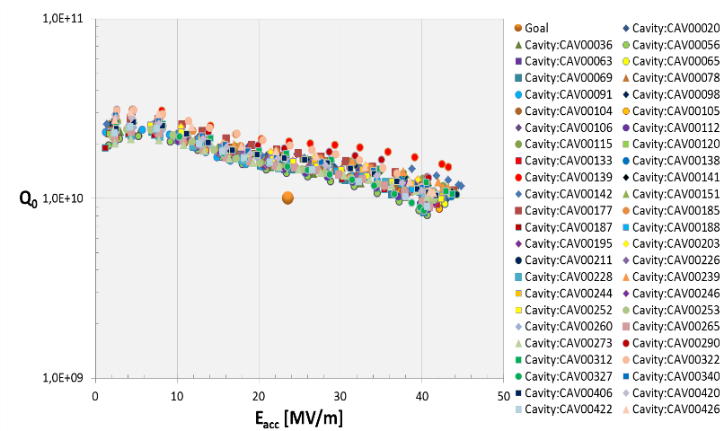
Best results for ILC Technology
9-cell test results from DESY: 40 – 45 MV/m
On > 40 cavities treated by RI with ILC Recipe

Slide 6
Large Grain Nb, 9-cells at DESY:
Best: 45 MV/m, Q = 10¹⁰

Slide 7
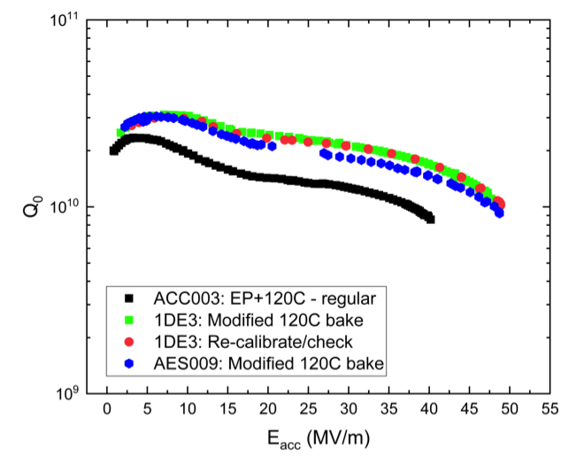
Path 1: Cold EP/Two-step Baking of 1-cell Cavities, Near 50 MV/m
Cold EP/Two-step baking
Standard ILC recipe

Slide 8
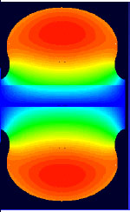
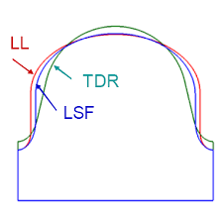
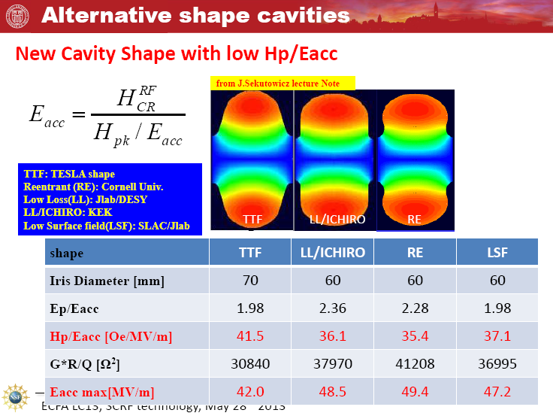
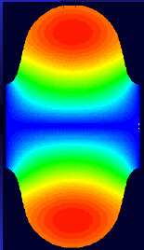
Path 2: Advanced Cavity Shapes (50 – 60 MV/m)
Re-entrant shape
60 mm aperture
H_{pk}/E_{acc} 35.4 Oe/(MV/m) and E_{pk}/E_{acc} = 2.28
Newer:
LSF Shape
SLAC/Jlab/KEK
Low-Loss/Ichiro Shape
60 mm aperture
H_{pk}/E_{acc} to 36.1 Oe/(MV/m), Epk/Eacc = 2.36
H_{pk}/E_{acc} = 37.1 Oe/(MV/m)
E_{pk}/E_{acc} = 1.98
Standard TESLA shape
60 mm aperture
H_{pk}/E_{acc} to 42 Oe/(MV/m), Epk/Eacc = 2.0

Slide 9
KEK Results
Low Loss
Ichiro
Re-entrant – 70 mm
52 MV/m
Cornell Results
Re-entrant 60 mm
59 MV/m

Slide 10
LSF Shape
50 MV/m in 3 mid-cells in the 5-cell cavity LSF5 _ JLAB/KEK
Need to improve welds

Slide 11
Path 3: N-Infusion 40 – 45 MV/m
Comparisons: N-doping (For High Q), Two-step Baking,
N-infusion, Standard ILC Recipe (EP and 120 C Baking), & EP/No baking.
N-Infusion needs very clean furnace
May be harder to reproduce

Slide 12
Path 4: Travelling Wave Structures (80 MV/m?)
The Travelling Wave structure avoids high peak surface fields of Standing Wave structure.
Travelling Wave (TW) structures have been studied at Fermilab in collaboration with companies
Requires a feedback waveguide for redirecting power to the front end of accelerating structure.
First 3-cell model using TESLA shape has Hpk reduction of 25%
Reached 26 MV/m with inferior (easier) treatment of BCP. Should do better with EP/baking

Slide 13
Goal: Develop Better TW structure to Reach 80MV/m!
Modelling studies are under way for further reducing Hpk by
Introducing Low Loss shape (18%)
Reduced aperture ( 20%)
To shoot for overall 60% reduction in magnetic field over the SW TESLA shape

Slide 14
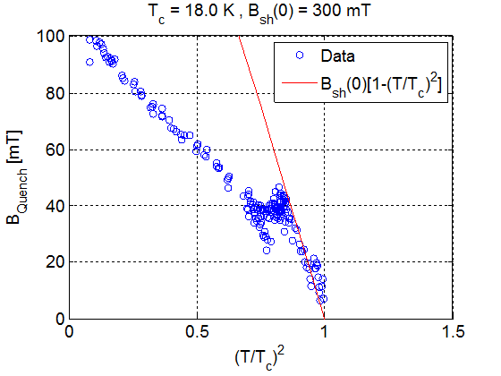
Path 5: Nb3Sn
High Power Pulsed Measurements to Avoid Thermal Quench
Best Nb3Sn result to date
CW Results limited by thermal quench.
Extrapolates to > 80 MV/m for advanced shape structures
23 MV/m

Slide 15
Main Promising R&D Paths
With proof-of principle results in hand
Cold Electropolishing/Two step final baking (75C/120C)
  40 – 50 MV/m - could be ready for ILC 0.38 - 0.5 TeV
Nitrogen Infusion 40 – 45 MV/m
  Derived from Nitrogen doping for high Q
  BUT Very sensitive to furnace quality, hard to implement
Advanced cavity shapes with lower peak surface magnetic fields + best surface treatment
  60 MV/m could be ready for ILC 1 - 2 TeV
  Travelling Wave structures
  80 MV/m Could be ready for 3 TeV
High Tc superconductors – Mainly Nb3Sn – 80 MV/m

