Slide 1
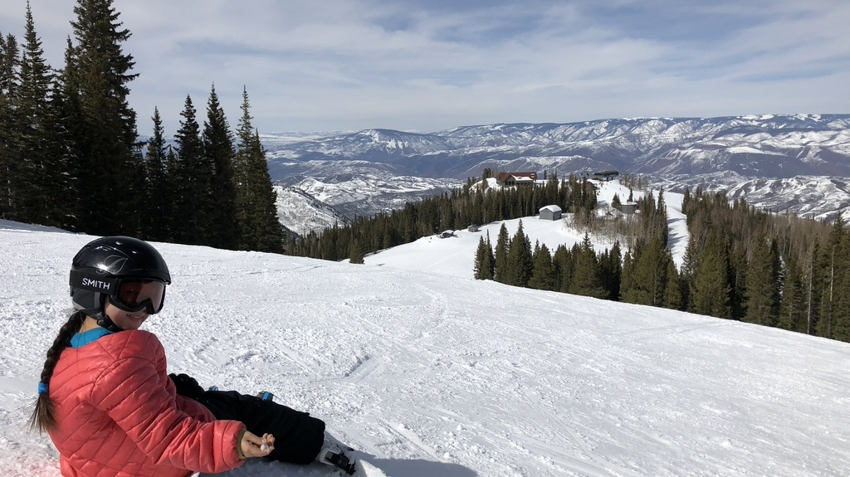
Cosmic Frontier Introduction
Snowmass CPM Session #3
Aaron Chou, Marcelle Soares-Santos, Tim Tait (CF conveners)
October 6, 2020

Slide 2


What is Snowmass?
Snowmass is a community science study organized by the Division of Particles and Fields of the American Physical Society to “assess the future of elementary particle physics, to explore the limits of our technological capabilities, and to consider the nature of future major facilities for particle physics in the U.S.”
For many (all?) of you, the goal should be to build a community consensus that your science topic is interesting, worthwhile, and timely. Talk with people, not at them, and take the time to listen. These are your future collaborators.

Slide 3
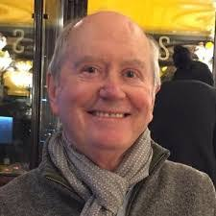
“How to Snowmass” by Chris Quigg
The goals of Snowmass—and the outcomes—are defined by individual participants, led by the organizers
Broaden our horizons—to look beyond our current research problems, our collaborations, our institutions, and to learn from others about their ideas, institutions, and scientific styles.
Advocate for your own projects, but also engage with initiatives other than your own and bring to them a fresh perspective.
https://indico.fnal.gov/event/45207/attachments/133652/164937/How_to_Snowmass-final-links.pdf

Slide 4
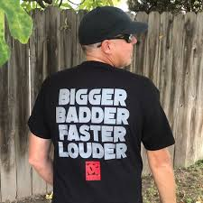


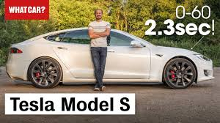
There are many viable strategies for the next decade of experiments

Slide 5
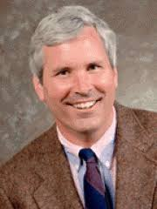
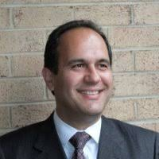
DOE / NSF perspectives from yesterday
Jim Siegrist (DOE):
  Bickering scientists get nothing.
  Let 1000 flowers bloom!
  Particular need for $30-100M scale projects
  Use imagination – partner with NASA for moon-based experiments?
  Cover as much dark matter parameter space as possible.
Saul Gonzales (NSF):
  Program will be aligned to community-driven needs, agency goals, national priorities
  Various answers on DOE-NSF collaboration: Agency will follow the science priorities of the community when considering new initiatives
Don’t feel constrained by programmatic aspects of the agencies – these will change (slowly) in response to community science priorities. We are the stakeholders!

Slide 6

By tradition, most of the Snowmass study happens prior to the CSS meeting in July, 2021
Engage with CF topical groups via Slack, ongoing telecons, workshops
Prepare white papers as references for final Snowmass report. This does not replace item #1 above.
Logistics discussion at Wednesday afternoon CF meeting

Slide 7

What to do at this CPM meeting?
Engage with others within Cosmic Frontier
  Topical groups have been mostly organized by science specifically to focus the discussions on science topics
Engage with others in other frontiers
  Cross-frontier breakout sessions have been mostly organized by science topics
  Free exchange of ideas across sub-communities is vital to prepare a unified community report.
Attend sessions relevant to you and see what they are doing.
Figure out what are the next steps to accomplish your goals
  Ask us and topical group conveners if unclear

Slide 8
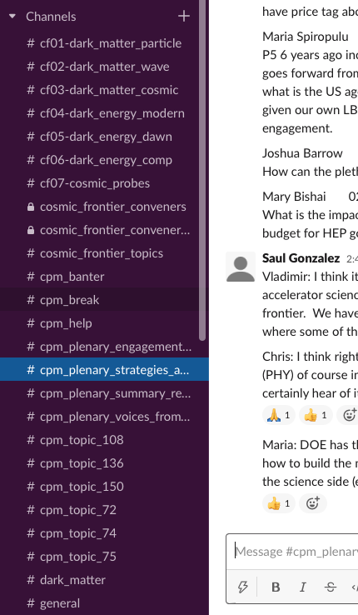
Most Snowmass communications are done via Slack
Sign up instructions at bottom of https://snowmass21.org
Topical group discussions
Science topic discussions
CPM questions/answers and spontaneous breakout sessions

Slide 9
Cosmic Frontier topical groups
CF1. Dark Matter: Particle-like
  Jodi Cooley (SMU), Tongyan Lin (UCSD), Hugh Lippincott (UCSB), and Tracy Slatyer (MIT)
  #cf01-dark_matter_particle
CF2. Dark Matter: Wave-like
  Joerg Jaeckel (Heidelberg), Gray Rybka (UW), Lindley Winslow (MIT)
  #cf02-dark_matter_wave
CF3. Dark Matter: Cosmic Probes
  Alex Drlica-Wagner (Fermilab), Chanda Prescod-Weinstein (UNH), Haibo Yu (UCR)
  #cf03-dark_matter_cosmic
CF4. Dark Energy and Cosmic Acceleration: The Modern Universe
  Jeffrey Newman (Pittsburgh), Masao Sako (Penn), Anže Slosar (BNL)
  #cf04-dark_energy_modern
CF5: Dark Energy and Cosmic Acceleration: Cosmic Dawn and Before
  Clarence Chang (ANL), Laura Newburgh (Yale), Deirdre Shoemaker (Georgia Tech)
  #cf05-dark_energy_dawn
CF6. Dark Energy and Cosmic Acceleration: Complementarity of Probes and New Facilities
  Chihway Chang (Chicago), Brenna Flaugher (Fermilab), David Schlegel (LBNL)
  #cf06-dark_energy_comp
CF7. Cosmic Probes of Fundamental Physics
  Rana Adhikari (Caltech), Luis Anchordoqui (CUNY), Ke Fang (UW-Madison), B.S. Sathyaprakash (Penn State), Kirsten Tollefson (MSU)
  #cf07-cosmic_probes
https://snowmass21.org/cosmic/start

Slide 10
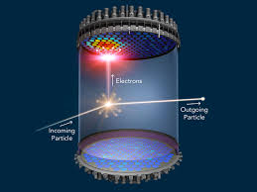
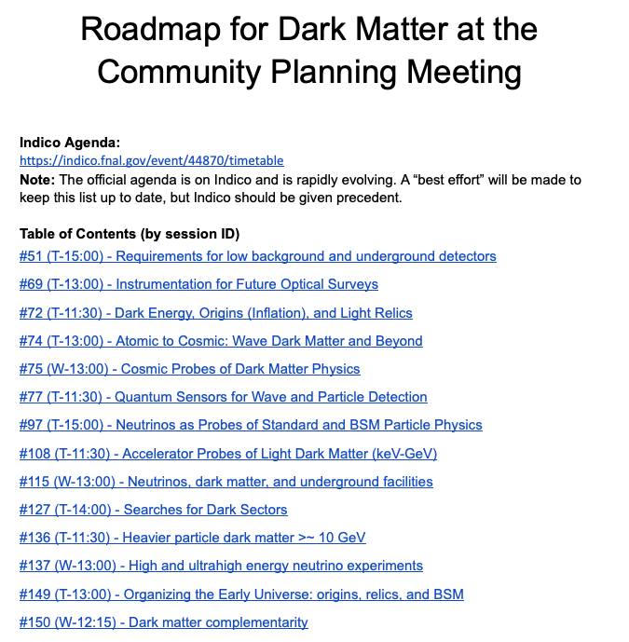
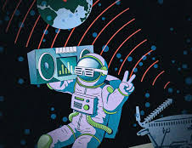
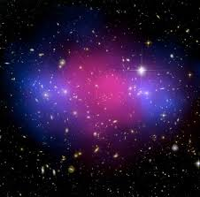

Slide 11
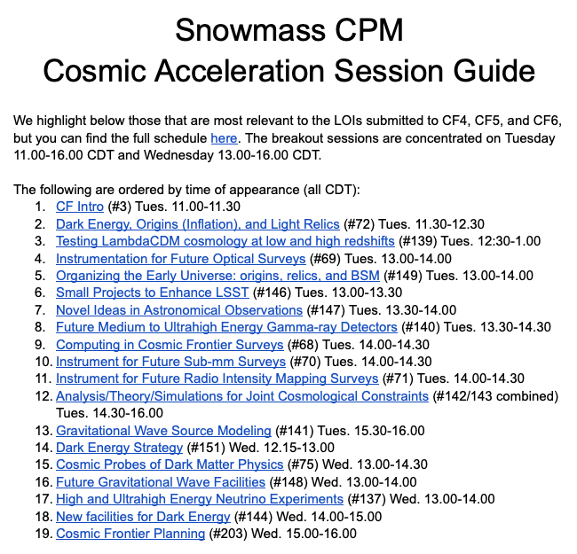
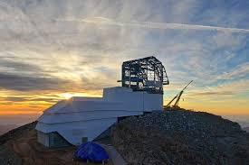
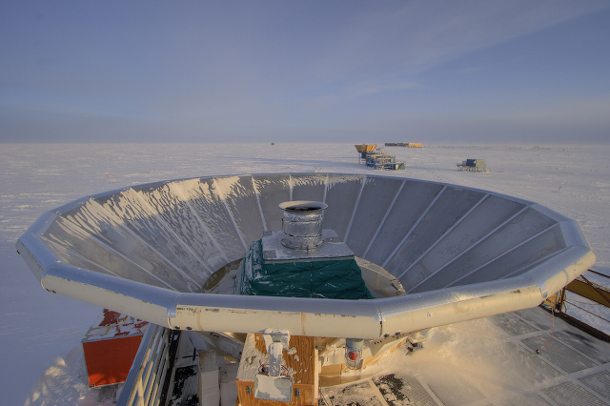
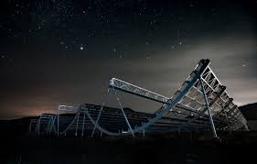

Slide 12
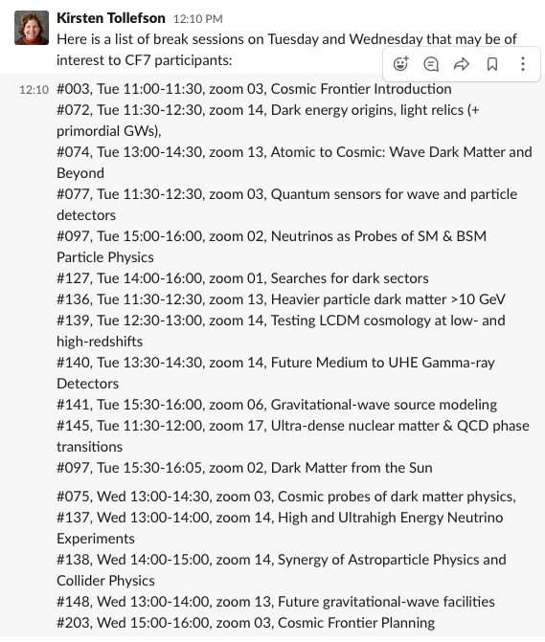
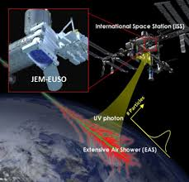
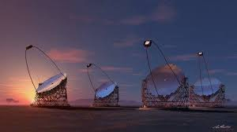
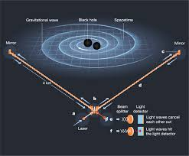
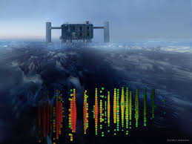
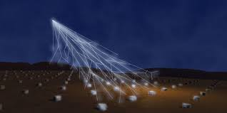
Cosmic Probes of Fundamental Physics Session Guide

Slide 13
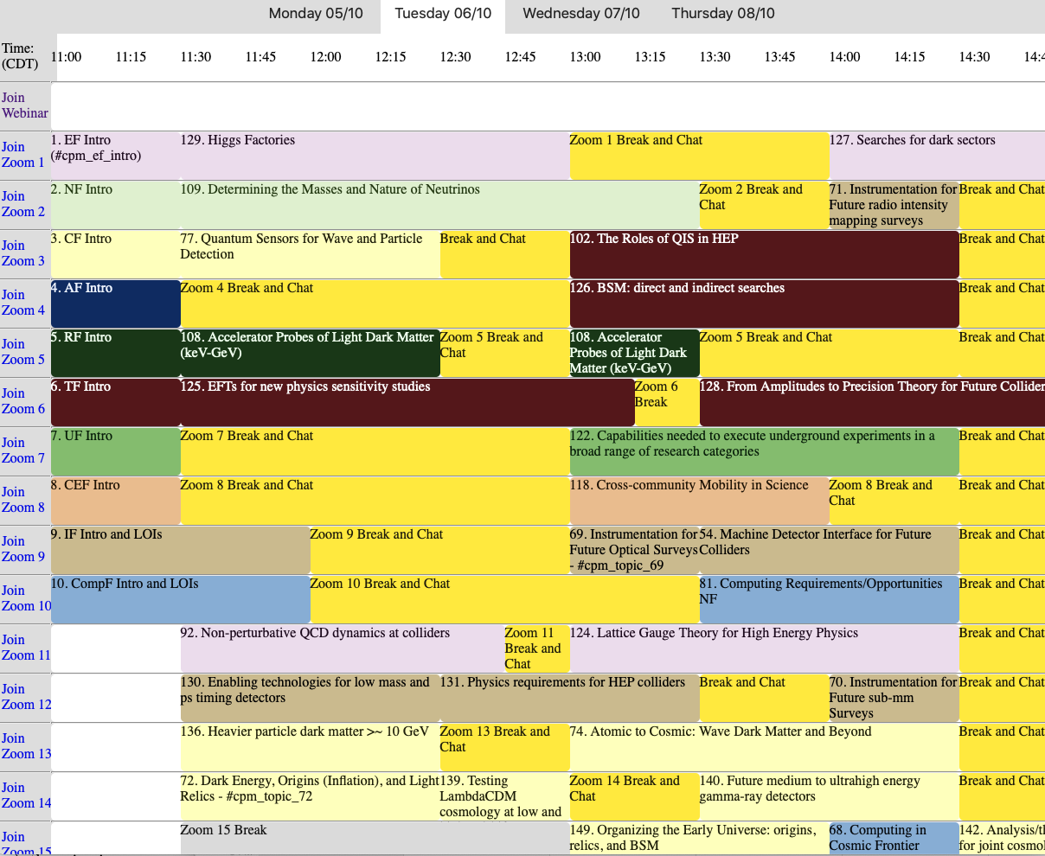
Overall schedule:
http://zgecse.web.cern.ch/zgecse/SessionTimeline.html

