Slide 1
Some tests with XArapuca module
Working in progress

Slide 2
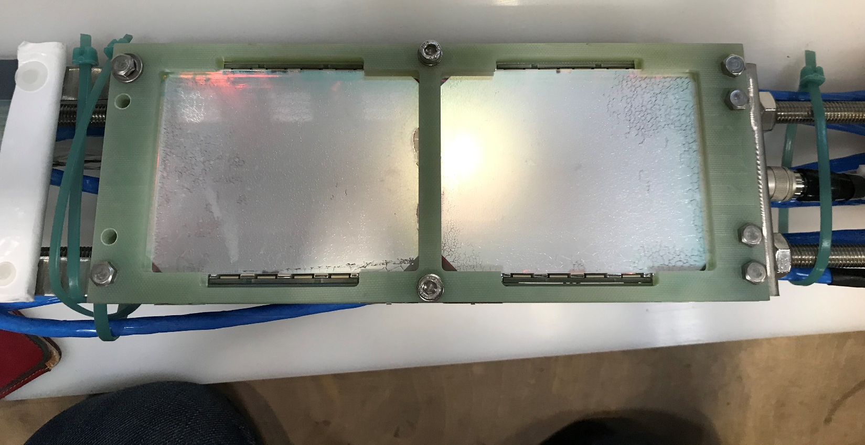
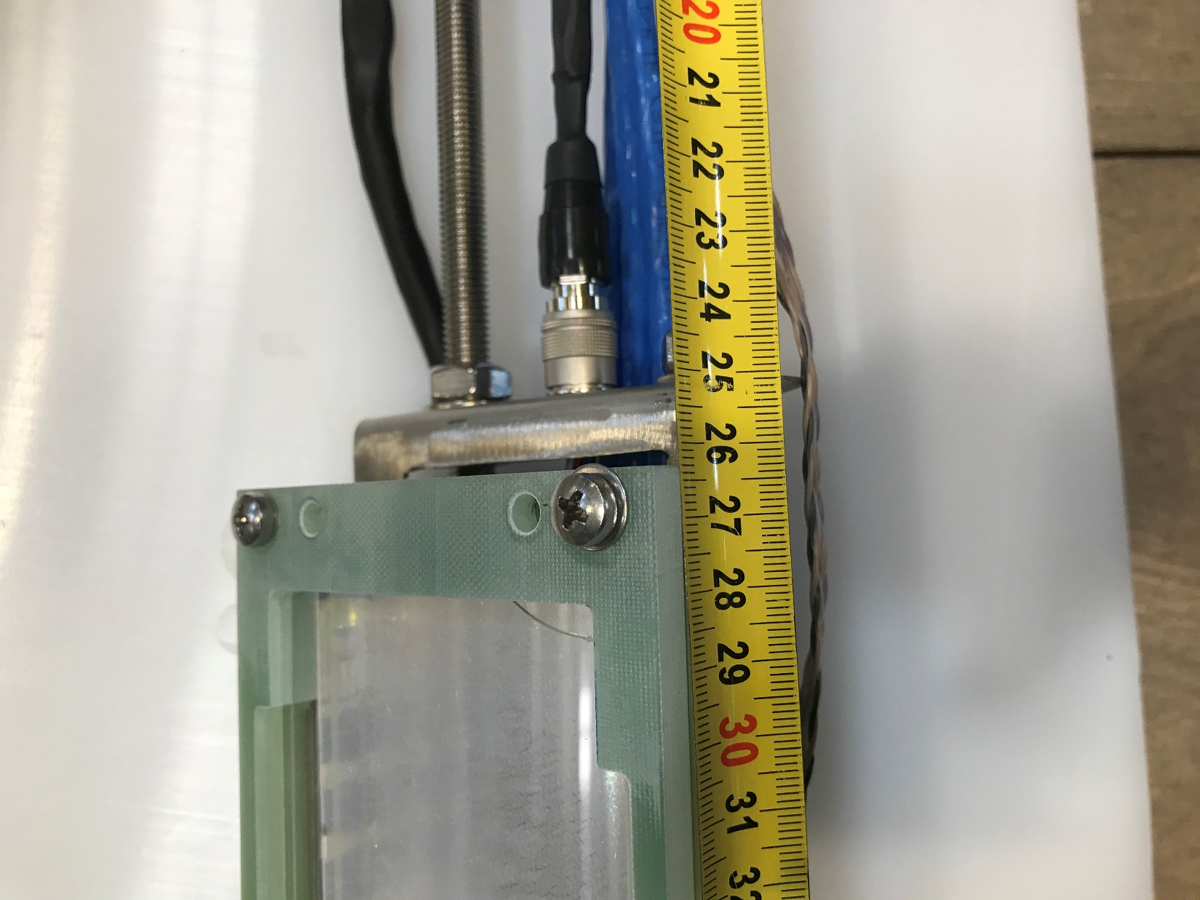
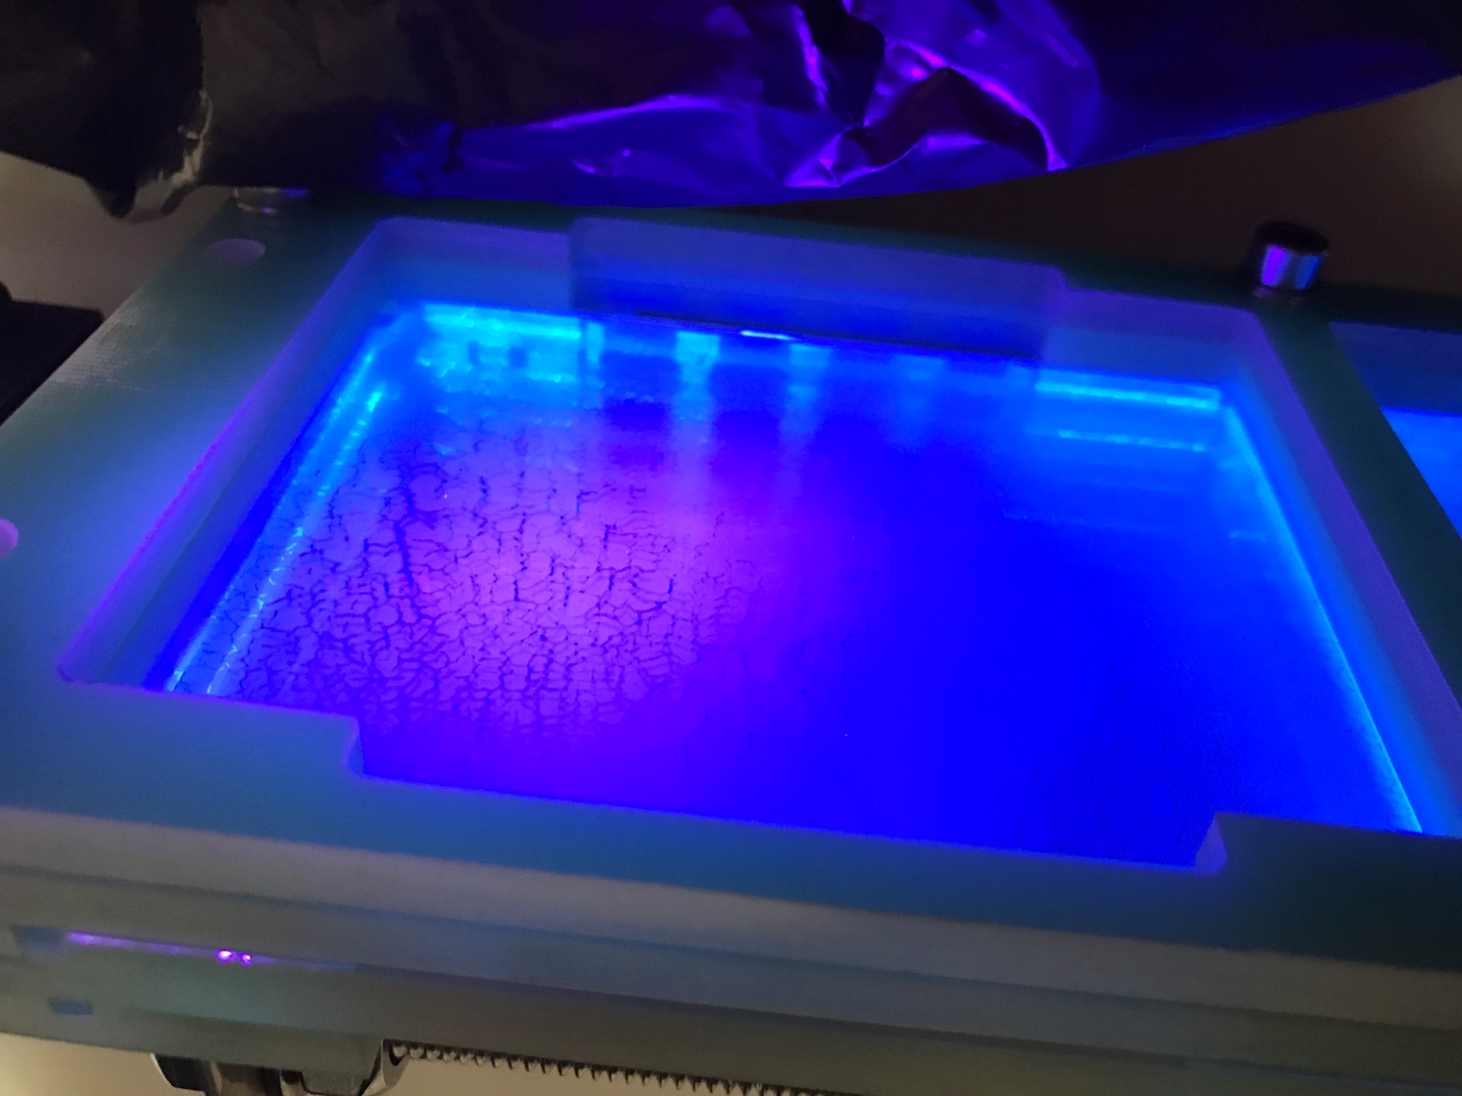
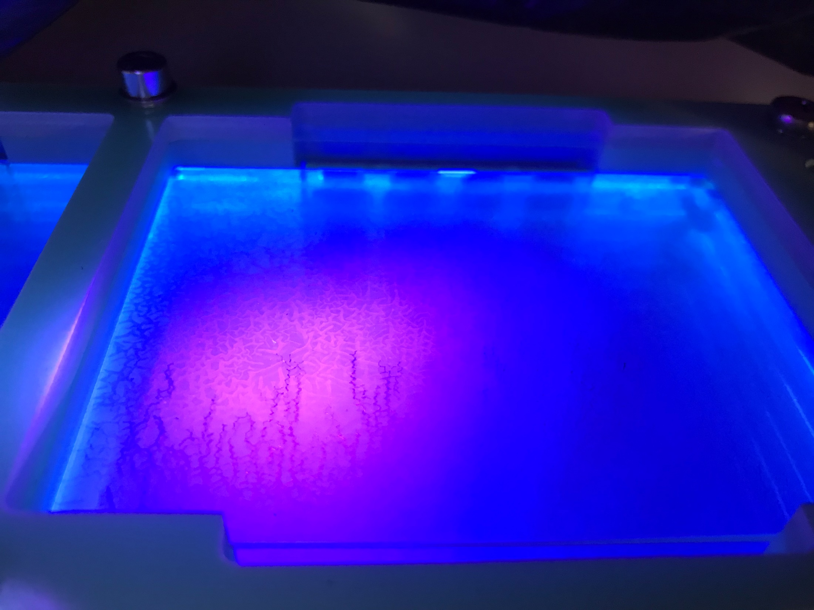
XArapuca modules are extracted from ProtoDUNE-SP.
XArapuca w/o Quartz window
XArapuca w/ Quartz window

Slide 3
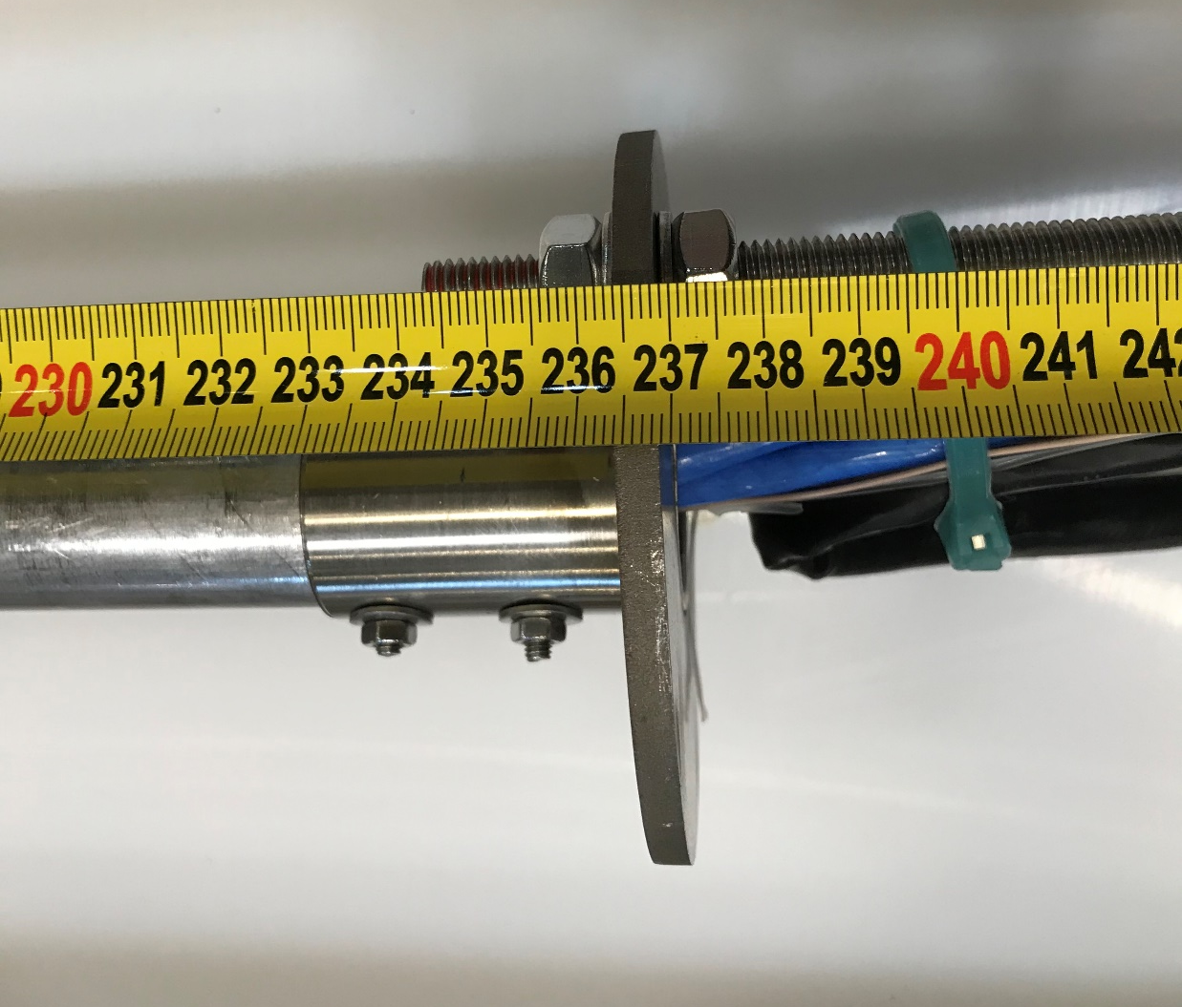
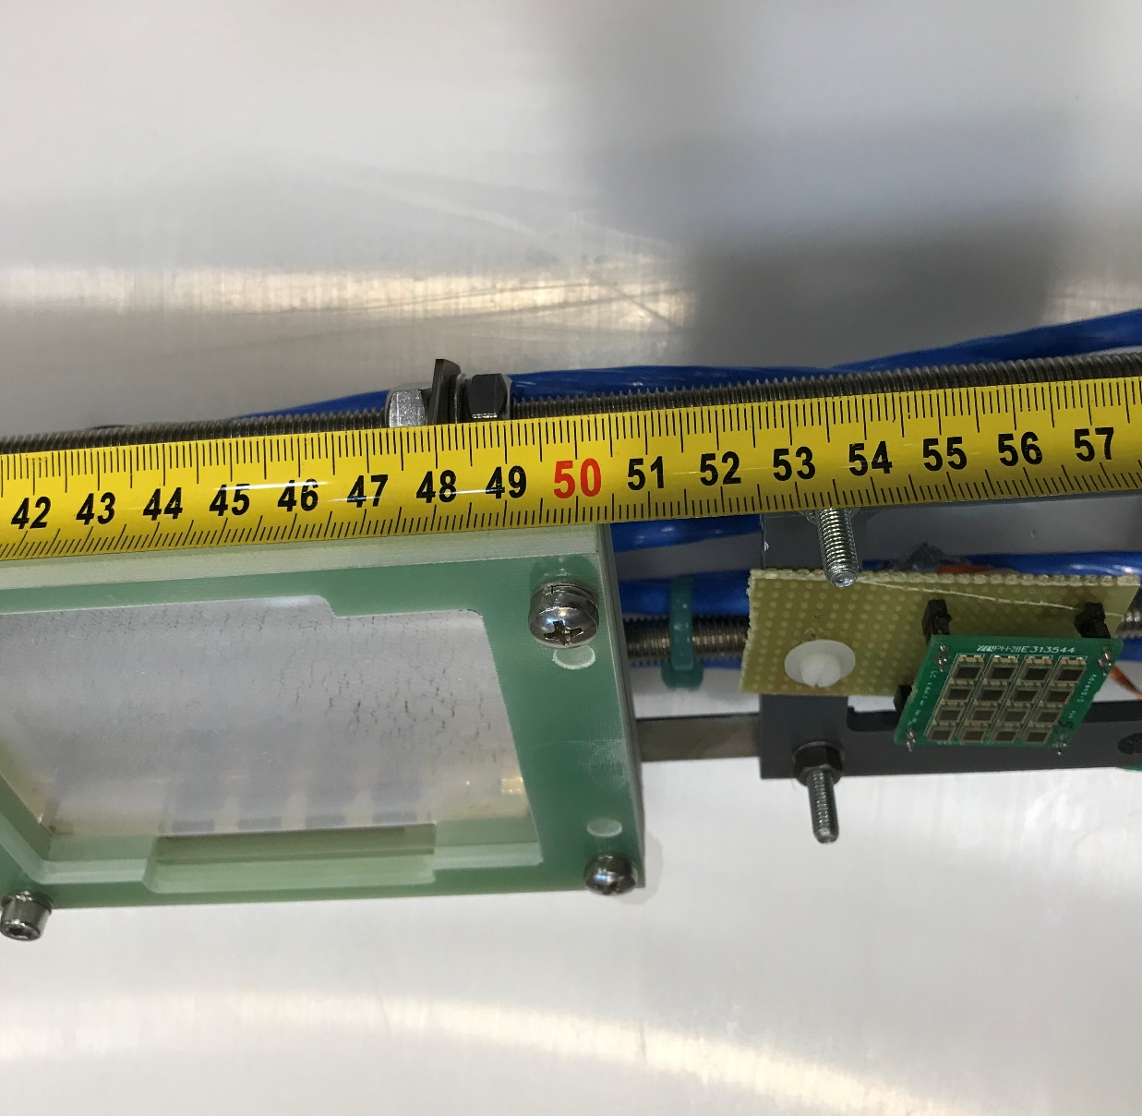
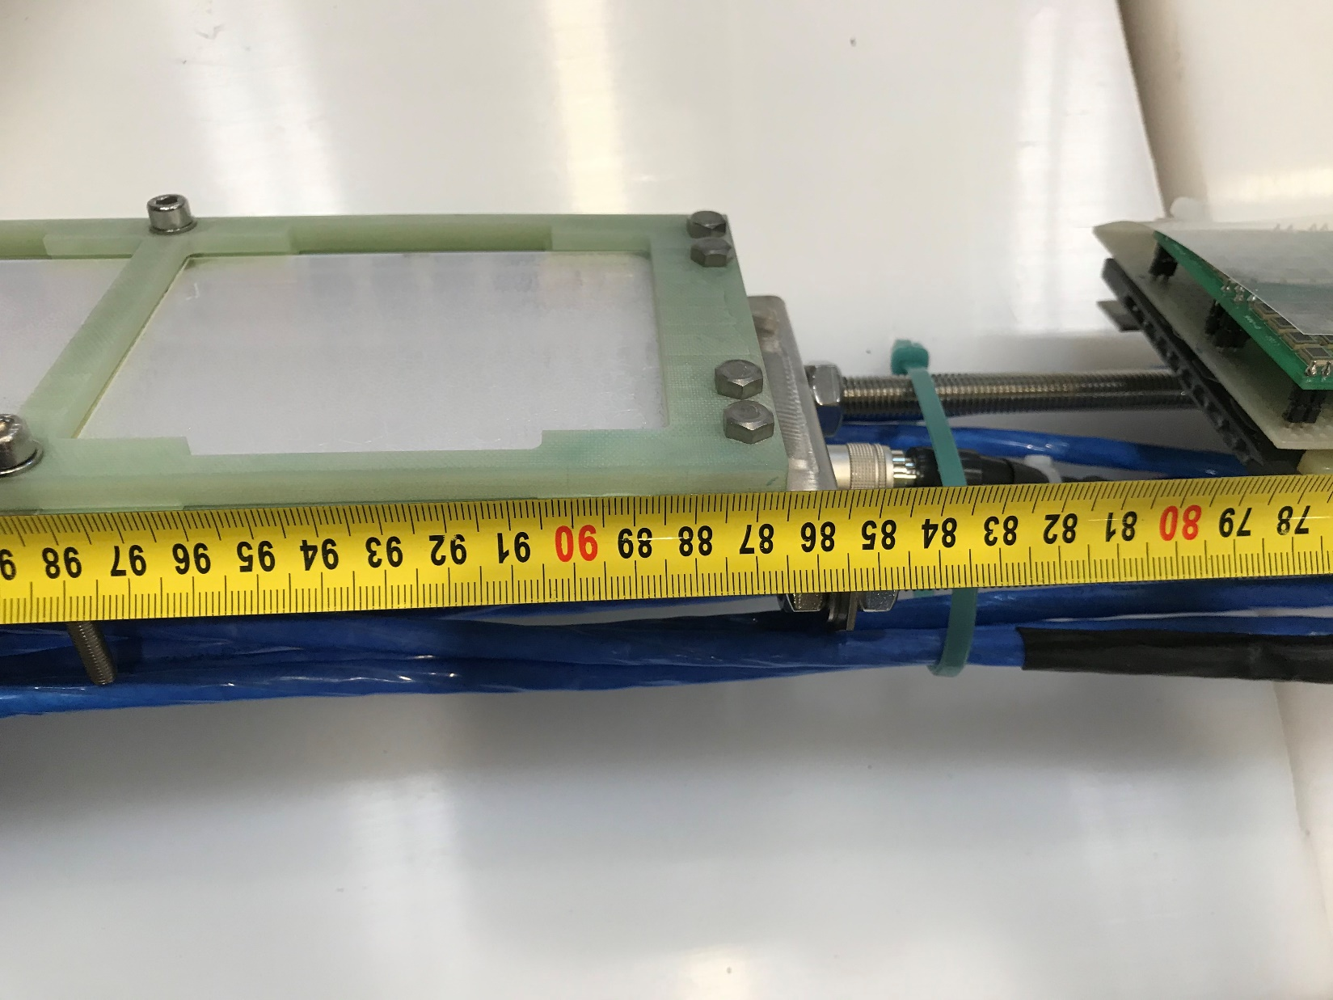
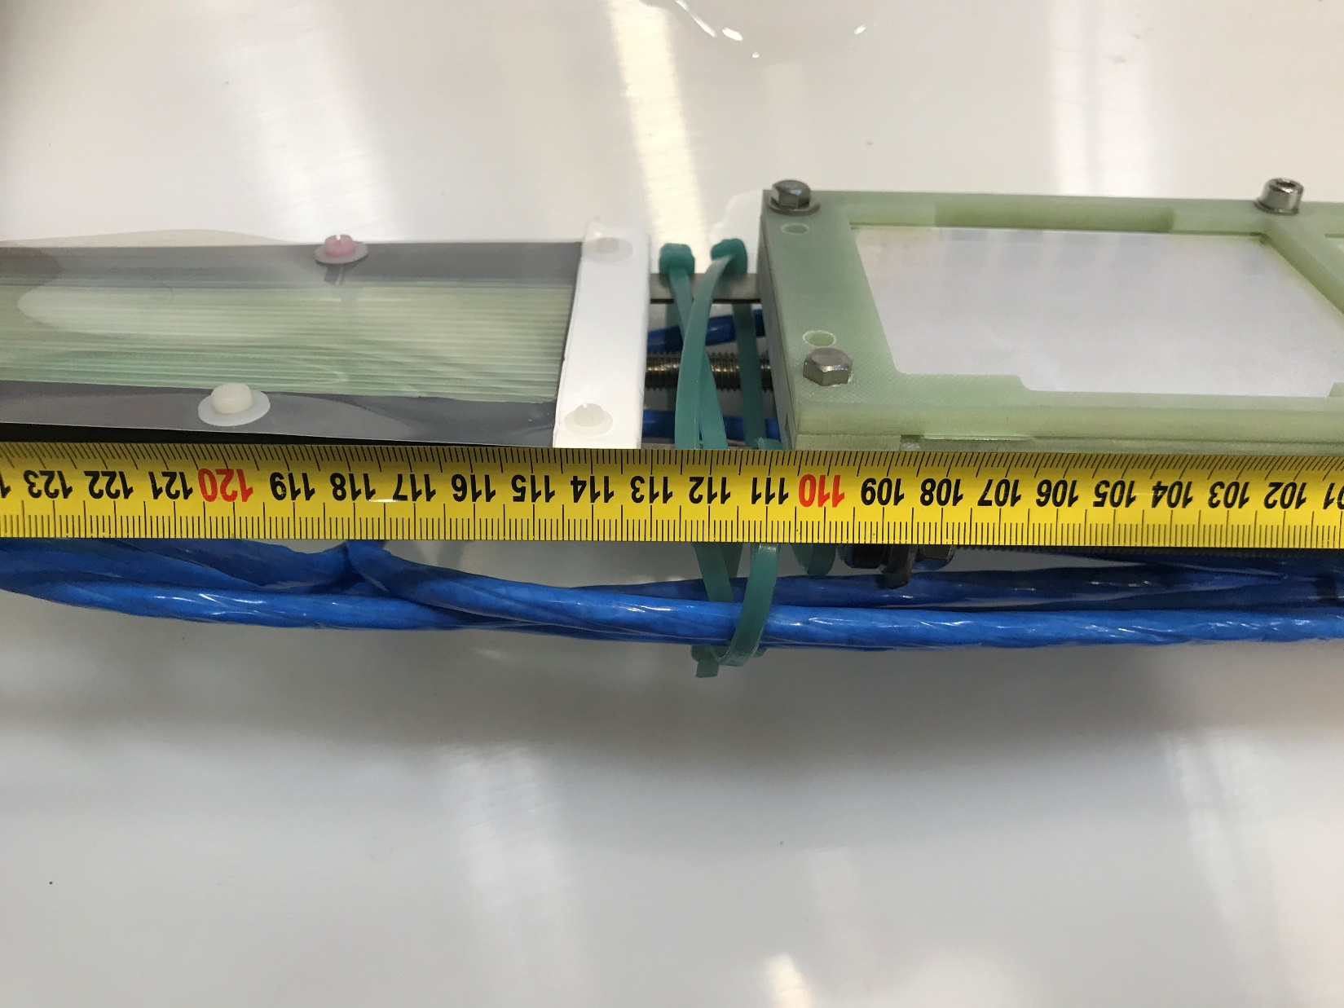
Distance from the feedthrough
XArapuca w/ QW
XArapuca w/ QW
XArapuca w/o QW
XArapuca w/o QW

Slide 4
X-Arapuca modules, PC, SSP modules, Power Supplies, scope, cables, etc. are moved to ideasquare on 3rd of August.
Ideasquare darkroom is equipped with monochromatic tuneable light source for PDE study of SiPM.
I wanted to study the blindness of XArapuca modules to visible light and also study trapping efficiency.

Slide 5
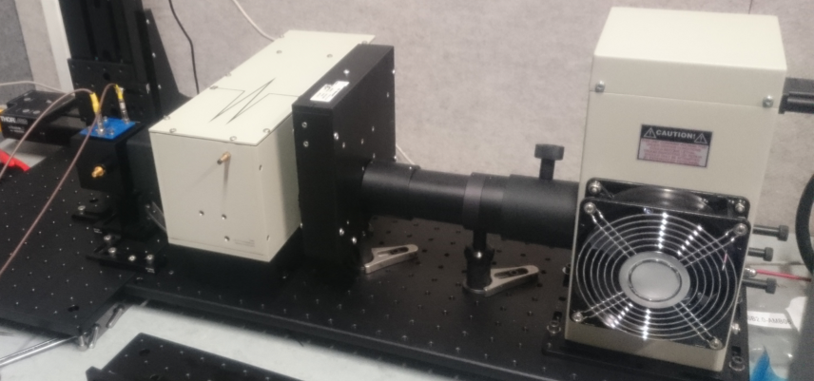
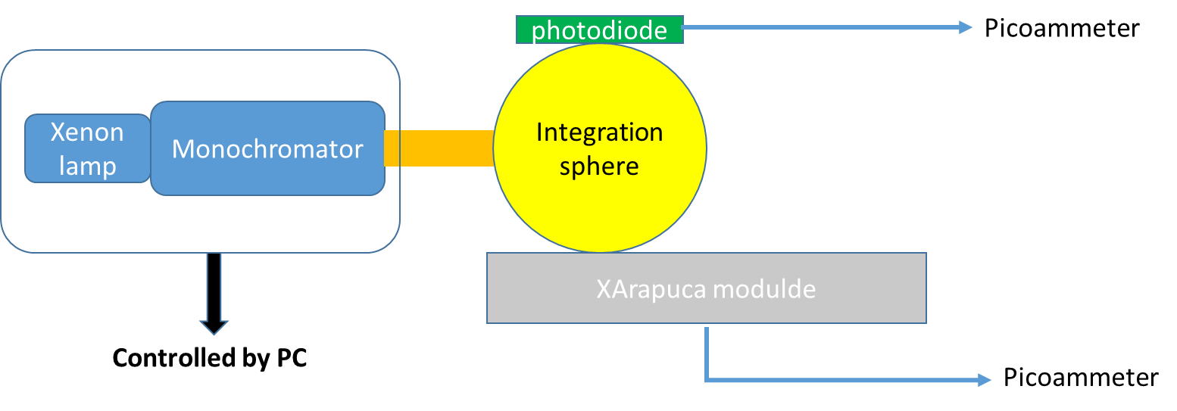
The set-up
Monochromator
Xe 75 W lamp
250 – 1800 nm
Photodiode
Integration sphere
Continuous monochromatic light source
Xe lamp operated with a slit width of 0.05 nm to have enough light. The resolution on the wavelength is about 0.7 nm.
Scan from 300 nm to 500 nm with a step of 10 nm (step of 2 nm @ 400-420nm)
To determine how many photons impinged into XArapuca, photodiode is used.
To ensure both detectors are exposed to the same amount of photons, an integration sphere is used to diffuse the light.
Photocurrent method
Notes:
The calibrated photodiode (Hamamatsu S1337-1010BQ, s/n 61) is used to measure the absolute light intensity. The incoming light is spreaded between SiPM and photodiode by an integrated sphere (Thorlab, Model IS200-4). The integrating sphere works as a beam splitter and a diffuser.
An integrating sphere (IS200-4, Thorlabs) that has its inner surface coated with a diffusely reflecting
material – PTFE – is used to redistribute the light isotropically over the sphere interior surface.
At 400nm = 400 E-9 m we have about 4E-6 W = 4E-6 J/s of power from the plot shown above
The energy = hc/lambda = (6.626E-34 Js * 3E8 m/s )/400E-9m = 4.969E-19 J
Number of photons= P/E = 4E-6 / 4.969E-19 = 8.05 E12

Slide 6
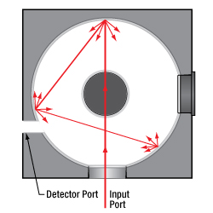
Integration sphere
An integrating sphere evenly spreads the incoming light by multiple reflections over the entire sphere surface.
The sphere is manufactured from PTFE based bulk material that has high reflectance in the 250 - 2500 nm wavelength range
https://www.thorlabs.com/newgrouppage9.cfm?objectgroup_id=1658

Slide 7
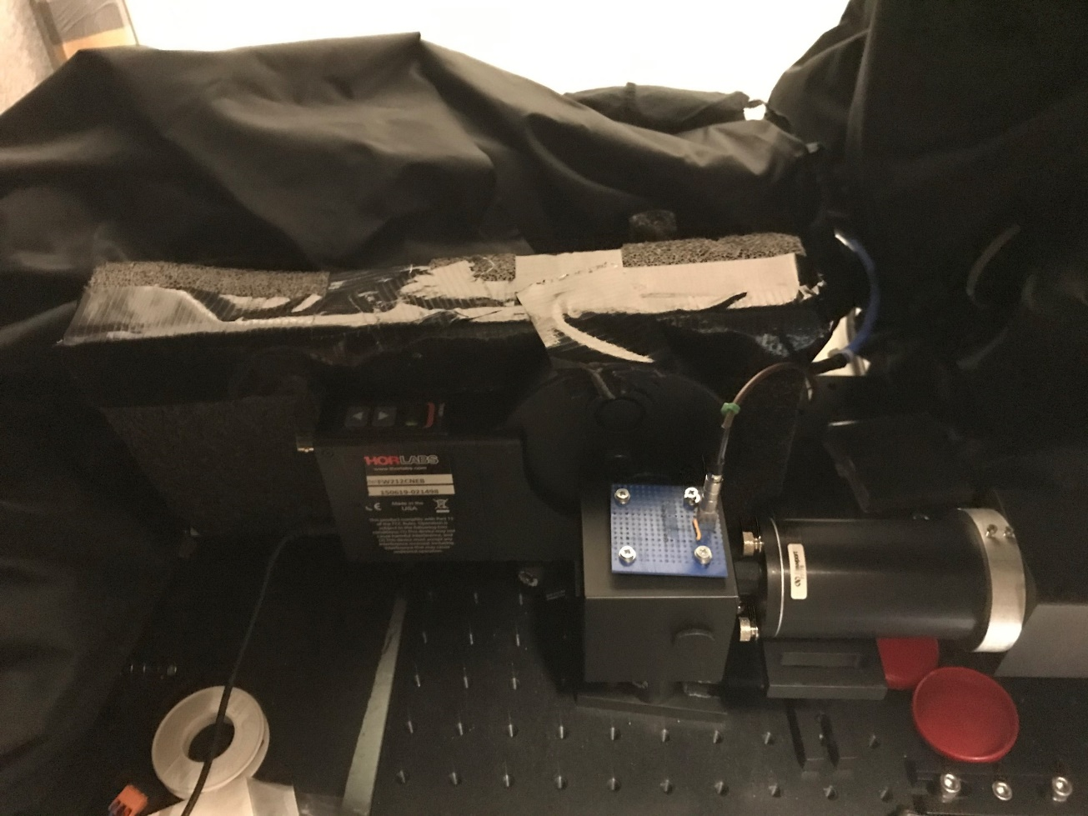
XArapuca module
Photodiode
Integration
sphere
2cm thick black foam hosting XArapuca module
3 x 2.5 cm² window allows photons to enter from integration sphere port at 90º

Slide 8
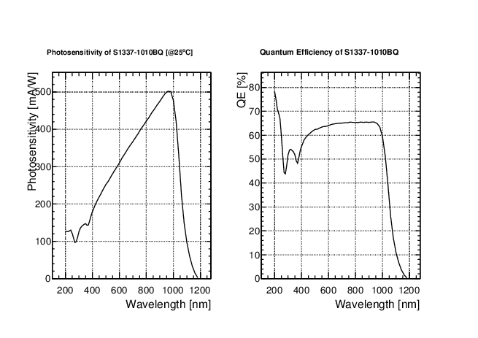
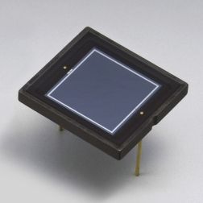
Si Photodiode (Hamamatsu S1337-1010BQ: For UV to IR)
A calibrated photodiode: S13370-1010BQ to determine the absolute amount of light scattered in the IS ports, in order to estimate the number of photons impinging on XArapuca Cell

Slide 9
Photocurrent an number of photons on PhotoDiode
Scanning from 300 to 500 nm with a step of 10 nm (400-420 nm step of 2nm)!

Slide 10
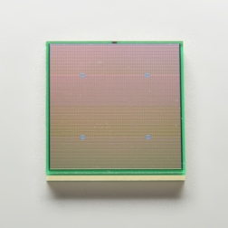
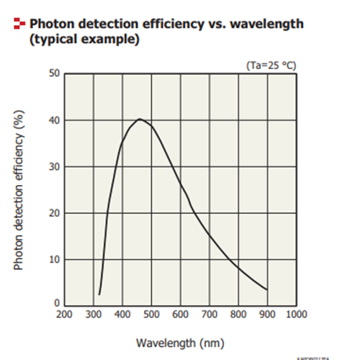
SiPM used in XArapuca modules
S13360-6050VE
4-SiPMs per channel → 144 mm2 active surface
@ 2V over voltage gain ~1E6
https://www.hamamatsu.com/resources/pdf/ssd/s13360-2050ve_etc_kapd1053e.pdf

Slide 11
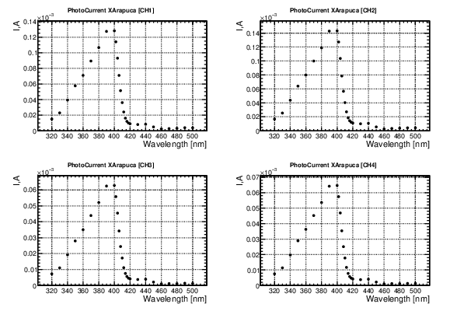
Photocurrents read out on X-Arapuca channels:
Vop @ 55 Volts

Slide 12
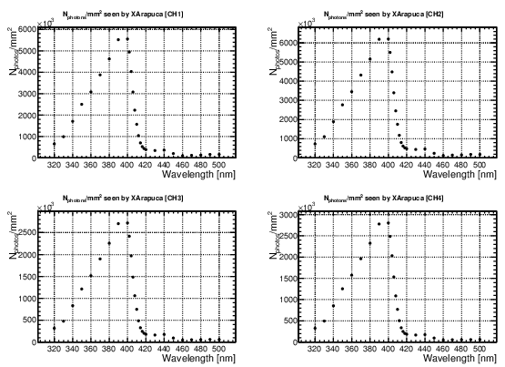
Number of photons on X-Arapuca channels:
Gain = 1E6 @ 55V
S_{XA} = 144 mm²

Slide 13
Trapping efficiency:

Slide 14
XArapuca modules, SSP modules, power supplies, PC, etc are stored in ideasquare clean room.
Monochromatic light source in ideasquare is used to study blindness of XArapuca to visible light (scan done from 300-500 nm).
Photocurrent method: reading photocurrent of photodiode and XArapuca channels by picoammeter.
The work is in progress, if you think it is worth to continue, then:
Perform additional test where the light exposed asymmetric into the cell.
Scan for different operating voltages
Measure also the gain of each XArapuca channel (4-SiPMs in parallel) for a given operating voltage
Wondering whether such measurements were performed before.
Any suggestions and critics are welcome

