Slide 1
IF03: Solid State Detectors and Tracking
Artur Apresyan, Lucie Linssen, Tony Affolder
August 13, 2020
Bi-weekly IF03 Solid State Detectors and Tracking

Slide 2
IF03: Solid State Detectors and Tracking
This topical group aims to study detectors and technologies needed for charged particle tracking:
Technologies for colliders, fixed target, or precision measurement experiments
Ranging from silicon to diamond and other alternative materials.
Also non-solid-state trackers, e.g. for high-intensity experiments.
3D integration, ultra-lightweight materials for mechanical support & cooling.
Trackers should be discussed in the context of future experimental challenges
Identify opportunities and technological challenges with different future accelerators, and explore possible technology solutions or directions
Highlight the importance of generic “blue sky” R&D in creating opportunities and future transformative breakthroughs’
The goal is to collect input on areas and strategic directions that the US community is interested to pursue
Collect and organize studies from the community and document its scientific vision

Slide 3
Who we are
Artur Apresyan
Fermilab, CMS experiment, MIP timing detector for HL-LHC
Lucie Linssen
CERN, silicon R&D for pixel trackers and granular calorimetry (CLIC, CMS).
Anthony Affolder
UC Santa Cruz, ATLAS tracker upgrade for HL-LHC

Slide 4
Snowmass process
Community-driven effort on long-term planning for particle physics
See APS Town Hall from Young-Kee Kim: http://meetings.aps.org/Meeting/APR20/Session/D23
See IF kickoff workshop: https://indico.fnal.gov/event/43730/
Instrumentation Frontier focuses on detector technologies and R&D needs for future experiments across the physics frontiers
Milestones along the way:
Letters of Interest due 31 Aug 2020
(Virtual) Community planning meeting: 4 days during week of Oct. 5
Summer Study meeting meeting: 11-20 July 2021
Contributed Papers due July 31 2021

Slide 5
Today’s and Upcoming Agenda
Plan on bi-weekly meetings to collect interests, requirements, collect LoIs and start Contributed Papers
Thursday, 1 pm Central
Today’s Agenda (Notes: please add to, especially attendance)
Parameters for future trackers (Simone Griso)
Silicon Detectors (Vitaliy Fadeyev)
Electronics/sensor Integration (Ron Lipton)
Silicon detectors (Jessica Metcalfe)
Future Meetings: If you are interested in giving a short presentation in future meetings, please email and/or add to notes

Slide 6
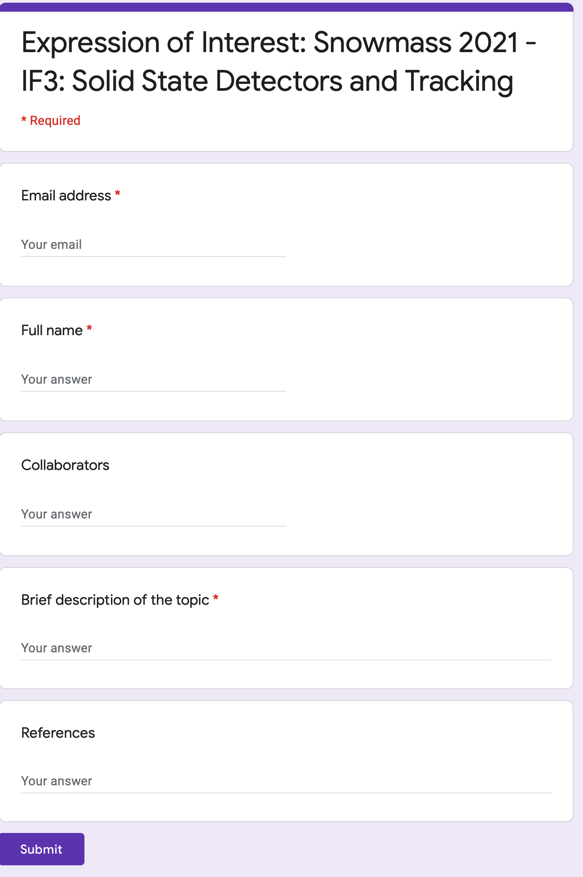
How to contribute
Several mechanisms to indicate your interest and contribute with studies
Google form to collect basic info: contact info, brief description of interests
Letters of Interest: short documents
Contributed papers: more extensive studies which will be part of Snowmass report
Subscribe to the mailing lists :
SNOWMASS-IF-03-TRACKING@FNAL.GOV
Wiki page:
https://snowmass21.org/instrumentation/tracking
Regular “general” IF03 group meetings
Topical meetings in closely related areas
https://forms.gle/aknT8FsFU1Pk47hn7

Slide 7
More Info

Slide 8
Conclusion
Many ideas and directions to explore and study
We look forward to your input, contributions, and working together towards the final report
The aim is to gather input and express the vision of the US community in the future R&D, so it’s vital to receive the submissions and technical documents
Reminder: fill out the GForm: https://forms.gle/aknT8FsFU1Pk47hn7
Subscribe to the mailing lists and slack channels:
https://snowmass21.org/instrumentation/start

Slide 9
Existing Detector R&D Overview Efforts
A lot of work has been done already for BRN, CPAD, EPSG
CPAD Workshops
Annual workshops since 2015
Report from CPAD 2019: https://wp.physics.wisc.edu/cpad2019/
Report from CPAD 2018: https://arxiv.org/abs/1908.00194
DOE BRN Study Workshop on HEP Detector R&D, Dec. 2019
HEPAP report: https://science.osti.gov/hep/hepap/Meetings/202007
European Strategy for Particle Physics Preparatory Group
2020 Update of the European Strategy for Particle Physics: http://cds.cern.ch/record/2720129
Deliberation Document on the 2020 Update of the European Strategy for Particle Physics: https://cds.cern.ch/record/2721371
Collaborative frameworks within CERN RD groups, and university-lab collaborative efforts

Slide 10
More details in intro @ https://indico.fnal.gov/event/43730

Slide 11
More details in intro @ https://indico.fnal.gov/event/43730

Slide 12
Organization of the work
In collaboration with other working groups within the Instrumentation Frontier and in other Frontiers, we aim to identify:
Physics benchmark goals that drive the need for advances in tracking detectors
Translate the physics requirements into detector needs for future experiments, and study which advances bring transformational changes
Identify areas where R&D will significantly impact future capabilities
Collect studies and organize ideas from the community on these set of topics
Capabilities, strengths and weaknesses of various approaches, and proposed future directions
Performance studies from new R&D directions, and promising directions
Identify the set of development tools, and the required expertise to maintain and strengthen the US intellectual contributions
Facilities required for effective work: fabrication, characterization, test beams, irradiation facilities, clean rooms, corresponding infrastructure, collaborative efforts

Slide 13
Future machines and requirements
Trackers for future colliders
Different requirements depending on e⁺e⁻ or hh
e⁺e⁻: very high spatial resolution, and low material budget
hh: very high radiation tolerance (10¹⁷ n/cm²), high resolution in position and/or time
μ⁺μ⁻: very high spatial resolution, and low material budget PLUS timing, high radiation tolerance
Need to collect similar technical requirements for fixed target and intensity frontier experiments, electron-ion collider
Upgrades in HL-LHC, extensions of the existing trackers
Given the timescales of these machines, we need to ensure that “blue-sky” R&D is pursued, and new opportunities and developments are fully taken advantage

Slide 14
Sample topics to be covered
Traditional silicon sensors development:
Low mass, finely-segmented radiation hard detectors needed for future experiments, with different degrees of focus on rad-hardness or position resolution
New silicon technologies: MAPS, SoI
Avoid bump-bonding, many developments in industry, many opportunities and challenges to adapt to HEP needs
Reduction in material budget and material cost
Advanced simulation tools to help in understanding the performance of new prototypes and to optimize the design of new detectors
Essential to minimize development costs and R&D cycles, often a rare set of expertise within collaborations.
Development and improvements of rad-damage simulation and comparisons with experiments

Slide 15
Sample topics to be covered
4D trackers for the future machines: position + time
Reduce backgrounds, track reconstruction, triggering, will need precision timing information, in addition to the precision position
Particle ID and LLP searches are new areas where we start utilizing the timing and position information
Time resolution:
Pico-second level time resolution critical for high occupancy environments in future hadron colliders.
Requirements in the range from ~5 to ~30 ps resolutions, need to clearly identify the needs and simultaneous requirements on position resolution

Slide 16
Sample topics to be covered
Electrical and thermal services: work in coordination with IF07
Efficiently deliver thousands of amps for powering the ASICs
Efficiently remove the heat: increasingly complex readout schemes, ASICs generate 100s of kWs
Approaches to improve the efficiency: DC-to-DC conversion and serial current delivery for HV; improve conversion efficiency and rad hardness.

Slide 17
Sample topics to be covered
Precision support structures and cooling
Cooling and support as an integrated problem
Issues related to development of support structures needed for increasingly complex tracking detectors
Typically interested in very stable and precise structures to support tracking sensors, with minimal mass and low radiation lengths
Studies of novel materials, advanced compounds, foams etc
Interconnections and readout:
Issues related to modules designs, assembly and large-scale productions
Packaging technologies: bump-bonding, wire-bonding, glues and adhesives, flex circuits, TSV, etc.

Slide 18
Sample topics to be covered
Developing and preserving knowledge and expertise
The EPSG “Physics Briefing Book” raised this point well, and presented a compelling case
We aim to study this question in the US context, and identify areas where funding agencies and the community can help to ensure that young talent is attracted and is maintained within the field
It is of critical importance to the future of the field to ensure career opportunities exist and are expanded
Explore and encourage multi-institutional developments and shared use of resources at labs and universities
Encourage the support of workshops, conferences, seminars on tracking detectors and encourage participation
Collaborative environments for sensor developments: e.g. multi project foundry submissions

Slide 19
Synergies with other groups
Some areas expected to be cross-cutting:
MAPS detectors or 3D integration: IF03 and IF07
Tracking reconstruction: development of new algorithms both online and offline, development of the detector designs, and will need to leverage on the computing developments: IF03 and CompF1
Effective use of precision timing in track reconstruction, and trigger formation: IF03 and IF04+CompF1
TPC and large area muon chambers: IF03 with IF05
We should identify how most effectively organize work in these cross-cutting areas

Slide 20
Plan of meetings
Have a dedicated discussion at this meeting
We want activities of this group to be community driven, please let us know your opinions and ideas
Meetings twice a month, to discuss areas of interest and possible collaborations towards LoI and CPs
Timing detectors and 4D trackers (today)
“Traditional” and “new” silicon detectors (e.g. 3D, MAPS, SoI)
Precision support structures, mechanics, cooling
Simulation tools, radiation damage
Electrical and thermal services, module designs, data transmission
Experimental and development facilities (test-beams, production and testing labs, irradiation facilities)

