Slide 1
Sensor-Electronics Integration –
Status and Possibilities
Ronald Lipton

Slide 2

Future Tracking Detector Commandments
Thou shalt minimize mass
Thou shalt have high bandwidth
Thou shalt be radiation hard
Thou shalt not dissipate power
Thou shalt have intelligence and complex functionality
Thou shalt maximize position resolution (minimize pitch)
Thou shalt minimize dead regions
Thou not covet thy neighbor’s signals (noise and crosstalk)
Thou shalt not steal (be affordable)
Thou shalt have picosecond time resolution
Thou shalt remember the trigger and keep it holy
…
Obeying these “commandments” force us to push the technological and engineering envelope

Slide 3
The Technological Roadmap
In HEP we are over a decade behind the state of the art in semiconductors. It is difficult to find new technologies that are both affordable and appropriate.
I will concentrate on areas where I have some experience and believe substantial progress can be made.
3D integration of electronics and sensors
Interposers, chiplets and other interconnect technology
Substrate engineering, LGADs
Utilization of these technologies separately or in combination to solve instrumentation problems
Other related and important components
Monolithic active pixel detectors
SPADs and other amplifying structures
Radiation hard materials and structures
Mechanics and cooling

Slide 4
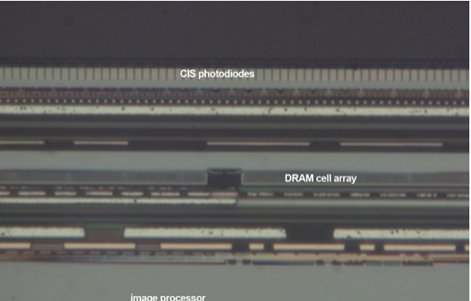
3D Integration
A three-dimensional integrated circuit (3D-IC) structure is composed of two or more layers of active electronic components using horizontal intra-tier and
vertical inter-tier connectivity (TSVs). We pioneered this for HEP circa 2010-12. Features:
Bond pitch of <4 microns
Three tier electronics/sensor stack
24 micron pixel pitch (w ADC,TDC)
Connection though bottom (bulk) of ROIC by thinning and etching
Small interconnect capacitance – low noise
We worked with a US company (Ziptronix) that was developing the technology. Hybrid bonding (DBI) is now licensed throughout the industry and is probably
in your cell phone camera.
FNAL/BNL 3-layer
detector stack
Sony 3-layer stacked imager

Slide 5
Possibilities and Challenges
3D integration offers a number of possibilities
Very fine pitch
Multiple layers of electronics (analog/digital)
Low noise (low capacitance interconnect, small pixels)
Heterogeneous integration (different sensor, IC technologies in a stack)
Challenges
Access/cost (Nhanced, MIT-LL, Tower/Jazz, Sandia. IZM …)
TSV integration (only from
some foundries)
Die-to-wafer bonding
Multi-chip stack yield
Design tools
3D stacked chips DBI bonded to BNL sensor
wafer (FNAL)

Slide 6
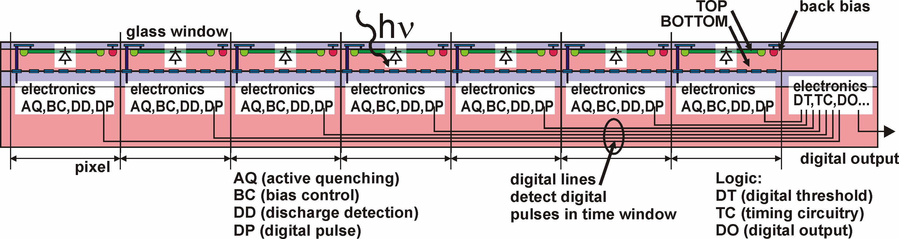
Applications – 3D SIPM
More sophisticated photodetector:
Active quenching
Interpixel communication
Digitial timing and discrimination
Hit pixel counting
Timing window
Prototyping at Sherbrooke, Canada
(J.F Pratte Sherbrooke)
(G. Deptuch Fermilab)

Slide 7
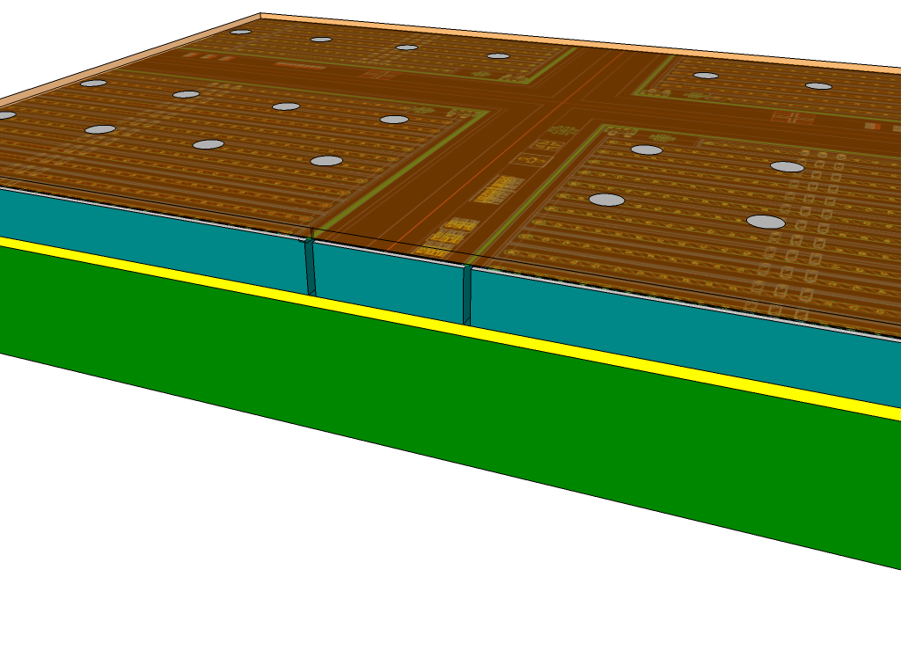
Applications - Edgeless array
Combine active edge sensor technology
with 3D electronics and oxide bonding
with through-silicon vias to produce fully active tiles.
These tiles can be used to build large area pixelated arrays with good yield and reasonable cost (test stack after 3D integration)
Tiles can populate complex shapes
with optimal tiling and low dead area
Only bump bonds are large pitch backside
interconnects
High density and geometrical flexibility
Prototypes fabricated, but not fully
Assembled (broken in shipment)
readout
IC and pads
200 micron
Buried
oxide
sensor
trenches
Handle wafer

Slide 8
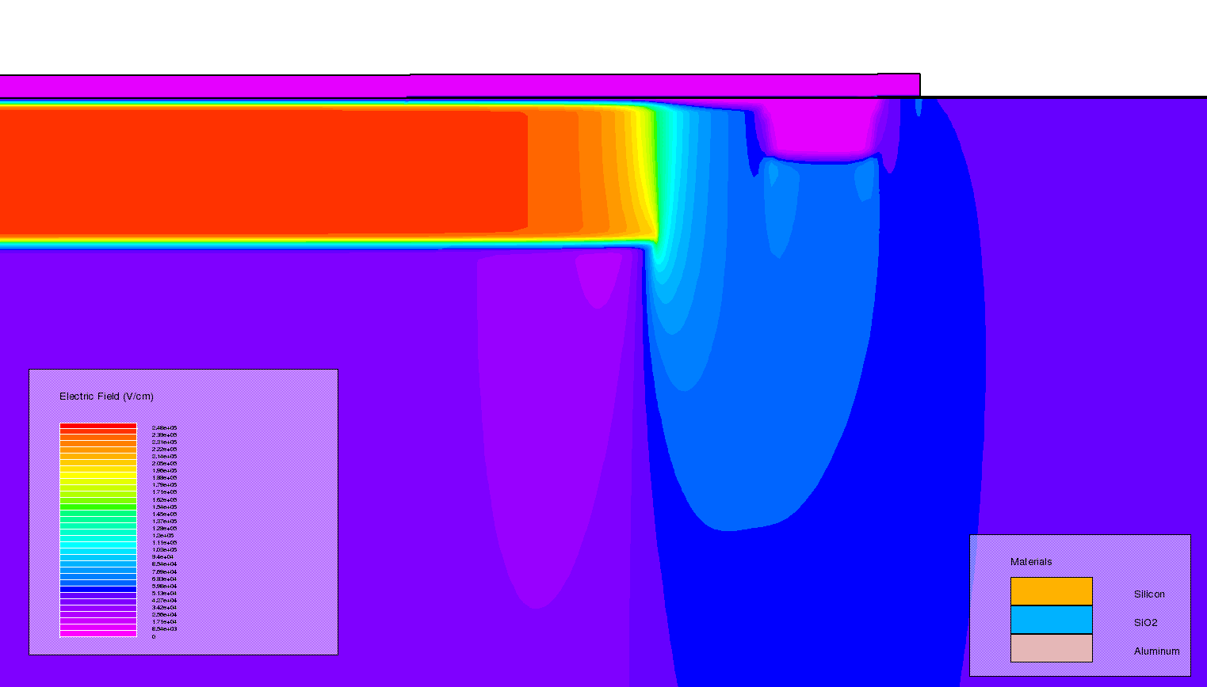
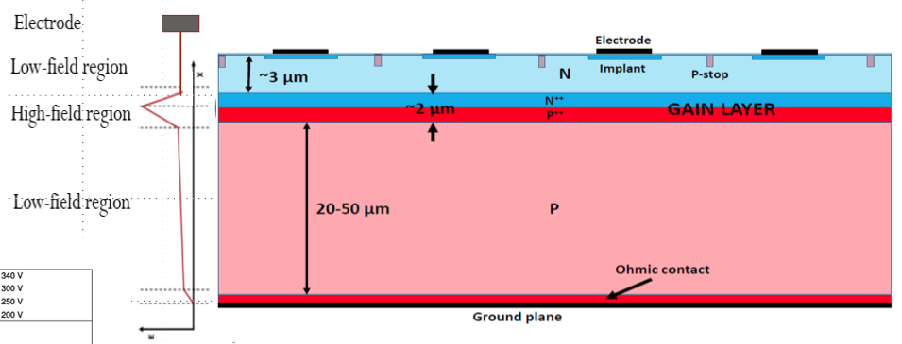
Substrate Engineering
We can now control the doping and fields deep within silicon wafers using wafer bonding and epitaxial growth. This allows us to control the internal fields and drift and amplification of charge carriers.
Buried layers for LGAD fabrication
  More radiation hard and configurable
  Control of fields
Bonded wafers for thick sensors
Buried layer LGAD
being fabricated at BNL
AC coupling
Epitaxial layer
implanted gain layer
Bonded wafer substrate
Electric Field
Double junction LGAD
RD50 2020 - Yuzhan Zhao University of California,Santa Cruz

Slide 9
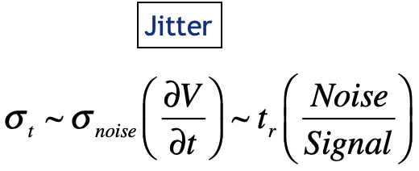
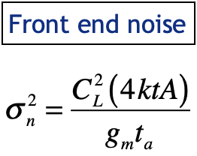
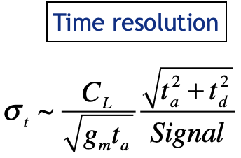
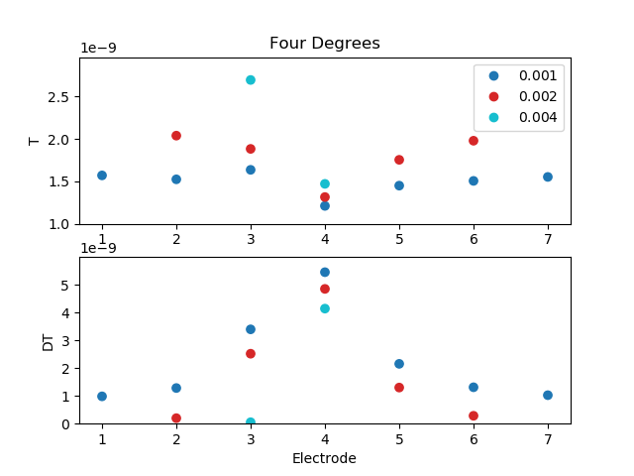
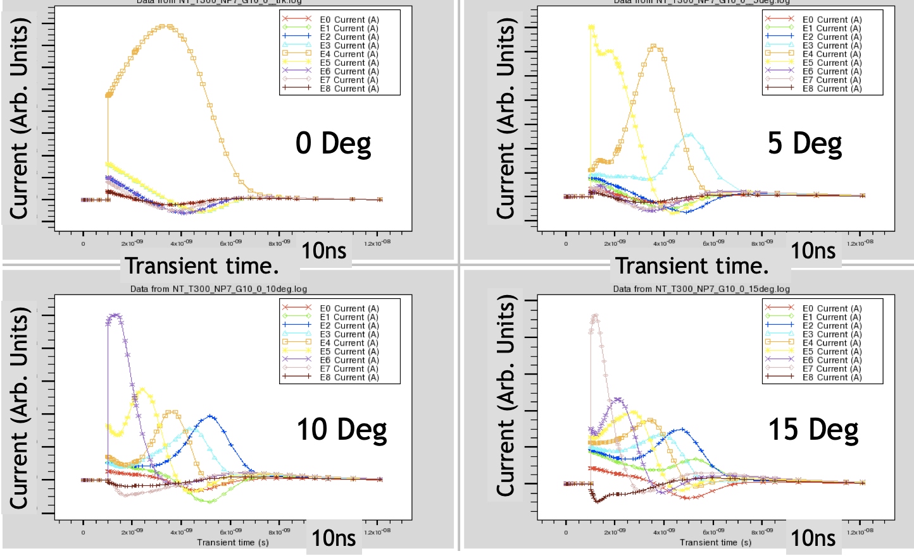
Applications – Induced currents
3D allows for small pixels with small associated load capacitance. Small pixels with ~25x smaller capacitance should have similar timing performance to LGADs.
Should be more radiation hard, but more power with denser electronics
The current pulse reflects charge motion deep in the detector
Can use the current pulse to measure track angle, depth of charge deposition
Depends sensitively on the “weighting field”

Slide 10
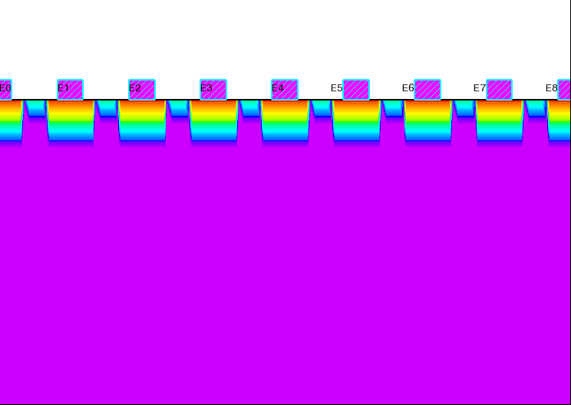

Applications – Double Sided LGAD
cathodes
Low Gain Avalanche Diode with fine pixels on the hole-collecting side
Anode can provide timing with coarse pitch
Cathode subdivided into small pixels
  Records “primary” hole collection, then holes from gain region – double peak that reflects charge deposition pattern
  Lower power due to large signal from the gain layer
Resulting current pattern can be used to measure angle and position.
A thicker detector can be optimized to measure angle or charge deposit location
25 microns
electrons
holes
Gain layer

Slide 11
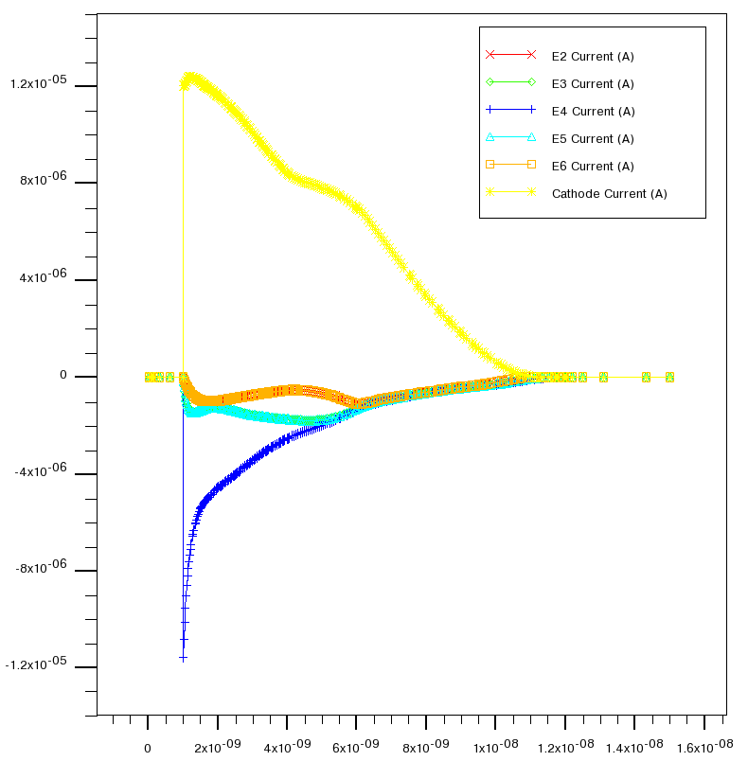
Double Sided LGAD Simulation
anode
Use anode for timing, cathodes for pulse shape discrimination
15 degree
track
15 degree track detector internal current distributions
cathodes
15 ns
anode
0 degree
track

Slide 12
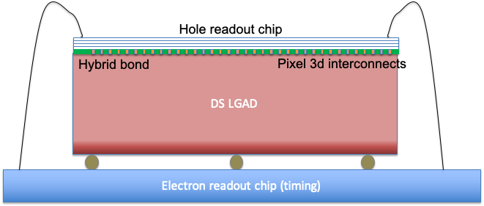
Implementation
3D Assembly with electron and hole ROICs
This is similar to VICTR from the 2012 3D run

Slide 13
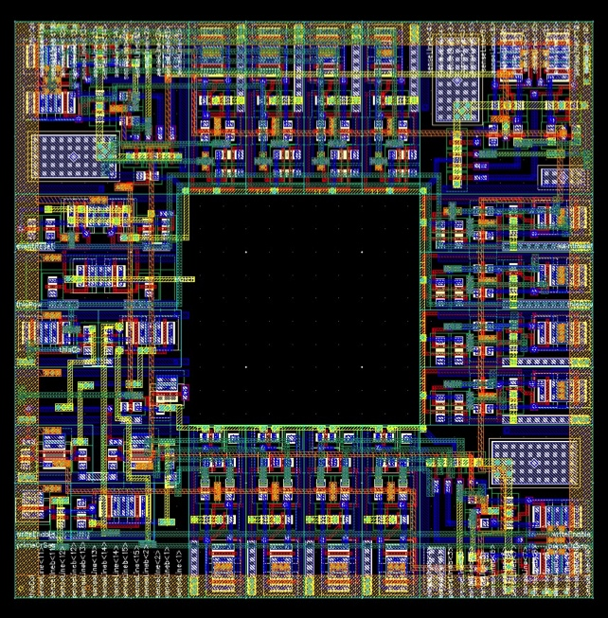
Application – 3D CAMS for trigger
The essence of VIPRAM is to divide the CAM trigger approach up into different tiers, maximizing pattern density while minimizing critical lengths and parasitics.
Each tier
~tracking layer
In 130nm
(Liu and Hoff (FNAL))

Slide 14
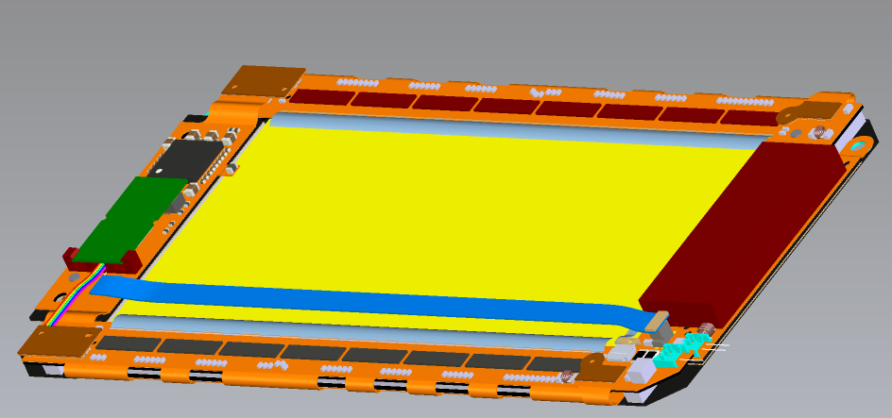
2.5D & Chiplets
Without TSV
Known good die can be combined on
an active or passive interposer, with or
without TSVs
Interconnect on silicon substrate
Depends on microbump arrays
Build complex assemblies with
specialized ASICs
A better way to implement
  Front end amplification
  Optical data transfer
  Power conversion
  Data concentration and filtering
  Trigger generation
A possibly more elegant solution for
i.e. the CMS PS module (3 chip-on-
flex hybrids)
With TSV, active interposer

Slide 15
Access and Comments
Comments on the “cutting edge”
Companies can appear and disappear (with access and capabilities)
We (HEP) are more willing to take risks than most other customers and can provide valuable service as “first adopters”
TCAD and simulation tools are powerful and underutilized (in the US)
Labs (for example BNL, MIT-LL, Sandia, FNAL) are capable and interested, but costly. R&D funds and people are limited
Access to foundries is crucial for much of the work – few are willing to talk
Collaboration with engineering groups is essential
University semiconductor labs can be a great resource, but help can be limited. Student participation is very important.
Funding can be obtained from SBIRs – that is what the program is for. But:
  Companies can overstate their capabilities – be skeptical
  You need to provide expertise to get what you want

Slide 16
Conclusions
Now is the time when detector R&D should ramp up for the next generation of experiments.
  Challenges are not getting any easier
There are many promising technologies becoming available that have the potential to revolutionize the next generations of experiments
  Investment with delayed payoffs
We need to think about what technologies will be available 10 years from now and start developing the tools to use them
The reach of our experiments has always been defined by the instrumentation we use. We need to continue to invest.

