Slide 1
Darshan+CMS
HEP-CCE IOS meeting
8/12/20

Slide 2
CMS workflow overview
Step 1
Step 2
Step 3
Step 4
?
Root
Root
Root
Root

Slide 3
CMS workflow I/O: Steps 1 & 2
Step 1
?
Did not see any sizeable input files being used by Step 1 (nothing greater than 1 MB of reads) -- is that expected?

Slide 4
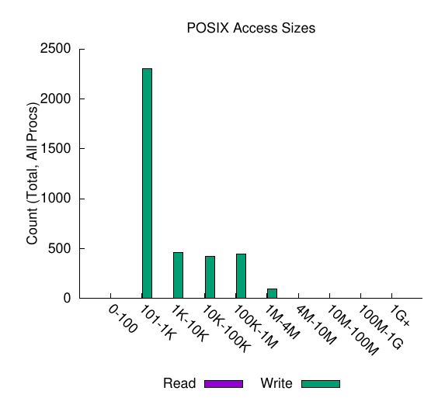
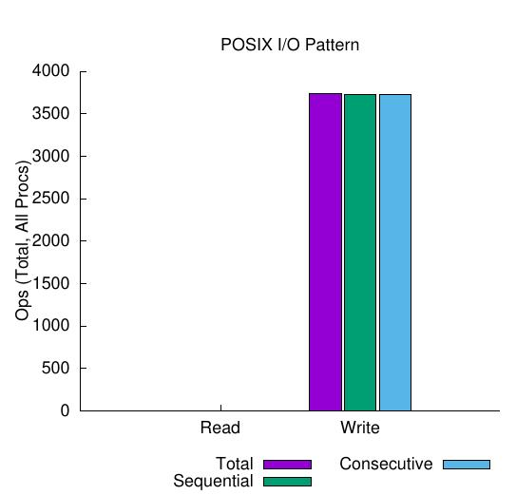
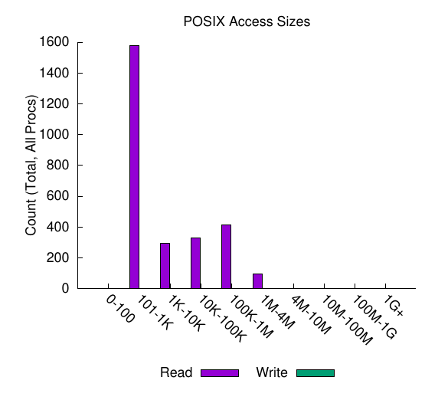
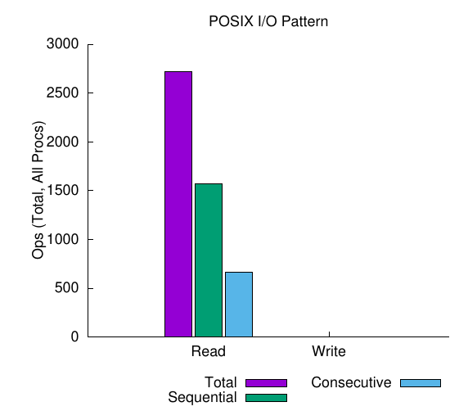
CMS workflow I/O: Steps 1 & 2
Step 1
Step 2
step1.root
~370 MB written
~880 MB/sec
~8,900 IOPs/sec
~360 MB read
~2,100 MB/sec
~16,000 IOPs/sec

Slide 5
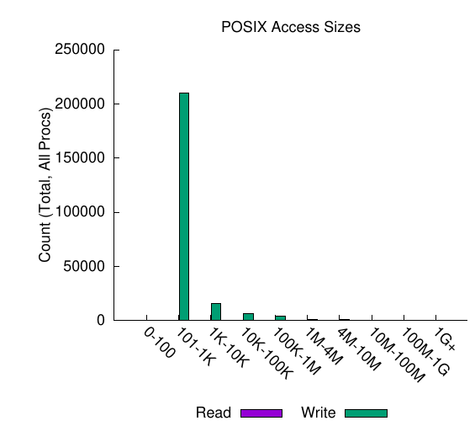
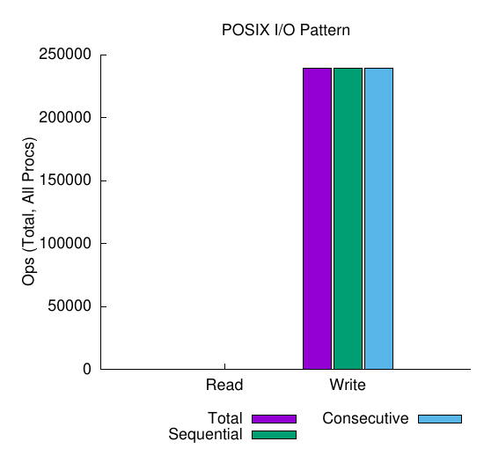
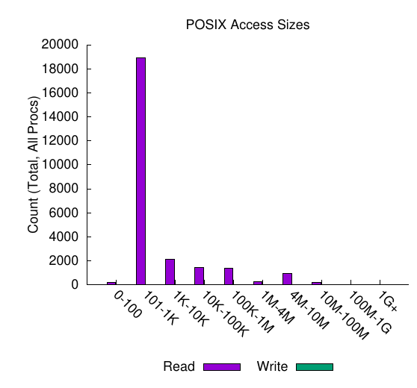
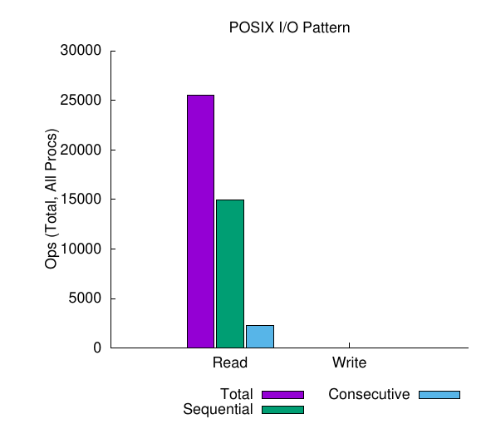
CMS workflow I/O: Steps 2 & 3
Step 2
Step 3
step2.root
~13,500 MB written
~1,100 MB/sec
~20,000 IOPs/sec
~10,200 MB read
~2,400 MB/sec
~6,000 IOPs/sec

Slide 6
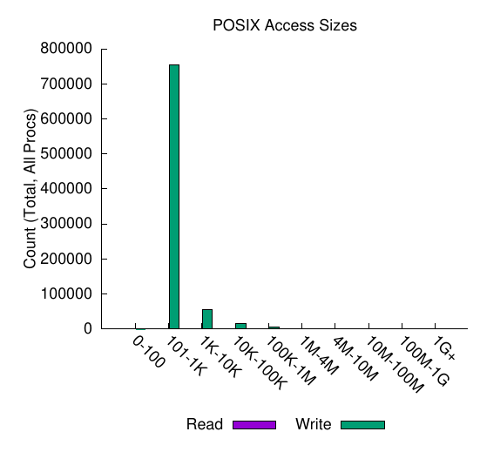
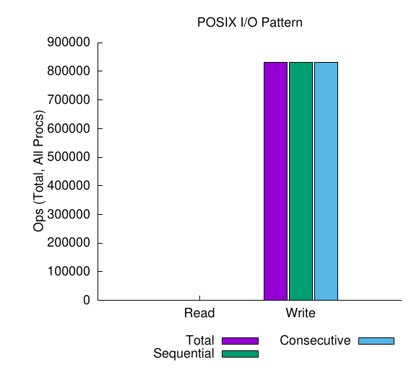
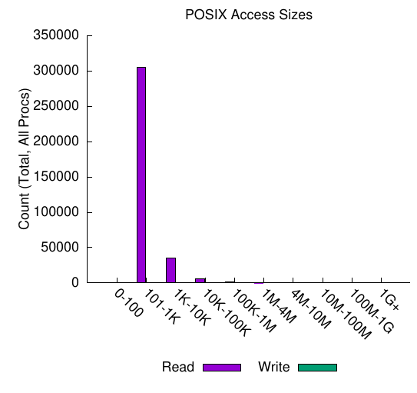
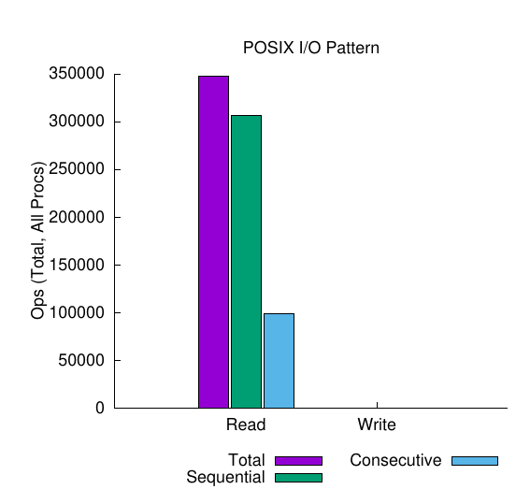
CMS workflow I/O: Steps 3 & 4
Step 3
Step 4
step3.root
~4,500 MB written
~310 MB/sec
~58,000 IOPs/sec
~844 MB read
~715 MB/sec
~300,000 IOPs/sec

Slide 7
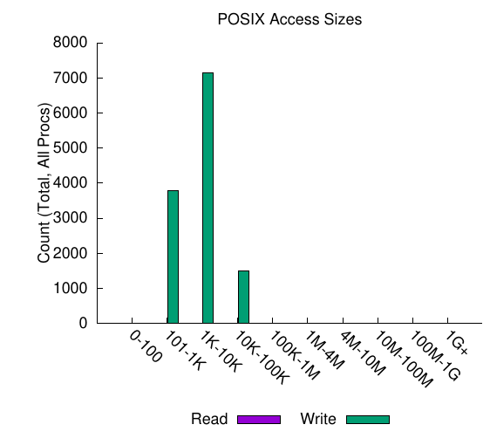
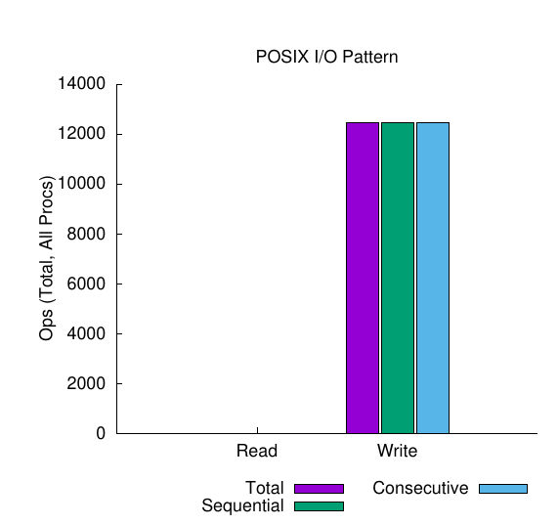
CMS workflow I/O: Step 4 final output
Step 4
step1.root
~50 MB written
~150 MB/sec
~40,000 IOPs/sec

Slide 8
CMS workflow I/O volume overview
Step 1
Step 2
Step 3
Step 4
Root
Root
Root
Root

Slide 9
CMS workflow I/O performance overview
Step 1
Step 2
Step 3
Step 4
Root
Root
Root
Root

