Slide 1
Simcenter Ansys Integration
TSD Topical Meeting
George Lolov
8/20/2020

Slide 2
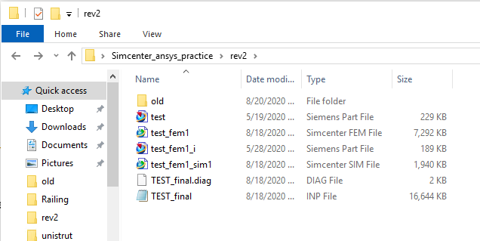
Relevant Files (Uploaded to Sharepoint)
Start with just original part and follow along
Compare your results to .fem and .sim files at the end

Slide 3
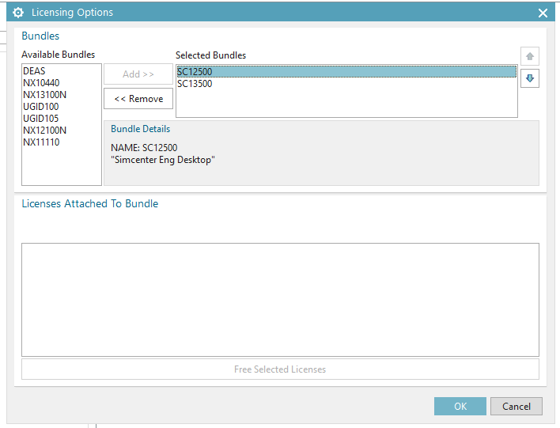
Choosing the Correct NX License
Make sure no parts are loaded yet or the “select bundles” option will not appear
Remove NX license bundles
Add Simcenter (SC) license bundles

Slide 4
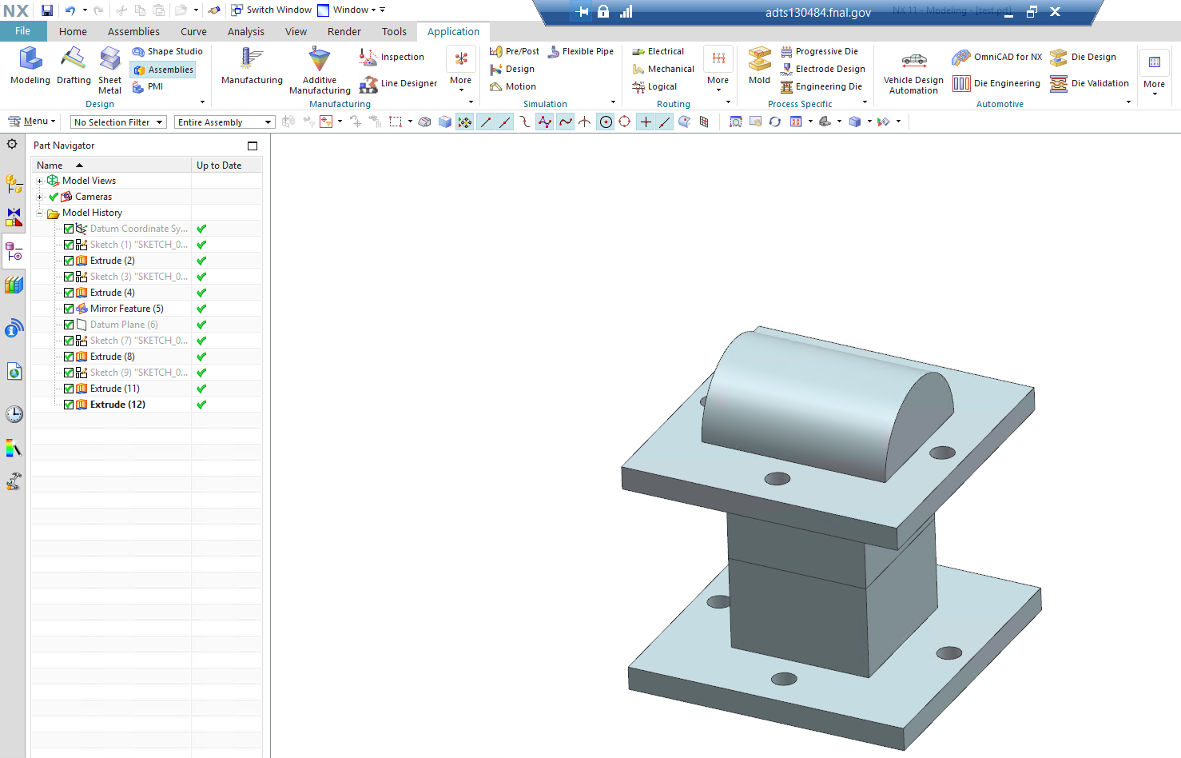
Open The NX Geometry and Enter Pre/Post Application

Slide 5
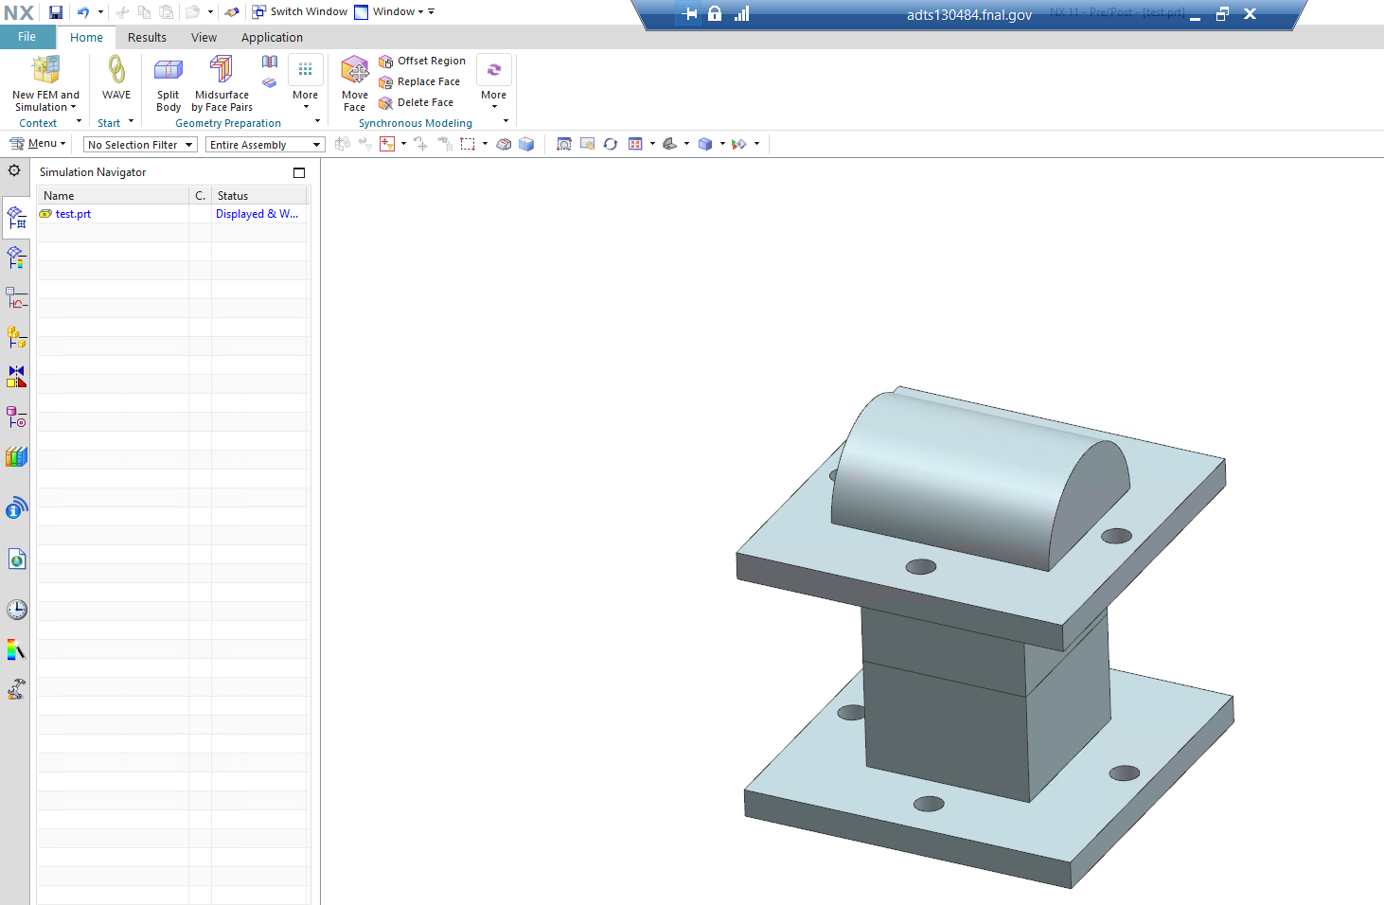
Create a New Fem and Simulation

Slide 6
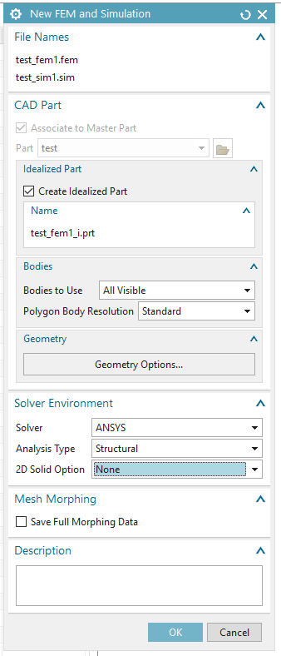
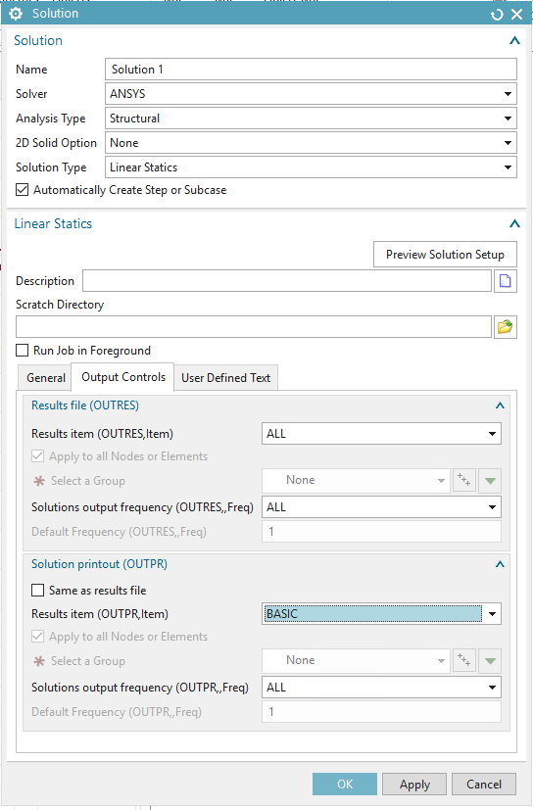
Select Correct Dialog Info for FEM/SIM Creation
Select ANSYS as solver
Choose correct analysis type (structural in this case)
Make sure to create an idealized part to work with so that the original part remains unchanged

Slide 7
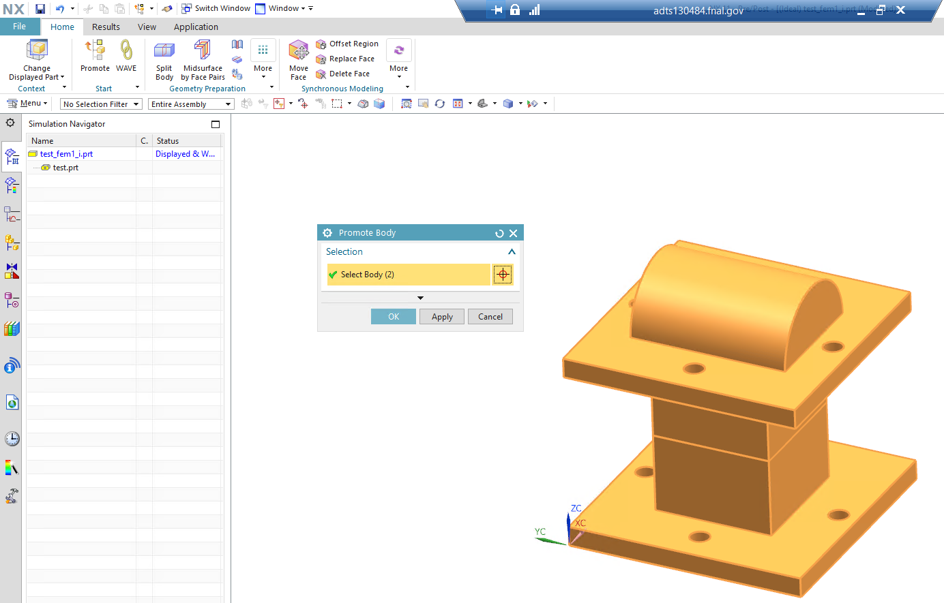
Promote Geometry to be Analyzed
Make sure you are working with the idealized part (i.prt)

Slide 8
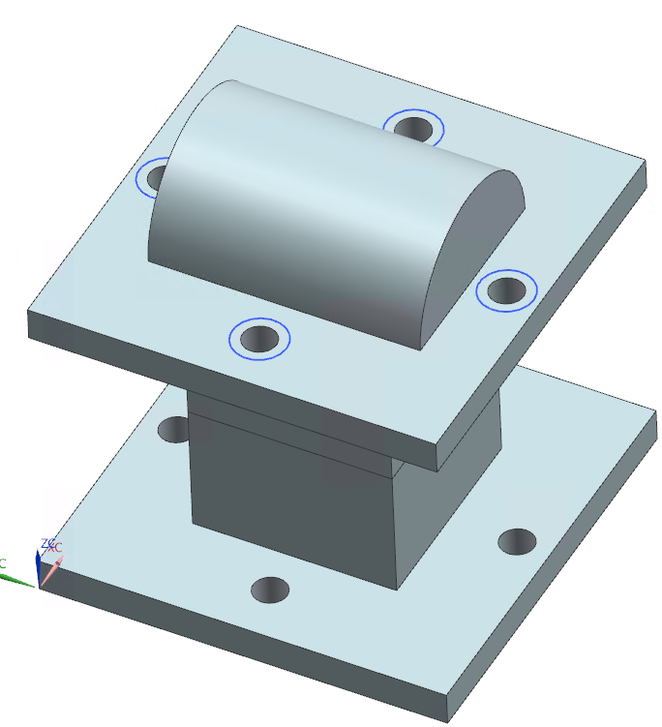
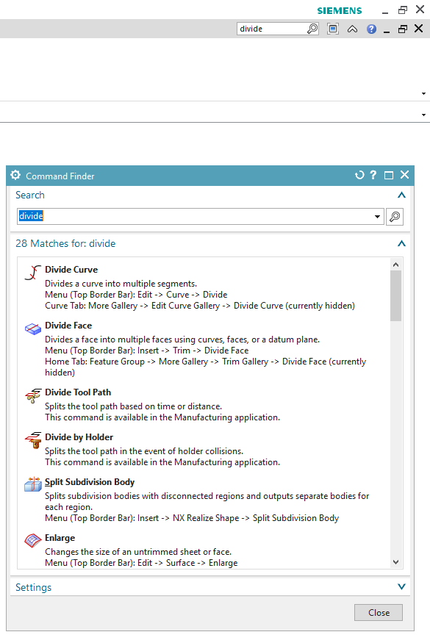
Prepare Geometry for Meshing
Make any idealizations in the modeling application
In this case, bolt head/washer faces were sketched on the top/bottom of this geometry (use “divide face” to make them separate faces)

Slide 9
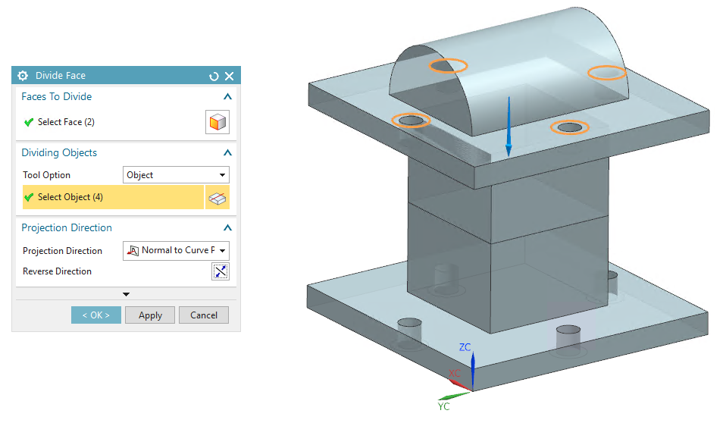
Using Divide Face to Create Bolt Head/Washer Faces
Select which faces you’d like to divide (highlighted in orange)
Select the sketch/objects you’d like to use to divide the faces (sketched circles in this case)

Slide 10
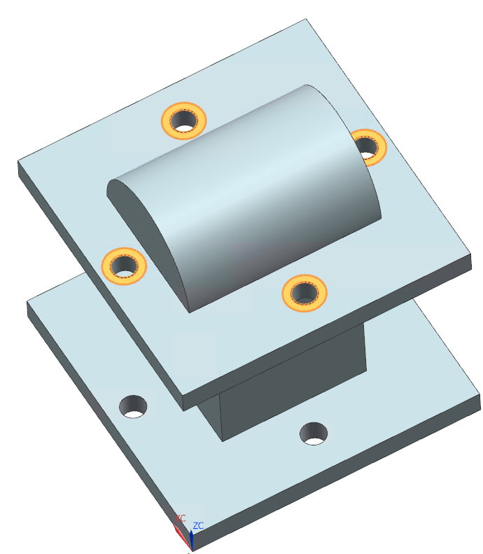
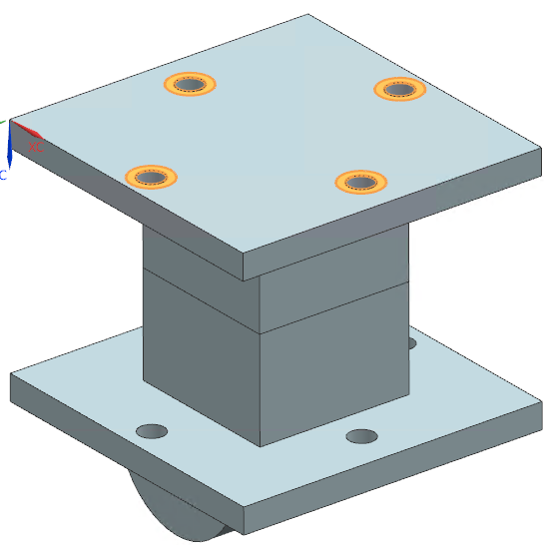
Bolt Head and Washer Faces Now Divided
Bolt Heads
Washers

Slide 11
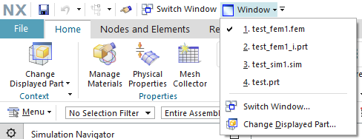
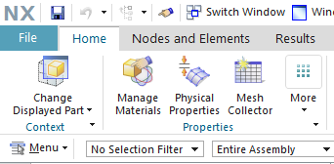
Transitioning Over to FEM
After idealization is complete, go to the Pre/Post Application
The easiest way to switch to the .fem is via the window selection dropdown
Once at the FEM, begin with the big 3…

Slide 12
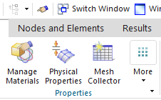
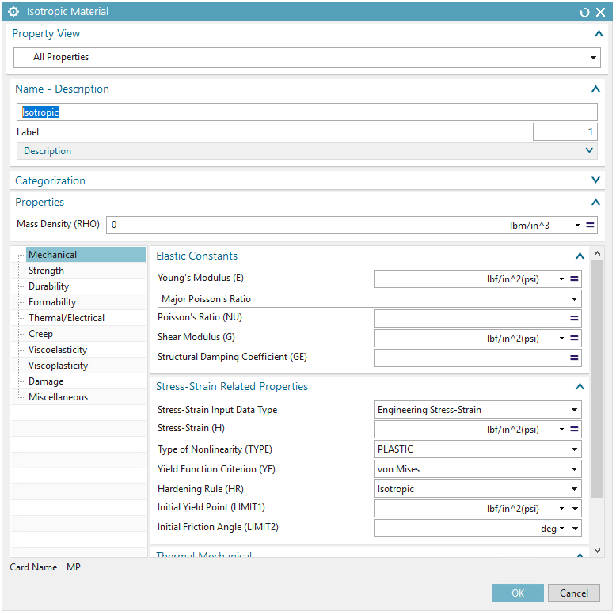
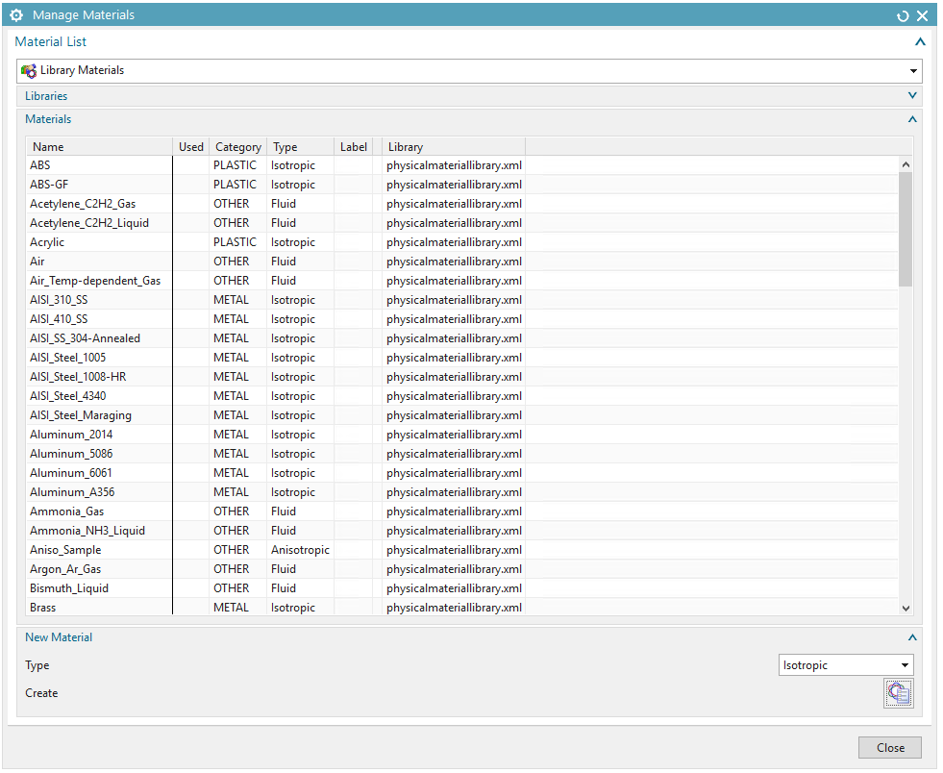
Managing Materials Used in Model
If the materials needed aren’t in the library, create custom materials by putting in the relevant info (density, YM, Poisson’s)

Slide 13
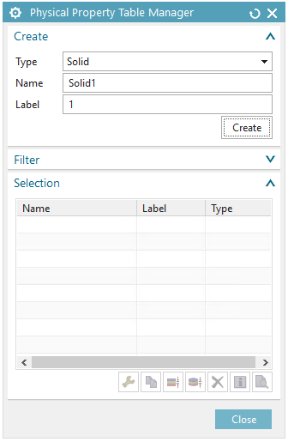
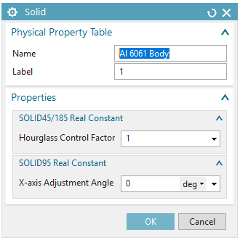
Solids
Use property manager to create physical properties for solid elements
Simply name the solid elements

Slide 14
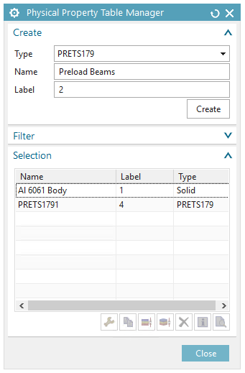
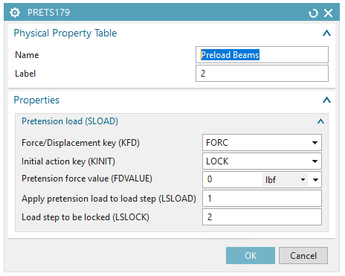
Pretension Elements: Used to Apply Preload
Leave force value as 0 for now (preload will be specified later)

Slide 15
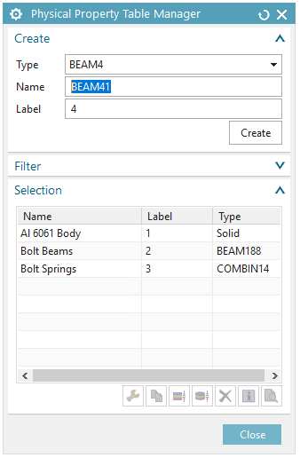
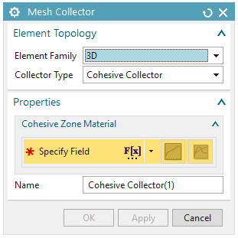
Mesh Collector: Organizing Mesh Types
Mesh collectors are used to group meshes of the same type and material

Slide 16
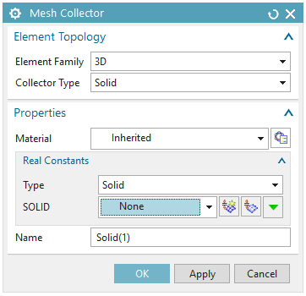
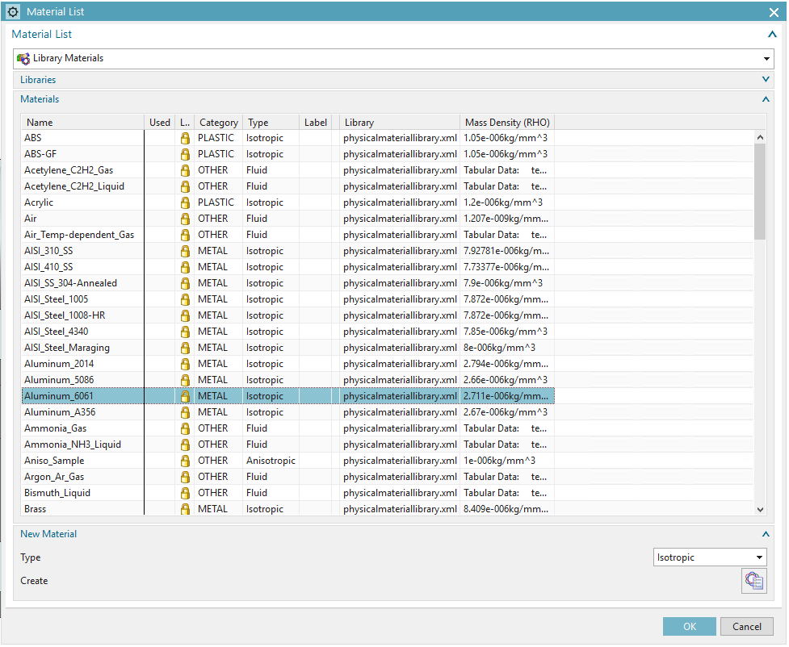
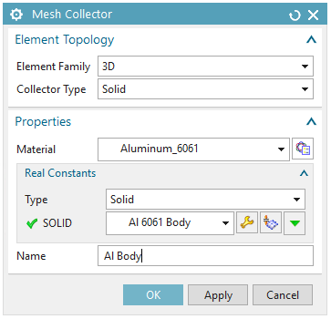
3D Solid Element Mesh Collector
Choose material from dropdown if custom, or from library
Select solid physical property from dropdown
Name the collector

Slide 17
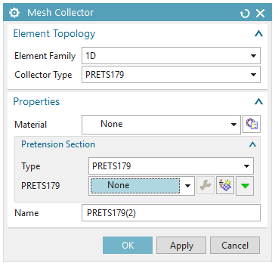
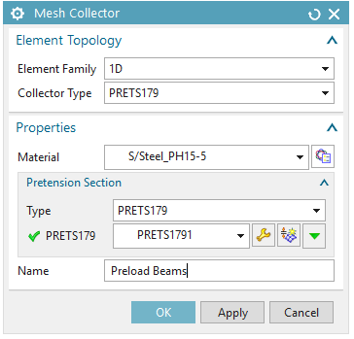
PRETS179 Mesh Collector (Preload Beams)
Same for preload mesh collector (PRETS179 elements)
Choose bolt material and PRETS179 property created from before

Slide 18
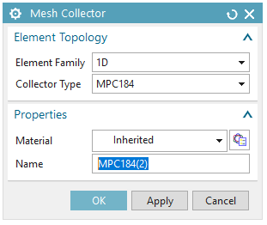
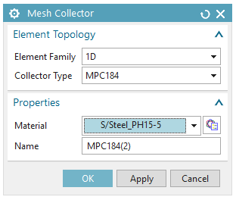
MPC184: Rigid Spider Links
Multiple Point Constraints (MPCs) are spider elements that will connect our bolt shaft (PRETS179) to the bolt head and washer faces
Need only specify material (bolt material) and give them a name

Slide 19
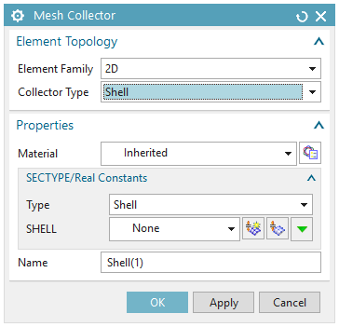
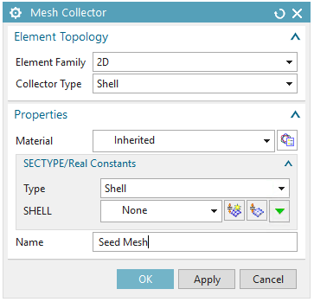
2D Shell Elements: Used for Seed Meshes
2D shell elements are not actually used in the model (in this case), just used to improve mesh
Properties/material does not matter for these

Slide 20
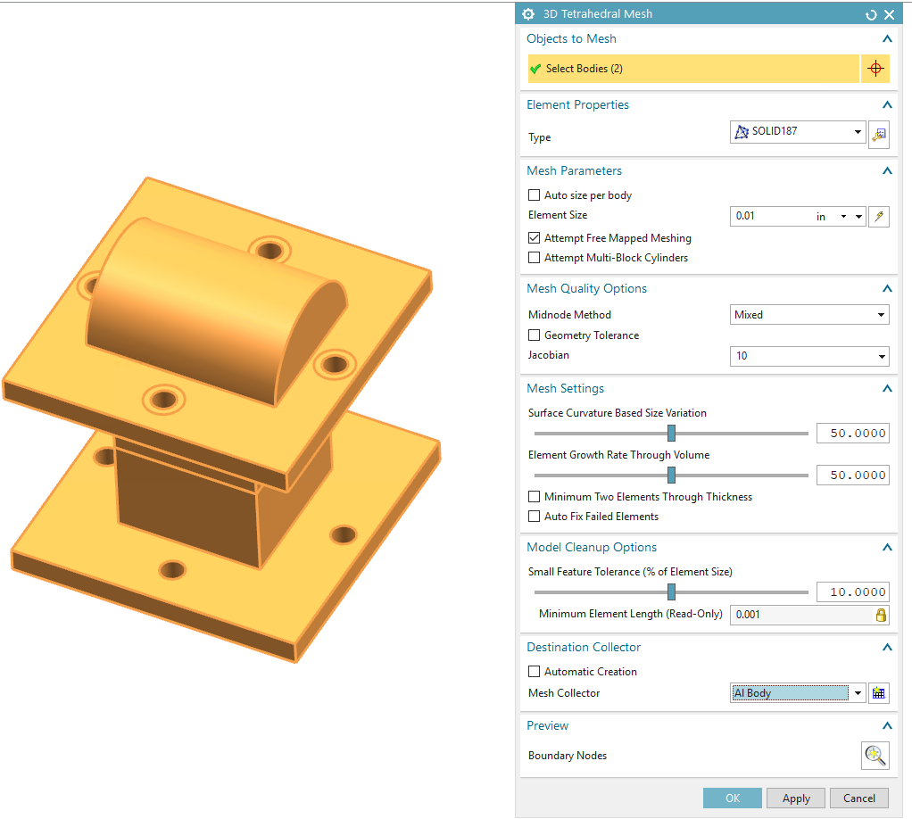
Attempting to Mesh: 3D Tetrahedral Only
Select the bodies to be meshed
Use SOLID187 (Parabolic elements) for most accurate results
Change element size (and other settings) as needed
Don’t do this part yet

Slide 21
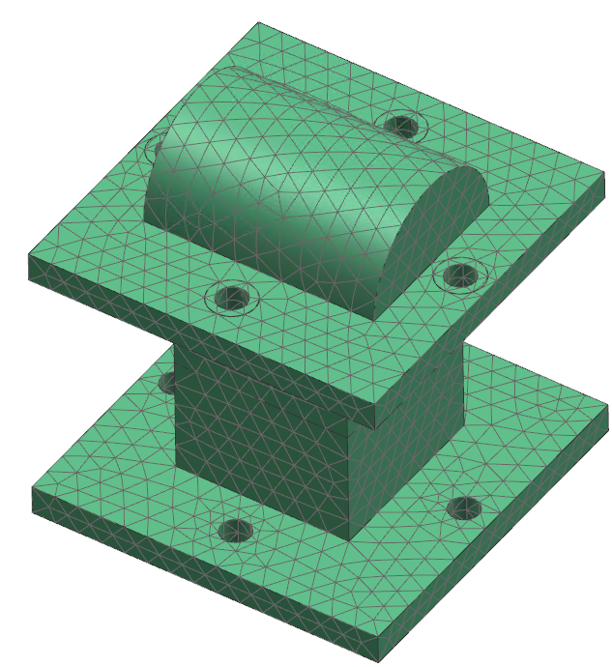
Mesh Looks Good…But Could be Better
Hit ctrl+z if you created this mesh

Slide 22
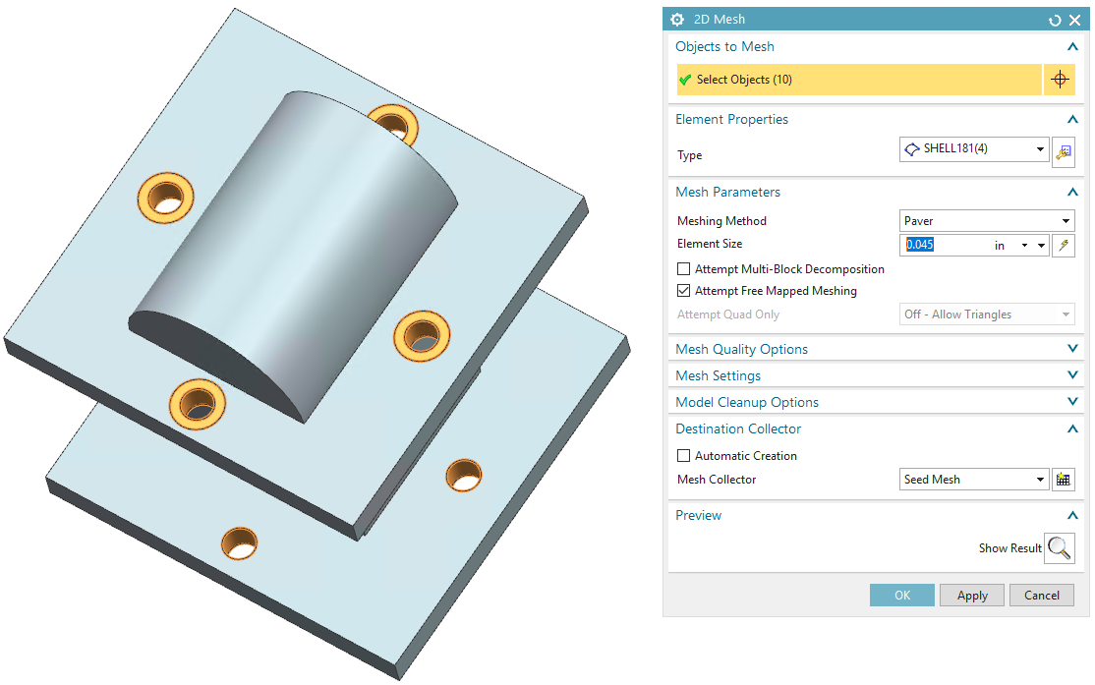
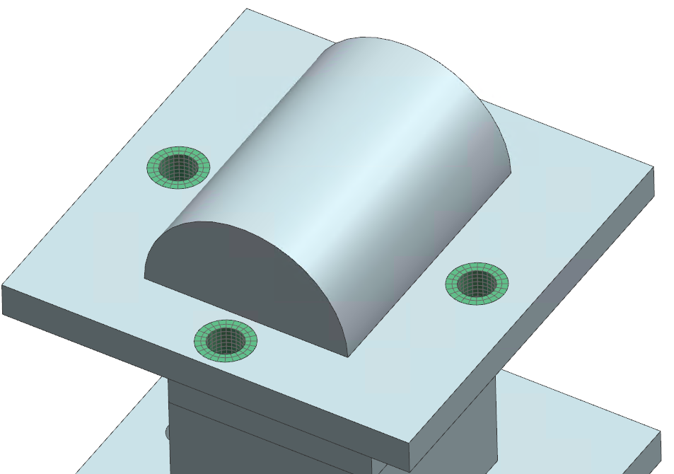
Use a Seed (Shell) Mesh on Fine Detail Areas
Create a seed mesh on the bolt/washer faces
Change element size/meshing method to produce a nicely distributed mesh
Remember to select the correct collector to group mesh under

Slide 23
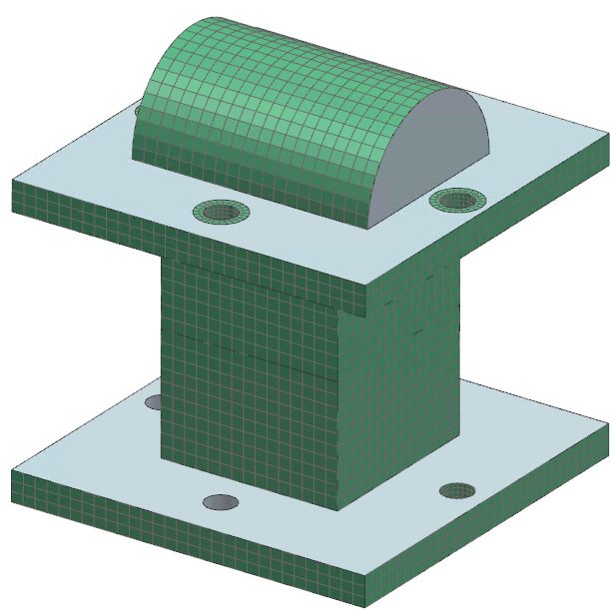
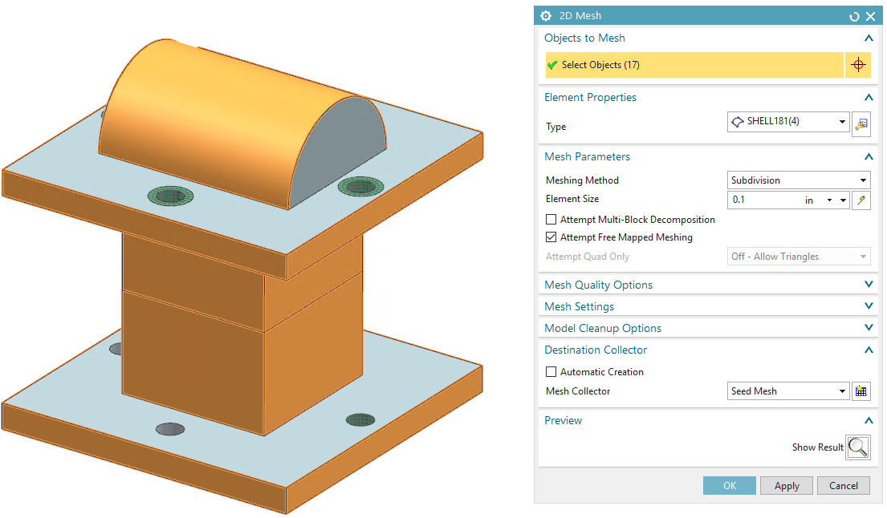
Create Seed Meshed on Other Important Areas
Make sure this is checked for curved surfaces

Slide 24
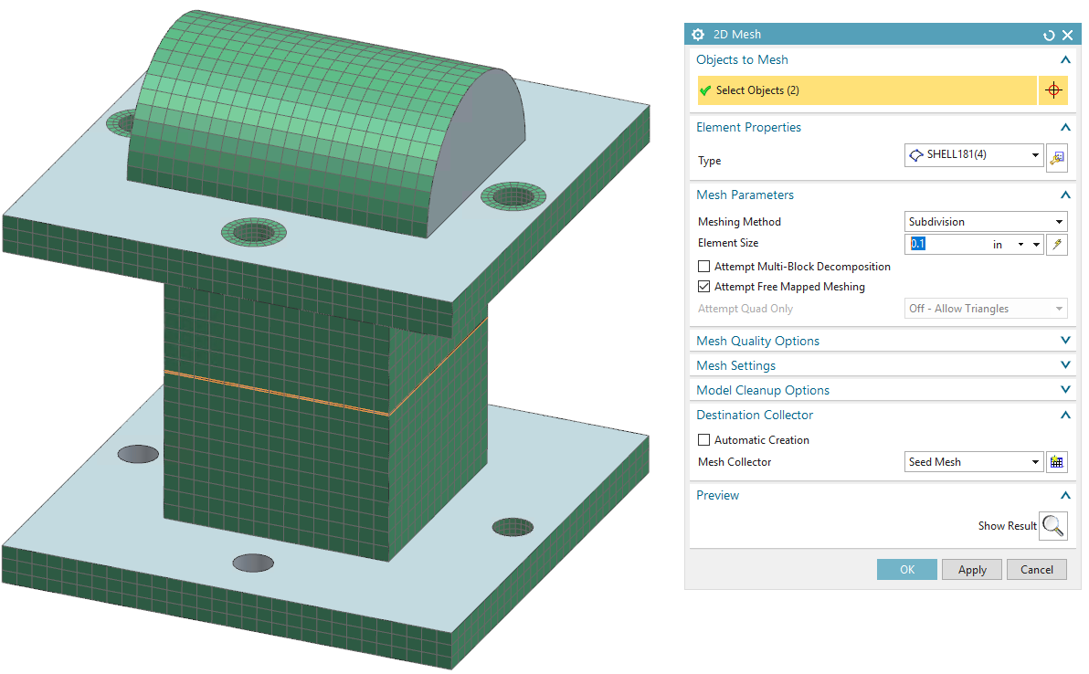
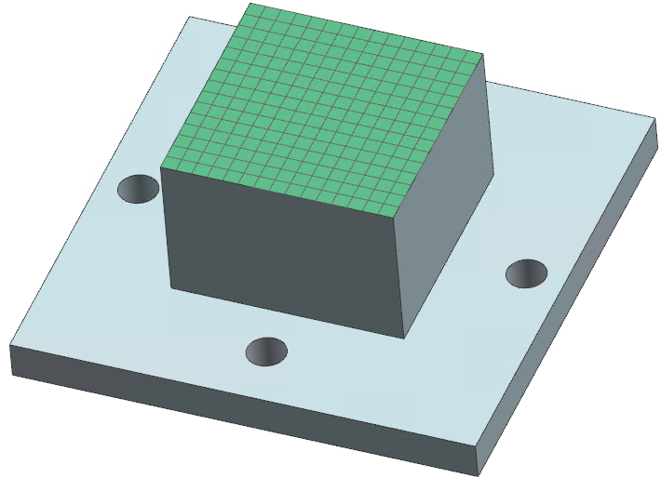
Create Seed Meshes on Contact Areas as Well
Best practice is to seed mesh both contact faces together so the meshes are uniform

Slide 25
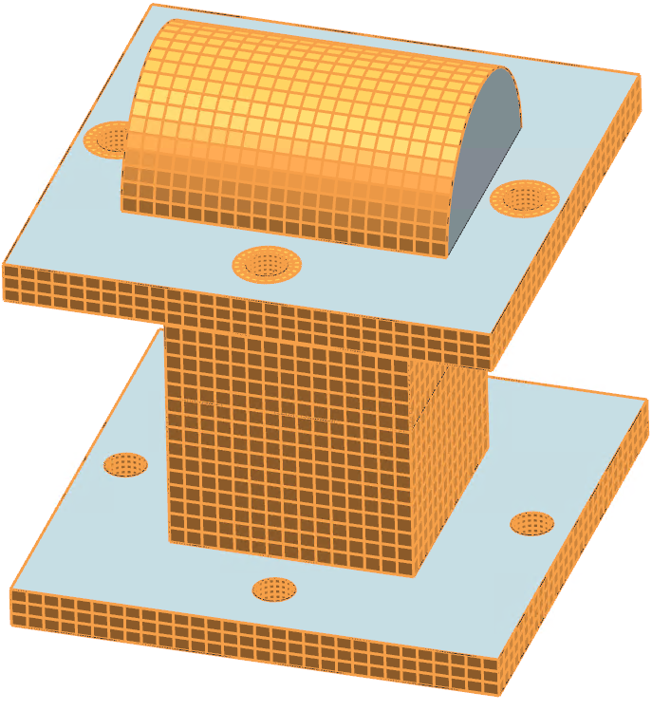
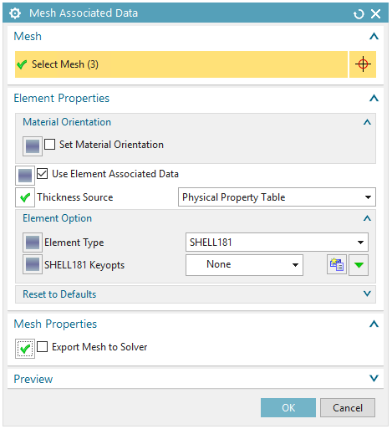
Seed Meshes are Not Used in the Model
Highlight all seed meshes and right click
UNCHECK this option as the seed meshes will NOT be part of the model (only used to make 3D mesh better)

Slide 26
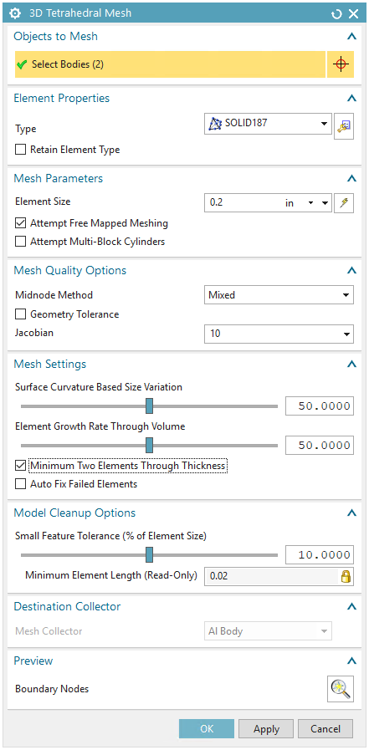
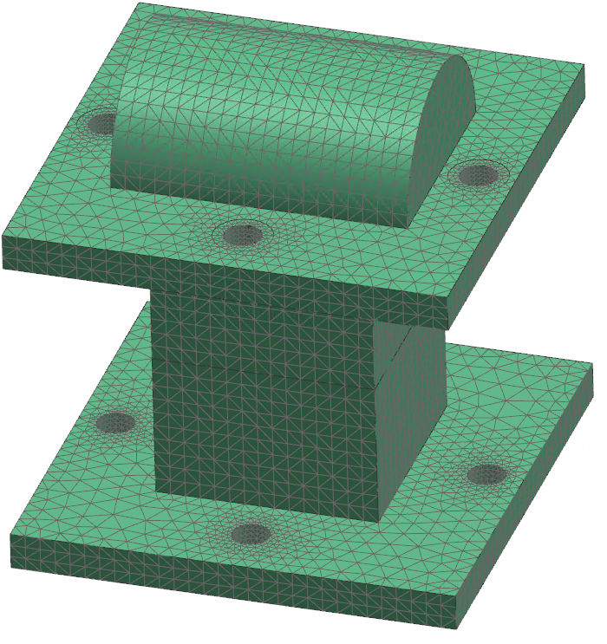
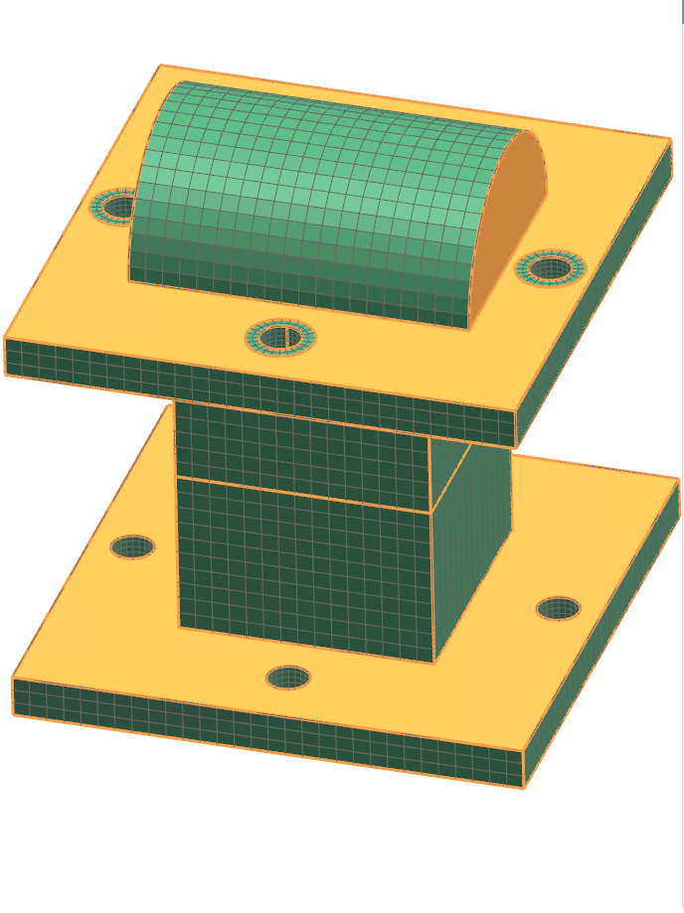
Now Create a 3D Tetrahedral Mesh
Looks much more uniform than before

Slide 27
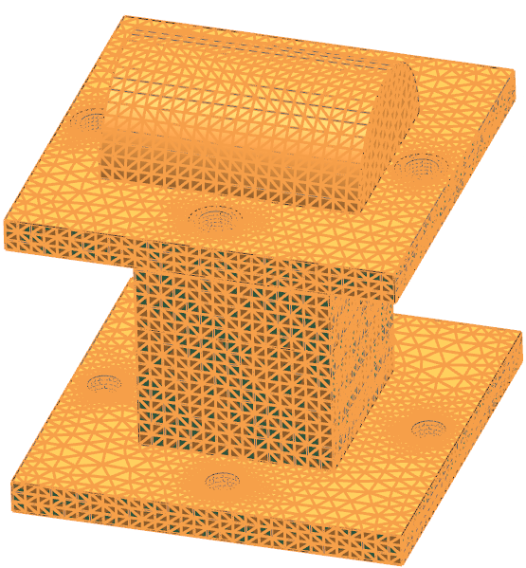
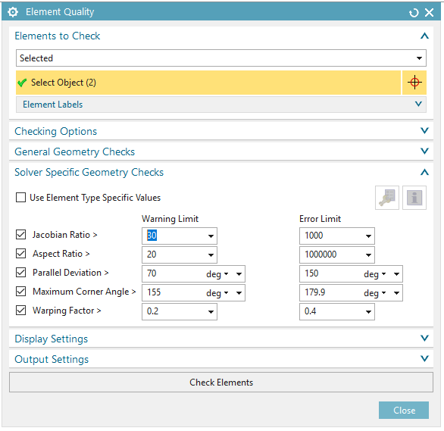
Perform an Element Quality Check
Highlight all 3D meshes and check quality
Warning elements are OK, but refine mesh if any failed elements

Slide 28
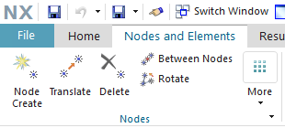
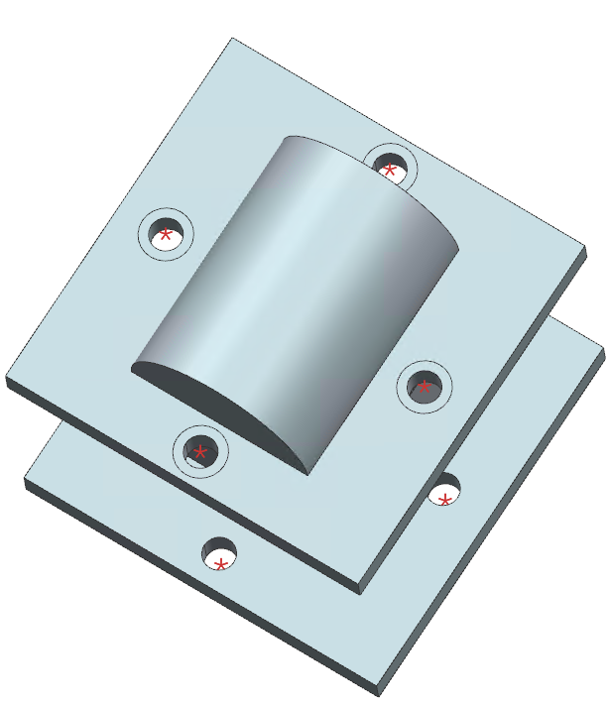
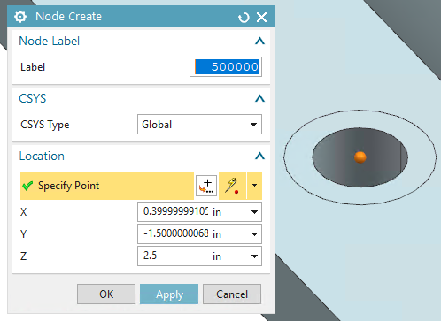
Setting up Preload: Create Center Nodes
Create center nodes at each bolt/washer location
Name them something convenient so easy to distinguish

Slide 29
Create Bolt Shafts with PRETS179 Elements
Select top/bottom node (1 source, 1 target) and create PRETS179 beam

Slide 30
Specify Pretension Node for PRETS179 Elements
Pretension node defines direction of preload
Node will need to be created somewhere in model
Resource

Slide 31
Create MPC Spider Elements to Bolt/Washer Faces
Source is center node, target is nodes on face

Slide 32
Change Key Options for MPC Meshes
MPC184 Info

Slide 33
FEM Complete

Slide 34
Create a Simulation (sim) File
Make sure to select ANSYS environment

Slide 35
Click Through .sim Creation Dialogue

Slide 36
Setting Up Boundary Conditions
In this case the bottom edges were fixed

Slide 37
Applying a Bolt Preload Force
Select the 4 PRETS179 beams
Sign of force depends on pretension node and direction specified when creating PRETS179 elements earlier (in this case sign is negative for compression)

Slide 38
Specifying Contact Areas
Manually select the source/target faces (interchangeable)
CONTA174 and TARGE170 elements created

Slide 39
Exporting Model Data to ANSYS .inp file
As there is no ANSYS license associated with Simcenter, analysis will not solve
However, ANSYS input file will be written in model directory

Slide 40
Open ANSYS Mechanical APDL Product Launcher
Make sure correct license is selected (depends on analysis type)
Select model directory and give job a name

Slide 41
Load Model .inp File into ANSYS APDL

Slide 42
Solving Through ANSYS
Analysis will solve through ANSYS and output will be a .rst file in working directory (the largest .rst file)

Slide 43
Loading Results File into Simcenter
In the .sim file, right click on Structural under Results and click Specify
Specify location of .rst file and click OK
Double (left) click on Structural to display results

Slide 44
Results are Displayed
Results are in dropdown bar on left side
Expand dropdown and double click on a result to see it

Slide 45
Refine Contour Plot for Better Visuals
Play around with display options for better contour plots

Slide 46
Good References
Use ANSYS Help manual for any element type questions (like those hyperlinked earlier)

