Slide 1
Comparative FEA Review for PIP II Hadron Dump using Ansys and Nastran
Presenter: Nnamdi Agbo
Date: 08/20/2020

Slide 2
Outline:
Thermal Analysis setup
Results
Conclusion/Findings

Slide 3
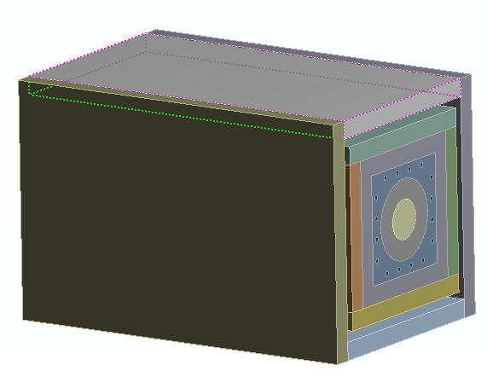
PIP II Hadron Dump
The graphite cylinder : 0.508 m
The aluminum block : 56 cm x 5​6 cm x 172 cm
The overall size : 70 cm x 70 cm x 172cm
8 cooling lines; 4 inlet and 4 return lines used
Approximate total weight is 3824.7Kg

Slide 4
PIP II Hadron Dump – Boundary Conditions
8 lines are shown in the image above, 4 inlet line at 33 deg C and
4 return lines at 39 deg C

Slide 5
PIP II Hadron Dump – Boundary Conditions
Film coefficient of 5 W/m^2 to account for convective air cooling occurring between the air gap

Slide 6
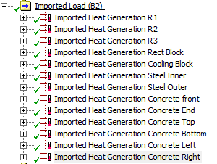
PIP II Hadron Dump – Boundary Conditions
All EDEP data where directly imported as shown above.
Convective coefficient of 5W/m^2 was equally applied to the external surfaces of the concrete

Slide 7
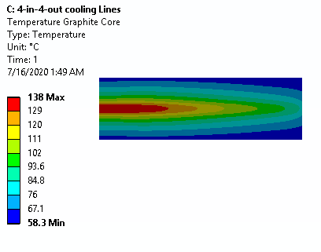
Results - Graphite Core Temperature
NX Nastran
Ansys
Max temperature recorded by NX Nastran was 129.74 deg C while 138 Deg C was reported by Ansys
Difference of 5.98%

Slide 8
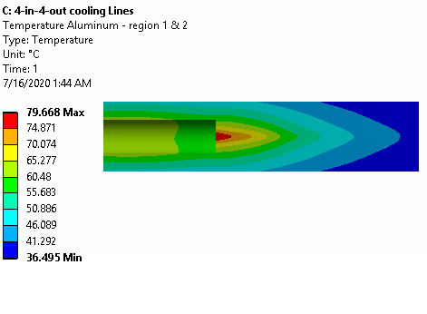
Results – Aluminum Region 2 & 3 Temperature
NX Nastran
Ansys
Max temperature recorded by NX Nastran was 82.77 Deg C while 79.668 Deg C was reported by Ansys
Difference of 3.6%

Slide 9
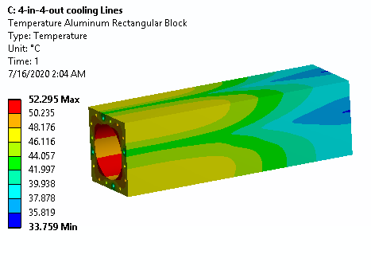
Results – Aluminum Rectangular Block Temperature
NX Nastran
Ansys
Max temperature recorded by NX Nastran was 53.67 Deg C while 52.295 Deg C was reported by Ansys
Difference of 2.6%

Slide 10
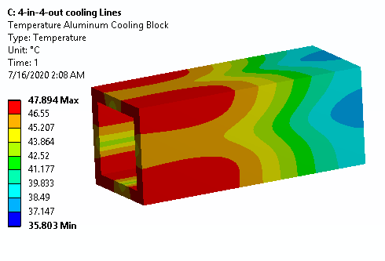
Results – Aluminum Cooling Block Temperature
NX Nastran
Ansys
Max temperature recorded by NX Nastran was 49.638 Deg C while 47.894 Deg C was reported by Ansys
Difference of 3.6%

Slide 11
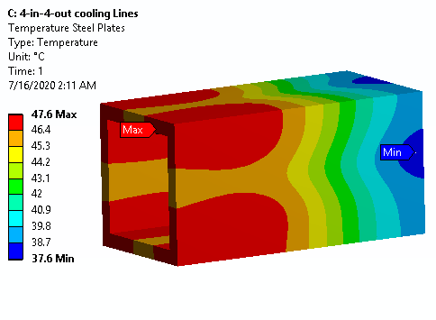
Results – Inner Steel Temperature
NX Nastran
Ansys
Max temperature recorded by NX Nastran was 49.393 Deg C while 47.6 Deg C was reported by Ansys
Difference of 3.8%

Slide 12
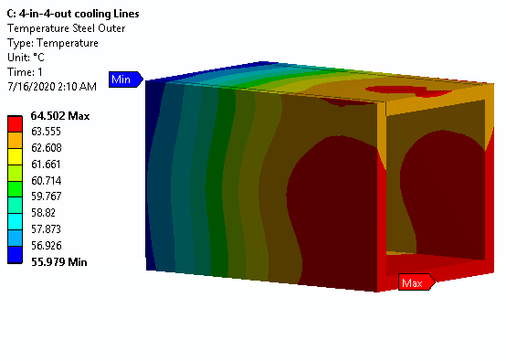
Results – Outer Steel Temperature
NX Nastran
Ansys
Max temperature recorded by NX Nastran was 67.009 Deg C while 64.502 Deg C was reported by Ansys
Difference of 3.9%

Slide 13
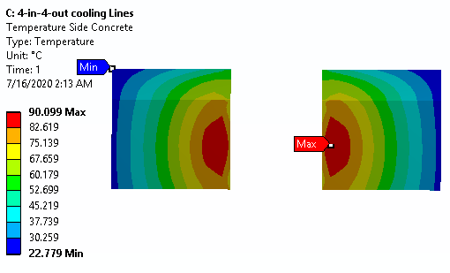
Results – Left and Right Concrete Shield Temperature
NX Nastran
Ansys
Max temperature recorded by NX Nastran was 92.32 Deg C while 90.099 Deg C was reported by Ansys
Difference of 2.5%

Slide 14
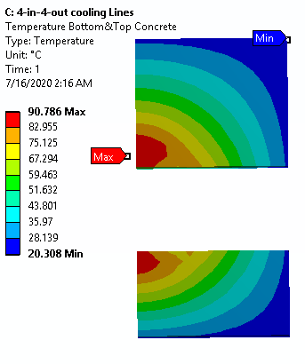
Results – Top and Bottom Concrete Shield Temperature
NX Nastran
Ansys
Max temperature recorded by NX Nastran was 94.23 Deg C while 90.786 Deg C was reported by Ansys
Difference of 3.8%

Slide 15
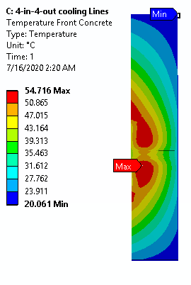
Results – Front Concrete Shield Temperature
NX Nastran
Ansys
Max temperature recorded by NX Nastran was 57.65 Deg C while 54.716 Deg C was reported by Ansys
Difference of 5.09%

Slide 16
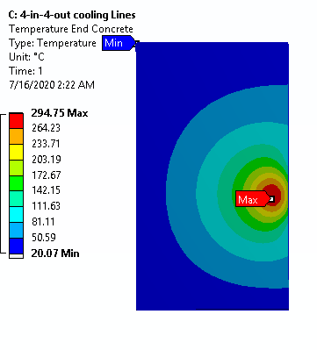
Results – End Concrete Shield Temperature
NX Nastran
Ansys
Max temperature recorded by NX Nastran was 308.96 Deg C while 294.75 Deg C was reported by Ansys
Difference of 4.8%

Slide 17
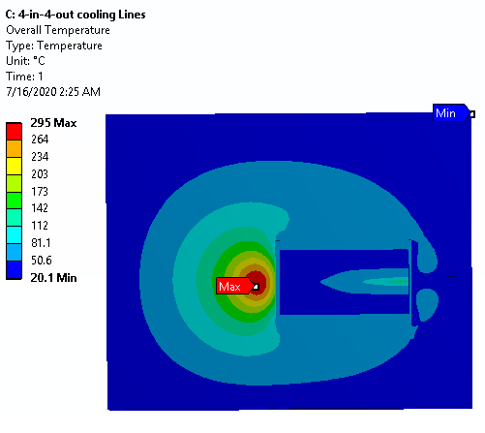
Overall Temperature Profile Cross-section
NX Nastran
Ansys
Max temperature recorded by NX Nastran was 308.96 Deg C while 295 Deg C was reported by Ansys
Difference of 4.73%

Slide 18
Results Data & Plot
Regions | NX Nastran (Max Temp) | NX Nastran (Min Temp) | Ansys (Max Temp) | Ansys (Max Temp)
Region 1 | 129.74 | 60.11 | 138 | 58.3
Region 2 & 3 | 82.77 | 42.03 | 79.668 | 36.495
Aluminum Rect Block | 53.67 | 37 | 52.295 | 33.759
Aluminum Cooling Block | 49.638 | 39.606 | 47.894 | 35.803
Inner Steel | 49.393 | 41.666 | 47.6 | 37.6
Outer Steel | 67.009 | 57.972 | 64.502 | 55.979
L & R Concrete Shield | 92.32 | 23 | 90.099 | 22.779
Top & Bottom Conrete Shield | 94.23 | 20.31 | 90.786 | 20.308
Front Conrete Shield | 57.65 | 20.06 | 54.716 | 20.061
End Conrete Shield | 308.96 | 20.07 | 294.75 | 20.07
This point both results at a 4% average percentage difference with NX Nastran seemingly more conservative
Difference mostly attributed to meshing pattern

Slide 19
Conclusion:
Meshing:
Although new to Nastran, I found the meshing process easier with relatively low mesh failure experienced especially when dealing with hex dominate meshes
By default, Nastran also offered more refined meshes which is a feature I believe offers an advantage to anyone just getting into FEA since this often results to a more conservative result. There are mesh refinement options on both software but in most cases meshing skill is often more of an art; gets better as one becomes more experience.
Setup time:
For this analysis, I found it easier to complete the setup on Ansys since I was more experienced with the software. However, one thing I found useful about the Nastran is the fact that both design and other needed setup changes could be completed within same environment.
Importing EDEP data was relatively easy on both. While Ansys used external data under the component system to do this, you just need to create a new field on Nastran sim. On both cases the process was relatively the same.
Run Time and Results
With relatively same meshing style and size applied on each component, it took about 30mins to complete this analysis on Ansys and approximately 39mins on Nastran.
From the result shown earlier, Nastran had a slightly higher result on most cases, 3% higher on the average for most cases.
The difference mostly attributed to slight differences in the mesh and could be accounted for with a reasonable safety factor applied.

Slide 20
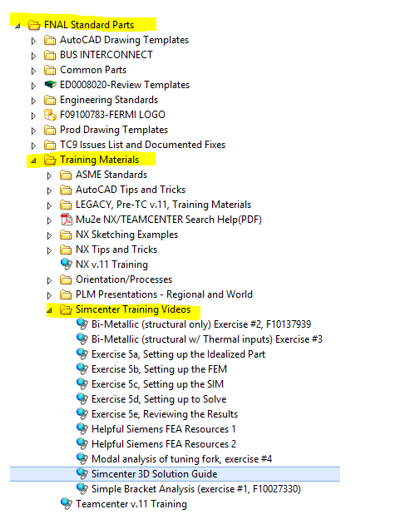
Conclusion:
License Availability and training:
At the moment, I have not experienced any license issue with Nastran as there are relatively more available license and fewer user at the moment. There are also many training resources available online
Donald Mitchell has setup the training hub for the lab which has many videos that one could start with;

