Slide 1
Snowmass’21 Accelerator Frontier
AF7 Accelerator Technology
Magnet LoI
Status and Plans
LoI Authors
August 27, 2020

Slide 2
AF7/Magnet LoI Presentations
Regional program overviews
  US (Prestemon); EU (Bottura); Japan (Ogitsu); China (Xu)
Detector Magnets
  FCC-hh, FCC-ee, AMS (Mentink); J-PARC g-2/EDM, COMET-I&II, ILC (Sasaki)
New superconducting wire and cable development
  Ultra thin A-15 (Kitaguchi); PIT-IBS (Ma)
Dipole magnet design and development
  Cosθ, CCT, Fast ramping (Fabbricatore); Block (Felice); Common coil (Gupta); REBCO (Wang); Bi-2212 Accelerators (Garcia-Fajardo); Hybrid Nb3Sn/HTS (Ferracin); Bi-2212 Solenoids (Davis);
Special magnets and new fabrication technologies
  Direct wind, high field solenoids (Amm); wind-react-wind (Caspi)
New accelerator concepts
  Collider in the sea (McIntyre)

Slide 3
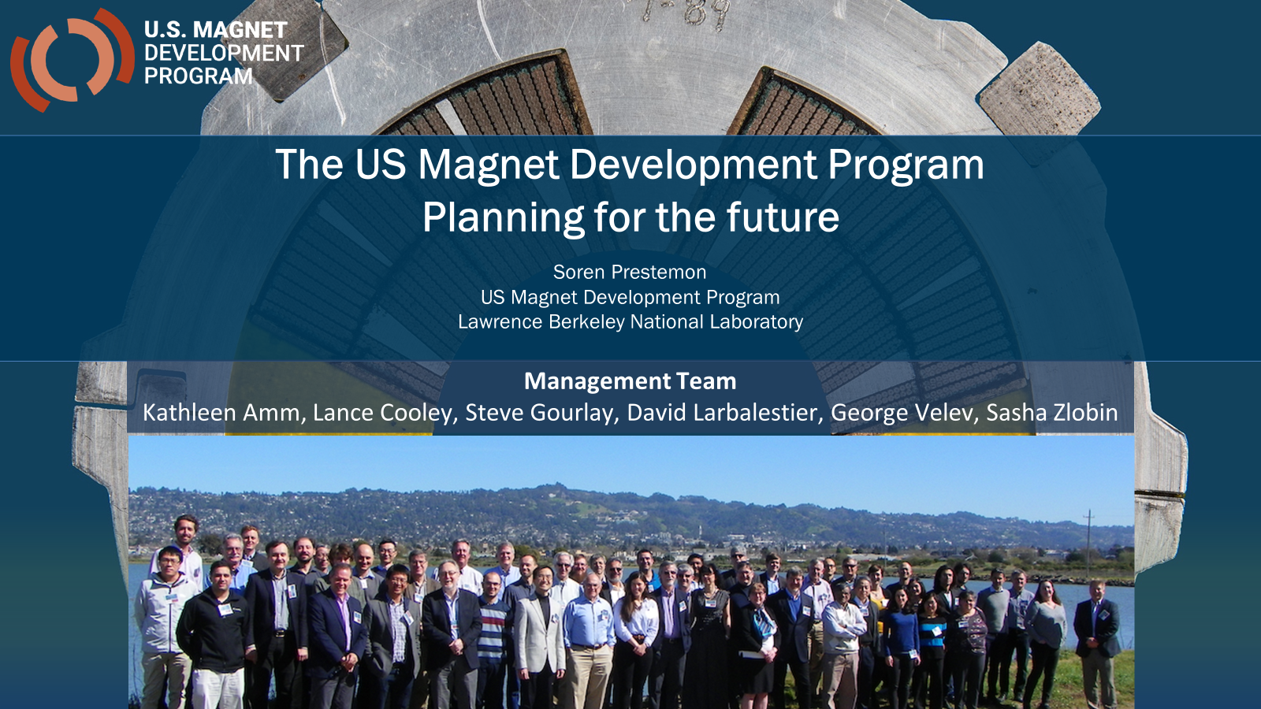
US Magnet Development Program

Slide 4
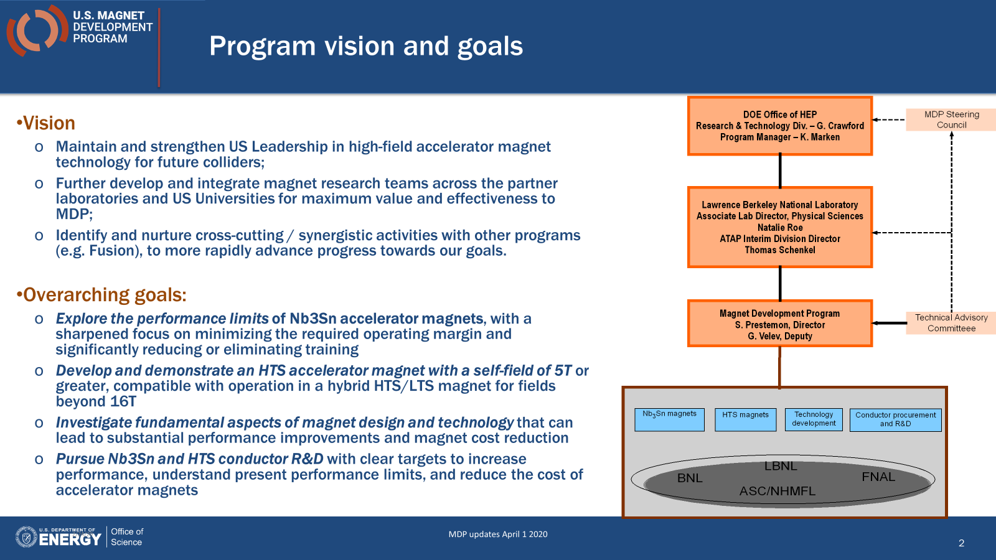
US Magnet Development Program

Slide 5
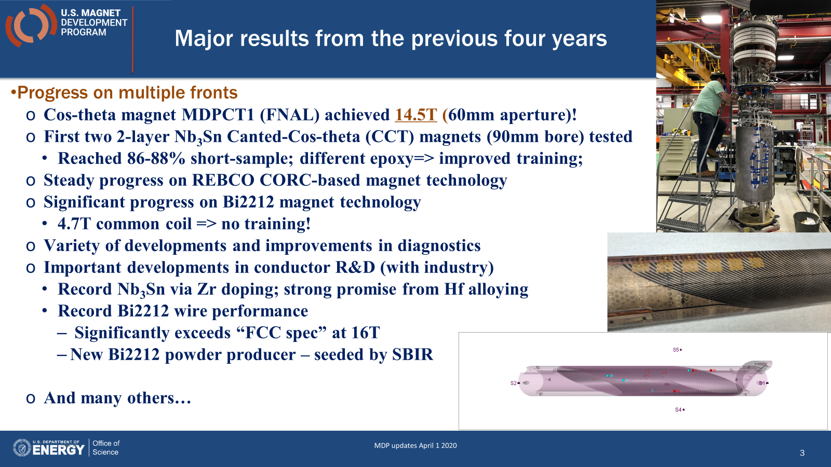
US Magnet Development Program

Slide 6
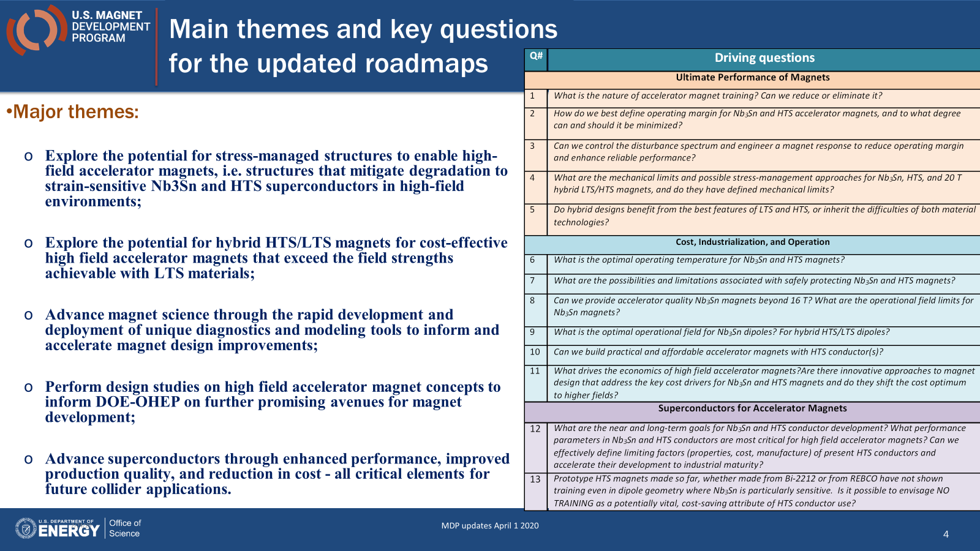
US Magnet Development Program

Slide 7
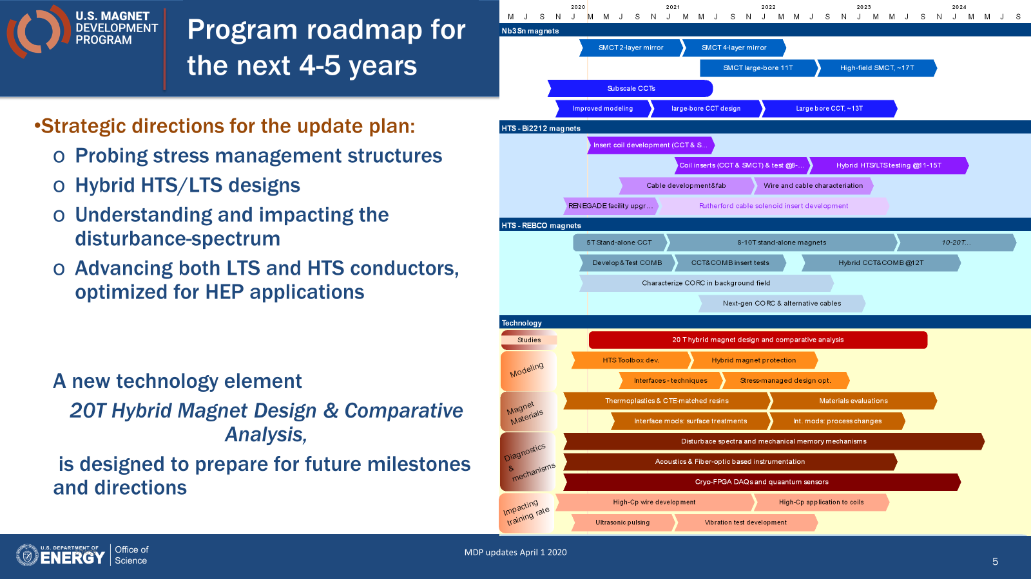
US Magnet Development Program

Slide 8
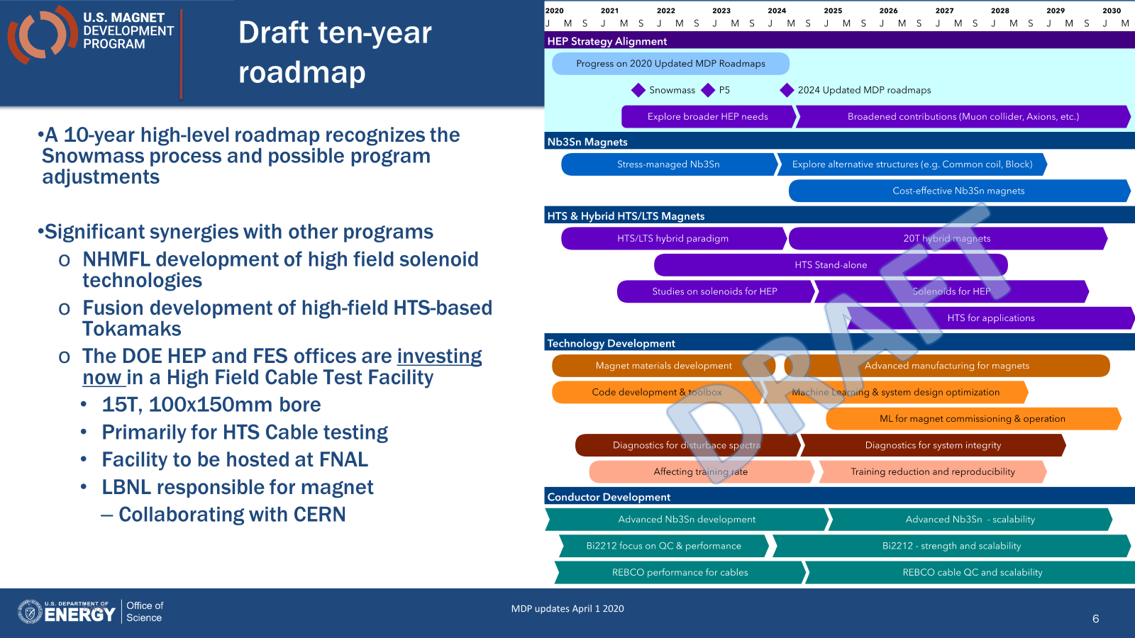
US Magnet Development Program

Slide 9
High Field Magnet Development for HEP – A Proposal
L. Bottura (CERN), B. Auchmann (CERN), A. Ballarino (CERN), A. Devred (CERN), S. Izquierdo-Bermudez (CERN), L. Rossi (CERN), F. Savary (CERN), E. Todesco (CERN), D. Tommasini (CERN), G. De Rijk (CERN), D. Schoerling (CERN)
H. Felice (CEA), P. Vedrine (CEA)
F. Toral (CIEMAT), L. Garcia-Tabares Rodriguez (CIEMAT), J.-M. Perez (CIEMAT)
P. Fabbricatore (INFN), S. Farinon (INFN), M. Sorbi (INFN)
M. Seidel (PSI), S. Sanfilippo (PSI)
C. Senatore (UniGe)
B. Holzapfel (KIT), M. Noe (KIT), T. Arndt (KIT)
NOTE: draft author list for the moment

Slide 10
The Status (August 2020)
The HL-LHC Nb₃Sn program has set a new benchmark: we have completed the initial model and prototype magnet development for operation in the 11-12 T field range and the next step is to capitalize on it, use this benchmark to develop industrial, robust and efficient techniques
We have a few demonstrators showing that Nb₃Sn has the potential to operate at fields beyond 14 T, the next step is to confirm this potential with model magnets and prototypes
We have not yet had the opportunity to explore the potentials of HTS, the next step is to develop and test demonstrators to assess this technology

Slide 11
HFM Mission Statement (2021-2027)
Push Nb₃Sn magnet technology to its practical limit, both in terms of maximum performance as well as production scale
  Demonstrate Nb₃Sn full potential in terms of ultimate performance (target 16 T)
  Develop Nb₃Sn magnets for collider-scale production, through robust design, industrial processes and cost reduction (benchmark 12 T)
Provide a proof-of-principle for HTS magnet technology beyond the reach of Nb₃Sn, and sufficient field quality for accelerator application (target in excess of 20 T)
I
II
III
OMNE TRIVM PERFECTVM

Slide 12
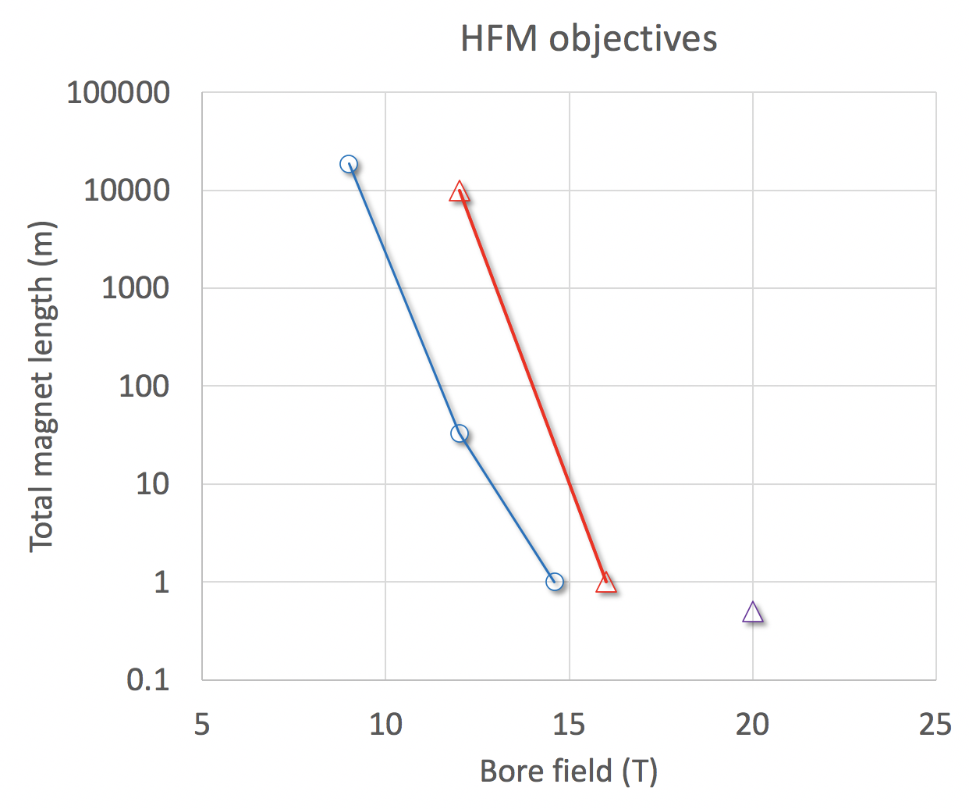
HFM Mission Statement (2021-2027)
LHC
Value-engineered Nb₃Sn
HL-LHC
Next phase
Fresca2
MDPCT1
Ultimate Nb₃Sn performance
HTS target
NOTE: we move in parallel along both fronts !

Slide 13
Future plans
A paper is in drafting phase, shared with the collaborators (description of the HFM program)
Discussions are on-going with present and potential collaborators
The program is intended as a collaborative effort, and will benefit from coordination and communication (worldwide)
  How to build the structure of the program (work packages)
  How to coordinate ands communicate
    A governance ?

Slide 14
R&D work for Superconducting Magnet for Future Accelerator Applications
Toru Ogitsu^{1a}, Tatsushi Nakamoto¹, Ken-ichi Sasaki¹, Michinaka Sugano¹, Masami Iio¹, Kento Suzuki¹, Makoto Yoshida², Satoshi Awaji^{3b}, Naoyuki Amemiya^{4c}, Yusuke Sogabe⁴;
  ¹ KEK Cryogenics Science Center, ² KEK Institute of Particle and Nuclear Physics,
  ³ Tohoku University High Field Laboratory for Superconducting Materials,
  ⁴ Kyoto University Graduate School of Engineering Department of Electrical Engineering
Technical Highlights
  High Field Superconducting Accelerator Magnet Technologies
  Radiation Hard Superconducting Magnet Technologies
Technology | Near Term Target | Mid Term Target | Ultimate Target
High Field | High Field High Jc Reinforced Nb₃Sn | 12T Large Aperture R&D Dipole | High Field Radiation Hard SC Magnets for Future High Energy and High Intensity Accelerators (FCC, Muon Collider..)
Radiation Hard | Radiation Hard HTS Mag. Technologies | J-PARC MLF 2nd Target

Slide 15
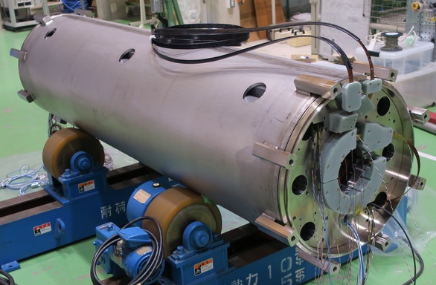
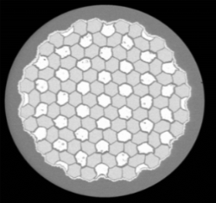
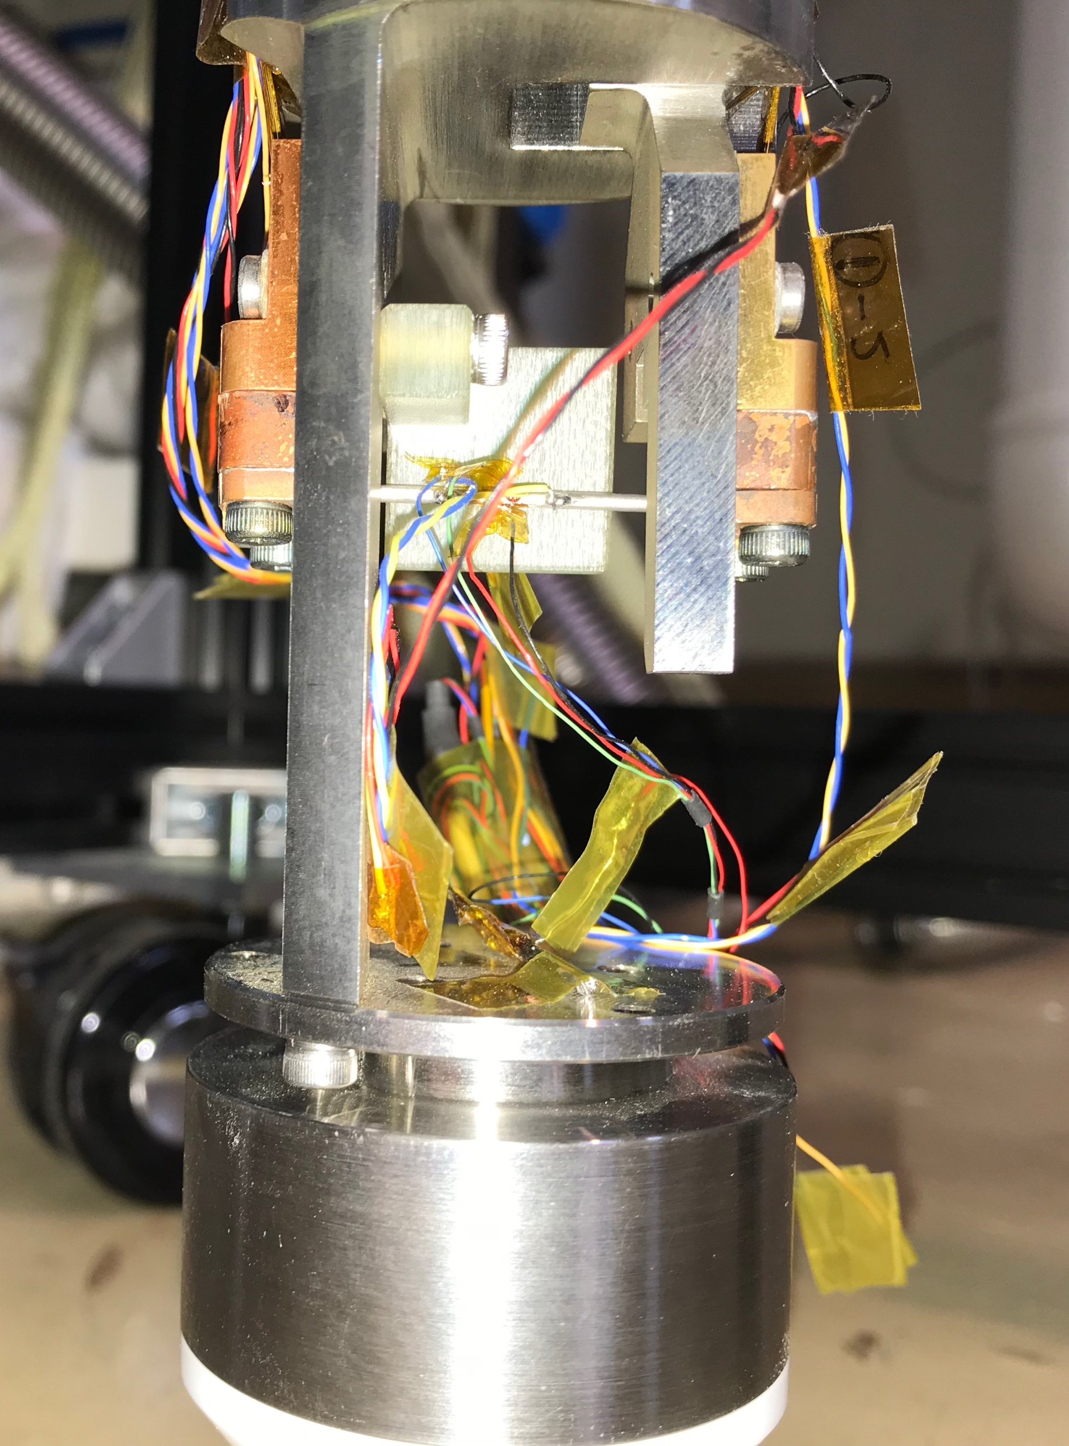
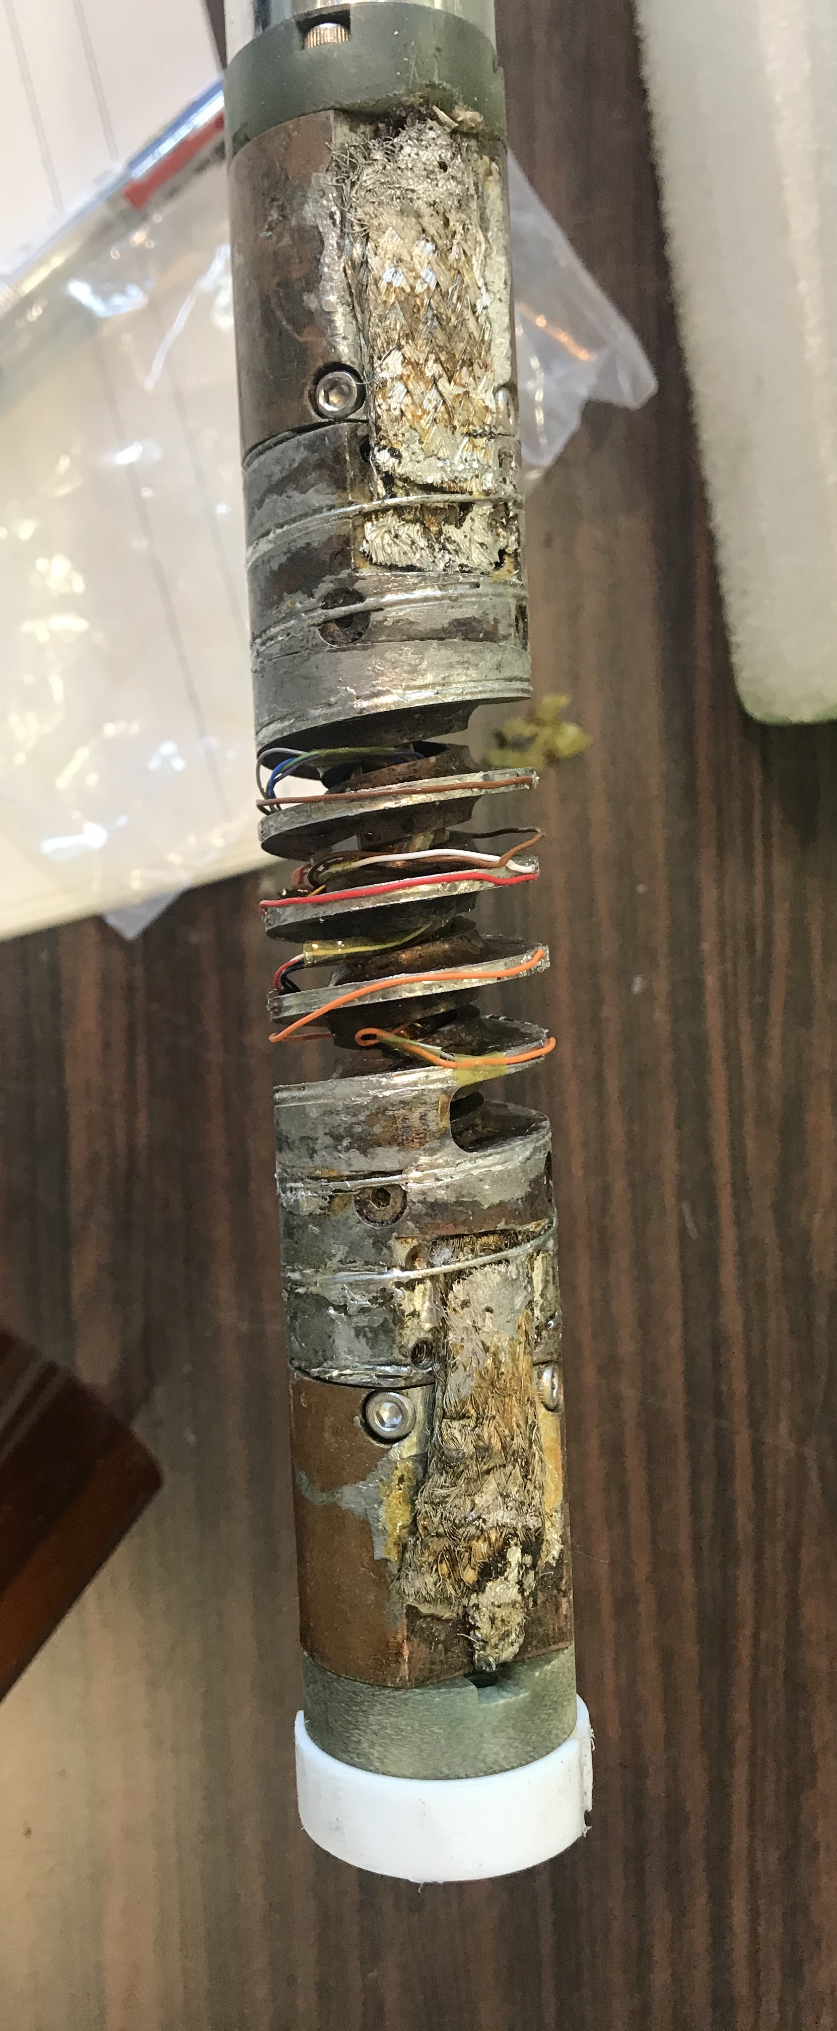
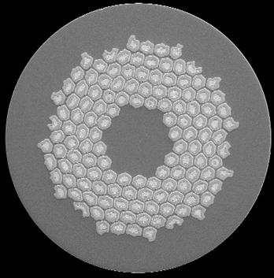
R&D work for Superconducting Magnet for Future Accelerator Applications
High Field Superconducting Accelerator Magnet Technologies
12 T large aperture (100mm) Nb₃Sn dipole magnet development (FCC D1 Model)
HL-LHC D1 Development
FCC D1 Design Study
High Field High Jc Nb₃Sn R&D (with Mechanical Reinforcement)
16 T dipole magnet R&D with 4 T Nb₃Sn insert
Strain-Jc Measurement Instruments
Internal Strain Measurement by Neutron Diffraction at J-PARC
20 T dipole magnet R&D with 8 T HTS insert

Slide 16
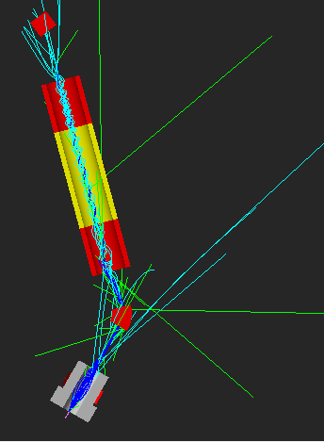
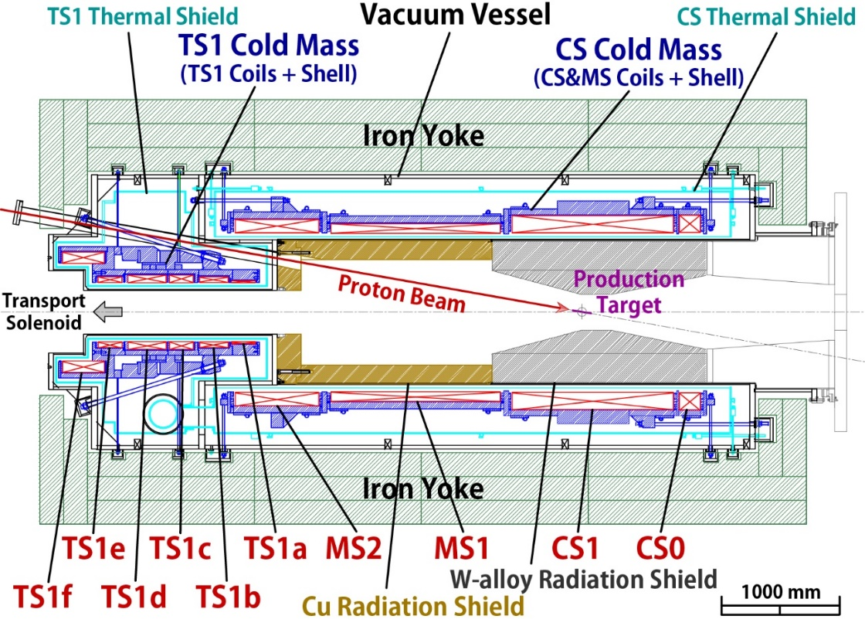
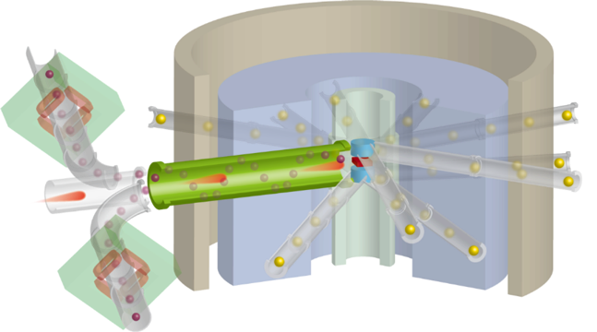
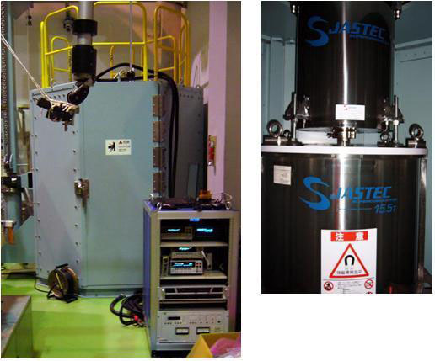
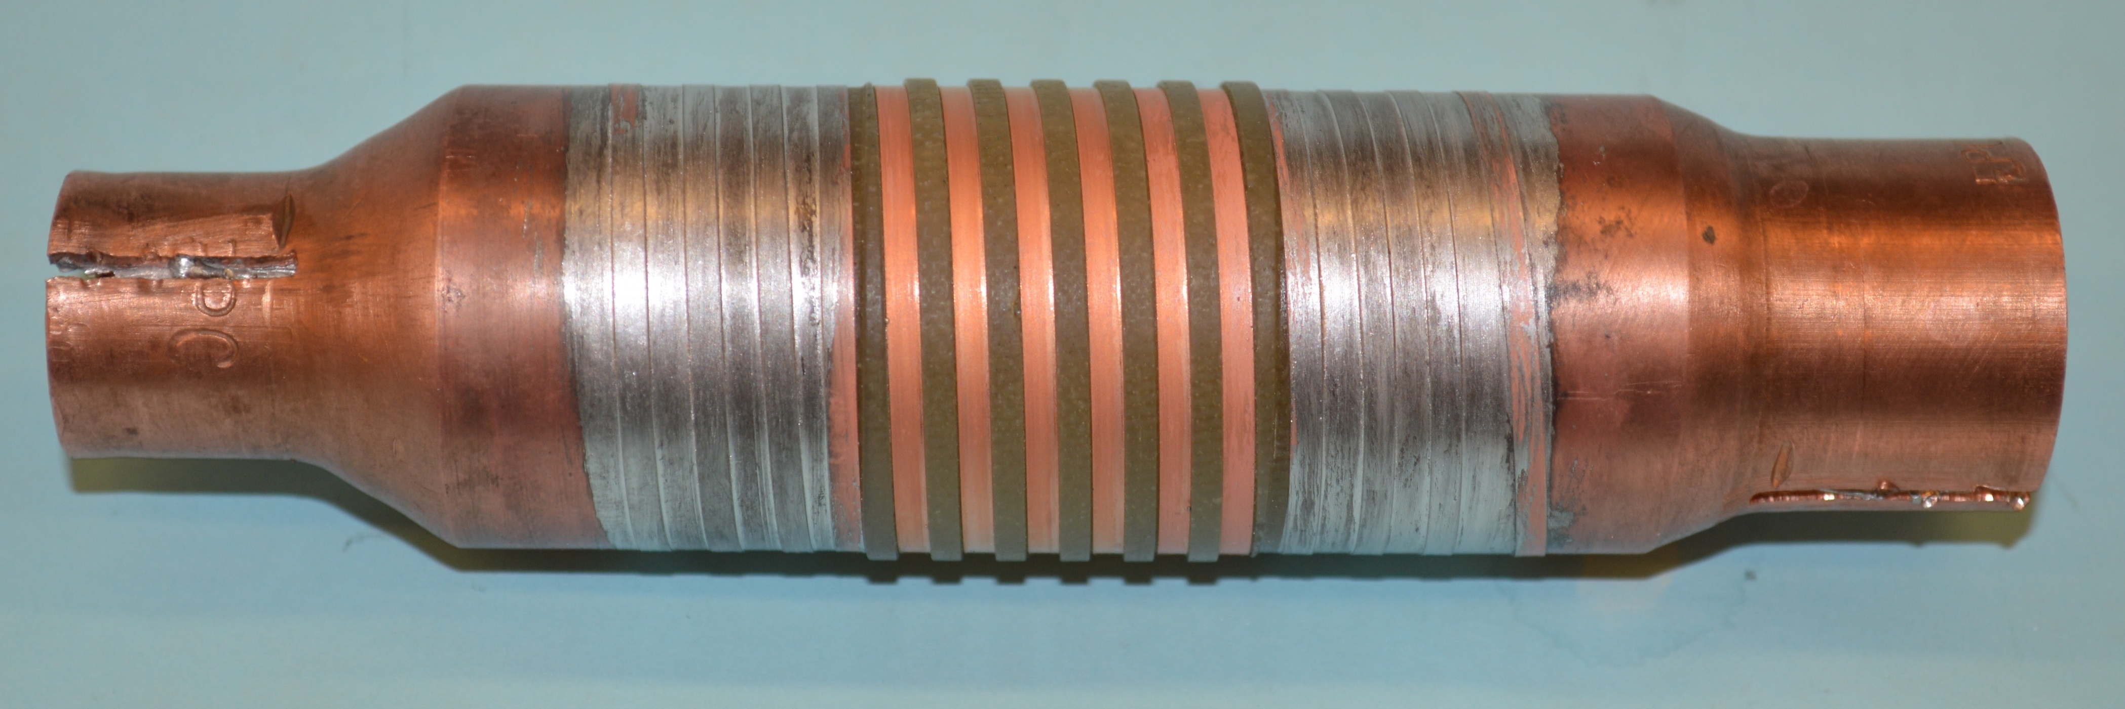
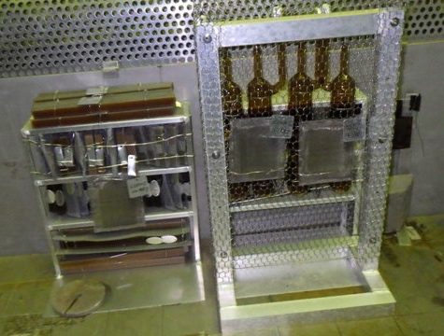
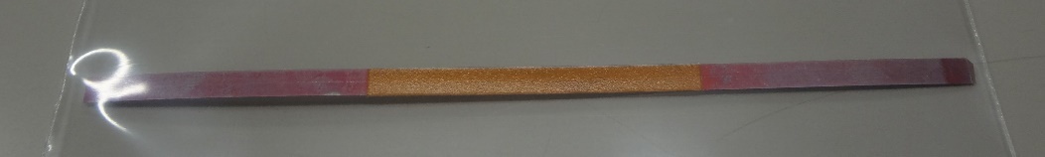
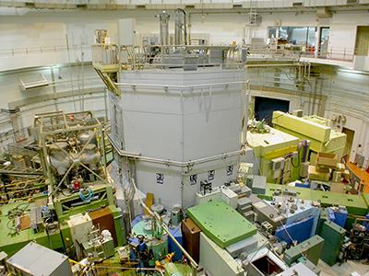
R&D work for Superconducting Magnet for Future Accelerator Applications
Radiation Hard Superconducting Magnet Technologies
COMET Capture Solenoid Development
J-PARC MLF Second Target Design Study
J-PARC MLF Second Target with High Intensity Muon Source
1MW Proton Beam
SCS4050-AP (SuperPower)
US-JP R&Ds
High Field Radiation Hard SC Magnet Technologies
Neutron Irradiation on Superconductor
Inorganic Insulation Study
HTS Quench Protection Study
(Al Stabilizer
See Sasaki’s Proposal)
Gamma Irradiation on Organic Material
FCC IRQ
Muon Collider
Etc..

Slide 17


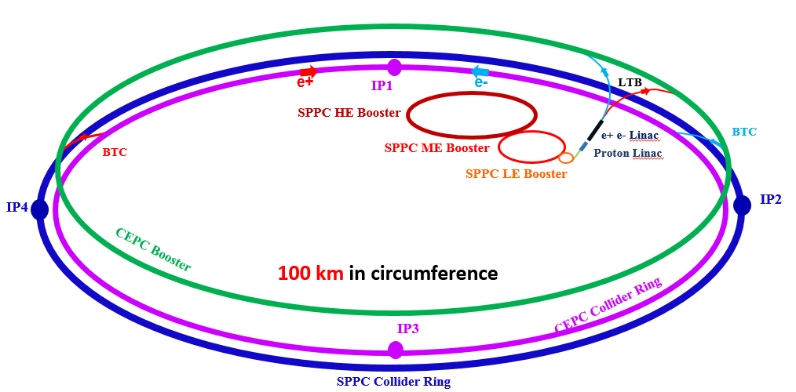
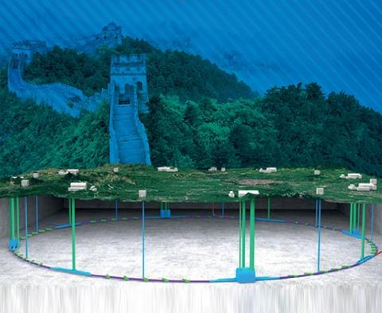
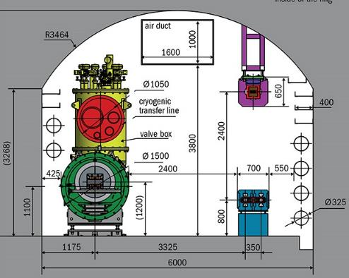
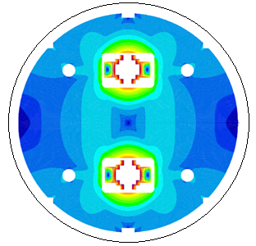

Status and Plan of the High Field Magnet R&D
for Future Accelerators
Qingjin Xu (IHEP-CAS) and Yanwei Ma (IEE-CAS)
SPPC Magnet Design Scope
Field strength: 12-24 Tesla to get 75-150 TeV in a 100-km tunnel
Baseline Iron-Based Superconductor (IBS), Nb₃Sn/ReBCO etc. as options
Aperture diameter: 40~50 mm
Field quality: 10⁻⁴ at the 2/3 radius
CEPC
booster
SPPC
collider
CEPC
collider
Site study of the CEPC-SPPC
6-m width Tunnel for CEPC-SPPC
SPPC Dipole with IBS

Slide 18
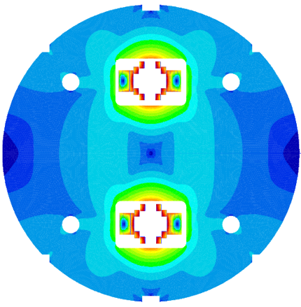
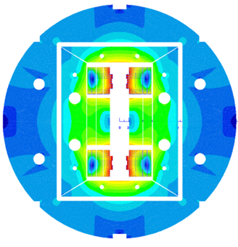
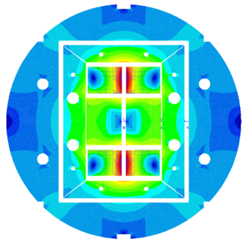
Status and Plan of the High Field Magnet R&D
for Future Accelerators
Qingjin Xu (IHEP-CAS) and Yanwei Ma (IEE-CAS)
Field (T)
R&D Roadmap for next years
20
Nb₃Sn+HTS
2*ф30 aperture
15T @ 4.2K
NbTi+Nb₃Sn
2*ф10 aperture
10T @ 4.2K
Nb₃Sn+HTS or HTS
2*ф45 aperture
20T @ 4.2K
With 10⁻⁴ field quality
10
year
2018
2028

Slide 19
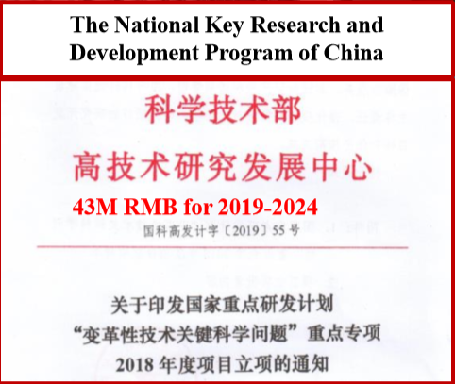
Status and Plan of the High Field Magnet R&D
for Future Accelerators
Qingjin Xu (IHEP-CAS) and Yanwei Ma (IEE-CAS)
Now China has two 5-Year Programs for IBS and high-field magnets, starting in 2018 and 2019, respectively.
Proposal for
Strategic Priority Research Program
of Chinese Academy of Sciences (CAS)
Science and Technology Frontier Research
for High Field Applications of High Temperature Superconductors
Ranked No. 1 in 7 candidates
by Academic Committee of CAS
360M RMB for 2018-2023
R&D from Fundamental research, advanced IBS conductors to Magnet & SRF technology
Mainly 122 PIT wires & tapes
11 coated conductors
(100 m long fabrication)
International collaboration are welcome!

Slide 20
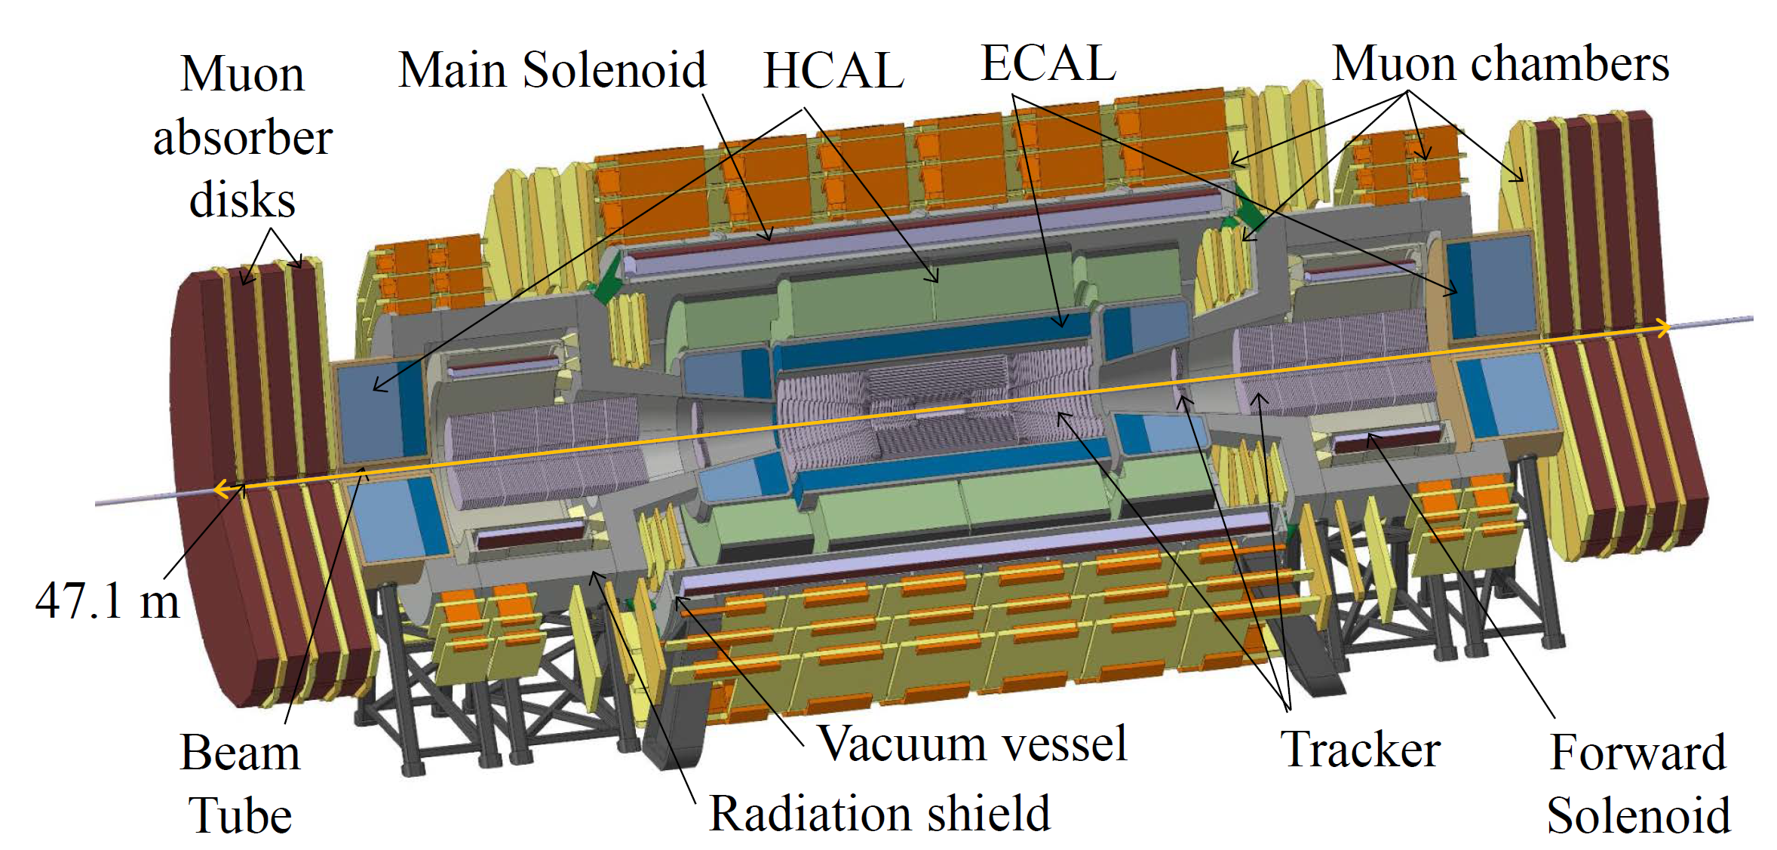
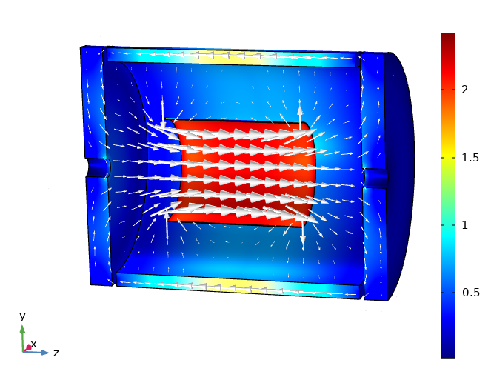
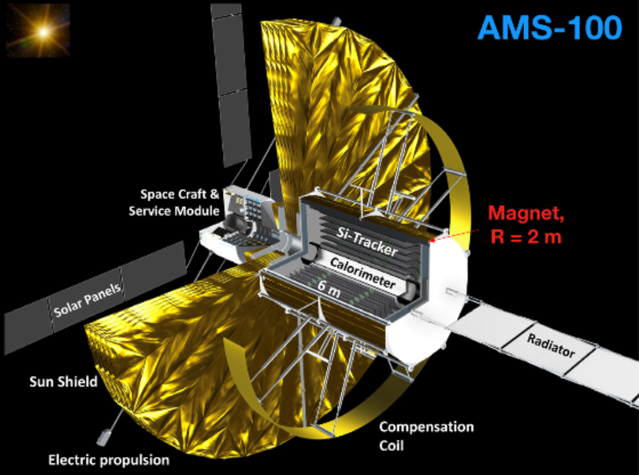
Superconducting Detector Magnets for High Energy Physics
Matthias Mentink, Helder Pais Da Silva, Tim Mulder, Alexey Dudarev, CERN
Technical Highlights:
  FCC-hh baseline detector design comprising superconducting solenoids utilizing aluminum-stabilized Nb-Ti conductor
  FCC-ee “IDEA” baseline detector design, featuring ultra-transparent solenoid utilizing high-stress aluminum-stabilized Nb-Ti conductor
  ReBCO-based ultra-transparent concentric superconducting solenoid for AMS-100 [1,2], also of interest for FCC-ee
Solenoid
Return yoke
B [T]
FCC-hh baseline design featuring superconducting Al/Nb-Ti solenoids
FCC-ee “IDEA”baseline design featuring
ultra-transparent Al/Nb-Ti solenoid
AMS-100 featuring ultra-transparent
ReBCO-based concentric solenoid [2]
In collaboration with: University of Aachen, Paul Scherrer Institute, University of Geneva
S. Schael et al., https://doi.org/10.1016/j.nima.2019.162561

Slide 21
Development of Large Scale Superconducting Solenoid Technologies for Future Accelerator Experiments
Ken-ichi Sasaki¹, Mitsushi Abe¹, Makoto Yoshida², Masami Iio¹, Takahiro Okamura², Yasuhiro Makida², Naoyuki Sumi¹, Toru Ogitsu¹, Hiromi Iinuma³;
  ¹ KEK Cryogenics Science Center, ² KEK Institute of Particle and Nuclear Physics, ³ Ibaraki University Graduate School of Science and Engineering,
Technical Highlights
  Technology for high precision magnetic field design, control and mechanical design in 3-D and cryogenic system.
  R&D for advanced Al stabilized superconducting cable
 | Near Term Target | Mid Term Target | Ultimate Target
Design technology | J-PARC g-2/EDM COMET Phase-I | COMET Phase-II J-PARC MLF 2nd Target | ILD for ILC Detector for FCC Magnets for High Intensity Muon source
Al stabilized SC cable | Basic R&D -Advanced NbTi -HTS | Production
Notes:
(e.g. extended write-ups, collaboration opportunities, open questions for discussion)

Slide 22
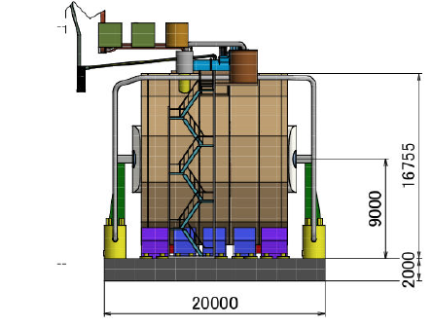
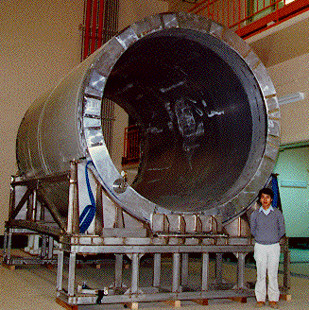
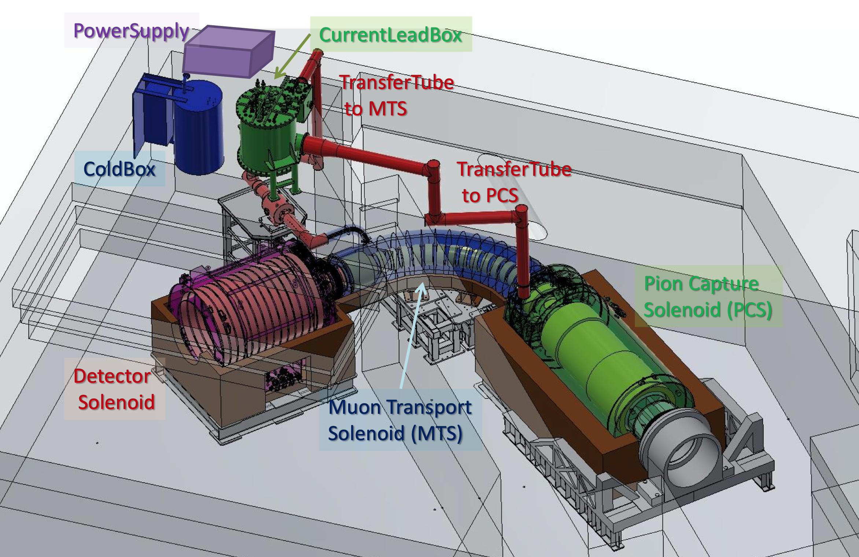
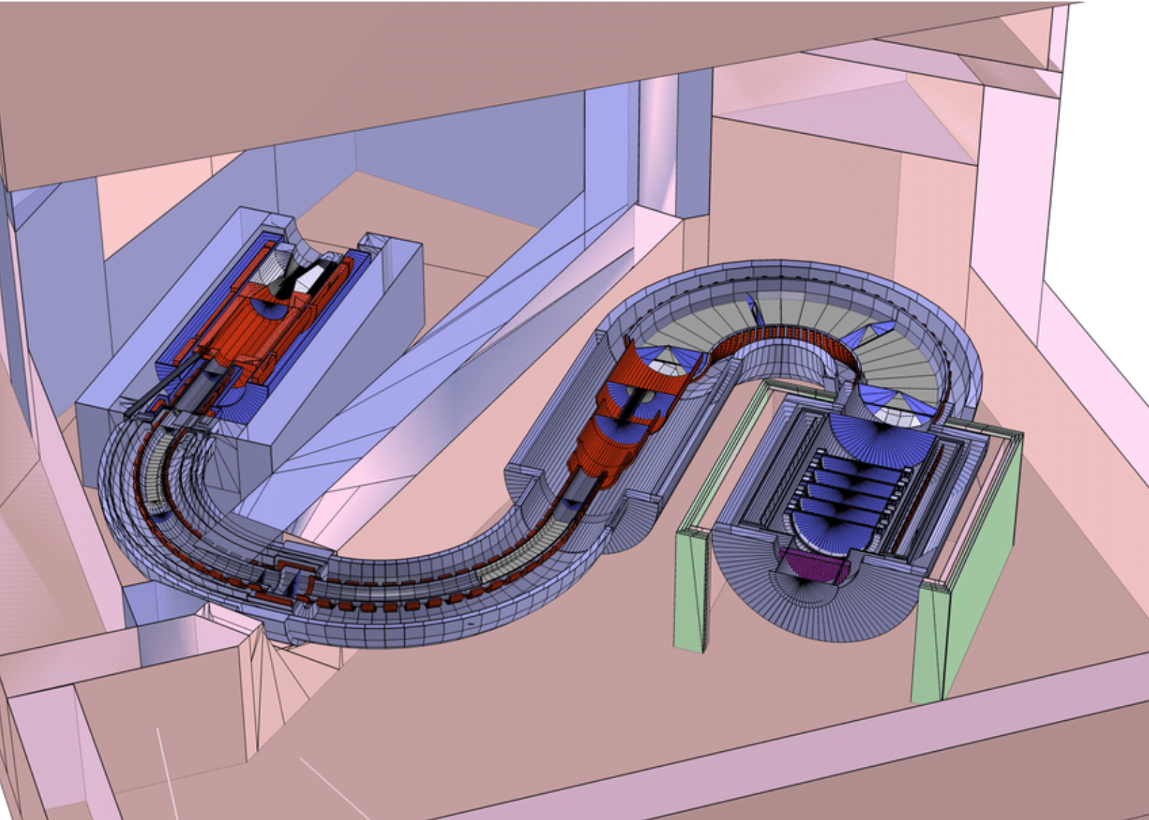
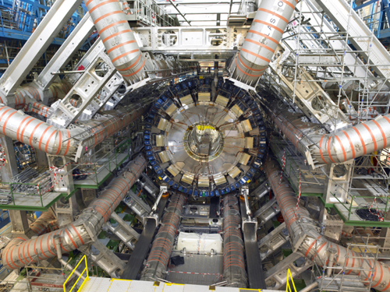
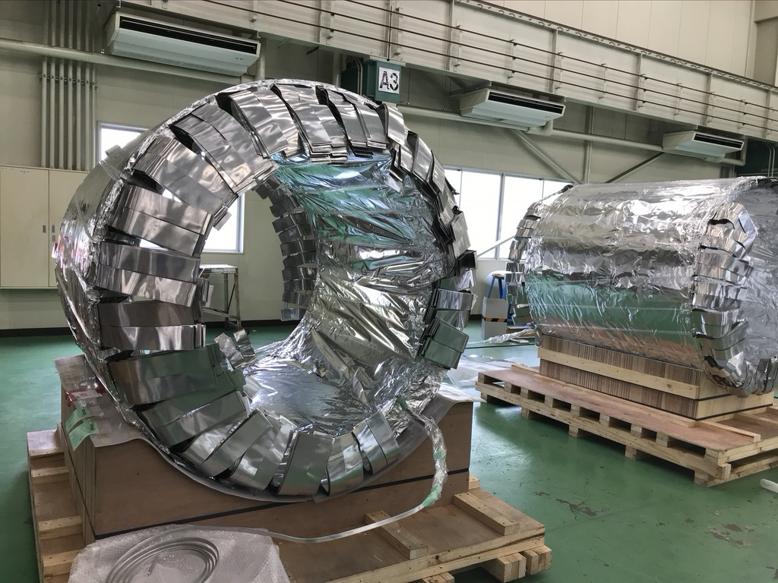
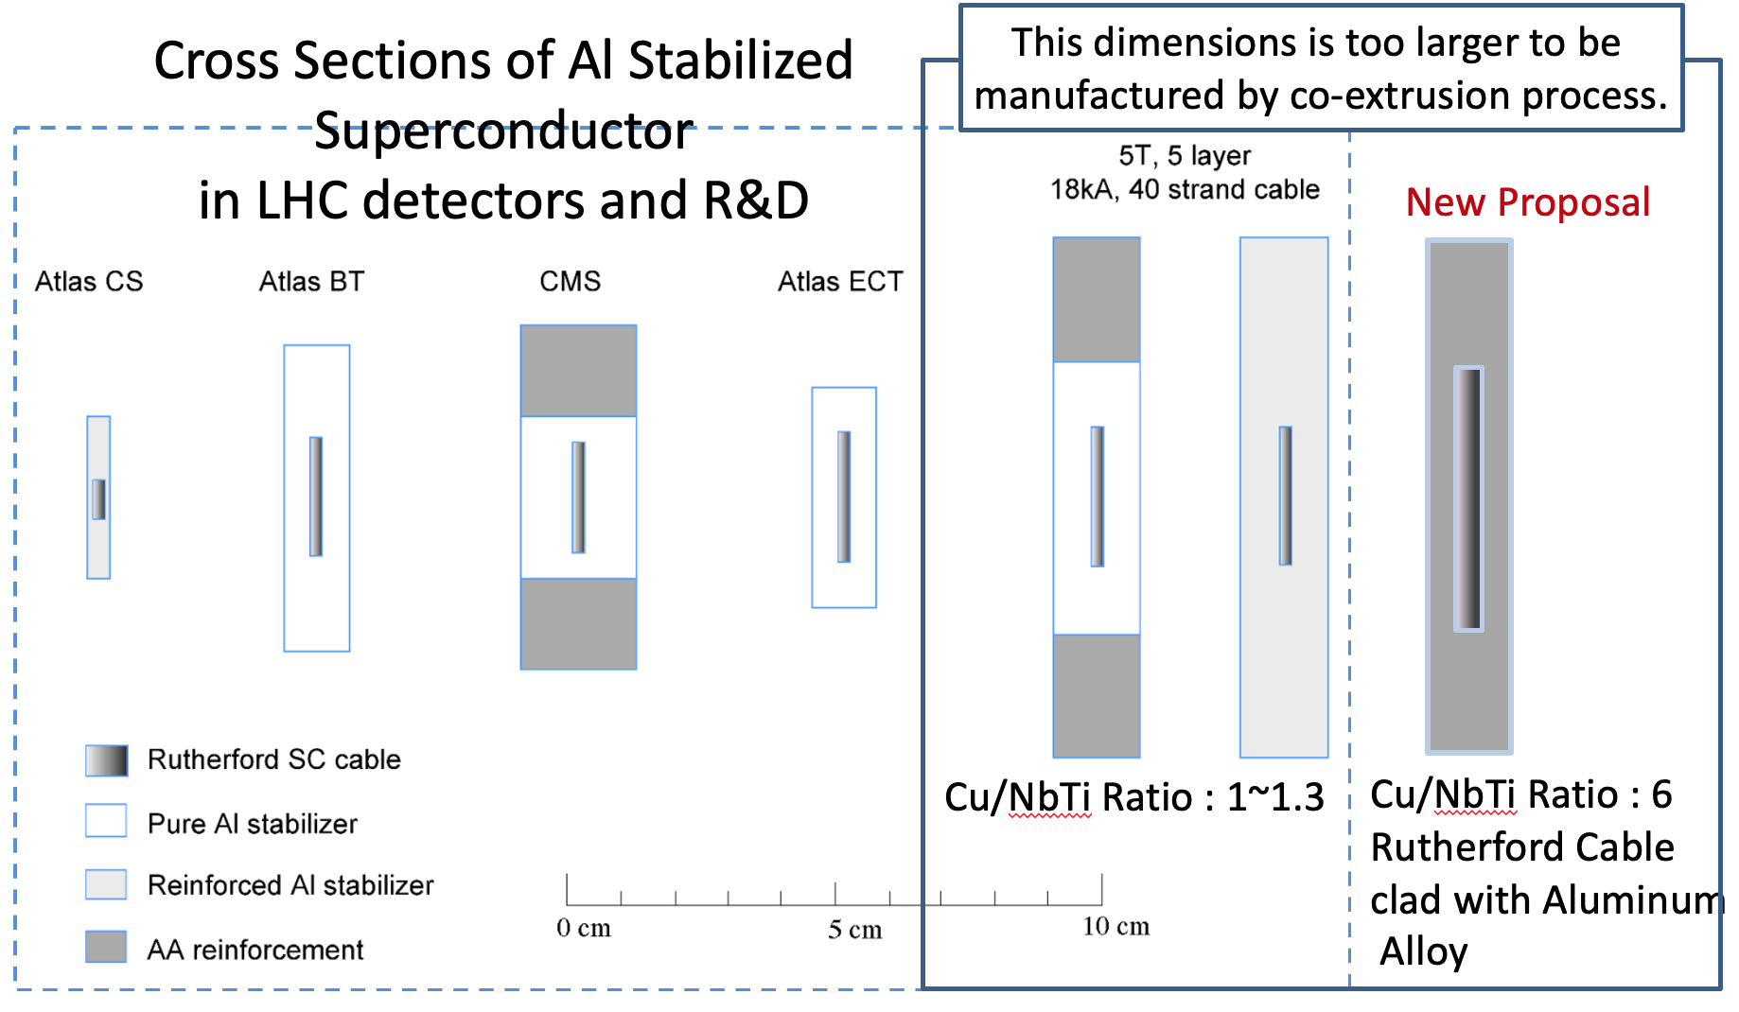
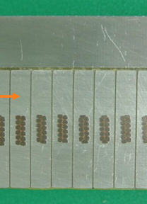
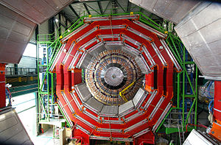
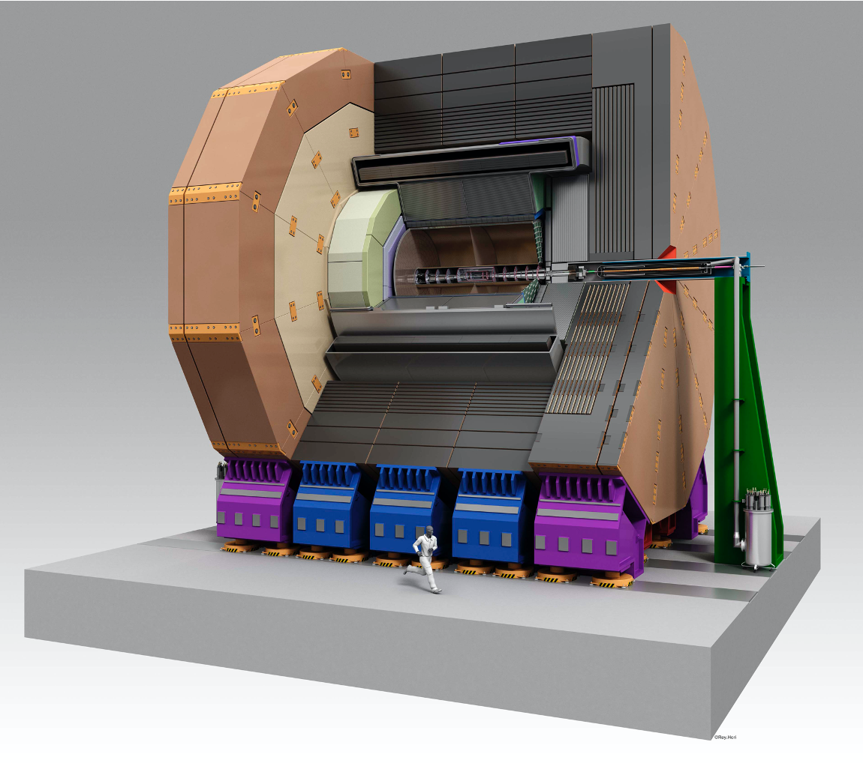
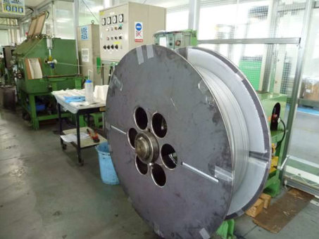
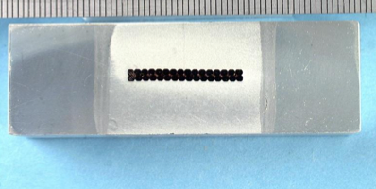
TOPAZ
VENUS
AMY
1980's~1990's
Design technology
Cryo Sytem for ILD
Precision Mag. Field Design
Sophisticated Cryo system
Mech. design for strong/complicated mag. force
TOPAZ
LHC ~2000's
COMET Phase-I
COMET Phase-II
- Ultimate target
ILD for ILC
Detector for FCC
Magnets for High Intensity Muon source
Advanced Al stabilized SC conductor
ATLAS
-Ni-doped Al
R&D of advanced cable for ILC
CMS
-Hybrid stabilizer
COMET CAP(2015)
ILD
Basic R&D of Al stabilized HTS

Slide 23
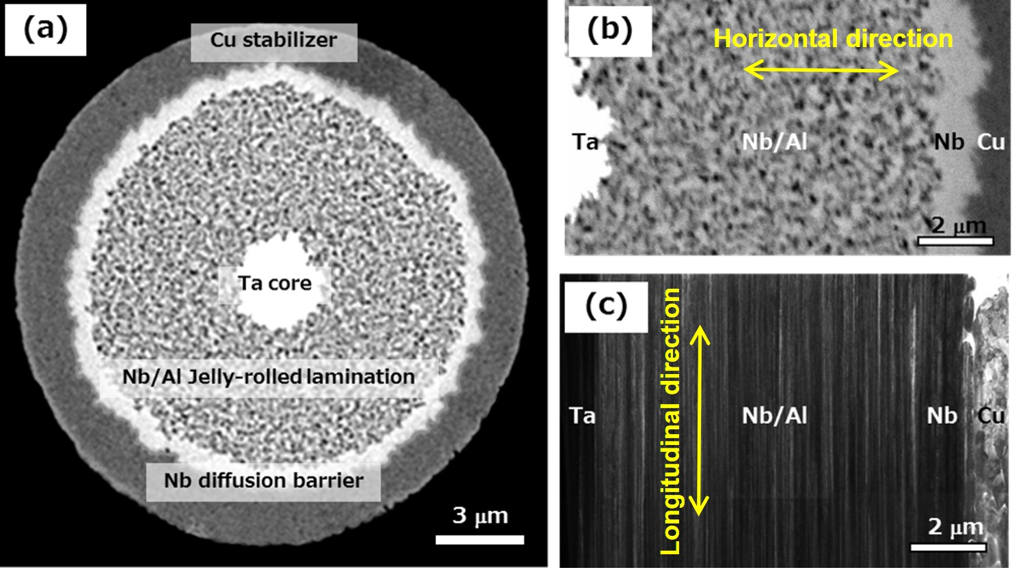
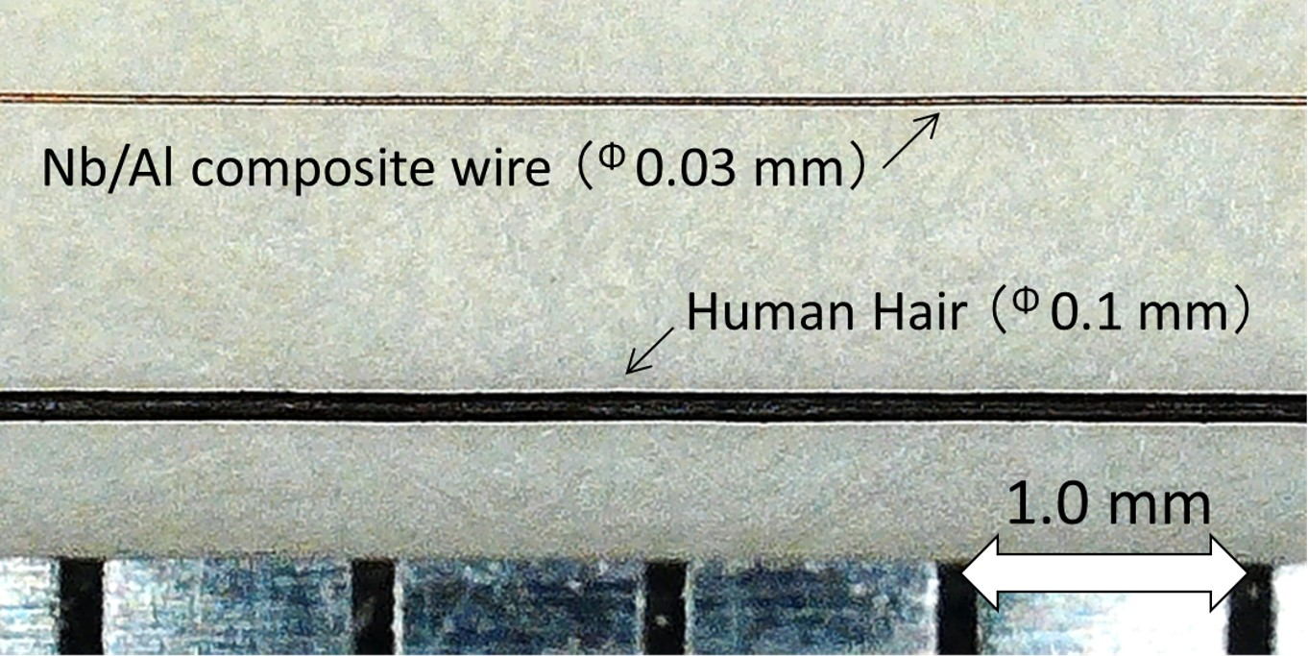
Ultra-thin A15 SC wires for future accelerators
Hitoshi KITAGUCHI and Akihiro KIKUCHI
(National Institute for Materials Science, Japan)
Technical Highlights:
0.03-0.05mm^{dia} ultra-thin A15 SC (Nb₃Al, Nb₃Sn) wires
→ “React and Wind (R&W)” coil fabrication
Higher flexibility in cable design & tuning
Example: 0.03mm^{dia} Nb₃Al wire

Slide 24
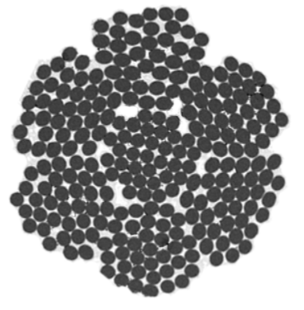
Rutherford cable for R&W magnets (under development)
Ultra-thin SC strand
1st bundle
2nd bundle
37 ultra-thin strands
37x7(259) ultra-thin strands
(Equivalent to 1 mm^{dia} monolith strand)
Final flexible Rutherford cable
Successful feasibility study for cabling by using 0.05mm^{dia} pure copper strands

Slide 25
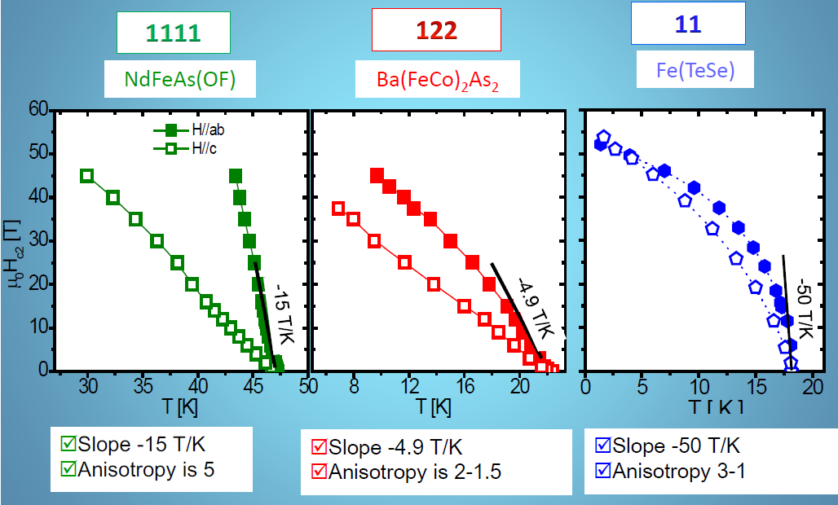
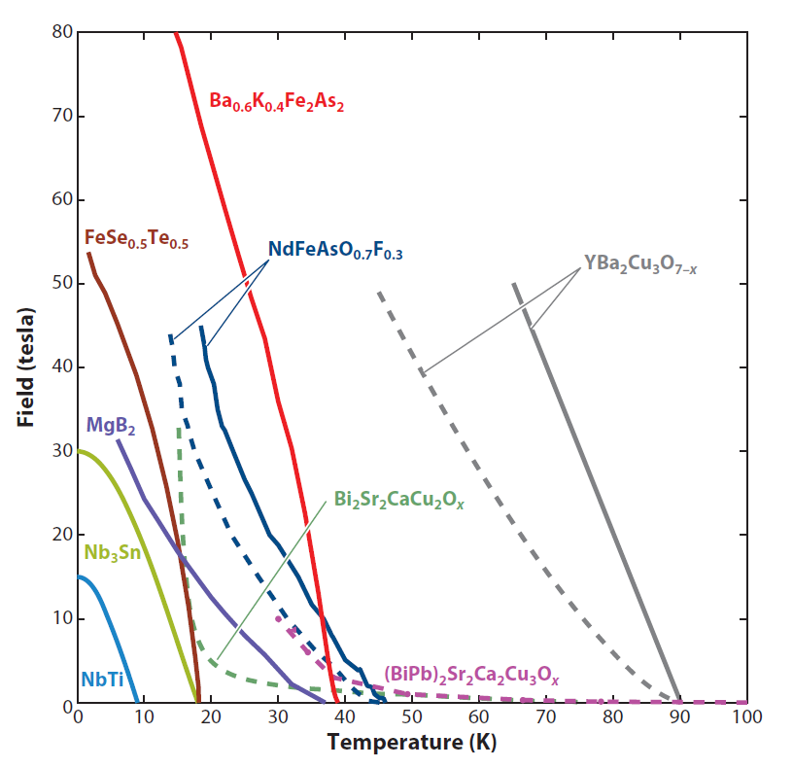
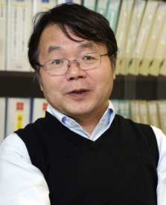
IBS Wires Toward High-Field Applications
Qingjin Xu (IHEP-CAS) and Yanwei Ma (IEE-CAS)
Iron-based
Superconductor
(Tc = 55K)
2008
20 K, H_{c2} ~70 T
Putti et al. SuST 23 (2010) 034003
Gurevich, Nature Mater. 10 (2011) 255
Advantages of IBS:
High T_{c} (55 K), Ultra-high H_{c2} (150 T) and High J_{c}.
Small anisotropy, e.g., 1~2 for 122 type and Large n-value.
Simple fabrication process and good Mechanical properties.
No oxygen environment required, cheap metal sheath material can be used.

Slide 26
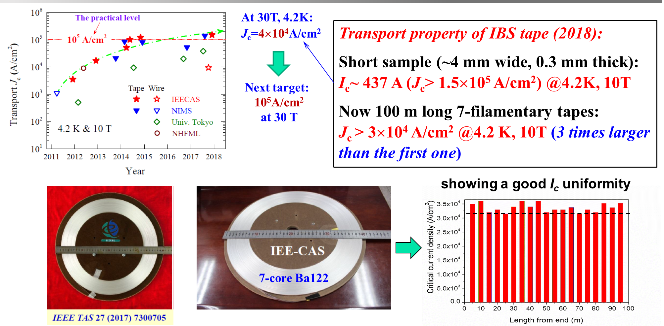
Latest Progress on PIT-IBS wires
Qingjin Xu (IHEP-CAS) and Yanwei Ma (IEE-CAS)

Slide 27
Development of Superconducting Magnets for Future Accelerators
P.Fabbricatore¹, E.De Matteis², S.Farinon¹, U.Gambardella³, G.Iannone³, F.Levi¹, S.Mariotto², R.Musenich¹, A.Pampaloni¹, M.Prioli², L.Rossi², M.Sorbi², M.Statera¹, R.U.Valente² (INFN Genova¹, Milano-LASA² and Napoli-Salerno³)
Technical Highlights
  High Field Nb₃Sn dipoles. Based on the cos-theta EuroCirCol design for a 16T dipole, in the framework of a CERN-INFN agreement a short model single aperture (Falcon_D) is under construction in collaboration with industry.
  HTS magnets. First developments of canted cos-theta magnets are going on.
  Pulsed sc magnets. First design of fast cycled magnets for the accelerator chain of a future Muon Collider
  All the above developments are considered a first step toward long R&D activities with construction of many models and prototypes.
Future plans
  Availability to contribute to the extended write-ups.
  Open to other labs to finding common field of interest for specific developments and/or for sharing and complementing knowledges/expertise

Slide 28




Toward FCC-hh and future colliders:
Exploration of high field magnet technology at CEA-Paris Saclay
Hélène Felice, G. Dilasser, Maria Durante, Philippe Fazilleau, Thibault Lécrevisse, Clément Lorin, P. Manil, F. Nunio, Etienne Rochepault, Françoise Rondeaux, Pierre Védrine
Highlights:
  Nb₃Sn :
  Demonstrator toward FCC, Multi-scale approach modeling, PhD work on dimensional changes through digital image correlation
  HTS :
  Eucard (5.4 T record), Eucard 2 cosθ (assembly stage), Metal-as-insulation double pancakes Nougat (32.5 T), studies of screening currents in REBCO tapes
Next steps:
  Some key topics identified: from modeling to fabrication and test
  Reinforced synergy btw EU development strategy and International labs is required to achieve accelerator ready high field magnets
  One tool: pursuit of topical Workshops such as:
    Workshop on Nb₃Sn technology for accelerator magnets, October 2018, Paris, https://indico.cern.ch/event/743626/

Slide 29
Common Coil Dipole for High Field Magnet Design and R&D
K. Amm¹, M. Anerella¹, R. Gupta¹, P. Joshi¹, BNL
More co-authors from other institutions ² (list still forming)
Technical Highlights:
Alternate design to the conventional cosine theta
Goal is to develop a field quality design with a lower cost in a large production with improved technical performance
Design allows a variety of cables, technologies and material
Future Plans:
Make a case for how this design can help future colliders based on high field dipoles and support R&D programs
Prepare a write-up and discuss opportunities to collaborate in demonstrating a collider quality high field dipole

Slide 30



Develop high-temperature superconducting
REBCO magnet technology for future circular colliders
Members from main REBCO magnet programs support the LoI
  Bosque (ASC/NHMFL); Ben Yahia, Gupta (BNL); Kashikhin, Lombardo (FNAL); and Gourlay, Wang (LBL)
Our message: rapidly develop REBCO magnet technology as a new tool to enable future energy frontier proton and muon colliders
  Key advantages of REBCO: enable a dipole field of 20 T and above. Operation over a wide temperature range (2 – 50 K) and capable to tolerate higher heat loads than LTS
  Significant room for cost reduction; synergy with HTS fusion development
  Boost the US-Magnet Development Program and allied programs to propel REBCO R&D
How can the REBCO R&D better meet/serve future experimental needs?
  Provide more input to Snowmass
  Engage physicists to understand each other and explore ideas/opportunites
STAR™ wires, AMPeers LLC
REBCO tapes, SuperPower Inc.
CORC® wires, Advanced Conductor Technologies LLC

Slide 31
Very high field superconducting magnet technologies based on Bi-2212 for future proton colliders
E. Barzi (FNAL), E. Bosque (NHMFL), D. Davis (NHMFL), L. Garcia Fajardo (LBNL), Y. Kim (NHMFL), D. Larbalestier (NHMFL), I. Novitski (FNAL), S. Prestemon (LBNL), T. Shen (LBNL), U. Trociewitz, A. Zlobin (FNAL)
Opportunities and technical Highlights: (1) Bi-2212 – the only multifilamentary, twisted, round wire HTS conductor. (2) The conductor technology (wire J_{e} of 1000 A/mm² achieved at 4.2 K and 27 T in 2017), experience with prototype coils, and CCT and SMCT magnet design provide an opportunity for adding a very high field, potentially quench training free accelerator dipole magnet technology (>15 T).
Need for fabrication and test facility: RENEGADE (1 m x ∅0.25 m) OPHT furnace (being constructed@NHMFL)), hybrid magnet test facility, and high-field, large bore Nb₃Sn dipole magnets.
Collaboration opportunities: (1) Rutherford cable engineering and transverse pressure measurement. (2) Conductor development. (3) Hybrid Nb₃Sn/HTS magnet design and testing.
LOI in preparation.
Open questions: Are HTS accelerator magnets quench training free? Is the HTS magnet technology scalable?

Slide 32

20 T hybrid magnets
Most effective way to achieve very high collision energies in HEP accelerators: very high field dipole magnets -> 20+ T bore field
Beyond 16 T (limit Nb3Sn) -> HTS superconducting materials, but still significant higher cost than Nb3Sn and Nb-Ti
Economically viable option: “hybrid” magnets
R&D on modelling and with short model fabrication and testing to address different challenges: optimum coil and magnet design for both HTS and LTS, mechanical integration, HTS/LTS ratio, peak stresses, protection with all coils in series, testing, cost, industrialization
Development will pave the way towards very high field magnets for the next generation of particle accelerators
(1) Lawrence Berkeley National Laboratory, Berkeley, CA 94720, pferracin@lbl.gov
(2) Fermi National Accelerator Laboratory, Batavia, IL 60511, barzi@fnal.gov
(3) Applied Superconductivity Center, National High Magnetic Field Laboratory, Tallahassee, FL 32310
(4) Brookhaven National Laboratory, Upton, NY 11973

Slide 33
The time is right for BSCCO 30 T solenoids
E. Barzi (FNAL), E. Bosque (NHMFL), D. Davis (NHMFL), Y. Kim, D. Larbalestier (NHMFL), T. Shen (LBNL)
LOI in preparation
Opportunities and technical Highlights:
Bi-2212 – the only multifilamentary, twisted, round wire HTS conductor, 800-1200 m strand lengths
Wire Ag matrix strengthened up to 160 MPa, composite conductor reinforced above 300 MPa, and magnet level reinforcement above 275 MPa under active development.
Stable, training-free test coil operation with conventional quench management.
Rutherford cable based >30 T solenoids are promising for final muon cooling.
Facilities:
Renegade over-pressure furnace (1 m x ∅ 0.25 m now in construction @NHMFL)
Large bore (>150 mm) 8-14 T LTS solenoid test beds, resistive & hybrid facilities at NHMFL
Collaborations:
Conductor development.
Development of 25 T commercial user solenoids
Rutherford test solenoids towards 25 T operation
Proposed 28 T insert towards UHF-NMR development.
Open question: Can we reliably react and reinforce magnets with high current densities under extreme Lorentz stresses?

Slide 34
Integrated Magnet Development for HEP accelerators
Kathleen Amm, Michael Anerella, Ramesh Gupta, Brett Parker, Piyush Joshi(BNL) Joseph Minervini, John Brisson, (MIT)
Technical Highlights
  Specialty magnets –
    Direct wind(Linear e+e- colliders, electron-ion machines, proton-proton machines, muon colliders)
    New methods for very high energy colliders
  HTS
    solenoids (30-50T small bore for muon collider cooling, >15T large bore for muon collider 6D cooling, >20T for HEP experiments(e.g. Axion search)
    VHF Dipoles (20-25 T) - high energy proton-proton, muon colliders (linear luminosity dependence)
    VHF quadrupoles and multipoles – IR regions for all high energy machines, specialty applications
  Cross cutting applications with other SC applications – EIC, compact fusion, offshore wind. HEP can leverage efforts and expertise – more bang for the buck
Future plans –partnerships with sister magnet teams (FNAL, LBNL, BNL, MIT NHMFL) and industry

Slide 35
Snowmass 2020 - Wind-React-Wind (WRW)
Shlomo Caspi (LBNL)
SC magnet technology
Nb3Sn magnets, like NbTi magnets, have similar issues that remain unsolved
Good progress in SC Nb3Sn magnet technology has reached a point where it is difficult to progress unless new ways are introduce to understand, explain and avoid magnet training – a critical costly problem.
Ask yourself, in what way the R&D magnet I am building Is going to be different in solving a problem that thousand other magnets were unable to solve. If the answer is pre-stress stop and look for something new.
Future SC magnet technology
Reduced stress in CCT coils did not solve magnet training but suggested an intrinsic mechanisms within turns to be a more likely source – sintering during reaction, the use of epoxy and mismatch between mechanical properties.
Reacted Nb3Sn is brittle but like any other brittle material can maintain a certain degree of elasticity (e.g. fiber optics)
The “Wind-React-Wind” method is a NEW approach for CCT coils:
  Annealed Nb3Sn (650 C) coils retain their annealed form and maintain a degree of elasticity.
  Reacted Nb3Sn conductor is sufficiently elastic when it is removed from a reacted CCT mandrel.
  Placing the removed turns into a similar new unreacted mandrel should be the same.
  Unreacted mandrel has controlled tolerances and can be made from other materials such as Aluminum.
  Mandrels should be insulated or coated (e.g. anodizing) voiding the use of cable insulation.
  Removing impregnation will place liquid Helium within the cable and greatly improve stability
This new R&D study has a steep learning curve on technology the potential for better understanding foundamental training issues, reduce magnet cost and improve safety

Slide 36




Reacted Nb3Sn cable
in a CCT bronze mandrel
Flexible Nb3Sn cable removed
Turns replaced into a new anodized (black) Aluminum mandrel
Removed Nb3Sn turns

Slide 37



Collider in the Sea: 500 TeV with High Luminosity
Peter McIntyre, Texas A&M University
Technical Highlights:
  Magnet cost/TeV increases steeply with magnetic field.
  Tunnel cost/TeV increases with size – faults, bad rock.
  Solution: Choose magnetic field for minimum cost/TeV 3-4 T
  No tunnel!: 1900 km circular pipeline at 100 m depth, neutral-buoyant
  C-magnet w/ LN₂ side channel for SR: ultimate luminosity
doi:10.1109/TASC.2017.2656157
doi 10.18429/JACoW-NAPAC2016-MOB2CO03
Working group: Collider-in-the-Sea 500 TeV p-mcintyre@tamu.edu
Gulf of Mexico
3.5 T NbTi Cable-in-Conduit 3.5 T REBCO NI Conformal Supercritical He 4-6 K NI blocks – LH₂ 20-30K

Slide 38
Additional/Backup Slides

Slide 39





Nb₃Sn magnets

Slide 40








Best-of-breed LTS magnets
2020: eRMC
16.5 T at 1.9 K
No bore
2020: MDPCT1
14.5 T at 1.9 K
60 mm bore
2018: FRESCA2
14.6 T at 1.9 K
100 mm bore
2019: MBHB002
11 T at 1.9 K
60 mm bore
Each one of these realizations is a 10-years history

Slide 41

HTS magnets

Slide 42











Best-of-breed HTS magnets
4.7 T
5.37 T
REBCO tapes
4.2 T
REBCO Roebel
This is the infancy of HTS accelerator magnets

Slide 43



Status and Plan of the High Field Magnet R&D
for Future Accelerators
Qingjin Xu (IHEP-CAS) and Yanwei Ma (IEE-CAS)
Status of the High Field Dipole Magnet R&D
10.7 T NbTi+Nb₃Sn Common Coil Model Dipole

Slide 44




Test of the 1st IBS solenoid coil at 24 T and the 1st IBS racetrack coil at 10 T
Status and Plan of the High Field Magnet R&D
for Future Accelerators
Qingjin Xu (IHEP-CAS) and Yanwei Ma (IEE-CAS)
Very good performance!
25T-HM, RT bore Φ38 mm
Demonstrating that IBS are very promising for high-field magnet applications
Supercond. Sci. Technol. 32 (2019) 04LT01
Supercond. Sci. Technol. 2020, in press

