Slide 1
NF03 – BSM@nu Kick-Off
Sept. 17, 2020
Pilar Coloma, Lisa Koerner, Ian Shoemaker and Jaehoon Yu
The scope: Searches for and discoveries of signals from BSM physics involving neutrinos and are accessible using neutrino facilities in both theoretical and experimental perspectives
Mailing list: snowmass-nf03-bsm@listserv.fnal.gov
Slack channel: neutrino_bsm

Slide 2
Roles of BSM@nu
BSM@nu picked up steam after the 2013 Snowmass exercise
Must leverage the neutrino facility capabilities for precision measurements to the next step
Need to further increase community interests on BSM opportunities and complement that in the EF regime
Need a strategic plan to strengthen the fundamental measurements to support precision measurements
Need to start thinking about managing and mitigating background from “neutrino interactions”
Important to play a leadership role in expanding physics opportunities

Slide 3
NF03- BSM LoI’s
Of the 147 LoI’s total (~half NF LoI’s), we’ve accepted 32 as the primary + additional 115 non-primary
Kick-off meetings in two large categories of topics
Day 1: BSM w/ Neutrinos
9 – 12 (CDT), Thursday, Sept. 17
Registration and agenda https://indico.fnal.gov/event/44987/
63 registered
Day 2: BSM using Neutrino Facilities
9 – 12:30 (CDT), Thursday, Oct. 1
Registration and agenda https://indico.fnal.gov/event/44988/
The detailed agenda is being worked out
40 registered

Slide 4
NF03 Kick-Off Meeting Goals
Assess and understand the received LoI’s
Identify missing potential topics
Form sub-topical groups based on LoI’s
Identify interested people and encourage them to form a group through the discussion
Primary LoI’s show some emerging patterns
Incorporate non-primary LoI’s and other ideas into the sub-group structure
Begin skeleton whitepaper for each sub-topical group
To prepare for CPM on 10/5 – 8, 2020
Skeleton document with some minimal structure
Assign topics to participants
Begin to work together for necessary studies
Devise schedule and milestones for completing and documenting the work
Midway progress check at the U. Pitt joint workshop: 2/24 – 27, 2021
Snowmass 2021 summer study: 7/11 – 17, 2021➔ Final report 10/21

Slide 5
NF03 Vision on Whitepapers
Each sub-topical group generates one or more whitepapers supported by detailed studies
Most ideal if one whitepaper can be produced for each sub-topical group, that encompasses all frontiers
Encourage synergy between similar topics
Promote new ideas out of the existing ones
Give input to facilities to prepare to meet the BSM needs
Provide strong physics justifications to the planning document, with associated timeline
Parts of these whitepapers make up the NF03 contributions to the Snowmass planning document

Slide 6
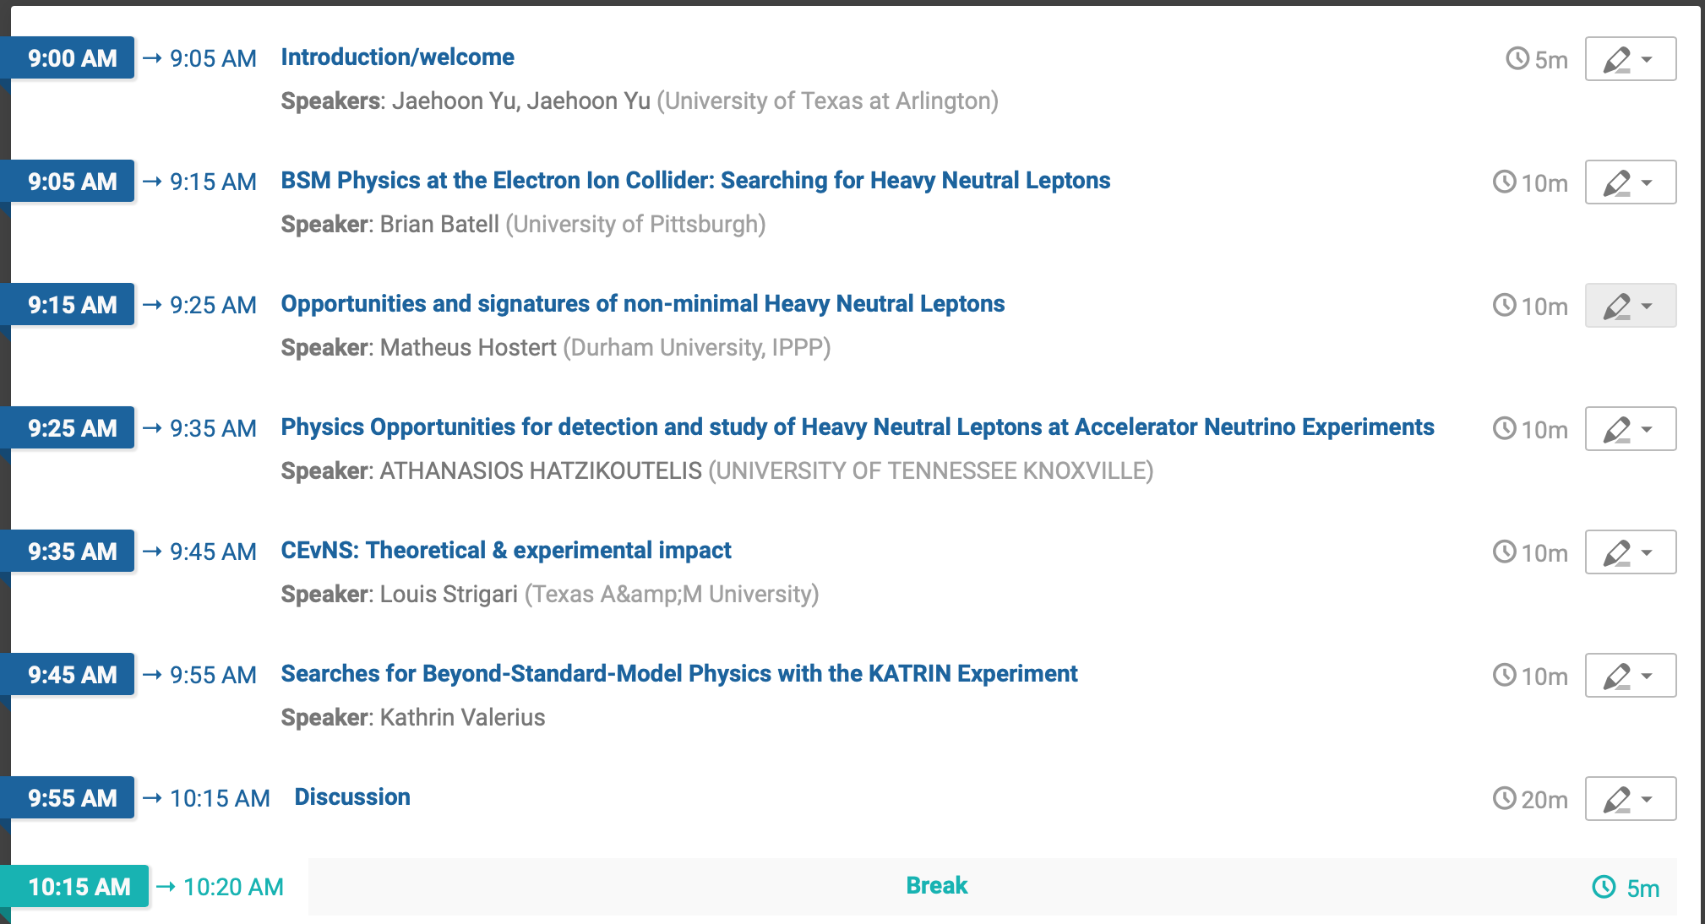
NF03 – BSM Kick-Off D1S1

Slide 7
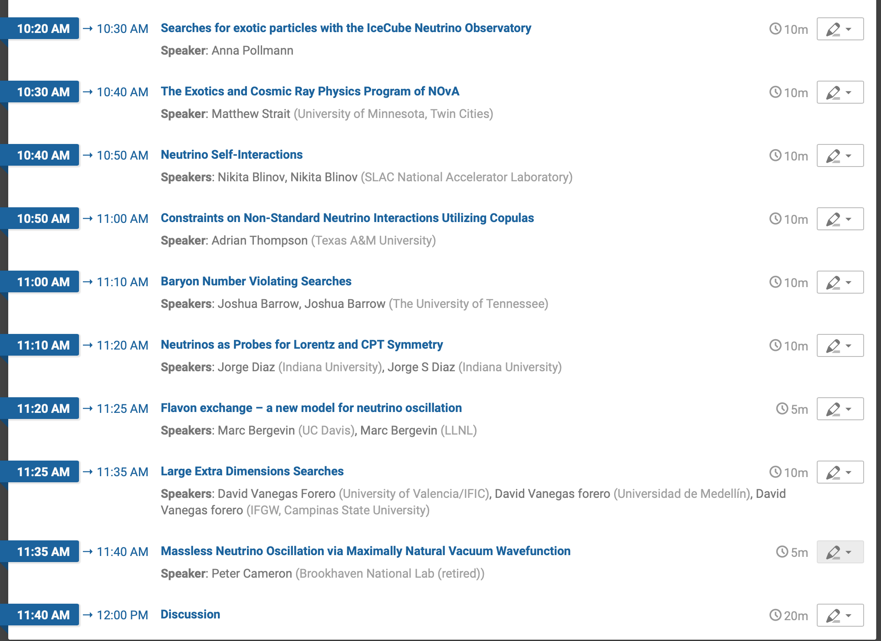
NF03 – BSM Kick-Off D1S2

Slide 8
“Potential F2F” Joint Workshop
A joint meeting with NF01, NF02, NF03, RF06, TF11 and any other interested groups
Workshop dates: Wed., Feb. 24 – Sat. Feb. 27, 2021
If fully online, Wednesday (2/24) – Friday (2/26)
Host: University of Pittsburg
Format of the workshop
Plan on hybrid in-person or fully online meeting
Monitor COVID – 19 situation through as late a stage as possible and make a decision – Likely to be mid Jan. 2021
Suggested scope: New Physics Opportunities at Neutrinos in Theoretical and Experimental Perspectives

