Slide 1


302.4.01 Magnets Vertical Test at BNL
Weekly Report
Joseph F Muratore – BNL
17-Aug-2020

Slide 2
Return to Work Planning– Building 902 High Bay
Magnet Division Electrical Group
Date | Days | Probable Staff | Job | # of SMD staff | Staff %
Ph 1a | D+0 | William McKeon,Frank Teich, John Cintorino | Tower water, compressors for pump and purge. | 6 | 15
 |  | Ray Ceruti, Glen Jochen, Toby Levin | Coil fabrication preparation.
 |  |  | DI water, QA cable, start cryo plant.
Ph 1b | D+15 | Above+ Piyush Joshi, Honghai Song | Validate and debug field measurement | 21 | 50
 |  | Sebastian Dimaiuta, Daniel Sullivan | LabView program.
 |  | Joseph Muratore, Patrick Doutney, Richard Felter | AUP magnet preparation.
 |  | William Themann, Dominick Milidantri | QA cable, start cryo plant, start coil fabrication.
 |  | Matthew Milidantri,Drew Carleton, Michael Hartsough | Alpha G.
 |  | Thomas Van Winckel, Jesse Schmalzle, Andy Marone
Ph 2a | D+30 | Above + Peter Galioto, Suresh Deonarine, Jorge Galarraga | Start AUP magnet testing. | 30 | 75
 |  | Shresht Joshi, Anis Ben Yahia, Henry Hocker, Paul Kovach | Prepare 10kA and 8kA PS for
 |  | Michael Anerella, Chris Runyan | sweet spot magnet testing.
Ph 2b | D+45 | Above + John Cozzolino, Steve Plate, Ramesh Gupta | Engineering and scientific work. | 40 | 100
 |  | Brett Parker, Kyle Capobianco, Kathleen Amm
 |  | Peter Wanderer, William Sampson, Marteenio Sams,
 |  | New Admin
Started 1-June
Started 18-June
Started 6-July
Started 22-July
P. Joshi and K Amm.

Slide 3
CRYOGENICS UPDATES
  Linde1610:
    Remote commissioning with Linde using HoloLens 2 system DONE.
    No damage or leaks were detected.
    Liquefier temperature is nominal with 5K input into JT valve.
    He gas has been scrubbed using external LN₂ purifier. Alternate scheme.
    Making liquid into 3785 L Storage Dewar with liquefying rate of 74 L / hr (nominal).
    CTI4000 (main refrigerator) to start after 100K z-scan done Tues AM.
    There may be possible problem with gas contamination when compressors started.

Slide 4
MQXFA04 UPDATE
Quench Antenna bench test in progress (>50%) to verify signals from all elements. So far OK.
Acoustic sensor tests done.
Room temperature gravity and MM z-scans have been done.
Magnet cooldown to 100K is in progress.
Z-scan done yesterday at 210 K (top) and 199 K (bottom).
Presently at 180 K (top) and 135 K (bottom)
Should reach 100 K about midnight tonight.
MM and gravity z-scans to be done at 100 K Tues AM.
CTI4000 to start after 100K z-scan done.

Slide 5
OLDER SLIDES

Slide 6
Different scenarios
Scenario 1: Continue with present status of liquifying at slow rate, introduce new-pure helium on Tuesday. No warmup. If clogging happens. Stop , pump and purge. Repeat the process to continue with low yield. Risk of multiple thermal cycle. But can start testing in few days when we have enough liquid in storage tank.
Stop operation after all existing gas is used up. (convert all gas into liquid). Pump and purge to remove blockage between Heat Exchangers 2 and 3. Start the system fresh with pure helium. Risk of multiple thermal cycles, but may be far apart. Delays: about a week to start test of 04.
Restart the system without LN₂ cooling of first stage heat exchanger. Risk: Very low liquefaction rate and internal purifier will not work. May be one quench every other day. Schedule impacted.
Stop all operations. Install new heat exchanger. Risk: 2 months of delay in testing of magnet 04. Services from F&O are sketchy: non-availability of riggers, welders, carpenters for scaffold, etc. may add more delays

Slide 7
Status of liquification
Plant is running at very low efficiency. Liquefaction rate is about 100 L/hr as compared to ideal rate of 250 L/hr.
Some blockage between 2nd and 3rd heat exchanger.
Contamination at present (9:30am today). Oxygen 3.8 ppm, Nitrogen 5.6 ppm.
Two expansion engines running at very low speed (115 rpm).
Plant in JT mode.
Will receive trailer of 100,000 SCF of 99.99% pure helium on Tuesday.
So far, we have had two start ups. On first attempt we reached 20K and had to stop because of clog. On second attempt after pump and purge we are able to bring down contamination to a stage where we started making liquid at low rate. Power dip on Saturday disturbed the system. Contamination went up.

Slide 8
MQXFA04 UPDATE
Present schedule:
  Cooldown to start later in week.
  If all goes well, test will be completed by 4-Sept.
  Breakdown of A04 to start on 8-Sept.
  Lab is closed on 7-Sept for Labor Day.
  Maintenance of CTI4000 and replacement of heat exchanger had been scheduled to start immediately after A04 test completion.
  Decision on progressing with above or proceeding on to MQXFA05 to be determined.

Slide 9
MQXFA04 UPDATE
Test of MQXFA04 is now in the critical path to CD3 due to COVID-19 shutdown and delay.
Magnet in Dewar 2 with plumbing, WBT, and heat exchanger installed and ready for pump and purge.
HBM strain gauge DAQ system running OK and taking vertical data.
CQ4 (112) T and Z gauges reading low. Checks of connector wiring and resistances showed no problems.
1 A and 10 A level shift tests to verify fast logger DAQ channels completed.
Additional tap reversal detected in 10 A level shift test at Test Dewar B07-B08 in Q2. All non-conformities have been documented.
Open taps and reversed taps have been re-configured at back of iso-amp rack.

Slide 10
MQXFA03 UPDATE
Accelerometers are installed.
Magnet in crate (with shock detectors).
Magnet was shipped and has been received at Fermilab (9-July).

Slide 11
AUP TEST STAND UPGRADES
Gravity sensor system to measure deflection from vertical and bending of the warm bore tube / magnet.
New independent DAQ for new quench antenna with 128 simultaneous sampling, 16-bit analog input channels.
Addition of two 1” ball mixing valves for smoother control of and possibly faster magnet cooldown from 300K to 80K, while maintaining temperature gradient of 50K.
Updates to AUP LabVIEW programs, such as improvements to room temperature z-scan operation.

Slide 12
AUP DOCUMENTS COMPLETED
Traveler document AUP-300 MQXFA Magnet Testing – Preparation for Cold Test.
Traveler document AUP-310 MQXFA Magnet Testing – Magnet Cold Test.
Traveler document AUP-320 MQXFA Magnet Testing – Preparation for Shipment.
Traveler document SMD-AUP-4001 Procedure, Room Temperature Electrical Checks of AUP MQXFA Quadrupole Magnets.
MQXFA03 test report.
MQXFA03 magnetic measurements report.
MQXFP1b magnetic measurements report.
AUP Interface Control Document 302.4.01-302.4.02 US-Hilumi-doc-207 V4.0.
MQXFA04 Test Plan
MQXFA04 Magnetic Measurements Test Plan

Slide 13
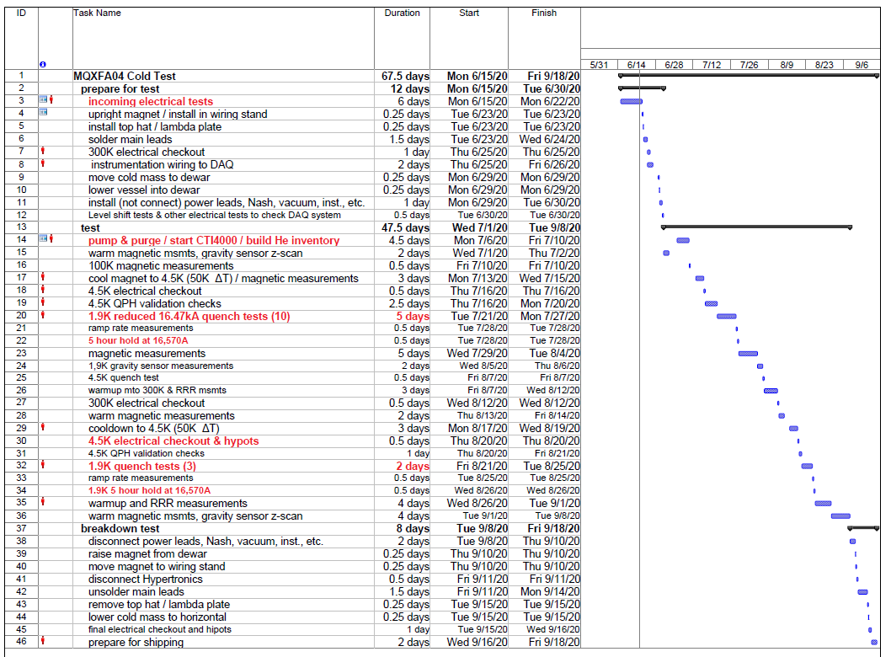
MQXFA04 UPDATE

Slide 14
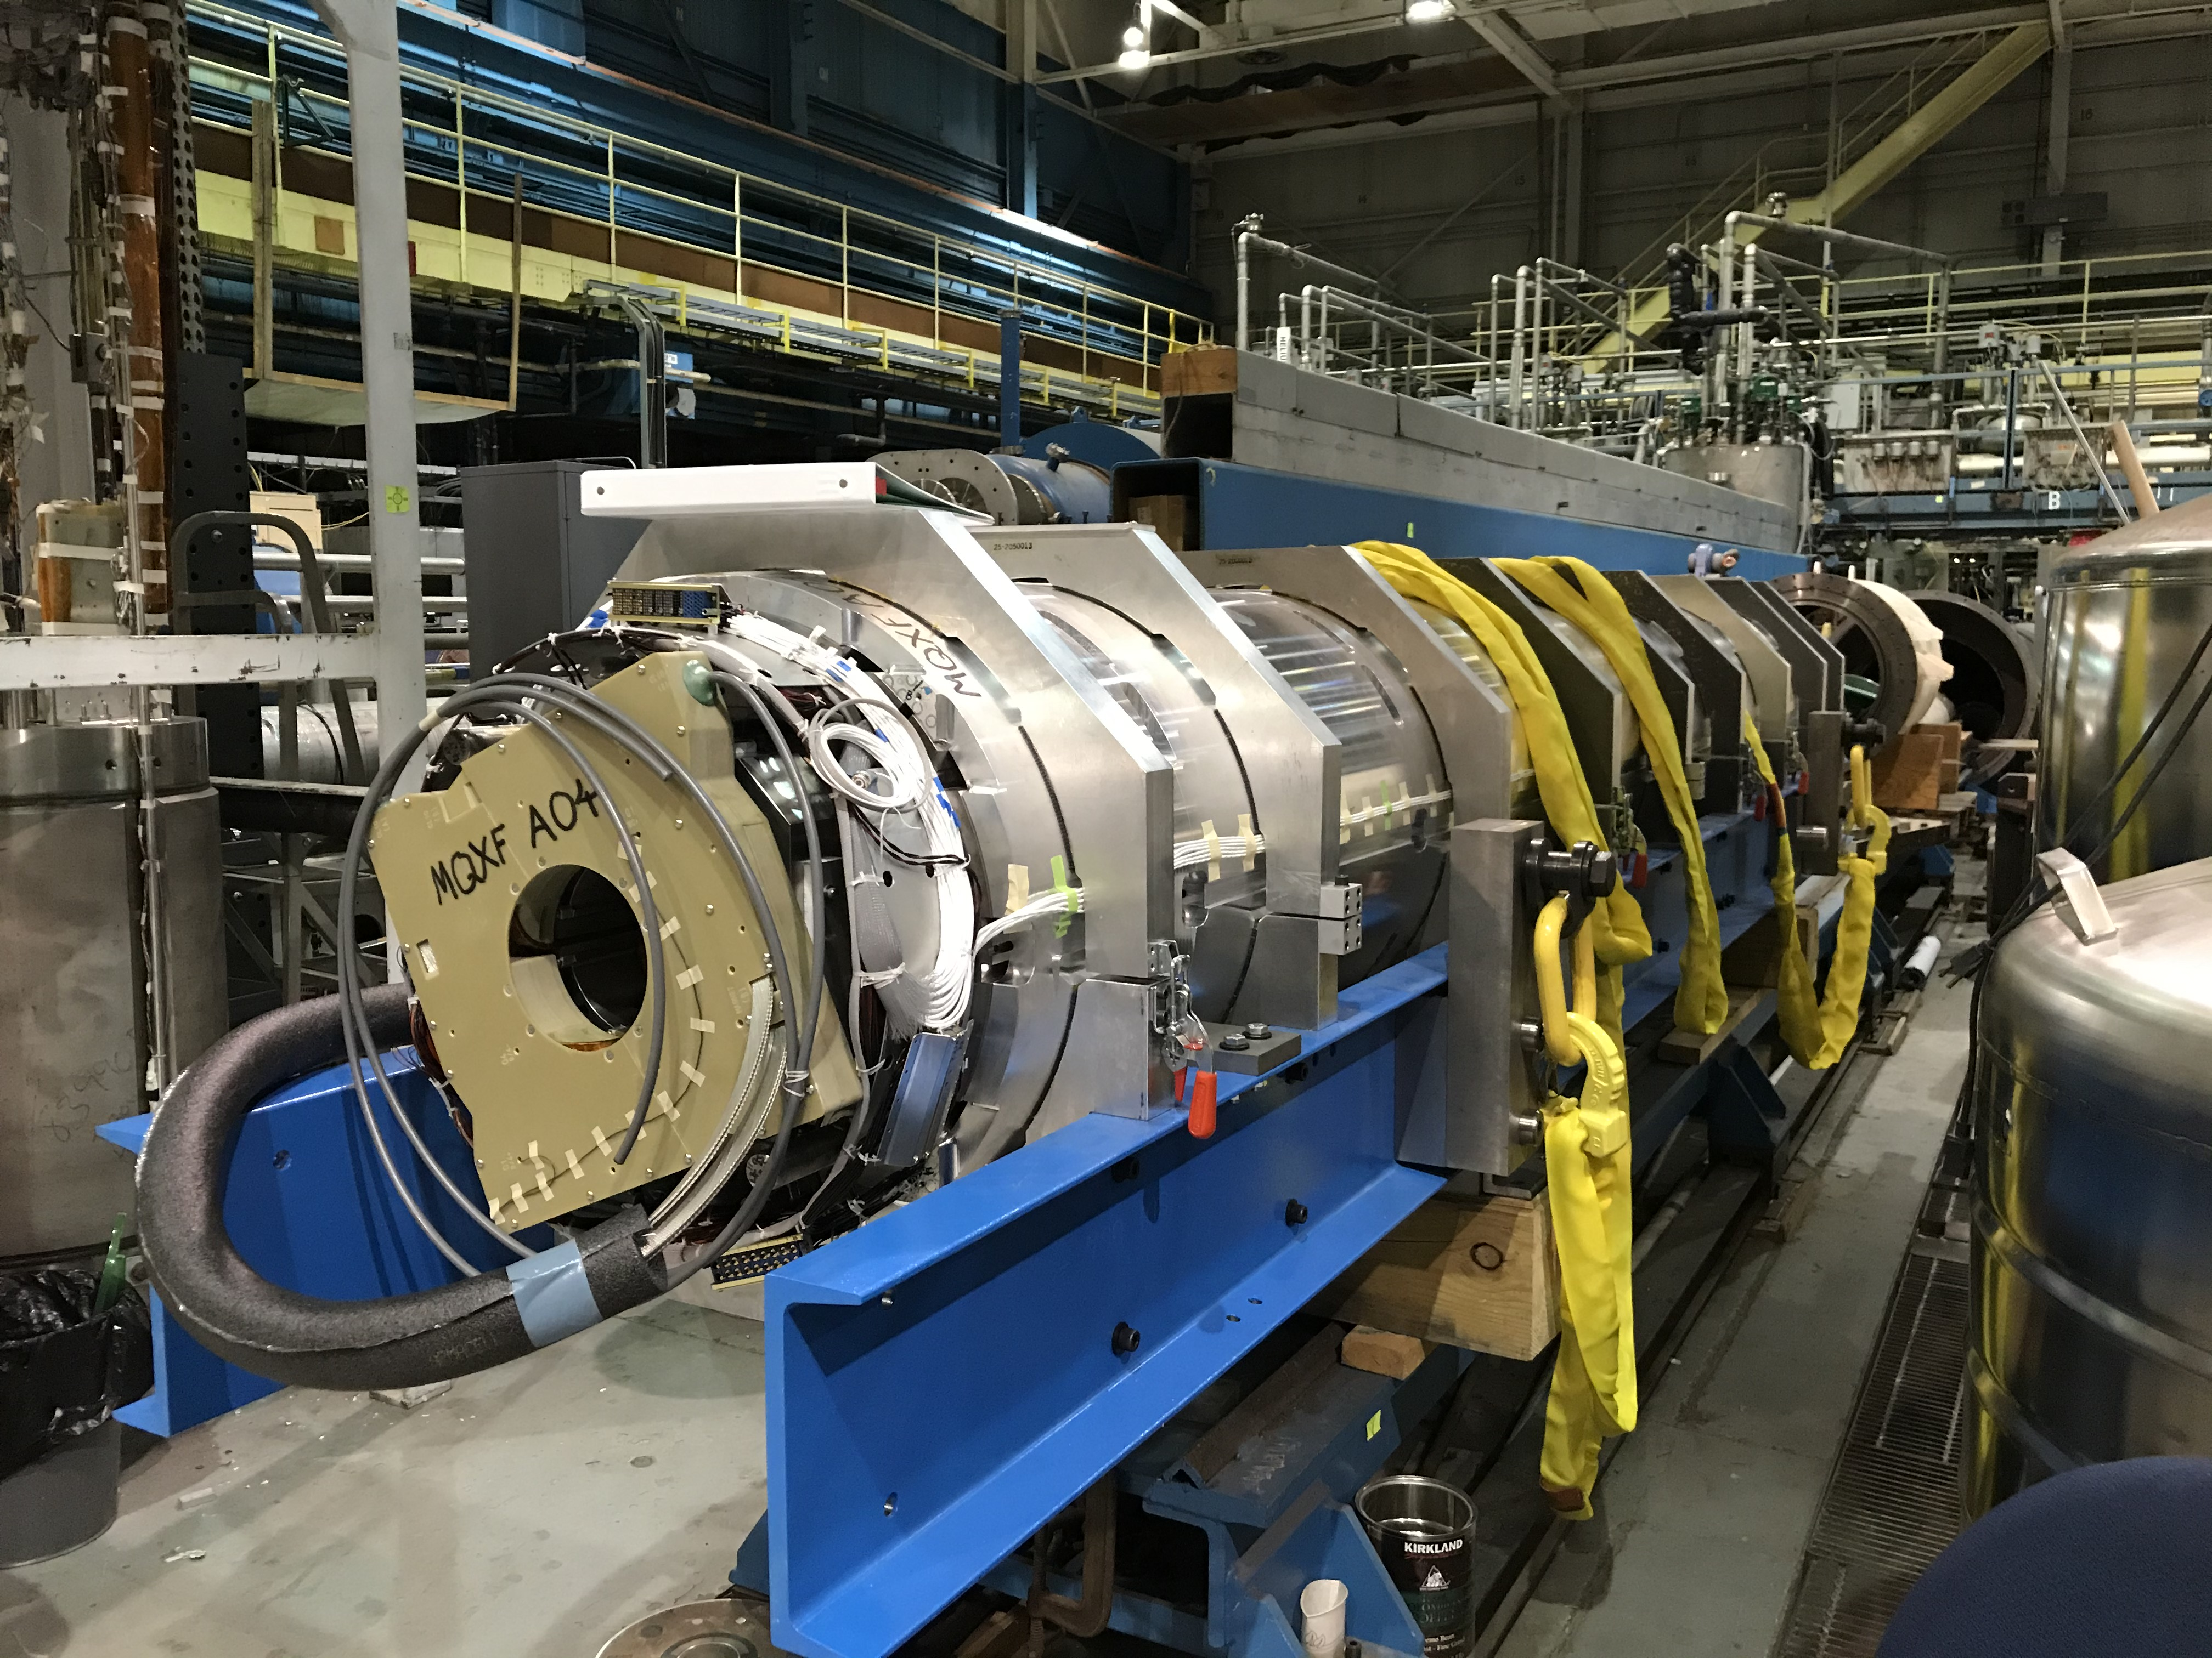
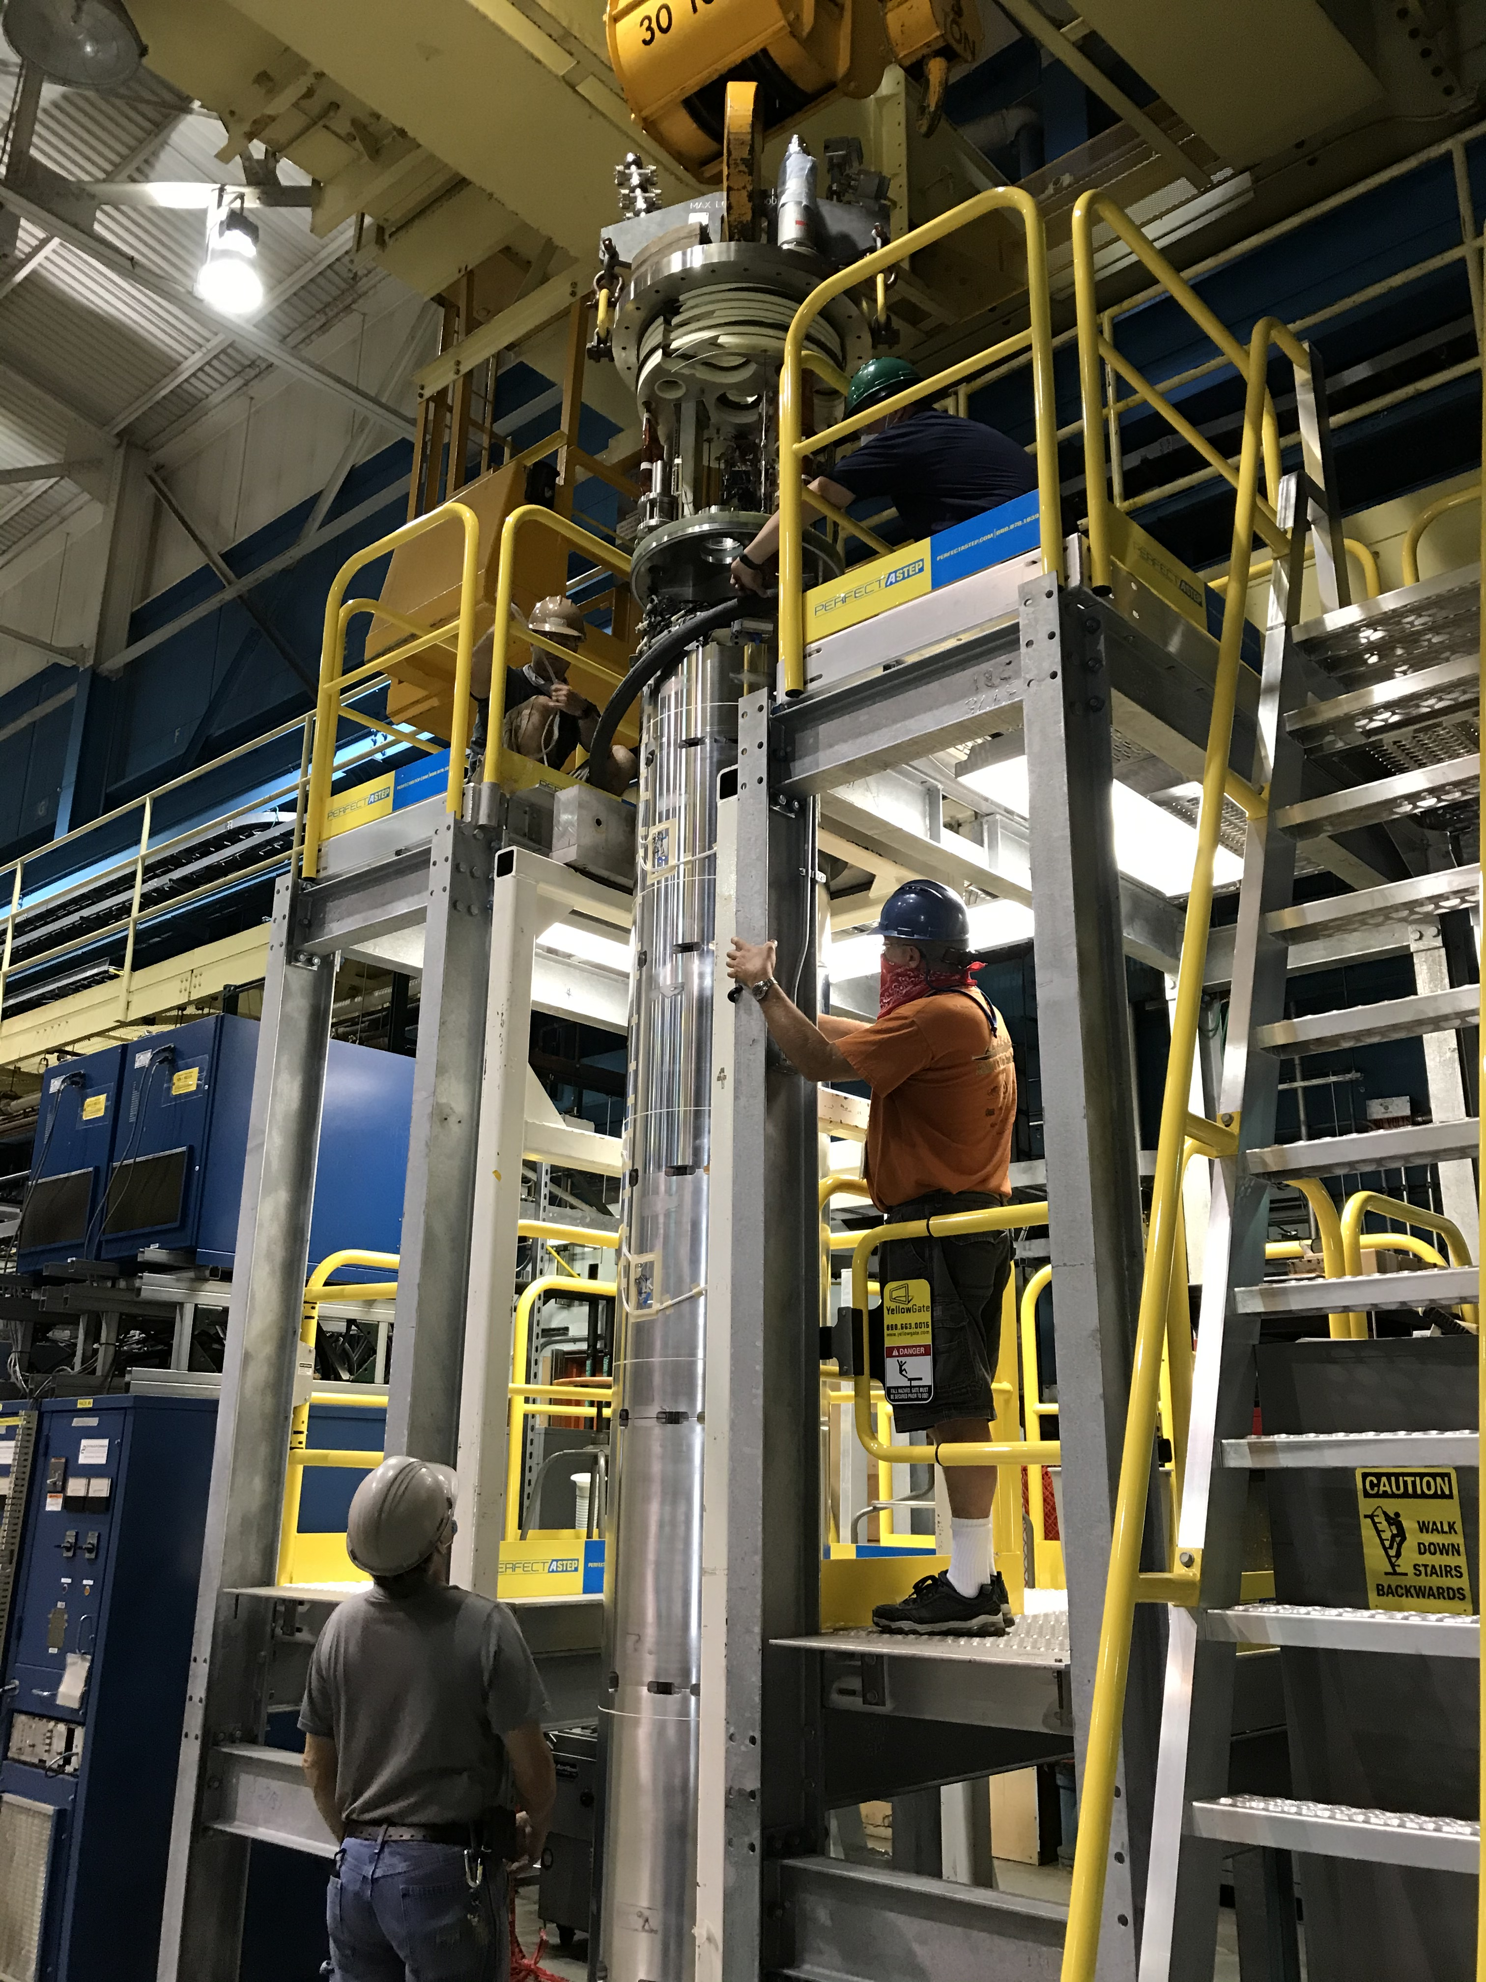
MQXFA04 UPDATE

Slide 15
MQXFA04 UPDATE
Incoming electrical checkout done.
  Taps A6 and A7 (inner layer pole turn return end) of Q1 quadrant coil are open and will be re-configured at back of iso-amp rack.
  Three tap reversals detected and will be re-configured at back of iso-amp rack.
  Rod 4 strain gauge has open circuit and is not useable.
  Hipots at 3680 V done successfully for coils and strip heaters. RH at 38%.
Power supply system tested.
All control room software has been run and checked.
DAQ system checked and verified.
Interlock test finished (6-month).

Slide 16
MQXFA04 UPDATE
Incoming electrical checkout done.
  Taps A6 and A7 (inner layer pole turn return end) of Q1 quadrant coil are open and will be re-configured at back of iso-amp rack.
  Three tap reversals detected and will be re-configured at back of iso-amp rack.
  Rod 4 strain gauge has open circuit and is not useable.
  Hipots at 3680 V done successfully for coils and strip heaters. RH at 38%.
Power supply system tested.
All control room software has been run and checked.
DAQ system checked and verified.
Interlock test finished (6-month).

Slide 17
OTHER STUFF
AUP documents work being done.
Traveler document AUP-300 MQXFA Magnet Testing - Preparation for Cold Test Rev B finished and approved.
Traveler document AUP-310 MQXFA Magnet Testing – Magnet Cold Test Rev B finished and under approval process.
Traveler document AUP-320 MQXFA Magnet Testing – Preparation for Shipment finished and under approval process.
Traveler document SMD-AUP-4001 Procedure, Room Temperature Electrical Checks of AUP MQXFA Quadrupole Magnets finished updating and in approval process.
MQXFAP1b test report in progress (Joe). ≥ 70% done.
MQXFAP1b magnetic measurements report (Honghai) finished and submitted.

Slide 18
CRYOGENICS UPDATE
Linde 1610 Liquefier:
  All work is done and ready for commissioning.
  Linde has cancelled all travel. Commissioning has been postponed.
  Detailed plan and hardware being obtained for remote commissioning of Linde 1610.
  Working on purchase of HoloLens 2 / Dynamics 365 Remote Assist.
  Risk remains if there is internal damage so far undetected.
Restart of the cryogenic facility work is underway with COVID-19 protocols in place (6 staff only).
BNL re-opened with Phase 1 4-June, but SMD received permission to start 1-June for AUP-related work.
Cryogenics system components (compressors, pumps, valves etc.) are being restarted and checked.
When needed, Piyush and Sonny go in for troubleshooting by swapping with other staff.
Building (AC and crane) issues being addressed.

Slide 19
OTHER STUFF
Online training in LabVIEW and Diadem systems and reviews of manuals and AUP documents by technicians and other staff underway.
LabVIEW program updates for AUP.
  Example – Work on updated LabVIEW program for magnetic field z-scans at 100 – 300K.
Return to Lab work planning.
  Example – Electrical workers during testing of MQXFA magnets (Sonny Dimaiuta). See next slide.

Slide 20
Return to Work Planning– Building 902 High Bay
Tasks involving >1 electrical/test technicians – These are to be done while maintaining 6 ft minimum distance between workers. 16 other tasks (not listed here) can be done with one technician. (S. Dimaiuta)
Any electrical testing - 2 techs - One to probe the connectors on the magnet the other to enter the data on the laptop.
Hookup/removal of flex links to gas-cooled leads, installation/removal of connectors - 2 techs - One to maneuver the portable engine hoist or overhead crane, one to guide/remove the flex links in/out of place and start/remove the bolts.
Level Shift Testing - 2 techs - One tech in the control room to run DAQ system, one tech at the dewar area to fire off the quench simulator.
Installation/removal of rotating coil or tower platform for magnetic measurements - 2 techs - One to operate the overhead crane, one to guide/remove the coil or platform.
Installation/removal of tower - 3 techs - One to operate the overhead crane, two to guide/remove the tower on/from the platform.
Installation/ removal of Quench Antenna - 2 techs – One to operate overhead crane, one to guide/remove quench antenna.
Power Supply turn on/off procedure - 2 techs - One tech to throw the two AC disconnect switches in the 30KA PS room, one tech to keep watch while the switches are thrown.
Control room operations - 2 techs - One to monitor the status of the PS, one to monitor the DAQ/Quench Detector.

Slide 21
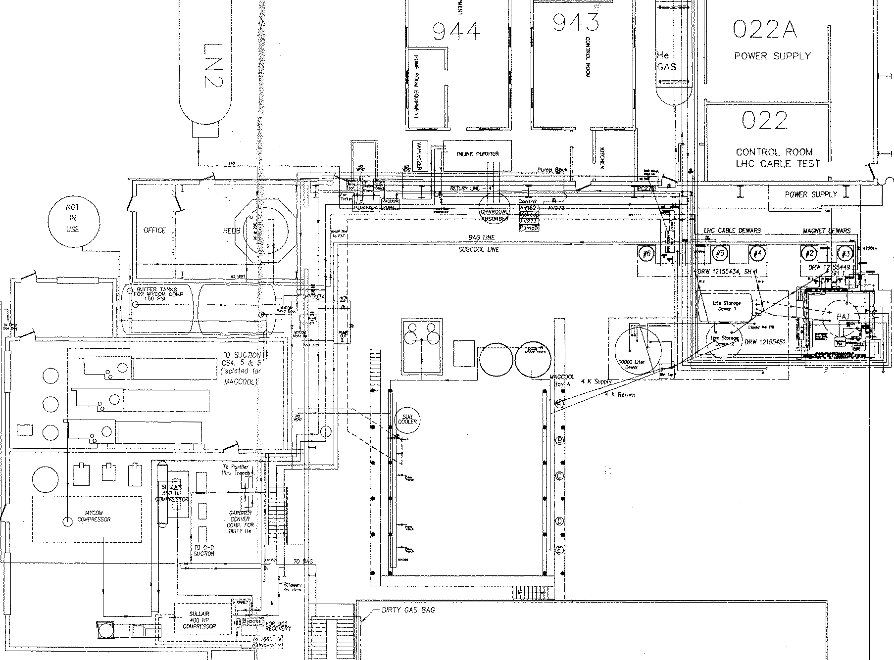
Return to Work Planning– Building 902 High Bay
Nash “high capacity” vacuum Pump (1.9 K)
7a
Building 902 Test Facility Floor Plan and Overview
7b
30 kA Power Supply
3a
8
MQXF
CTI 4000 He Refrigerator
CONTROL ROOM
1
2
3b
2.7 m Deep Test Dewars
5
6.1 m Magnet Deep Test Dewars
6
Vertical Test Dewars 2-6
4
1

Slide 22
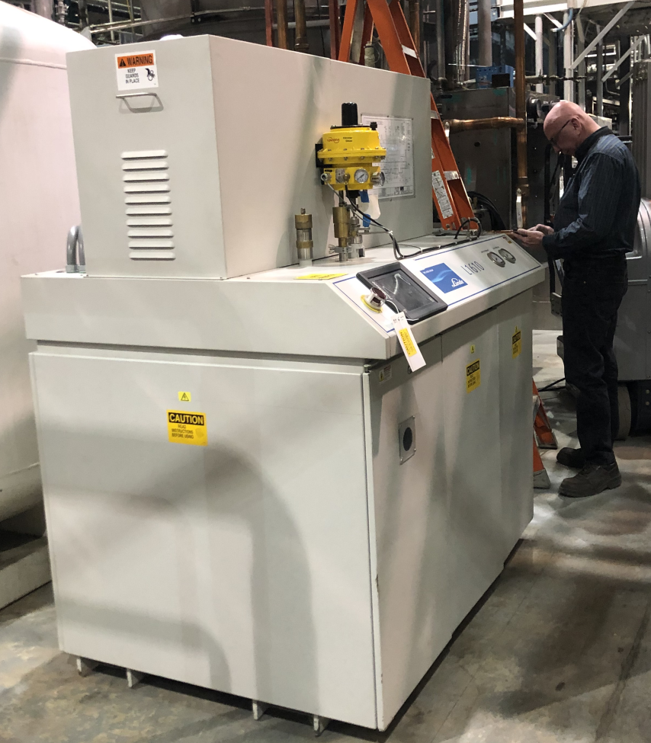
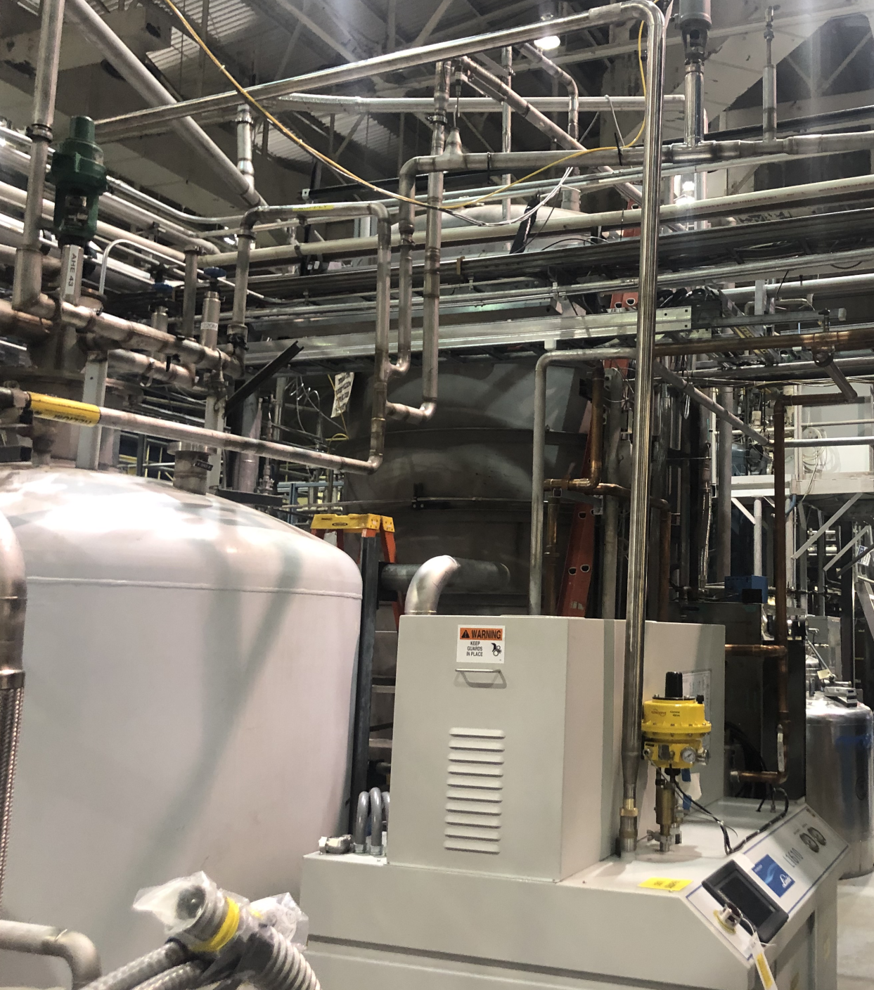
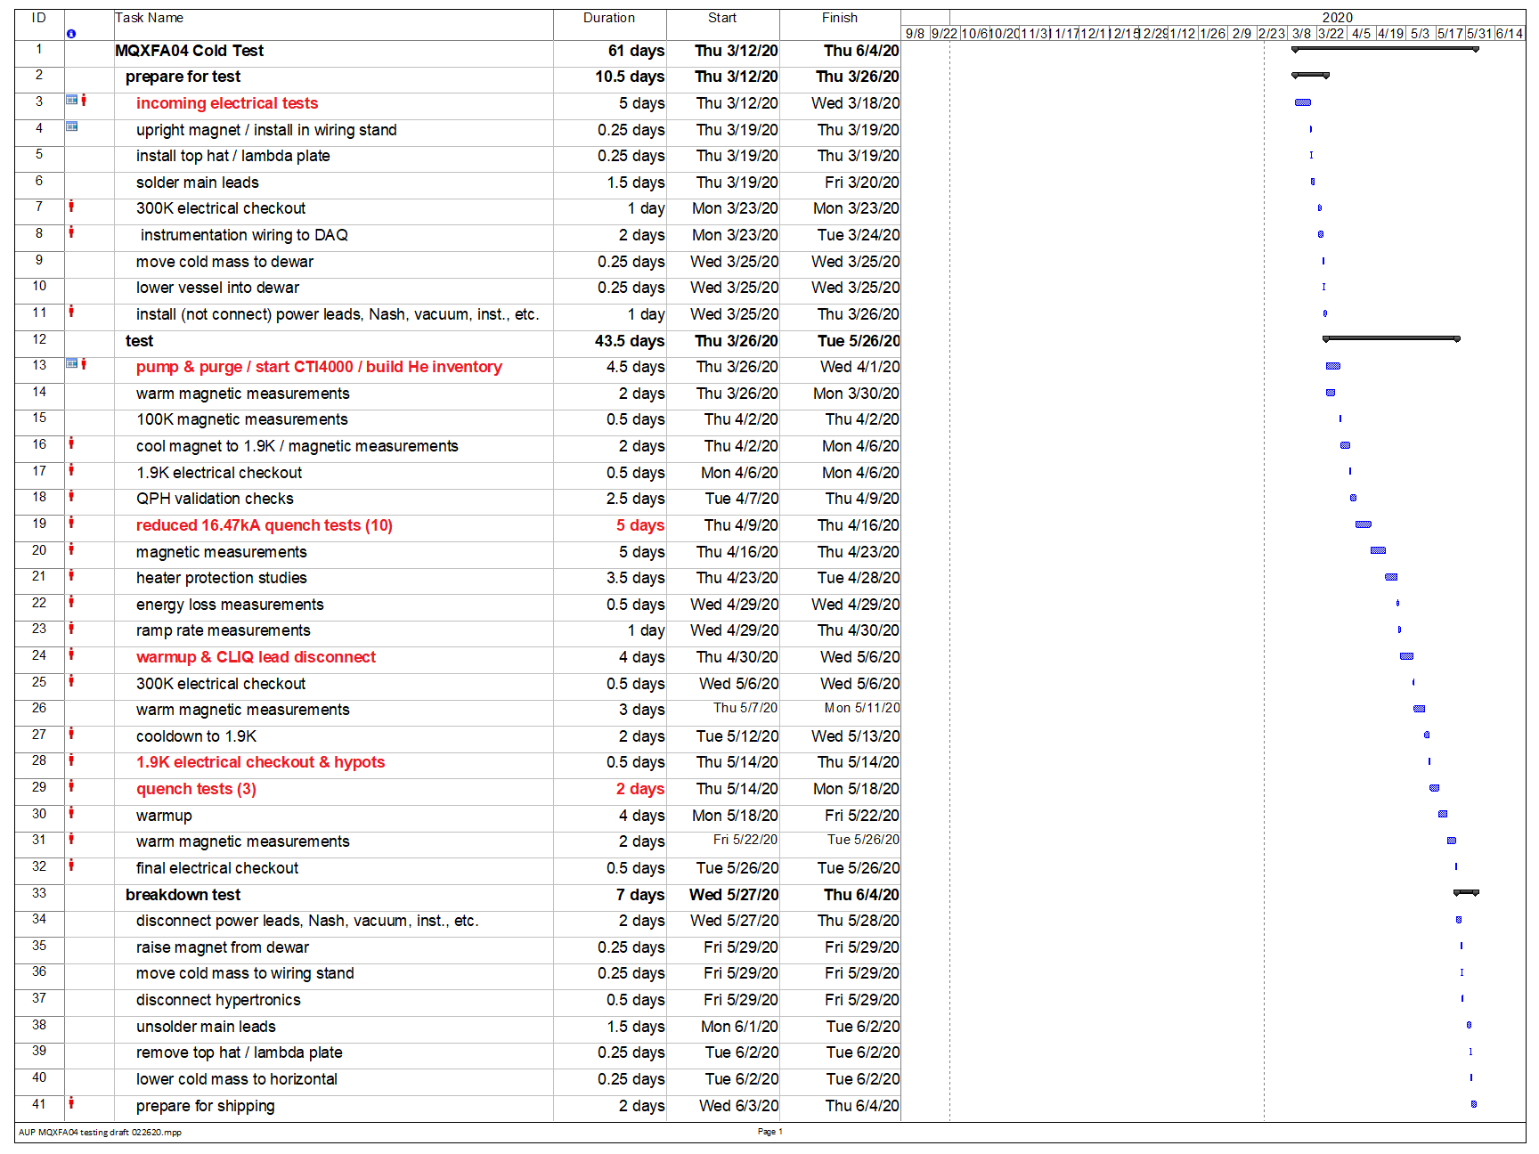
Linde 1610 helium liquefier installation
MQXFA04 test schedule
Arrives 3/12/20
Cryo turn-on 3/26/20
Linde 1610 installation with helium transfer line installed
Warmup 5/22/20
Work remaining – ONLY Nitrogen transfer line installation - received
Plan:
Commission when Linde representative arrives 3/23/2020, prior to magnet 04 test
Back-up plan: Linde system is independent – Linde commissioning can continue in parallel with AUP magnet test if necessary

Slide 23
Magnet Testing Challenge:
Linde 1610 is not operational in time for the March 2020 test of magnet MQXFA04:
  11 quenches per week with only CTI4000 instead of 15 quenches per week if we were using both CTI4000 and Linde 1610 (details in backup slides)
  INDEPENDENT OF CRYO, MQXFA04 will follow “reduced functional requirement” of achieving “nominal + 200A” current (16.67kA) instead of “ultimate” current (17.89kA) – THIS IS TO ENSURE MAGNET AVAILABILITY FOR 1ST CRYOSTATTED HORIZONTAL TEST – estimate based on prior magnet test is 10 training quenches
  MQXFA04 testing schedule potential impact of 1 day

Slide 24
MQXFAP1b UPDATE
MQXFAP1b disassembly completed.
Coils P03 andP04 are crated and will be shipped this week.
Structure is crated and will also be shipped this week.

Slide 25
MQXFA03 UPDATE

Slide 26
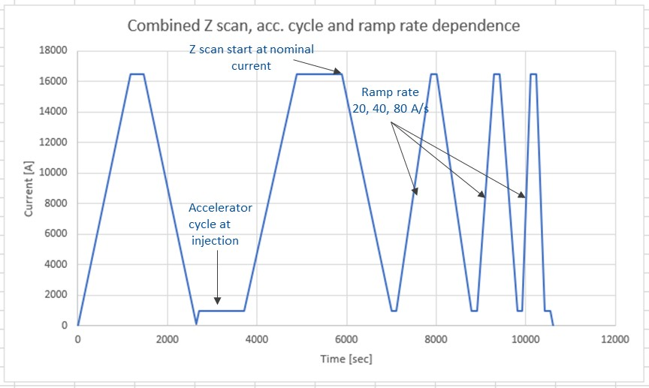
MQXFA03 UPDATE

Slide 27
CRYOGENICS FACILITY UPDATE
From Cryogenics Control Room Log
LHe is now being generated at nominal rate.

Slide 28
OTHER UPDATES
Quench antenna ready for operation.
Second top plate and test fixture status:
  All parts are in house.
  Additional instrumentation wires still need to be obtained.
  Main leads insulation done. Hipots are to be done soon.

Slide 29
MQXFA03 UPDATE
Magnet was up-righted and hung to test fixture on Fri 18-Oct.
Main leads soldered to test fixture.
Main leads soldered to test fixture.
Hipot of mains to ground with everything connected.
Connector trees were bagged with N₂ gas flow inside and outside.
Hipot failed at 3590V (breakdown).
With Hypertronics connectors unplugged, mains hipot to 3680V was successful.

Slide 30
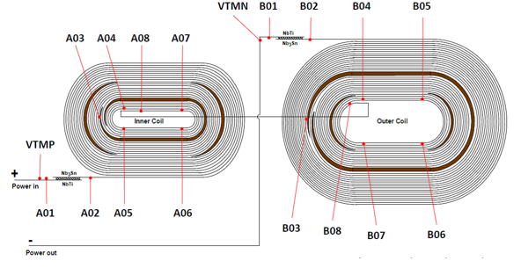
MQXFA03 UPDATE
On inspection it was noticed that the leads going into the splice box needed insulation.
Magnet placed on horizontal stand.
Electrical checkout and hipots done to 3680 V.
3 taps in Coil 202 (Q3) open: B5, B6, A7 (pole turns)
Dan and Josh arrived 15-Oct BNL to insulate leads.
Splice box leads insulated successfully by disassembling the splice box, but unsoldering was not needed.
Some electrical checkout and hipots to 3680 V were repeated. All checked out OK.

Slide 31
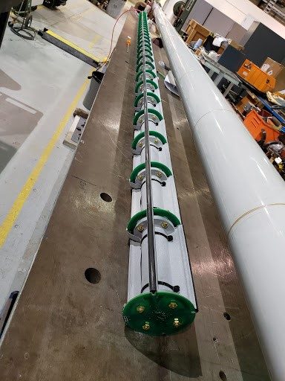
QUENCH ANTENNA UPDATE
Quench antenna assembly is done.
27 elements with dual sets of windings – 54 channels.
Re-designed circuitry on PCBs and new 3D- printed supports.
Extra channels added to fast DAQ system.
Test of quench antenna done.
It is ready for operation in MQXFA03.

Slide 32
CRYOGENICS FACILITY UPDATES
Cryogenics facility is ready for test of MQXFA03.
Linde technician was at BNL and repaired Linde 1610 heat exchanger damaged during shipping from Linde (after initial repair) to BNL.
A leak in the 1610 was detected and Linde technician will return to repair.
Plumbing for both water and He lines to compressors for new Linde liquefiers is proceeding.
Electrical work for new Linde liquefiers underway.
Installation of 6” quench line to first He recovery buffer tank is underway: 1) under floor section by Cryostat 3 is done; 2) outside line to tank is mostly done.
NOTE: Linde liquefiers and 6” quench line will not be ready for test of MQXFA03.

