Slide 1
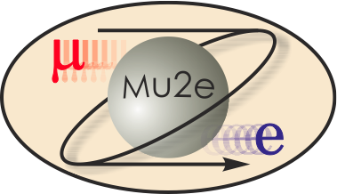
-II
Mu2e-II Workshop (iii) - Introduction
Frank Porter
August 26, 2020
DocDB-34962
This meeting will be recorded

Slide 2
Working Groups
Mu2e-II working groups | Tentative Convenors
Theory MU2EII-THEORY@FNAL.GOV | Julian Heeck Lorenzo Calibbi
Accelerator (including PS, production target, extinction) (TBA) | David Neuffer Eric Prebys
Radiation mitigation (includes radiation simulation) MU2EII-RADIATION@fnal.gov | Vitaly Pronskikh Michael MacKenzie Stefan Mueller
Tracker mu2eii-tracker@fnal.gov | Daniel Ambrose Giovanni Tassielli
Calorimeter (and STM?) mu2eii-calorimeter@listserv.fnal.gov | Ivano Sarra Luca Morescalchi David Hitlin
CRV mu2eii-crv@listserv.fnal.gov | Yuri Oksuzian Craig Dukes
Sensitivity estimate (includes simulation, stopping target) mu2e-ii-sensitivity@listserv.fnal.gov | Lisa Goodenough Sophie Middleton Yuri Oksuzian
Trigger and DAQ mu2e-ii-tdaq@listserv.fnal.gov | Giani Pezzullo Antonio Gioiosa

Slide 3
Letter Of Interest
Read link: https://www.overleaf.com/read/rmscdsghznbs
Due August 31, 2020
Called for signers on Wednesday, August 5
105 signatures as of Tuesday, August 25
Deadline to respond was August 19 (but taking late arrivals)
Will submit to Snowmass before August 31

Slide 4
Other “Mu2e-II” LOIs
Topic | Proponents
Production target | K. Lynch, …
Stopping target monitor | K. Lynch, …
Calorimeter Draft circulated to listserv list | D. Hitlin, I. Sarra, L. Morescalchi, et al.
Mu2e-II: a trigger-less TDAQ system based on software trigger https://www.overleaf.com/4494769535mbpggbjngpkt | N. H. Tran, et al.
Mu2e-II: TDAQ based on GPU co-processor https://www.overleaf.com/1195943198qrwhwdvyhtfd | N. H. Tran, et al.
Mu2e-II: a 2-level TDAQ system based on FPGA pre-filtering https://www.overleaf.com/9669925525vjrqwjgxpvwf | N. H. Tran, et al.
CRV | CRV working group
Theory https://www.dropbox.com/s/kyo3wjlen4vkcf4/LOI_Mu2e_II_theory.pdf?dl=0 | J. Heeck and L. Calibbi (contacts), et al.
Tracker | Tracker working group

Slide 5
Other related LOIs
Topic | Proponents
Physics potential with MEGII-fwd | L. Calibbi et al. https://www.snowmass21.org/docs/files/summaries/RF/SNOWMASS21-RF5_RF6-006.pdf
Muonium Gravity Experiment at Fermilab (MAGE) | D. Kaplan et al. https://www.snowmass21.org/docs/files/summaries/RF/SNOWMASS21-RF0-AF0-005.pdf
A new charged lepton flavor violation program at Fermilab | M. Aoki et al. https://www.snowmass21.org/docs/files/summaries/RF/SNOWMASS21-RF5_RF0-AF5_AF0_Robert_Bernstein-009.pdf
Letter of Interest for an Upgraded Low-Energy Muon Facility at Fermilab | R. Bernstein et al. https://www.snowmass21.org/docs/files/summaries/RF/SNOWMASS21-RF0-AF0-007.pdf

Slide 6
Future Mu2e-II/Snowmass21 Events of interest
September 14, 2020 Mu2e-II TDAQ workshop
September 22, 2020 Mu2e-II calorimeter workshop
Wednesday, September 23, 2020 (10AM-2PM CT) Mu2e-II workshop
September 28-29 – CLFV (RF5) workshop - Meson and Baryon decays
Snowmass Community Planning Meeting - October 5-8
https://snowmass21.org/2020_oct_cpm
Registration open mid-August
Date TBA, October, CLFV – CLFV with high intensity muon factory
Wednesday, October 28, 2020 (10AM-2PM CT) Mu2e-II workshop
June 2021 Rare/precision frontier meeting

Slide 7
Snowmass Community Planning Meeting - October 5-8
https://snowmass21.org/2020_oct_cpm
Registration open mid-August
Meeting timetable https://indico.fnal.gov/event/45129/timetable/#20201005
October 5,6,8 Plenary
October 6,7 “Organized breakout sessions, unorganized chat rooms”
Details under development, but Mu2e-II likely to group LOIs into ~2-3 presentations in breakout sessions

Slide 8
Mu2e-II workshops
Nearby workshop dates | Links to recordings
Thursday, June 18 https://mu2e-docdb.fnal.gov/cgi-bin/sso/DisplayMeeting?conferenceid=9755 | AM: https://caltech.box.com/s/b67edbgtxofaujuooorafm4kfq9owhjd PM: https://caltech.box.com/s/vnsm9nh7qroznt3n6q5n3sn4ut1bswo5
Wednesday, July 29 https://indico.fnal.gov/event/44541/ | https://caltech.box.com/s/k45jik5i7uztq2letmaxb93fq3arl0kf
Wednesday, August 26 https://indico.fnal.gov/event/44997/
Wednesday, September 23
Wednesday, October 28

Slide 9
Mu2e-II wiki
https://mu2eiiwiki.fnal.gov
This is a public wiki page
If you log in, you can edit
Added nominal parameter list
https://mu2eiiwiki.fnal.gov/wiki/Learn_about_Mu2e-II
Requesting also a private Wiki
At least to post meeting links, Zoom coordinates, email addresses
Perhaps calendar of events with links
Computing instructions

Slide 10
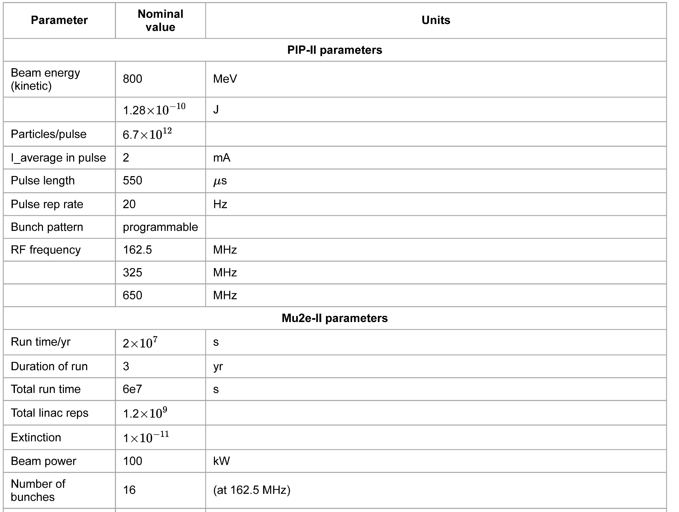
Wiki Mu2e-II parameter list
https://mu2eiiwiki.fnal.gov/wiki/Learn_about_Mu2e-II
Wiki has a table of nominal Mu2e-II parameter values
The top portion is shown here
Expect to grow and evolve as the effort evolves
Additions/Corrections/Comments welcome

Slide 11
Calendar
Wiki already has a calendar of Mu2e-II workshops:
https://mu2eiiwiki.fnal.gov/wiki/Calendar_of_Workshops
Also, Rare frontier has a calendar:
https://snowmass21.org/rare/start#calendar_of_meetings
Proposing to provide an editable Mu2e-II calendar on the private Wiki page
Working group meetings and workshops
Ad hoc working meetings
Convenor meetings
Committee meetings
Related Snowmass21 events
Include links to Zoom, agendas

Slide 12
We have a Mu2e-II Slack channel
https://join.slack.com/t/caltech-tka1525/shared_invite/zt-glsr3405-OondWg0KCpBoUJwIr2uyJw

Slide 13
August 26 Mu2e-II workshop agenda
When (CT) | Who | What
10:00-10:20 | Frank Porter | Introduction
10:25-10:45 | Lisa Goodenough | Working group reports - Sensitivity
10:50-11:10 | David Hitlin | Working group reports –Calorimeter
11:15-11:35 | Daniel Kaplan | MAGE
11:40-12:10 | All | Break
12:10-12:30 | Michael Mackenzie | Working group reports – Radiation/Production Solenoid
12:35-12:55 | Dan Ambrose | Working group reports – Tracker
13:00-13:15 | Antonio Gioiosa | Brief update - TDAQ
13:20-13:35 | Eric Prebys | Brief update - Accelerator
13:40-13:50 | Julian Heeck | Brief update - Theory
14:00 | All | End

Slide 14
Additional Material

Slide 15
Theory group members
Julian Heeck, Convenor, Uva
Lorenzo Calibbi, Convenor, Nankai U

Slide 16
Accelerator group members
David Neuffer, Convenor, FNAL
Eric Prebys, Convenor, UCD
Keegan Harrig, UCD
Andrei Gaponenko, FNAL
Kevin Lynch, CUNY
Diktys Stratakis, FNAL

Slide 17
Radiation simulation and mitigation group members
Michael MacKenzie, Convenor, Northwestern
Vitaly Pronskikh, Convenor, FNAL
Stefan Mueller, Convenor, HZDR
Anna Ferrari, HZDR
Reuven Rachamin, HZDR

Slide 18
Tracker group members
Daniel Ambrose, Convenor, UMinn
Giovanni Tassielli, Convenor, INFN Lecce
Brendan Casey, FNAL
Manolis Kargiantoulakis, FNAL
Mete Yucel, FNAL

Slide 19
Calorimeter group members
David Hitlin, Convenor, Caltech
Luca Morescalchi, Convenor, INFN Pisa
Ivano Sarra, Convenor, LNF
Leo Borrell, Bertrand Echenard, Dexu Lin, Sophie Middleton, James Oyang, Frank Porter, Liyuan Zhang, Renyuan Zhu, Caltech
Eleonara Diociaiuti, Raffaella Donghia, Simona Giovannella, Fabio Happacher, Stefano Miscetti, LNF
Stefano Di Falco, Simone Donati, Antonio Gioiosa, Elena Pedreschi, Franco Spinella, INFN Pisa

Slide 20
Cosmic Ray Veto group members
Yuri Oksuzian, Convenor, ANL
Craig Dukes, Convenor, UVa
TBD

Slide 21
Trigger/DAQ group members
Gianantonio Pezzullo, Convenor, Yale
Antonio Gioiosa, Convenor, INFN Pisa
Rebecca Chislett, UCL
Ryan Rivera, FNAL

Slide 22
Sensitivity estimates group members
Lisa Goodenough, Convenor, FNAL
Sophie Middleton, Convenor, Caltech
Yuri Oksuzian, Convenor, ANL
Rebecca Chislett, UCL
Michael Hedges, Purdue
Cole Kampa, Northwestern
Manolis Kargiantoulakis, FNAL
Michael Mackenzie, Northwestern

Slide 23
Development of scenarios
Exciting and diverse potential future muon program at FNAL
g-2
µ⁻ → e⁻, µ⁻ → e⁺, µe → ee conversion
µ → eX
μ→eγ, μ→eee
muonium
etc.
Mu2e, Mu2e-II
induction linac
surface muon beam
PRISM muon FFAG ring
Can we develop scenarios for how this could play out?
Put Mu2e-II in context of a larger program
Each component of the program stands by itself
Can we really alternate some of these?

Slide 24
“Working group reports”
Brief initial thoughts from working groups, covering, as relevant
Physics goals
Backgrounds
Status of requirements
What information is needed from others
Problems to solve
Potential technological solutions
R&D needed
May be continued at August workshop
May become more detailed as progress is made in future meetings

Slide 25
Mu2e-II Snowmass21 Committee
Name | Institution | Email
Dan Ambrose | U Minn | ambrose0028@gmail.com
Rebecca Chislett | UC London | rebecca.chislett@ucl.ac.uk
Lisa Goodenough | FNAL | goodenou@fnal.gov
Julian Heeck | U Virginia | julian.heeck@gmail.com
David Neuffer | FNAL | neuffer@fnal.gov
Yuri Oksuzian | ANL | yoksuzian@anl.gov
Frank Porter (chair) | Caltech | fcp@caltech.edu
Giovanni Tassielli | INFN-Lecce | giovani.tassielli@le.infn.it
Robert Bernstein (ex officio) | FNAL | rhbob@fnal.gov
Jim Miller (ex officio) | Boston U | miller@bu.edu

