Slide 1
A2D2 Operational Meeting
Michael Geelhoed

Slide 2
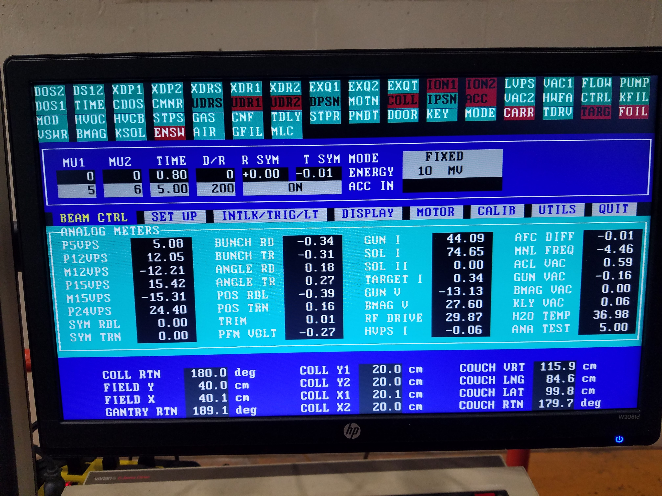
Upgrade and Status
Machine errors
Down to ENSW, CARR, FOIL Errors
With a new control board
Not Ideal, but beam available with interlocks bypassed
Acceletronics PO has passed
Technician on site August 20th to continue troubleshooting
Computer battery Dead
Either new battery $150
New computer ~$2,600
Procurements
HX PO #667964 Delivery Est. Sept
Low Dose Films Pur Req #311174

Slide 3
Work and Samples on the horizon
Stonybrook (SUNY CRADA)
GWRC Ballast Water (CRADA)
NIU/DuPage (NPUA)
Regher Solar (SPP)
PPD CMS Detector Boards (Internal)
APS-TD Nb Cavity (Internal)
FDA (CRADA/RCA)
APTIM Leachrate (CRADA/SOW pending)
MWRD (~ months)
EERE 3M
SRNL

