Slide 1
400 MeV Test Area (MTA) Accelerator Readiness Review (ARR)
Maddie Schoell
September 9-11, 2020

Slide 2
Overview
Key Definitions
Scope
Goals
Charge Questions
CRADs & LOIs
ARR Plan
Review Committee & SMEs
Schedule
COVID-19 Protocols
Summary

Slide 3
Scope – Fermilab Accelerator Complex

Slide 4
Scope – Fermilab Linac & 400 MeV Test Area (MTA)

Slide 5
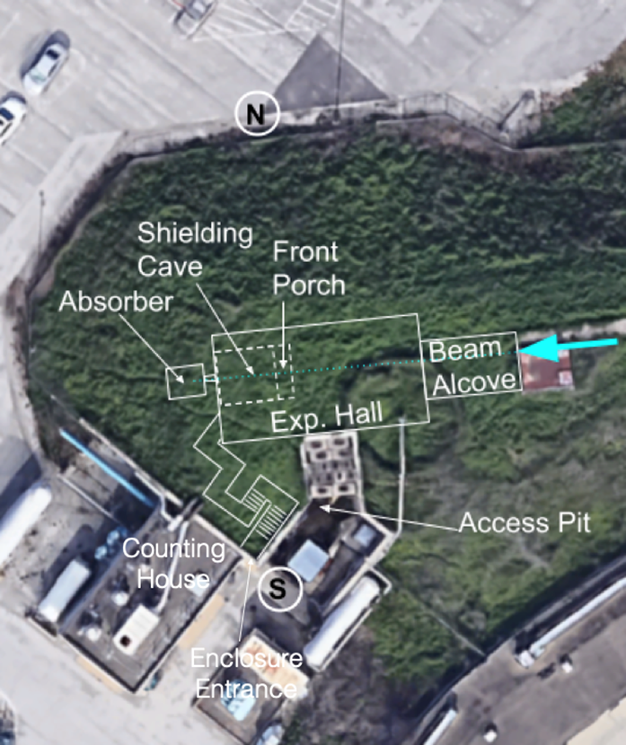
Key Definitions
MeV Test Area (MTA) – Beam enclosure containing the 400 MeV beam line and the experimental area.
Irradiation Test Area (ITA) – The experimental shielding cave and associated infrastructure located at the end of the MTA beam line. The ITA covers the broad experimental program taking place within the MTA.
Counting House – Service building adjacent to the beam enclosure entrance for experimental monitoring. (Formerly known as the MuCool Refrigeration Room.)

Slide 6
Scope
Updates made to the 400 MeV beamline and associated experimental hall in order to support beam operations into the Irradiation Test Area (ITA).
Addition of a stripping foil to allow for H- or proton transport
Installation of a shielding block cave inside the experimental hall to allow for higher intensity beam.
ITA will support experiments studying the radiation effects on material.
Material will be intentionally irradiated; however the facility is not intended to be used as an isotope production facility and any radionuclides produced are incidental to the radiation effects studies.
New Shielding Assessment & Updated SAD Chapter for MTA and updated ASE Intensity Limits

Slide 7
Goals
Members of the ARR Committee will assess work performed for resuming MTA beam operations in support of ITA to determine if Fermilab is prepared to safely begin commissioning and operations.
Determination will be based on DOE Order 420.2c, Safety of Accelerator Facilities, by reviewing documentation, programs, processes and systems in place to support safe accelerator operations.

Slide 8
Charge Questions
Are the necessary program elements from DOE O 420.2c, Safety of Accelerator Facilities, and the associated Contractor Requirements Document (CRD) in place for MTA operations?
Accelerator Safety Envelope (ASE)
Safety Assessment Document (SAD)
Developed based on a Shielding Assessment (SA)
Clearly defined roles and responsibilities for individuals involved in accelerator activities in support of MTA
A facility Configuration Management Program that is related to accelerator safety, and
Credited control and appropriate administrative processes related to accelerator safety
Are the procedures for reviewing and approving proposed experiments, within in the scope of the SAD and USI process, well defined and understood? Are they adequate in determining that the facility will not be used as an isotope production facility?
Are the procedures for experimental installation, retrieval, storage and release well defined and understood?

Slide 9
CRADS & LOIs
Developed to help ARR Committee in their review
1.1 Welcome
1.2 Discussion of Changes of Operations in Support of MTA 1.3 Facility Tour of MTA
2.1 Safety Assessment Document (SAD)
2.2 Accelerator Safety Envelope (ASE)
2.3 Safety Configuration Management (SCM) Documentation
2.4 Commissioning & Operations Plan
3.1 Accelerator Component Readiness
3.2 Training/Qualification Program for Accelerator Operations Personnel
3.3 Accelerator Operations Procedures for MTA Operations for ITA
3.4 Work Planning and Control Related to Accelerator Safety
3.5 Credited Controls (CC)
3.6 Radiological Protection

Slide 10
ARR Plan
This ARR will not go into detail about the SA/SAD/ASE/USID Process, FESHCom Committee, FESHM/FRCM of the Contractor Assurance System (CAS). These programs were extensively reviewed in February 2020 as part of the Muon Campus 13W Beam to the Diagnostic Absorber ARR.
Final Report: ESH DocDB 5630. iTrack Review 52249.
This ARR will provide an overview of the programs and cover how they are implemented for MTA operations in support of ITA.
Indico site established to outline the schedule and contains support documentations and presentations.

Slide 11
ARR Plan – Review Committee and SMEs
ARR Committee
John Anderson, Jr., lead (safety, accelerator operations)
Kamran Vaziri, (radiological protection)
Jerry Annala (beamline hardware, commissioning & operations)
Carrie McGivern (experiments)
Angela Aparicio (safety)
Wally Kissel (operations)
Rachel Madiar (FSO)
MTA/ESH/Operations SMEs
Tom Kobilarcik (AD External Beamline)
Jason St. John (AD External Beamline)
Evan Niner (PPD ITA)
Sue McGimpsey (ESH assigned RSO)
Maddie Schoell (ESH RPO Dept. Head)
Matt Quinn (ESH SRSO)
Todd Sullivan (AD Operations)
Joe Compton (AD Operations)

Slide 12
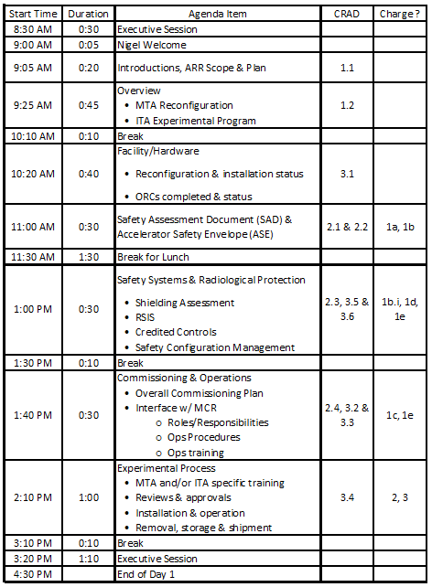
ARR Plan – Schedule
Presentations today will have full review committee together, with remote presentations.
Tomorrow will consist of tours of the MTA facility and executive session time for any follow-ups with SMEs.

Slide 13
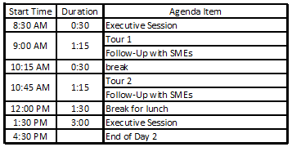
ARR Plan – Schedule
Tomorrow will consist of tours of the MTA facility and executive session time for any follow-ups with SMEs.
Ample time allotted for tours to accommodate social distancing.
Close-out on Day 3
Tour 1: John, Jerry, Angela, Rachel
Tour 2: Kamran, Carrie, Wally

Slide 14
ARR Plan – COVID-19 Protocols
If in the meeting room, the following COVID-19 protocols are in effect:
Maintain a social distance of 6 feet
Face covering required
PPE/Training requirements for facility tour:
Radiological Worker Training
MTA Hazard Awareness Training
Dosimetry badge & pocket dosimeter
Closed toe, low heel shoes
Gloves (provided)
Face covering
Maintain a social distancing of 6 feet wherever possible
Multiple tour groups to help facilitate social distancing
No refreshments will be provided

Slide 15
Summary
This plan allows for all review committee members to participate in all presentations as well as visit the enclosure and service building.
We believe this plan will support your evaluation and determination of readiness for the commissioning and operation of MTA in support of ITA.
We will demonstrate that our documentation, programs, processes and systems are ready to begin beam commissioning and operations,
And we have processes in place to support experiments studying the effects of radiation damage on material while ensuring the facility is not used as an isotope production facility.

Slide 16
Summary
We look forward to your findings, observations, and pre- and post-start recommendations.
Finding: statements of fact that summarize noteworthy information presented during the review
Observation: judgment statements about the facts presented during the review and are based on reviewers’ experience and expertise
Recommendation: suggestions for considering a different approach, calculation method, parameter, requirement, or data to the project that may impact the project
Pre-Start: A recommendation suggested to be implemented prior to the start of beam commissioning and operations.
Post-Start: A recommendation suggested to be implemented, but may be implemented after the start of beam commissioning and operations.

