Slide 1
IF03: Solid State Detectors and Tracking
Artur Apresyan, Lucie Linssen, Tony Affolder
August 27, 2020
Bi-weekly IF03 Solid State Detectors and Tracking

Slide 2
Snowmass process, Instrumentation Frontier
Community-driven effort on long-term planning for particle physics
Bottom-up process => your input is needed !!
  That’s the most important aspect at this phase of the process
  See text “how to Snowmass” by Chris Quigg
  The idea is to get the community at large involved
Milestones along the way:
    Letters of Interest due 31 Aug 2020
    (Virtual) Community Planning Meeting: October 5-8
    Summer Study meeting meeting: 11-20 July 2021
    Contributed Papers due July 31 2021
Instrumentation Frontier focuses on detector technologies and R&D needs for future experiments across the physics frontiers
See IF kickoff workshop: https://indico.fnal.gov/event/43730/

Slide 3
IF03: Solid State Detectors and Tracking
IF03 tracking: https://snowmass21.org/instrumentation/tracking
This topical group aims to study detectors and technologies needed for charged particle tracking:
  Technologies for colliders, fixed target, or precision measurement experiments
  Ranging from silicon to diamond and other alternative materials.
  Also non-solid-state trackers, e.g. for high-intensity experiments.
  3D integration, ultra-lightweight materials for mechanical support & cooling.
Trackers should be discussed in the context of future experimental challenges
  Identify technological challenges and technology opportunities with different future accelerators
  Moreover “blue sky” R&D is important => opportunities for future transformative breakthroughs’

Slide 4
IF03: How to connect and give input
Connect:
  Our IF03 tracking indico category https://indico.fnal.gov/category/1183/
  At each meeting we try to focus on a particular subject
  In a flexible way, taking availability of speakers into account
Past meetings:
  July 30:
  Timing detectors, LGAD
  August 13:
  Parameters for future detectors
  Trends for future silicon detectors – MAPS
  Detector integration - interconnect
  Today August 27:
  Mechanics and support structures
  Silicon drivers and physics drivers

Slide 5
IF03: How to connect
Inscribe to our mailing list:
  snowmass-if-03-tracking@listserv.fnal.gov
  Instructions can be found here: https://snowmass21.org/instrumentation/start (go down to “communications”)
Note that, on our last meeting of August 13 we had up to ~40 people connected, while only 2/3 are on the mailing list.
Contact the conveners in case you have suggestions for us:
Artur Apresyan apresyan@fnal.gov
  Fermilab, CMS experiment, MIP timing detector for HL-LHC
Lucie Linssen lucie.linssen@cern.ch
  CERN, silicon R&D for pixel trackers and granular calorimetry (CLIC, CMS).
Anthony Affolder affolder@ucsc.edu
  UC Santa Cruz, ATLAS tracker upgrade for HL-LHC

Slide 6
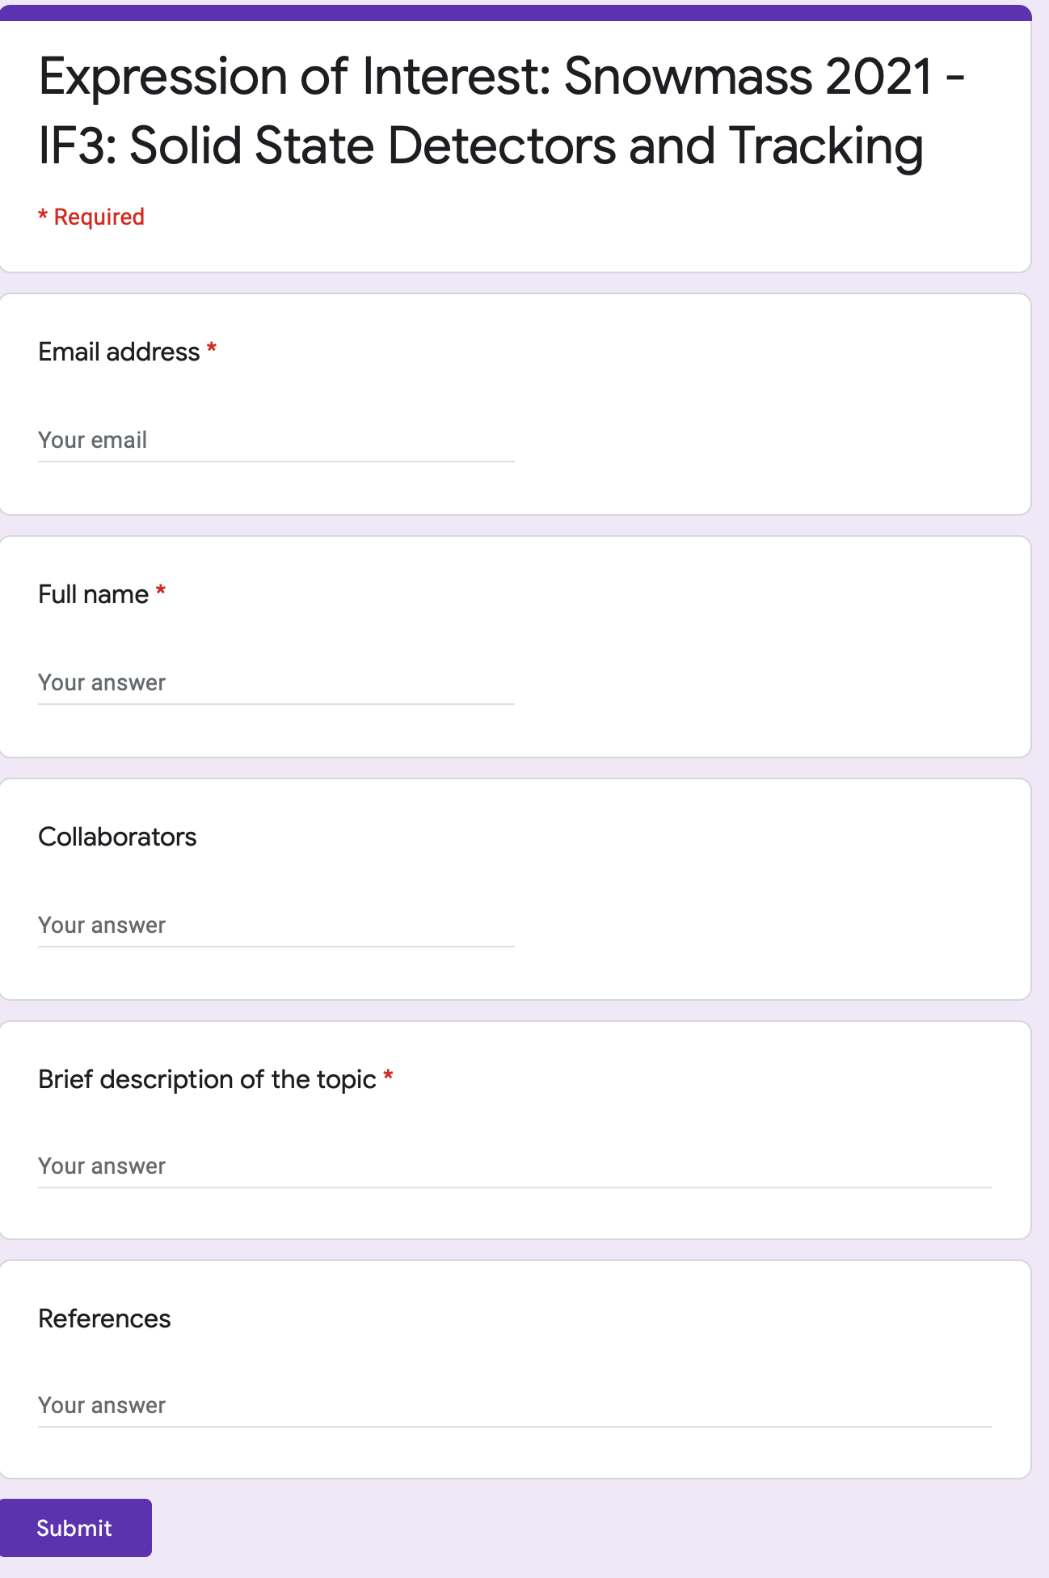
How to contribute
IF03 google form:
https://forms.gle/aknT8FsFU1Pk47hn7
Several mechanisms to indicate your interest and contribute with studies
  Google form to collect basic info: contact info, brief description of interests
  Letters of Interest: short documents
    Deadline August 31st !!!
    https://snowmass21.org/loi
  Contributed papers: more extensive studies which will be part of Snowmass report

Slide 7
Community Planning Meeting
October 5-8, virtual
(replaces the community meeting initially planned at Fermilab in November)
Inscribe here:
https://indico.fnal.gov/event/44870/

Slide 8
Conclusion
Many ideas and directions to explore and study
  We need you input and participation in shaping the process,
  working together towards conclusions on directions and needs for the future,
  to be summarized in the final report
Now urgent: fill out the google form and/or submit a short letter of interest:
  https://forms.gle/aknT8FsFU1Pk47hn7
  https://snowmass21.org/loi
Subscribe to the mailing lists and slack channels:
  https://snowmass21.org/instrumentation/start

Slide 9
Reserve slides

Slide 10
Existing Detector R&D Overview Efforts
A lot of work has been done already for BRN, CPAD, EPSG
  CPAD Workshops
    Annual workshops since 2015
    Report from CPAD 2019: https://wp.physics.wisc.edu/cpad2019/
    Report from CPAD 2018: https://arxiv.org/abs/1908.00194
  DOE BRN Study Workshop on HEP Detector R&D, Dec. 2019
    HEPAP report: https://science.osti.gov/hep/hepap/Meetings/202007
  European Strategy for Particle Physics Preparatory Group
    2020 Update of the European Strategy for Particle Physics: http://cds.cern.ch/record/2720129
    Deliberation Document on the 2020 Update of the European Strategy for Particle Physics: https://cds.cern.ch/record/2721371
Collaborative frameworks within CERN RD groups, and university-lab collaborative efforts

Slide 11
Sample topics to be covered
Traditional silicon sensors development:
  Low mass, finely-segmented radiation hard detectors needed for future experiments, with different degrees of focus on rad-hardness or position resolution
New silicon technologies: MAPS, SoI
  Avoid bump-bonding, many developments in industry, many opportunities and challenges to adapt to HEP needs
  Reduction in material budget and material cost
Advanced simulation tools to help in understanding the performance of new prototypes and to optimize the design of new detectors
  Essential to minimize development costs and R&D cycles, often a rare set of expertise within collaborations.
  Development and improvements of rad-damage simulation and comparisons with experiments

Slide 12
Sample topics to be covered
4D trackers for the future machines: position + time
  Reduce backgrounds, track reconstruction, triggering, will need precision timing information, in addition to the precision position
  Particle ID and LLP searches are new areas where we start utilizing the timing and position information
Time resolution:
  Pico-second level time resolution critical for high occupancy environments in future hadron colliders.
  Requirements in the range from ~5 to ~30 ps resolutions, need to clearly identify the needs and simultaneous requirements on position resolution

Slide 13
Sample topics to be covered
Electrical and thermal services: work in coordination with IF07
  Efficiently deliver thousands of amps for powering the ASICs
  Efficiently remove the heat: increasingly complex readout schemes, ASICs generate 100s of kWs
  Approaches to improve the efficiency: DC-to-DC conversion and serial current delivery for HV; improve conversion efficiency and rad hardness.

Slide 14
Sample topics to be covered
Precision support structures and cooling
  Cooling and support as an integrated problem
  Issues related to development of support structures needed for increasingly complex tracking detectors
  Typically interested in very stable and precise structures to support tracking sensors, with minimal mass and low radiation lengths
  Studies of novel materials, advanced compounds, foams etc
Interconnections and readout:
  Issues related to modules designs, assembly and large-scale productions
  Packaging technologies: bump-bonding, wire-bonding, glues and adhesives, flex circuits, TSV, etc.

Slide 15
Sample topics to be covered
Developing and preserving knowledge and expertise
  The EPSG “Physics Briefing Book” raised this point well, and presented a compelling case
  We aim to study this question in the US context, and identify areas where funding agencies and the community can help to ensure that young talent is attracted and is maintained within the field
  It is of critical importance to the future of the field to ensure career opportunities exist and are expanded
Explore and encourage multi-institutional developments and shared use of resources at labs and universities
  Encourage the support of workshops, conferences, seminars on tracking detectors and encourage participation
  Collaborative environments for sensor developments: e.g. multi project foundry submissions

Slide 16
Synergies with other groups
Some areas expected to be cross-cutting:
  MAPS detectors or 3D integration: IF03 and IF07
  Tracking reconstruction: development of new algorithms both online and offline, development of the detector designs, and will need to leverage on the computing developments: IF03 and CompF1
  Effective use of precision timing in track reconstruction, and trigger formation: IF03 and IF04+CompF1
  TPC and large area muon chambers: IF03 with IF05
We should identify how most effectively organize work in these cross-cutting areas

