Slide 1
MQXFA06 Coils Acceptance Review QXFA119, QXFA122, and QXFA123
Fred Nobrega, CAM/L3
Miao Yu, Deputy L3
Marcellus Parker, Electrical
Coil Fabrication at FNAL
U.S. HL-LHC Accelerator Upgrade Project
MQXFA06 Coils Acceptance Review
September 25, 2020

Slide 2
Outline
Coil Specifications
(Conforms to QXFA Series Coil Production Specification, US-HiLumi-doc-2986)
MQXFA Final Design Report, US-HiLumi-doc-948
QXFA Coil Fabrication Electrical QA, US-HiLumi-doc-521
QXFA119, QXFA122, and QXFA123
Coil length results
Electrical measurement results
Discrepancy Reports
Recommendations addressed from MQXFA05 coil acceptance review

Slide 3
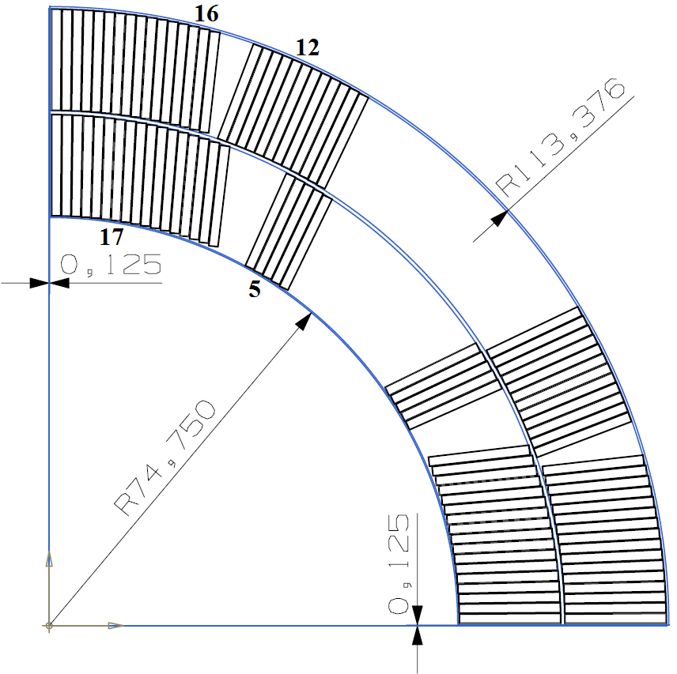
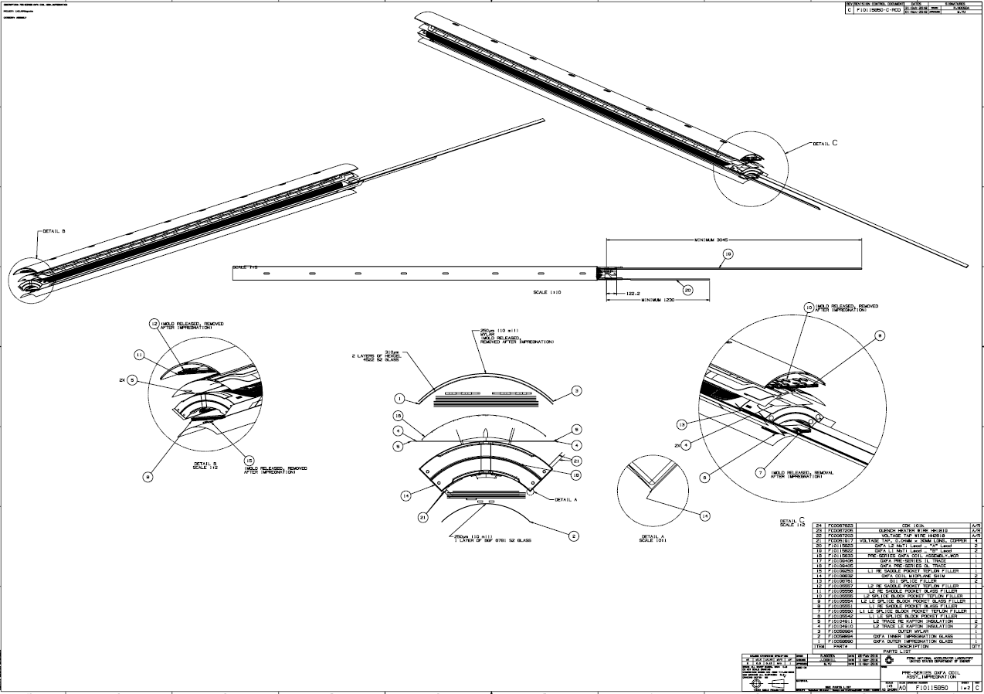
Coil Dimensional Specifications
MQXFA Final Design Report, US-HiLumi-doc-948
 | Dimension (mm) | Tolerance (mm)
Inner radius | 74.750 | ± 0.250
Outer radius | 113.376 | ± 0.250
Coil to midplane gap | 0.125 | ± 0.050
Keyway width | 14.00 | ± 0.25
Coil length | 4529 | ± 5
Coil tolerances per drawing F10115850.

Slide 4
Coil Reaction & Impregnation Specifications
MQXFA Final Design Report, US-HiLumi-doc-948
Coil Reaction | Step | Description | Average Rate | Time
Step 1 | Ramp | from 20 °C to 210 °C | 25 C/hour
Step 2 | Soak | 210 °C |  | 48 hours
Step 3 | Ramp | from 210 °C to 400 °C | 50 C/hour
Step 4 | Soak | 400 °C |  | 48 hours
Step 5 | Ramp | from 400 °C to 665 °C | 50 C/hour
Step 6 | Soak | 665 °C |  | 50 hours
Step 7 | Ramp | from 665 °C to 20 °C |  | ~ 80 hours
Coil Impregnation | Description | Average Rate | Time | Comment
Ramp | from 20 °C to 110 °C | 10 C/hour |  | Coil Degas
Soak | 110 °C |  | 8 hours
Ramp | from 110 °C to 55 °C | 1.7 C/hour
Soak | 55 °C |  | 4-6 hours | Epoxy Fill
Ramp | from 55 °C to 110 °C | 10 C/hour |  | Epoxy Cure
Soak | 110 °C |  | 5 hours
Ramp | from 110 °C to 125 °C | 10 C/hour
Soak | 125 °C |  | 16 hours

Slide 5
Coil Electrical Measurement Range
QXFA Coil Fabrication Electrical QA, US-HiLumi-doc-521
 | Measurement | Ref. Min-Max
 | Coil Resistance @ 1A | 590.00-610.00 mV
 | Ls @ 20 Hz | 4.80-5.10 mH
 | Q @ 20 Hz | 0.80-0.90
 | Ls @ 100 Hz | 3.20-3.50 mH
 | Q @ 100 Hz | 1.50-1.70
 | Ls @ 1 kHz | 1.80-2.00 mH
 | Q @ 1 kHz | 1.90-2.10

Slide 6
Coil Length
 | Overall Coil Length (mm)
Pre-Series Requirement | 4532 ± 5.0
Series Requirement | 4529 ± 5.0
QXFA 119 | 4531.2
QXFA 122 | 4531.3
QXFA 123 | 4529.9

Slide 7
DR Summary
Legend
Noncritical DR
Critical DR
Critical DR – affects form/fit/function and needs L2 review
Coil # | Total DR’s | Critical DR’s
QXFA119 | 10 | 2 (Selva, keyway shift)
QXFA122 | 12 | 1 (reaction out of spec)
QXFA123 | 10 | 1 (react COVID shutdown)
Coil # | W&C | React | Impreg | CMM | Electrical
QXFA119 | 2* |  | 4 | 1* | 3 (0)
QXFA122 |  | 2* | 2 |  | 8 (6)
QXFA123 | 1 | 3* | 3 |  | 3 (1)
*Critical DR
() Electrical tolerances are based on the std dev of previous coils. A draft version of updated electrical tolerances will soon be circulated for review.

Slide 8
QXFA119 DR’s
Legend
Noncritical DR
Critical DR
Critical DR – affects form/fit/function and needs L2 review
DR Number | Description | Disposition
11904 Coil Winding and Curing | When wind 14th turn on the lead end, the mandrel stops working. We try to rotate the mandrel in both directions, but it would only move to the west hand side of the machine. | Moved coil from Selva winder to backup winding station (rotating table).
11911 Coil Winding and Curing | When doing the electrical test, the LS measurement was lower than normal. | The LCR meter, at the time of this measurement was in need of recalibration.
11932 Splice / Epoxy Impregnation | The Hexcel 4522 blanket is tuck in between the coil and mandrel. The location of the tuck, starts from the LE baseplate is between 138"- 142". | Remove the Hexcel 5422 material from coil and continue with coil fabrication.
11939 Electrical Testing | While performing this test the coil to structure the meter showed a short of 15 ohms. Had Fred to come and look at it and we aren't sure what the cause is, but we suspect that it maybe from the voltage taps. | Continue following the traveler to roll and remove reaction tooling. Measure coil to tooling resistance and report results if less than 10 mega-ohm.
11941 Splice / Epoxy Impregnation | When the side rails were sent out for modification, there was supposed to be 1 from the A set of tooling and 1 from the B set of tooling. Upon installing, we realized that both side rails that were modified were from set B. This caused an issue with the orientation of the threaded holes/slots in the side rails. | Follow AUP off-Normal Work Planning & Control document attached. A summary is below.

Slide 9
QXFA119 DR’s
Legend
Noncritical DR
Critical DR
Critical DR – affects form/fit/function and needs L2 review
DR Number | Description | Disposition
11942 Splice / Epoxy Impregnation | During inspection of the coil. We discover that VTA02 is tuck in between the LE Splice Block and the coil lead. | Using tweezers, carefully pull flag out from between the splice and form block.
11943 Splice / Epoxy Impregnation | During the inspection of filling the gaps to fill with S2 glass. The gap between B2-IC4 Saddle and last reacted cable turn is 2mm larger than the gap from previous coil QXFA117. Also, Miao pointed out that the gap on the 5th turn @ B2-IC1 has a gap of 1.63mm. | Fill gap on the 5th turn with S2 glass flat ribbon and carefully trim excess glass. For the saddle gap, roll the S2 glass into a rod to a diameter approximately the width of the gap and place between the saddle and coil. Repeat until entire gap is filled with rolled S2 glass. Carefully trim excess glass.
11952 Electrical Testing | The Tap Voltages reading are out of spec. | The appropriate action is to cycle the multimeter and reinitiate the QXFA script for 4-wire measurements on the machine and repeat the measurements of the voltage taps.

Slide 10
QXFA119 DR’s
Legend
Noncritical DR
Critical DR
Critical DR – affects form/fit/function and needs L2 review
DR Number | Description | Disposition
11963 Coil Interface | Per CMM results at cross section -327 mm from LE, the keyway has shifted out of tolerance by 0.115 mm and the midplane is out of tolerance by 0.075 mm. The relevant CMM cross section is attached as a pdf. | This coil may be used as it is following this plan: - the Coil fabrication L3 shall inform the Structure assembly L3 about this DR, because the pole key will have to be adjusted to compensate for this nonconformity; - a note shall be added to the Interface Traveler of this coil stating "DR 11963 requires pole key adjustment" - this DR must be considered as Critical because it affects an interface.
11967 Electrical Testing | An initial impulse test performed for QXFA 119 displayed questionable behavior. More specifically, a short-lived peak shown commonly observed in most QXFA Coils. | Perform a full factory reset to the impulse tester. Confirm that it is working appropriately on another coil. Perform the test again on coil 119 and confirm the waveform being observed using a secondary oscilloscope. The coil passed after tester reset.

Slide 11
QXFA122 DR’s
Legend
Noncritical DR
Critical DR
Critical DR – affects form/fit/function and needs L2 review
DR Number | Description | Disposition
11972 Reaction | While removing the mica from the voltage taps, voltage tap B05 broke. I removed the mica in the same manner as I did the rest of the taps but the mica was pretty much stuck on the voltage tap at this location. | Make an attempt to pull the flag out from the coil to use with the quench heater trace. Successfully completed.
11975 Electrical Testing | The measured resistance for this coil is slightly higher than normal. | Continue to move forward with fabrication and observe the coils resistance during the next electrical measurements as the coil should have reached thermal equilibrium with the room. The next measurement should fall with in the expected range of resistance.
11991 Splice / Epoxy Impregnation | Most of the bolts were hard to remove. The initial flow rate for this coil was on the low side so the bolts were tightened again after installation to see if argon flow would improve. | Remove bolts if possible. Use an extracting bit to remove bolt(s)if head breaks off.

Slide 12
QXFA122 DR’s
Legend
Noncritical DR
Critical DR
Critical DR – affects form/fit/function and needs L2 review
DR Number | Description | Disposition
12014 Reaction Traveler | The Series Coil Production Specification (DocDB #2986, section 4, 22-Apr-2020 revision) states that the temperature of all thermocouples shall be within the defined limits (+/- 7C for the 210C and 400C soaks, and +/- 5C for the 665C soak) for the defined durations (4 hours after the start of the soak). As can be seen in the process capability plots attached to this step, approximately 2% of the 210C and 400C measurements are out of spec, and approximately 20% of the 665C are out of spec. It is worth noting that the averages for all soak temperatures are in spec. | Check calibration of T/C#12, 13 and T/C#2 and inform engineer of results prior to reaction of coil QXFA123. Replace all reaction tooling T/C's with Type K, same as the control T/C's, as soon as reasonably possible. Notes: Adjusted 665C ramp. Similar to coil QXFA123 DR12049. See next slides.
12016 Splice / Epoxy Impregnation | The flux was left on the Coil Leads during the Covid 19 shut down. There is green corrosion on the leads. (Only on the IL coil lead). | Clean leads with abrasive pad and flux.
12019 Electrical Testing | While taking electrical measurements, we noticed the following pole to pole shorts: Pole 1-2 60.6ohm, Pole 2-3 .2ohm, Pole 3-4 .2ohm, Pole 4-5. 15.6ohm, Pole 5-6 5.1ohm, Pole 6-7. 21ohm, Pole 8-9 3.4ohm, Pole 9-10 .2ohm | Given that the intended pole to pole electrical relationship requires that the pole does not have electrical continuity about each other, each of the poles listed above should be inspected again after impregnation to confirm that they are no longer in contact with one another.

Slide 13
QXFA122 DR12014
Plan for Furnace
May have PID oscillation at 665C. Add a step in the recipe to reduce ramp as furnace temperature approaches plateau.
The 210C and 665C average plateaus are higher than the previous coils. Reduce the recipe setpoint by 3.9C and 4.3C respectfully to move all T/C's lower. (The temperature reduction is based on the previous coil QXFA122.)
React coil QXFA123
Perform furnace testing with a dummy load after coil QXFA123

Slide 14
QXFA123 DR12049
DR generated for coil QXFA123. Parameters out of spec but there was improvement over QXFA122.
Furnace changes from QXFA122
210 target temperature lowered from 214 to 210.1
665 target temperature lowered from 669 to 664.7
2 step ramp up from 400C to 665C (see steps 6 & 7)
Areas of focus
Temperature spread on reaction tooling
Thermocouple calibration procedure
Application of calibration data to furnace temperature output
Continue furnace tests with dummy load. Next test is Oct 5.

Slide 15
QXFA122 DR’s
Legend
Noncritical DR
Critical DR
Critical DR – affects form/fit/function and needs L2 review
DR Number | Description | Disposition
12021 Electrical Testing (Prior to impregnation ID up) | A short between the coil and structure was measured to be ~3.5 MOhms during the coil's continuity check. Concurrently, The Ls and Q measurements were found to be both high and Low respectively. It has been determined that the continuity between the tooling and coil is related to the Ls and Q measurement. | Measurement results are: Coil voltage drop is 0.608V Readings for the tooling were 0.21 V and 0.26V from the opposite lead indicating that the short is somewhere around the middle of the coil and might be a form block pin.
12079 Electrical Testing | The measured Q-Value was observed to beat 1.36. This is 3% lower than the defined minimum limit of 1.40. | Continue to monitor Electrical behavior throughout the fabrication of this coil.
12080 Electrical Testing | The measured Q value for this step is currently reading 1.39. The designated minimum for this step is 1.40. The measured reading is ~0.72 % away from the set minimum. Based on what was provided by the Machines instruction manual, the Machine error for measurements on this order (1mH and 1 Ohm) at 20 Hz is around 0.65%. | The tolerances should be reviewed, and a decision of the coil's conformance should be made during the appropriate coil readiness review.
12081 Electrical Testing | The minimum set range for the Q is 1.20 for this step. Meanwhile, a reading of 1.19 was measured. This is ~0.84 % below the defined minimum | The tolerances should be reviewed, and a decision of the coil's conformance should be made during the appropriate coil readiness review.

Slide 16
QXFA122 DR’s
Legend
Noncritical DR
Critical DR
Critical DR – affects form/fit/function and needs L2 review
DR Number | Description | Disposition
12082 Electrical Testing | The Q value was measured at 1.18. This is lower than the minimum by 0.02 and has a percent difference of 1.69 %. | The tolerances should be reviewed, and a decision of the coil's conformance should be made during the appropriate coil readiness review.
12083 Electrical Testing | The cause of this nonconformance is not known. However, the Ls, and R for this reading were within their defined limits. Additionally, the Ls and Q taken at a 100 Hz, and 1 kHz were found to be at nominal values. | The tolerances should be reviewed, and a decision of the coil's conformance should be made during the appropriate coil readiness review.

Slide 17
QXFA123 DR’s
Legend
Noncritical DR
Critical DR
Critical DR – affects form/fit/function and needs L2 review
DR Number | Description | Disposition
11976 Coil Winding and Curing (Using Rotating Table) | While making the first turn on the LE pole, the cable on the spool fell onto itself and got caught on itself I lifted the cable to get it untangled, after the cable came off the spool it had roped. | Zero the tension, remove the insulation and repair the roped cable. After repair, wrap the cable using 3 mil S2 glass with 50% overlap, paint binder and cure the insulation and the cable
11986 Reaction Traveler | While resuming work on this coil, I noticed that section 4.1 was not completed. I had to remove the form blocks and filler/liner to complete the section of electrical testing(Multimeter) for the OD. (at this point the coil had not been torqued. Form blocks were on but not bolted down. | As described above, the assembly was not bolted together. Remove form blocks, liner, filler and perform electricals per step 4.1 in the traveler. Resume reaction traveler step 2.14.
11990 Electrical Testing | Coil Resistance is over by 3.8mΩ’s. (warm coil) | Measure resistance again in the next step to confirm that the coils resistance is within the expected range. Verified.

Slide 18
QXFA123 DR’s
Legend
Noncritical DR
Critical DR
Critical DR – affects form/fit/function and needs L2 review
DR Number | Description | Disposition
11992 Reaction Traveler | At approximately 8PM on Friday, March 20 the furnace heaters were shut down with the consent of Giorgio Apollinari due to the implementation of the Modified Min Safe Plan at Fermilab. The furnace state was post argon purge and temperature ramping up to 210C. The tooling temperature was 76C when the heaters were turned off. The fans remained on and the argon flowed until the following morning when Martel Walls powered down the furnace. | No impact is expected on coil performance. Therefore, upon return to work, open the furnace door and do a visual inspection, measure and record the argon exit flow from the tooling, close door and begin reaction cycle from the very beginning (i.e. 5 hour argon purge followed by standard heat treatment cycle).
12034 Splice / Epoxy Impregnation | Doing a visual inspection of the coil. The color on RE, transition side, turns is darker than normal. | Lightly vacuum area to remove loose material.
12036 Splice / Epoxy Impregnation | While installing the first layer of insulation, The "c" shaped voltage tap on the lead broke | Leave the damaged soldered flag in place. Insulate and solder the new VT flag with the steps below. (More details can be found using the DR link.)

Slide 19
QXFA123 DR’s
Legend
Noncritical DR
Critical DR
Critical DR – affects form/fit/function and needs L2 review
DR Number | Description | Disposition
12049 Reaction Traveler | The statistical analysis of the reaction data (attached to this traveler step) show the following regarding individual T/C temperature measurements: 210C: 0.24% out of spec low 400C: 10% out of spec high 665C: 5.5% out of spec low The averages are acceptable, but our specification is applied to individual measurements. | Use witness sample test results to make final determination of the coil disposition for use in a magnet. Note: This is a continuation of the investigation started with coil 122, DR12014.
12063 Electrical Testing (Prior to impregnation ID up) | Shorts found in multiple locations between the coil and tooling. They were measured using the Keithley multimeter to be ~1.5 MOhms. Based on the attached images the tooling is only able to make contact with the pole via pins attached to the modified form-blocks. With this information there all appears to be a short between the coil and pole also at ~1.5 MOhms. | Continue with coil fabrication. Note: same as DR 12021

Slide 20
QXFA123 DR’s
Legend
Noncritical DR
Critical DR
Critical DR – affects form/fit/function and needs L2 review
DR Number | Description | Disposition
12068 Splice / Epoxy Impregnation | As Technicians completed the potting the process ~ 22” of excess epoxy were measured inside of the outlet tube. When they arrived the next day 4” epoxy remained inside the tube. Epoxy could be seen dropping from the hose clamp that keeping the tube connected to the brass fitting (see image in attachments) onto the platform below. Given the ID of the hose is ~.778” and ~18” of epoxy were lost, this amounts to ~8.5 in2 of lost epoxy which can be seen on the platform below. | Tighten hose clamp. Add epoxy to the overflow tube as outlined below. Other: We expect 1-4" of epoxy to flow from the overflow tube back into the coil during the 16 hour soak. We calculated about 140 ml of epoxy leaked onto the cardboard on the floor. Attached is a photo with 150 ml of water on cardboard and it looks similar. We conclude that the epoxy back flow into the coil is likely similar to other coils. Nevertheless, as an added precaution we elected to add additional epoxy to the overflow tube during coil gelling and curing.
12101 Electrical Testing | The Q value was measured lower than the set design specification. | Review the current standing low limit tolerance to assess if this is too tight to be feasible.

Slide 21
QXFA119 Hi-pot & Electrical Checks
Measurement | QXFA119 | Avg | StDev | StDev/Avg | Min | Max
Coil R @1 A (mΩ) | 599.74 | 605.77 | 5.08 | 0.01 | 595.73 | 614.75
Ls @ 20 Hz (mH) | 4.87 | 4.79 | 0.11 | 0.02 | 4.56 | 4.97
Q | 0.79 | 0.78 | 0.03 | 0.03 | 0.73 | 0.81
Ls @ 100 Hz (mH) | 3.33 | 3.30 | 0.10 | 0.03 | 3.17 | 3.48
Q | 1.59 | 1.61 | 0.02 | 0.02 | 1.57 | 1.66
Ls @ 1 kHz (mH) | 1.88 | 1.89 | 0.02 | 0.01 | 1.87 | 1.95
Q | 2.04 | 2.04 | 0.05 | 0.03 | 1.95 | 2.15
VTA1 (mΩ) | 0.50 | 0.28 | 0.26 | 0.95 | 0.02 | 0.83
VTA2 | 0.50 | 0.35 | 0.29 | 0.83 | 0.07 | 1.00
VTA3 | 192.08 | 195.28 | 1.79 | 0.01 | 192.08 | 198.50
VTA4 | 251.01 | 254.44 | 2.24 | 0.01 | 250.52 | 258.60
VTA5 | 251.18 | 254.64 | 2.22 | 0.01 | 250.74 | 258.80
VTA6 | 256.54 | 260.26 | 2.31 | 0.01 | 256.38 | 264.60
VTA7 | 256.72 | 260.50 | 2.27 | 0.01 | 256.54 | 264.80
VTA8 | 263.07 | 265.89 | 2.27 | 0.01 | 261.71 | 270.10
VTB8 | 263.85 | 266.21 | 2.26 | 0.01 | 262.11 | 270.50
VTB7 | 264.44 | 267.16 | 3.47 | 0.01 | 262.37 | 277.42
VTB6 | 269.82 | 271.93 | 2.35 | 0.01 | 267.91 | 276.40
VTB5 | 270.35 | 272.40 | 2.31 | 0.01 | 268.19 | 276.80
VTB4 | 274.48 | 277.92 | 2.46 | 0.01 | 273.62 | 282.40
VTB3 | 416.32 | 420.30 | 3.60 | 0.01 | 413.86 | 427.10
VTB2 | 598.40 | 604.22 | 5.56 | 0.01 | 593.70 | 614.70
VTB1 | 598.60 | 604.85 | 4.76 | 0.01 | 595.61 | 614.80
QHB1 | 1.91 | 1.89 | 0.14 | 0.07 | 1.61 | 2.13
QHB2 | 1.97 | 1.93 | 0.13 | 0.07 | 1.65 | 2.12
QHB3 | 1.91 | 1.92 | 0.12 | 0.06 | 1.62 | 2.12
QHB4 | 1.90 | 1.90 | 0.12 | 0.06 | 1.61 | 2.10
 | QXFA119
Hi-Pot (<1µA Leakage)
Coil to Pole (V) | 100/100
QH to Coil (V) | 3680/3680
Coil to Saddle (V) | 1000/1000
QH to Saddle (V) | 2500/2500
Saddle to Saddle (V) | 1000/1000
Impulse (V) | 2500/2500

Slide 22
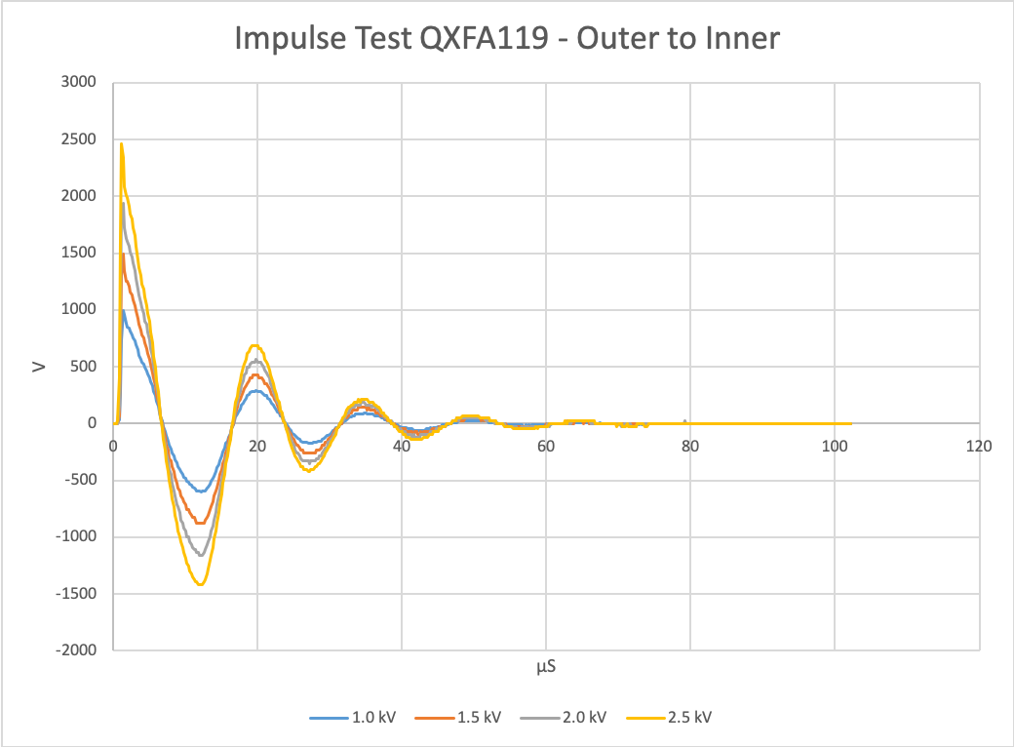
QXFA119 Impulse Test

Slide 23
QXFA122 Hi-pot & Electrical Checks
Measurement | QXFA122 | Avg | StDev | StDev/Avg | Min | Max
Coil R @1 A (mΩ) | 609.44 | 605.77 | 5.08 | 0.01 | 595.73 | 614.75
Ls @ 20 Hz (mH) | 4.80 | 4.79 | 0.11 | 0.02 | 4.56 | 4.97
Q | 0.76 | 0.78 | 0.03 | 0.03 | 0.73 | 0.81
Ls @ 100 Hz (mH) | 3.29 | 3.30 | 0.10 | 0.03 | 3.17 | 3.48
Q | 1.58 | 1.61 | 0.02 | 0.02 | 1.57 | 1.66
Ls @ 1 kHz (mH) | 1.88 | 1.89 | 0.02 | 0.01 | 1.87 | 1.95
Q | 2.06 | 2.04 | 0.05 | 0.03 | 1.95 | 2.15
VTA1 (mΩ) | 0.40 | 0.28 | 0.26 | 0.95 | 0.02 | 0.83
VTA2 | 1.00 | 0.35 | 0.29 | 0.83 | 0.07 | 1.00
VTA3 | 195.13 | 195.28 | 1.79 | 0.01 | 192.08 | 198.50
VTA4 | 254.62 | 254.44 | 2.24 | 0.01 | 250.52 | 258.60
VTA5 | 254.64 | 254.64 | 2.22 | 0.01 | 250.74 | 258.80
VTA6 | 260.21 | 260.26 | 2.31 | 0.01 | 256.38 | 264.60
VTA7 | 260.45 | 260.50 | 2.27 | 0.01 | 256.54 | 264.80
VTA8 | 266.64 | 265.89 | 2.27 | 0.01 | 261.71 | 270.10
VTB8 | 266.25 | 266.21 | 2.26 | 0.01 | 262.11 | 270.50
VTB7 | 277.42 | 267.16 | 3.47 | 0.01 | 262.37 | 277.42
VTB6 | 272.21 | 271.93 | 2.35 | 0.01 | 267.91 | 276.40
VTB5 | 272.90 | 272.40 | 2.31 | 0.01 | 268.19 | 276.80
VTB4 | 279.15 | 277.92 | 2.46 | 0.01 | 273.62 | 282.40
VTB3 | 421.69 | 420.30 | 3.60 | 0.01 | 413.86 | 427.10
VTB2 | 608.50 | 604.22 | 5.56 | 0.01 | 593.70 | 614.70
VTB1 | 609.40 | 604.85 | 4.76 | 0.01 | 595.61 | 614.80
QHB1 | 1.88 | 1.89 | 0.14 | 0.07 | 1.61 | 2.13
QHB2 | 1.90 | 1.93 | 0.13 | 0.07 | 1.65 | 2.12
QHB3 | 1.90 | 1.92 | 0.12 | 0.06 | 1.62 | 2.12
QHB4 | 1.88 | 1.90 | 0.12 | 0.06 | 1.61 | 2.10
 | QXFA122
Hi-Pot (<1µA Leakage)
Coil to Pole (V) | 100/100
QH to Coil (V) | 3680/3680
Coil to Saddle (V) | 1000/1000
QH to Saddle (V) | 2500/2500
Saddle to Saddle (V) | 1000/1000
Impulse (V) | 2500/2500

Slide 24
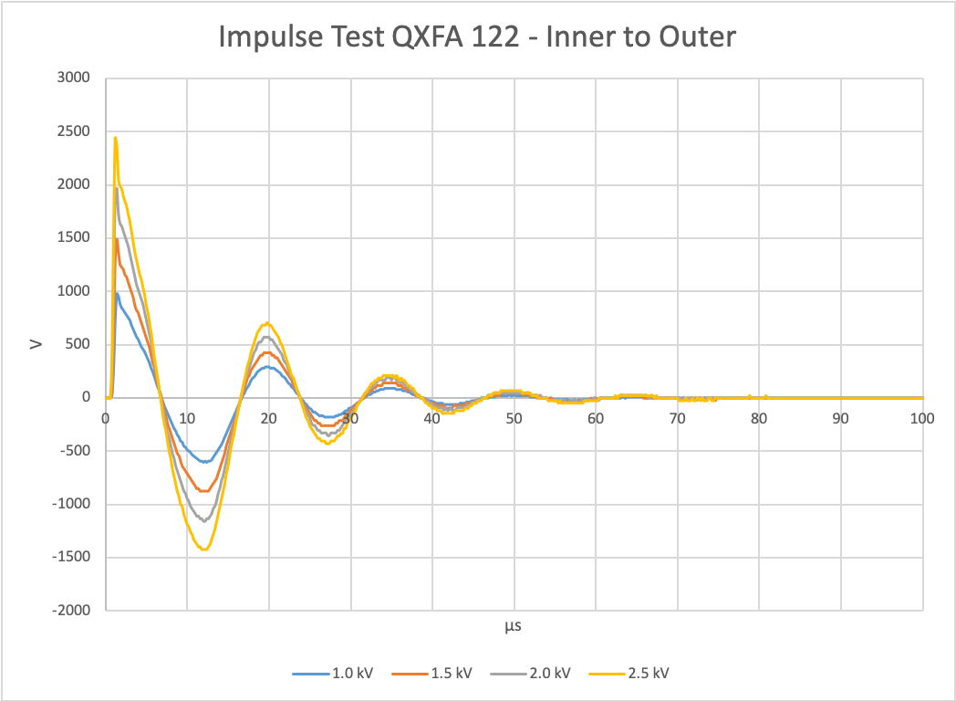
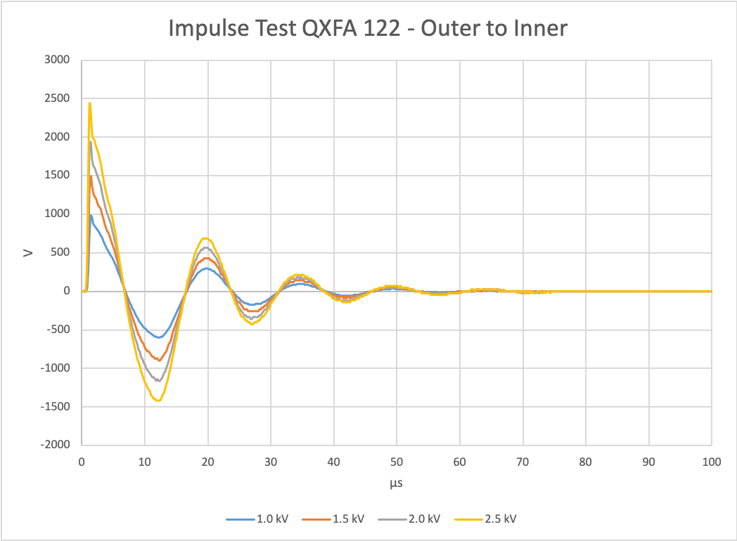
QXFA122 Impulse Test

Slide 25
QXFA123 Hi-pot & Electrical Checks
Measurement | QXFA123 | Avg | StDev | StDev/Avg | Min | Max
Coil R @1 A (mΩ) | 608.25 | 605.77 | 5.08 | 0.01 | 595.73 | 614.75
Ls @ 20 Hz (mH) | 4.97 | 4.79 | 0.11 | 0.02 | 4.56 | 4.97
Q | 0.81 | 0.78 | 0.03 | 0.03 | 0.73 | 0.81
Ls @ 100 Hz (mH) | 3.48 | 3.30 | 0.10 | 0.03 | 3.17 | 3.48
Q | 1.66 | 1.61 | 0.02 | 0.02 | 1.57 | 1.66
Ls @ 1 kHz (mH) | 1.95 | 1.89 | 0.02 | 0.01 | 1.87 | 1.95
Q | 1.95 | 2.04 | 0.05 | 0.03 | 1.95 | 2.15
VTA1 (mΩ) | 0.83 | 0.28 | 0.26 | 0.95 | 0.02 | 0.83
VTA2 | 0.93 | 0.35 | 0.29 | 0.83 | 0.07 | 1.00
VTA3
VTA4
VTA5
VTA6
VTA7
VTA8
VTB8
VTB7
VTB6
VTB5
VTB4
VTB3
VTB2 | 604.80 | 604.22 | 5.56 | 0.01 | 593.70 | 614.70
VTB1 | 605.30 | 604.85 | 4.76 | 0.01 | 595.61 | 614.80
QHB1 | 2.13 | 1.89 | 0.14 | 0.07 | 1.61 | 2.13
QHB2 | 2.12 | 1.93 | 0.13 | 0.07 | 1.65 | 2.12
QHB3 | 2.12 | 1.92 | 0.12 | 0.06 | 1.62 | 2.12
QHB4 | 2.10 | 1.90 | 0.12 | 0.06 | 1.61 | 2.10
 | QXFA123
Hi-Pot (<1µA Leakage)
Coil to Pole (V) | 100/100
QH to Coil (V) | 3680/3680
Coil to Saddle (V) | 1000/1000
QH to Saddle (V) | 2500/2500
Saddle to Saddle (V) | 1000/1000
Impulse (V) | 2500/2500
Series coil, no voltage tap trace.

Slide 26
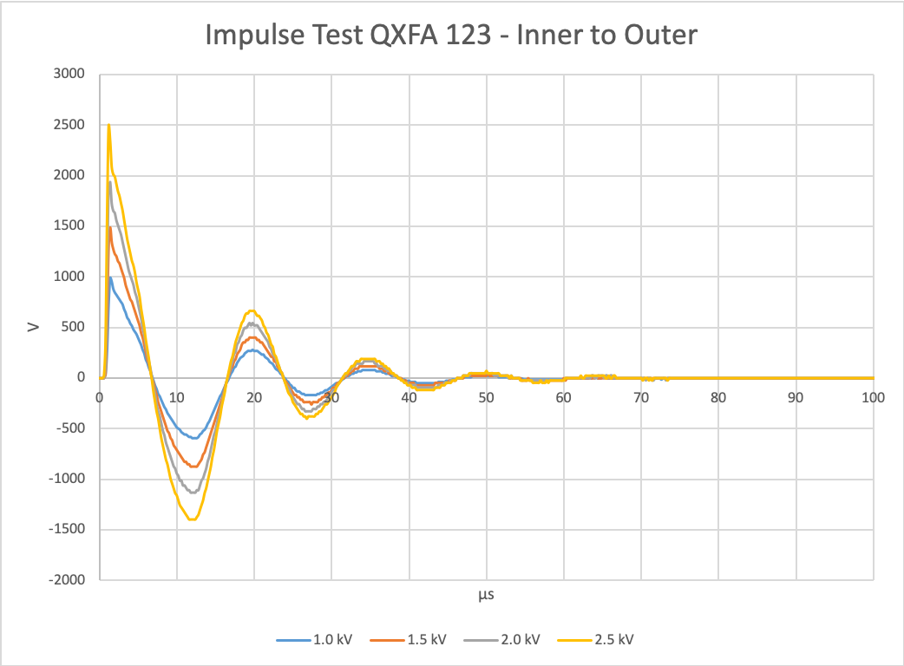
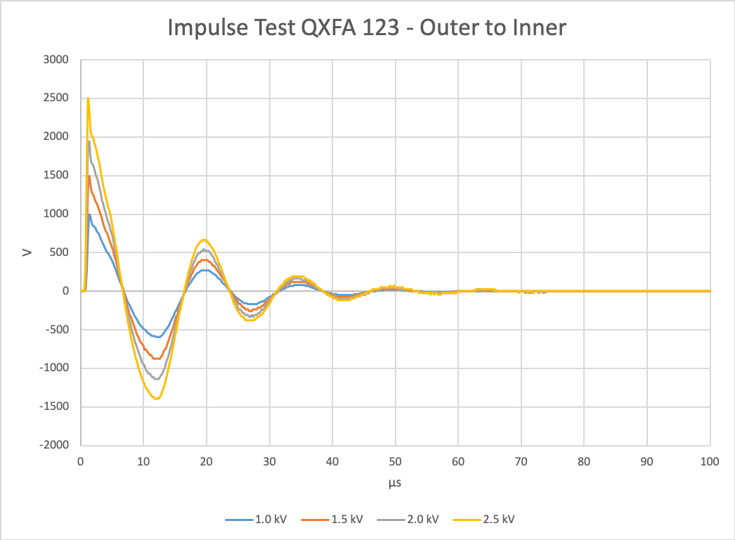
QXFA123 Impulse Test

Slide 27
Recommendations from MQXFA05 Coil Acceptance Review
Data was lost during the reaction of one coil in FNAL (117) and one coil in BNL (209). We recommend studying the reliability of the system and implement a backup data storage if it is considered necessary.
The SpecView software and PC reliability has had 1 spontaneous system crash in 14 years. A 2nd PC with software is available as a backup.
A group was formed to examine a variety of backup data recording systems. It was determined that any system selected would require rework or preplacement of the furnace PLCs at significant cost and time. No further action was taken.
Some of the reported dwell times appear to be out of specs. We recommend adjusting the reaction cycle to meet specifications or modify acceptance criteria. Otherwise a DR shall be issued.
Furnace trouble shooting is in progress to resolve the out of spec issues.
DR’s are written when parameters are out of spec.
Define and follow a consistent DR classification process as critical/non-critical at all Labs. For future coil reviews, access to DR records should be provided for coils fabricated at both Labs.
Critical DR’s are those that effect coil form, fit, or function and require L2 notification.
Non-critical DR’s are nonconformities during coil fabrication written against a specific step in the traveler that don’t effect coil form, fit, or function.

