Slide 1


Magnets 302.2.02 and 03 –
Strand Procurement and Testing
Cable Fabrication
Lance Cooley – NHMFL/ASC (302.2.02 L3)
Vito Lombardo – FNAL (302.2.02 CAM)
Ian Pong – LBNL (302.2.03 L3 and CAM)
Elizabeth Lee – LBNL (302.2.03 CAM deputy)
Jonathan Lee – LBNL Intern Student

Slide 2
Outline
Cable Summary
Wire Summary
Cable and Wire Details for Coil -- x4 times
  Summary
  Date and Lengths
  Strand and SS Core ID
  Respooling Wire Diameter
  Cable Mechanical QC
  Braiding Details
  Wire Parameters
    S & V QC data, XS RRR and Witness I_{C} and RRR
  SSL
Summary

Slide 3
Cable Summary
Coil | Cable | Strand | Spec.
QXFA119 | P43OL1117 | 0.85 mm 108/127 | HiLumi (2017)
QXFA122 | P43OL1126 | 0.85 mm 108/127 | HiLumi (2017)
QXFA123 | P43OL1130 | 0.85 mm 108/127 | HiLumi (2017)
QXFA211 | P43OL1120 | 0.85 mm 108/127 | HiLumi (2017)
QXFA 209, 210, 119 are made with cables using strand exchanged from CERN

Slide 4
Cable Summary
Coils used:
  119, 122, 123, 211
Corresponding cables:
  P43OL1117, P43OL1126, P43OL1130, P43OL1120
All cables are 2nd generation QXF cables with 108/127 RRP® strands procured under LARP
All AUP cables
One cable used strands exchanged from CERN

Slide 5
Wire Summary
All “HiLumi” spec,
  Procured by LARP under:
    FNAL PO 632982 C – Spec 0
    FNAL PO 632982 D – Spec 0
  Procured by AUP under:
    FNAL PO 6461164 Shipment A – Spec 0
    FNAL PO 6461164 Shipment B – Spec 0
    LBNL PO 7428700 Shipment A – Spec 0
    LBNL PO 7428700 Shipment B – Spec 0
  Procured by CERN under:
    CERN Contract F663
0.85 mm, Ti-doped, reduced Sn
LARP procurement spec was US-HiLumi-Doc-40, modification to HT was applied to PO 632982, changing the final stage from 665°C for 75 h to 665°C for 50 h.
CERN procurement spec HT was 665°C for 75 h – so, I_{C} higher but RRR lower

Slide 6
Strand Procured by LARP and Supplier’s QC
A change of the heat treatment was approved in 2017 → shift in data
Final step from 665C 75hr to 665C 50hr
  4.9% reduction in I_{c}(15 T) for 14.7% gain in RRR (15% rolled)
Verification testing did not receive HT change notice in time
Round
Rolled
314 A
331 A

Slide 7
Billets in the LARP production run
PO624035
PO632982
AUP
A
B
C
D
Due to HT
Due to Test
Spec (round)
331 A
314 A
Spec (15% rolled)
Supplier is conservative by 2.1% after accounting for heat treatment
2.1% is comparable to the inter-lab test uncertainty (1.6 % in 2015) and past BNL-OST comparison (3% primarily due to strain).

Slide 8
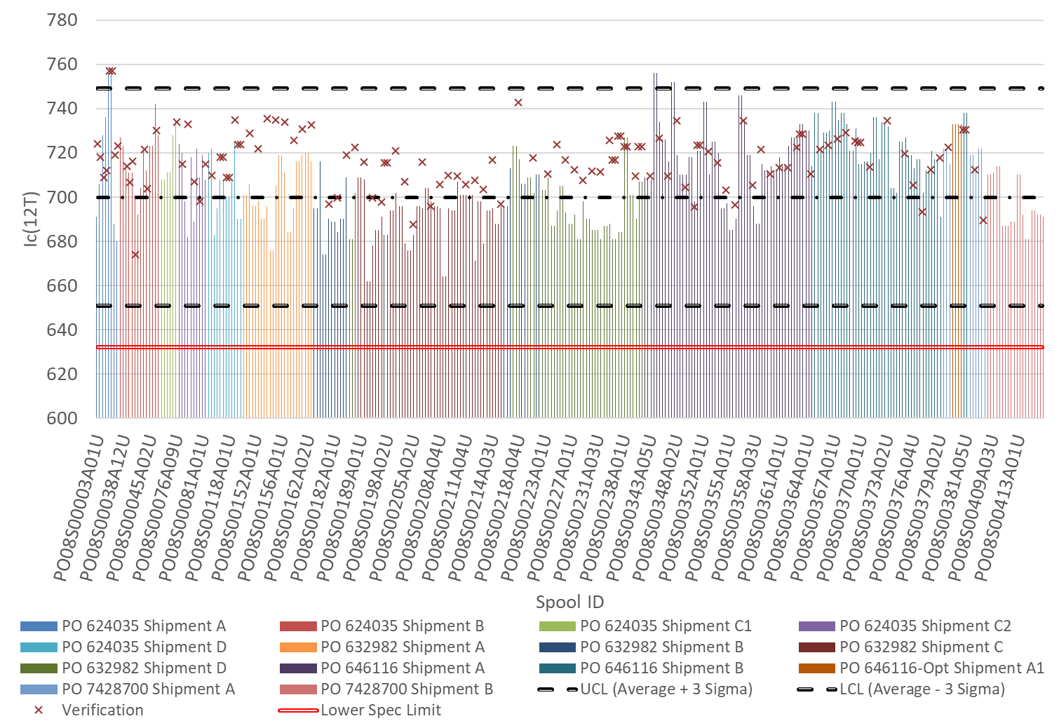
Ic@12T
LARP
AUP
3-sigma (99.7%) SPC upper
X = verification test
3-sigma (0.3%) SPC lower
SPEC

Slide 9
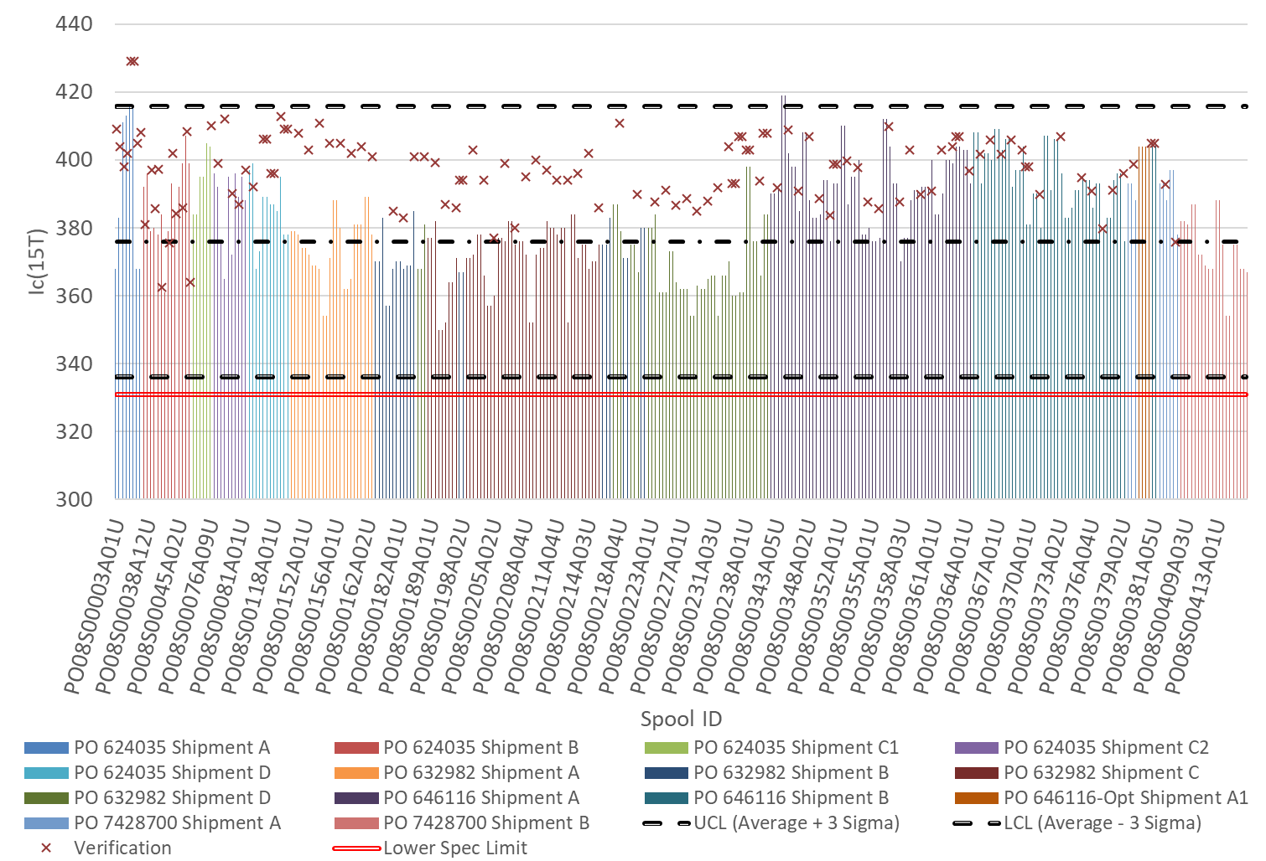
Ic@15T
LARP
AUP
3-sigma (99.7%) SPC upper
X = verification test
3-sigma (0.3%) SPC lower
SPEC

Slide 10
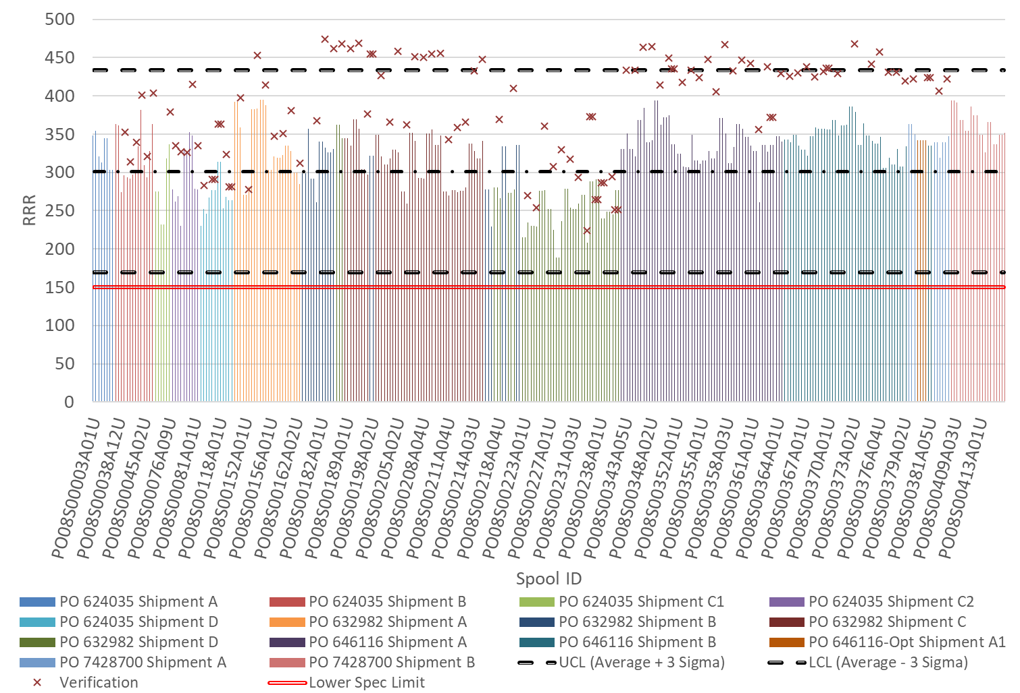
3-sigma (99.7%) SPC upper
LARP
AUP
3-sigma (0.3%) SPC lower
SPEC
RRR Round wire
X = verification test

Slide 11
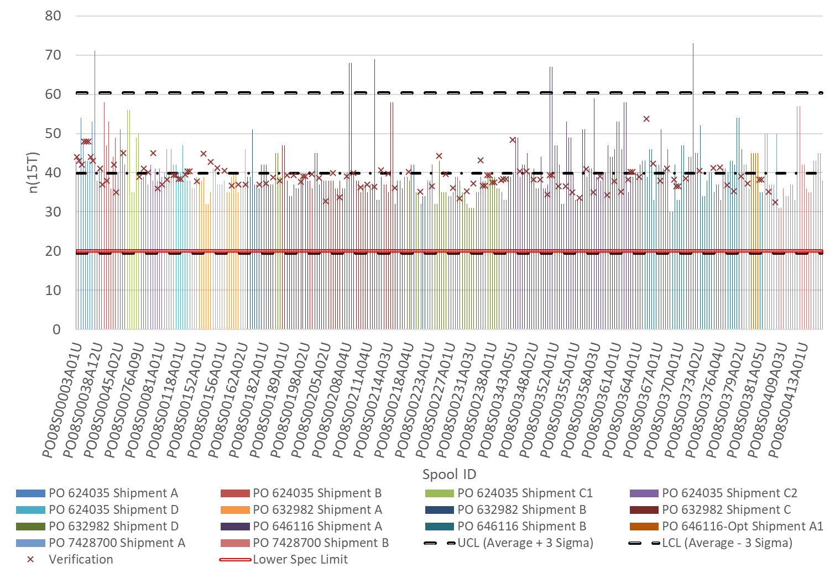
LARP
AUP
N-value at 15 T
X = verification test
3-sigma (99.7%) SPC upper
3-sigma (0.3%) SPC lower
SPEC

Slide 12
QXFA-119 / P43OL1117

Slide 13
Cable Summary
Magnet: MQXFA-06
Coil: QXFA-119
Corresponding Cable: P43OL1117 (AUP 019)
Cable is 2nd generation QXF cables with 108/127 RRP® strands procured by CERN

Slide 14
Wire Summary
All “HiLumi” spec, procured by CERN under:
  Contract 663
0.85 mm, Ti-doped, reduced Sn
Exchanged lengths with AUP

Slide 15
P43OL1117 – Cable Date, Lengths
Cable Manufacture Date
  2018 12 07 (Production run)
Cable Length:
  472 m (LBNL, fabricated, including LBNL samples)

Slide 16
P43OL1117 – Strand and SS Core ID
Spool:
  AO08S00126A01U x 1 ULs,
  AO08S00128A03U x 2 ULs,
  AO08S00134A04U x 11 ULs,
  AO08S00130A01U x 18 ULs,
  AO08S00128A01U x 8 ULs.
Core:
  120L32A7322313
    Core width: 12.0 mm; material: 316L;
    Heat: 844979; Lot: 16-597;
    Chemical Properties CoT/CoC 172660-1: 0.14 wt% Co
From 4 billets

Slide 17
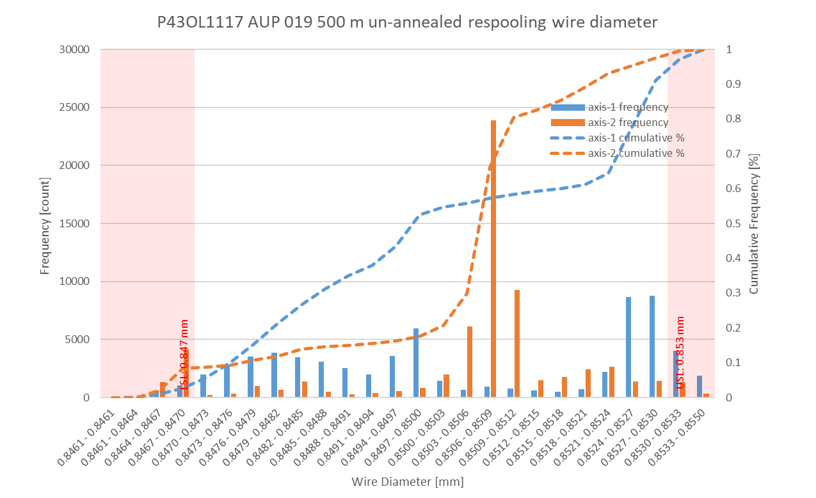
P43OL1117 Respooling Wire Diameter
Below LSL: 5.51%
Above USL: 1.68%
Non-conformance captured in Vector: DR 12145

Slide 18
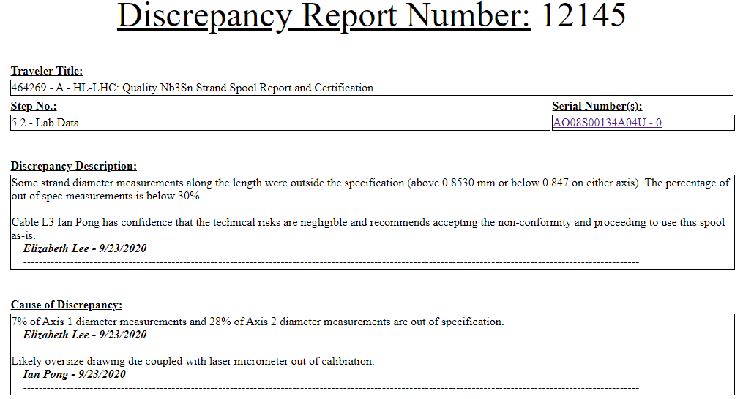
DR

Slide 19
P43OL1117 – Cable QC Data Summary
CME:
Residual Twist:
  125°
10-stack:
  Qualification: 1.521 mm
  Production tail end: 1.526 mm
 | Pressure (MPa) | Angle (°) | Width (mm) | Thickness (mm)
Maximum | 17.1 | 0.427 | 18.160 | 1.529
Average | 17.0 | 0.408 | 18.149 | 1.524
Minimum | 16.5 | 0.390 | 18.143 | 1.521
Sigma | 0.03 | 0.007 | 0.003 | 0.001

Slide 20
Rollers: P-91 (2017-12-08) and P-92 (2017-12-08)

Slide 21
Rollers: P-91 (2017-12-08) and P-92 (2017-12-08)

Slide 22
Rollers: P-91 (2017-12-08) and P-92 (2017-12-08)

Slide 23
P43OL1117 – Braiding
Fiberglass Lot #100858
P/I: 18.0
Spool tension: 10 lbs. (payoff); 20 lbs. (takeup)
Bobbin payoff tension: 0.125 lbs. (min), 0.250 lbs. (max)
NEWT 10-stack QC:
  Cycle #1) 0.149 mm; #2) 0.147 mm; #3) 0.146 mm;
  Mean 0.147 mm
LBNL 10-stack verification QC:
  Cycle #1) 0.143 mm; #2) 0.141 mm; #3) 0.140 mm;
  Mean 0.141 mm
Vector #464342

Slide 24
P43OL1117 – Wire Parameters
Properties | Inspected Average
Wire Diameter | 0.850 ± 0.003 mm (LBNL)¹
Cu ratio ª | 54.3% (OST)
Strand twist pitch ª | 18.7 mm (OST)
RRR (RW) ª | 204 (OST)
RRR (15% rolled) ª | 131 (OST)
I_{C} (4.2 K, 15 T) ª | 384 A (OST)
I_{C} (4.2 K, 14 T) ª | 477 A (OST)
I_{C} (4.2 K, 13 T) ª | 582 A (OST)
I_{C} (4.2 K, 12 T) ª | 702 A (OST)
ª First billet averaged, then weighted average according
to the spool distribution in the cable
¹ As-received, all LBNL respooling data; mean ± 1 sigma

Slide 25
P43OL1117 – Wire Parameters
Supplier (S) and Verification (V) I_{C} Data
S: 650°C/75h
CERN Verification data not available
No AUP Verification data
Number of spools from that billet used in the cable

Slide 26
P43OL1117 – Wire Parameters
Supplier (S) and Verification (V) RRR Data
S: 650°C/75h
CERN Verification data not available
No AUP Verification data
Number of spools from that billet used in the cable

Slide 27
P43OL1117 – Extracted Strand RRR
 | Cable ID | No. of Units from Billet (spool) | HT/sample ID | Major edge RRR | Minor edge RRR | Straight section 1 RRR | Straight section 2 RRR
ID #1 | P43OL1117AE49E AO08S00128A01U | 10 (18) | LRLK190205ALC1 | 279 | 223 | 287 | 274
ID #2 | P43OL1117AE24E AO08S00130A01U | 18 (18) | LRLK190205ALC1 | 259 | 195 | 314 | 292
ID #3 | P43OL1117AE23E AO08S00130A01U | 18 (18) | LRLK190205ALC1 | 263 | 198 | 297 | 262
ID #4 | P43OL1117AE06E AO08S00134A04U | 11 (11) | LRLK190205ALC1 | 296 | 294 | 425 | 393
ID #5 | P43OL1117AE05E AO08S00128A03U | 10 (2) | LRLK190205ALC1 | 237 | 189 | 300 | 275
Vector #464342

Slide 28
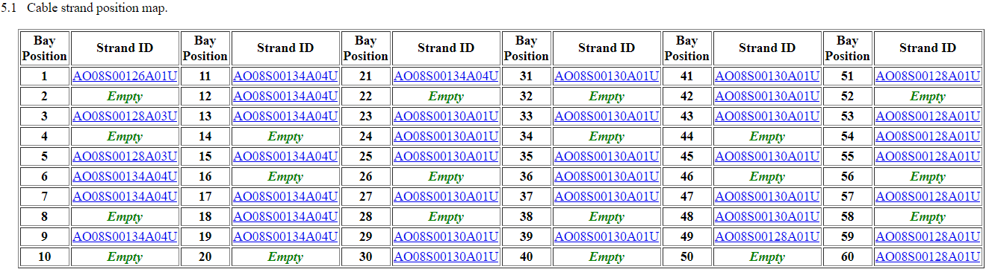
P43OL1117 – Witness Samples
Witness extracted strand (XS)
Witness virgin strand (VS)
XS RRR
P43OL1117AE23V was tested due to marginal RRR of the corresponding XS

Slide 29
P43OL1117 – Witness Samples
ID | RRR (293K / 20K) XS > 100 RW > 150 | Ic(12T) XS > 600 RW > 632 | Ic(13T) | Ic(14T) | Ic(15T) XS > 314 RW > 331
AO08S00130A01U | 187 | 726 | 599 | 487 | 392
P43OL1117AE23V (AO08S00130A01U) | 160
P43OL1117AE09E | 121
P43OL1117AE06E | 143
P43OL1117AE23E | 105 | 717 | 594 | 490 | 397
P43OL1117AE25E | 119 | 707 | 586 | 478 | 383
nnnQ denotes a critical current measurement that showed a transition but quenched before the criterion was reached
Q denotes a critical current measurement that did not show a transition before quenching

Slide 30
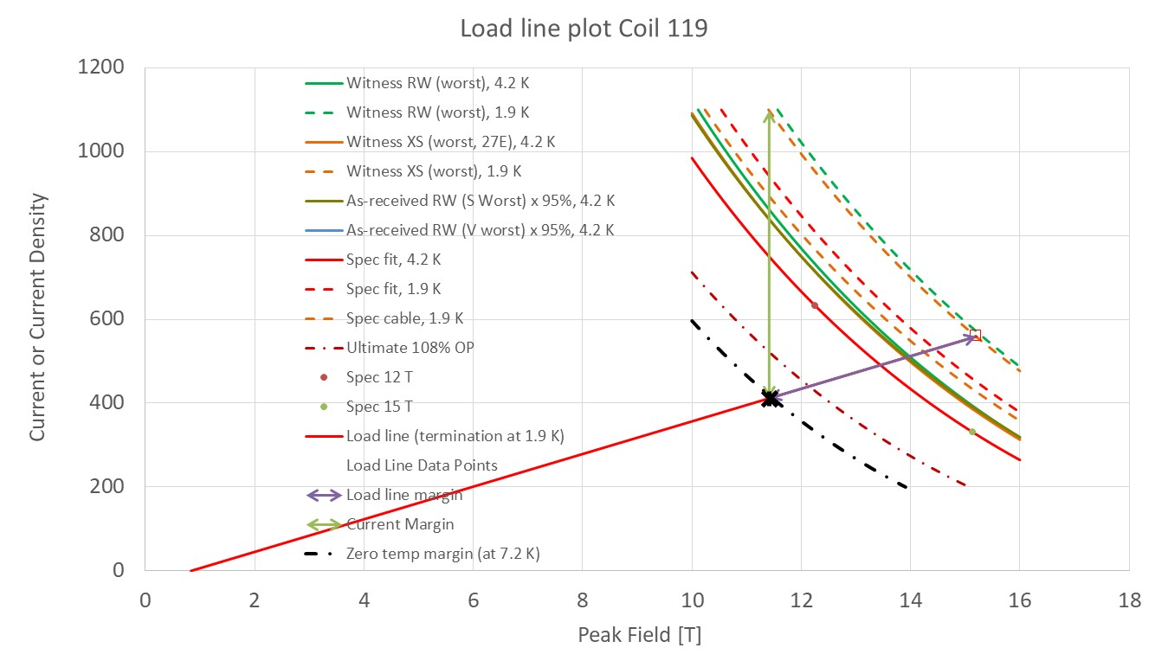
P43OL1117 - SSL

Slide 31
Coil 119 / Cable P43OL1117
Cable current to calculate margin | 16230 | No
I [A] to calculate margin at | 405.75
Corresponding load line B [T] | 11.26
SS curve to calculate margin from | Witness XS (worst), 1.9 K
Margins | Margin | Operating Point (X)
Load line margin (purple arrow) | 27.4% | 72.6%
Current margin (green arrow) | 64.0% | 36.0%
Temperature margin & intercept [K] | 5.5 | 7.4
Limits | Strand | Cable
"Witness XS (worst), 1.9 K" current [A] at margin-calculation field | 1126 | 45045
"Witness XS (worst), 1.9 K" current [A] at 100% SSL | 559 | 22359
"Witness XS (worst), 1.9 K" field [B] at 100% SSL | 15.20

Slide 32
QXFA-122 / P43OL1126

Slide 33
Cable Summary
Magnet: MQXFA-06
Coil: QXFA-122
Corresponding Cable: P43OL1126 (AUP 026)
Cable is 2nd generation QXF cables with 108/127 RRP® strands procured under LARP

Slide 34
Wire Summary
All “HiLumi” spec, procured by AUP under:
  FNAL 646116 Shipment B
0.85 mm, Ti-doped, reduced Sn

Slide 35
P43OL1126 – Cable Date, Lengths
Cable Manufacture Date
  2019 04 09 (Production run)
Cable Length:
  473 m (LBNL, fabricated, including LBNL samples)

Slide 36
P43OL1126 – Strand and SS Core ID
Spool:
  PO08S00372A01U x 6 ULs,
  PO08S00373A01U x 2 ULs,
  PO08S00381A03U x 3 ULs,
  PO08S00378A03U x 2 ULs,
  PO08S00375A03U x 1 ULs,
  PO08S00372A02U x 12 ULs,
  PO08S00381A02U x 5 ULs,
  PO08S00378A02U x 9 ULs,
Core:
  120L25A7322313
    Core width: 12.0 mm; material: 316L;
    Heat: 844979; Lot: 16-597;
    Chemical Properties CoT/CoC 172660-1: 0.14 wt% Co
From 5 billets

Slide 37
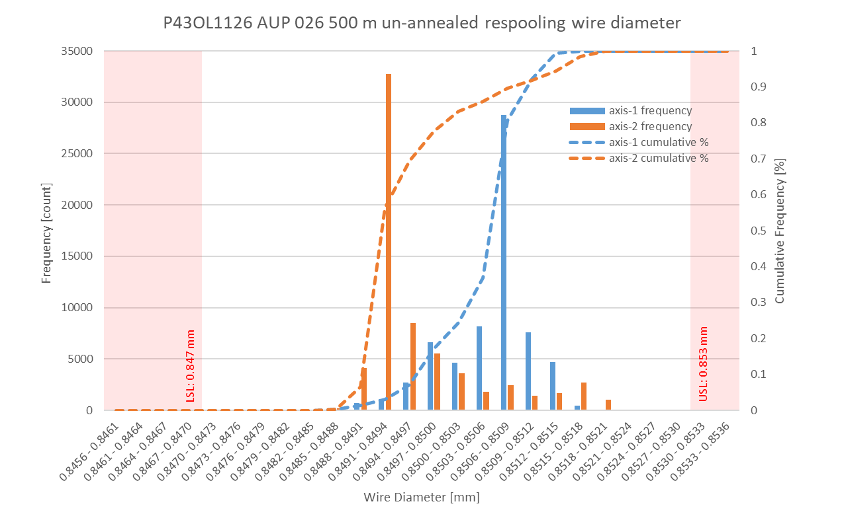
P43OL1126 Respooling Wire Diameter
Below LSL: 0.00%
Above USL: 0.00%

Slide 38
P43OL1126 – Cable QC Data Summary
CME:
Residual Twist:
  125°
10-stack:
  Qualification: 1.521 mm
  Production tail end: 1.526 mm
 | Pressure (MPa) | Angle (°) | Width (mm) | Thickness (mm)
Maximum | 17.1 | 0.420 | 18.170 | 1.532
Average | 17.0 | 0.402 | 18.153 | 1.526
Minimum | 17.0 | 0.371 | 18.148 | 1.521
Sigma | 0.01 | 0.007 | 0.003 | 0.002

Slide 39
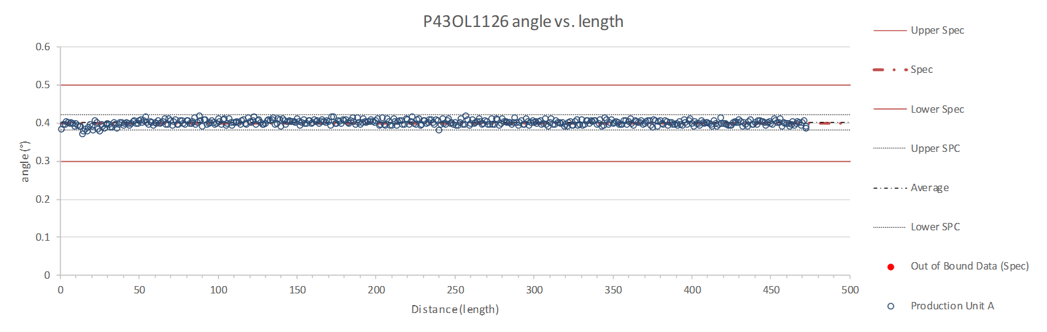
Rollers: P-91 (2017-12-08) and P-92 (2017-12-08)

Slide 40
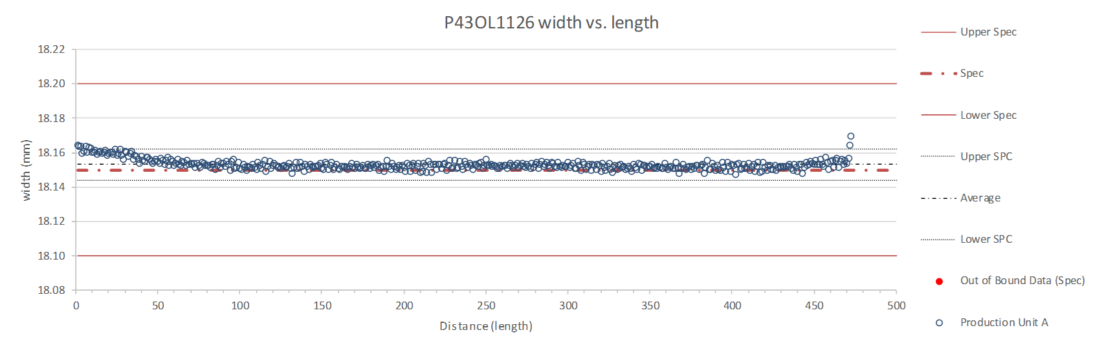
Rollers: P-91 (2017-12-08) and P-92 (2017-12-08)

Slide 41
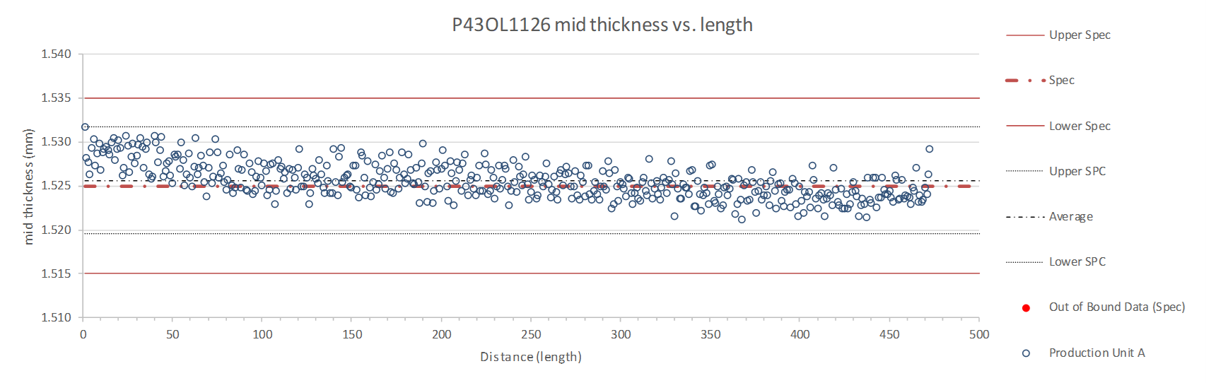
Rollers: P-91 (2017-12-08) and P-92 (2017-12-08)

Slide 42
P43OL1126 – Braiding
Fiberglass Lot #100858
P/I: 18.9
Spool tension: 10 lbs. (payoff); 20 lbs. (takeup)
Bobbin payoff tension: 0.125 lbs. (min), 0.250 lbs. (max)
NEWT 10-stack QC:
  Cycle #1) 0.149 mm; #2) 0.146 mm; #3) 0.145 mm;
  Mean 0.147 mm
LBNL 10-stack verification QC:
  Cycle #1) 0.151 mm; #2) 0.149 mm; #3) 0.148 mm;
  Mean 0.149 mm
Vector #464342

Slide 43
P43OL1126 – Wire Parameters
Properties | Inspected Average
Wire Diameter | 0.850 ± 0.001 mm (LBNL)¹
Cu ratio ª | 53.5% (OST)
Strand twist pitch ª | 18.6 mm (OST)
RRR (RW) ª | 354 (OST)
RRR (15% rolled) ª | 267 (OST)
I_{C} (4.2 K, 15 T) ª | 394A (OST)
I_{C} (4.2 K, 14 T) ª | 490 A (OST)
I_{C} (4.2 K, 13 T) ª | 599 A (OST)
I_{C} (4.2 K, 12 T) ª | 721 A (OST)
ª First billet averaged, then weighted average according
to the spool distribution in the cable
¹ As-received, all LBNL respooling data; mean ± 1 sigma

Slide 44
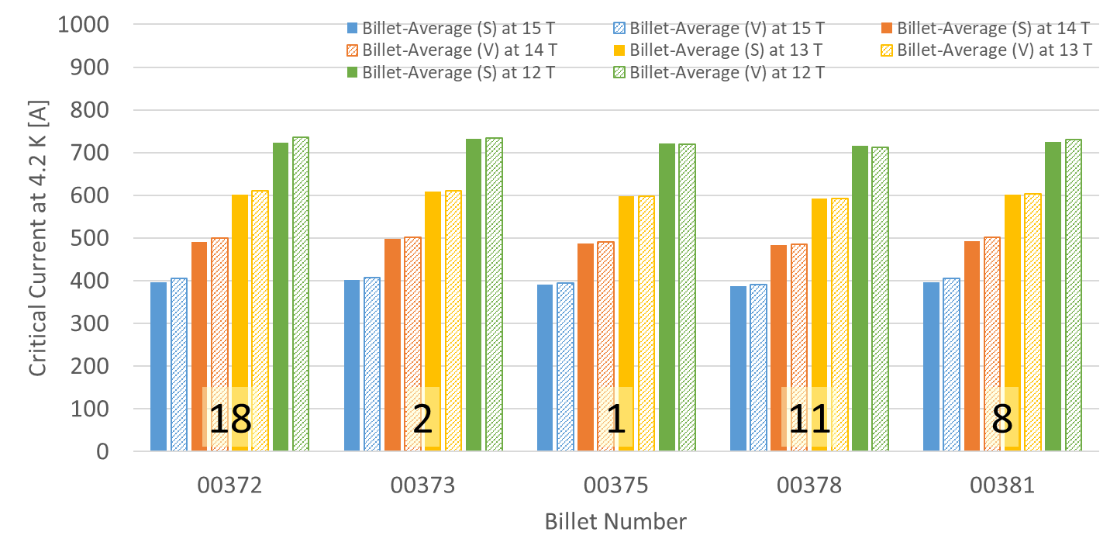
P43OL1126 – Wire Parameters
Supplier (S) and Verification (V) I_{C} Data
Number of spools from that billet used in the cable

Slide 45
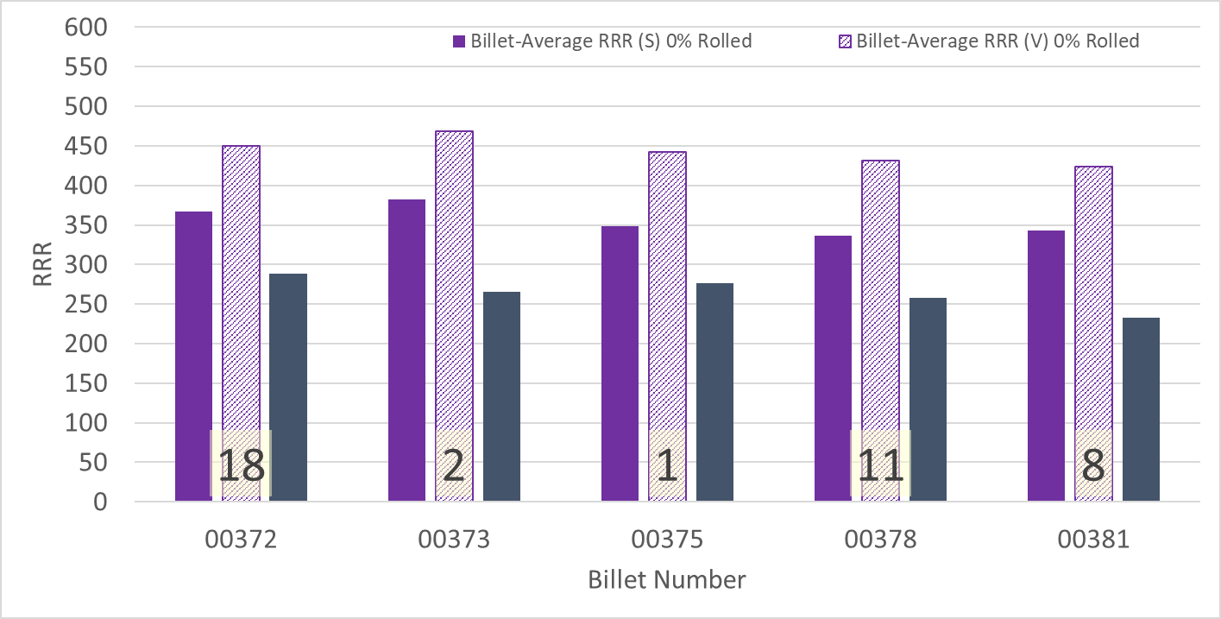
P43OL1126 – Wire Parameters
Supplier (S) and Verification (V) RRR Data
Number of spools from that billet used in the cable

Slide 46
P43OL1126 – Extracted Strand RRR
 | Cable ID | No. of Units from Billet (spool) | HT/sample ID | Major edge RRR | Minor edge RRR | Straight section 1 RRR | Straight section 2 RRR
ID #1 | P43OL1126AE48E PO08S00378A02U | 11 (9) | LRLK190524ALC2 | 359 | 303 | 407 | 409
ID #2 | P43OL1126AE24E PO08S00372A02U | 18 (12) | LRLK190524ALC3 | 342 | 288 | 407 | 407
ID #3 | P43OL1126AE23E PO08S00372A02U | 18 (12) | LRLK190524ALC2 | 310 | 363 | 408 | 422
ID #4 | P43OL1126AE41E PO08S00381A02U | 8 (5) | LRLK190524ALC2 | 328 | 283 | 390 | 378
ID #5 | P43OL1126AE05E PO08S00372A01U | 18 (6) | LRLK190524ALC2 | 391 | 326 | 435 | 433
Vector #464342

Slide 47
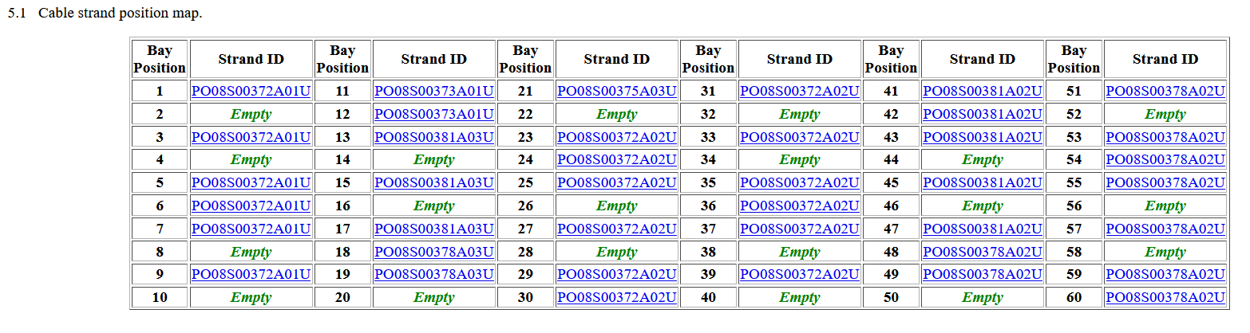
P43OL1126 – Witness Samples
Witness extracted strand (XS)
Witness virgin strand (VS)
XS RRR

Slide 48
P43OL1126 – Witness Samples
ID | RRR (293K / 20K) XS > 100 RW > 150 | Ic(12T) XS > 600 RW > 632 | Ic(13T) | Ic(14T) | Ic(15T) XS > 314 RW > 331
P43OL1126AE48V | 171
P43OL1126AE23V | 201 | 712Q | 643 | 526 | 427
P43OL1126AE23E | 149 | 731 | 611 | 505 | 411
P43OL1126AE25E | 158 | 741 | 620 | 511 | 415
P43OL1126AE48E | 140
nnnQ denotes a critical current measurement that showed a transition but quenched before the criterion was reached
Q denotes a critical current measurement that did not show a transition before quenching

Slide 49
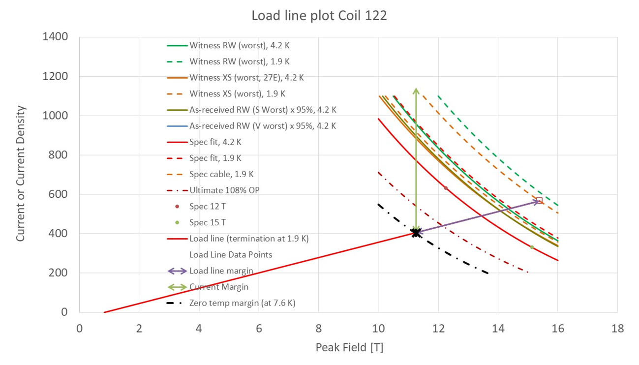
P43OL1126- SSL

Slide 50
Coil 122 / Cable P43OL1126
Cable current to calculate margin | 16230 | No
I [A] to calculate margin at | 405.75
Corresponding load line B [T] | 11.26
SS curve to calculate margin from | Witness XS (worst), 1.9 K
Margins | Margin | Operating Point (X)
Load line margin (purple arrow) | 28.4% | 71.6%
Current margin (green arrow) | 64.5% | 35.5%
Temperature margin & intercept [K] | 5.7 | 7.6
Limits | Strand | Cable
"Witness XS (worst), 1.9 K" current [A] at margin-calculation field | 1143 | 45728
"Witness XS (worst), 1.9 K" current [A] at 100% SSL | 567 | 22664
"Witness XS (worst), 1.9 K" field [B] at 100% SSL | 15.39

Slide 51
QXFA-123 / P43OL1130

Slide 52
Cable Summary
Magnet: MQXFA-06
Coil: QXFA-123
Corresponding Cable: P43OL1130 (AUP 030)
Cable is 2nd generation QXF cables with 108/127 RRP® strands procured under LARP

Slide 53
Wire Summary
All “HiLumi” spec, procured by AUP under:
  LBNL 7428700 Shipment A – Spec 0
  LBNL 7428700 Shipment B – Spec 0
0.85 mm, Ti-doped, reduced Sn

Slide 54
P43OL1130 – Cable Date, Lengths
Cable Manufacture Date
  2019 05 21 (Production run)
Cable Length:
  469 m (LBNL, fabricated, including LBNL samples)

Slide 55
P43OL1130 – Strand and SS Core ID
Spool:
  PO08S00383A03U x 8 ULs,
  PO08S00415A01U x 16 ULs,
  PO08S00416A01U x 16 ULs,
Core:
  120L21A7322313
    Core width: 12.0 mm; material: 316L;
    Heat: 844979; Lot: 16-597;
    Chemical Properties CoT/CoC 172660-1: 0.14 wt% Co
From 3 billets

Slide 56
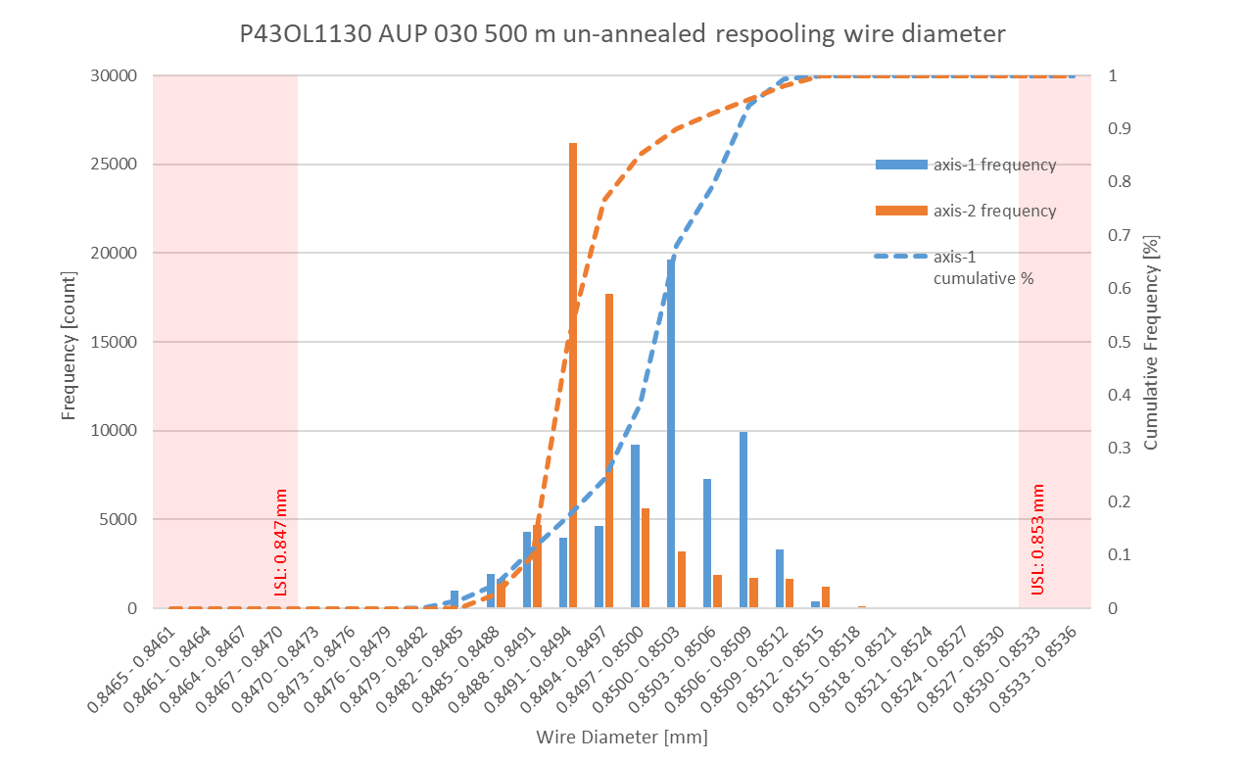
P43OL1130 Respooling Wire Diameter
Below LSL: 0.00%
Above USL: 0.00%

Slide 57
P43OL1130 – Cable QC Data Summary
CME:
Residual Twist:
  140°
10-stack:
  Qualification: 1.530 mm
  Production tail end: 1.528 mm
 | Pressure (MPa) | Angle (°) | Width (mm) | Thickness (mm)
Maximum | 17.1 | 0.423 | 18.174 | 1.533
Average | 17.0 | 0.404 | 18.154 | 1.527
Minimum | 17.0 | 0.379 | 18.148 | 1.522
Sigma | 0.01 | 0.008 | 0.003 | 0.002

Slide 58
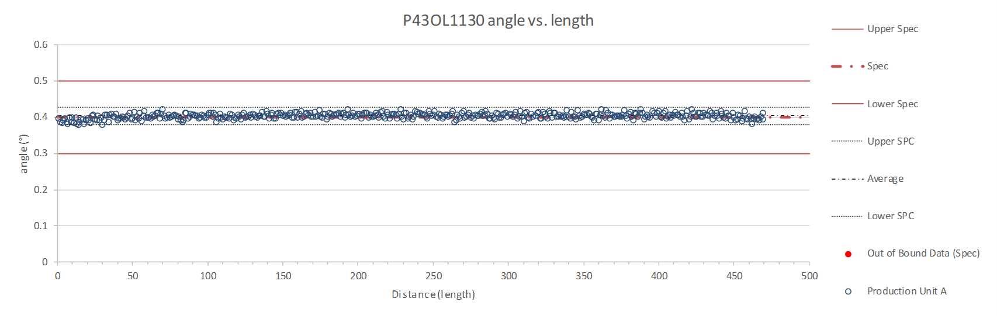
Rollers: P-91 (2017-12-08) and P-92 (2017-12-08)

Slide 59
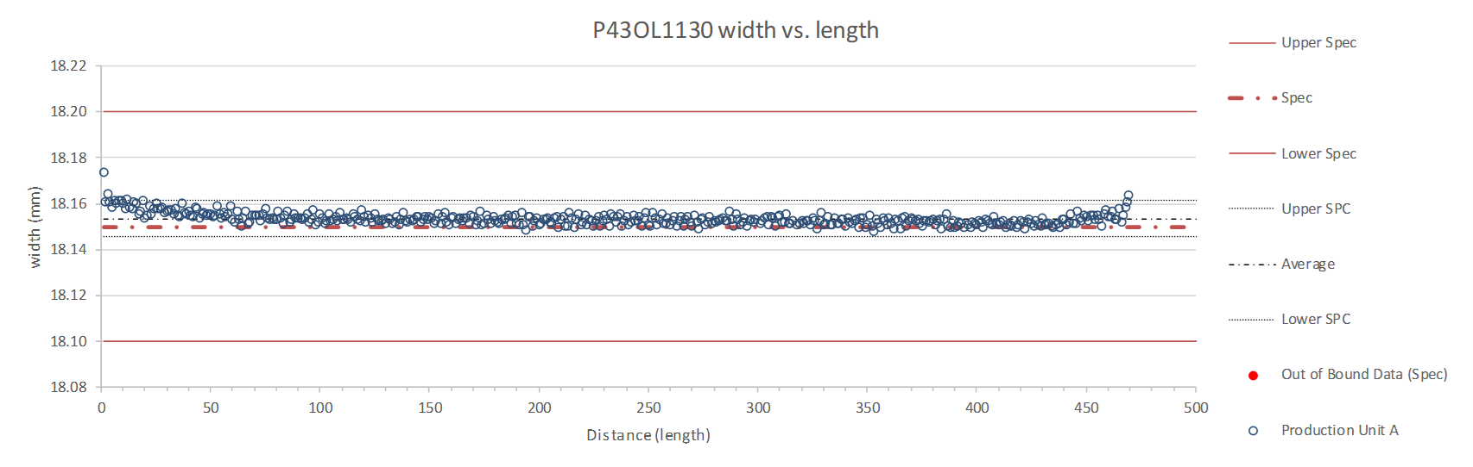
Rollers: P-91 (2017-12-08) and P-92 (2017-12-08)

Slide 60
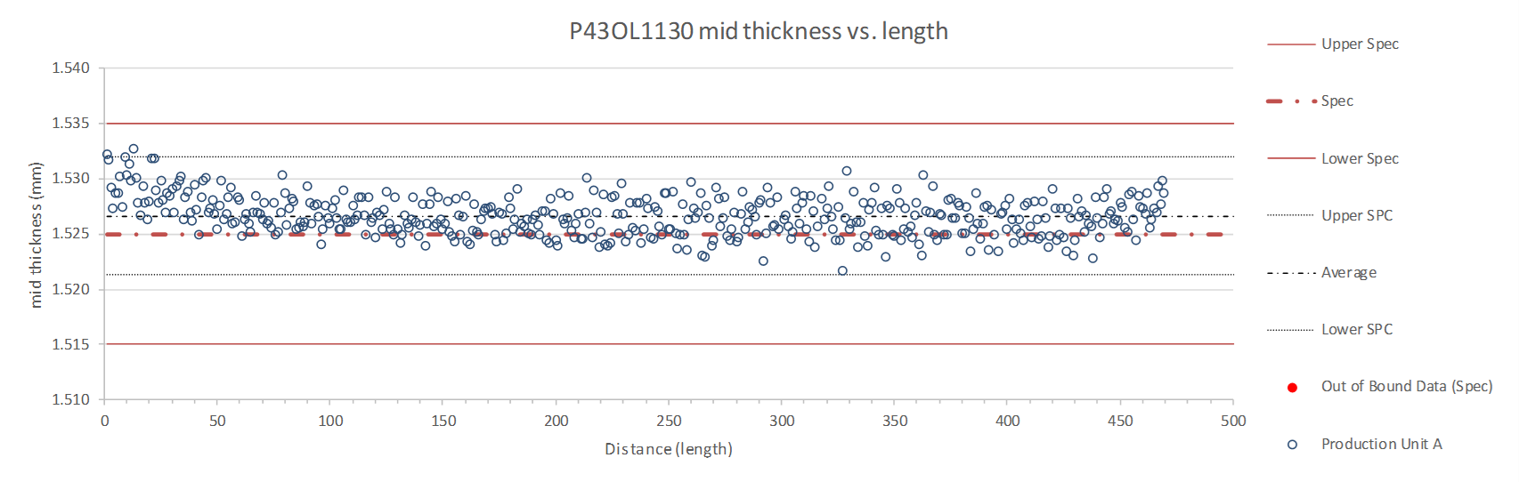
Rollers: P-91 (2017-12-08) and P-92 (2017-12-08)

Slide 61
P43OL1130 – Braiding
Fiberglass Lot #100858
P/I: 18.9
Spool tension: 10 lbs. (payoff); 20 lbs. (takeup)
Bobbin payoff tension: 0.125 lbs. (min), 0.250 lbs. (max)
NEWT 10-stack QC:
  Cycle #1) 0.147 mm; #2) 0.145 mm; #3) 0.144 mm;
  Mean 0.145 mm
LBNL 10-stack verification QC:
  Cycle #1) 0.148 mm; #2) 0.146 mm; #3) 0.144 mm;
  Mean 0.146 mm
Vector #464342

Slide 62
P43OL1130 – Wire Parameters
Properties | Inspected Average
Wire Diameter | 0.850 ± 0.001 mm (LBNL)¹
Cu ratio ª | 53.6% (OST)
Strand twist pitch ª | 18.5mm (OST)
RRR (RW) ª | 347 (OST)
RRR (15% rolled) ª | 229 (OST)
I_{C} (4.2 K, 15 T) ª | 374 A (OST)
I_{C} (4.2 K, 14 T) ª | 467 A (OST)
I_{C} (4.2 K, 13 T) ª | 575 A (OST)
I_{C} (4.2 K, 12 T) ª | 697 A (OST)
ª First billet averaged, then weighted average according
to the spool distribution in the cable
¹ As-received, all LBNL respooling data; mean ± 1 sigma

Slide 63
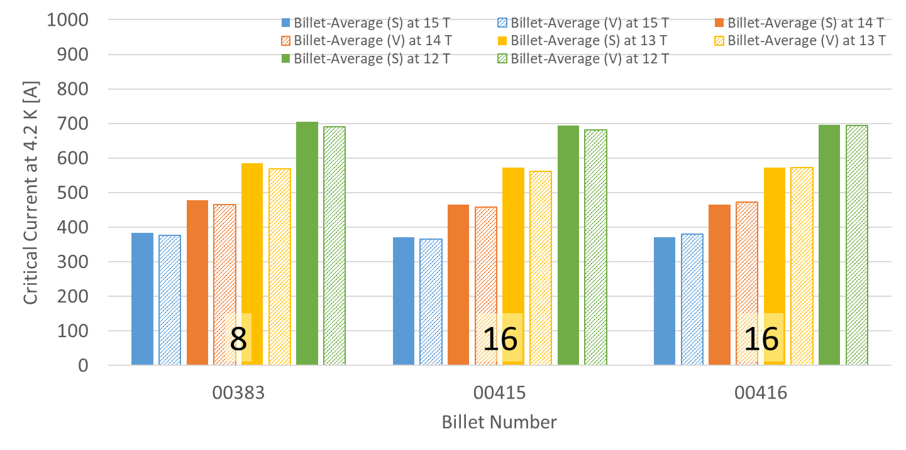
P43OL1130 – Wire Parameters
Supplier (S) and Verification (V) I_{C} Data
Number of spools from that billet used in the cable

Slide 64
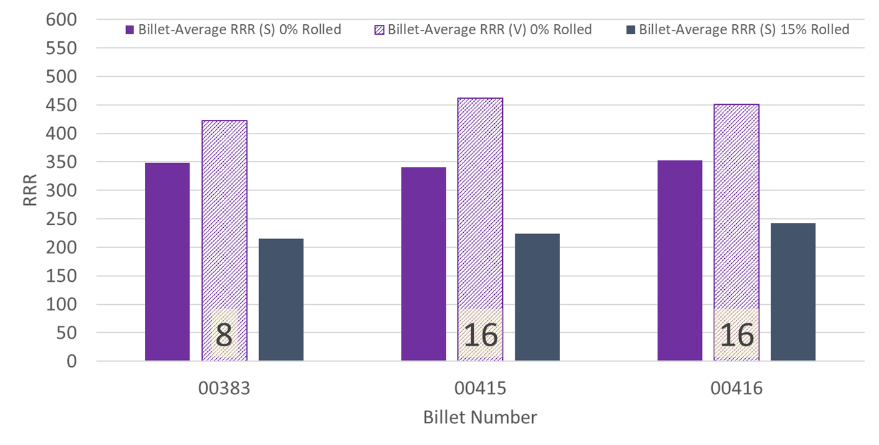
P43OL1130 – Wire Parameters
Supplier (S) and Verification (V) RRR Data
Number of spools from that billet used in the cable

Slide 65
P43OL1130 – Extracted Strand RRR
 | Cable ID | No. of Units from Billet (spool) | HT/sample ID | Major edge RRR | Minor edge RRR | Straight section 1 RRR | Straight section 2 RRR
ID #1 | P43OL1130AE05E PO08S00383A03U | 8 (8) | LRLK191212ALC1 | 319 | 242 | 363 | 373
ID #2 | P43OL1130AE39E PO08S00416A01U | 16 (16) | LRLK191212ALC1 | 352 | 238 | 365 | 390
ID #3 | P43OL1130AE37E PO08S00416A01U | 16 (16) | LRLK191212ALC1 | 293 | 305 | 425 | 389
ID #4 | P43OL1130AE15E PO08S00415A01U | 16 (16) | LRLK191212ALC1 | 294 | 257 | 372 | 381
ID #5 | P43OL1130AE13E PO08S00415A01U | 16 (16) | LRLK191212ALC1 | 317 | 215 | 309 | 344
Vector #464342

Slide 66
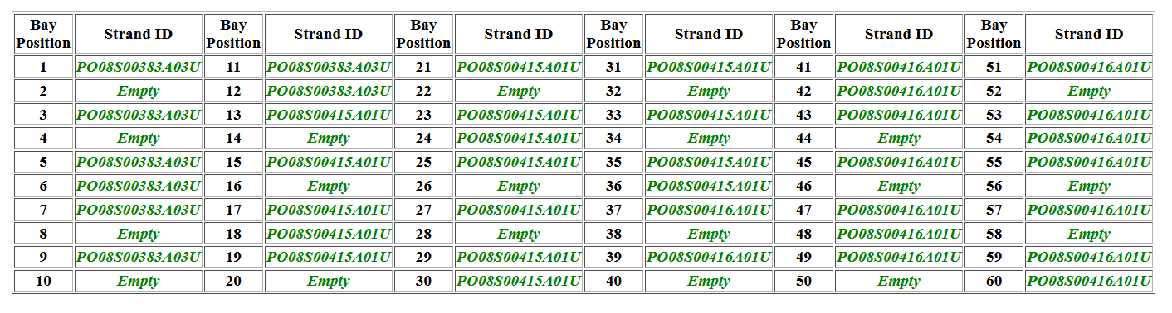
Cable P43OL1130 – Witness Samples
Witness extracted strand (XS)
Witness virgin strand (VS)
XS RRR

Slide 67
P43OL1130 – Witness Samples
ID | RRR (293K / 20K) XS > 100 RW > 150 | Ic(12T) XS > 600 RW > 632 | Ic(13T) | Ic(14T) | Ic(15T) XS > 314 RW > 331
P43OL1130AE37V | 241
P43OL1130AE13V | 234 | 696 | 573 | 468 | 373
P43OL1130AE13E | 201 | 679 | 564 | 458 | 367
P43OL1130AE17E | 181 | 682 | 564 | 457 | 364
P43OL1130AE37E | 176 | 674 | 556 | 449 | 358
P43OL1130AE41E | 175
nnnQ denotes a critical current measurement that showed a transition but quenched before the criterion was reached
Q denotes a critical current measurement that did not show a transition before quenching

Slide 68
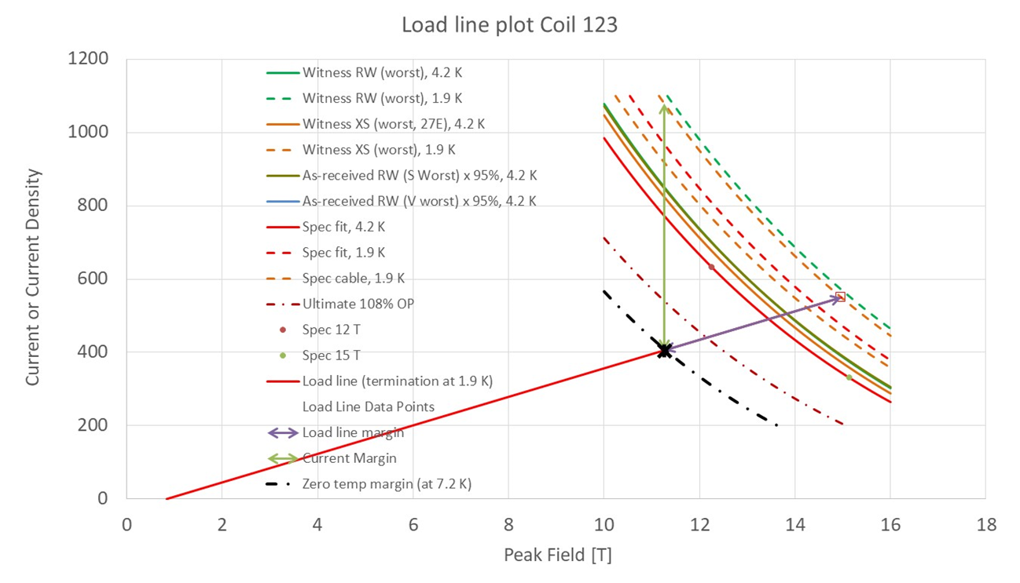
P43OL1126- SSL

Slide 69
Coil 123 / Cable P43OL1130
Cable current to calculate margin | 16230
I [A] to calculate margin at | 405.75
Corresponding load line B [T] | 11.26
SS curve to calculate margin from | Witness XS (worst), 1.9 K
Margins | Margin | Operating Point (X)
Load line (purple arrow) | 26.2% | 73.8%
Current (green arrow) | 62.4% | 37.6%
Temperature margin & intercept [K] | 5.3 | 7.2
Limits | Strand | Cable
"Witness XS (worst), 1.9 K" current [A] at margin-calculation field | 1079 | 43174
"Witness XS (worst), 1.9 K" current [A] at 100% SSL | 550 | 21998
"Witness XS (worst), 1.9 K" field [B] at 100% SSL | 14.97

Slide 70
QXFA-211 / P43OL1120

Slide 71
Cable Summary
Magnet: MQXFA-06
Coil: QXFA-211
Corresponding Cable: P43OL1120 (AUP 020)
Cable is 2nd generation QXF cables with 108/127 RRP® strands procured under LARP and AUP

Slide 72
Wire Summary
All “HiLumi” spec,
  Procured by LARP under:
    FNAL 632982 C – Spec 0
    FNAL 632982 D – Spec 0
  Procured by AUP under:
    FNAL 646116 Shipment A
0.85 mm, Ti-doped, reduced Sn

Slide 73
P43OL1120 – Cable Date, Lengths
Cable Manufacture Date
  2019 01 29 (Production run)
Cable Length:
  473 m (LBNL, fabricated, including LBNL samples)

Slide 74
P43OL1120 – Strand and SS Core ID
Spool:
  PO08S00216A01U x 9 ULs
  PO08S00227A03U x 2 Uls
  PO08S00229A01U x 2 ULs
  PO08S00231A04U x 2 ULs
  PO08S00235A02U x 5 ULs
  PO08S00343A02U x 1 ULs
  PO08S00343A05U x 1 ULs
  PO08S00350A01U x 1 ULs
  PO08S00350A02U x 5 ULs
  PO08S00353A04U x 3 ULs
  PO08S00355A04U x 8 ULs
  PO08S00357A01U x 1 ULs
Core:
  120L31A7322313
    Core width: 12.0 mm; material: 316L;
    Heat: 844979; Lot: 16-597;
    Chemical Properties CoT/CoC 172660-1: 0.14 wt% Co
From 10 billets

Slide 75
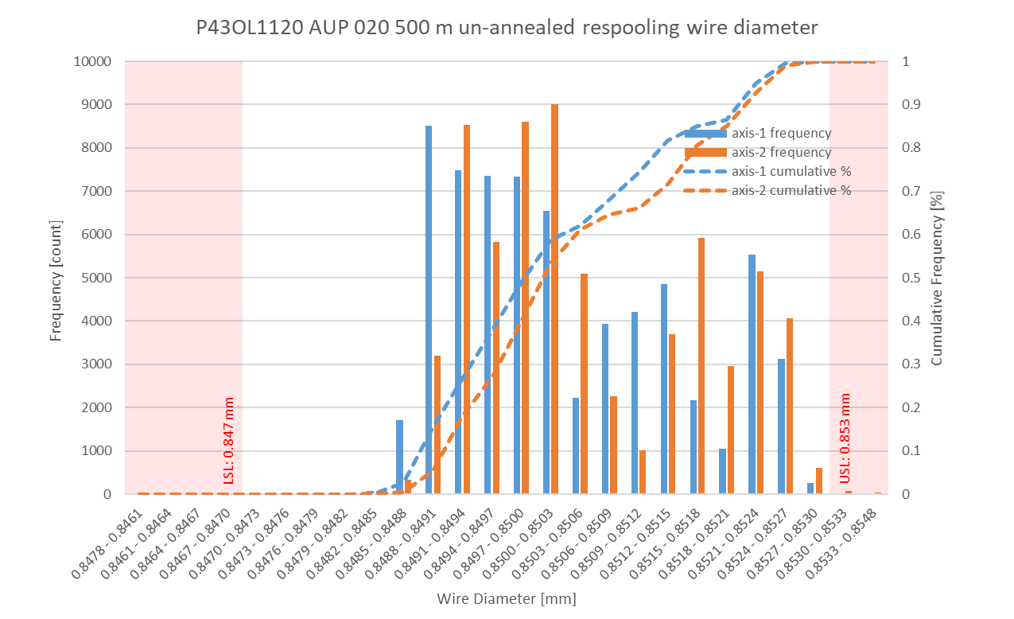
P43OL1120 Respooling Wire Diameter
Below LSL: 0.00%
Above USL: 0.04%

Slide 76
P43OL1120 – Cable QC Data Summary
CME:
Residual Twist:
  109°
10-stack:
  Qualification: 1.528 mm
  Production tail end: 1.525 mm
 | Pressure (MPa) | Angle (°) | Width (mm) | Thickness (mm)
Maximum | 17.1 | 0.415 | 18.160 | 1.530
Average | 17.1 | 0.400 | 18.145 | 1.524
Minimum | 17.0 | 0.383 | 18.140 | 1.521
Sigma | 0.01 | 0.006 | 0.002 | 0.002

Slide 77
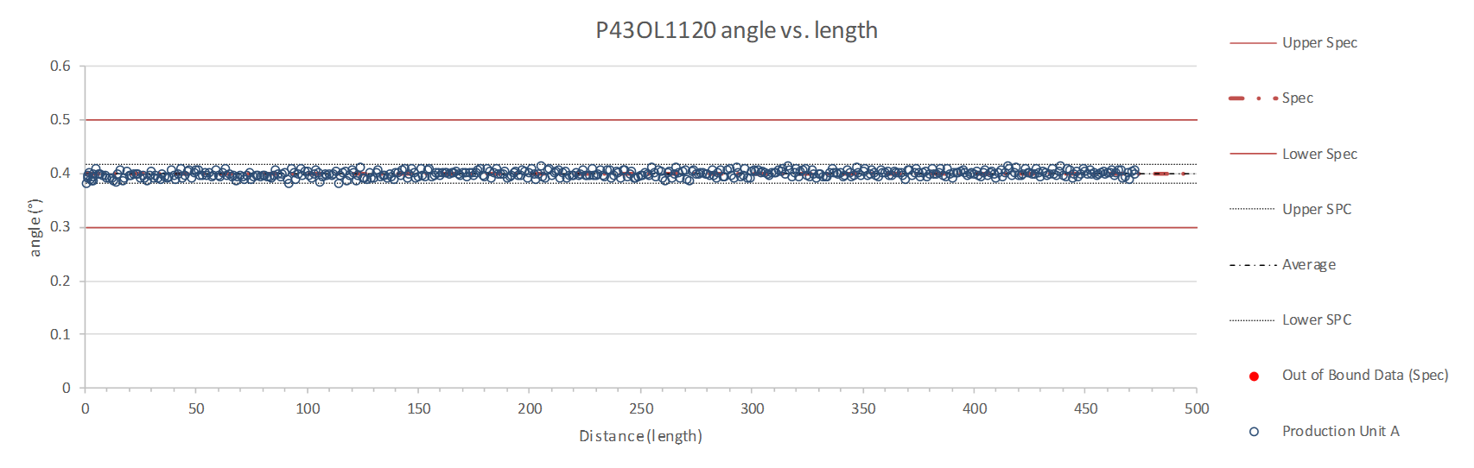
Rollers: P-91 (2017-12-08) and P-92 (2017-12-08)

Slide 78
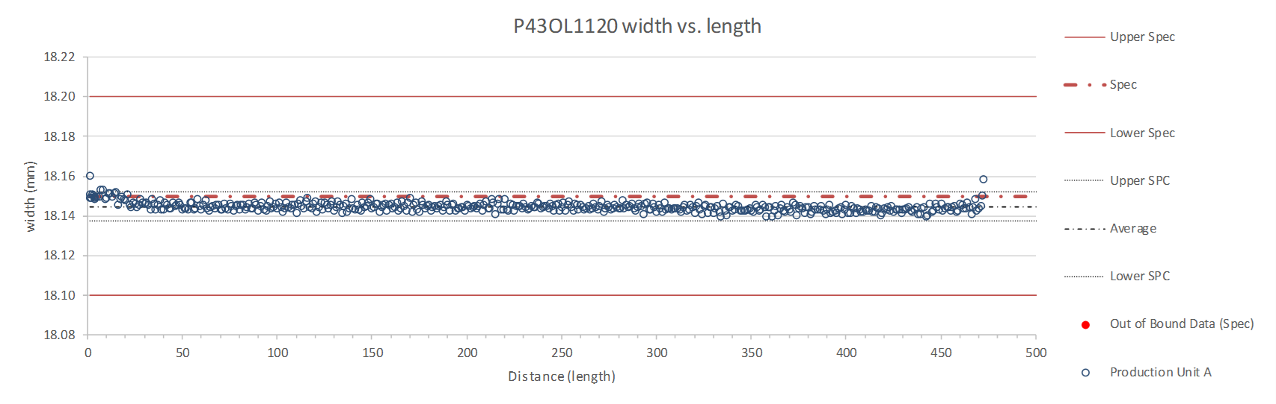
Rollers: P-91 (2017-12-08) and P-92 (2017-12-08)

Slide 79
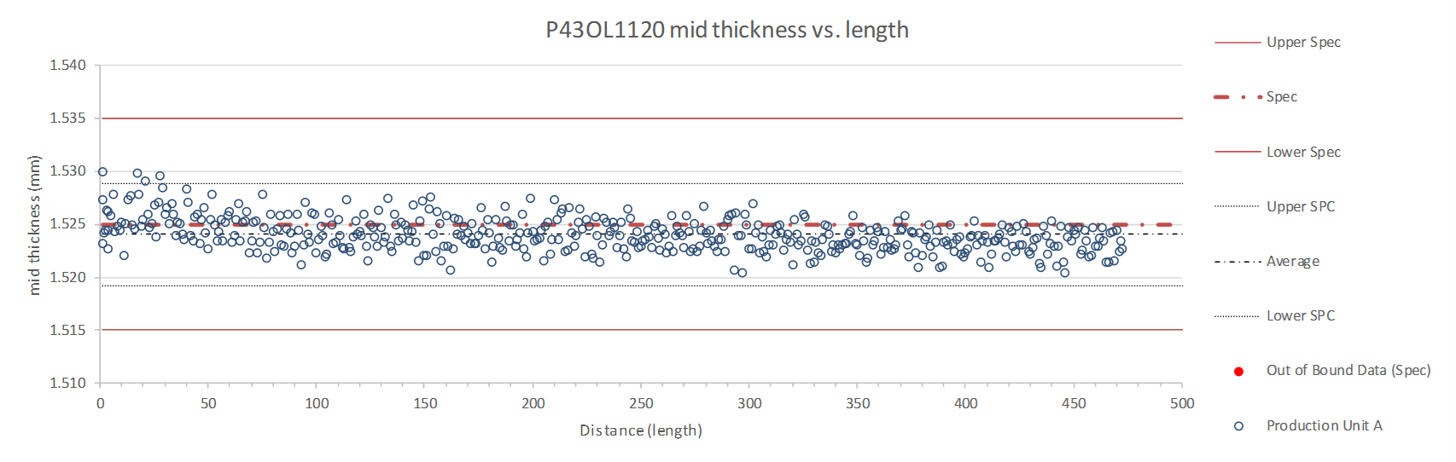
Rollers: P-91 (2017-12-08) and P-92 (2017-12-08)

Slide 80
P43OL1120 – Braiding
Fiberglass Lot #100858
P/I: 18.0
Spool tension: 10 lbs. (payoff); 20 lbs. (takeup)
Bobbin payoff tension: 0.125 lbs. (min), 0.250 lbs. (max)
NEWT 10-stack QC:
  Cycle #1) 0.151 mm; #2) 0.149 mm; #3) 0.148 mm;
  Mean 0.149 mm
LBNL 10-stack verification QC:
  Cycle #1) 0.138 mm; #2) 0.136 mm; #3) 0.135 mm;
  Mean 0.136 mm
Vector #464342

Slide 81
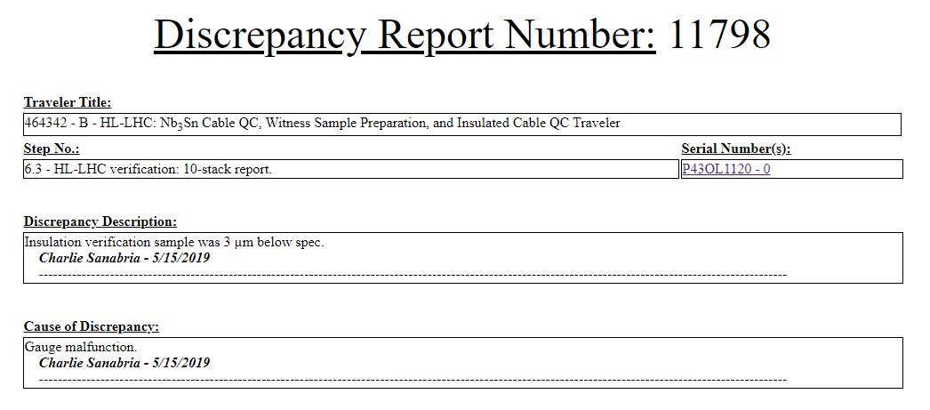
DR

Slide 82
P43OL1120 – Wire Parameters
Properties | Inspected Average
Wire Diameter | 0.8504 ± 0.0011 mm (LBNL)¹
Cu ratio ª | 54.47% (OST)
Strand twist pitch ª | 18.6mm (OST)
RRR (RW) ª | 313 (OST)
RRR (15% rolled) ª | 234 (OST)
I_{C} (4.2 K, 15 T) ª | 375 A (OST)
I_{C} (4.2 K, 14 T) ª | 468 A (OST)
I_{C} (4.2 K, 13 T) ª | 572 A (OST)
I_{C} (4.2 K, 12 T) ª | 692 A (OST)
ª First billet averaged, then weighted average according
to the spool distribution in the cable
¹ As-received, all LBNL respooling data; mean ± 1 sigma

Slide 83
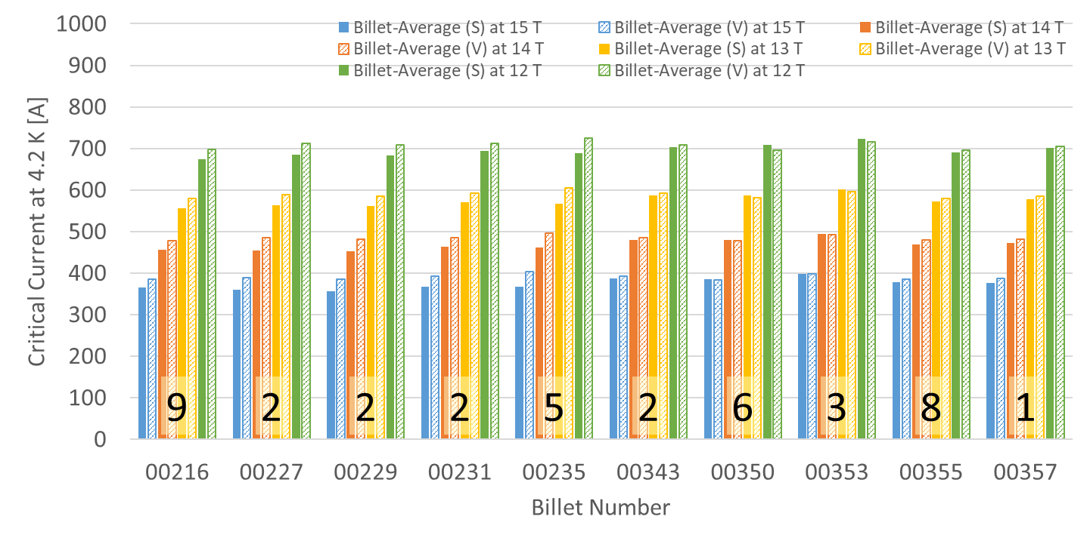
P43OL1120 – Wire Parameters
Supplier (S) and Verification (V) I_{C} Data
632982-C: (S) 650°C/50h
632982-D: (S) 650°C/50h
646116-A: (S) 650°C/50h
Number of spools from that billet used in the cable

Slide 84
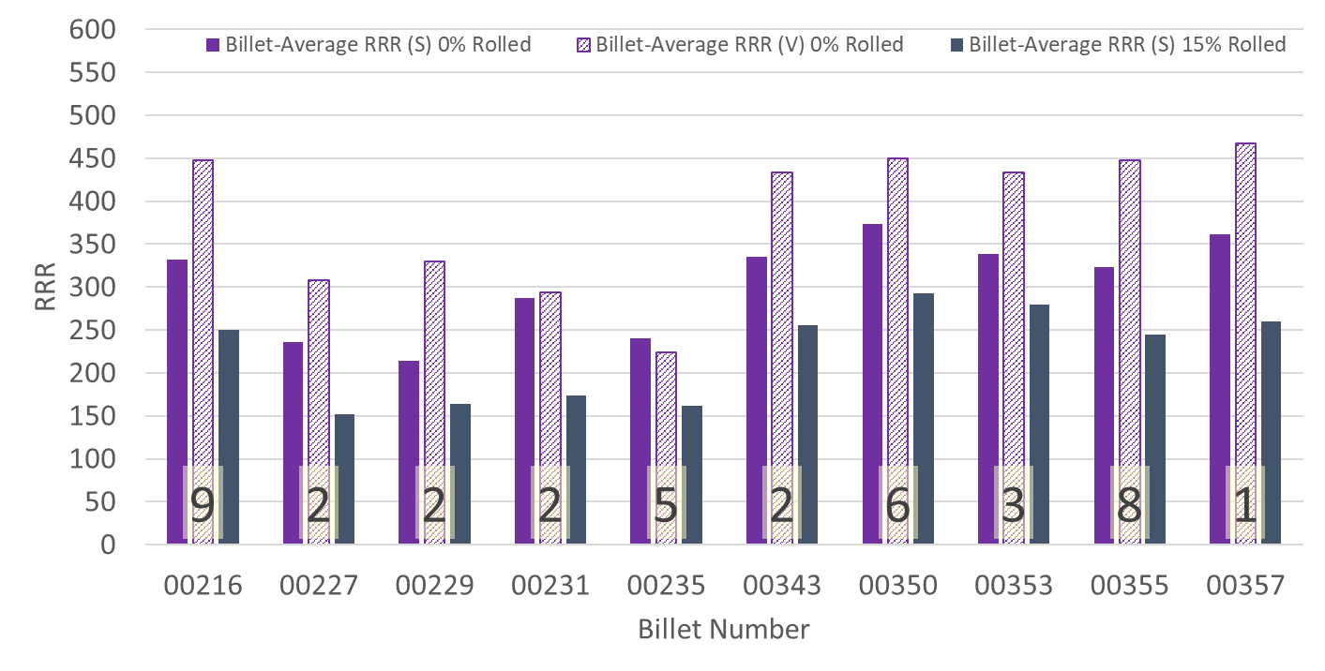
P43OL1120 – Wire Parameters
Supplier (S) and Verification (V) RRR Data
632982-C: (S) 650°C/50h
632982-D: (S) 650°C/50h
646116-A: (S) 650°C/50h
Number of spools from that billet used in the cable

Slide 85
P43OL1120 – Extracted Strand RRR
 | Cable ID | No. of Units from Billet (spool) | HT/sample ID | Major edge RRR | Minor edge RRR | Straight section 1 RRR | Straight section 2 RRR
ID #1 | P43OL1120AE36E PO08S00355A04U | 8 (8) | LRLK190205ALC1 | 280 | 404 | 396 | 392
ID #2 | P43OL1120AE48E PO08S00216A01U | 9 (9) | LRLK190205ALC1 | 386 | 419 | 469 | 469
ID #3 | P43OL1120AE07E PO08S00353A04U | 3 (3) | LRLK190205ALC1 | 414 | 372 | 459 | 404
ID #4 | P43OL1120AE29E PO08S00235A02U | 5(5) | LRLK190205ALC1 | 178 | 274 | 268 | 266
ID #5 | P43OL1120AE21E PO08S00350A02U | 9 (5) | LRLK190205ALC1 | 293 | 374 | 435 | 445
Vector #464342

Slide 86
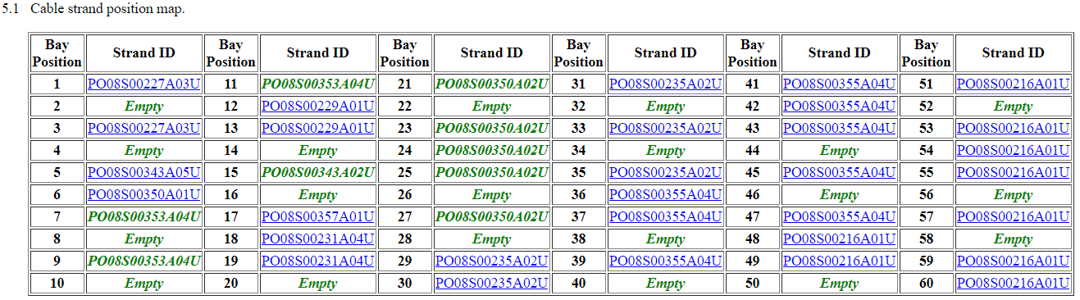
P43OL1120 – Witness Samples
Witness extracted strand (XS)
Witness virgin strand (VS)
XS RRR

Slide 87
P43OL1120 – Witness Samples
ID | RRR (293K / 20K) XS > 100 RW > 150 | Ic(12T) XS > 600 RW > 632 | Ic(13T) | Ic(14T) | Ic(15T) XS > 314 RW > 331
PO08S00355A04U | 300 | 714 | 594 | 491 | 397
P43OL1120AE48E | 414 | 683 | 567 | 464 | 376
P43OL1120AE51E | 319 | 688 | 571 | 469 | 378
P43OL1120AE36E | 395
P43OL1120AE39E | 297
nnnQ denotes a critical current measurement that showed a transition but quenched before the criterion was reached
Q denotes a critical current measurement that did not show a transition before quenching

Slide 88
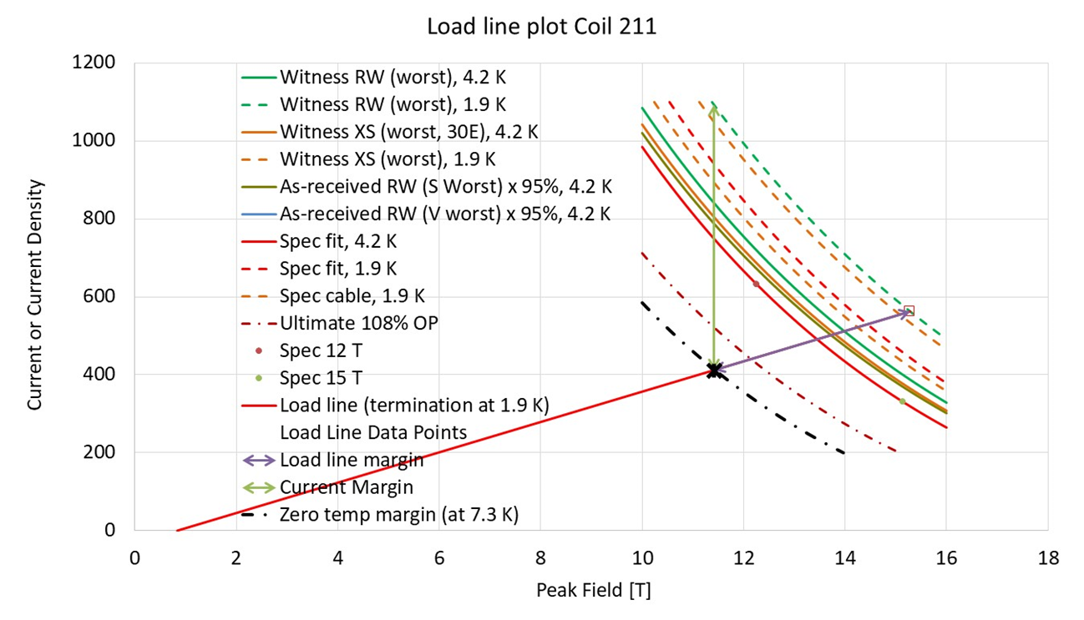
P43OL1120- SSL

Slide 89
Coil 211 / Cable P43OL1120
Cable current to calculate margin | 16230
I [A] to calculate margin at | 405.75
Corresponding load line B [T] | 11.26
SS curve to calculate margin from | Witness XS (worst), 1.9 K
Margins | Margin | Operating Point (X)
Load line margin (purple arrow) | 26.8% | 73.2%
Current margin (green arrow) | 62.3% | 37.7%
Temperature margin & intercept [K] | 5.4 | 7.3
Limits | Strand | Cable
"Witness XS (worst), 1.9 K" current [A] at margin-calculation field | 1076 | 43043
"Witness XS (worst), 1.9 K" current [A] at 100% SSL | 554 | 22172
"Witness XS (worst), 1.9 K" field [B] at 100% SSL | 15.08

Slide 90
Summary
Coil | SSL field (T) | SSL current (kA) | I_{OP}/I_{SSL} (%) | T margin (K) | Cable I_{C} (kA) | I_{OP}/I_{C} (%)
QXFA119 | 15.2 | 22.4 | 73.7 | 5.3 | 43.9 | 37.5
QXFA122
QXFA123
QXFA211 | 15.3 | 22.5 | 73.2 | 5.4 | 43.7 | 37.7
Although the strand for coil 119 did not test well according to CERN data, the coil performs well based on XS data.
Coil 119 may have been overcooked; taken together with strand having RRR at low of run range, this results in RRR slightly above lower specification limit.

