Slide 1
Coil 122 VTB07
Followup to MQXFA06 Coil Selection Review
Dan Cheng, Bob Memmo, Jordan Taylor
9/29/2020
LBNL

Slide 2
MQXFA06 Coil Electrical QC Summary With Updated Coil 211 Data
 |  |  | 117 | 119 | 122 | 211 | 123
See DocDB #956 / SU-1010-1903D
RLQ
 | R | (mΩ) | 614 | 607 | 611 | 600.91 | 608
 | L_{s} (mH) | 20 Hz | 10.018 | 10.016 | 10.064 | 9.986 | 10.008
 |  | 100 Hz | 6.4188 | 6.441 | 6.4179 | 6.4263 | 6.4155
 |  | 1 kHz | 5.8528 | 5.8255 | 5.8164 | 5.8252 | 5.8388
 | Q | 20 Hz | 1.282 | 1.295 | 1.28 | 1.296 | 1.289
 |  | 100 Hz | 5.587 | 5.529 | 5.497 | 5.564 | 5.61
 |  | 1 kHz | 8.548 | 8.402 | 8.549 | 8.504 | 8.531
QH R (Ω)
 | NT | A01 | N/A | N/A | N/A | N/A | N/A
 | T | A02 | N/A | N/A | N/A | N/A | N/A
 | T-P | B01 | 2.3 | 2.03 | 2.02 | 2.31 | 2.13
 | NT-P | B02 | 2.3 | 2.03 | 2.03 | 2.29 | 2.13
 | T-M | B03 | 2.2 | 2.03 | 2.03 | 2.28 | 2.12
 | NT-M | B04 | 2.2 | 2.02 | 2.03 | 2.26 | 2.1
VT R (mΩ) Individual coils
@1 Amp |  | A1 | 614 | 606 | 611 | 604 | 608
 |  | A2 | 613 | 606 | 611 | 604 | 607
 |  | A3 | 415 | 410 | 414 | 409
 |  | A4 | 355 | 352 | 354 | 350
 |  | A5 | 355 | 352 | 354 | 350
 |  | A6 | 350 | 345 | 349 | 345
 |  | A7 | 350 | 345 | 348 | 344
 |  | A8 | 344 | 340 | 342 | 339
 |  | B8 | 343 | 340 | 342 | 339
 |  | B7 | 343 | 340 | 330 | 338
 |  | B6 | 338 | 334 | 336 | 333
 |  | B5 | 337 | 333 | 336 | 333
 |  | B4 | 331 | 328 | 331 | 327
 |  | B3 | 187 | 186 | 187 | 185
 |  | B2 | 0 | 2 | 1 | 0.1 | 0
 |  | B1 | 0 | 1 | 1 | 0.06 | 0
HIPOT |  |  | OK | OK | OK | OK | OK
IMPULSE |  |  | OK | OK | OK | OK | OK
211 data now shown with updated measurements
122 B7 is not sequential, Examination follows in next slides

Slide 3
Coil 122 Measurement Differential
Reference Values from Coil 119
 | Coil 119 FNAL | C119 FNAL Differential
A1 | 0.5
A2 | 0.5 | 0
A3 | 192.08 | 191.58
A4 | 251.01 | 58.93
A5 | 251.18 | 0.17
A6 | 256.54 | 5.36
A7 | 256.72 | 0.18
A8 | 263.07 | 6.35
B8 | 263.85 | 0.78
B7 | 264.44 | 0.59
B6 | 269.82 | 5.38
B5 | 270.35 | 0.53
B4 | 274.48 | 4.13
B3 | 416.32 | 141.84
B2 | 598.4 | 182.08
B1 | 598.6 | 0.2
 | Coil 122 FNAL | C122 FNAL Differential | Coil 122 LBNL retest | C122 LBNL Differential
A1 | 0.4 |  | 0
A2 | 1 | 0.6 | 0 | 0
A3 | 195.13 | 194.13 | 196 | 196
A4 | 254.62 | 59.49 | 256 | 60
A5 | 254.64 | 0.02 | 256 | 0
A6 | 260.21 | 5.57 | 262 | 6
A7 | 260.45 | 0.24 | 262 | 0
A8 | 266.64 | 6.19 | 267 | 5
B8 | 266.25 | -0.39 | 268 | 1
B7 | 277.42 | 11.17 | 280 | 12
B6 | 272.21 | -5.21 | 274 | -6
B5 | 272.9 | 0.69 | 274 | 0
B4 | 279.15 | 6.25 | 280 | 6
B3 | 421.69 | 142.54 | 423 | 143
B2 | 608.5 | 186.81 | 608.872 | 185.872
B1 | 609.4 | 0.9 | 608.93 | 0.058

Slide 4
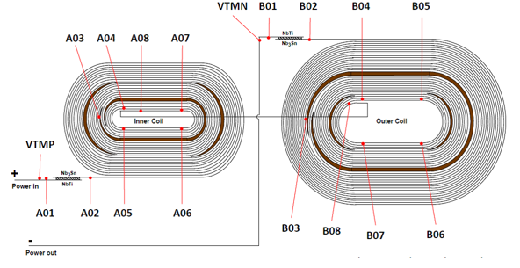
Voltage Tap Mapping
B07 is ~two straight sections away from B08
B07 is ~one straight section away from B06 in the opposite direction
B07 and B04 are very close in value, within ~1 ohm
Conclusion:
VTB07 is actually not on pole turn, but rather on 2nd turn, between VTB03 and VTB04
 | Coil 122 LBNL retest | C122 LBNL Differential
A1 | 0
A2 | 0 | A2-A1 | 0
A3 | 196 | A3-A2 | 196
A4 | 256 | A4-A3 | 60
A5 | 256 | A5-A4 | 0
A6 | 262 | A6-A5 | 6
A7 | 262 | A7-A6 | 0
A8 | 267 | A8-A7 | 5
B8 | 268 | B8-A8 | 1
B7 | 280 | B7-B8 | 12
B6 | 274 | B6-B7 | -6
B5 | 274 | B5-B6 | 0
B4 | 280 | B4-B5 | 6
B3 | 423 | B3-B4 | 143
B2 | 608.872 | B2-B3 | 185.872
B1 | 608.93 | B1-B2 | 0.058
~6 ohms, straight section

Slide 5
Coil Fabrication Intermediate EQC Steps

Slide 6
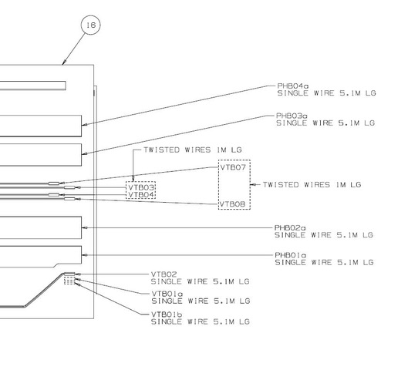
Coil 122 LE VTB Wires Soldered
Soldered wires appear to be correctly placed and labeled, per coil fabrication drawing
Fred Nobrega

Slide 7
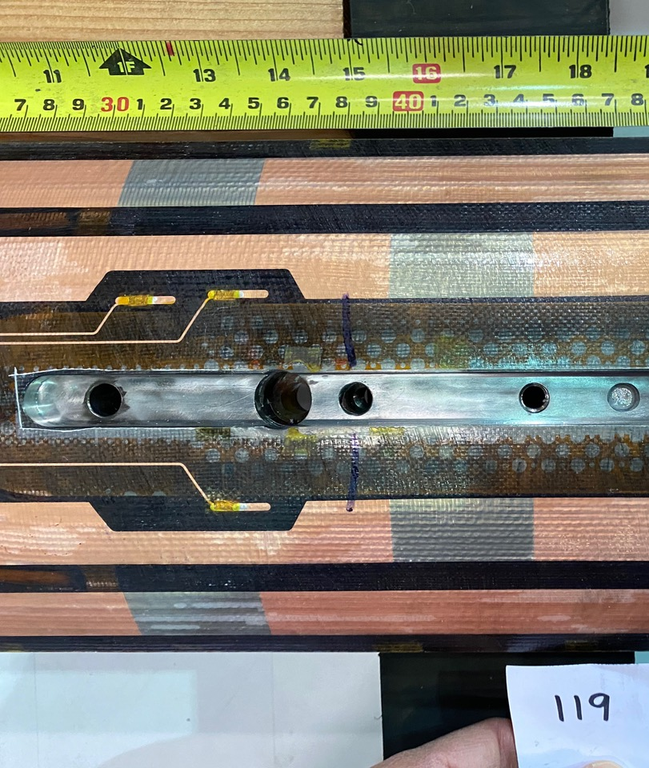
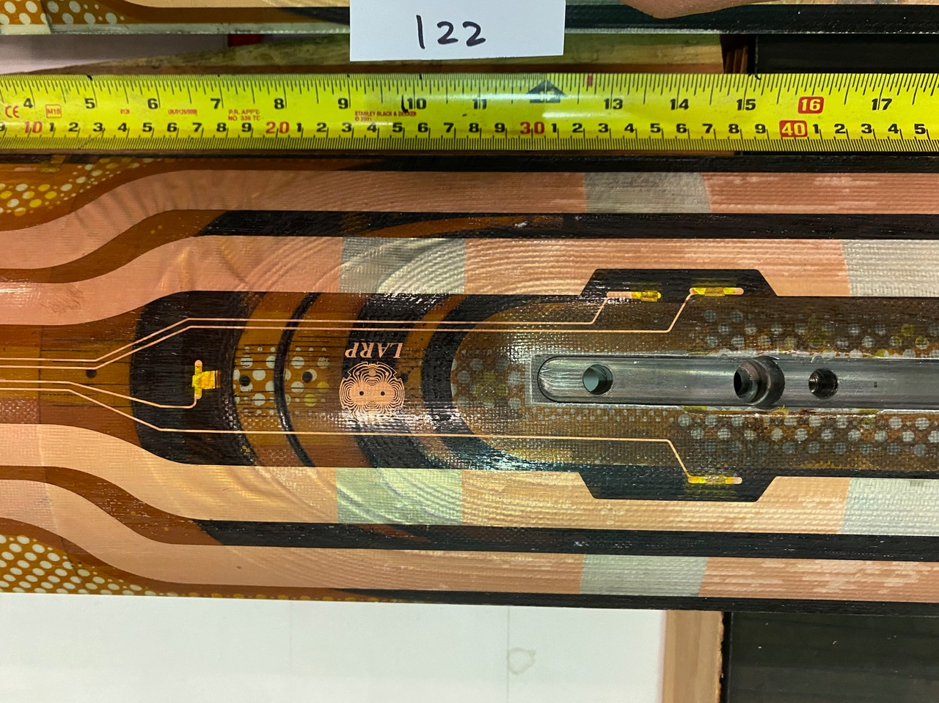
VT Flags, Coil 119 and 122
There appears to be a shift of a cable’s width in Coil 122 VTB07 flag
Courtesy of Fred Nobrega

Slide 8
Summary and Conclusion
Fabrication data shows same out of sequence values from trace installation
Data was remeasured and confirmed at LBNL
Photos presented
Measurement data suggests that the VTB07 VT flag was placed on the 2nd turn from the pole
Actual order of the outer layer voltage taps are: B01, B02, B03, B07, B04, B05, B06, B08, A08, etc...

Slide 9
Additional Slides

Slide 10
Electrical Testing Notes
Keithley 2110 Multimeter (Sequential-R Voltage Measurements, Resistance Measurements)
HP E3610A DC Power Supply (Current Source for Sequential R)
Hypotultra 7805 (Hipot)
LCR Meter
GW Instek LCR-819
ECG-Kokusai Winding Test DWX-05 (Impulse Testing)

