Slide 1
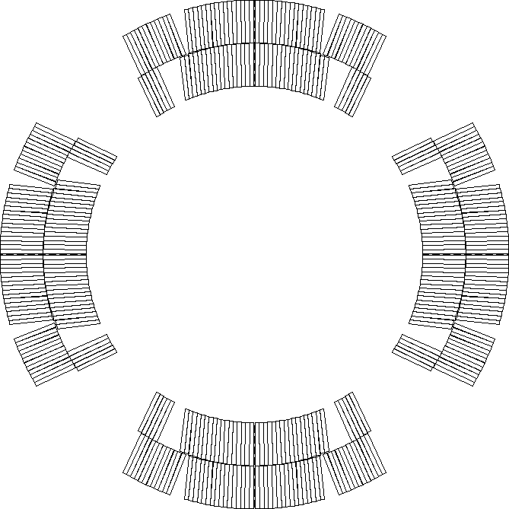
Assumptions
Nominal current (16470 A)
Nominal protection (CLIQ 600 V - 40 mF, OL QH 300 V – 7.05 mF)
No failures
Coils 123 – 119 – 122 – 211
RRR 229 – 139 – 267 – 234
Cu/NCu 1.23 – 1.183– 1.149 – 1.196
Coil 117 is a spare
RRR 188, Cu/NCu = 1.185
119
123
122
211

Slide 2
MQXFA6 peak voltages
Coil MECHANICAL ordering Q1-Q2-Q3-Q4 | Peak voltage [V]
123-119-122-211 | 321
123-119-211-122 | 324
123-211-119-122 | 371
123-211-122-119 | 361
123-122-211-119 | 375
123-122-119-211 | 340
119-123-122-211 | 460
119-123-211-122 | 478
119-211-123-122 | 476
119-211-122-123 | 435
119-122-211-123 | 433
119-122-123-211 | 455
Coil MECHANICAL ordering Q1-Q2-Q3-Q4 | Peak voltage [V]
122-119-123-211 | 343
122-119-211-123 | 321
122-211-119-123 | 347
122-211-123-119 | 402
122-123-211-119 | 403
122-123-119-211 | 368
211-123-119-122 | 370
211-123-122-119 | 382
211-122-123-119 | 401
211-122-119-123 | 368
211-119-122-123 | 321
211-119-123-122 | 349

Slide 3
Failure cases
2 QH failures in some acceptable cases
Coil MECHANICAL ordering Q1-Q2-Q3-Q4 | Peak voltage no fail [V] | Peak voltage 2 QH fail [V]
123-119-122-211 | 321 | 324
123-119-211-122 | 321 | 326
123-122-119-211 | 325 | 340
122-119-123-211 | 321 | 343
122-119-211-123 | 321 | 341
122-211-119-123 | 340 | 347
211-119-122-123 | 321 | 335
211-119-123-122 | 321 | 349

Slide 4
Worst case with BNL protection system
Worst acceptable case
211-119-123-122 (el. Order 211->122->119->123)
Nominal current (16470 A)
37.5 mΩ dump (10 ms delay)
2 QH fail
Peak voltage to ground: 455 V

Slide 5
Coil ordering stability check
Chosen MECHANICAL order is 122-119-211-123
Electrical order 122-123-119-211
Considering unceratinty of RRR for coil 119, we computed peak voltage for different values (with 2 QH failures)
Peak voltage is 341 V for Coil 119 RRR = 139
Peak voltage is 345 V for Coil 119 RRR = 131
Peak voltage is 325 V for Coil 119 RRR = 243
Peak voltage computation is stable against coil 119 RRR variation
It goes in the good direction

