Slide 1
PPD Department Heads Meeting ESH/DSO Presentation August 2020
Raymond Lewis & Katie Swanson

Slide 2
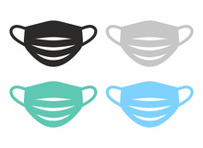
Requirement – face coverings required in government vehicles
Government vehicles, even if assigned to individuals, always have the potential for being used by someone else. Therefore face masks must be worn in government vehicles, even if alone.
Exceptions create confusion and inconsistency.
Use of face coverings is a primary mitigation to the spread of SARS-CoV-2. The more we use face coverings, the better. Relaxing this requirement is a risk.
Raymond Lewis & Katie Swanson | Department Heads Meeting

Slide 3
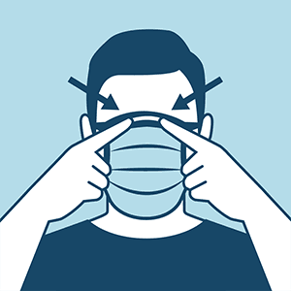
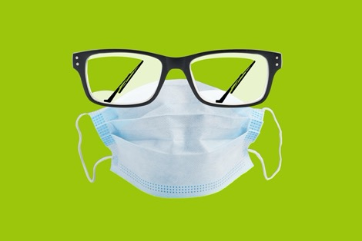
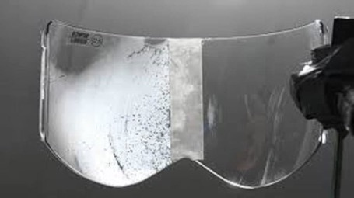
Concerns
Driving with face coverings can be hazardous due to fogging of glasses.
This hazard MUST be mitigated
Easy and effective solutions:
Use face coverings with nose wires, pinch down around nose
Tuck face covering under glasses
Don’t wear glasses if you don’t have to
Use anti-fog safety/sunglasses
Use anti-fog wipes
Use anti-fog spray
Personal vehicle (mileage reimbursement)

Slide 4
Stock Room Solutions
2650-350500 TOWELETTES, PRE-MOISTENED, W/ ANTI FOG & STATIC CLEANING SOLUTION, SAFE FOR GLASS, PLASTIC & COMPUTER SCREENS, INDIVIDUALLY WRAPPED, 100/BOX, ALLEGRO P/N 0350
2650-093000 GLASSES, SAFETY, NON-PRESCRIPTION, BLACK ONYX FRAME, GRAY ANTI-FOG LENS, TRIWEAR P/N T1112AF
2650-090400 GLASSES, SAFETY, NON - PRESCRIPTION, ADJUSTABLE BLACK TEMPLES, ANTI FOG, SCRATCH RESISTANT, CLEAR LENS, LARGE LEXA, 3M P/N 15154-00000-100
3154-180500 GLASSES,SAFTEY,UVEX,GENESIS,CLEAR,W/BROW GUARDSANTI FOG-KK385
3155-154500 SAFETY GLASSES,UVEX,BLACK FRAMES, OVER GLASSES,ASTRO 3001ANTI-FOG-KK383
2650-092500 GLASSES, SAFETY, NON-PRESCRIPTION, ONYX FRAME, CLEAR ANTI-FOG LENS, TRIWEAR P/N T1110AF
2650-092000 GLASSES, SAFETY, BOUTON 5900 CLEAR POLYCARBONATE LENS,ANTI-FOG, ANTI-SCRATCH, SMOKE FRAMES W/ BUILD IN WIRE MESH SIDE SHIELDS, MOLDED NOSE BRIDGE, 48MM EYE SIZE, P/N PI 249-5907-400

Slide 5
Face Coverings
Masks with Exhalation Valves or Vents are Prohibited
The purpose of masks is to keep respiratory droplets from reaching others to aid with source control. Masks with one-way valves or vents allow exhaled air to be expelled out through holes in the material. This can allow exhaled respiratory droplets to reach others and potentially spread the COVID-19 virus. Therefore, CDC does not recommend using masks if they have an exhalation valve or vent.
https://www.cdc.gov/coronavirus/2019-ncov/prevent-getting-sick/about-face-coverings.html

Slide 6
Examples of Masks with Exhalation Valves or Vents that are Prohibited

Slide 7
Pleated Mask Orientation
Front pleats open DOWN
Material doesn’t
accumulate in the pleats
Back pleats open UP
Exhaled droplets, etc. are caught in the pleats

Slide 8
Eating/Lunchrooms
Face covering can be removed only when eating or drinking
Maintain a 6 foot or greater social distance from others.
Respect the room capacity limitations.
Clean surfaces after eating/drinking.
Wash/sanitize hands prior to eating/drinking and before returning to work.
Don mask immediately after eating/drinking is complete or when traversing in the area.

Slide 9
Social Distance - better to overestimate

Slide 10
Summary of Latest CDC & IDPH Guidance 7/20/2020
Confirmed/Suspected, i.e., Cases (Isolation) | Close Contact (Quarantine)
Must be isolated for a minimum of 10 days after symptom onset and can be released when fever free for at least 24 hours (without using fever-reducing medication) and improvement of COVID-19 symptoms. OR If no symptoms, must be isolated for a minimum of 10 days after first positive test for COVID-19. OR Has 2 negative COVID-19 tests in a row, with testing done at least 24 hours apart. | Must be quarantined for 14 days after the last/most recent contact with the case when the case was infectious. IDPH and CDC now state: “You can’t test your way out of Quarantine”. It’s 14 days.
For patients with severe illness, duration of isolation up to 20 days after symptom onset may be warranted – consultation may be needed with infection control expert. | For COVID-19, a close contact is defined as any individual who was within 6 feet of an infected person (note, if having COVID-19 like symptoms without a test, must assume COVID-19) for at least 15 minutes starting from 2 days before illness onset (or for asymptomatic patients, 2 days prior to positive test) until the time the patient is isolated.

Slide 11
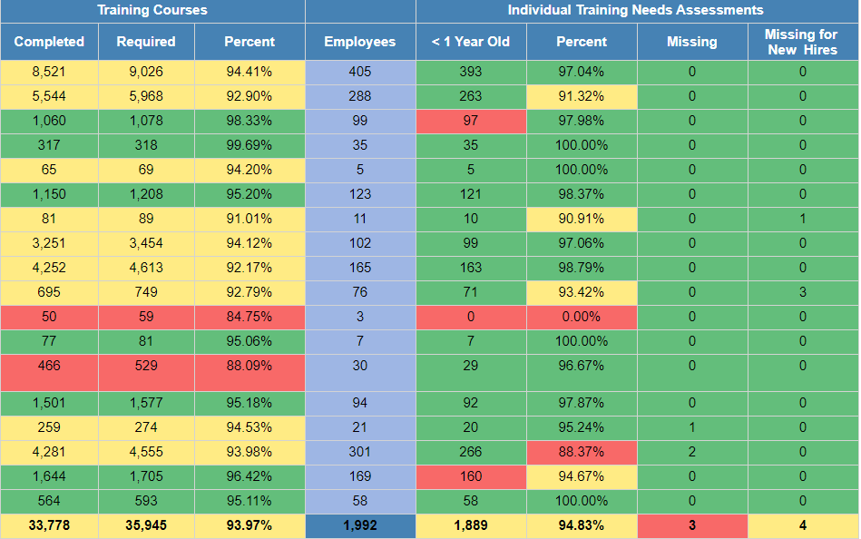
Training and ITNA Status for employees – as of 8/25/2020

