Slide 1
HR Updates- August 26, 2020
Ilene Winston

Slide 2
HR Updates
The 2020 Performance Review cycle
August
  Performance reviews need to be completed and submitted for final approval ASAP
  Start thinking about your goals for the 2021 review period – October 1 will kick-off goal setting in Fermiworks!
Timeline Overview
Dates | Activity
Sept 8 - 15, 2020 | Merit Managers enter merit increases in FermiWorks.
Sept 16-18, 2020 | Division Head reviews to ensure merit pools are balanced. Final approval in FW due on 9/18
Sept 21-25, 2020 | Final approval by Compensation department of merit increase amounts.
Sept 28, 2020 | Performance review documents visible to employees in FermiWorks. New salaries visible to managers in FermiWorks.
Oct 1, 2020 | Merit Increase effective date. Merit Statements viewable by all employees in FermiWorks.
Sept 28 – Oct 9, 2020 | Managers schedule individual meetings with employees for performance review discussion and merit increase notification.

Slide 3
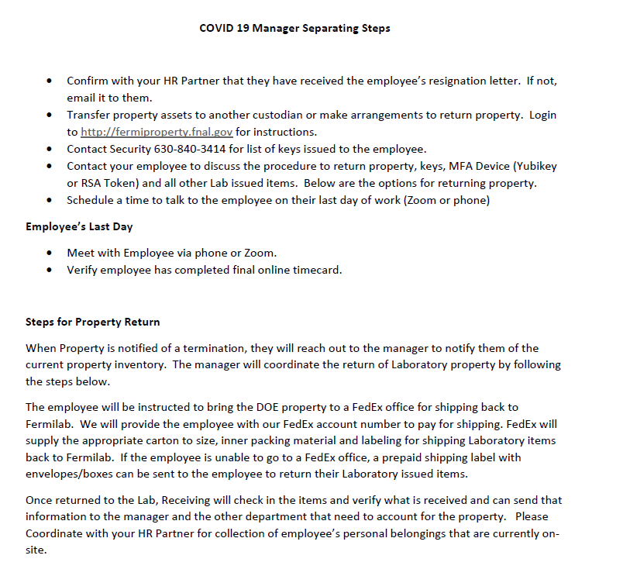
HR Updates
Termination Process

Slide 4
HR Updates
Updates to Remote Work Policy
A revised Remote Work Policy, replacing the lab’s current Telework Policy, which establishes the categories of remote work at Fermilab, describes each category, and clarifies that most employees now working remotely due to COVID-19 are telecommuting.
You do NOT need to fill out a new form if you have an existing one, including those who have checked “occasional telecommuting”
The Remote Work Reimbursement Policy establishes a standard reimbursement of up to $24 per month to reimburse employees for personal internet access used for business purposes during the period of extended telecommuting that has resulted from the COVID-19 pandemic.
Visit the WDRS Home page (must be on the Fermilab network to view) for links to more information about the FermiWorks reimbursement request process and highlights of the new policies. If you have questions, please email askhr@fnal.gov.
Tutoring discounts for Fermilab badge holders
Tutoring discounts are now available to Fermilab badge holders through the following companies: Club Z!, Elite Tutoring Services Batavia, Sylvan Learning Center Naperville and Varsity Tutors. For specific details and services on all tutoring discounts please go to Fermilab Discounts and look for Tutoring at the bottom of the page, or contact Jeanne Ecker, Global Services Recreation, at jecker@fnal.gov or x2548.
https://news.fnal.gov/2020/08/tutoring-discounts-for-fermilab-badge-holders/
We are working on options to further support employees who have child- and adult-care needs. If you are interested in participating in on-site childcare, Kindergarten, or the learning center option for children whose schools are remote-only, please let me know. More information is to come, based on interest. If you already responded to the survey as interested, there is no need for further action.

Slide 5
HR Updates
EAP Workshops – available recorded or live on Zoom
Every Wednesday 12:00 – 12:45 p.m. on zoom
August 26th – How To Talk To Kids About Current Events
      Join Zoom Meeting
      https://fnal.zoom.us/j/95280151361?pwd=bktBMFdjYVBqNmkzUlMxNk9ac1YzUT09
      Meeting ID: 952 8015 1361 Passcode: 698737One tap mobile +13126266799, 95280151361# US (Chicago)
  Webinars available on the EAP website: https://allonehealth.com/blog/
  Create a New Account, visit https://allonehealth.com
  1.Click “Create a new account with your company code”. 2.Enter your company access code: Fermilab
  3. Follow the instructions in the activation email. (will ask you to create new password)

