Slide 1
Mu2e-II DAQ Thoughts
14-Sep-2020 Trigger & DAQ
Mu2e-II Workshop
Ryan Rivera – Mu2e TDAQ L2

Slide 2
Introduction
What are the requirements for the Mu2e-II DAQ?
Mu2e-II will have more beam on target and higher granularity detectors.
Assumptions:
Power and cooling limitations are solved by money
Installation around 2030
Control and Synchronization of the detector will work itself out, this talk focuses on Trigger and Data Paths
This talk introduces some DAQ thoughts, hopefully the presentations to follow and our discussion will help make the thoughts coherent.

Slide 3
Implications (1 of 2)
~2x more detector channels, and ~5x more pulses on target, for ~10x higher data rate (if background remains the same).
Current expected Mu2e-I data rate from front-ends is 40GBps
More detector channels and more background implies bigger event sizes (maybe ~3x?)
Mu2e-I expected event size is 200KB
Tape capacity for Mu2e-I is 7PB/year
Might assume 2x increase for Mu2e-II to 14PB/year
Necessary rejection for Mu2e-II is ~3000:1
600KB events @ 3MHz ➔ 560MB
Notes:
1.7us / 5 ➔ 3MHz; 560MBps maps to 14PB/yr with 80% uptime.

Slide 4
Implications (2 of 2)
Reduced OFF Spill periods (to no OFF Spill time?) implies less advantage for large front-end buffers streaming data
In Mu2e-I, have second of downtime to play catchup
In Mu2e-II, steady event rate (could buffer just to handle event to event variation, not large accelerator time structures)
No large front-end buffers at CRV would imply need for low-latency trigger decision for CRV.
Low latency trigger decision implies an FPGA trigger layer.
Consider the cost of these scenarios:
Large CRV buffers and software trigger
Small CRV buffers and hardware trigger

Slide 5
Streaming vs Triggered
Important upfront decision as to which detector subsystems are triggered.
Same as Mu2e-I?
Stream all Tracker and Calorimeter data
Software Trigger for CRV based on Tracker and Calorimeter
Alternatives?
Stream Calorimeter Data
Hardware Trigger for Tracker and CRV based on Calorimeter
High-level Software Trigger for storage decision

Slide 6
Radiation Tolerance Requirements
Radiation levels at the detector will be higher than Mu2e-I
Mu2e-II comparable to Calorimeter level of CMS phase-II?
For Mu2e-I, using the VTRx was a primary constraint
We had to change the DAQ topology as a result
Mu2e-II likely will not want to design their own rad-hard links, so we will be at the mercy of CMS/Atlas (again)
This should be worked out as soon as possible.

Slide 7
Generic Data Readout Topology
Front-ends
Data Concentrator
Layer
Event Builder
Layer
Storage Decision
Layer

Slide 8
Generic Data Readout Topology
Data Concentrator Layer
Aggregate small front-end fragments into larger chunks for efficient event building
Event Builder Layer
Data is switched from Concentrator Layer to Event Builder Layer such that full events arrive at Event Builder Layer and are buffered.
Preprocessing or filtering could occur
Storage Decision Layer
Available decision nodes make high level storage decision on full events retrieved from Event Builder Layer buffer.

Slide 9
Generic Data Readout Applied to Mu2e-I
ROCs
DTCs
DTCs
PCs
10Gb 96-port Switch
10Gb PCIe
Data Concentrator
Layer
Event Builder
Layer
Storage Decision
Layer

Slide 10
Generic Trigger Path Topology
Front-ends
Triggered Data
Triggered Data
Trigger Layer
Streaming Data

Slide 11
Generic Trigger Path Applied to Mu2e-I
Front-ends
CRV Triggered Data
Software Trigger Layer
Streaming Tracker/Calorimeter Data

Slide 12
Generic Topology Applied to other experiments
Other workshop talks will describe how other experiment (e.g. ATLAS and CMS) map to this generic topology.

Slide 13
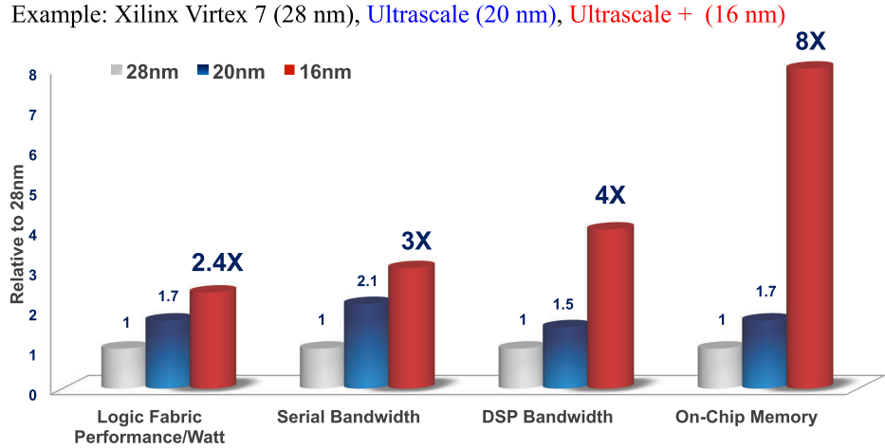
FPGA scaling

Slide 14
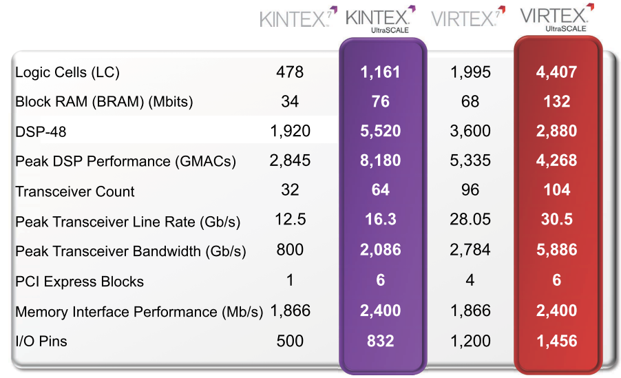
FPGA scaling
Mu2e-I DTC

Slide 15
FPGA Trend to HLS
High Level Synthesis is now good enough to rival manual VHDL or Verilog algorithm development.
Allows physicists to easily understand and develop low and fixed latency FPGA algorithms.
Makes emulation easy for offline.
Debug and verify in a software environment (often 10x faster iterations than firmware simulation tools).
CMS is heavily investing in HLS approach to FPGA algorithm development.
There is a hls4ml collaboration developing machine learning (neural network) tools using HLS.

Slide 16
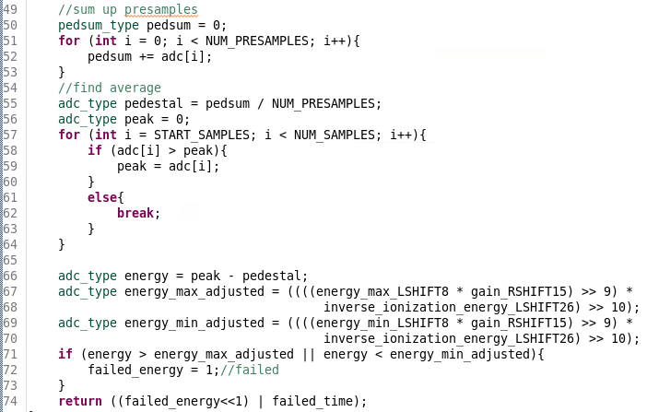
HLS Code

Slide 17
FPGA Algorithm Development
It’s important to realize that FPGA development can take place now – hardware is not needed!
Starting now would help decide how many resources are needed, what size FPGA is in the ballpark, and could inform DAQ topology choices.
Could consider associative memories for pattern matching.
Could inform custom trigger board design or commercial board selection.

Slide 18
Decision Process
Which subsystems are streaming?
What are the constraints imposed by rad-hard links?
Is it possible to have a low-latency Level-1 trigger with rejection power?
Lock an HLS developer and a firmware-system developer in a room for six months and tell them to understand the specs of a hardware trigger layer (what type of FPGA, how much memory) that would do the job.
A hardware trigger layer may save money
downstream due to data reduction.
upstream due to reduced buffer size.
How much processing is needed for High Level Trigger?

Slide 19
Overview of TDAQ LOIs for Snowmass 2021
A 2-level TDAQ system based on FPGA pre-processing and trigger primitives
ROCs (create trigger primitives, buffer event fragments), L1 FPGA layer (getting trigger primitives from calo and tracker), and HLT layer (requests event fragments from full detector)
A 2-level TDAQ system based on FPGA pre-filtering
Leverage HLS for FPGA rejection
TDAQ based on GPU co-processor
Using GPUs at HLT (or L0)
A trigger-less TDAQ system based on software trigger
Scale up current system.

Slide 20
Backup Slides

Slide 21
Where are the FPGAs for Mu2e-II?
At the detector front-ends, need rad-hard ASICS (Maybe already too late to design a new one) or FPGAs.
Low-Latency trigger
Data concentration
Event building
Can do custom application specific switching behavior
High Level Trigger preprocessor/co-processor?
Other co-processors? GPUs?

Slide 22
FPGA Landscape
Altera/Intel – Stratix 10
Up to 10 TFLOPS of single-precision floating-point DSP performance.
Up to 70% lower power than prior-generation high-end FPGAs
Up to 80 GFLOPS/Watt of single-precision floating point power efficiency.
Up to 144 full duplex transceivers in a single package.
Over 2.5 Tbps bandwidth for serial memory with support for Hybrid Memory Cube.
Over 2.3 Tbps bandwidth for parallel memory interfaces with support for DDR4 at 2,666 Mbps.
HLS C++ to RTL

Slide 23
FPGA Landscape
Xilinx – Virtex UltraSCALE+
Up to 128 33G transceivers deliver 8.4 Tb of serial bandwidth
460GB/s HBM bandwidth, and 2,666 Mb/s DDR4 in a mid-speed grade
Up to 60% lower power vs. 7 series FPGAs
HLS C++ to RTL

Slide 24
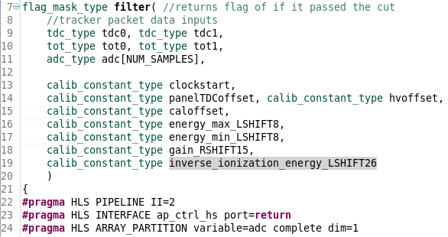
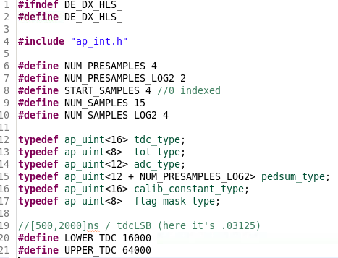
HLS Code

