Slide 1
Town Hall Meeting of the DPF Instrumentation Taskforce
June 9 12:45-2:00 PDT
12:45 The Taskforce/Origins/Goals and methods
/ The six tasks/ Schedule
Ian & Marcel
12:55 -2:00 Discussion
The Community
Meetings and minutes of the taskforce:
https://indico.fnal.gov/categoryDisplay.py?categId=22

Slide 2
The DPF Taskforce on Instrumentation
From Universities
  Marina Artuso, Syracuse
  Ed Blucher, Chicago
  Bill Molzen, Irvine
  Gabriella Sciolla, Brandeis
  Ian Shipsey*, Purdue
  Andy White, UT Arlington
  (*) co-Chair
From laboratories
  Marcel Demarteau*, Argonne
  David Lissauer, Brookhaven
  David MacFarlane, SLAC
  Greg Bock, Fermilab
  Gil Gilchriese, LBNL
  Harry Weerts, Argonne
Ex-officio
  Chip Brock, DPF MSU
  Patty McBride, DPF Fermilab
  Howard Nicholson, DOE Emeritus

Slide 3
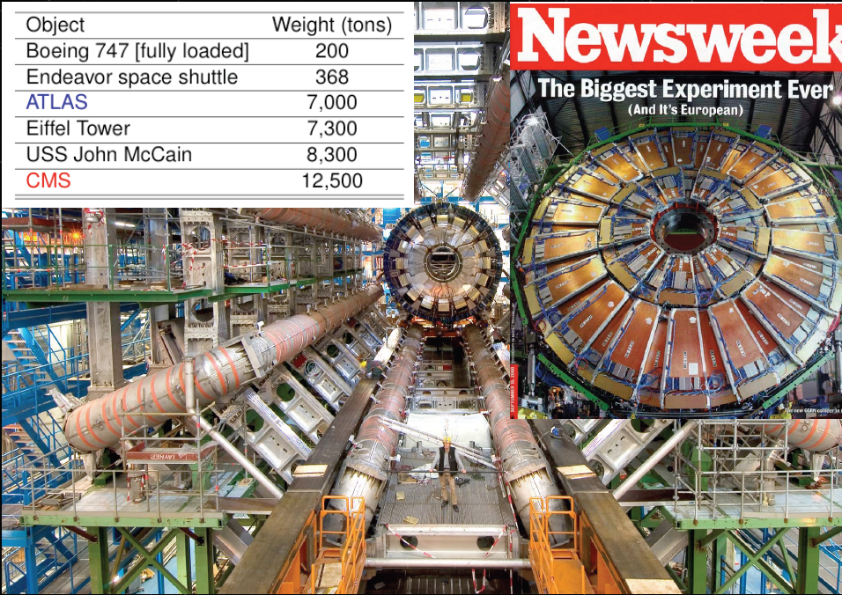
Instrumentation triumph
CMS
ATLAS
DIGITAL CAMERAS THE SIZE OF CATHEDRALS
Notes:
Dark matter & neutrinos/proton decay detectors
the emphasis should be on scalable technologies.
CMB: more sensitive transition edge sensors
Astro: ccd's with broad range of sensitivity

Slide 4
Instrumentation triumph
CMS
Instrumentation Challenge
ATLAS
DIGITAL CAMERAS THE SIZE OF CATHEDRALS

Slide 5
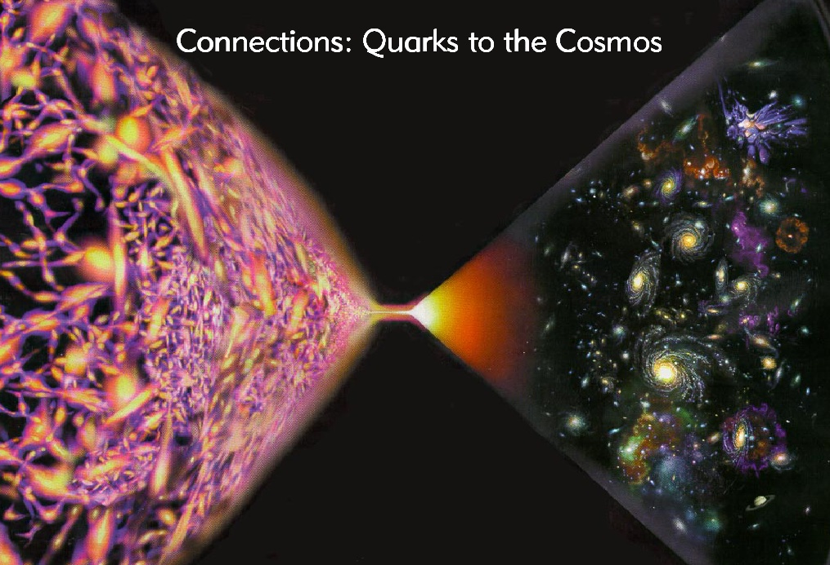
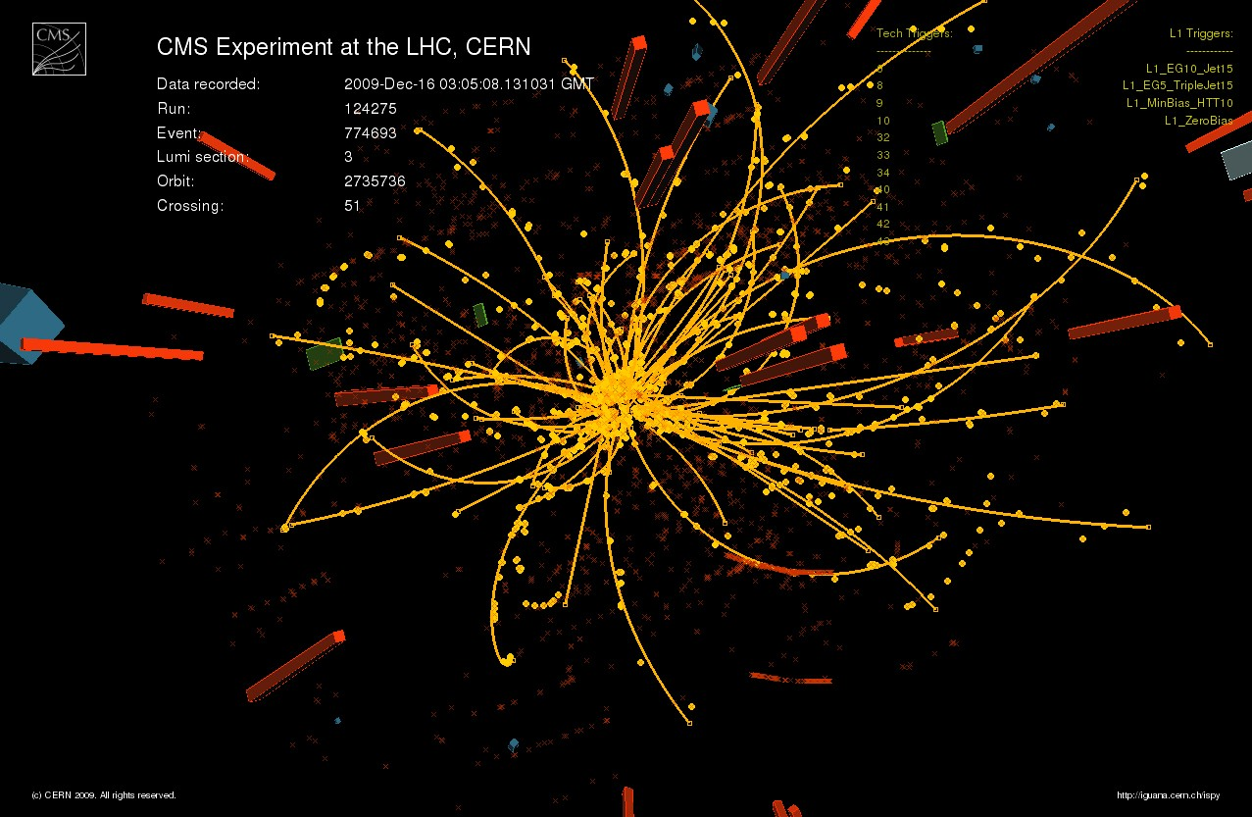
Instrumentation Challenge
Instrumentation is the great enabler of science both pure and applied. Instrumentation is critical to the mission of High Energy Physics, which is to explore the fundamental nature of energy, matter, space and time. Our field is embarking on a new golden age of discovery with the recent turn-on of the LHC, and with new experiments being planned at proposed new accelerators, deep underground, at the poles, and in space that together will reveal the origin of mass, explain the matter anti-mater asymmetry of the universe, search for extra spatial dimensions, determine the nature of dark matter and dark energy, and may probe the Planck scale. For the very first time we may come to know how our universe was born, how it will evolve and its ultimate fate.
LHC data
June, 2011
Notes:
This lab is today and has been for a very long tme a place where new knowledge is born
the physics division is partcularky concerned with new knowledge about the subatom wordl of particles
and knowledge about the cosmos and the connection between the two and has been one of the leadingplaces in the world exploring this connection
Expaning fronters of knowledge this talk will desibe tha program and its possible evolstion
At a time when fudning for partcile physcs aand cosmology has been flat flat for a long time and where the funds availble to invoate are curatked
I also lokk at exapdning forntoers of funding.

Slide 6
However, we embark on this adventure of discovery with instrumentation that represents both a towering achievement, and, in some cases, a scaled up version of techniques used in the past. We have gargantuan accelerators equipped with gargantuan experiments that have gargantuan costs associated with them that are outstripping the internationally available public funding for particle physics. The result is accelerator projects with exceptionally long time scales for construction and completion, and major de-scoping of detectors and their capabilities to the detriment of physics reach to match costs. In consequence opportunities for new generations of students to work with instrumentation are rare. In addition the time scales for our experiments and our large collaborations may have insulated us from instrumentation advances and innovations in industry.

Slide 7
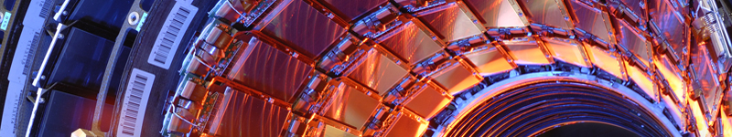
Instrumentation R&D has the power to transform this situation, from novel new acceleration techniques such as plasma wake-field, to novel new detectors that provide enhanced capabilities with significantly reduced cost. However, there has been a decline in DOE and NSF funding for instrumentation research and development during the last two decades at universities and national laboratories. If this funding trend is not reversed declining capabilities will surely lead to a dramatic change in how our field functions, and we will confront a different kind of future for HEP– the golden age of discovery will be stalled and its goals unfilled. Energy, matter, space, and time will remain enigmas.

Slide 8
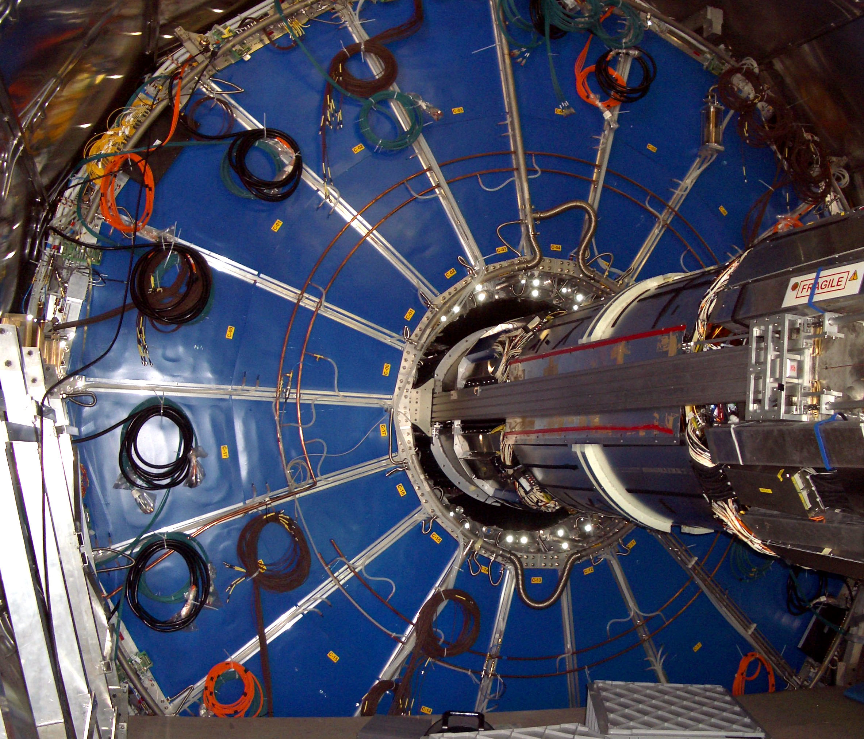
The field of HEP would clearly benefit from the development of both evolutionary and transformative detector instrumentation that is coordinated across the national laboratories and with the university community and international partners and with other disciplines. Accordingly, at this unique moment for HEP it has never been more necessary to examine instrumentation research and development in its entirety. The DPF has decided to form a taskforce to this end.

Slide 9
How the taskforce came to be
Summer 2009: A review of the detector R&D programs at the five national laboratories urged development of a coherent national instrumentation program & self-organization of the community
October 2010 A workshop dedicated to an overview of Detector R&D in the country was organized. This was a first.
The workshop was informative and positively received by the community. A great deal of high quality R&D is being carried out
There seems to be an acute awareness that for a sustained viability of the field a renewed investment in instrumentation development with the appropriate organization is needed
A DPF taskforce has been established to address the organization of HEP instrumentation

Slide 10
Taskforce Charge
Charge organized in three broad areas
Structure for a National Instrumentation R&D strategy
  Need, merit and process for evaluating and promoting the national R&D program through a National Instrumentation Advisory Panel
  Appropriate role for a standing panel on instrumentation vis-à-vis existing and new projects
  Models for universities-laboratory collaborative projects
  Strategic links to other scientific disciplines
  Strategic links to industry
Models for Entrepreneurial Instrumentation Science Strategy
  Availability of targeted resources at each of the five national laboratories to specifically support particular needs of individual researchers at the universities and the laboratories?
Notes:
Points 1 and 2 Will elevate & champion instrumentation, guide, community voice,
representative of the community ensure complete coordinated
balanced program, promote cooperation across community, decadal
perspective, advocate with congress and industry & other disciplines
Concerns: additional bureaucracy, should not impact running projects
Point 3 best practices? ) Large Area Planar Photo Detector development multiple labs, multiple disciplines, multiple universities, multiple industrial partners benefits HEP & industry required LDRD, ADR MRI, DOE mission need for future nu detector (<100M$ for phototubes) , vision of Howard and Dennis, + ARRA
Links to other discipline and industry through exchange program and joint workshops benefits everyone and provdies and independent voice for our filed in DC
Essence of lab + university partnerships in instrumentation
Collaborative use of resources at labs is a good idea
Create centers of excellence @ labs each with own specialty, needs national coordination

Slide 11
Taskforce Charge
Graduate Student and Post Doctoral Training
  Role of experience in instrumentation R&D in the life of US graduate students
  Academic, intensive, US-based instrumentation experience for graduate students with academic credits, within the context of a global program of coordinated instrumentation schools
  National instrumentation fellowship program for Ph.D. Students and postdoctoral scholars to encourage and support research in instrumentation.
Notes:
Is it impornat? I belive yes but the impression among the young and at the agenceis is that to advance the carreer physisc is the only crtieria
Suppose who interview 2 candidate for a job both have the sam phyisics capabilityies in analysis would you choose the one that also had te greatest hardware knowledge? If that is the cae let it be known to you collageusa and to the agencies. We must show we value insrumentation for it to thrive.
EDIT school at CERN an example. Schools recah many so ao high value but Many noted school is no substitute for working in an instrument group @ Uni, or lab. & with test beam
High stipend aim for tens f fellwos add prestige Exist in Europe CERN+ univs.
Exist in Europe Marie Curie , CERN+ univs. Suggest 50% instrumentation 50% physics. Will be hard to get industry funding target companies with many HEP PhDs/companies near national labs

Slide 12
Perspective, broad input, ownership
International Advisors
Asia: Yoshitako Kuno, Geoff Taylor, Yifang Wang. Hitoshi Yamamoto
Europe: Ariella Cattai, Joachim Mnich Tatsuya Nakada Peter Weilhammer
National Advisors
Karen Byrum. Minfang Yeh, Paul O’Connor, Mike Crisler, Ron Lipton, Joel Butler
Simon Kwan Hogan Nguyen Ted Liu Erick Ramberg Juan Estrada Steve Holland
Carl Haber David Nygren Chris Bebek Jim Fast David Asner Aaron Roodman
Chris Keeney SuDong Jerry Va’vra Natalie Roe Veljko Radeka
James White Priscilla Cushman Sally Seidel Wesley Smith Abe Seiden
David Saltzberg Bonnie Fleming Daniela Bortoletto, Mani Tripathi Jim Brau
~30 have provided multi-page answers to detailed questions related to the
themes and scope of the six tasks. They will continue to provide advice for the duration, and also have the option to serve on subgroups of the taskforce

Slide 13
The Six Tasks & Six Subgoups to develop them
(Membership Updated June 8 2011)
In response to the charge, recognizing its breadth & scope we formed
six subgroups who will meet in parallel & report back to the taskforce
National Instrumentation Program Advisory Group
A body to look at the national program as a whole, identify promising
new areas to explore, make connections including interdisciplinary
& industry
Blucher Artuso Lissauer Gilchriese(C) Weerts Asner(*)
Targeted Resources @ the National Labs
To support development needs of researchers especially for new
instrumentation ideas at universities and labs?
Bock Gilchriese Macfarlane(C) Weerts Lissauer White Molzon
Blucher Cushman(*) Fast(*) Smith(*) Lipton(*)
(C) denotes chair (*) denotes National Advisor

Slide 14
National Fellowships
A national instrumentation fellowship program supported by NSF/DOE
and Industry to encourage and support research in instrumentation,
awarded through competitive proposals from labs and universities
Sciolla Schumm (*C) Bock MacFarlane
Instrumentation School
Regular EDIT style instrumentation schools at the US labs
with academic credits similar to ICFA accelerator schools
Cattai (*C) Para (*C) Sciolla Bock MacFarlane Seidel(*) Asner(*)

Slide 15
National Prize
Creation of an APS prize on instrumentation in HEP similar to Panofsky
Prize, and best thesis and best paper prizes. Focus on
younger researchers
Molzon(C) Lissauer
Interdisciplinary
The relative importance of developing strategic links to nuclear physics,
materials science, condensed matter physics, and
electrical and computer engineering both in academia and in industry
to the future of HEP instrumentation as the complexity
of our experiments increases.
How might these links be developed and sustained?
Artuso White Gilchriese Weerts(C) Cushman(*) Fast(*)
We encourage the community to join subgroups

Slide 16
Taskforce Timeline
December/January Charge written
February Taskforce members identified
March/April National and International Advisors identified
March Expressions of interest & support from agencies (at HEPAP mtg)
End April Working groups created to address charge
May 2 taskforce kickoff meeting
June TIPP town hall for community input
August DPF Brown detector town hall for community input
Friday August 12 1400-1530 EDT
August main ideas and recommendations well-advanced and available for community comment at Brown meeting
September Final report to DPF by end of September
regular subgroup meetings and taskforce meetings throughout period

Slide 17
Our overriding goal is to change the way instrumentation
is viewed in the U.S.
We can begin that change by producing a compelling report.
This will require each subgroup and the taskforce as a whole to think broadly and creatively, and it will require continued broad community input and buy-in (town halls and surveys are part of this process)
Taskforce meetings and minutes at
https://indico.fnal.gov/categoryDisplay.py?categId=22
Next town hall:
August DPF Brown detector town hall for community input
Friday August 12 1400-1530 EDT

