Slide 1
Status of High Pressure gas filled RF cavity beam test
K. Yonehara

Slide 2
Goal of HPRF beam test
Study beam loading effect in dense hydrogen gas filled RF cavity by observing
modulation of RF pickup signal & optical signal during beam on & off with
various conditions

Slide 3
First beam run plan
Beam intensity dependence
Gas pressure dependence
Gas species dependence
H2, N2, He
H2 + electronegative gas
Full linac beam intensity = 7 10¹² protons/pulse @ 60 μs
Beam rep rate = 1 pulse/min
Total beam running time = 12 hours
# of beam pulses = 720 pulses

Slide 4
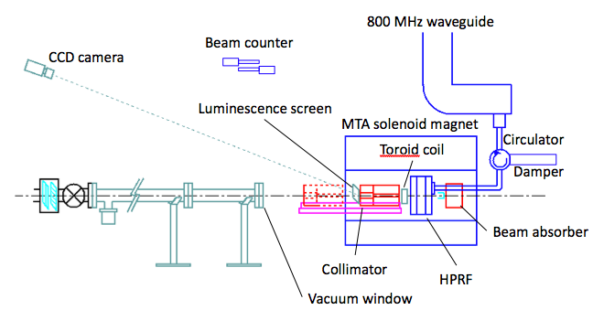
MTA beam line and experimental apparatus
Beam intensity in the cavity is tuned by collimator and triplet
No energized device within 15 feet from HP cavity due to
hydrogen safety issue
Beam must be stopped in the magnet due to radiation safety
Elastic scattered proton from
vacuum window (~20 events/pulse)
400 MeV
H⁻ beam
Triplet (7.3 meter upstream
from collimator
New apparatus:
New HPRF cavity
Collimator + Beam absorber
Luminescence screen + CCD
Beam counter
RF circulator + damper
(Ti)
Bound electrons of H⁻ will be
fully stripped in the vacuum window
Ex) Thickness = 4.5 g/cm³ × 0.005 = 0.023 g/cm²
Stripping cross section ~ 10⁻¹⁸ cm²
0.023/47.9 × 6.0 10²³ = 3 10²⁰
3 10²⁰ 10⁻¹⁸ = 300 strip collisions
4

Slide 5
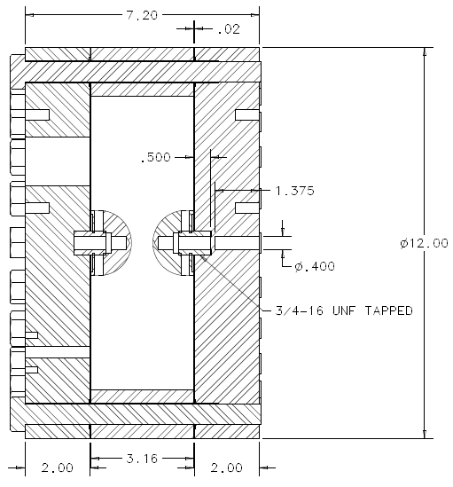
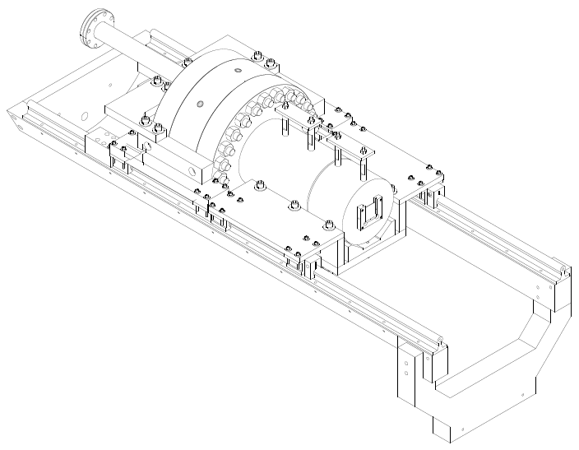
New HPRF cavity and collimator
Current cavity is operated in low pressure region (≤ 1000 psi) due to pressure safety
Commissioning cavity at 2nd RF station for beam test
Investigate plasma-electron dynamics in breakdown
Plan to increase MAWP to 1600 psi for beam test
Met new safety code
Need to upgrade gas manifold system
Loaded Q = 7,200
RF coax line
HPRF cell
Collimator
RF
inlet
Luminescence
screen
beam
Gas
inlet
beam
Support rail

Slide 6
Simulated residual dose level in experimental apparatus
RF cavity
collimator
Beam absorber
Surface residual dose rate at collimator
(red & blue) and Cu electrode
Inject full intensity linac beam for 1 beam pulse/min
12 hours operation
Less than 10² mrem/hr at 1 ft after 1 wk cooling
→ Class II radioactive material
→ Allow to remove apparatus without big issue

Slide 7
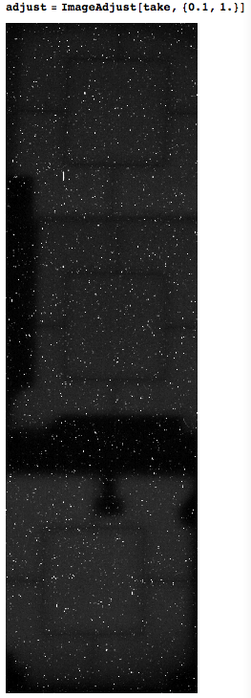
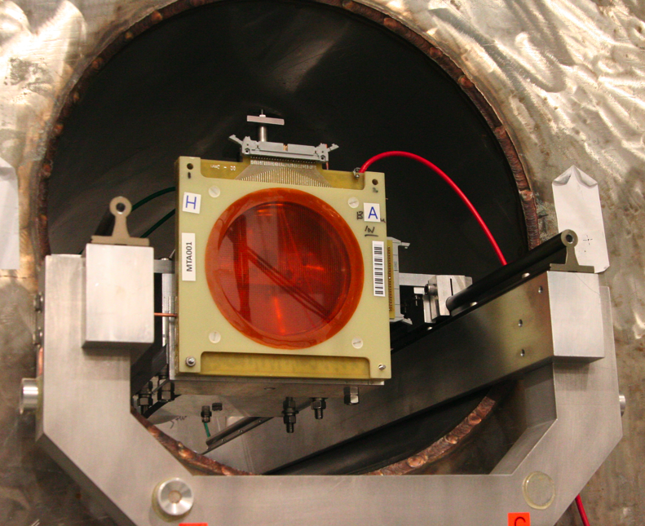
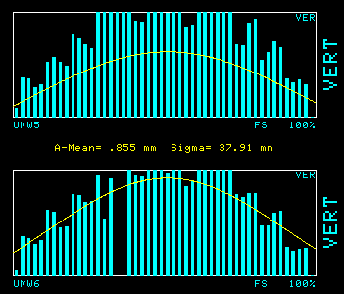
Beam profile monitor
Snap shot of screen
SWIC (cannot use for Hydrogen run)
Both beam profile
measurements show
very wide beam profile
Horizontal
Vertical

Slide 8
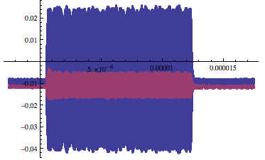
Collimator toroid signal
Upstream Toroid
Downstream Toroid
pu volt (V)
Downstream Toroid
Reference Current (A)
From reference curve, Downstream toroid pu voltage (V) = 3.5049 × Reference I + 0.0046
Measured toroid pu voltage = 0.007 ~ 0.009 V
Then observed current = 0.0007 ~ 0.0013 A
Beam intensity = (Observed I) 1.2 10⁻⁵ (s) /e = 5 ~ 9 10¹⁰ protons
We need better calibration since observed toroid pu voltage is lower
than the reference toroid voltage
Use well-calibrated toroid pickup (but slow response) and calibrate
fast response hand-made toroids

Slide 9
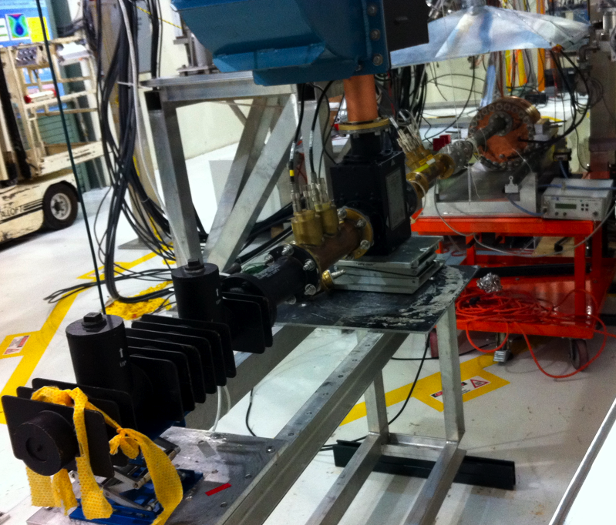
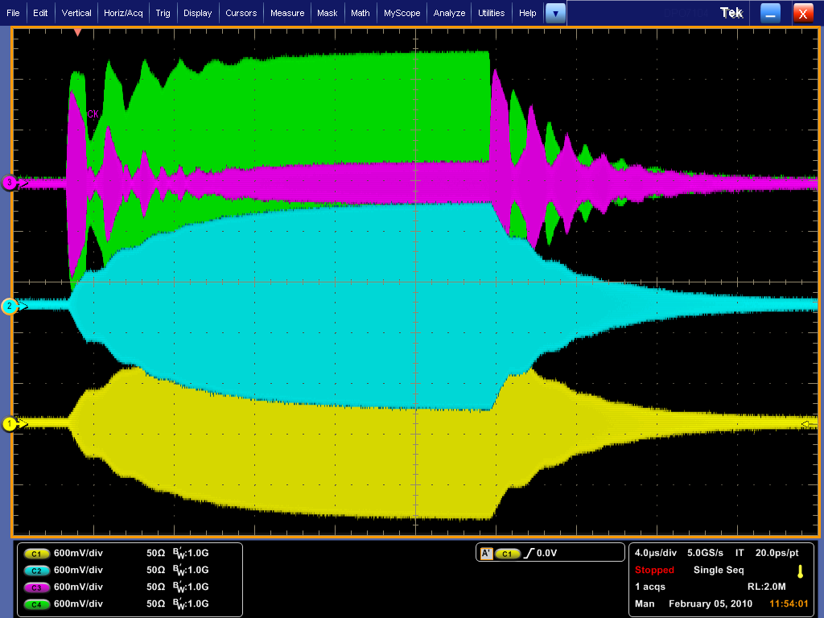
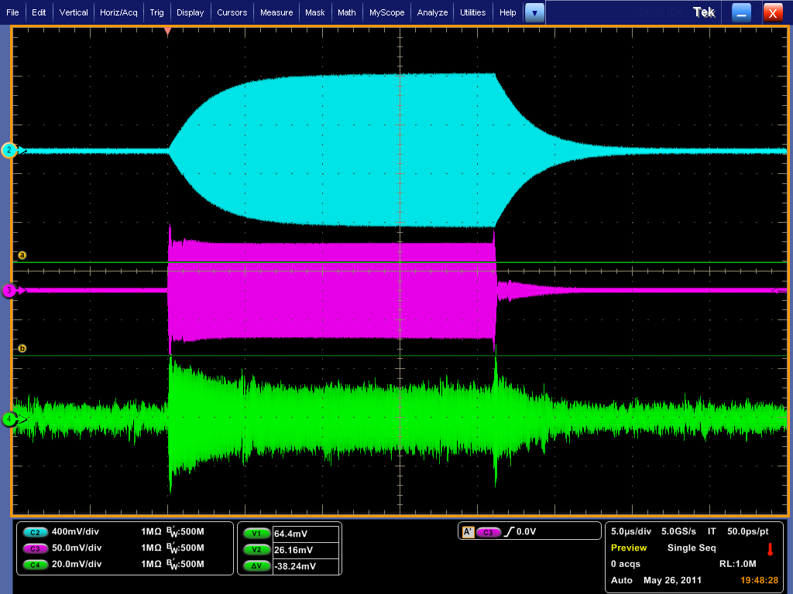
Circulator + load
No load
Forward
Reflect
Cavity
Circulator
RF Pickup#2
RF Pickup#1
Load
With load
RF Pickup#2
Forward
Circulator+load cleaned up
RF signals
Reflect

Slide 10
Current issue
Major upgrade of MTA beam line
Expect delay ~ 2 wks
Hydrogen safety approval
Need to pass all requirements related with hydrogen safety
Cable configuration/assignment/termination
15-foot-rule, LOTO
High pressure test
Current MAWP 1,000 psi -> 1,600 psi for beam test
Fix/upgrade device
Beam counter
One channel is broken
Toroid beam intensity monitor
Better calibration
Fix RF pickup probe
Electric pickup probe has leak
Optical system
Voltage distribution box
Replace to SiPM

Slide 11
Summary
Physics rich program
We have a strong physics analysis team
Almost all devices work properly
Concerning about major upgrade of MTA beamline
We missed a connection between users and beam line designers
I think that we have a rigid plan now
Hydrogen safety also needs to be done asap
Keep contacting with Jim Kilmer to call for hydrogen safety inspection
We almost make it!

Slide 12
Collaborator
Jana Mukti, Giulia Collura, Alan Bross, Ben Freemire,
Giovanni Pauletta, Yagmur Torun, Pierrick Hanlet, Leo Jenner,
Ajit Kurup, Dan Kaplan, Dave Neuffer, Gennady Romanov,
Moses Chung, Andreas Jansson, Alvin Tollestrup, Steve Geer,
Al Moretti, Rolland Johnson, Mike Neubauer, Gene Flanagan,
Masahiro Notani, Grigory Kazakevitch, Katsuya Yonehara

