Slide 1
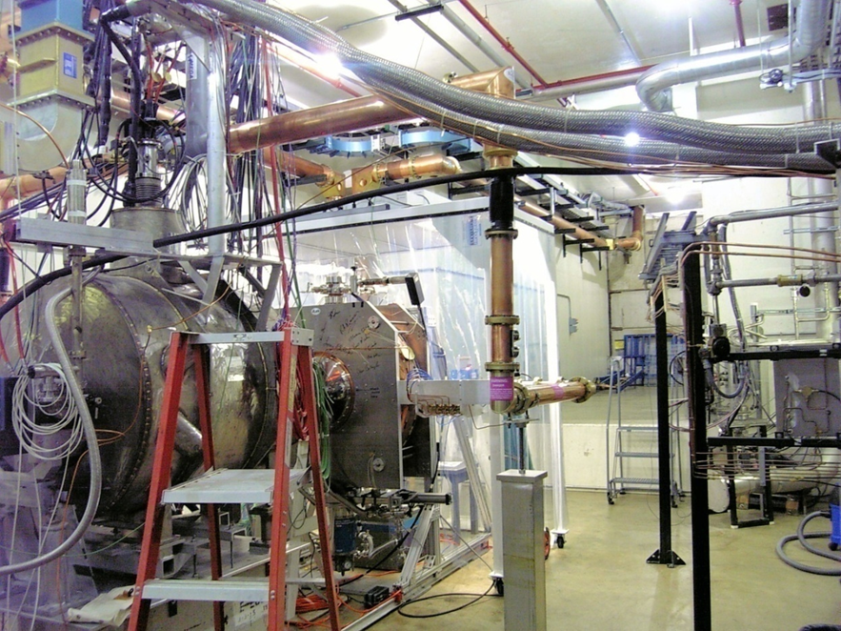
MuCool Resource Needs Mechanical

Slide 2
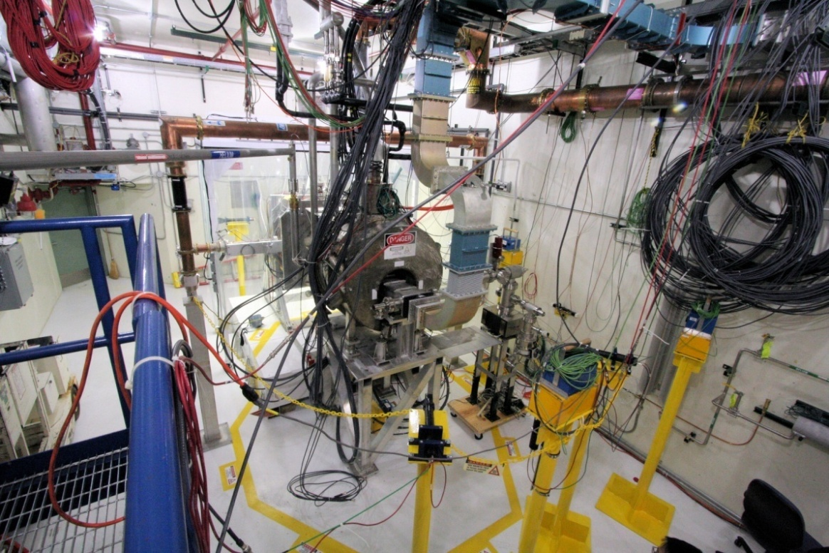
MuCool Test Area Overview
MuCool Test Area
RF Power
201 MHz (5MW)
805 MHz (12 MW)
Class 100 clean room
Instrumentation
Ion counters, scintillation counters, optical signal, spectrophotometer
4T SC Solenoid
250W LHe cryo-plant
400 MeV p beam line

Slide 3
Resource Needs Programmatic
Programmatic/on-going needs
Pillbox cavity inspection and window change Repetitive
3-4 times in 2 months
HPRF cavity installation in magnet in hall July 5
Installation/removal of cavities under test at
2nd RF station and/or inside magnet
(rectangular box(es), ALD-pillbox,
4-season, Be-wall Repetitive
201-MHz cavity coupler replacement and
pump down August 11

Slide 4
Upcoming Activities
HPRF with beam
Continued testing of existing cavities
“All-seasons” (vacuum & HP)
Pillbox
Button tests
Test of an E parallel to B box cavity
Test of 201 MHz cavity in realistic B
Resource Intensive

Slide 5
Resource Needs Requested
Design support system for installation of 805 MHz re-circulator and switch (linac gallery and MTA hall) and install. System delivery is scheduled for June 2011.
Our MP estimate:
1 man-month engineering
2 man-week designer
6 man-week technician for installation
No work started yet

Slide 6
Resource Needs Requested
Design/Fabrication/assembly of new "parallel" box cavity
1 man-month engineer
1 man-month designer/draftsman
2 man-week fabrication support
Develop plan and tooling and support design for installation of 2.5m bore solenoid in the MTA hall.
1 man-month engineering
2 man-week designer
Support for assembly of single-cell 201 MHz MICE cavity vacuum vessel
1 man-month Tech
Installation of the 2.5m bore superconducting solenoid in the MTA hall
1 man-week engineering
10 man-week technician
No work started yet

Slide 7
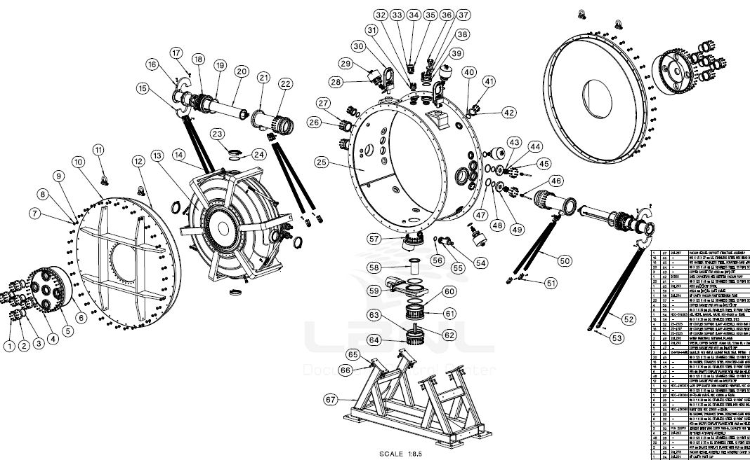
Coupling Coil & SCVV

Slide 8
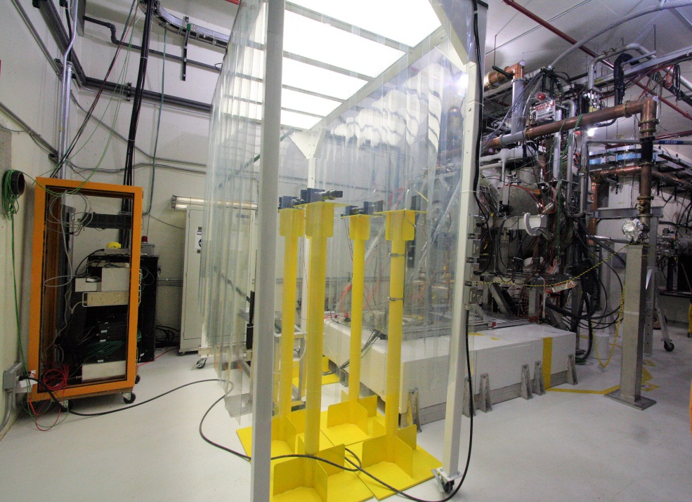

Slide 9
Conclusions
Programmatic/on-going needs are in good shape w/r to engineering & technical support
Supplemented to a great deal by experimenters
Resources for upcoming requirements have not been found
First step is to get engineering support to make detailed estimated of required resources
Our estimates are likely to be “lite”
Some things are just slipping day-for-day
New box cavity
Work to prepare for installation of coupling coil and SCVV becoming time critical due to complexity & schedule
SCVV out for bids
Expect Coupling Coil in 2012

