Slide 1
PIP-II Booster Upgrade – Longitudinal Damper Preliminary Design Review
Task 121.04.04.04.01
David Johnson PIP-II L3 Manager for Booster Upgrades
Proton Source Department
31 - March - 2021

Slide 2
Welcome
I would like to Welcome everyone to the Preliminary Design Review for the Booster Longitudinal Damper.
A special thanks to the Review committee
John Byrd
Brian Chase
Jim Steimel - Chair

Slide 3
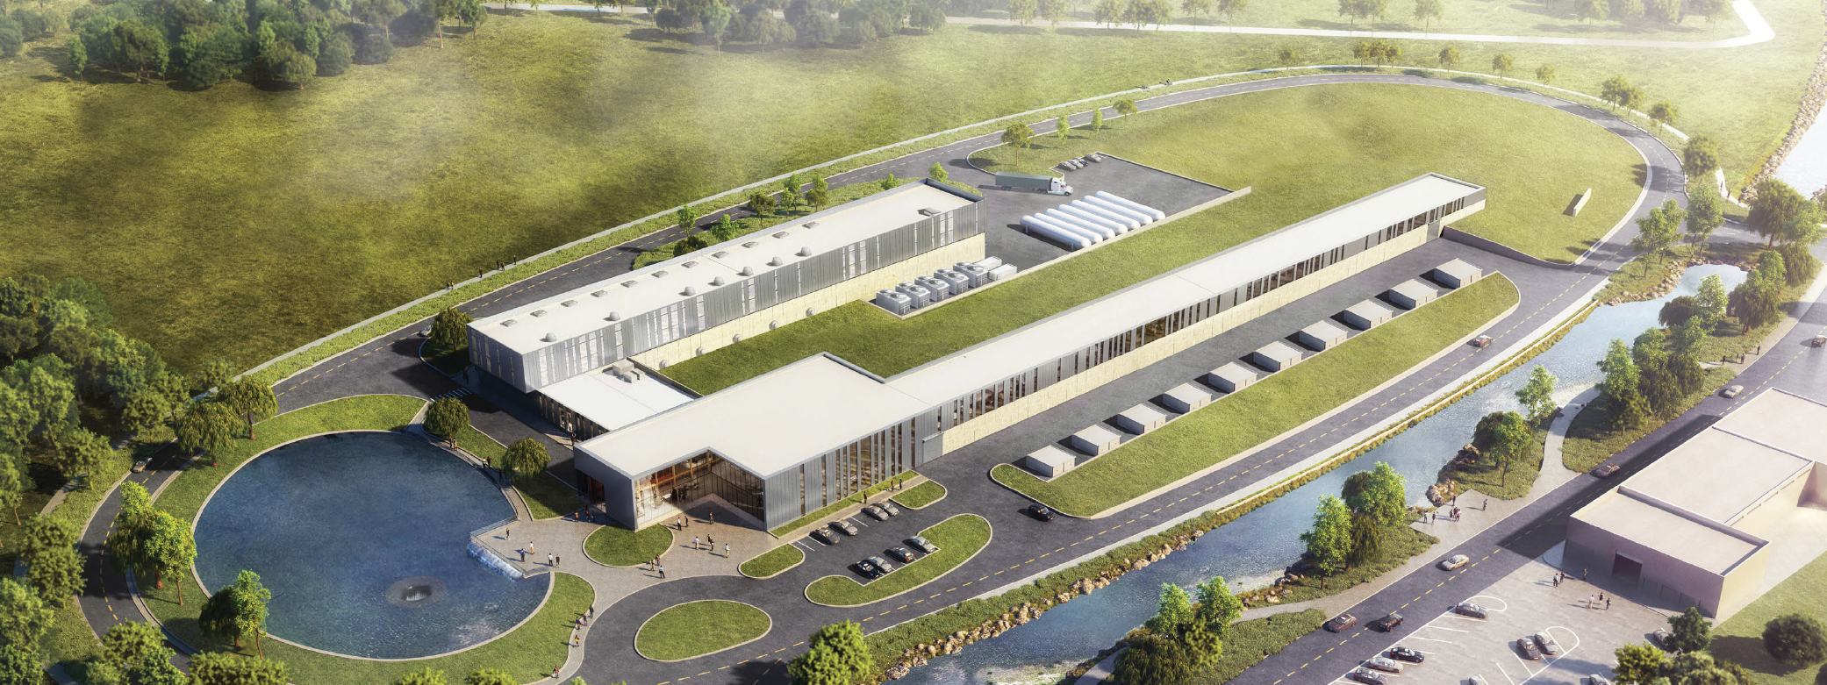
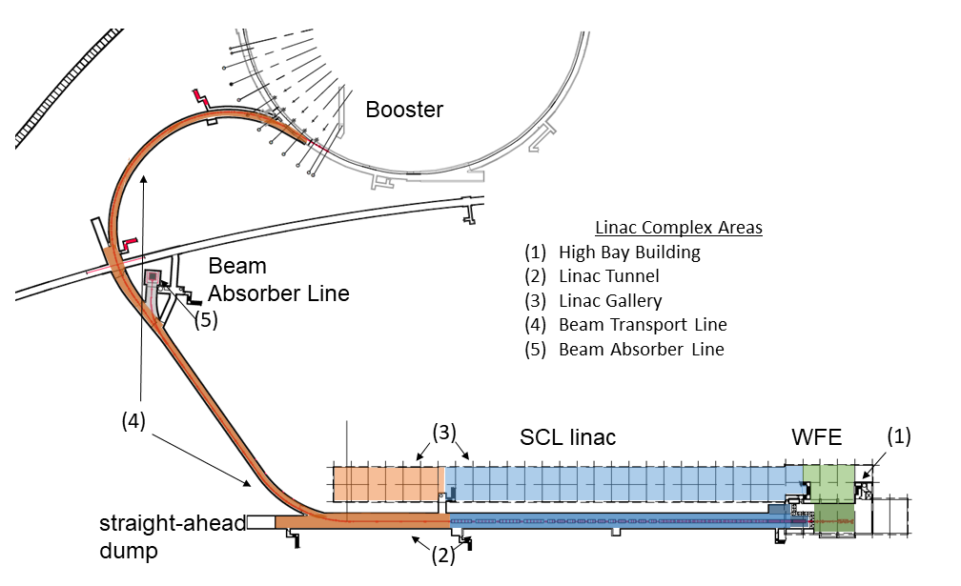
PIP-II Scope Driven by GRD Requirements
An 800-MeV superconducting H⁻, CW-compatible Linac
Beam transport of 800-MeV H⁻ from the SRF Linac to the Booster, beam dump capable of ~1% duty factor, and switch yard to the Muon Campus.
A new injection area in the Booster
Modifications to the Booster, Main Injector, and Recycler Ring to enable 1.2 MW power on LBNF target for 60-120 GeV.
Associated conventional facilities. The linac enclosure is compatible with upgrades.

Slide 4
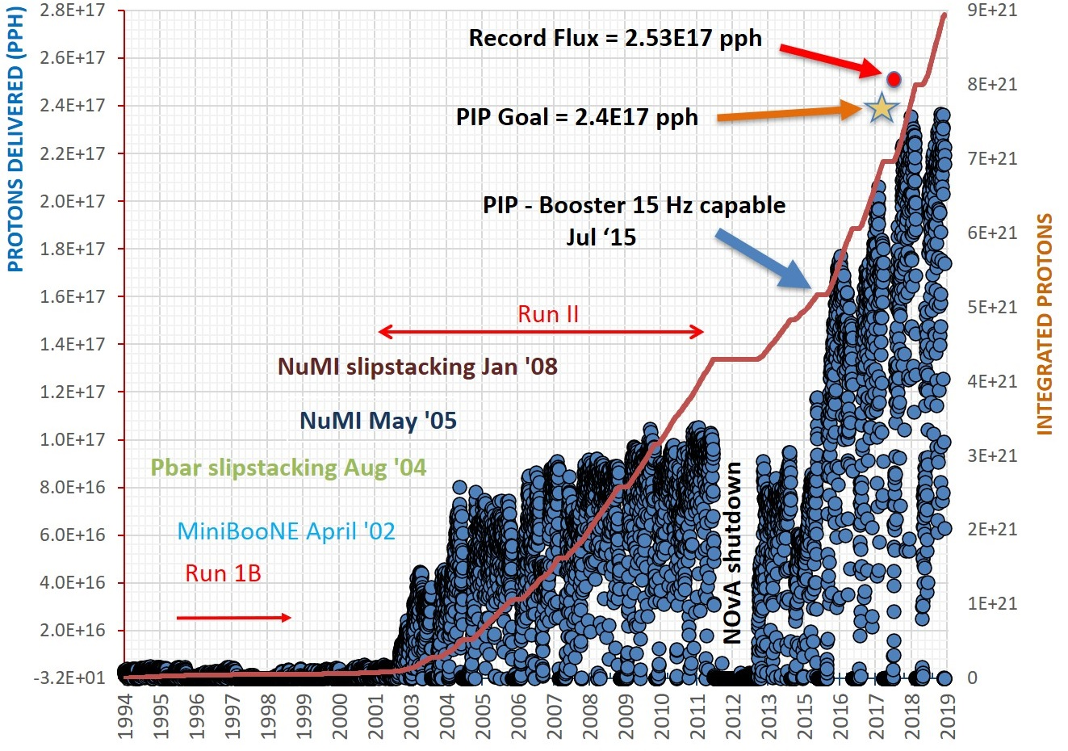
Evolution of Booster Intensity (end 2019)
PIP campaign is 2.4•10¹⁷ protons/hr (maintaining 2012 activation levels)
Intermediate “virtual” PIP-I+ (AIP) with a goal 2.8•10¹⁷pph proposed in ~2017
PIP-II with the new SC linac (~2027) requires up to 4.8•10¹⁷ pph in Booster.
AIP Tasks moved into
PIP-II summer 2019
4.8E17 pph
20 Hz ~ 6.7E12 ppp
Following the PIP Campaign -
PIP-1+ Task Force
Joint PIP-II /AD Booster
Physics Study Task Force
Recommendations
Booster Dampers
longitudinal
transverse
Booster Collimator
Current Monitor
Ext. D magnet
Wide Bore RF cavity
15 Hz ~ 5.7E12 ppp
15 Hz ~ 4.4E12 ppp
15 Hz ~ 3.2E12 ppp
7.5Hz ~3.7E12 ppp
7.5Hz ~3.0E11 ppp

Slide 5
PIP-II Accelerator Upgrades – Booster Organization
WBS 121.05
ACCELERATOR COMPLEX UPGRADES
I. Kourbanis
System Manager
WBS 121.05.04.01
Project Management
WBS 121.05.01 Project Management
I. Kourbanis
WBS 121.05.04.02
800 MeV Injection
WBS 121.05.02
Transfer Line/Beam absorber
M. Xiao
** Requirements/Specifications
Determined by AD/PS
WBS 121.05.04.03
20 Hz Upgrade*
Transverse Dampers**
N. Eddy
Start 2022
WBS 121.05.03
Beam Transfer Line Installation
D. Morris
Longitudinal Dampers**
N. Eddy
B. Pellico
AD/PS**
AD/Inst
AD/Controls
AD/Mech Sup
WBS 121.05.04.04
Dampers*
WBS 121.05.04
Booster
D. Johnson
interface
WBS 121.05.04.05
Collimators*
Current Monitor**
Michelle Ibrahim
WBS 121.05.05
MI/RR
J. Dey
In Process
* Tasks are carried out totally within AD.

Slide 6
Review Process
All Documentation and talks are uploaded to the indico Review website
Jim and I will act a host /co-host – Jim will be host during committee deliberations and closeout.
During presentations
Speakers will give their presentations from slides on their personal computer
We would like to ask all participants to mute their mics.
No need for video during presentations except for speaker sharing their desktop
Discussion time is built into each presentation and a dedicated period before and after lunch for more detailed questions
Currently, we have a lunch hour scheduled from 12:00 to 1:00 CST . We can modify time and length if necessary
Returning from lunch we will continue discussion and questions from Committee
The committee will decide when they go into Deliberations (they decide if it is a private or public meeting)
If private, everyone leaves and waits to be re-invited to join for the close out. We will try to keep it on time.

Slide 7
Charge
The reviewers are asked to perform a Preliminary Design Review of Booster Longitudinal Dampers for PIP II.
A “preliminary design” has matured from a conceptual design and should by about the 60% point in the design process
Specifically, the Committee is asked to answer the following charge questions:
1. Are the requirements documented, clear, complete and appropriate?
2. Is the proposed design for the Booster Longitudinal Dampers likely to meet requirements? Explain any deficiencies or concerns.
3. Are there any features present (or absent) that threaten the intended function and performance of this design?
4. Have safety and environmental aspects been appropriately considered?
5. Have quality aspects been appropriately considered?
6. Does the proposed schedule seem reasonable?
The intended outcome of the review:
Collect and document findings, comments and recommendations necessary to proceed to the Final Design stage.

Slide 8
Project Schedule

