Slide 1
Longitudinal Dampers
3/10/2021

Slide 2
History
Coupled bunch modes have been seen since the 70s.
Old logs entries from Chuck A. and Steve H. –
Mode one was an issue even at low intensity
When the Tevatron – collider started – the issue became a bottleneck
Loading the proton bunches – we typically ran about 5.1E12 to 5.5E12 per batch
Late 80’s – early 90s – Modeling of the linear couple-bunch (including ESME)
D Wildman, K Harkay, P Colestock, D McGinnis (others)
Could get some agreement at higher energy but had inconsistencies
Passive dampers were installed which reduced modes – still at lower intensity
Tunable modes were measured at 127 to 169 MHz and 202-221 MHz
This is referred to as ‘centered mode 16 band’ (focus on higher frequency – reached at high field)
Non tunable modes around 79 – 83 MHz (but really a bit larger).
Due to physical length of cavity drift tube
In Mid 90’s D. McGinnis applied active mode 1 damping via Booster HL RF
Dave and I then tried to do the same with 80 MHz band –
Unable to get adequate power and phase control – a dedicated 80 MHz built 2001

Slide 3
Passive Dampers
80MHz
Band
64 MHz
Band
Mode 1
Hidden
Under 2E12 Booster Batch

Slide 4
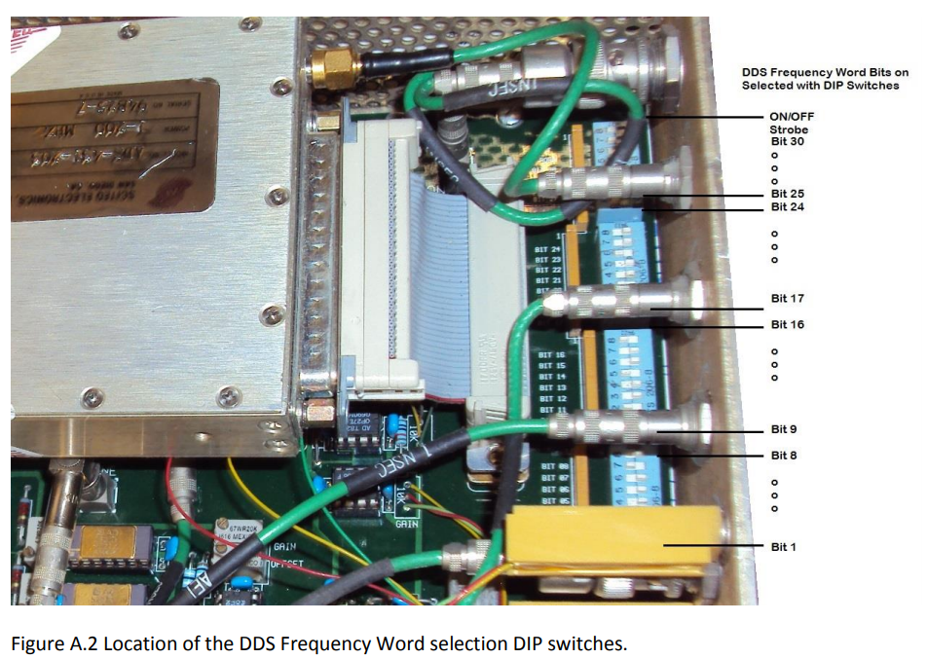
Analog Active System
Obsolete

Slide 5
Focus these days….
Under PIP (a project done under budget and on time)
Conversion to digital system (based upon a fast digitalization board)
Using the same amplifier as being used by Recycler (spares & tech support)
Using the 80 MHz (10 MHz BW) cavity installed in 2002
Continue to use RF High Level for Mode 1
(Mode two was an issue – but uncertain about delivery system at that point)
Digital up and running in 2016 – 2017
Initially had both analog and digital for mode one
Mode two persisted –
Digital system has growing pains – working on version 3ish-
Working for most modes now – but updating underway to improve
Completely off all analog systems – except mode 2 analog

Slide 6
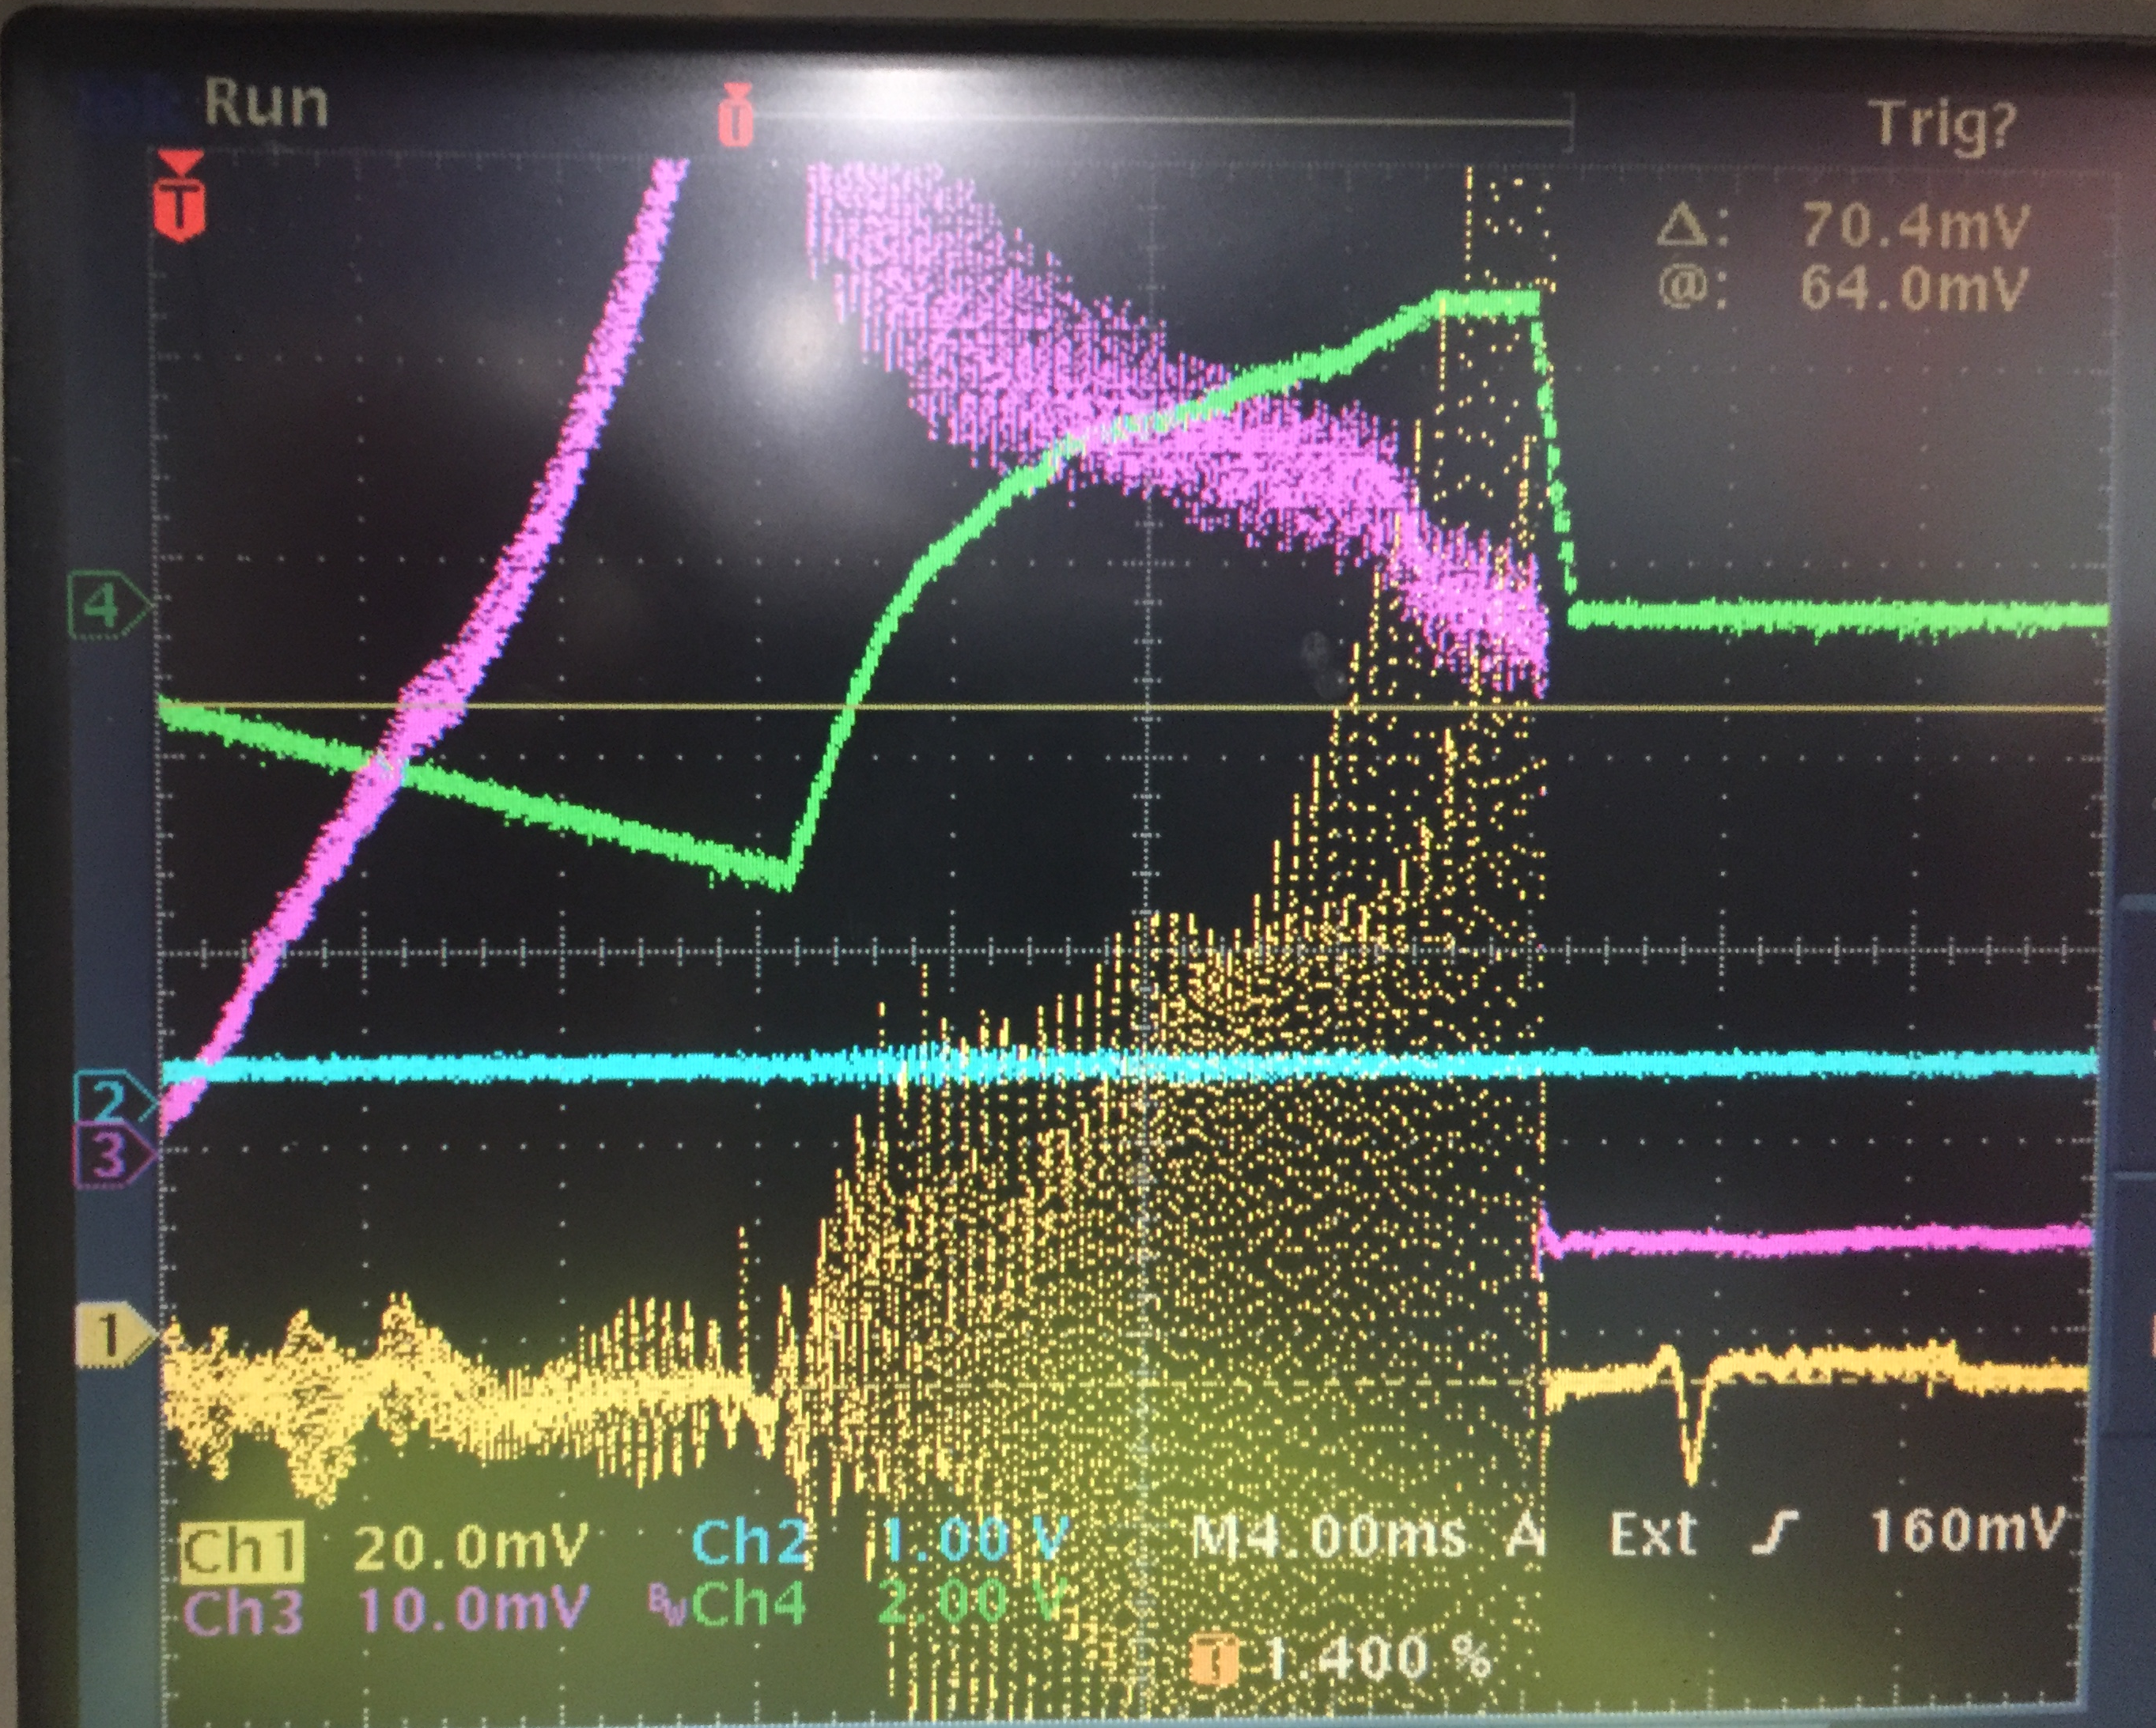
Mode 2 growth rates
No quad damping or fuzzing
Quadrupole Osc post transition
Bunch Length Growth
Reduction of Couple Bunch
Still large mode 2
Quad Amp Osc – Seen by Mode 2 damper
Reacts to this and puts some ‘correction’ out to RF
Analog could be improved but will digital system will need to fix
Growth rate is about 1.8 ms – ~ twice that of mode 1

Slide 7
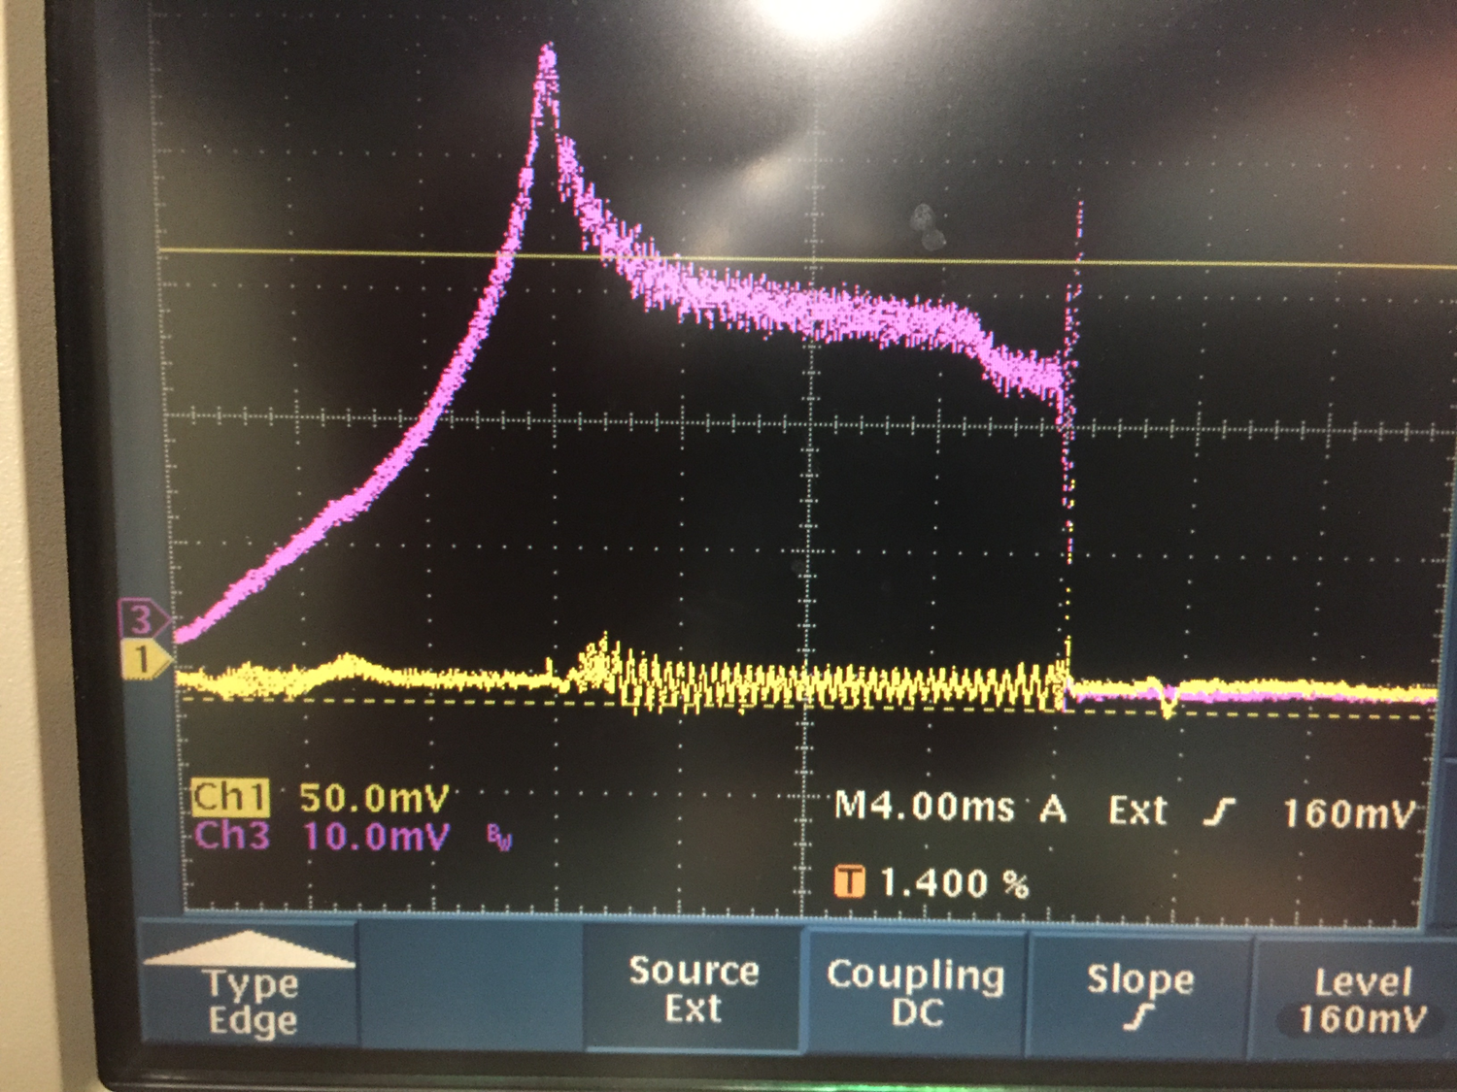
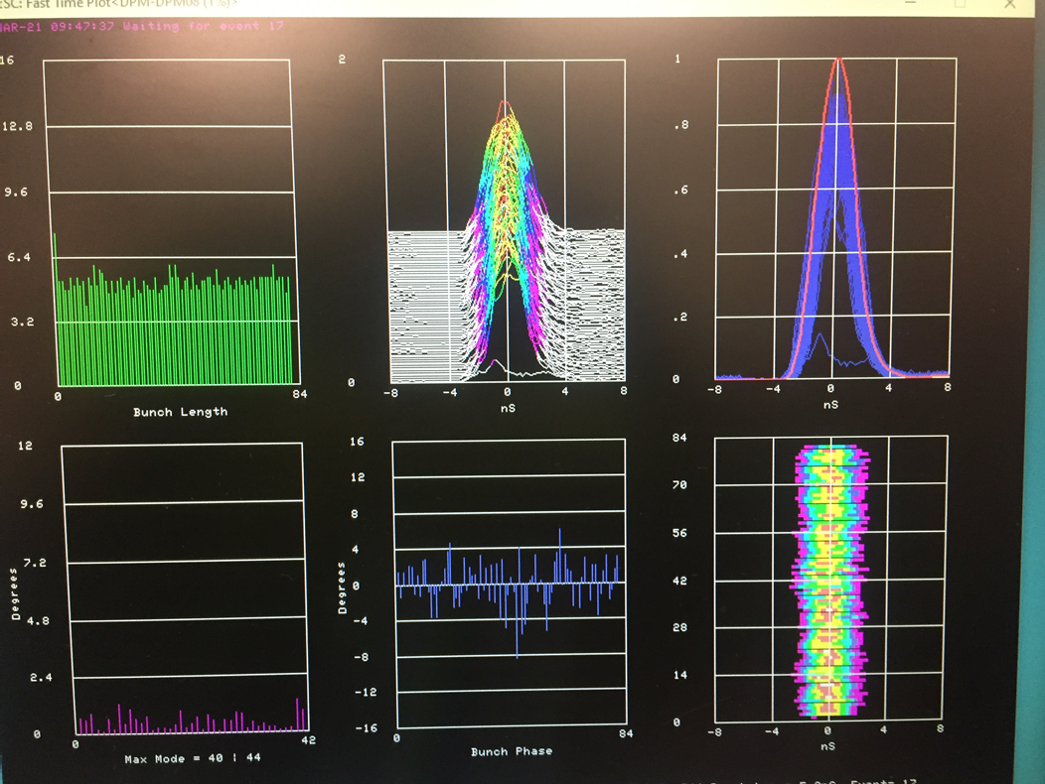
Ideally – 4.3E12 case shown
Quad damper and transition are tuned – no quad oscillation
Mode 2 damper is tuned and has sufficient S/N and gain to properly damp
No modes detected at 4.3E12
Bunch Length is good (under 7 ns)
Beam has no longitudinal shoulders
Mode 2 sideband – amplitude corresponds to phase error

Slide 8
Mode 2 no damper – no fuzzing
Beam at high intensity shakes itself to pieces:
Sometimes causing Booster high field loss
But mostly feeding it the accelerators downstream unharmed.
This phase shaking also causes issues for phase lock – not correctly getting the phase, the lock will drive to incorrect phases at extraction.

Slide 9
Fuzzing at transition – reduces modes….but
So how did we manage before mode 2 damper
We ‘carefully’ fuzzed at transition – then anti- damped with quad damper
If done properly – you preserve phase but do get non gaussian bunches
Quad damping can cause issues with RF – being sensitive to large amplitude drive required.
Some headroom is required on stations to do this around transition.
Same circuit is used for bunch rotation – but stations have a lot more voltage overhead at the end of the cycle (still need to watch RF response).

Slide 10
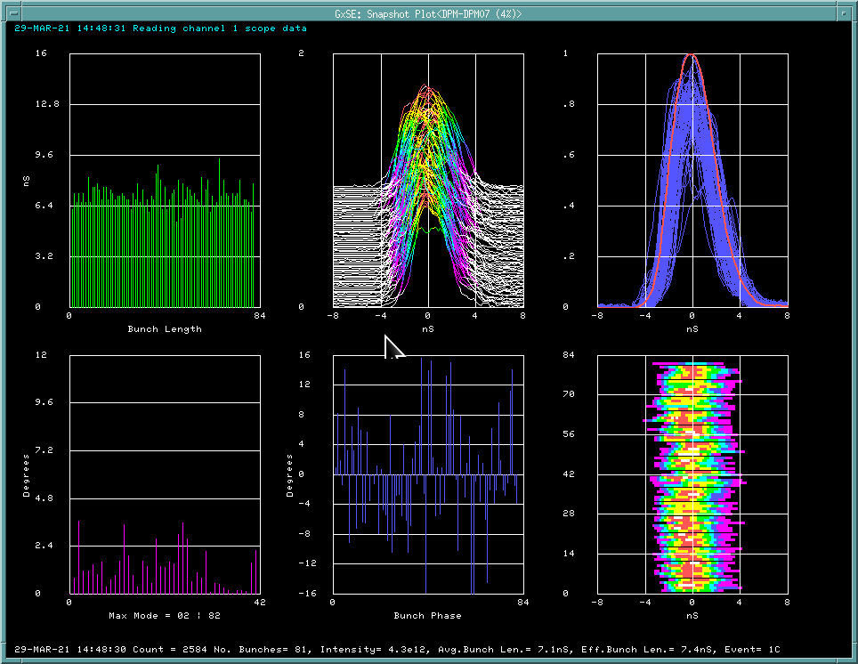
Compromising
Some ‘fuzzing’ and some phase error:
This was typically the result of carful balancing of fuzzing and longitudinal bunch shape.
At nominal intensity for HEP – we meet phase error requirement
This has been tested up to 4.7E12 with no fuzzing of beam.
Damper drive to cavity is within acceptable levels.

Slide 11
Things to consider- using RF for mode 2 damping: Driving equal power to stations – RF system has about 12 dB more at mode 1 than mode 2.

Slide 12
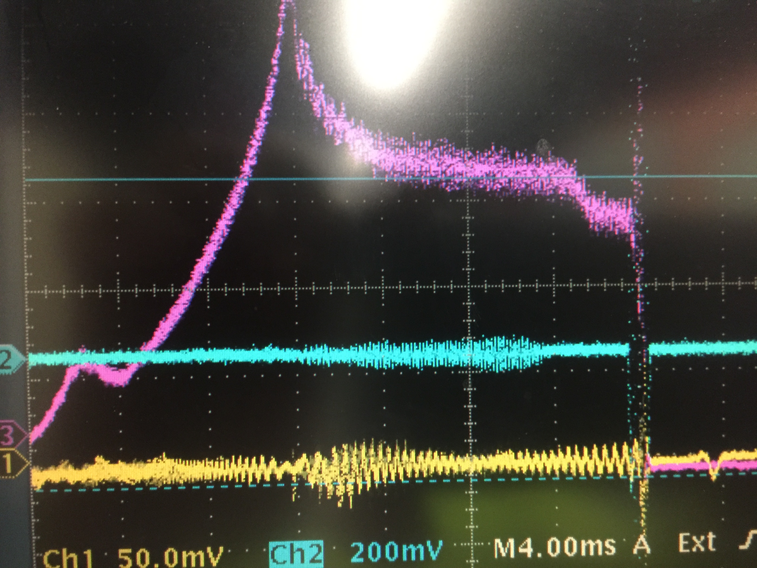
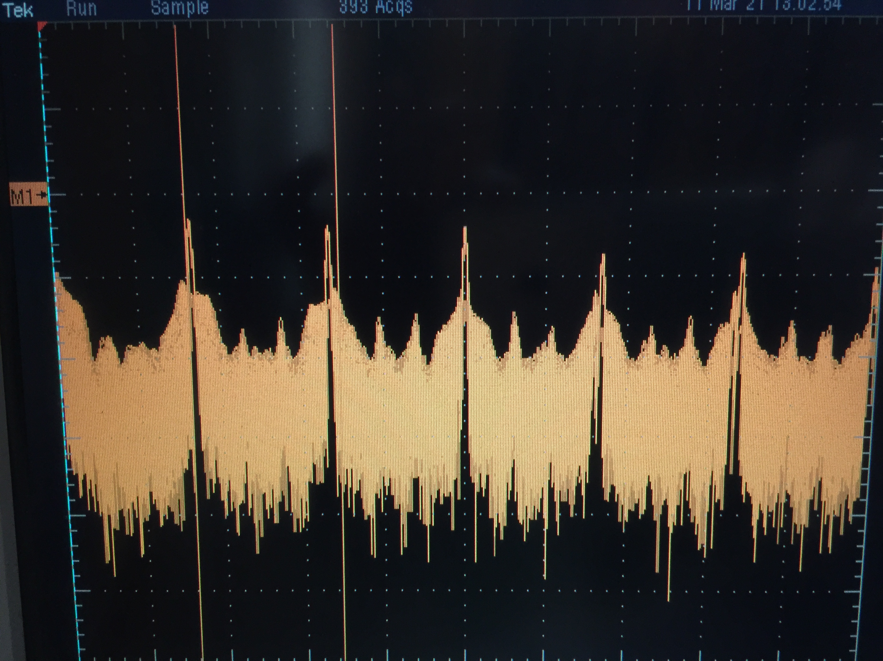
Today – running at ~4.5E12
We still see some line around 80 MHz
Mode two power is comparable to mode 1
No fuzzing is required

Slide 13
Modes – Now and PIP-II
We presently damp mode 46 to 52
These were once analog dampers but now are all digital
(Nathen Eddy will describe the digital dampers and these modes)
We also damp mode 1 and mode 2
Mode one has also been moved over to the digital
Mode 2 will also be moved to digital system shorty
Future mode(s) are likely to pop up around the 80 MHz –
Higher brightness beam
Improved transition crossing
Cavity testing is being planned – stretched wire – to remeasure modes

Slide 14
Recent Rate Measurements
Growth Rate –
Depends upon brightness
Each pulse is slightly different
Average number of pulse at various beam intensities – with nominal transition oscillations/dilution
Results in about 1.8 ms time constant.
This is used to calculate required damping voltage
Which I can’t seem to match reality…
Mode 16 had about 1.1 ms time constant
Mode 1 is about .7 to .8 ms time constant.
Impedances (one or two stations measured)
80 MHz line – about 10 kohm
Mode 16 line – about 15 kohm

Slide 15
Mode 2 goal -
Deliver mode two power to all stations (1.2 MHz above F drive) but keep drive 10 – 12 dB below F drive. Stations seem to handle this without issue: Tested recently increasing drive and looking at cavity response. This level seems to provide enough headroom to keep stations operating.
Present analog damping is being done this way – phasing is still not optimized
Power being delivered is near what I would say is limit –
Question – after properly phasing can we damp higher intensity (brighter bunches)?
Deliver to one station tested (RF 7) but could not get the same damping – had to increase the power.
This could have been due to the phase not being optimized. More time is needed. This would allow for better phase control. This would require at least two stations being phased properly in the digital system – redundancy.

Slide 16
Summary
We have a long history of damping coupled bunch modes in the Booster. We have measured growth rates and power required to damp at present intensities. It is clear, higher intensity will require improved damping. The present digital system will need to improve so that the gain and response of the system can work at the higher PIPII intensities.
Mode 1 and 2 will be challenging – but we have options:
First need to complete fanout cavity damper testing then -
Do we use all the stations as we do now or select two cavities
Do we need another dedicated cavity,
Do we detune a fundamental cavity
As we bring up the new digital system – we will be able to more readily test.

Slide 17
Summary
Mode 16 (Around 61 MHz after transition)
We will continue to push intensity
If mode becomes apparent and posses a driving term
We will install the 61 MHz cavity
Location for cavity has been set aside
Higher order modes (80 MHz band)
Tuning of new digital system underway
New design reduces delay,
Design allows for quick transfer measurements
NE talk -

