Slide 1
PIP2 ACLK Preliminary Design Review
ACLK Generator
Mark Austin
AD/Controls
7 December 2021

Slide 2
ACLK Generator Physical Requirements
Serves as the source of both ACLK and TCLK timing signals (required to be synchronized). Receives Input from TLG-II, the AD Network, machine-based beam synchronous clock systems, machine specific beam permit systems, line related Master Clock Oscillator, Booster timing sources and a GPS receiver.
19” rack mountable
120VAC 60 Hz power
Support firmware updating
Gigabit Ethernet
Minimum of 26 Rear Panel LEMO style 50 Ohm TTL inputs
Minimum of 2 Rear Panel LEMO style 50 Ohm TTL outputs (TCLK)
Minimum of 2 Rear Panel LC style Single Mode Fiber outputs (ACLK)
Minimum of 28 Front Panel LEMO style 50 Ohm TTL monitor outputs with LED active signal indicators (Input monitors, TCLK & ACLK)
ref: ACLK TRS (ED0013499)

Slide 3
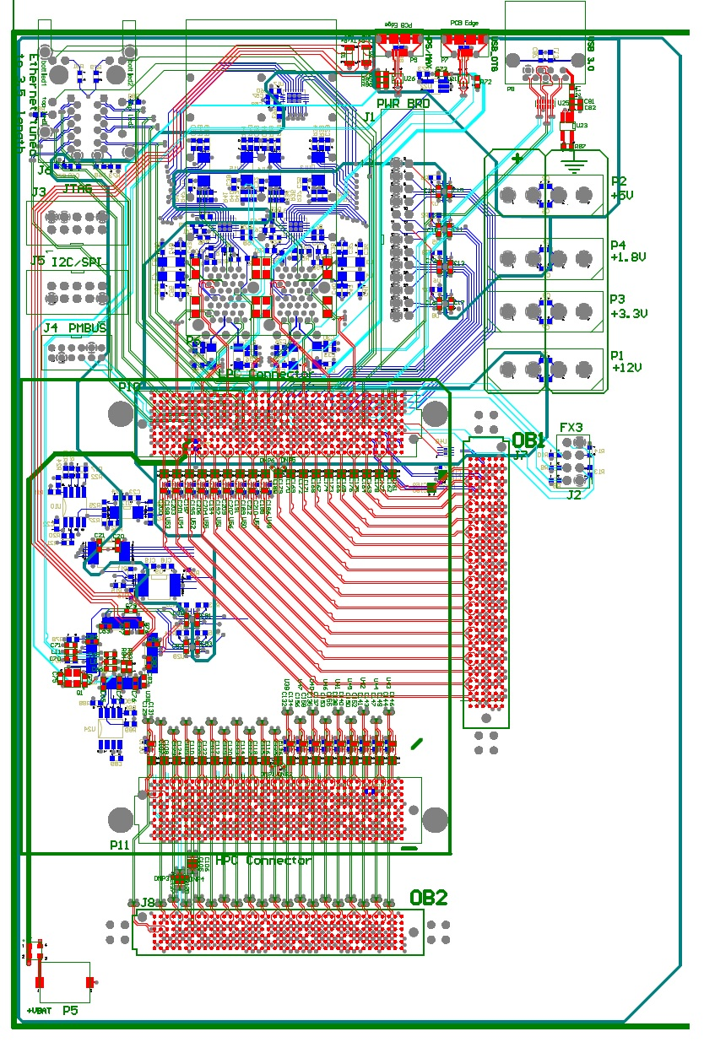
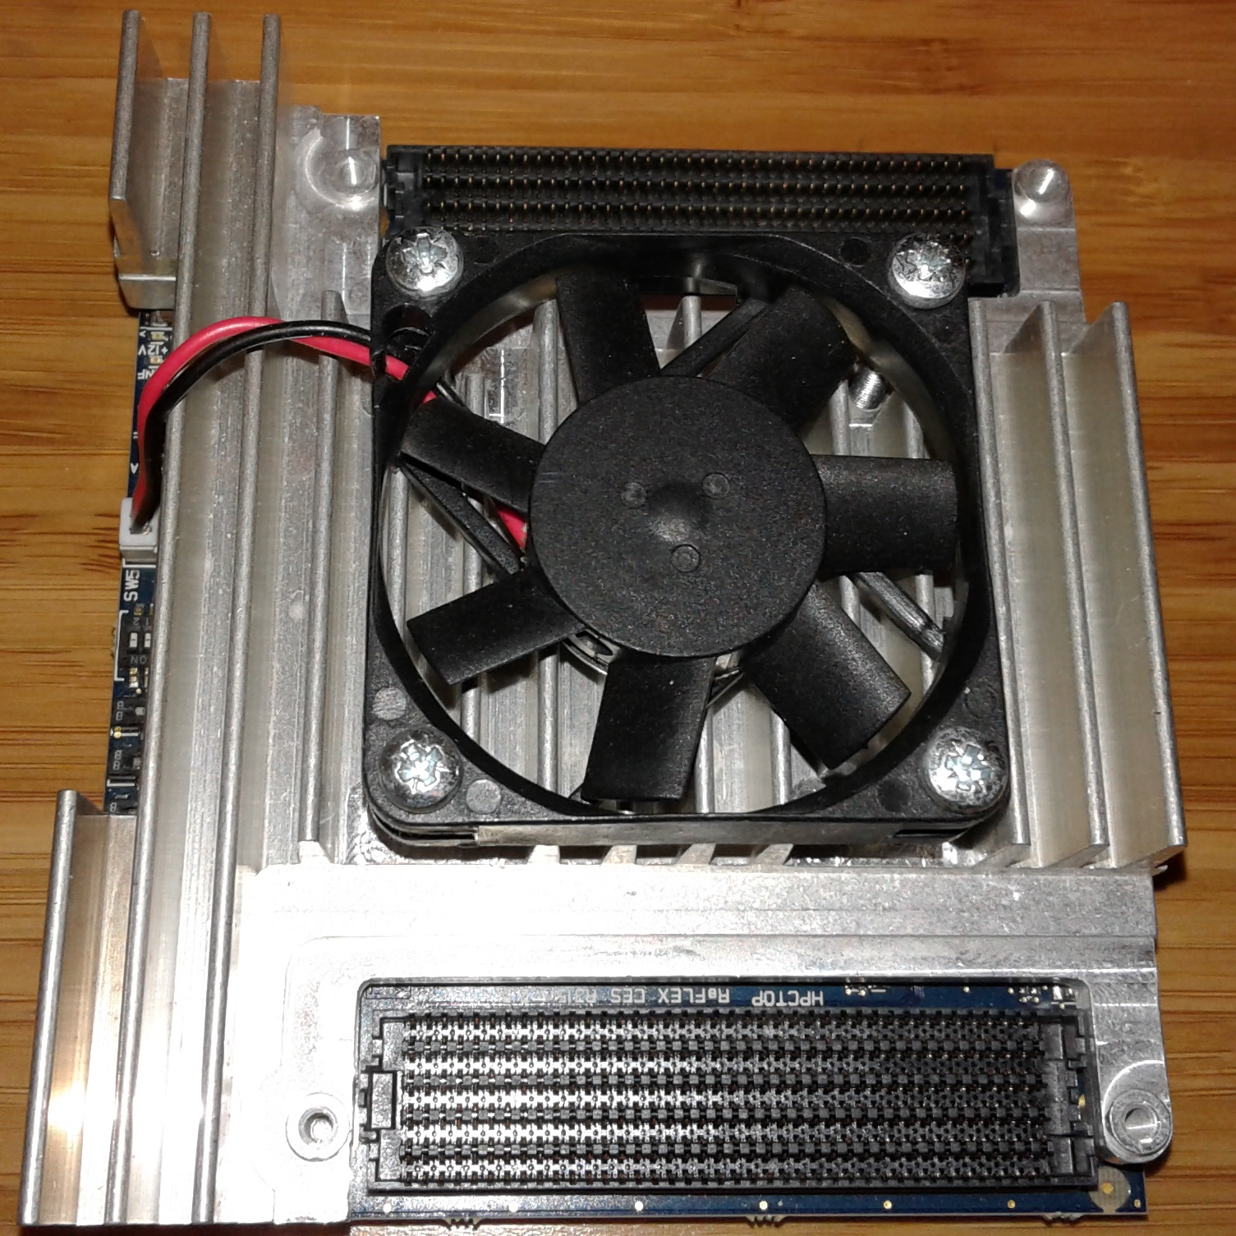
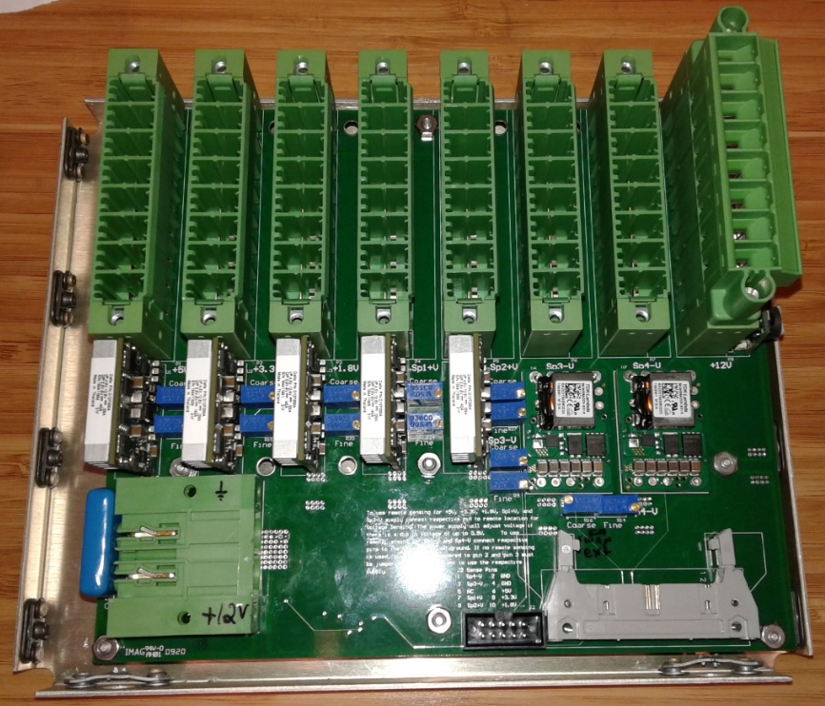
ACLK Preliminary Hardware Design

Slide 4
ACLK Generator
Hardware Under Design
Clocking System
OffBoard 1 (not started)
OffBoard 2 (not started)
Cost
$5K
$2K
$2K
Proposed Usage
ACLK Generator
ACLK Generator Rear Board
ACLK Generator Front Board

Slide 5
Clocking System
The Clocking System consists of a 4U chassis (half or full depth) with a 12V 650W internal power supply. This supply feeds the Power Supply Board (PwrBoard) which in turn feeds the BaseBoard. The BaseBoard is then used to interface with riser cards, front panel cards, or back panel cards, etc. that can be quickly produced since they will contain significantly less components. The chassis also contains cooling fans for the system.

Slide 6
Clocking System: PwrBoard
The PwrBoard contains a connector with up to 4 different screw terminal connections for each of the following supplies: 12V, 5V, 3.3V, 1.8V, 2 manually adjustable positive supplies settable from 0.6V to 5V, as well as 2 manually adjustable negative supplies settable from -3.3V to -30V. The positive supplies are capable of up to 200W each and the negative supplies are capable of up to 75W each given that the total of all supplies cannot exceed the total 650W main supply.
Each supply can be monitored for appropriate voltage and each supply can be independently enabled or disabled (except the 12V supply; if it is off, the FPGA is powered down). The positive power supplies also have remote sensing pins that can be wired to other locations. This allows the power supply to automatically adjust the voltage if there is a small voltage drop at the remote location.

Slide 7
Clocking System: PwrBoard cont…
Completed board design and tested.
Takes a couple hours per build.

Slide 8
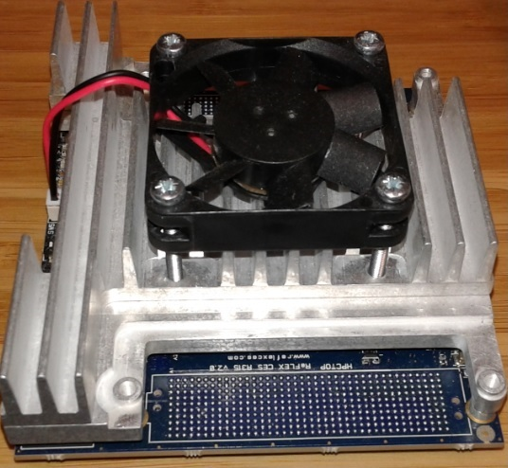
Clocking System: BaseBoard
The 12V supply feeds the BaseBoard located within the chassis. The BaseBoard has the connectors to receive an Arria 10 SOC SOM (system-on-chip and system-on-module) manufactured by Reflex CES. This SOM contains an ARM dual-core Cortex-A9 MPCore.
Arria 10 SoC SOM “Lite”
270KLE
$900
Arria 10 SoC SOM “Turbo”
660KLE
$1800

Slide 9
Clocking System: BaseBoard cont…
I/O rear panel: USB 3.0 connector, USB connector for connection to the hard processor system and the MAX10 on the board, USB-OTG, JTAG connector, 2 ethernet-RJ45 connectors, 4 SFP+ connectors for fiber transceivers.
I/O internal: I2C/SPI, PMBUS, FX3 (not available with “Lite” SOM), as well as 2 Off-Board connectors that each contain 10 transceivers and 40 LVDS pairs.
These two OffBoard connectors are meant to be used for connecting to yet to be designed riser cards, front panel cards, or back panel cards that will reside within the chassis and be powered by the other connections available on the PwrBoard. All transceiver channels and LVDS pairs are 100 Ohm impedance.
The OffBoard connectors and FPGA really allow this system to be used in many different applications by quickly designing other cards and programming the desired functionality for the hardware in the FPGA.

Slide 10
Clocking System: BaseBoard cont…
Still not built but design well under way.

Slide 11
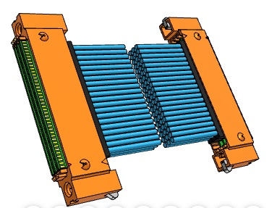
OffBoard 1 and 2:
OffBoard 1 and 2 are connected to the BaseBoard with Samtec SEARAYTM connectors. These are precision cables that are 100 Ohm twinax, ideal for handling all 20 transceiver channels (up to 10.3125 Gbps) and the 80 LVDS channels (up to 1.25 Gbps).
The OffBoard designs will contain LVDS to TTL translators to handle all the required I/O for the ACLK Generator design.

Slide 12
Summary:
Completed
Clocking System PwrBoard 100% design complete and tested.
Clocking System BaseBoard 60% design complete.
Next steps
Finish Clocking System BaseBoard design.
Design Clocking System OffBoards 1 and 2 to meet specifications for ACLK.
Build prototypes, write code, and test complete system.

Slide 13
Thank you!

