Slide 1
A2D2 Operational Meeting
Michael Geelhoed

Slide 2
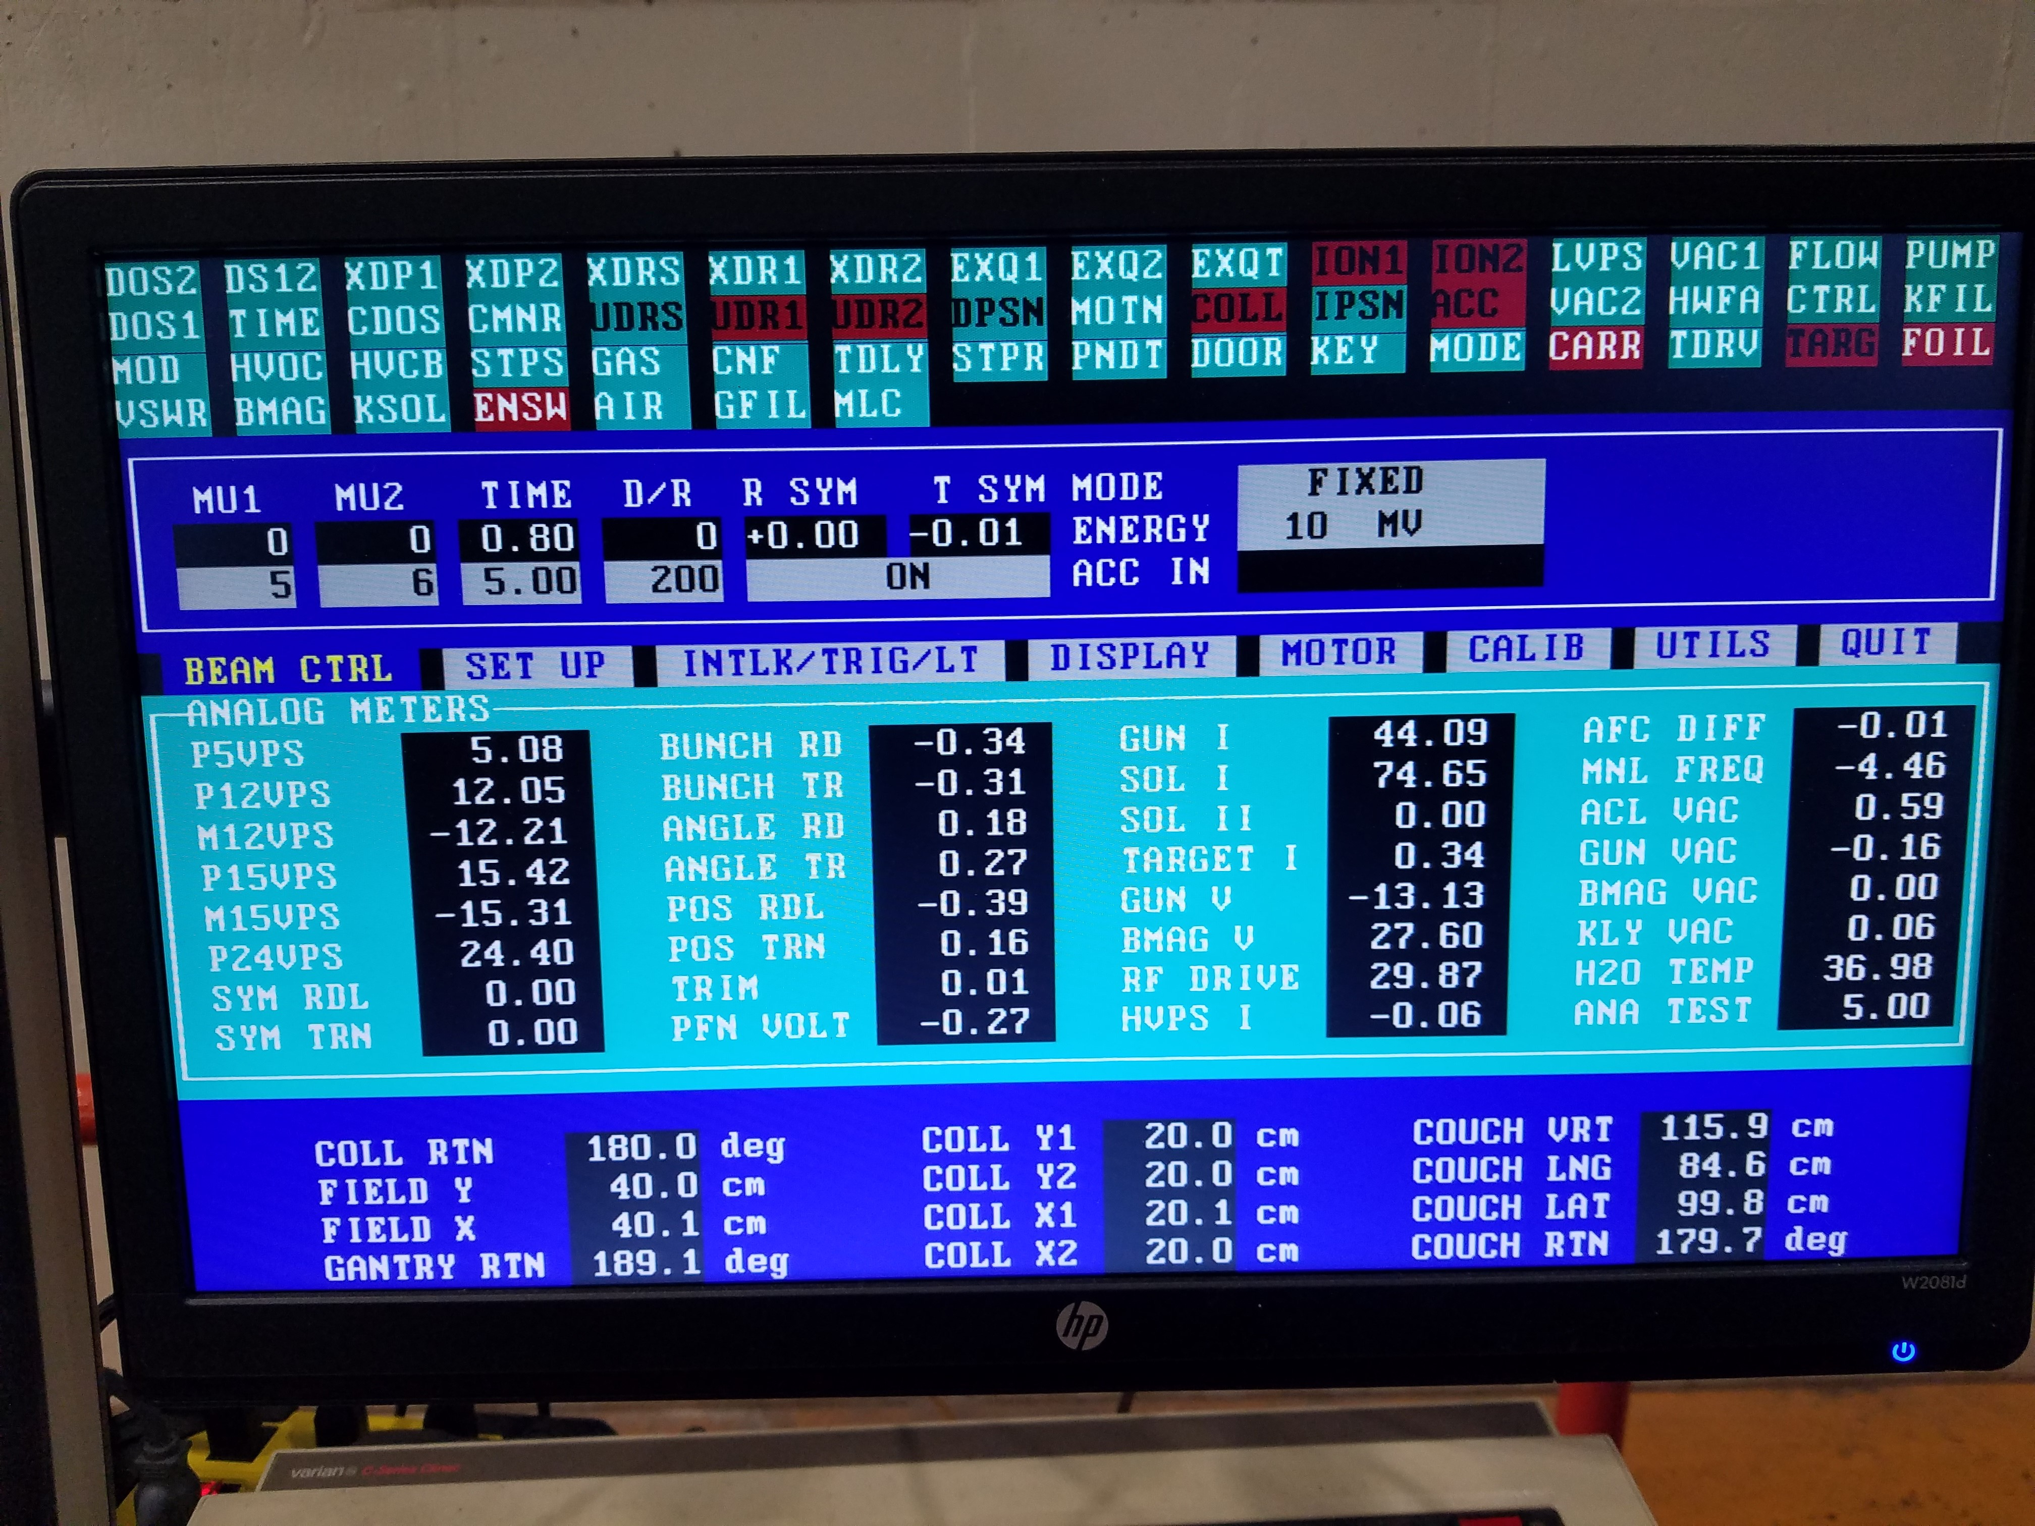
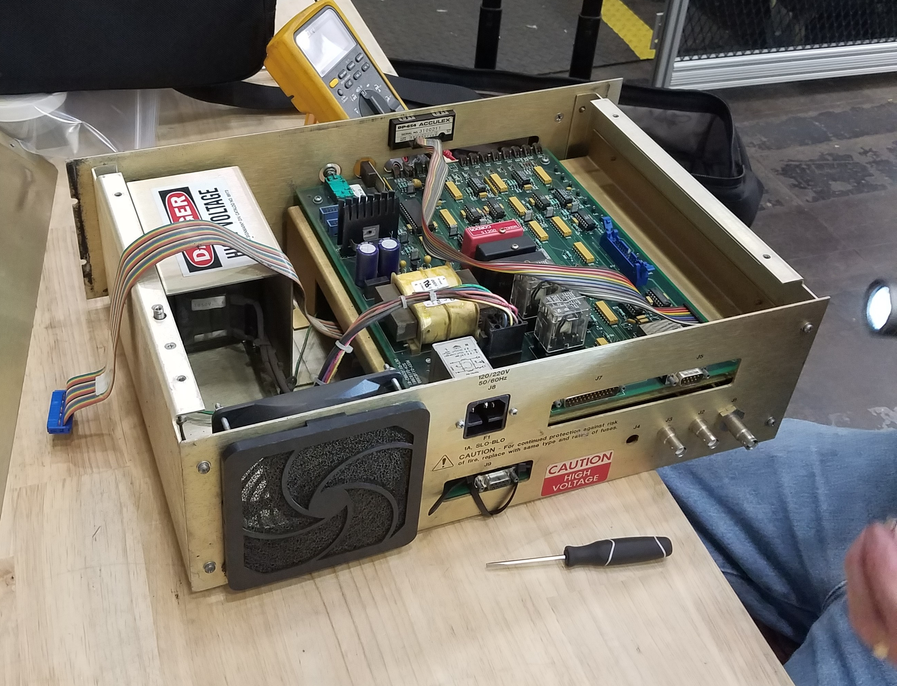
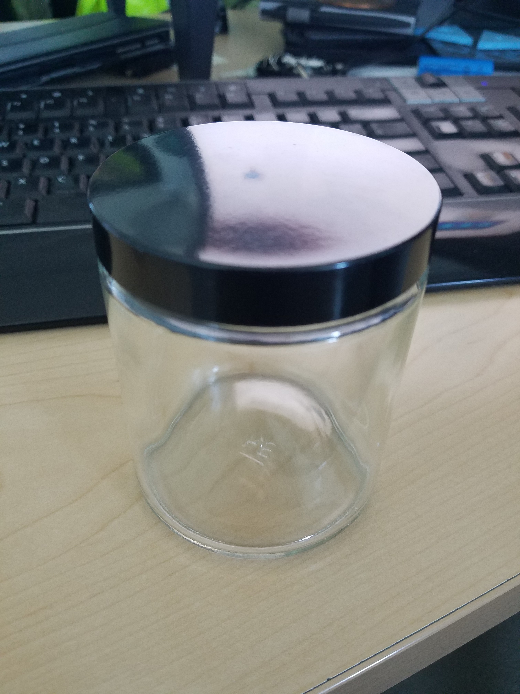
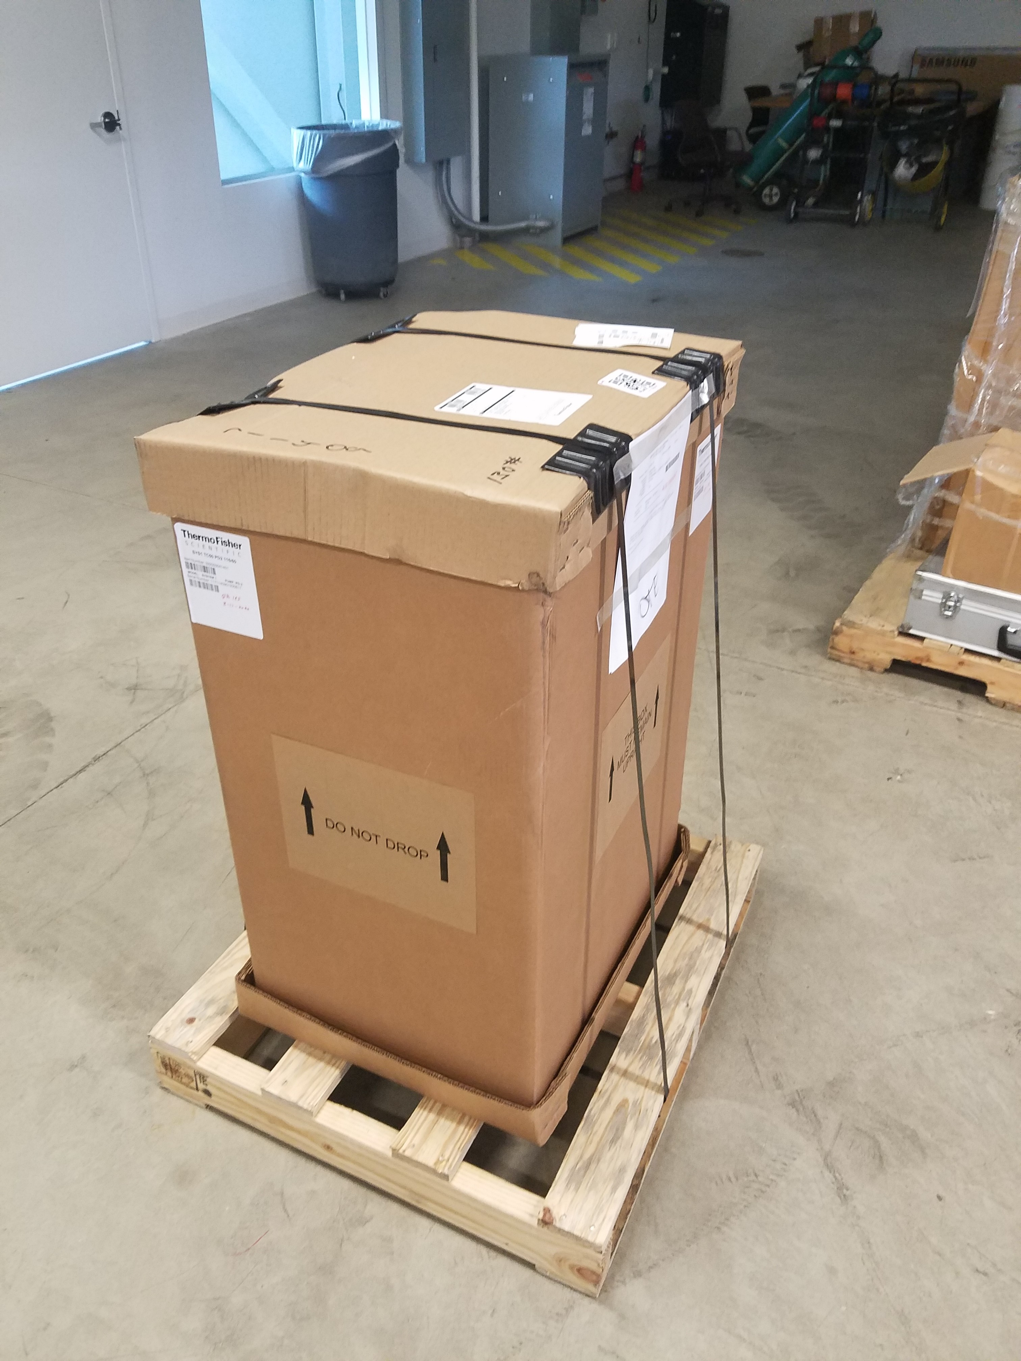
Upgrade and Status
Machine errors
  Still have ENSW, CARR, FOIL Errors
  Technician on site September 1st to continue troubleshooting
Computer battery Dead
  Either new battery $150
  New computer ~$2,000
Procurements
  New SUNY Containers are in
  Low Dose Films Pur Req #311174

Slide 3
Work and Samples on the horizon
Stonybrook (SUNY CRADA)
GWRC Ballast Water (CRADA)
APS-TD Nb Cavity (Internal)
Regher Solar (SPP)
PPD CMS Detector Boards (Internal)
FDA (CRADA/RCA)
NIU/DuPage (NPUA)
APTIM Leachrate (CRADA/SOW pending)
MWRD (~ months)
EERE 3M
SRNL

