Slide 1
Job submission overview
Marco Mambelli – marco@hep.uchicago.edu
August 9 2011
OSG Summer Workshop
TTU - Lubbock, TX
THE UNIVERSITY OF
CHICAGO

Slide 2
Campus and Production Grid
Campus Grid
Direct trust relationship
Local authentication (username and password)
Accessible as a single Condor pool
Production Grid
OSG and VO mediated trust relationship
Authentication via grid certificates (x509)
Varied resources accessed via GRAM protocol
Different tools to submit jobs

Slide 3
Job classification
HPC High Performance Computing
Massively parallel
Specialized resources
HTC High Throughput Computing
Many independent jobs
Common denominator across resources
HTPC High Throughput Parallel Computing
Take advantage of multi-core architectures
Multiple threads on a single node
All jobs in OSG should have minimal assumptions about the resources

Slide 4
High Throughput Computing
Opposed to High Performance Computing
Simple serial jobs, Mote Carlo simulation, parameter sweep (pleasantly parallel)
Complex workflows with data and/or job dependencies
User is decoupled from the resource
Must be able to express the work in a highly portable way
Cannot care about exactly where pieces are executed
May not have SSH access to resources -> many implications
Must be able to respect the community rules of a shared infrastructure; “plays well with others”
Minimize time between job‐submit and job‐complete
and...ensembles of small node count MPI jobs (HTPC)

Slide 5
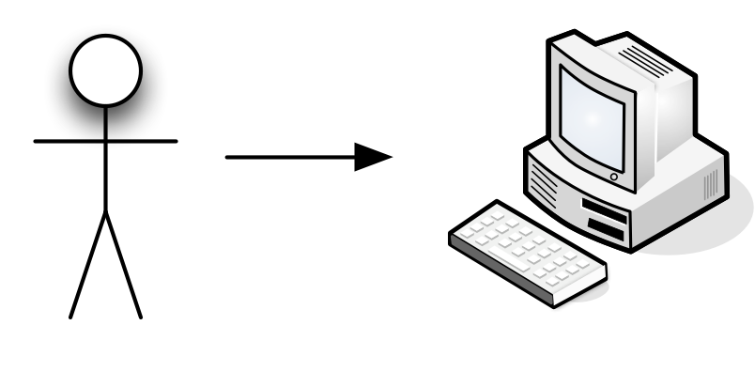
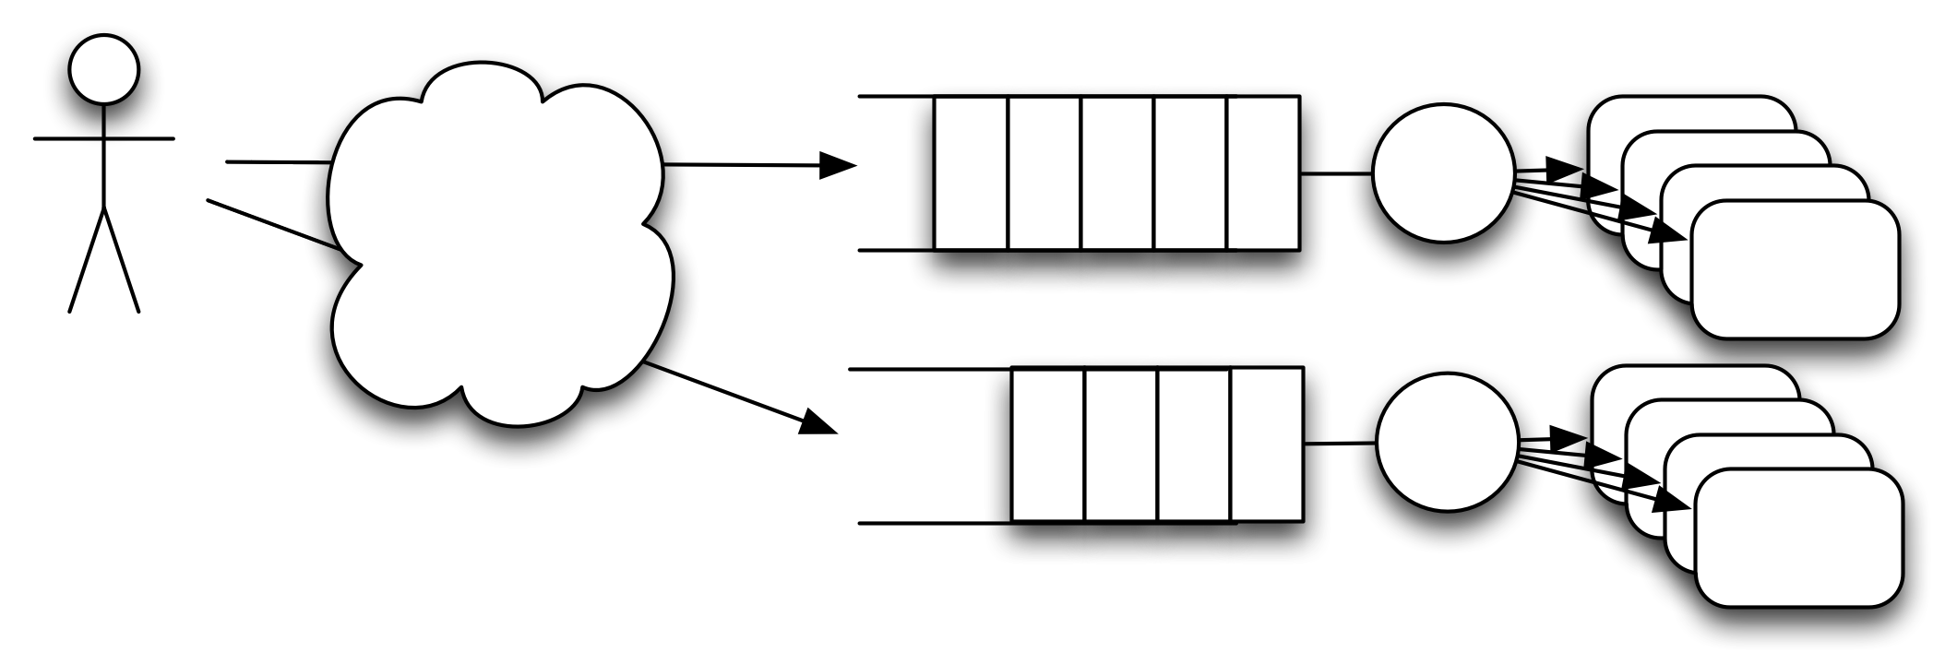
Local vs Distributed
Submission, wait in queue, execution, completion
Variety of resources
Many possibilities for failures (more complex)
Different order
Big latency
Black boxes
Difficult end-to-end monitoring
Local
Distributed

Slide 6
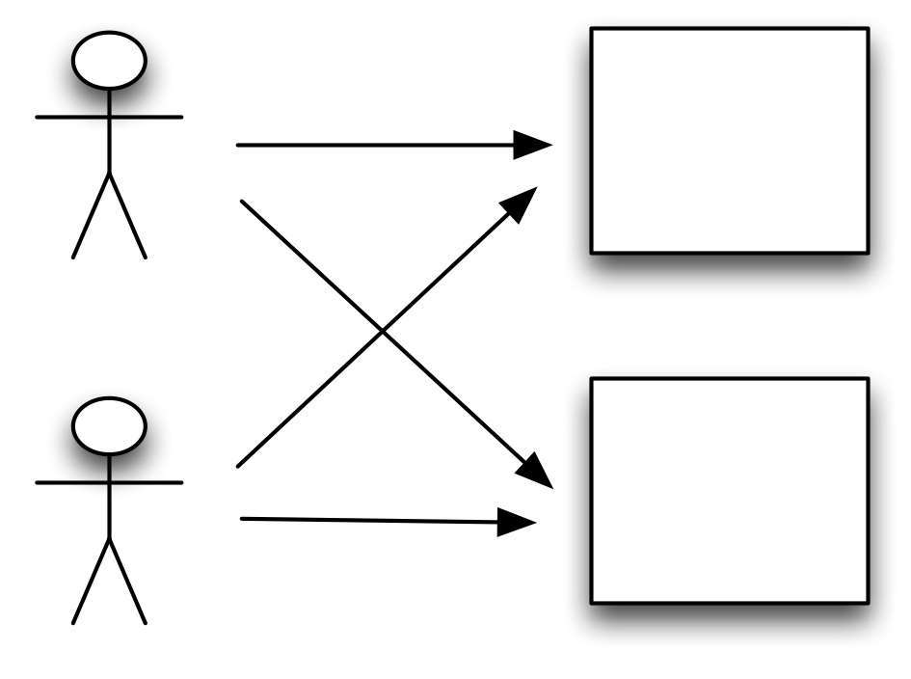
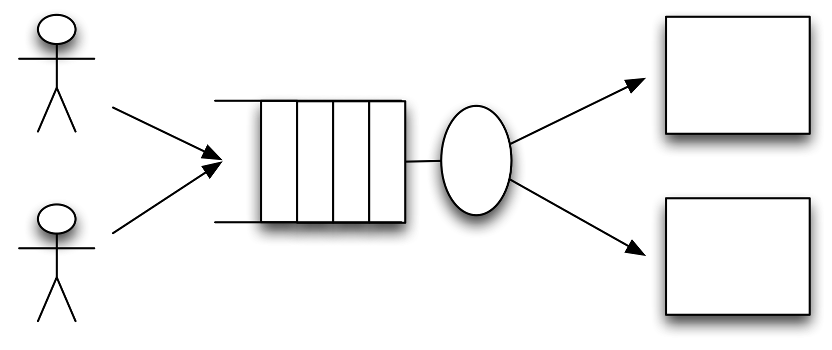
Direct submission vs Brokering
Competing for resources
Coordinate the scheduling
There are still others
Direct submission
Brokering

Slide 7
Single job vs Workflow
Direct acyclic graph
Workflow manager
Runs jobs in order
Retries

Slide 8
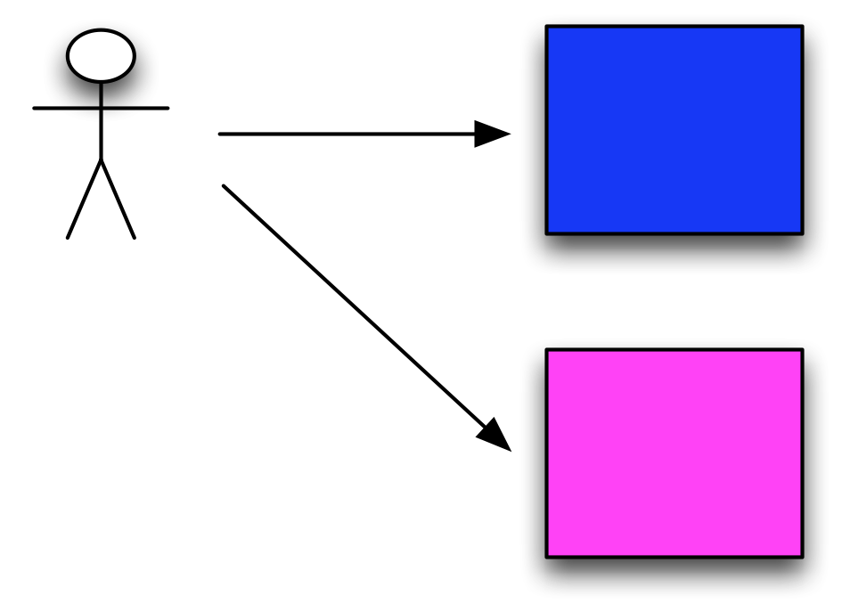
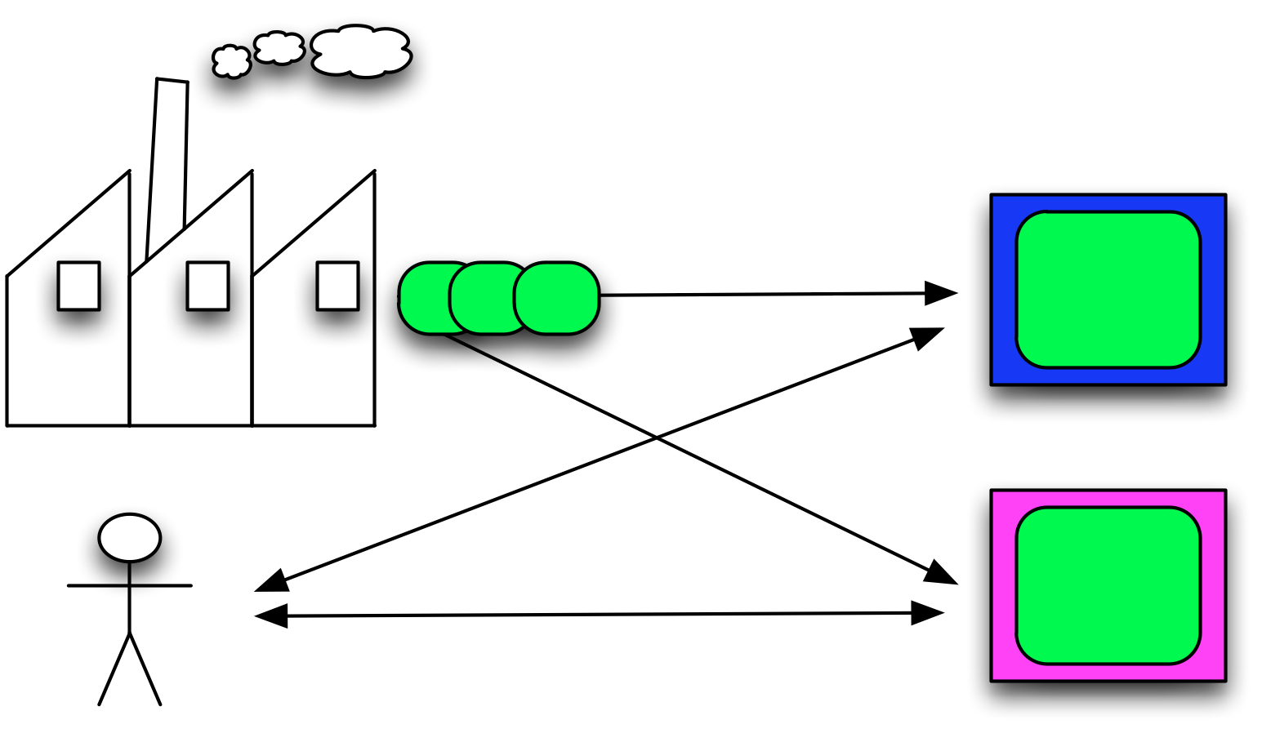
Direct execution vs Pilot jobs
Pilots
Separate user job from grid job
Have some overhead
Can perform some initial test
Uniform (enhanced) environment
Delayed scheduling
Direct execution
Pilot jobs

Slide 9
Pilot system: Pilot vs Direct job submission
Pilot
Direct job
Submitted by factories
Central (GiWMS, autopilot)
Cluster factories
Managed by factories
Scheduled centrally (allows late scheduling)
Code to support VO job execution
Submitted continuously
Partially accounted
no big deal if some fail
Submitted by users or production managers
Managed by workflow manager (or user)
Scheduled by local resource managers (cluster queues)
Code for both support and VO tasks
Submitted when needed
Fully accounted
error statistics

Slide 10
Pilot system: Pilot vs VO job
Pilot
VO job (on pilot)
Submitted by factories
Central (GiWMS, autopilot)
Cluster factories
Managed by factories
Code to support job execution
Submitted continuously
Partially accounted
no big deal if some fail
Submitted by users or production managers
Managed by Panda/GiWMS Server
Runs VO software
Submitted when needed
Fully accounted
error statistics

Slide 11
Low level job management
Tools
LRM: Condor, PBS, LSF, SGE, …
Globus GRAM
They are
More flexible
A lot of different tools
Steep learning curve
Technology may change (CREAM)
Notes:
Pilot partially separates Grid and VO softwares

Slide 12
More advanced tools
Condor-G
Uniform interface, workflow management (Dagman)
OSG MM
Brokering, uniform interface (C-G), workflow mgm. (Dg)
Glidein WMS
Brokering, uniform interface (C-G), workflow mgm. (Dg)
Panda
Monitoring, brokering, uniform interface (C-G), workflow mgm. (Dg), integrated with VO software
CRAB
integrated with VO software
http://twiki.grid.iu.edu/bin/view/Documentation/JobSubmissionComparison
Notes:
Pilot partially separates Grid and VO softwares

Slide 13
PANDA
PANDA = Production ANd Distributed Analysis system
Designed for analysis as well as production
Project started Aug 2005, prototype Sep 2005, production Dec 2005
Works both with OSG and EGEE middleware
A single task queue and pilots
Apache-based Central Server
Pilots retrieve jobs from the server as soon as CPU is available  late scheduling
Highly automated, has an integrated monitoring system
Integrated with ATLAS Distributed Data Management (DDM) system
Not exclusively ATLAS: CHARMM, OSG ITB

Slide 14
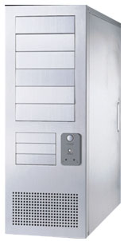
Panda System
DQ2
Panda server
ProdDB
LRC/LFC
bamboo
job
send log
logger
pull
http
https
site B
job
job
pilot
https
submit
site A
submit
pilot
condor-g
Autopilot
End-user
Worker Nodes

Slide 15
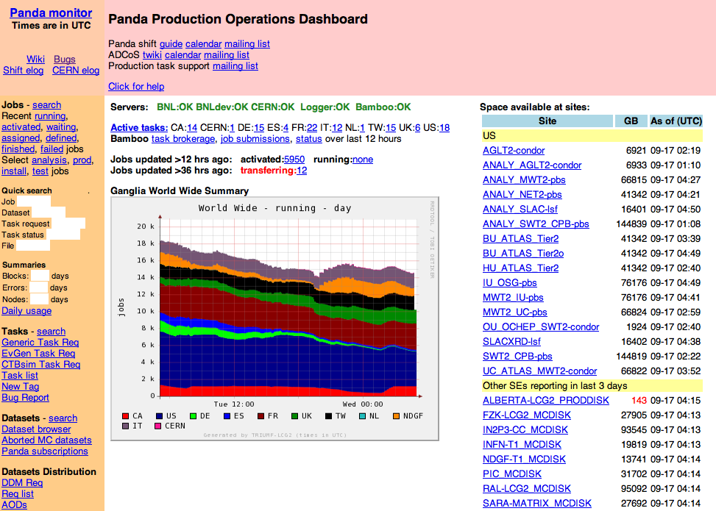
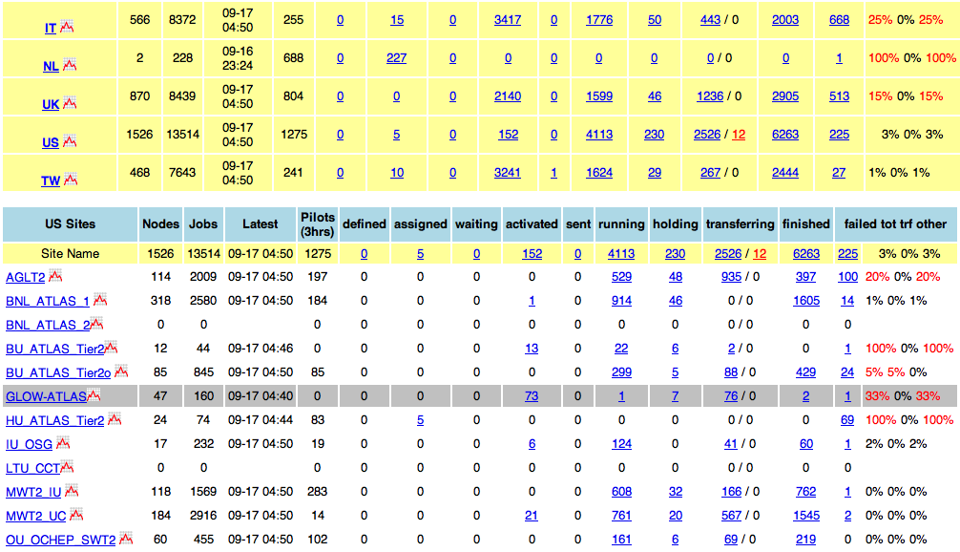
Panda Monitor: production dashboard
http://panda.cern.ch/server/pandamon/query?dash=prod

Slide 16
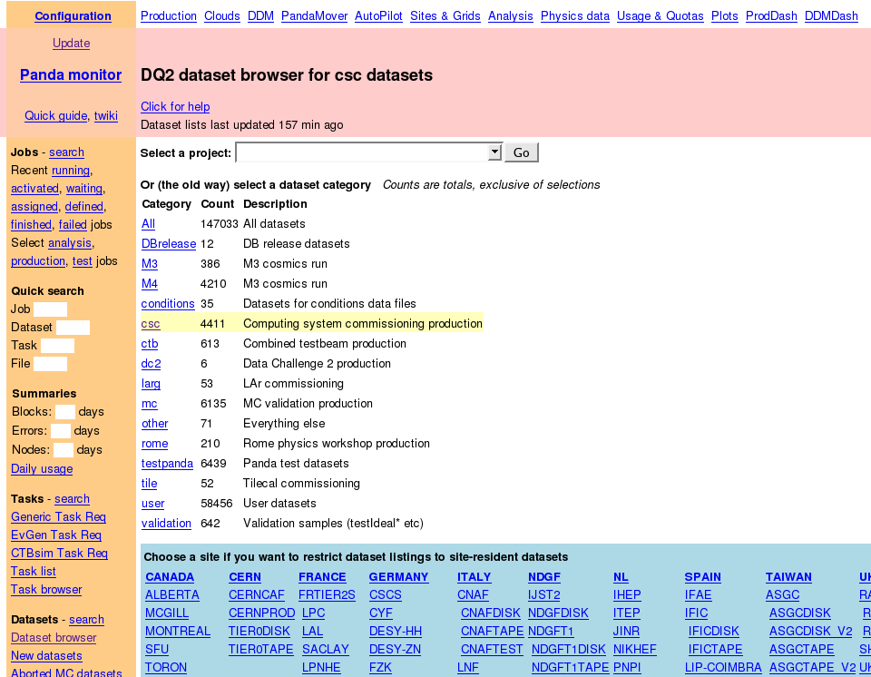
Panda Monitor: Dataset browser

Slide 17
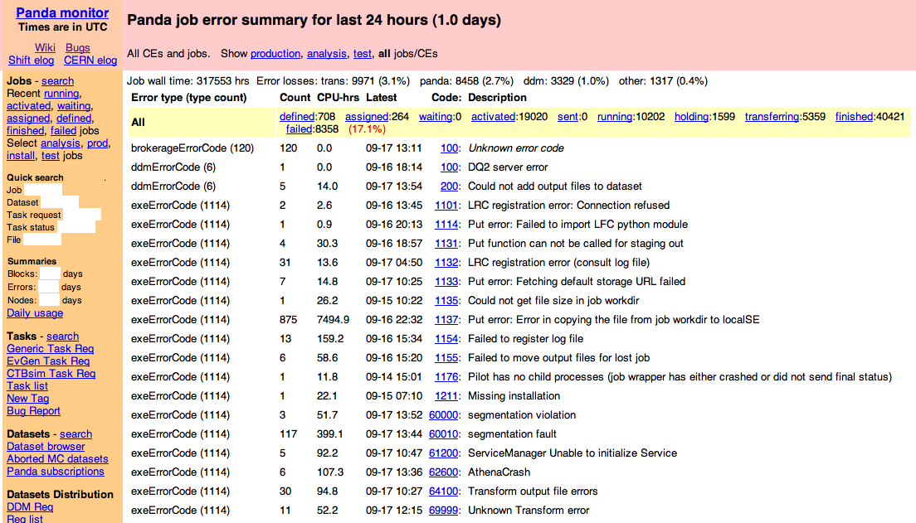
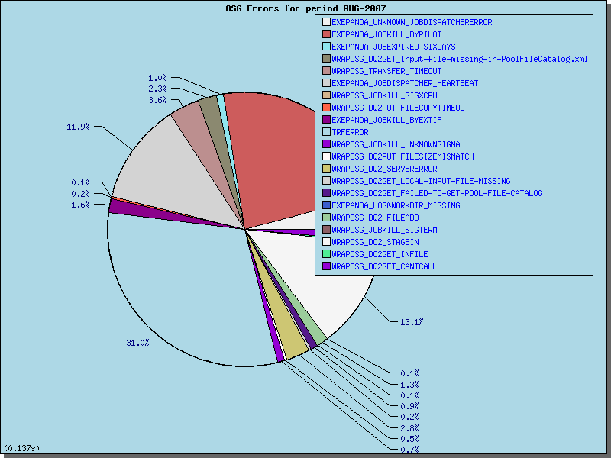
Panda Monitor: error reporting

Slide 18
Glide-in WMS
Provide a simple way to access the Grid resources. GlideinWMS is a Glidein Based WMS (Workload Management System) that works on top of Condor
Workflow (as visible in the next page illustration)
Users submit jobs to the User Pool Condor schedd process.
The GlideinWMS Frontend polls the user pool to make sure that there are enough glideins (worker nodes) to satisfy user jobs. It submits requests to the glidein factory to submit glideins.
Alternatively, users can control their workflow with the CorralWMS frontend.
The glidein factory and WMS pool receives requests from the frontend(s) and submits a condor startd wrapper to entry points (grid sites).
The grid sites receive the jobs and starts a condor startd that joins the user pool. This shows up as a resource in the user pool.
Final users can submit regular Condor jobs to the local queue

Slide 19
Glide-in WMS workflow

Slide 20
Glide-in WMS system
http://www.uscms.org/SoftwareComputing/Grid/WMS/glideinWMS/doc.prd/index.html

Slide 21
Submit File for Condor (or Campus Grid)
Universe = vanilla
#notify_user = <user email address>
Executable = serial64ff
#transfer_executable = false
# Files (and directory) in the submit host: log, stdout, stderr, stdin, other files
InitialDir = run_1
Log = serial64ff.log
Output = serial64ff.stdout
Error = serial64ff.stderr
#input = serial64.in
fetch_files=serial64ff.in
#Arguments = <arg1> <arg2> <argn>
should_transfer_files = IF_NEEDED
when_to_transfer_output = ON_EXIT
Queue

Slide 22
Submit File for Glidein WMS
Universe = vanilla
#notify_user = <user email address>
Executable = serial64ff
#transfer_executable = false
# Files (and directory) in the submit host: log, stdout, stderr, stdin, other files
InitialDir = run_1
Log = serial64ff.log
Output = serial64ff.stdout
Error = serial64ff.stderr
#input = serial64.in
fetch_files=serial64ff.in
#Arguments = <arg1> <arg2> <argn>
should_transfer_files = IF_NEEDED
when_to_transfer_output = ON_EXIT
# This line is required to specify that this job should run on GlideinWMS system
requirements = IS_GLIDEIN == True
x509userproxy=/tmp/x509up_u20003
Queue

Slide 23
?
!

