Slide 1
HTPC on the OSG

Slide 2
Overview
What/Why HTPC
How to set up local HTPC
GlideIn/WMS for HTPC

Slide 3
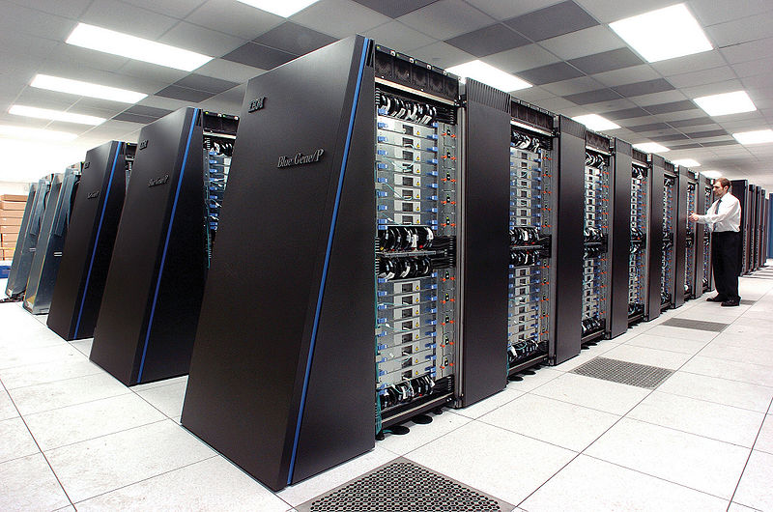
Terms: HPC
Run one job fast
MPI
SuperComputer
Metric:
FLOPS
Fast interconnect

Slide 4
HPC
Goal: Run jobs as fast as possible
Relatively few,
Big parallel jobs
(usually…)

Slide 5
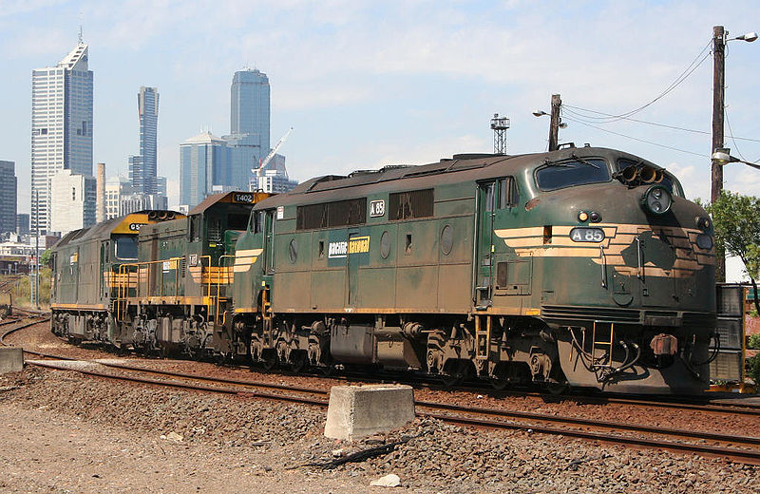
HTC
Metric:
CPU hours/year
Utilization
Each core independent
Lots of serial jobs
More, cheaper machines
No fast interconnects

Slide 6
Hardware trends
Moore’s Law
Moore cores
12 core deployed today
48 core tomorrow?
Machines are not homogenous

Slide 7
Combine the two…
What do you get?

Slide 8
HTPC, or “Whole Machine”
HTPC schedules whole machines,
Not cores
When an HTPC job lands, not other jobs are running on that machine.

Slide 9
What is this good for?
Need > 1 core,
i.e. “small parallel” jobs
Need more memory
Need all local disk throughput
Need GPU or other dedicated hardware

Slide 10
HTPC is parallel agnostic
Just schedules a machine,
Parallelism is up to you
MPI
Threads
Processes
OpenMP, etc.
“Bring it with you”

Slide 11
Sample Apps
Several MPI-ported apps good fit
Molecular dynamics:
Gromacs, Namd, CHARMM, etc.
Parallel enabled matlab
Simple fork-fork-fork jobs

Slide 12
Hybrid HTC - HTPC
Very powerful approach to science
Use HTPC to search broadly
HTC to search deeply

Slide 13
HTPC is not…
Ability to schedule partial machines
(yet)
Built-in MPI library support
Magic bullet for scheduling parallel jobs

Slide 14
HTPC gotchas
Ideally, job needs to run on arbitrary number of cores that are there
Need to bring MPI or runtimes along
Limited resource on OSG today
Running on half dozen sites
Still have time limits at most sites

Slide 15
Setting up HTPC locally
Start locally, act globally
Depends on local batch system:
Submitting via GRAM to local scheduler, needs RSL magic token

Slide 16
SGE
Dunno? Anyone?

Slide 17
LSF
“exclusive” flag to job description
Can only ask for whole machines
Rsl =(jobtype=single)(exclusive=1)(maxWallTime=2800)"

Slide 18
PBS
Use host_count and host_xcount:
rsl="(jobtype=single)(xcount=8)(host_xcount=1)(maxWallTime=2800)"

Slide 19
Condor
See recipe at
http://condor-wiki.cs.wisc.edu
https://condor-wiki.cs.wisc.edu/index.cgi/wiki?p=WholeMachineSlots

Slide 20
Condor
#we will double-allocate resources to overlapping slots
NUM_CPUS = $(DETECTED_CORES)*2
MEMORY = $(DETECTED_MEMORY)*2 # single-core slots get 1 core each
SLOT_TYPE_1 = cpus=1
NUM_SLOTS_TYPE_1 = $(DETECTED_CORES)
# whole-machine slot gets as many cores and RAM as the machine has
SLOT_TYPE_2 = cpus=$(DETECTED_CORES), mem=$(DETECTED_MEMORY)
NUM_SLOTS_TYPE_2 = 1
# Macro specifying the slot id of the whole-machine slot
# Example: on an 8-core machine, the whole-machine slot is 9.
WHOLE_MACHINE_SLOT = ($(DETECTED_CORES)+1)
# ClassAd attribute that is True/False depending on whether this slot is
# the whole-machine slot CAN_RUN_WHOLE_MACHINE = SlotID == $(WHOLE_MACHINE_SLOT) STARTD_EXPRS = $(STARTD_EXPRS) CAN_RUN_WHOLE_MACHINE
# advertise state of each slot as SlotX_State in ClassAds of all other slots
STARTD_SLOT_EXPRS = $(STARTD_SLOT_EXPRS) State
# Macro for referencing state of the whole-machine slot.
# Relies on eval(), which was added in Condor 7.3.2. WHOLE_MACHINE_SLOT_STATE = \ eval(strcat("Slot",$(WHOLE_MACHINE_SLOT),"_State")) # Macro that is true if any single-core slots are claimed
# WARNING: THERE MUST BE AN ENTRY FOR ALL SLOTS
# IN THE EXPRESSION BELOW. If you have more slots, you must
# extend this expression to cover them. If you have fewer
# slots, extra entries are harmless. SINGLE_CORE_SLOTS_CLAIMED = \ ($(WHOLE_MACHINE_SLOT_STATE) =?= "Claimed") < \ (Slot1_State =?= "Claimed") + \ (Slot2_State =?= "Claimed") + \ (Slot3_State =?= "Claimed") + \ (Slot4_State =?= "Claimed") + \ (Slot5_State =?= "Claimed") + \ (Slot6_State =?= "Claimed") + \ (Slot7_State =?= "Claimed") + \ (Slot8_State =?= "Claimed") + \ (Slot9_State =?= "Claimed") + \ (Slot10_State =?= "Claimed") + \ (Slot11_State =?= "Claimed") + \ (Slot12_State =?= "Claimed") + \ (Slot13_State =?= "Claimed") + \ (Slot14_State =?= "Claimed") + \ (Slot15_State =?= "Claimed") + \ (Slot16_State =?= "Claimed") + \ (Slot17_State =?= "Claimed") + \ (Slot18_State =?= "Claimed") + \ (Slot19_State =?= "Claimed") + \ (Slot20_State =?= "Claimed") + \ (Slot21_State =?= "Claimed") + \ (Slot22_State =?= "Claimed") + \ (Slot23_State =?= "Claimed") + \ (Slot24_State =?= "Claimed") + \ (Slot25_State =?= "Claimed") + \ (Slot26_State =?= "Claimed") + \ (Slot27_State =?= "Claimed") + \ (Slot28_State =?= "Claimed") + \ (Slot29_State =?= "Claimed") + \ (Slot30_State =?= "Claimed") + \ (Slot31_State =?= "Claimed") + \ (Slot32_State =?= "Claimed") + \ (Slot33_State =?= "Claimed") # Single-core jobs must run on single-core slots START_SINGLE_CORE_JOB = \ TARGET.RequiresWholeMachine =!= True && MY.CAN_RUN_WHOLE_MACHINE == False && \ $(WHOLE_MACHINE_SLOT_STATE) =!= "Claimed" # Whole-machine jobs must run on the whole-machine slot START_WHOLE_MACHINE_JOB = \ TARGET.RequiresWholeMachine =?= True && MY.CAN_RUN_WHOLE_MACHINE START = ($(START)) && ( \ ($(START_SINGLE_CORE_JOB)) || \ ($(START_WHOLE_MACHINE_JOB)) ) # Suspend the whole-machine job until single-core jobs finish. SUSPEND = ($(SUSPEND)) || ( \ MY.CAN_RUN_WHOLE_MACHINE && ($(SINGLE_CORE_SLOTS_CLAIMED)) ) CONTINUE = ( $(SUSPEND) =!= True ) WANT_SUSPEND = ($(WANT_SUSPEND)) || ($(SUSPEND)) # In case group-quotas are being used, trim down the size # of the "pie" to avoid double-counting. GROUP_DYNAMIC_MACH_CONSTRAINT = CAN_RUN_WHOLE_MACHINE == False

Slide 21
Condor
This is
A) Clever use of Condor’s flexibly policy
B) An egregious hack
C) There must be a better way

Slide 22
Example local submit file
universe = grid
grid_type = gt2
globusscheduler = lepton.rcac.purdue.edu/jobmanager-pbs
globusrsl = (jobType=mpi)(queue=standby)(xcount=8)(host_xcount=1)
executable = wrapper.sh
should_transfer_files = yes
when_to_transfer_output = on_exit
transfer_input_files = mdrun, mpiexec, topol.tpr
transfer_output_files = confout.gro, ener.edr, traj.xtc, traj.trr, md.log
output = out.$(CLUSTER)
error = err.$(CLUSTER)
log = log
queue

Slide 23
Note the wrapper
#!/bin/sh
touch output1 output2
chmod 0755 ./mdrun ./mpiexec
./mpiexec -np 8 mdrunome_input_file

Slide 24
Common problems
Usual scheduling problems
New HTPC problem:
Job run, but not exclusively
condor_ssh_to_job help
run a ps command to verify

Slide 25
Computer Engineer Barbie says:
Parallel programming is hard
HTPC doesn’t make it much easier
(maybe it is easier to debug on one machine

Slide 26
That was painful Can there be a better way
Problems with site-selection
Everyone needs to know every site
Everyone needs to know site RSL

Slide 27
Usual OSG Solution:
Primary theorem of Computer Science:
Any problem can be fixed with another layer of abstraction
i.e. Pilots

Slide 28
The glideinWMS
http://home.fnal.gov/~sfiligoi/glideinWMS/
Legenda:
Central manager
Execute daemon
WMS Legenda:
Submit node and user(s)
Collector
Gatekeeper
Glidein factory
Worker node
VO frontend

Slide 29
Use Glidein “Groups”
HTPC is a glidein “group”
A subset of machines with some property
Each glidein lands on a whole machine
Each glidein advertises one slot
Represents the whole machine

Slide 30
Edit the frontend config:
<groups>
<group name="HTPC" enabled="True">
<config>
<idle_glideins_per_entry max="100" reserve="5"/>
<idle_vms_per_entry curb="5" max="100"/>
<running_glideins_per_entry max="10000" relative_to_queue="1.15"/>
</config>
<downtimes/>

Slide 31
The trick to select jobs
<job query_expr="RequiresWholeMachine">
<match_attrs>
</match_attrs>
<schedds>
</schedds>
</job>

Slide 32
Machine Attrs
<attrs>
<attr name="CAN_RUN_WHOLE_MACHINE" glidein_publish="True" job_publish="False" parameter="True" type="expr" value="True"/>
<attr name="GLIDECLIENT_Group_Start" glidein_publish="True" job_publish="False" parameter="True" type="string" value="TARGET.RequiresWholeMachine"/>
</attrs>

Slide 33
Example local submit file
universe = grid
grid_type = gt2
globusscheduler = lepton.rcac.purdue.edu/jobmanager-pbs
globusrsl = (jobType=mpi)(queue=standby)(xcount=8)(host_xcount=1)
executable = wrapper.sh
should_transfer_files = yes
when_to_transfer_output = on_exit
transfer_input_files = mdrun, mpiexec, topol.tpr
transfer_output_files = confout.gro, ener.edr, traj.xtc, traj.trr, md.log
output = out.$(CLUSTER)
error = err.$(CLUSTER)
log = log
queue

Slide 34
New job submission file
universe = vanilla
executable = wrapper.sh
should_transfer_files = yes
when_to_transfer_output = on_exit
transfer_input_files = mdrun, mpiexec, topol.tpr
#transfer_output_files = confout.gro, #ener.edr,traj.xtc, traj.trr, md.log
+RequiresWholeMachine=true
REQUIREMENTS = CAN_RUN_WHOLE_MACHINE
output = out.$(CLUSTER)
error = err.$(CLUSTER)
log = log
queue

Slide 35
Why is this man smiling?

Slide 36
No User proxy!
Not an HTPC feature
Plain-old Glidein In feature
Controversial, but very user friendly.

Slide 37
Glidein provides uniformity
condor_ssh_to_job works
file transfer works
periodic_exprs work

Slide 38
“Glidein”
What, exactly do we me my glidein?
What about Panda? (or your fav. Pilot)

Slide 39
HTPC Glue Schema
New schema for HTPC
htpc = enabled
htpc_queues = queue1, queue2, queue3
# can also take "*"
htpc_blacklist_queues =
htpc_rsl = (foo=bar) # this is the default for HTPC queues
htpc_rsl_queue1 = (zork=quux) # this is a specialized rsl for queue1 only

Slide 40
Want to export your HTPC cluster for all?
Great! Talk to us

Slide 41
Final benefits of HTPC
HTC and HTC can work together
Remove small jobs from supercomputers

Slide 42
Summary
Real users doing real work with HTPC today
Talk to Dan or Greg for more info
Check out HTPC twiki for more info

